Slide 1
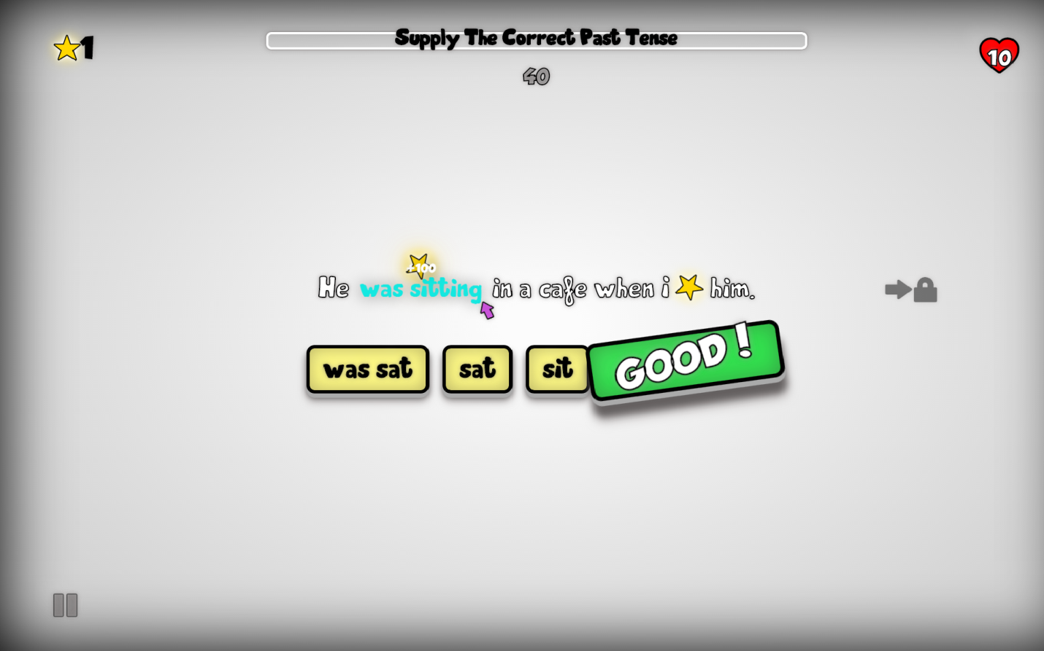





הפקולטה למדעי ההנדסה
המחלקה להנדסת מערכות מידע
110
מערכת מבוססת משחק לתרגול דקדוק אנגלית
גיא מנזורולה
מנחים: ד"ר מירב טייב מימון
Enjoy Learning!
Fact: When we enjoy ourselves, we learn better
In almost all areas of learning, knowledge is acquired through extensive and repetitive practice of
the learned material. This is especially true when learning a second language.
Fun in the learning process creates relaxation and motivation. Relaxation enables learners to take things in more easily; motivation enables them to put forth effort without resentment.
Without compelling content, learners are left to find the necessary motivation themselves.
When a person faces a challenge and then overcomes it, that person has learned something. Players will learn from games, even if that learning is limited to the context of the game.
Problem: Unmotivated Learners
Motivation has long been considered an important step in learning. It has always been one of the teacher’s primary roles to provide students with the motivation required to stick with the learning process to the end. However, motivating students has also been one of the biggest problems in education over the last half century or so.
PRODIGY
To The Rescue
Prodigy is an e-learning tool developed with the learner in mind. It implements attempts to increase learner motivation by implementing design principles from computer games, such as multiple level goals, visual feedbacks, clues, scoring and rewards, with an emphasis on a visually appealing interface.
Solution: w
What Is E-Learning
In essence, E-Learning is the transfer of instructional material through digital devices such as mobile phones, tablet computers, laptop and desktop computers, and more .
E-Learning enables learners to study at times and places of their choosing. It may also provide people with the ability to study at their own pace (asynchronous study), and in the order they prefer. It is especially appealing now days, due to the high availability of the instruments required to participate in such activities (Clark & Mayer, 2011; McGinnis, Bustard, Black, & Charles, 2008).

