Slide 1
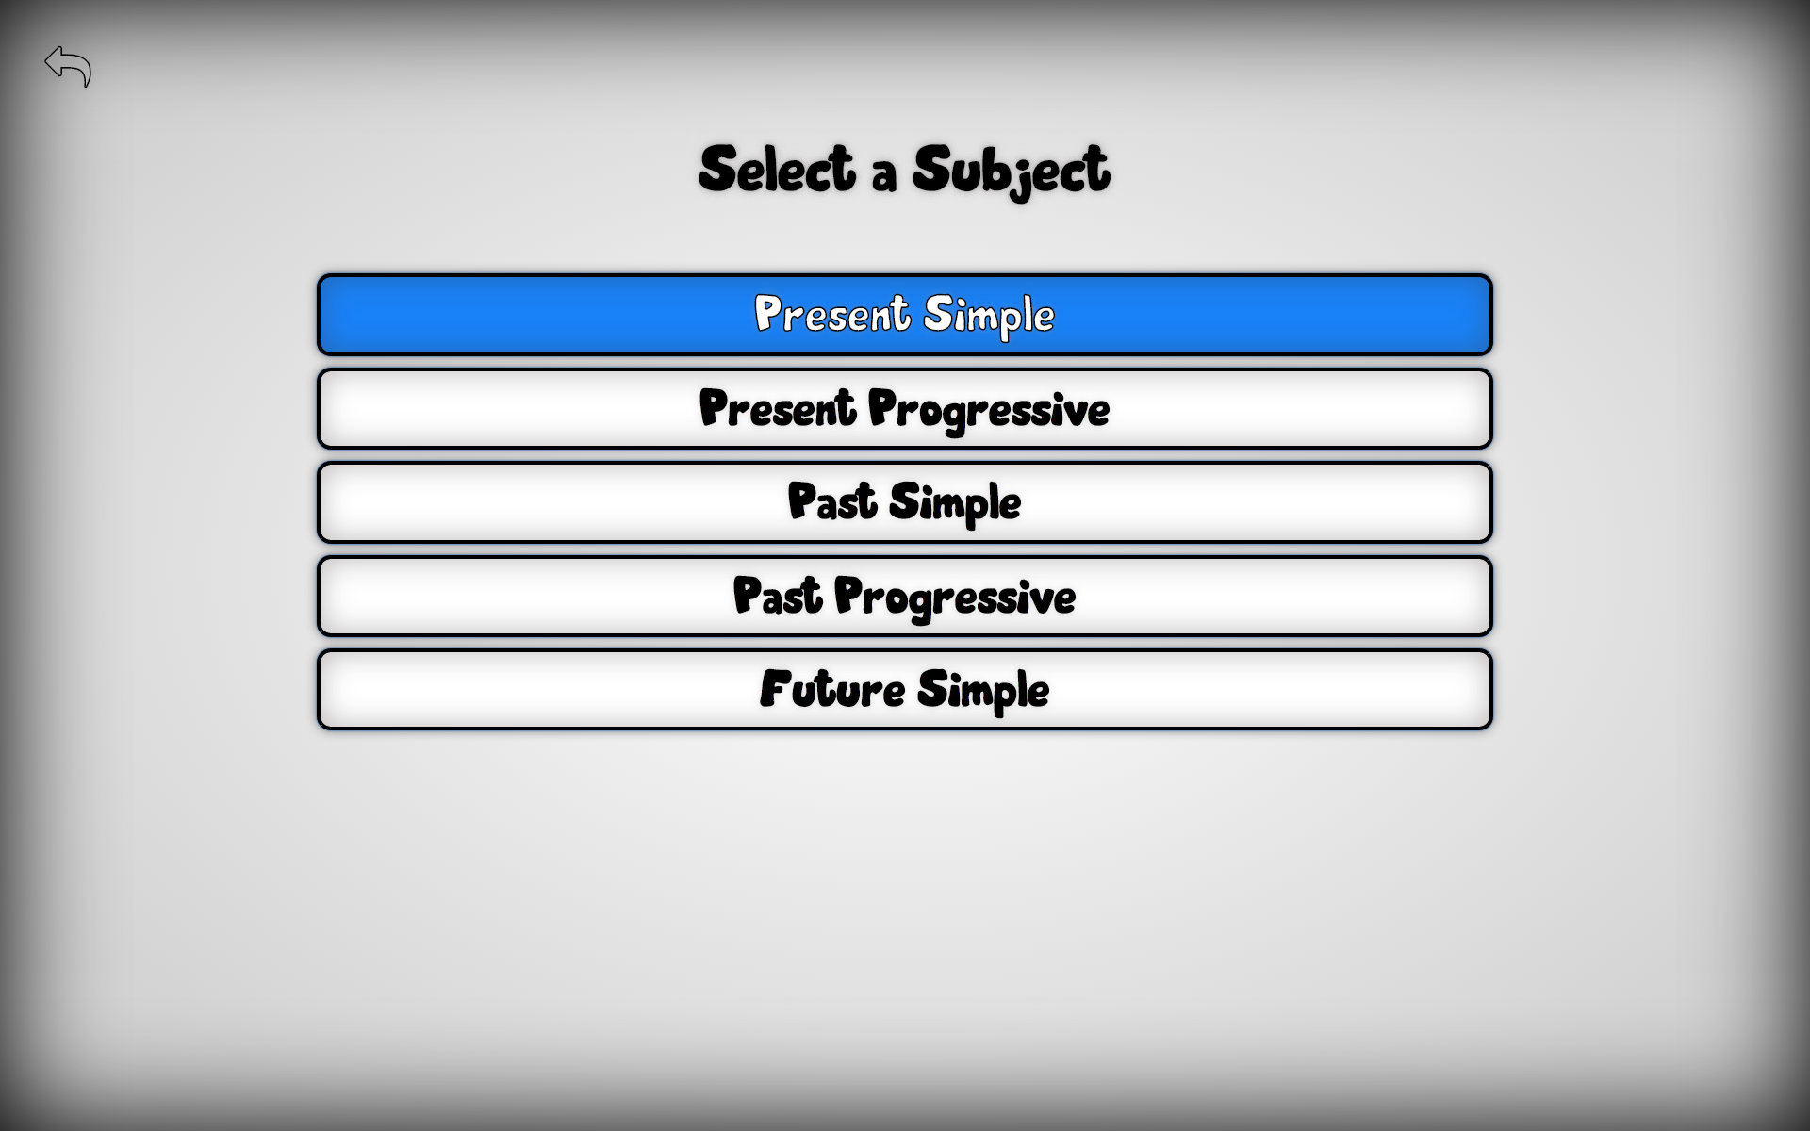
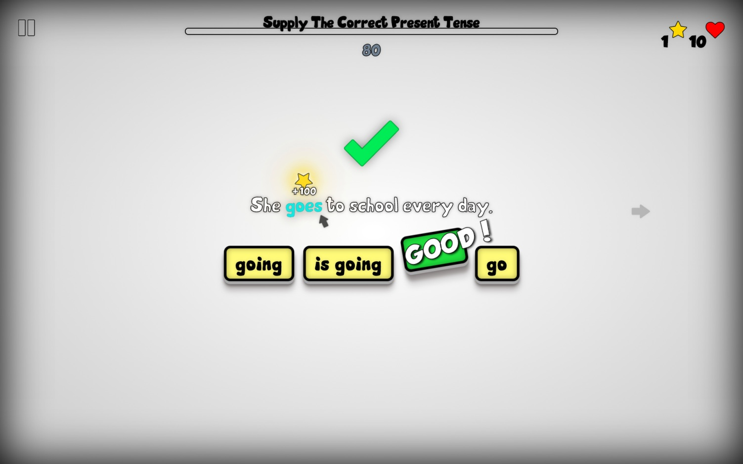
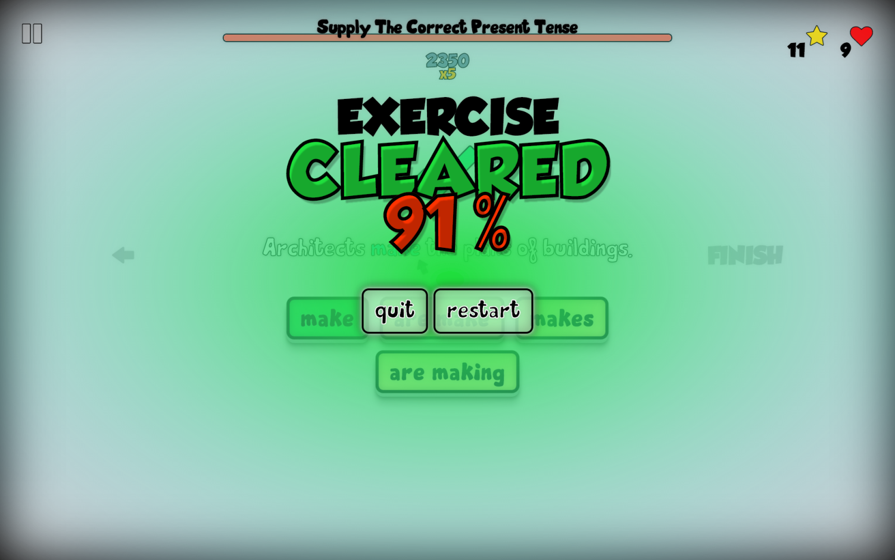
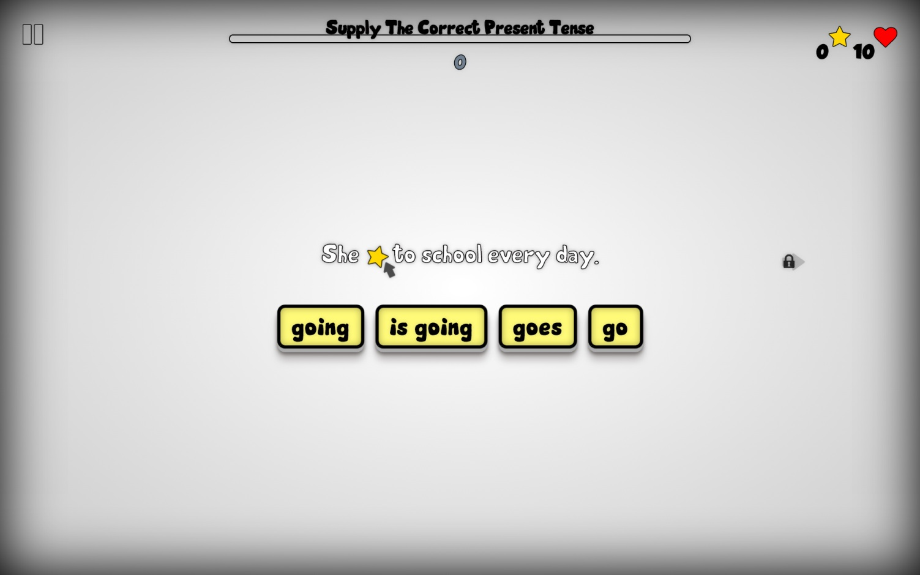
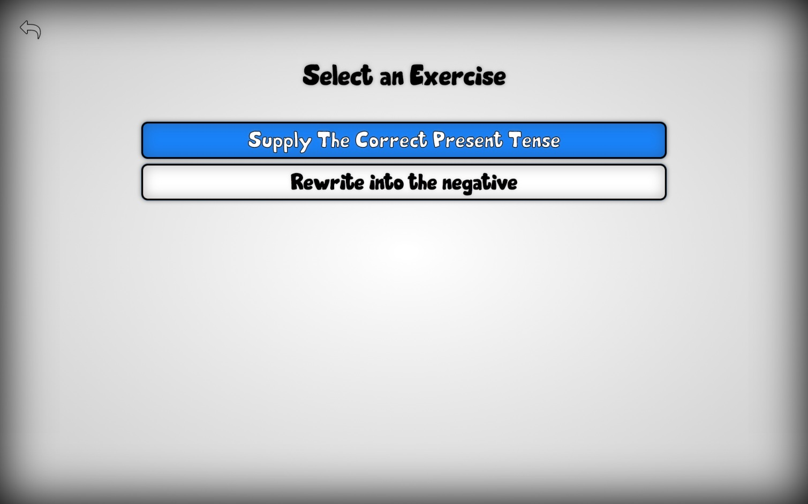
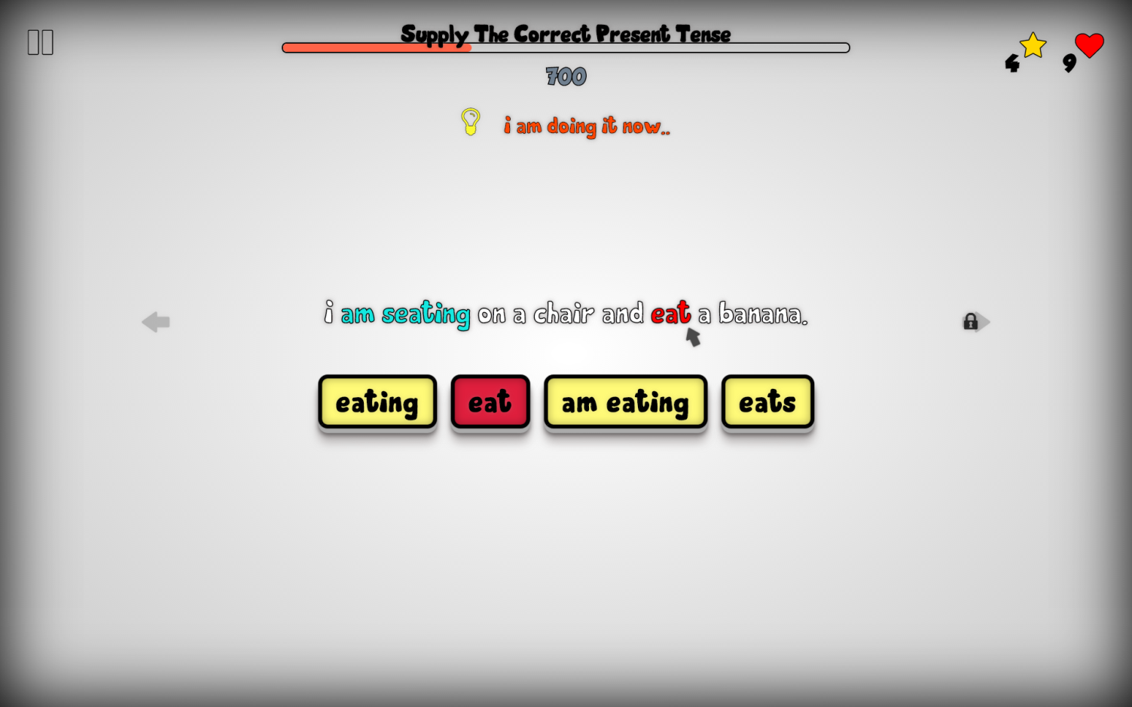
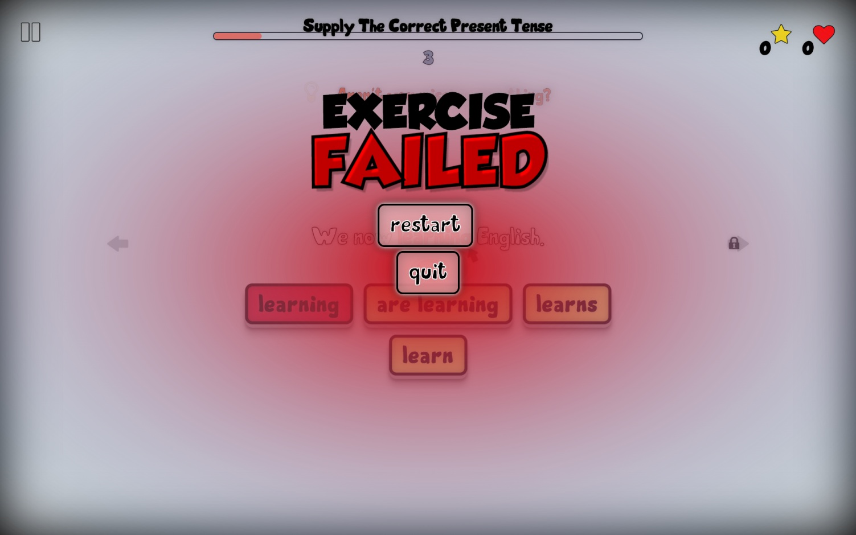











הפקולטה למדעי ההנדסה
המחלקה להנדסת מערכות מידע
10
תשע"ג
Game based system for English grammar practice
Guy Manzurola
Instructor: Dr. Meirav Taieb-Maimon
1
2
Intro
In almost all areas of learning, knowledge is acquired through extensive and repetitive practice of the learned material. A popular and appealing course of providing users with learning material is via digital devices, i.e. “e-learning”.
Problem
Most E-Learning systems do not yet have the impact that many believe is possible. Engaging learners long enough to see them through to the end of a course has become one of the most significant problems faced by e-learning developers
Solution
Engage learners through games. We all enjoy games, and when we enjoy ourselves, we learn better. Games are inherently motivating.
Goal
Enhance learner motivation through English grammar exercises using design principles from computer games.
3
The Game
1
Select a subject
Collect stars and get points
You win!
אסוף כוכבים וצבור נקודות.
3
Play!
2
Select an exercise
Get feedbacks on mistakes
Careful not to fail…
4
קבל משוב על טעויות
Behind The Scenes
Response
Response
Request
Request
A MySQL database contains the data of subjects, exercises, questions, answers and feedbacks. A question may contain an unlimited number of blanks. Answers and their appropriate feedbacks are associated to each blank in a question.
Tomcat Servlet container runs the application’s Java Servlets, exposing a RESTful interface(HATEOS constrained). Responses are transmitted in JSON format.
A rich single page app, implemented in pure JavaScript. HTML5 and CSS3 allow robust graphical content. Data is fetched pre-game – Immediate In-Game Response Times!
PRODIGY
Made With
Only On
Gamified Learning

