Slide 1
Continuous Learning: Git and Its Discontents
January 19, 2017
Notes:
Use title slides at the beginning of your presentation or as dividers within your presentation.
If a two-line title or subtitle is required, be sure to SHIFT-RETURN, to create a line break. RETURN alone creates a paragraph break.
Use the Header and Footer to set the date and footer text if desired.

Slide 2
Topics of this Lesson
Visualizing the branch workflow
Merging with Conflicts
Homework Assignment

Slide 3
What You Will Learn
The basic workflow of a single-user with multiple branches.
How to resolve conflicts when merging a file from two branches.

Slide 4
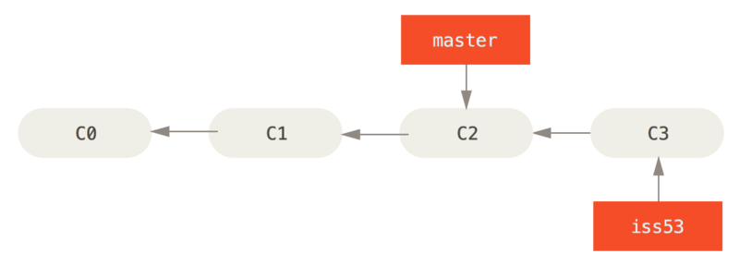
Branch Basics
1. Visualizing the Workflow
Assume you have a project with a few commits and production code in the ‘master’ branch with a second branch to address Issue 53 of a project.
$ git branch iss53 #Create iss53 branch
$ git checkout iss53 #Switch to iss53 branch

Slide 5
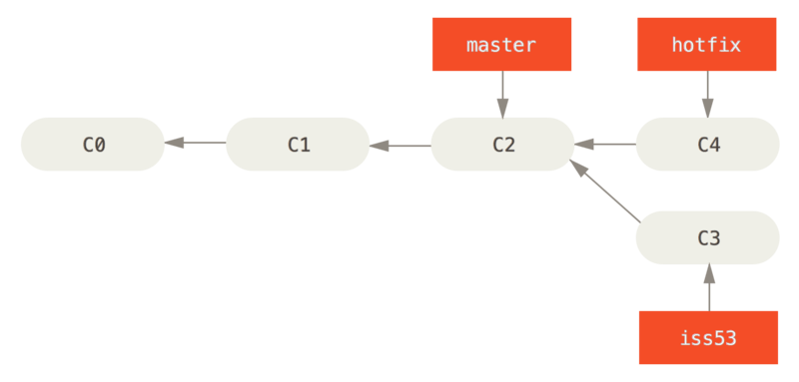
Multiple Branches
1. Visualizing the Workflow
Now assume you have to perform a quick fix to the code in master branch. You can checkout from iss53 and create a new branch of the production code called ‘hotfix’ to work on a quick fix to the production code.
$ git checkout -b hotfix #switch to ‘hotfix’ branch
$ git commit –a –m “fixed hotfix issue” #commit

Slide 6
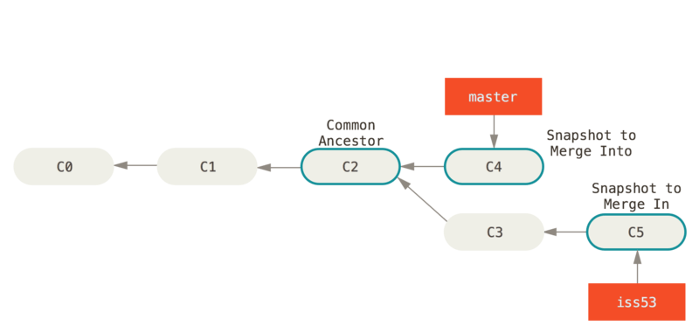
Merging Branches Back Together
1. Visualizing the Workflow
With the quick fix from the ‘hotfix’ branch deployed, we can return and finish coding Issue 53. Now, we can merge the two branches back together.
$ git checkout master #switch to ‘master’ branch
$ git merge iss53 #merge ‘master’ and ‘iss53’ branches

Slide 7
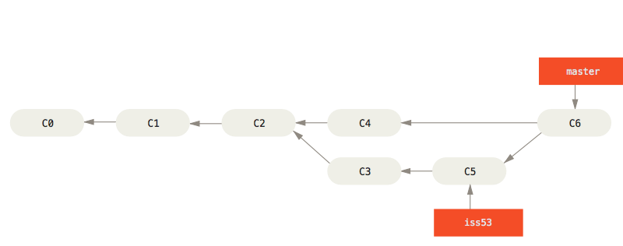
Final Workflow after Merge
1. Visualizing the Workflow
With the quick fix from the ‘hotfix’ branch deployed, we can return and finish coding Issue 53. Now, we can merge the two branches back together.
$ git branch –d iss53 #delete iss53 branch

Slide 8

Handling Merge Conflicts
2. Merging with Conflicts
The merge statement earlier in the slides assumes we haven’t changed the same part of the same file differently in the two branches. However, sometimes we aren’t so lucky when working off of multiple computers or as one contributor to a group project.
But too often we run across the following:

Slide 9
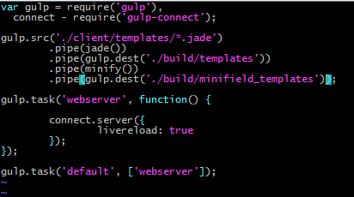
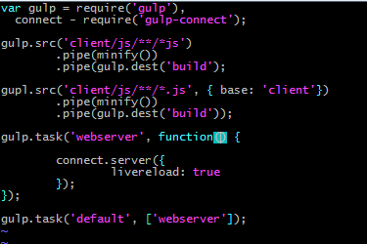
Merge Conflict: Example
2. Merging with Conflicts
master branch
dev branch

Slide 10
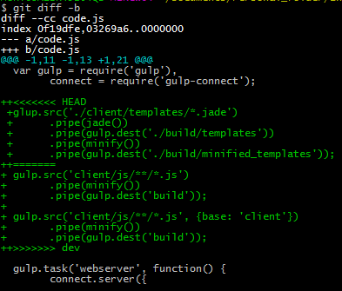
Merge Conflict: Example
2. Merging with Conflicts
Better yet, we can use the git diff -b command to have git tell us the difference between the two branches.
Question: Which branch does the ‘HEAD’ code belong to?

Slide 11
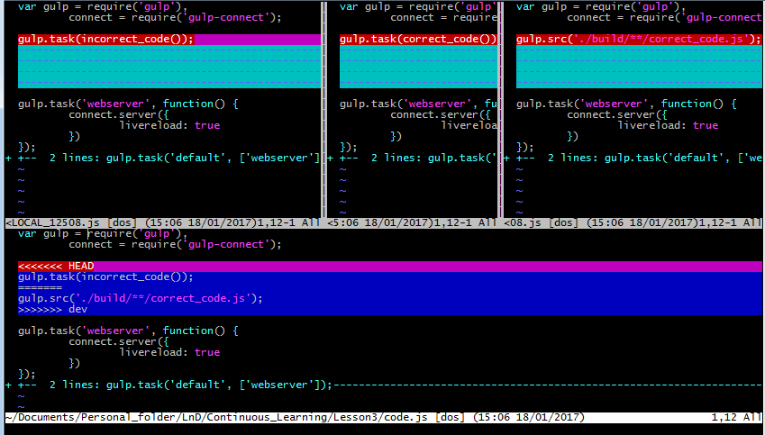
Mergetool: The Go-To Merge Resolutor
2. Merging with Conflicts
The mergetool command opens an interactive session to resolve conflicts among branches in a single file.
I will be using vimdiff to resolve the conflicts in this resolution.

Slide 12
Post-Merge: Tidy Up
2. Merging with Conflicts
Once we are done merging, we should clean up the code.js.orig which is a copy of the original base code.
Additionally, we should delete the branch dev where we were working so that the workflow is clean again with a single path.
And that’s all she wrote! (for today…)

Slide 13
Homework Assignment
3. Homework Assignment
Take a completed project from Lesson 1 or Lesson 2 and push your results to Github.
Create a second branch off of master with a change that will cause a conflict.
Use the mergetool to resolve at least one conflict among branches.

Slide 14
Next Time
Next time, let’s cover the workflow of git in a group of developers… which we didn’t cover this time because I had already made the slides for the basic workflow…

Slide 15
References
Lesson code and examples are pulled from the book Pro Git found at https://git-scm.com/book/en/v2.
Specific chapters references are Chapters 3.2. Chapter 7.8 has other options for handling merge conflicts, but I was not able to replicate the example.
Merge conflict example pulled from https://coderwall.com/p/o1psnw/handle-a-git-merge-conflict.

Slide 16


