Slide 1

New Strategies for Finding Failures and its Domains
Welcome to my Thesis Seminar on
Mian Asbat Ahmad
24-01-2013

Slide 2

Objectives
Development of new automated strategies with the following Goals:
To Find maximum faults and also its domain
To use minimum test calls and time
To require minimum resources
To give comprehensive results and regressive test suite

Slide 3

Achievements
Dirt Spot Sweeping Random Strategy
It is up to 33% better than Random
It is up to 17% better than Random+
Automated Discovery of Failure Domain Strategy
It finds & Plots fault domain of program
It makes GUI Front-End for YETI
DSSR with Daikon Strategy
Implementation of DSSR strategy with Daikon
Work in Progress

Slide 4

Why random testing?
Testing of all values is impossible
Infinite values between 0 and 1
Limited Time and Resources
Simple but practical selection approach
Easy implementation
Free from human bias
Quick and effective in finding faults
Code Privacy

Slide 5
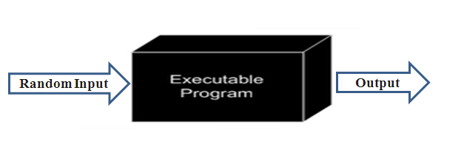
What is Random Testing?
Black-box testing technique
Dynamic testing process
Input Domain
Random Selection
Test Execution
Test Evaluation
Test Output

Slide 6

Automated Random Testing
Automating the process of random testing
Test data generation
Test execution
Test oracle
Evaluation Report
Regression Test cases

Slide 7
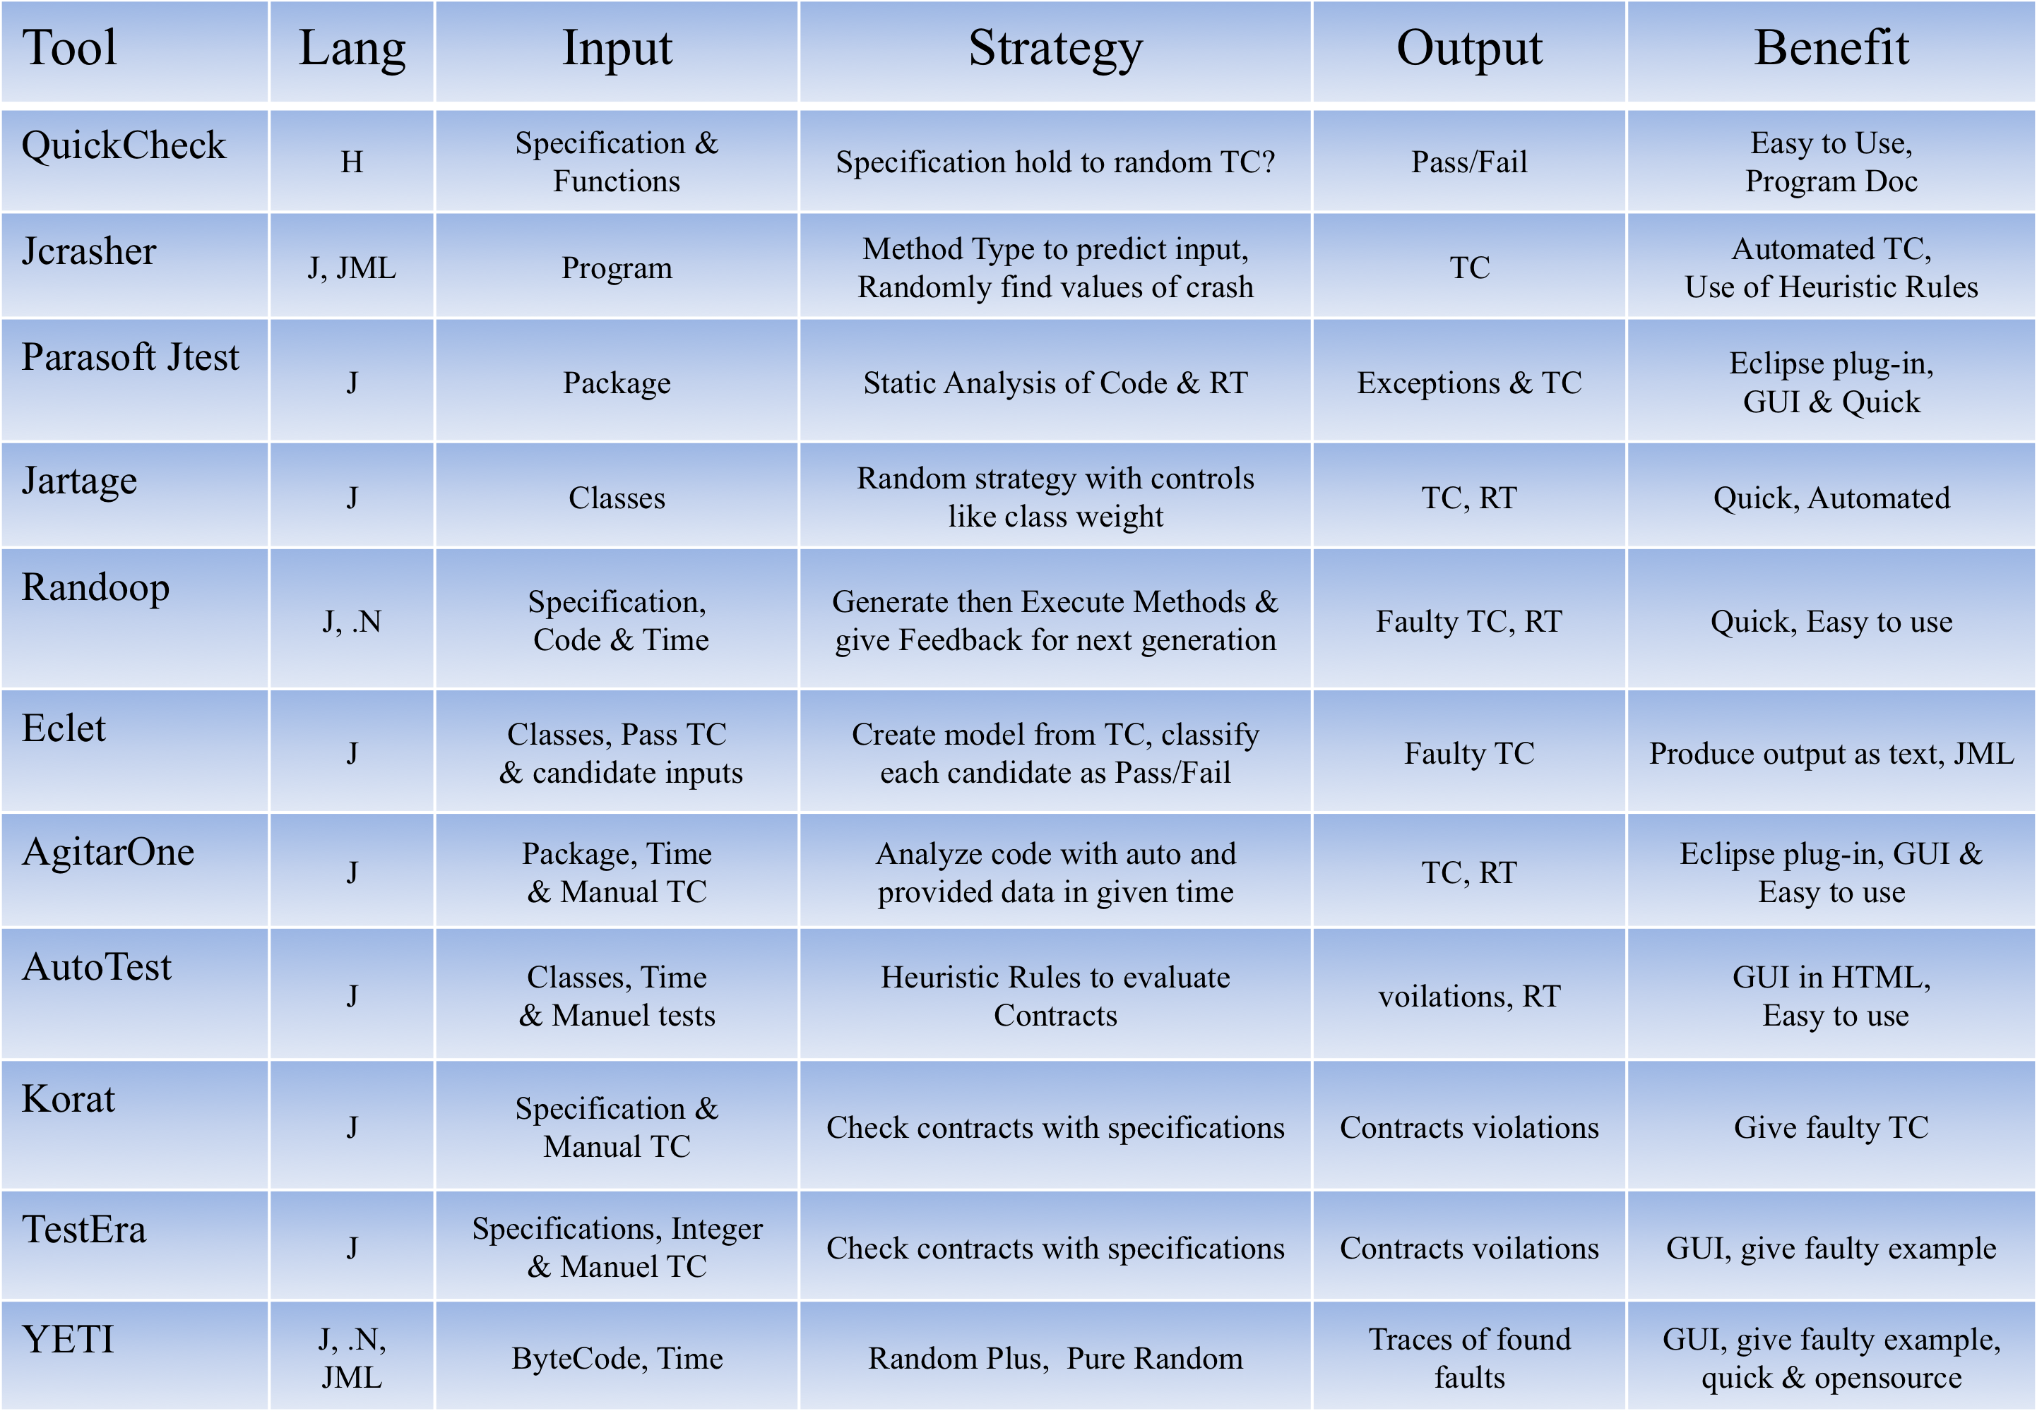
Automated Random Testing Tools

Slide 8
York Extensible Testing Infrastructure
Random Testing Tool
Implemented in Java
Strong decoupling between strategies and object code
YETI engine is language agnostic
Supports multiple language like (Java, JML, .Net)
High performance 10⁶ calls per minute
It have both CLI and GUI interfaces
Interactive testing of software
Verified experimentally by testing java.lang and iText.
Cloud enable version of YETI is also developed now
Notes:
Yeti is a random testing tool, strategy used is random testing
Coded in Java
Decoupling ?
Language agnostic ?
High speed of processing
Yeti can be operated from both CLI and GUI
Testing can be changed at run time

Slide 9
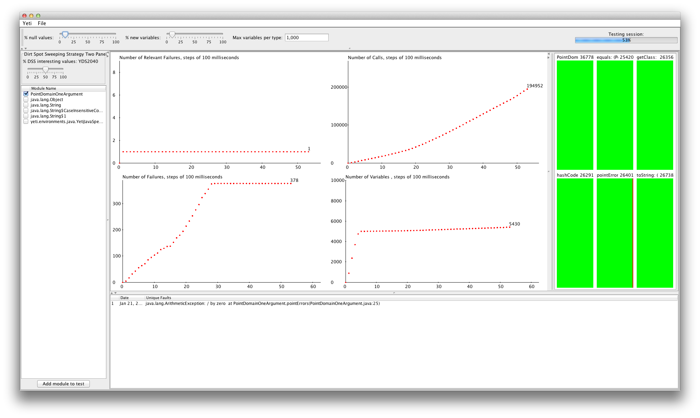
YETI Front-end

Slide 10
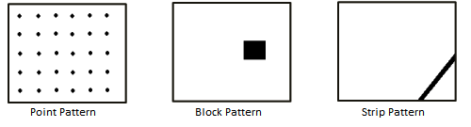
Fault Domains
Point Fault Domain:
Fault lies scattered across input domain
Block Fault Domain
Fault lies in a block across input domain
Strip Fault Domain
Fault lies in a strip across the input domain

Slide 11
Need of Improvement
To increase coverage
To increase efficiency
To decrease over-head
To generate friendly output
To introduce automation

Slide 12

Enhanced versions of Random Testing
Adaptive Random Testing (ART)
Quasi Random Testing (QRT)
Mirror Adaptive Random Testing (MART)
Restricted Random Testing (RRT)
Feedback-Directed Random Testing (FDRT)
Random+ Testing (R+)

Slide 13
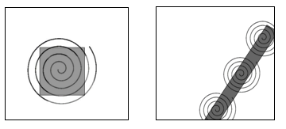
Dirt Spot Sweeping Random Strategy
Based on three strategies
Random
Random Plus
Spot Sweeping

Slide 14
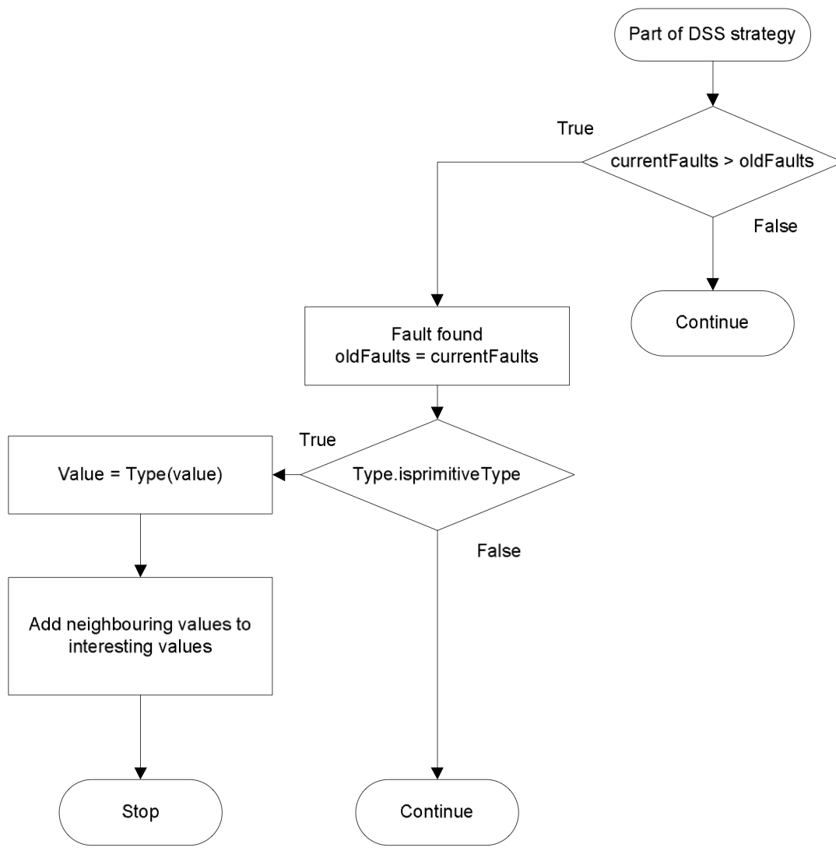
Working Mechanism of DSSR Strategy

Slide 15
Example to illustrate working of DSSR strategy
/**
* Calculate square of given number and verify results.
* The code contain 3 faults.
* @author (Mian and Manuel)
*/
public class Math1{
public void calc (int num1) {
// Square num1 and store result.
int result1 = num1 * num1;
int result2 = result1 / num1; // 1
assert Math.sqrt(result1) == num1; // 2
assert result1 >= num1; // 3
}
}

Slide 16
Performance of DSSR compared to R and R+
60 classes from 32 projects were tested by R, R+ and DSSR strategy
In 43 classes all the strategies found same number of faults
In 17 classes, the performance varied
DSSR strategy found the highest number of unique failures () followed by R+ () and R found the lowest number ()
On overall basis DSSR strategy performed better than R and R+.

Slide 17
Test Results of 17/60 classes
DSSR strategy better up to 33% than R and up to 17% than R+

Slide 18
Limitations of DSSR strategy
Lake of improvement for point fault domain
Excess time involved to find first fault
5% over-head than R and 2% than R+

Slide 19
Development of new improved strategy
Salient Features
Automated Method
Fault finding ability
Fault Domain finding ability
Plot Domain Graphing ability

Slide 20
Automated Discovery of Failure Domain
It is a new strategy based on YETI Tool
It provides GUI interface for simplicity
It allow User to control lower and upper bound
It finds the fault and its domain
It present the test results using Graphs

Slide 21

Steps of Testing SUT by ADFD strategy
Launch ADFD front-end
Starts Testing of SUT
Finds Fault
Generates program Dynamically
Compiles the program
Executes the program
Generates data
Presents data in Graphical format

Slide 22
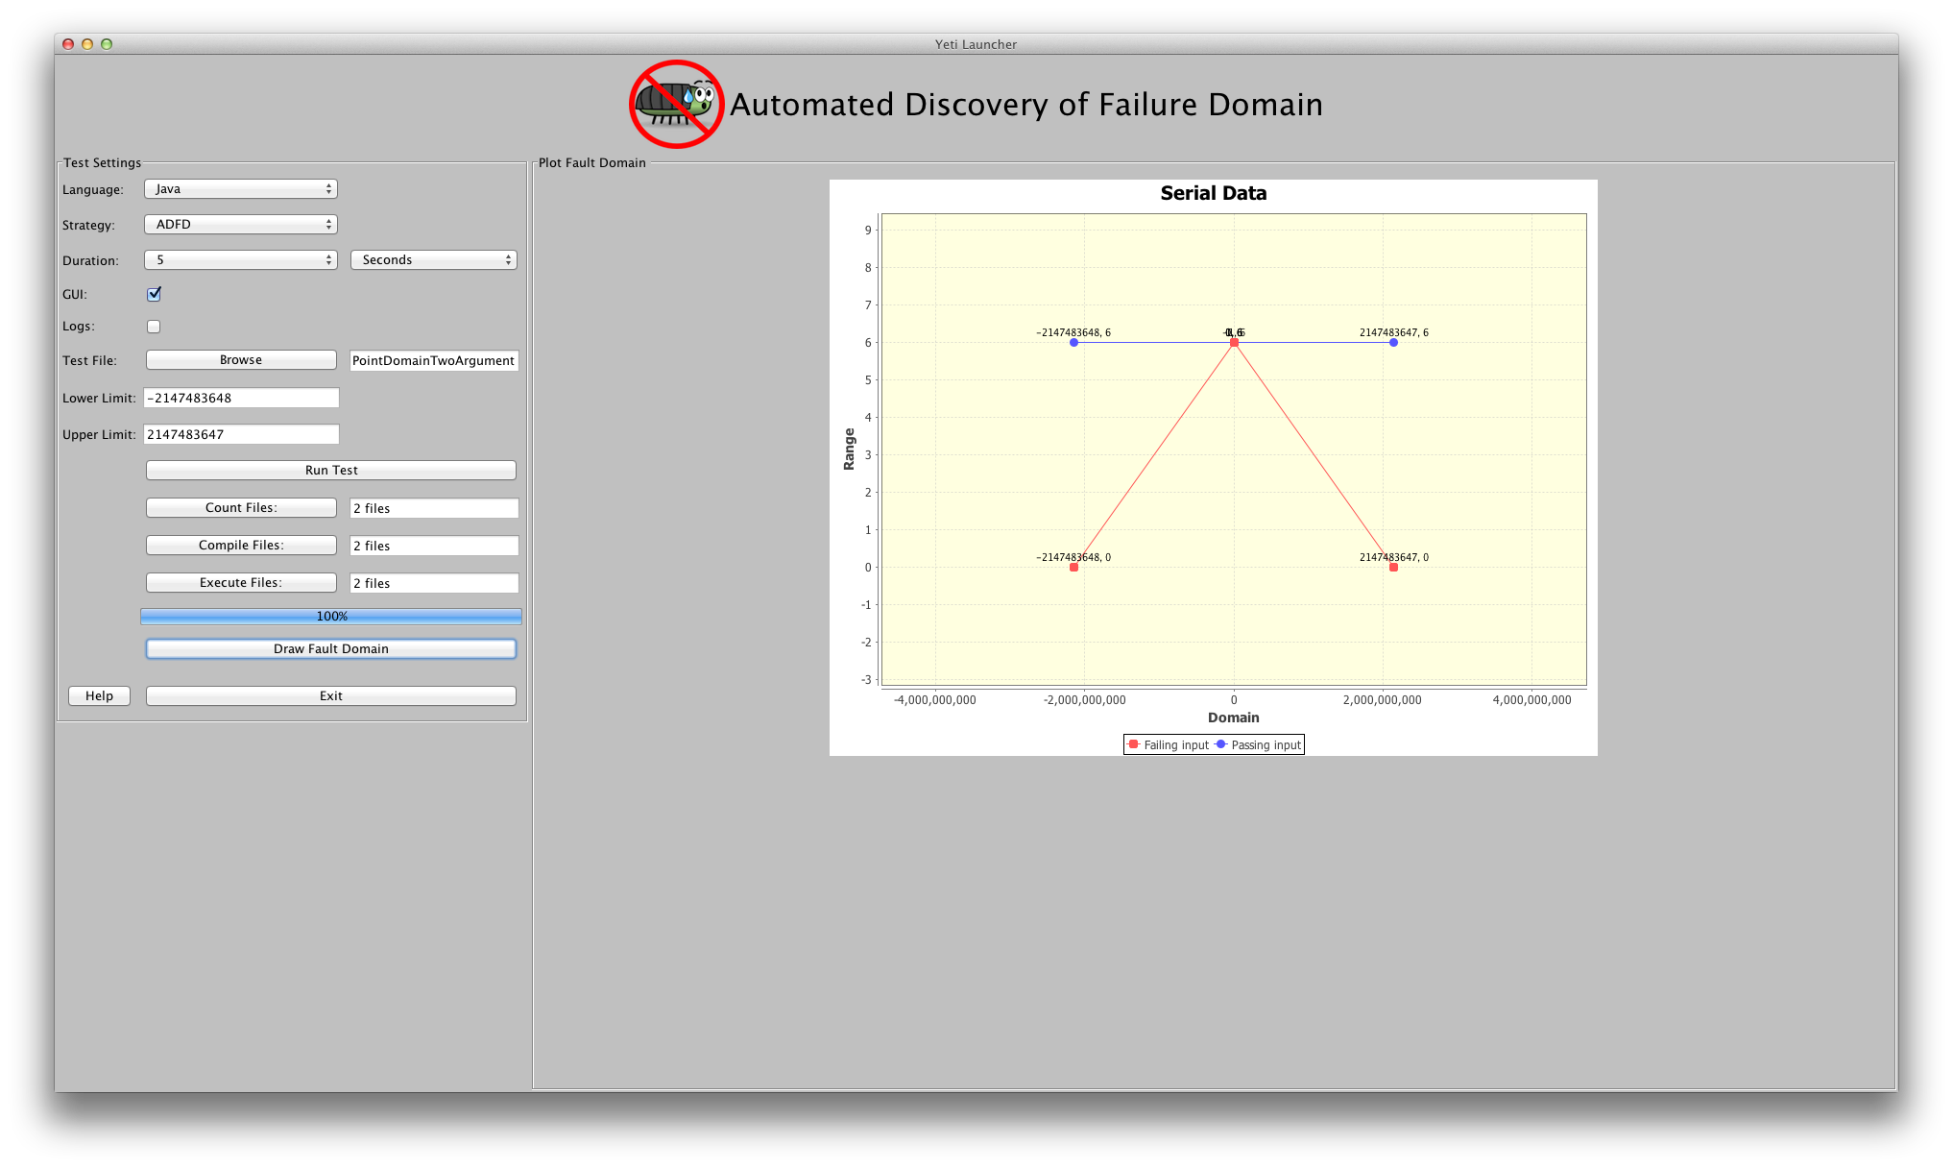
Front-end of ADFD strategy

Slide 23
Example to illustrate working of ADFD strategy on one and two argument programs with point, block and strip fault domains

Slide 24
Point Fault Domain
/**
* Point Fault Domain example for one argument
* @author (Mian and Manuel)
*/
public class PointDomainOneArgument{
public static void pointErrors (int x){
if (x == -66 )
abort();
if (x == -2 )
abort();
if (x == 51 )
abort();
if (x == 23 )
abort();
}
}
/**
* Point Fault Domain example for two arguments
* @author (Mian and Manuel)
*/
public class PointDomainOneArgument{
public static void pointErrors (int x, int y){
int z = x/y;
}
}

Slide 25
Block Fault Domain
/**
* Block Fault Domain example for one argument
* @author (Mian and Manuel)
*/
public class BlockDomainOneArgument{
public static void blockErrors (int x){
if((x > -2) && (x < 2))
abort();
if((x > -30) && (x < -25))
abort();
if((x > 50) && (x < 55))
abort();
}
}
/**
* Block Fault Domain example for two arguments
* @author (Mian and Manuel)
*/
public class BlockDomainTwoArgument{
public static void blockErrors (int x, int y){
if((x > 0)&&(x < 20) || (y > 0) && (y < 20)){
abort();
}
}
}

Slide 26
Strip Fault Domain
/**
* Strip Fault Domain example for one argument
* @author (Mian and Manuel)
*/
public class StripDomainOneArgument{
public static void stripErrors (int x){
if((x > -15) && (x < 15))
abort();
}
}
/**
* Strip Fault Domain example for two arguments
* @author (Mian and Manuel)
*/
public class StripDomainTwoArgument{
public static void stripErrors (int x, int y){
if((x >-40)&&(x < 40) || (y > -40) && (y < 40))
abort();
}
}

Slide 27
Development of DSSR with Daikon strategy
Salient Features
Capability to execute SUT by Daikon to generate invariants
Capability to add data to the list of interesting values from invariants
Capability to Execute DSSR strategy at this stage

Slide 28
Daikon Invariant Detector
Developed by MIT Program Analysis Group
Automated tool
Dynamically reports likely program invariants
Detect C, C++, Eiffel, IOA, Java and Perl programs.
freely available: http://groups.csail.mit.edu/pag/daikon/download/

Slide 29
Daikon with DSSR strategy
We are working on to utilize daikon invariants as:
Oracle for comparing test results
To find border also called interesting value
Remove the dependence of DSSR on R+
Increase test performance by restricting the the upper and lower bound.

