Slide 1

New Automated Random Test Strategies for Finding Failures & its Domains
Mian Asbat Ahmad
24-01-2013

Slide 2

Research Objectives
Develop New test strategies that
  Find maximum number of faults
  In minimum number of test calls
  In minimum possible time
  Use minimum H/W & S/W resources
  Use minimum Human Resource
  Works in automated fashion
  Find fault and its domain
  Provide easy to Understand results
  Provide regressive test suite
Notes:
Regressive because in ADFD the fault values are stored so after correction it can be checked with those values.

Slide 3

Research Contributions
DSSR Strategy
  Dirt Spot Sweeping Random Strategy
  Up to 33% better than Random
  Up to 17% better than Random+
ADFD Strategy
  Automated Discovery of Failure Domain
  Find & Plot fault and its domain
  GUI Front-End for YETI
DSSR with Daikon Strategy (in progress)
  Implementation of DSSR strategy with Daikon
  Aiming for more improved DSSR strategy

Slide 4

Why random testing
Exhausting testing is not possible
  Infinite values between 0 and 1
  Compatibility across multiple systems
  Limited Time and Resources
Simple but practical selection approach
  What will you do if you are asked to check the quality of rooms in CS building in 5 minutes?
Easy implementation
Free from human bias
Quick and effective in finding faults
Code Privacy
Notes:
It takes a lot of time to check all possible combinations.
Compatibility to check e.g. if a flash game is developed how it will be tested on all the available devices like tablets, mobiles, pcs, mac etc so that it is working correctly and displayed properly.
Limited resources like hardware, software and human resources.
Algorithm for random testing is very simple yet it found high number of subtle faults

Slide 5

Random Testing
Black-box testing technique
Dynamic testing process
Input Domain
Random Selection
  Test Input
  Test modules
Test Execution
Test Evaluation
  Specifications
  Language exceptions
Test Output
Notes:
Pure random testing is a black box testing because we don’t need to see the code of the program before testing.
Random testing is Dynamic testing because the program is executed as against static testing.
Input domain for a program under test is either mentioned in specifications or consider it in full. Like for int the input domain can be -100 to 100 taken from specifications or the whole limit like -2147483648 to -2147483617
Random selection of values from input domain and random selection of modules for testing.
Test execution by time or by number of calls
Test evaluation to see if output is correct or not. It is compared to the specifications like assertions or in case of absence of specifications language exceptions are considered

Slide 6

Automated Random Testing
Automating the process of random testing that include reading specifications, test data generation, test execution, result analysis and identification of failures.
Examples of Automated
Random testing tools
are YETI, JCrasher,
JUnit, Haskel etc…

Slide 7
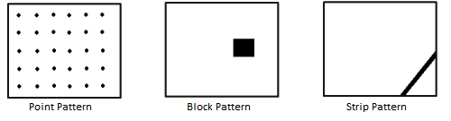
Fault Domains
Fault lies in Domains [Chan et al]
Input Domain
Fault Domain
  Point Fault Domain
  Fault lies scattered across input domain
  Block Fault Domain
  Fault lies in a block across input domain
  Strip Fault Domain
  Fault lies in a strip across the input domain

Slide 8
Need of Enhancement in RT
Random Testing is simple and fast
  YETI* can call up to 10⁵ in one minute
But low coverage with simple random
  ( x == 10 ) in a program
  has only one chance to be exercised out of
  2³² if x is a 32 bit integer [DART]
To increase coverage
To increase efficiency of random testing
To decrease overhead
To maintain its high speed
To keep it unbiased

Slide 9

Enhancement in Random Testing
Test Strategy?
  Process of data selection and execution
  E.g. Random Test Strategy
Famous Variations in Random Strategy
  ART
  M-ART
  RRT
  FD-ART
  R+
  QRT

Slide 10
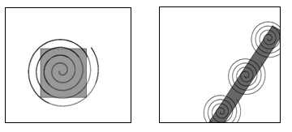
Dirt Spot Sweeping Random Strategy
Combination of strategies
  Random
    Input and module selection at random
  Random Plus
    Random testing with border values
  Spot Sweeping
    Select neighbors of the failure finding values

Slide 11
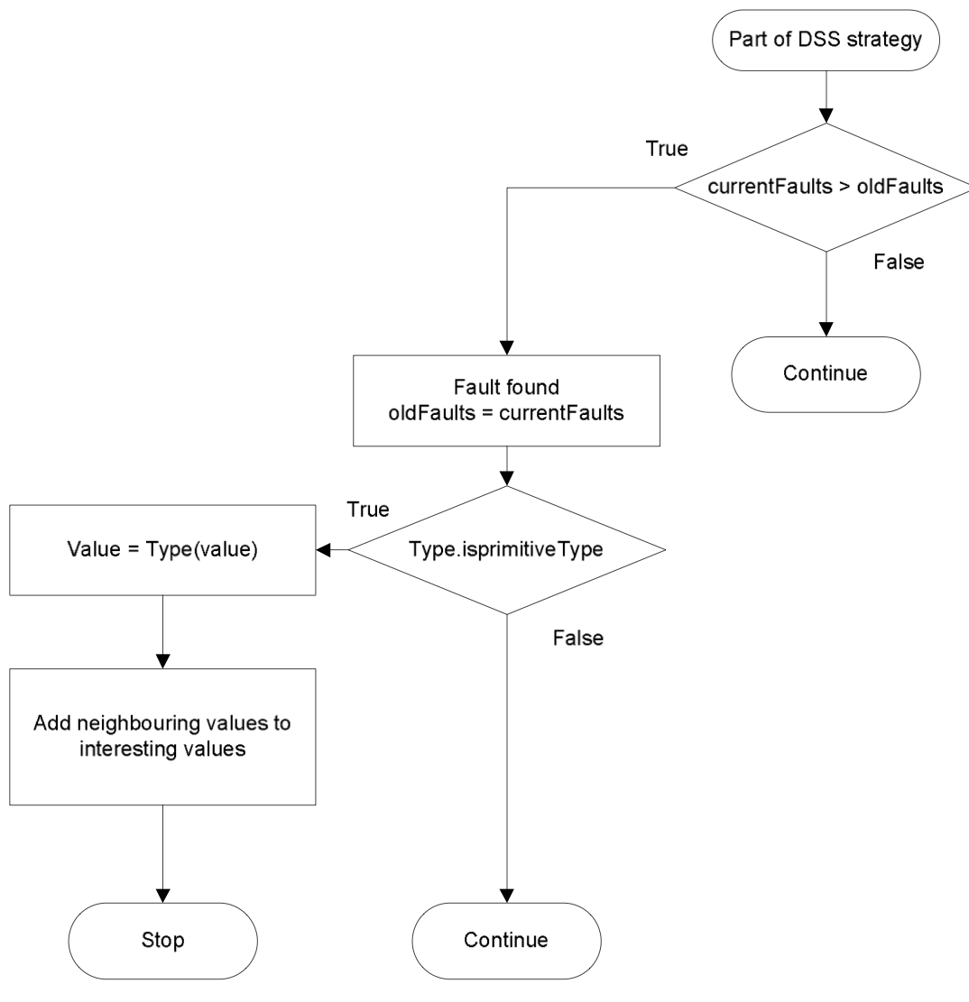
Working of DSSR
Start with R and R+
Switch to DSSR, when Fault found
After Evaluating block/strip, switch back to R and R+

Slide 12
Example of DSSR Working
/**
* Calculate square of given number and verify results.
* The code contain 3 faults.
* @author (Mian and Manuel)
*/
public class Math1{
public void calc (int num1) {
// Square num1 and store result.
int result1 = num1 * num1;
int result2 = result1 / num1; // 1
assert Math.sqrt(result1) == num1; // 2
assert result1 >= num1; // 3
}
}

Slide 13
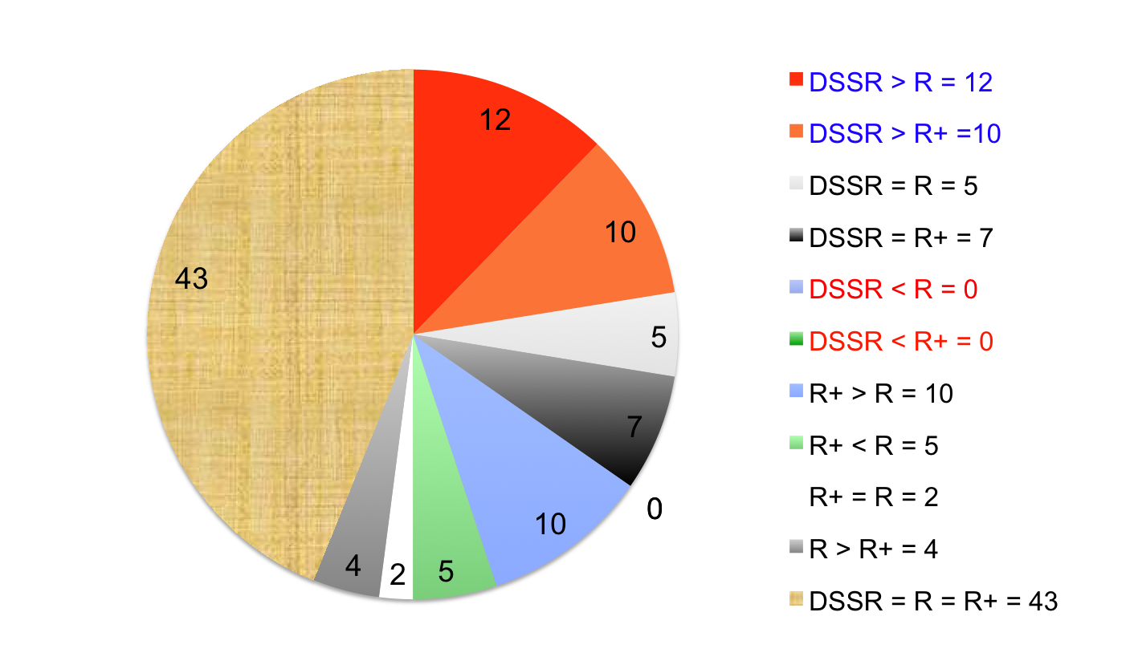
Evaluation of DSSR strategy
  60 classes selected from 32 different projects
  In 43 classes all the strategies found same number of faults
  In 17 classes strategies performed different than one another
  DSSR found the highest number of faults
  No strategy performed better than DSSR

Slide 14
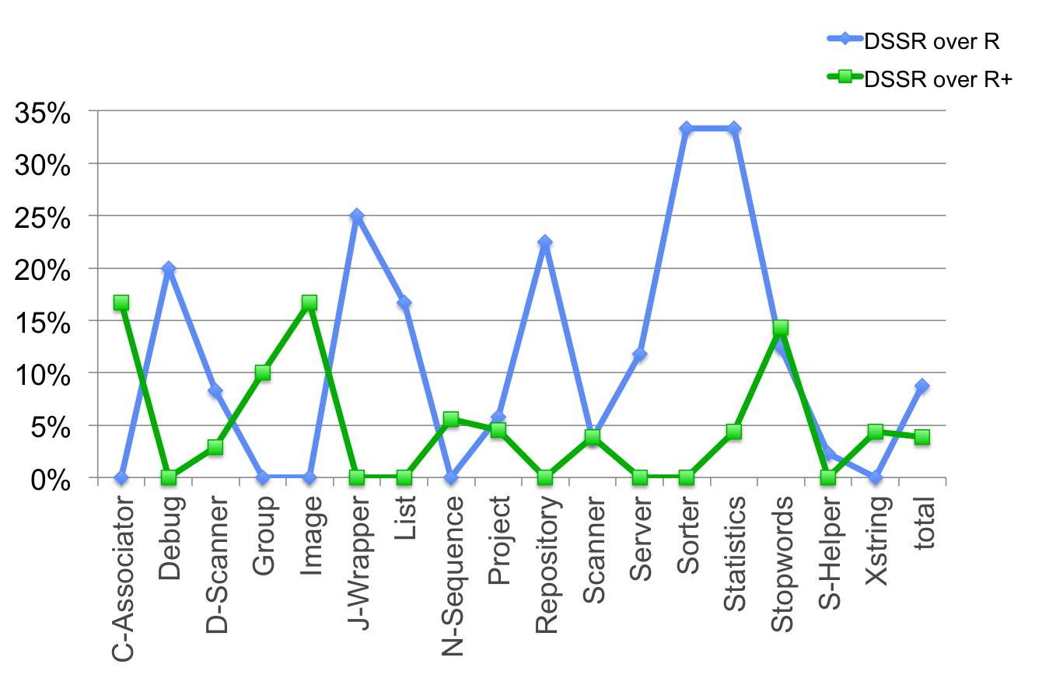
Test Results of 17/60 classes
DSSR better up to 33% than R and 17% than R+

Slide 15
DSSR Strategy Limitations
Fault Domain
  Existence Frequency not known
    Point, Block and Strip in programs
Time to Find First Fault
  DSSR strategy uses R and R+ to start with and thus the F-measure of DSSR = R or R+
5% Overhead
  To add neighbor values of the fault

Slide 16
Solutions to Limitations
ADFD strategy
  Automated Method
  Find Fault & its Domain
  Plot Domain on Graph
DSSR strategy with Daikon/contracts
  Execute system under test by Daikon
  Get class invariants
  Add data to R+ from invariants
  Run DSSR testing
  Reliance on simple R and R+ is removed.

Slide 17
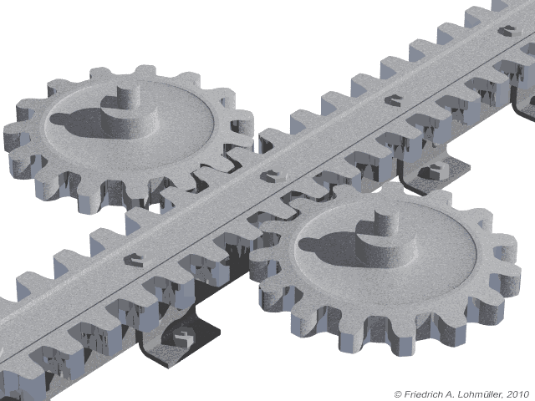
Automated Discovery of Fault Domain
Automated Technique
GUI Front-end
Start Test
Find Fault
Generate a program
Compile it
Execute it
Generate data
Plot Fault domain

Slide 18
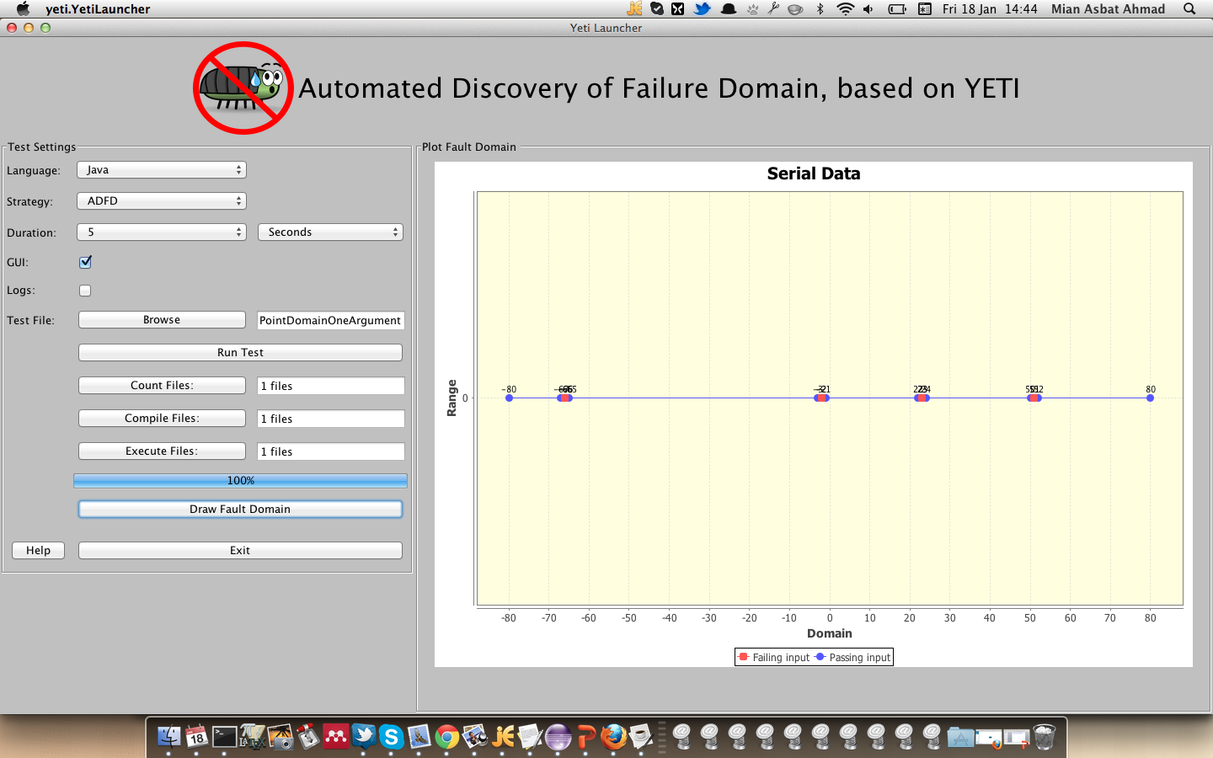
Working of ADFD using Example

Slide 19
Execute ADFD Demo

Slide 20
Daikon + DSSR strategy
Auto generation of Invariants by Daikon
Addition of values from Daikon
Addition of neighbour values to Daikon Values
Use of invariants as a test specifications

