Slide 1
Rookie
Jiazhen Tang, Xinmeng Zhang, Jing Wang

Slide 2
Value Proposition
We set our value proposition for Rookie as is an internship listing website that provides latest internship job postings categorised by area, requirements or other attributes for the computer science major students who are unhappy with the lack of specific targeting of Indeed and Glassdoor.
We have fulfilled our value proposition. Rookie has good value propositions for every part of our website, but one that is particularly impressive is the internship job posting for computer science students. In this part, our website helps students to find the job easier and faster.

Slide 3
Deliverables
This semester we plan to deliver a website which requires a user to register and login to the account. Users have a username and password. Furthermore, we will provide service for students and companies log in to our website. Students can register, build their profiles, upload their existing resumes, and look for internship postings matching their skill sets. Using a database of internship listing website, companies can register, post jobs, and search job seeker profiles. Companies can view profiles of registered students and contact them, initiative an interview, or perform some other action related to their post. In addition, registered users should be able to search for jobs and filter the results based on location, required skills, salary, experience level, etc.

Slide 4
Deliverables
Compared to the old one, we have covered all the stuff when we plan to deliver this semester. We have user management, company profiles, seeker profiles and job post management. But we still want to add more information later. For instance, we can have a discussion board that will allow students to rate the company and provide comment. Also, a module allows users to share interview tips and experience as job rookies.

Slide 5
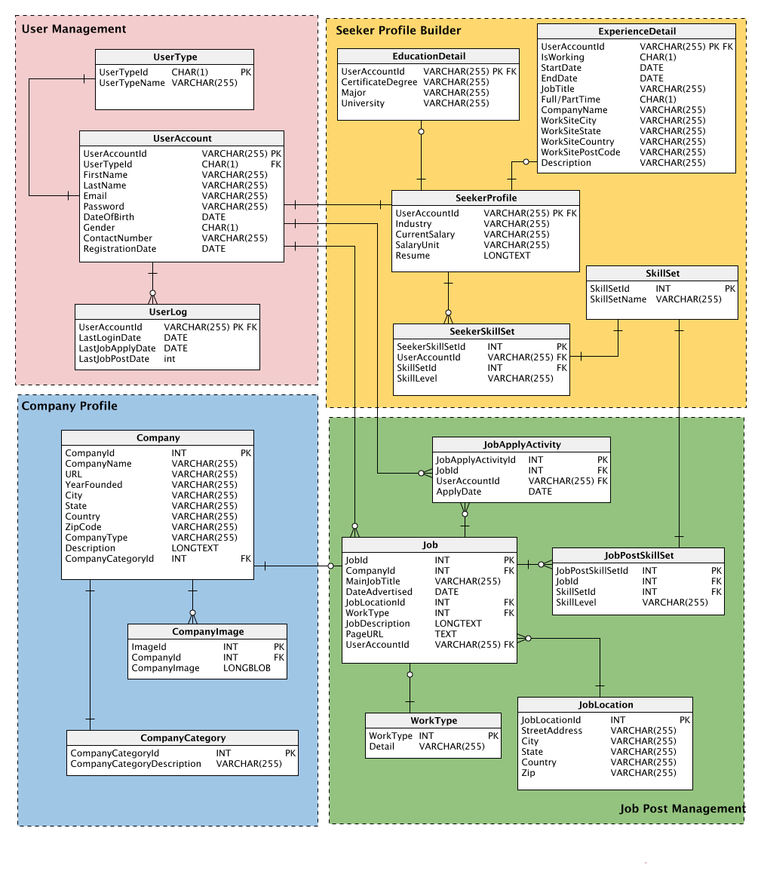
Final UML
Main changes:
Changed the diagram shape from horizontal to vertical for better and clear viewing.
Removed some unnecessary attributes.
Changes some names of table and attributes for better understanding.
Combining some common attributes for better management of users.
We changed our UML in PM3 when considering business insights to make the data more reasonable and manageable. Now each attribute is useful and intelligible.

Slide 6
Things went well via the course
For the process
Clear milestone plan
In each milestone, the goal was clear and the approach was stated in detail on videos. So we were able to fulfill every step of the project smoothly.
Discussion board help
Thanks for the discussion in each module, we were able to solve some difficult configuration problems when installing MySQL and CloverDX.

Slide 7
Things went well via teamwork
For the project
Collected data from source web as csv file.
Created an UML through teamwork using Vertabelo.
Build a sql database for job application, inserting up to 26k rows data.
Identified 10 questions regarding business insights and creates queries.
Used JDBC to build the data access layer.
Used JSP to build the web for job application.
Created 2 ETL workflows regarding employment information for user reference.
Web Development
Business Query
csv
Database Management
ETL workflow
MySQL Database
UML
Notes:
Build relational model using UML
Set up MySQL relational database
Parse data from websites using open source API
Build data access layer
Web development and user interface design

Slide 8
What would we do differently?
Since we set our proposition to mainly help computer science major students to search for internships. Instead, we could also set our target users to all majors.
Furthermore, instead of building our web application based on the method taught in class, we could build the generic type application and set up the Restful API server. Because our data are saved in database as resources, we could easily obtain the resources using get, put and update methods. This could be done by editing URLs to submit HTTP requests.

Slide 9
Future Plan
Build distributed database system or MySQL cluster.
Add cache which is a in memory database with optional durability to save database reading time. Add LRU cache to remove the least recently viewed job postings in the cache to save storage space.
Set up our servers using Amazon EC2 for hosting the website that provides grow and shrink resources.
Use AWS service for hosting the website that provides grow and shrink resources.
Add a load balancer which could evenly allocate requests to several backend servers.

