Slide 1
MATLAB
Programming Assignment Two
Instructor: 黃世強 (Sai-Keung Wong)

Slide 2
Program file name format
Write a program for each problem in one file.
The file name is hw02_X_yourStudentID.m, where X is the problem number.
For example, if your student ID is 12345678 and the problem number is 3, then the file name must be hw02_3_12345678.m.
Do not output all the intermediate results.
Output the results that are required only.

Slide 3
For each problem, display the problem number before showing the results.
clf; clear; clc; % clear the current figure
% clear variables, and clear screen
disp(‘Problem 2.1’) % show Problem 2.1

Slide 4
At the top of the file, write down your name, ID, email address, department, and date.
%%%%%%%%%%%%%%%%%%%%%%%%%%%
% Assignment Number: …
% Problem number: …
% Student Name: …
% Student ID: …
% Email address: …
% Department: Computer Science, NCTU
% Date: ….
%%%%%%%%%%%%%%%%%%%%%%%%%%%%

Slide 5
Example
This program asks a user to input a set of linear functions and plot all of them. The program quits if the coefficient of the x term is zero.
Clear screen. Show your student ID and name.
Ask the user to input the coefficients of a linear function y = ax + b.
Plot the curve for y, and x is in [-10, 10]. The step size is 0.05.
If a is zero, quit the program. When it is asked to input something, a message must be shown appropriately.

Slide 6
Example
clf; clear; clc;
fprintf('Student ID:.. Name:..\n');
x = -10:0.05;10; %bug
while 1
coef = input('Please input the coefficients [a,b]:');
if coef(1) == 0
fprintf('Thanks for playering.\n');
break
end
a = coef(1); b = coef(2);
y = a .*x + b;
plot(x,y);
hold on;
end

Slide 7
Problem 1
Write a problem to ask for inputs. Then it plots a function y = f(x).
The function y = a sin(x) + b cos(x). The process is stated as follows.
Clear the screen. Show your student ID and name.
Ask to input a0 and b0 in a vector form.
If both a0 and b0 are zero, show a message “Thanks for playing” and then quit the program. Otherwise go to step 4.
Clear all curves in the current figure.
Plot y versus x for all pairs of a and b, such that a is in [a0-10:1:a0+10] and b is in [b0-10:1:b0+10]. x is inside [-10:0.05:10]. The line width of all the curves is set to the default value. Call “hold on” so that all the curves are plotted in the same figure.
Go to step 2.

Slide 8
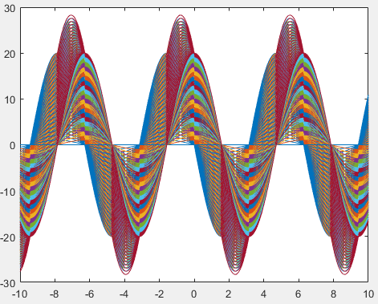
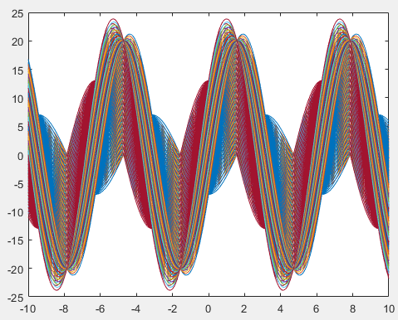
Problem 1
Write a problem to ask for inputs. Then it plots a function y = f(x).
The function y = a sin(x) + b cos(x). The process is stated as follows.
[ -10 -10]
[10 3]

Slide 9
Problem 2
Write a problem to ask for inputs. Then it plots a function y = f(x).
The function y = | sin(ax) cos(x) |. The process is stated as follows.
Clear the screen. Show your student ID and name.
Ask to input the range of a, [aMin, aMax]. Here, assume aMin < aMax.
Ask to input the step size, da, of a. da must be a non-negative number.
If da is zero, show a message “Thanks for playing” and then quit the program. Otherwise go to step 5.
Clear all curves in the current figure.
Plot all the curves of y with different a such that a is inside [aMin:da:aMax]. x is inside [-10, 10]. The step size of x is 0.05. The line width of the curve is set to 2. Call “hold on” so that more functions can be plotted in the same figure.
Go to step 2.

Slide 10
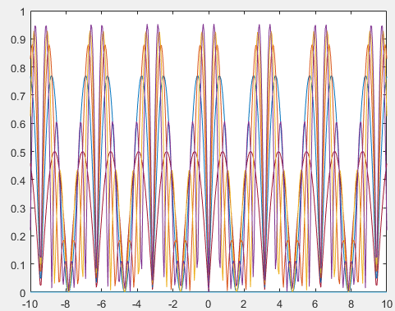
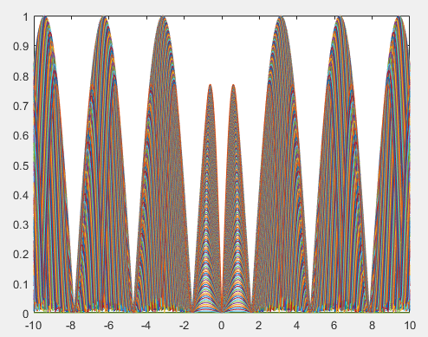
Problem 2
Write a problem to ask for inputs. Then it plots a function y = f(x).
The function y = | sin(ax) cos(x) |. The process is stated as follows.
Please input the range of a, [aMin, aMax]:[-5 5]
Please input da:1
Please input the range of a, [aMin, aMax]:[-2 2]
Please input da:0.01

Slide 11
Problem 3
Write a problem to ask for inputs. Then it plots function y1 = f(x) and a family of function y2 = y2(x,n).
y1 = sin(x)
y2(x,n) = x – x³/3! + x⁵/5! +… + ((-1)^{n}/(2n+1)!) x^{2n+1}
Clear the screen. Show your student ID and name.
Ask to input m. m is an integer inside [-1, 10]. MUST check if the input is valid.
If m is -1, show a message “Thanks for playing” and then quit the program. Otherwise go to step 4.
Clear all curves in the current figure. Use ylim([-1.5, 1.5]).
In the same figure, plot y1’s curve, and y2’s curves for all 0 <=n <= m.
x is inside [-1, 1]. The step size of x is 0.01.
The line width is set to 4 for y1’s curve.
The line width is set to 1 for y2’s curves. Put ylim([-1.5, 1.5]) after all curves are plotted.
Go to step 2.
Hint: use factorial

Slide 12
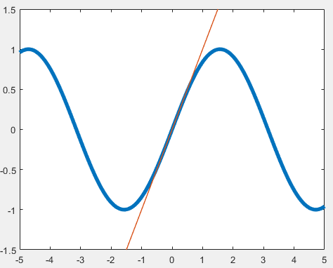
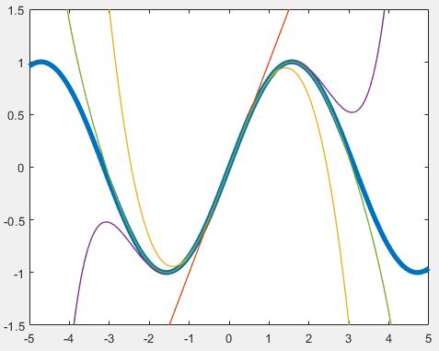
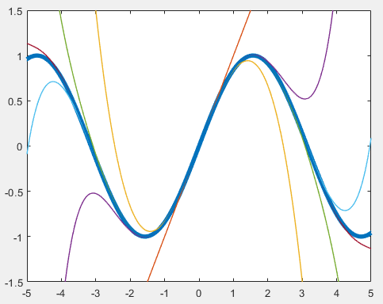
Problem 3
Write a problem to ask for inputs. Then it plots function y1 = f(x) and a family of function y2 = y2(x,n).
y1 = sin(x)
y2(x,n) = x – x³/3! + x⁵/5! +… + ((-1)^{n}/(2n+1)!) x^{2n+1}
m = 0
m = 3
m = 5

Slide 13
Problem 3
m = 5

Slide 14
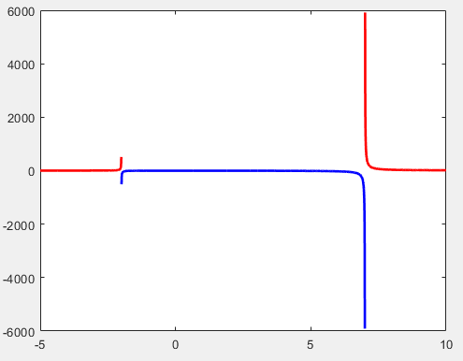
Problem 4
Plot y = (5x²+2x+7)/(x²-5x-14)
Plot the upper part of the curve
as red color, i.e., y >= 0.
Plot the bottom part of the curve
as blue color, i.e., y < 0.
The step size of x is 0.005.
Show something that is similar to the right figure.
The range of x is [-5, 10]. The line width is 2.
Hint: Create a row vector for y, with x changed in the interval. Then split the row vector based on y’s value into parts. Or you can find out the split points for x and then create the proper vectors.

Slide 15
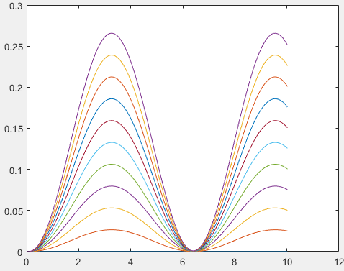
Problem 5
A dynamic system is updated by three rules as follows.
R1) v ← v + k sin(t) Δt - d v
R2) p ← p + v Δt
R3) t ← t + Δt
Initial condition: t = 0, v = 0 and p = 0. p is a function of time. Δt = 0.02.
Main process
Clear the current figure.
Ask to input d. Here d is in [0, 1].
Draw a curve p versus t for each k in [0:0.1:1], and t in [0, 10].
Put all the curves in the same figure.

Slide 16
End
Enjoy MATLAB Programming.

