Slide 1
MATLAB
Lab Three exercises
Image
Instructor: 黃世強 (Sai-Keung Wong)

Slide 2
About the demo video
A demo video may have bugs. The demo video shows roughly the results. These results may not be exactly the same as the requirements. They are for your own reference. You must follow the instruction to finish your programs.

Slide 3
Program file name format
Write all your programs in a folder. The folder name is your lab03_student_ID.
Zip the folder and upload it.
Write a program for each problem in one file.
The file name is lab03_X_yourStudentID.m, where X is the problem number.
For example, if your student ID is 12345678 and the problem number is 3, then the file name must be lab03_3_12345678.m.
Do not output all the intermediate results.
Output the results that are required only.

Slide 4
Show information
For each problem, display the problem number before showing the results.
clf; clear; clc; % clear the current figure
% clear variables, and clear screen
disp(‘Lab Problem 3.1’) % show Lab Problem 3.1

Slide 5
The header
At the top of the file, write down your name, ID, email address, department, and date.
%%%%%%%%%%%%%%%%%%%%%%%%%%%
% Assignment Number: …
% Problem number: …
% Student Name: …
% Student ID: …
% Email address: …
% Department: Computer Science, NCTU
% Date: ….
%%%%%%%%%%%%%%%%%%%%%%%%%%%%

Slide 6
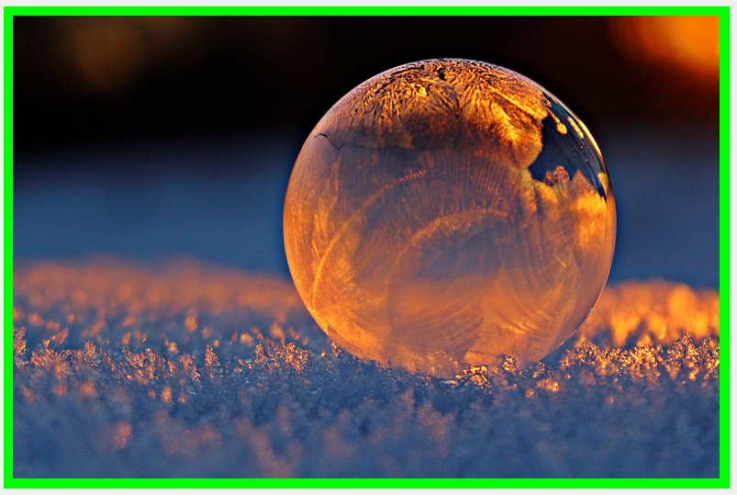
Problem Example
This program draws a green frame on the image.

Slide 7
(50%) Problem 3.1. Image processing
This program draws grids with different dimensions to an image.
Load an image.
Ask to input the option:
(5%) 0. Show ‘Thanks for playing.’
Then quit the program
(15%) 1. A 2x8 grid
(15%) 2. A 4x8 grid
(15%) 3. A 8x8 grid
After the image is shown, repeat the process.
Based on the option, draw the corresponding grid. The thickness of the wireframe of the grid is 5. The color of the grid is blue.
A 4x2 grid

Slide 8
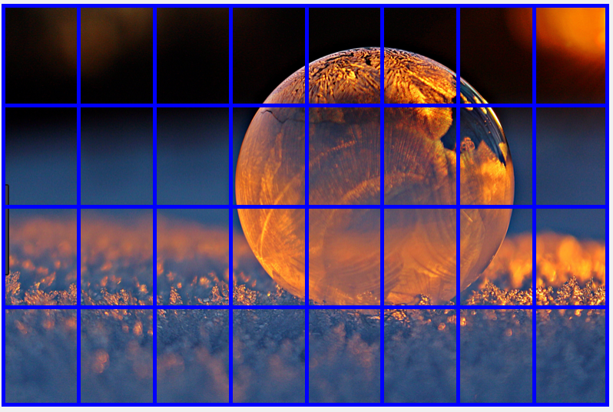
Problem 3.1. Image processing
This program draws grids with different dimensions to an image.
A 4x8 grid

Slide 9
(50%) Problem 3.2. Image processing
This program modifies the intensity of an image with a function.
Load an image.
Ask to input the option:
(5%) 0. quit the program
(25%) 1. Apply a function to modify the intensity of the image along the horizontal direction
(20%) 2. Apply a function to modify the intensity of the image along the vertical direction
After the image is shown, repeat the process.
The function is f(x) = |cos(x/w*2*pi)|, where x = [1:w]. w must be chosen properly.

Slide 10
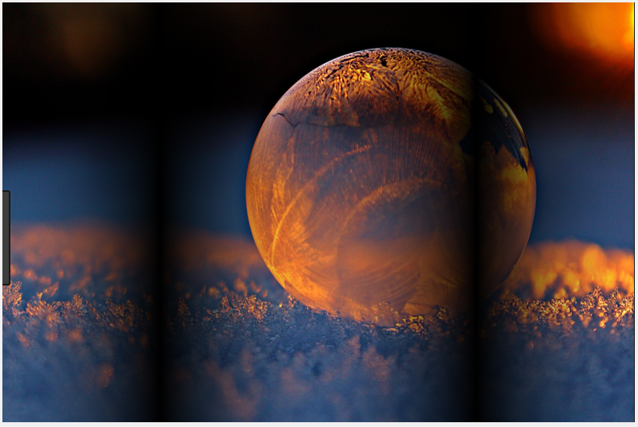
Problem 3.2. Image processing
This program modifies the intensity of an image with a function.
horizontal

Slide 11
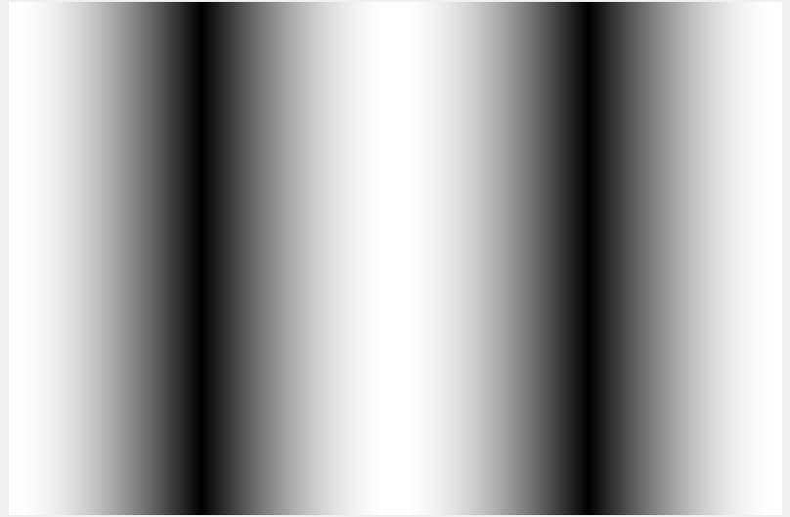
Problem 3.2. Image processing
Gradient map
horizontal
The value changes as:
1 to 0, 0 to 1, 1 to 0, and 0 to 1, from left to right.
|cos(x)|

Slide 12
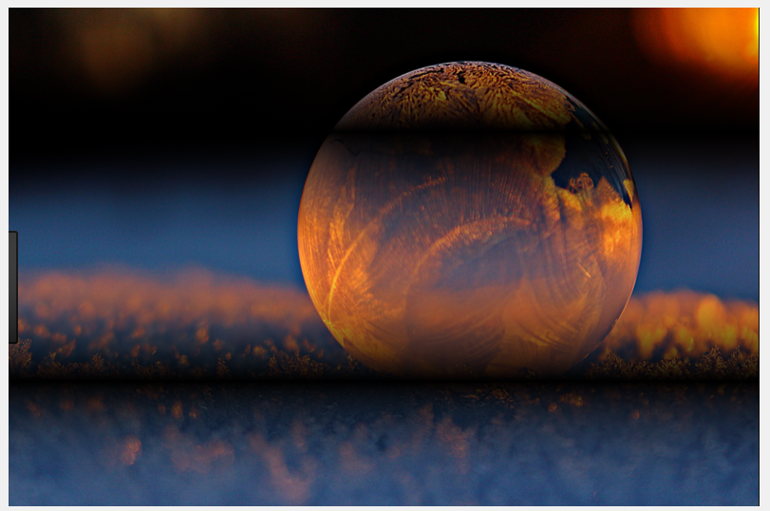
Problem 3.2. Image processing
This program modifies the intensity of an image with a function.
vertical

Slide 13
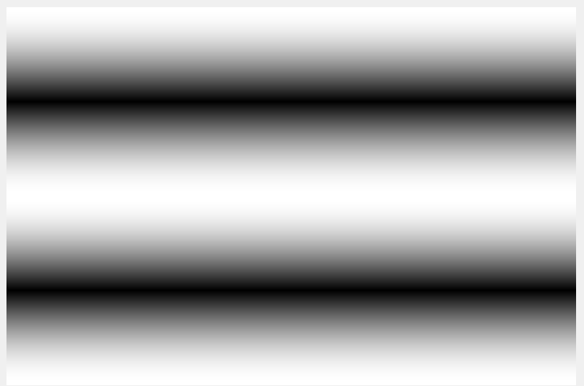
Problem 3.2. Image processing
Gradient map
vertical
The value changes as:
1 to 0, 0 to 1, 1 to 0, and 0 to 1, from top to bottom.
|cos(x)|

Slide 14
Hints
Use [x y] = meshgrid([1:w]);
Use x and y to produce a horizontal map or a vertical map. Then you need to resize them to fit to the size of the image.
You can type x or y to see their values and you can observe how their values are organized.

Slide 15
This part is for fun.
Could you animate the image by using
f(x) = a*|cos(x/w*2*pi)|
?
Here, a changes from 1 to 3 with a proper increment.

Slide 16
End
Enjoy MATLAB Programming.

