Slide 1
MATLAB
Lab Five exercises
Instructor: 黃世強 (Sai-Keung Wong)

Slide 2
About the demo video
A demo video may have bugs. The demo video shows roughly the results. These results may not be exactly the same as the requirements. They are for your own reference. You must follow the instruction to finish your programs.

Slide 3
Program file name format
Write all your programs in a folder. The folder name is your lab05_student_ID.
Zip the folder and upload it.
Write a program for each problem in one file.
The file name is lab05_X_yourStudentID.m, where X is the problem number.
For example, if your student ID is 12345678 and the problem number is 3, then the file name must be lab05_3_12345678.m.
Do not output all the intermediate results.
Output the results that are required only.

Slide 4
For each problem, display the problem number before showing the results.
clf; clear; clc; % clear the current figure
% clear variables, and clear screen
disp(‘Lab Problem 5.1’) % show Lab Problem 5.1

Slide 5
At the top of the file, write down your name, ID, email address, department, and date.
%%%%%%%%%%%%%%%%%%%%%%%%%%%
% Assignment Number: …
% Problem number: …
% Student Name: …
% Student ID: …
% Email address: …
% Department: Computer Science, NCTU
% Date: ….
%%%%%%%%%%%%%%%%%%%%%%%%%%%%

Slide 6
Guideline
For an animation, it must be interactive.
All programs must be finished under 10 seconds, except for animations and further notice.

Slide 7
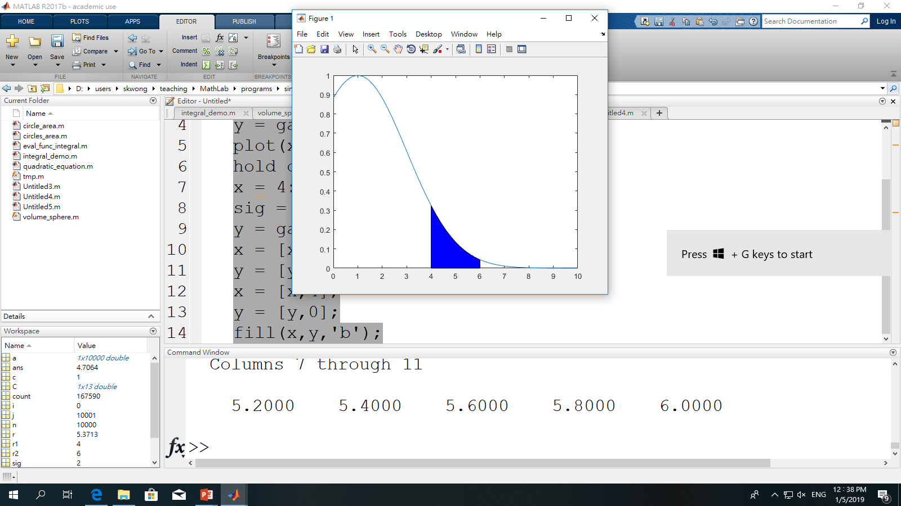
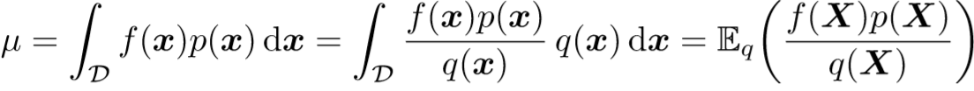
Example Importance sampling
Compute the average of random numbers generated by the normal distribution (1,2) inside the interval [r1,r2].
Use sym to compute the area A.
A
c = 1, sigma = 2; r1 = 4; r2 = 6;
y = sym('2.718281828^(-(x-1)^2/8)');
A = int(y,’x’, 4, 6);
x
X
x

Slide 8
Importance sampling
Use the uniform sampling method to generate a number x inside the interval [r1,r2]. Then compute p(x).
%Importance sampling
n = 10000; j = 1; r1 = 4; r2 = 6;
while (j<=n)
x = r1 + (r2-r1)*rand(1);
c = 1; sigma = 2;
p = gaussmf(x, [sigma, c])/A;
r = x*p*(r2-r1);
a(j) = r;
j = j +1;
end
mean(a)
A
q(x) = 1/(r2-r1)
x
X
x

Slide 9
(50%) Lab Problem 5.1. Use Importance Sampling
A. (15%) Compute the average and standard deviation of random numbers generated by the normal distribution (Mean, SD) = (-1,3) inside the interval [2.5,3.5].
B. (15%) Fill the region of the normal distribution within the interval [2.5, 3.5]. The color for filling the region is blue. No artifact.
C. (10%) Draw the curve. Show legends, and titles.
D. (10%) Report the results as a title for the followings:
The total number of the random numbers is n.
n = 1000 ; display n = 1000, and then show the result
n = 100,000 ; display n = 100,000, and then show the result
n = 1,000,000 ; display n = 1,000,000, and then show the result
See the demo result in the next page.

Slide 10
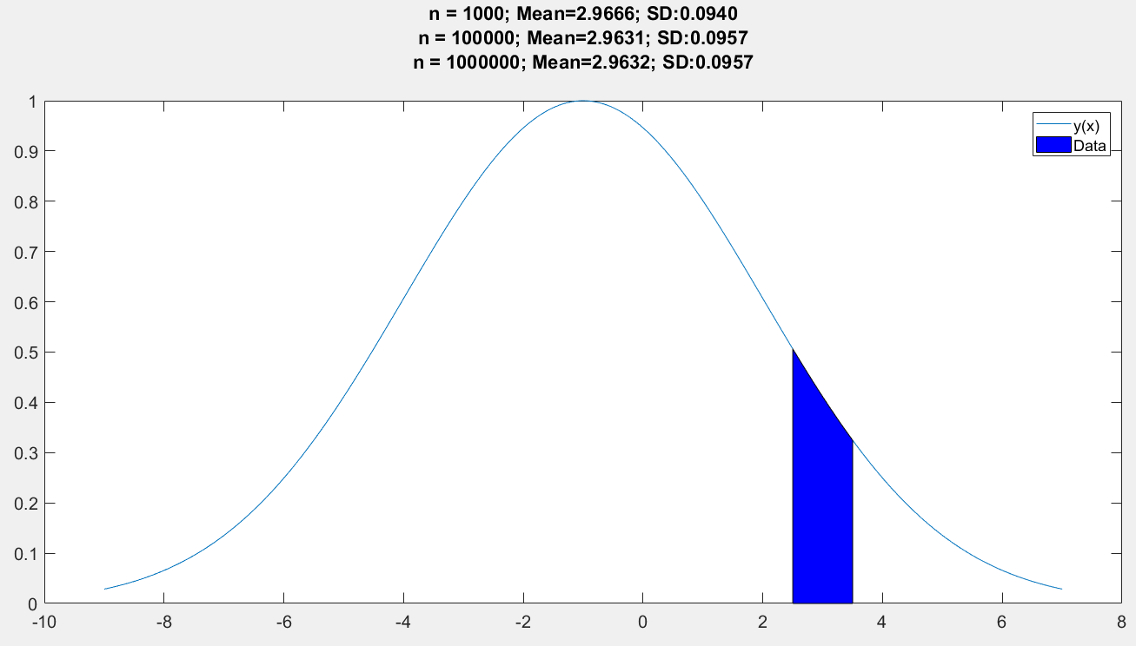
Lab Problem 5.1

Slide 11
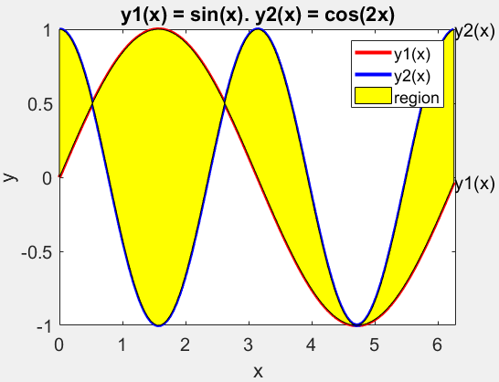
(50%) Lab Problem 5.2.
Let y1(x) = sin(x) and y2 = cos(2x).
A. (20%) Draw the curves of y1(x) and y2(x) interactively from x = 0 to 2π. The curves of y1 and y2 are red and blue, respectively. The linewidth is 3. The step size of x is 0.25;
B. (20%) At the same time, interacitvely fill a region with yellow.
C. (10%) Beautify the figure which has a title, legends, curve marks, and axis labels. See the demo.
Assume that x = x0 at the current step. The region is bounded by y1, y2, and the interval of the region is [0, x0] along the x-axis.

Slide 12
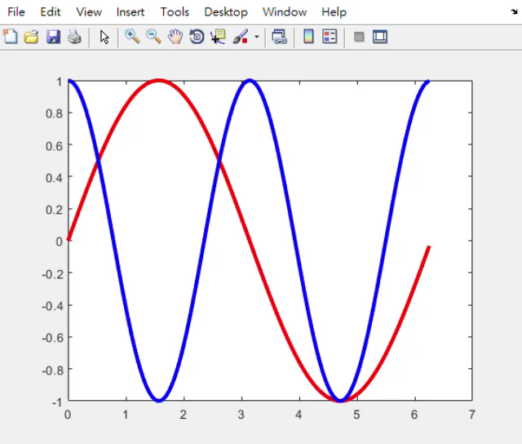
Lab Problem 5.2.

Slide 13
End
Enjoy MATLAB Programming.

