Slide 1
MATLAB Programming
Midterm One
Instructor: 黃世強 (Sai-Keung Wong)

Slide 2
Content
There are five questions. You must answer all of them.

Slide 3
Program file name format
Write all your programs in a folder. The folder name is mat_midterm01_student_ID. For example, if your ID is 12345678, the folder name is mat_midterm01_12345678.
Zip the folder and upload it.
Write a program for each problem in one file.
The file name is m01_X_yourStudentID.m, where X is the problem number.
For example, if your student ID is 12345678 and the problem number is 3, then the file name must be m01_3_12345678.m.
You must not output all the intermediate results.
Output the results that are required only.

Slide 4
File content header
At the top of the file, write down your name, ID, email address, department, and date.
%%%%%%%%%%%%%%%%%%%%%%%%%%%
% Midterm Number: …
% Problem number: …
% Student Name: …
% Student ID: …
% Email address: …
% Department:
% Date: ….
%%%%%%%%%%%%%%%%%%%%%%%%%%%%

Slide 5
File content
For each problem, display the problem number before showing the results.
close all; clear; clc; % close all windows
% clear variables, and clear screen
disp('Midterm Problem 1.1') % show Midterm Problem 1.1

Slide 6
(20 pts) Midterm Problem 1.1
Write a program to ask for inputs. Then it plots a function y = f(x).
The function y = a cos |x| + sin(6x²) – 1/(x²+1).
The process is stated as follows.
Clear the screen. Show your student ID and name.
Ask to input a.
If a is zero, show a message “Thanks for playing” and then terminate the program (use return). Otherwise go to step 4.
Ask to input the step size, dx, of x. if dx is zero, set it to a default value 0.025. if dx <0, show ‘dx must be a non-negative number’ and repeat Step 4. dx must be a positive number.
Plot y versus x. x is inside [-5, 5]. The step size of x is dx. The line width of the curve is set to 3. Call “hold on” so that more functions can be plotted in the same figure.
Go to step 2.

Slide 7
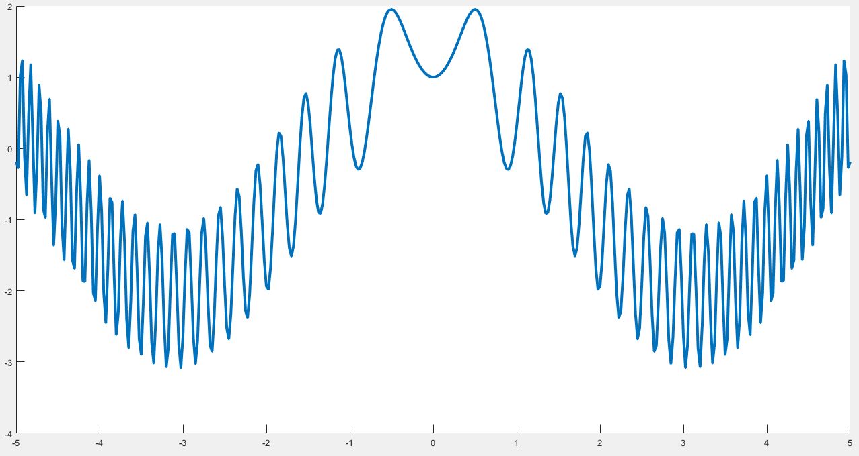
Midterm Problem 1.1
The function y = a cos |x| + sin(6x²) – 1/(x²+1).
a = 2. dx = 0.025

Slide 8
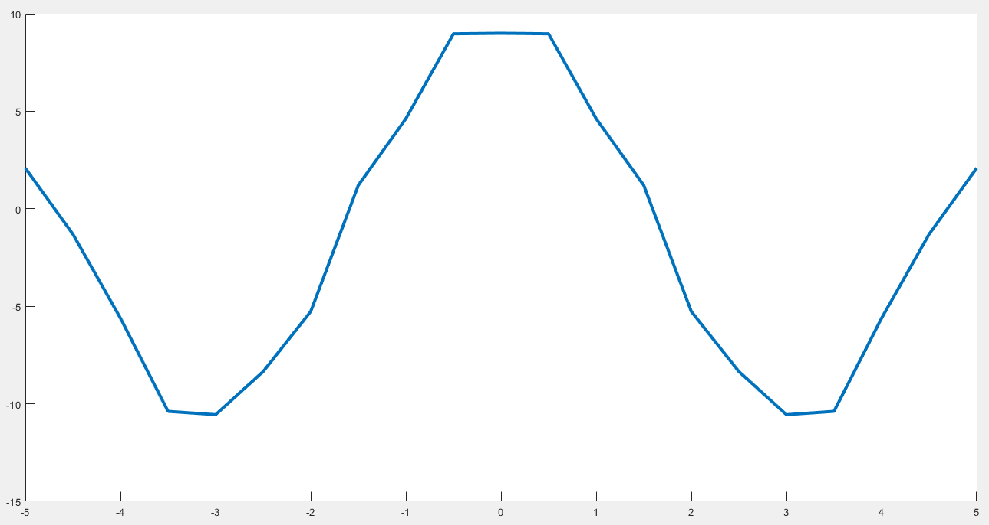
Midterm Problem 1.1
The function y = a cos |x| + sin(6x²) – 1/(x²+1).
a = 10. dx = 0.5

Slide 9
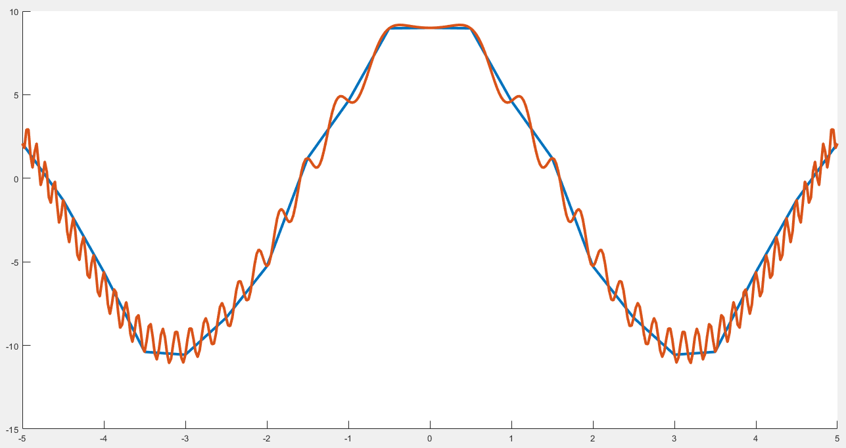
Midterm Problem 1.1
The function y = a cos |x| + sin(6x²) – 1/(x²+1).
1) a = 10. dx = 0.5; 2) a = 10. dx = 0.025.

Slide 10
(20 pts) Midterm Problem 1.2
Write a program to ask for inputs. Then it plots curves for a family of functions. The family of functions is: x y + b y² - a x² (|cos(y²)|+1) = 0.
The process is stated as follows.
Clear the screen. Show your student ID and name.
Ask to input b.
If b is zero, show a message “Thanks for playing” and then quit the program. Otherwise go to step 4.
Clear all curves in the current figure.
Set the step size properly so that all the curves is smooth. The line width of the curves is 3.
Plot 10 curves for each a inside {1,2,3…,10} in the same figure.
Set axis( [-10 10 -5 5] ).
Go to step 2.
Hint: This is a quadratic equation of x.

Slide 11
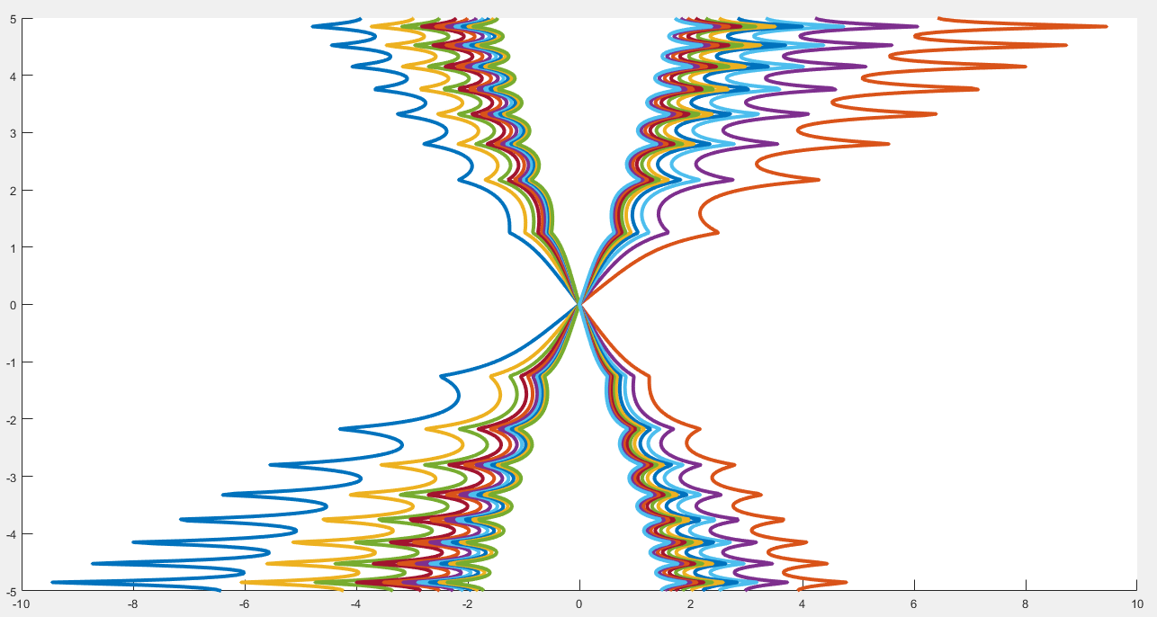
Midterm Problem 1.2
Write a program to ask for inputs. Then it plots curves for a family of functions. The family of functions is: x y + b y² - a x² (|cos(y²)|+1) = 0.
b=2

Slide 12
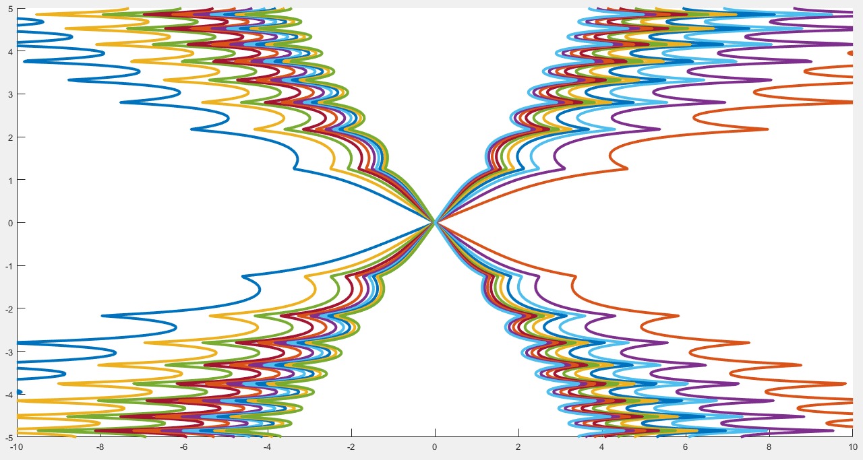
Midterm Problem 1.2
Write a program to ask for inputs. Then it plots curves for a family of functions. The family of functions is: x y + b y² - a x² (|cos(y²)|+1) = 0.
b=10

Slide 13
(20 pts) Midterm Problem 1.3
Write a program to ask for inputs. Then it plots function y1 = f(x) and a family of function y2 = y2(x,n).
y1 = sinh(x)
y2(x,n) = x + x³/3! + x⁵/5! +… + x^{2n+1}/(2n+1)!
Clear the screen. Show your student ID and name.
Ask to input m. m is a non-negative integer and inside [0, 5]. MUST check if the input is valid.
If m is zero, show a message “Thanks for playing” and then quit the program. Otherwise go to step 4.
Clear all curves in the current figure.
In the same figure, plot y1’s curve and y2’s curves for all 0 <=n <= m.
x is inside [-5, 5]. The step size of x is 0.02.
The line width is set to 5 for y1’s curve. The color is blue.
The line width is set to 2 for y2’s curves. Their colors are automatically assigned.
Go to step 2.
Hint: use factorial

Slide 14
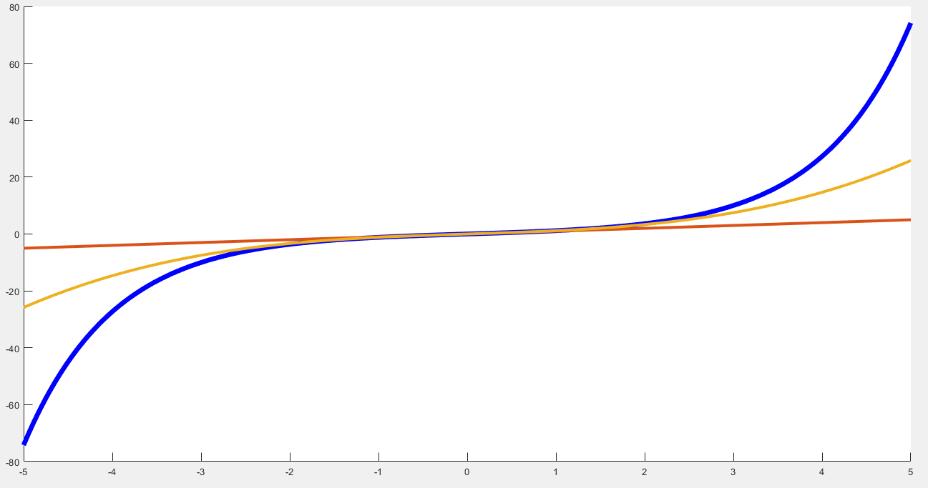
Midterm Problem 1.3
y1 = sinh(x)
y2(x,n) = x + x³/3! + x⁵/5! +… + x^{2n+1}/(2n+1)!
m=1

Slide 15
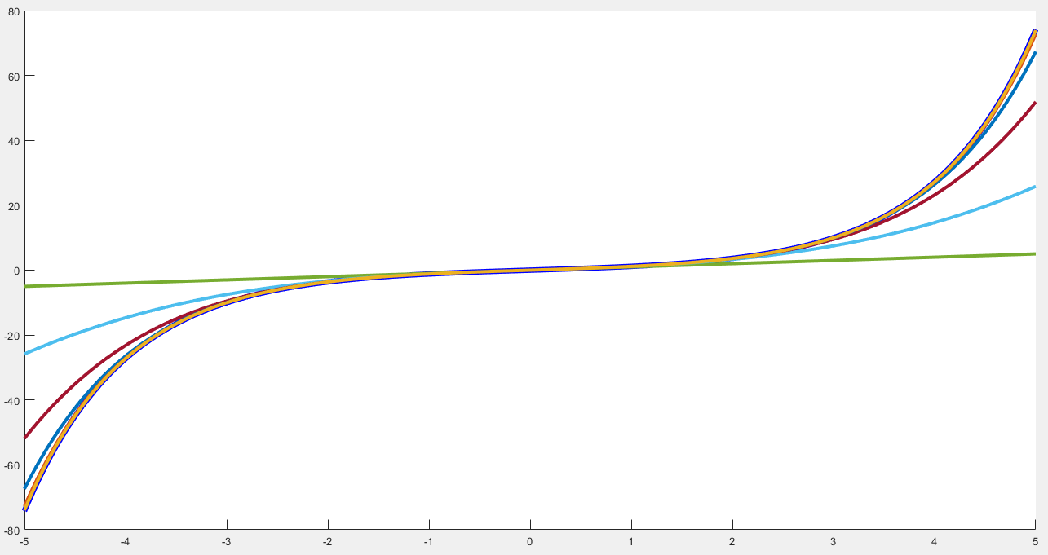
Midterm Problem 1.3
y1 = sinh(x)
y2(x,n) = x + x³/3! + x⁵/5! +… + x^{2n+1}/(2n+1)!
m=5

Slide 16
(30 pts) Midterm Problem 1.4
Plot y = (2e^{-2x} - b x cos (|5x|) + |x|^{1/2}) / ((x-1)(x-2)(x+1)(x+2))
The curve of y is divided into five segments due to four singular points.
Ask to input b.
dx = 0.001.
Display each segment in different color. The line width of a curve is 3.
The range of x is [-5, 5]. Set the limits of the y axis to -50 and 50.

Slide 17
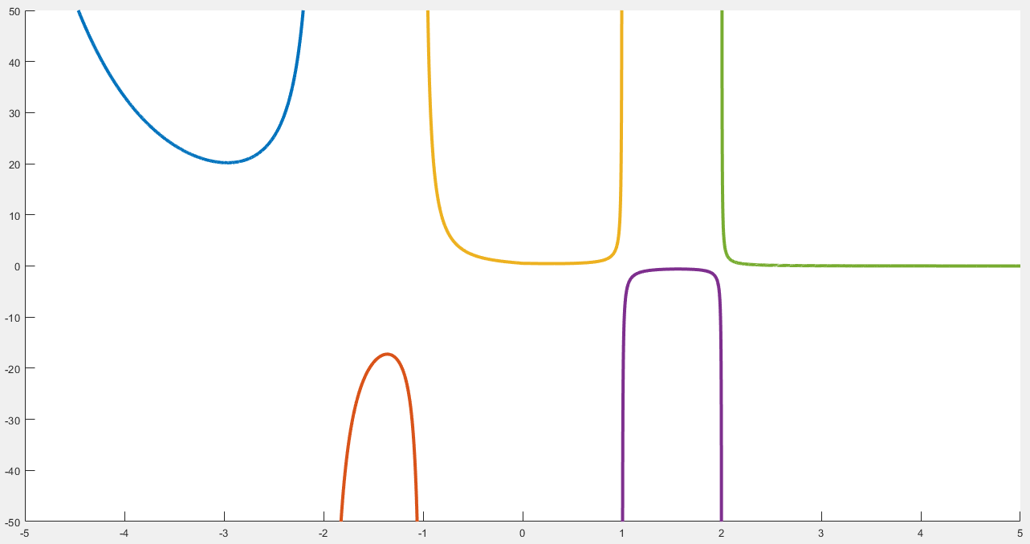
Midterm Problem 1.4
b=0

Slide 18
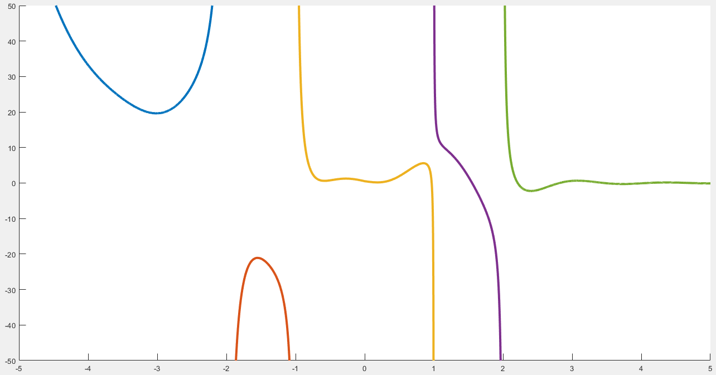
Midterm Problem 1.4
b=10

Slide 19
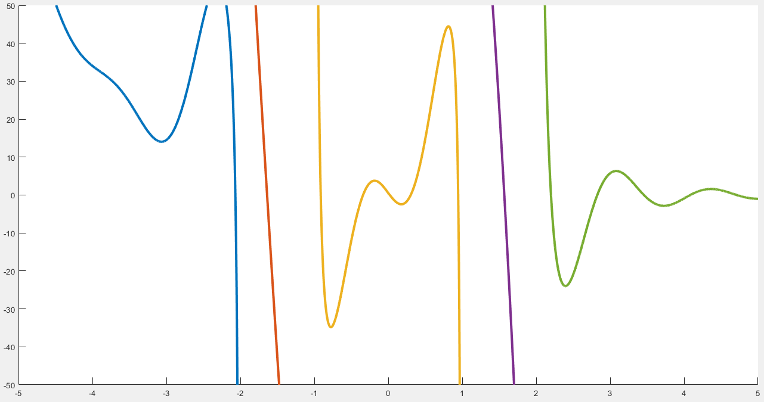
Midterm Problem 1.4
b=100

Slide 20
(10 pts) Midterm Problem 1.5
Write down your answer in the file, m01_5.m. Change the file name to m01_5_yourID.m
Assume that all the variables are defined properly. Answer the questions in words.
Do not write down any formulas or equations. Do not simply write down the values of the variables.
Examples
What is the purpose of each of the following code fragment?
a) [1:5] Ans: [1 2 3 4 5] % NOT OK
Ans: It returns a row vector with elements starting from 1 to 5, with an
increment 1. %OK
b) m(:,1) Ans: it returns m(1:end, 1). % NOT OK.
Ans: it returns a column vector of the first column of m. % OK

Slide 21
End
Enjoy MATLAB Programming.

