Slide 1
Match 3 with RL
組員：李昀奇、黃秉茂、薛睿泓
指導教授：吳毅成

Slide 2
Aim
Write a match 3 game so it can be used in this project, in which it has to be able to accept inputs in both UI interaction via mouse clicks and in commands.
To allow computer to play a game a match 3 by training it using reinforcement learning, and the score will beat that we play.

Slide 3
Process
Create match-3 game’s environment
Registry of GYM
Implement DQN and DDQN
Package to podman and image for lab
Considering legal actions
Use PPO and A3C from RLlib

Slide 4
Match-3 game environment

Slide 5
Rules
Any 2 shapes can be switched, steps would minus 1 even if no matches are found after switching
Matches if 3 or more of same shape are in a row, column or diaganol
for n number of same shape matched and connected, score of shape is added by n-2
Total score is the score of all shapes added together

Slide 6
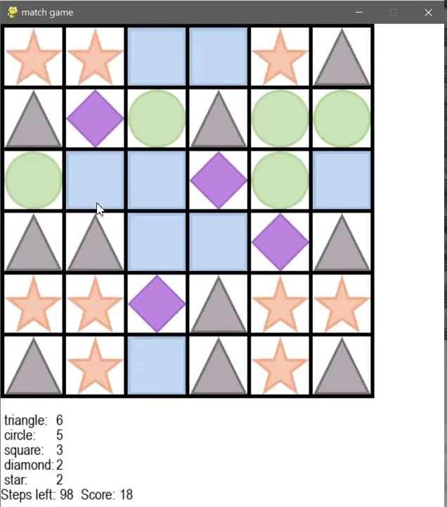
Examples
In the first step, 5 circles matched are connected, so score of circle +3
In second step, 4 circles matched are connecetd, so score of circle +2

Slide 7





Initialization
Creates a 6x6 plane (can be changed)
Fill in with the 5 random shapes (can add more if necessary)
Check to make sure no matches exist
If matches exist, try another shape
set num. of steps left and score to 100 and 0 (num. of max step can be changed)
display score of each shape, total score and steps left at the bottom

Slide 8
GYM

Slide 9
GYM
A toolkit for developing and comparing reinforcement learning algorithms
Makes no assumptions about the structure of your agent
Compatible with any numerical computation library, such as Pytorch
Package our environment to GYM for reinforcement learning experiment and easier access

Slide 10
GYM (cont.)
env = gym.make()
observation = env.reset()
env.render()
action = env.action_space.sample()
observation, reward, done, info = env.step(action)

Slide 11
Approach - RL

Slide 12
RL framework
Algorithm: DDQN, PPO, A3C
Action: The core mechanic of the game allows to swap two arbitrary shapes on the board
Environment: All the matrices and the game board.
Reward: For the current state, the action just is taken and the next state of the board reward is the number of deleted shapes minus 2. Each action of the agent should lead to reward.

Slide 13
Changes made
Some changes were made to package the environment
for reinforcement learning experiment
Plane was set to 8x8
Number of shapes was changed from 5 to 4
Rule was changed from swappable between any position to only swappable with arbitary shapes

Slide 14
RL implementation
Self implemented
Using RLlib
DQN
A3C
DDQN
PPO

Slide 15
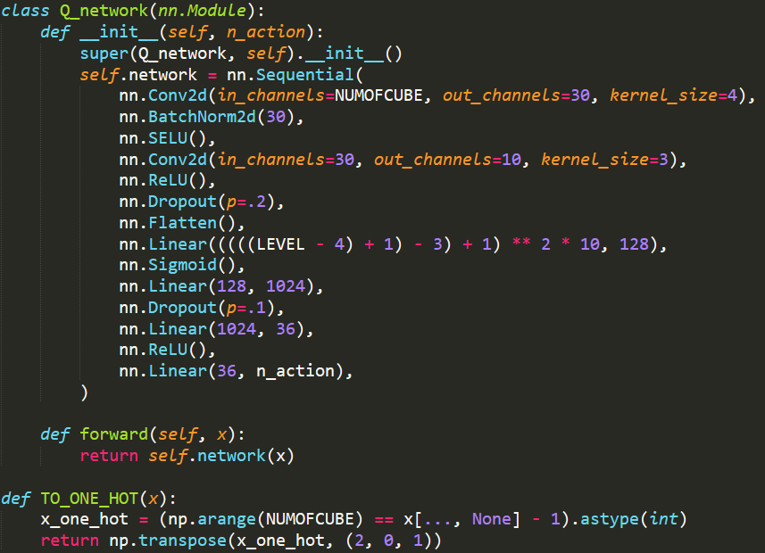
DDQN Model
2 Convolution layer
Various activate functions
Dropout layer
Fully connective layer
One Hot

Slide 16
Action
Normal actions – use argmax only to get swaps between different shapes
Legal actions – use argsort and checking to get swaps between different
shapes with matching results

Slide 17
Experiment

Slide 18
Baseline
Our goal is to train a model that performs better than
the random model and as close to the greedy model
as possible
Random
R L
Greedy
≤
≤

Slide 19
Performance

Slide 20
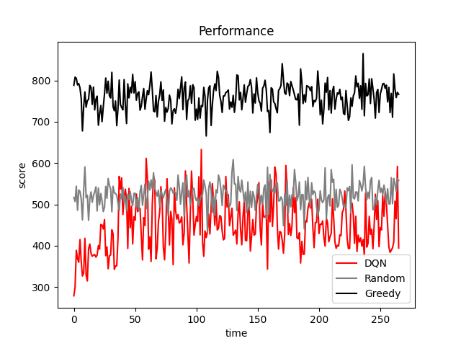
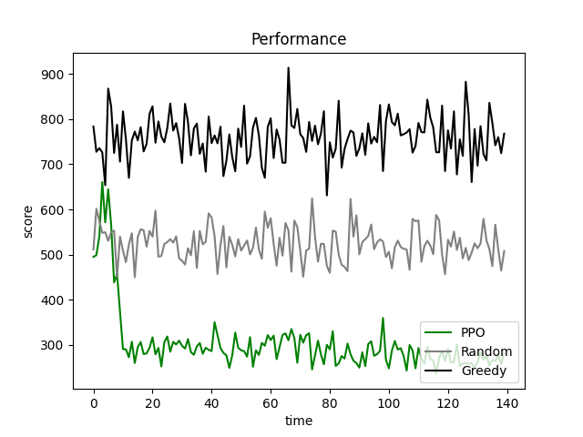
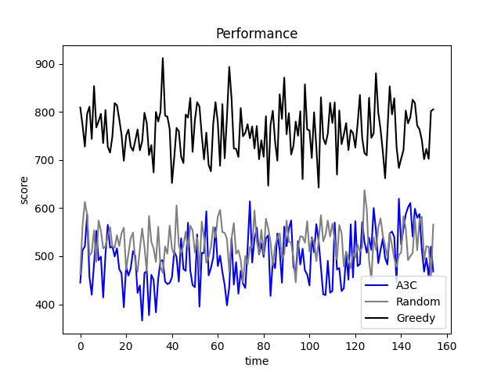
Scores vs time

Slide 21
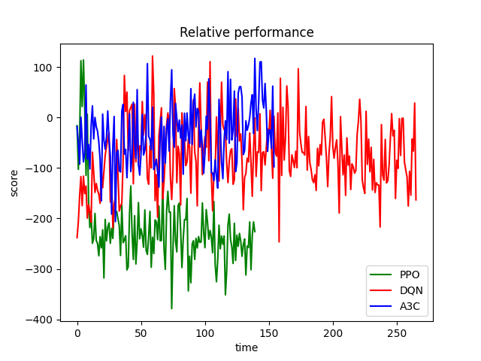
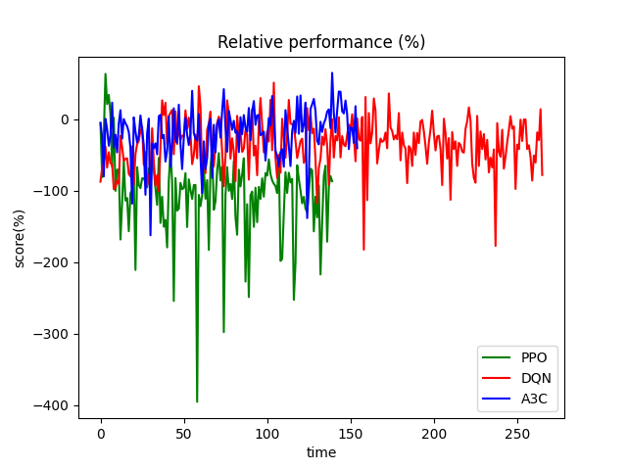
Relative score vs time
(compare to random baseline)

Slide 22
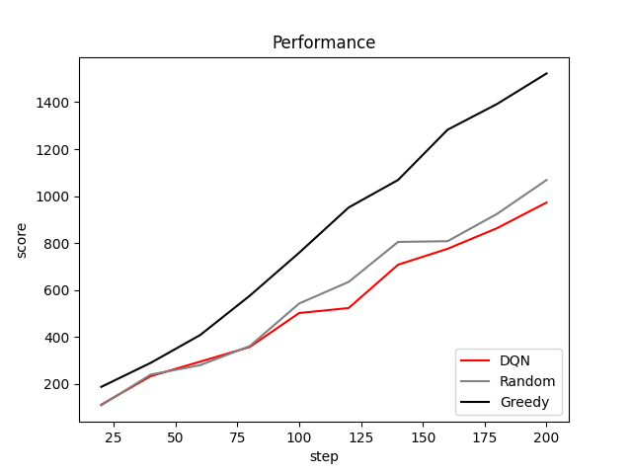
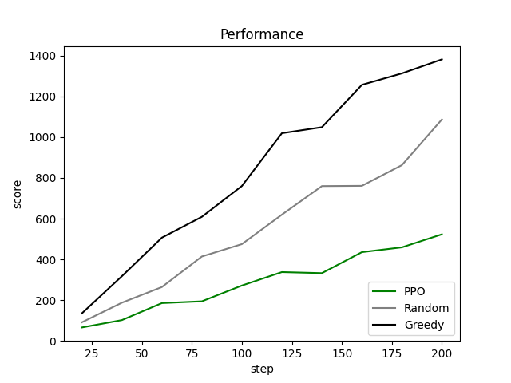
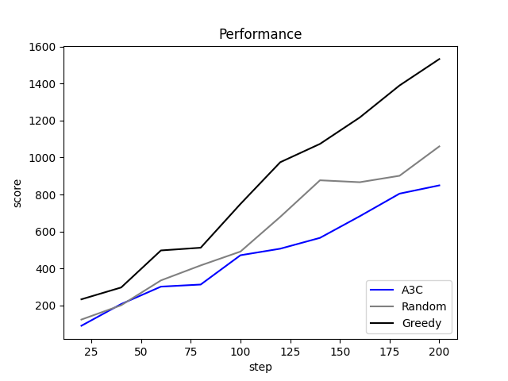
Score vs steps

Slide 23
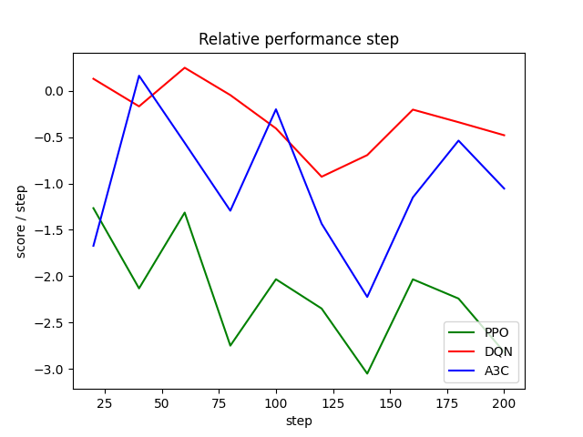
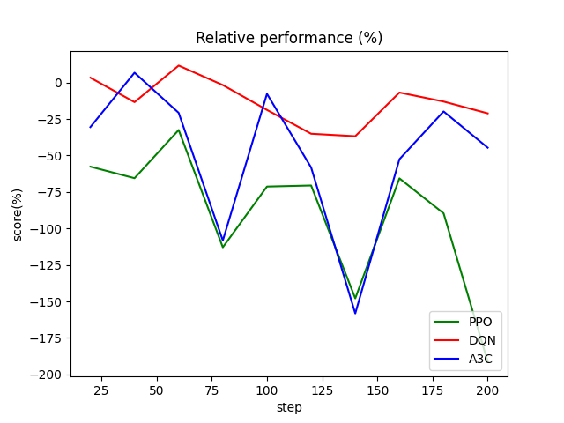
Relative score vs steps
(compare to random baseline)

Slide 24
Conclusion

Slide 25
Conclusion
Training with legal actions is time efficient but more complex due to
dynamic action space and requires masking
PPO and A3C isn’t training enough.
The game is too complicated to be trained well, since it has too many states. (# states = # shapes ^ (row * column))
PPO isn’t as good as expected.

Slide 26
Future Work
Model: RestNet
Legal actions mask
Other RL algorithms

Slide 27
Reference
https://gym.openai.com/docs/?fbclid=IwAR28D5AQlDWBo_UJ-3U2oFcCW_yz_t9wx1of0TQzKJK6PJfTfI0W6hkpRxI
https://github.com/hans1996/match3_env?fbclid=IwAR315g0k8qYmJAjt12FuZ6ycLwwRiK3b1Gt63l9EZ0nVdefOupo2tiy8DeU
https://pytorch.org/tutorials/intermediate/reinforcement_q_learning.html?fbclid=IwAR1UzQffW67bR-NAFrVGjeNNH93jeCT77nPyrdxM5aUz1Vx5TUkW_1gfKWE

Slide 28
Reference (cont.)
https://ieeexplore.ieee.org/document/8848003/authors?fbclid=IwAR1UzQffW67bR-NAFrVGjeNNH93jeCT77nPyrdxM5aUz1Vx5TUkW_1gfKWE#authors
https://docs.ray.io/en/master/rllib.html?fbclid=IwAR2X94QIGzZ18ryzaL4dg908maxORCQtNjqtfTY83t-s_nWW-F_4SWjTORA
https://github.com/wrk226/match_3_game_simulator_py

Slide 30
Thanks for watching

