Slide 1
Weekly Project Update
Daniil Karbukov
Ruochen Liao

Slide 2
Work done this week
01
02
03
Updated UMLs
Added new functions
Expanded existing UMLs with new functions
Created the create_person, update_person, delete_person, create_car, update_car, delete_car, create_license, update_ license, delete_ license, create_junktion, update_ junktion, delete_ junktion, view_cars functions.
Configure the database
Store all data in the PostgreSQL.

Slide 3
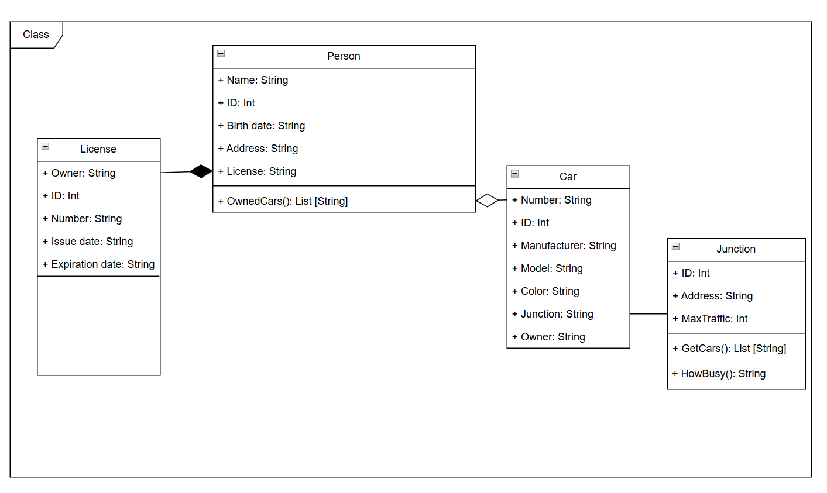
Class UML
The Book list attribute is created automatically by user adding new books or editing the existing ones.

Slide 4
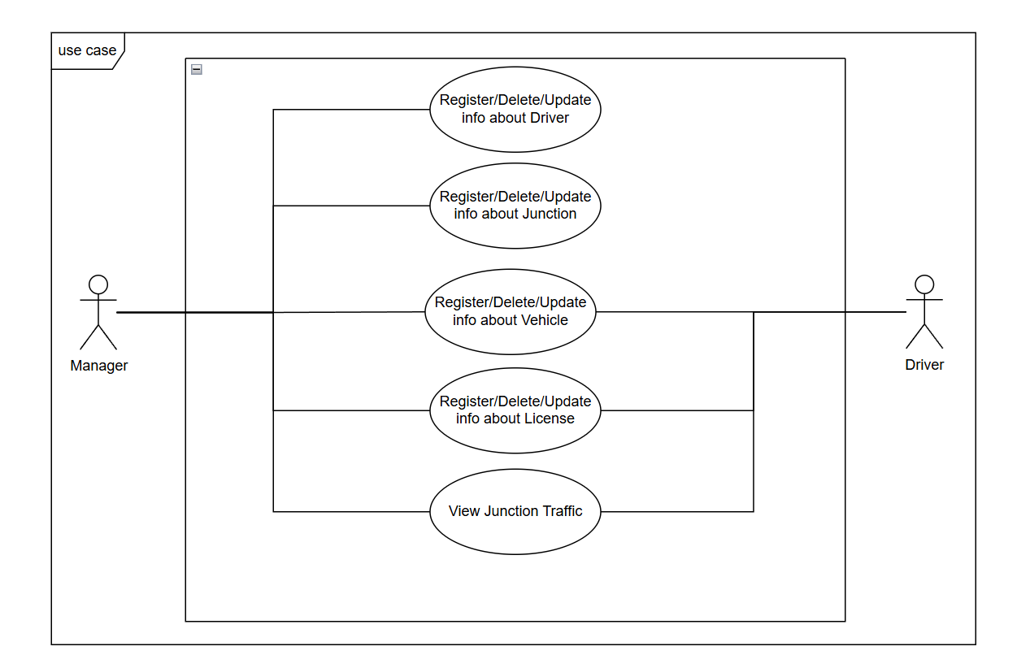
Use case UML
Added new functions

Slide 5
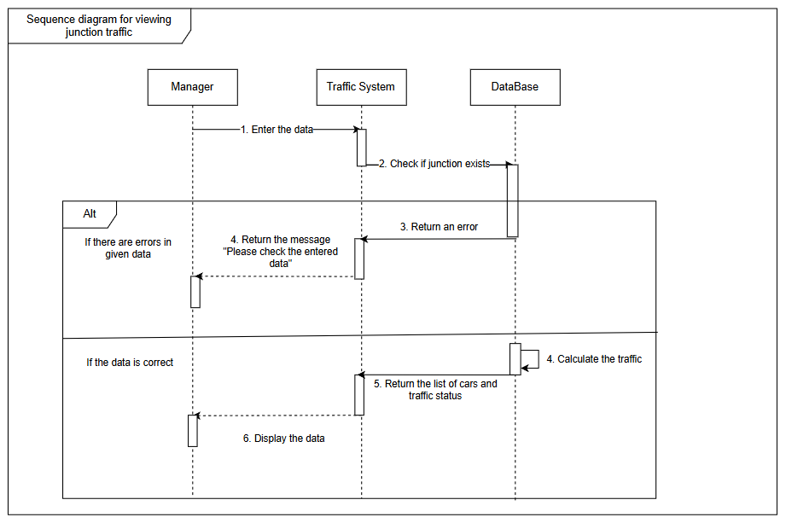
Sequence UML
Added new functions

Slide 6
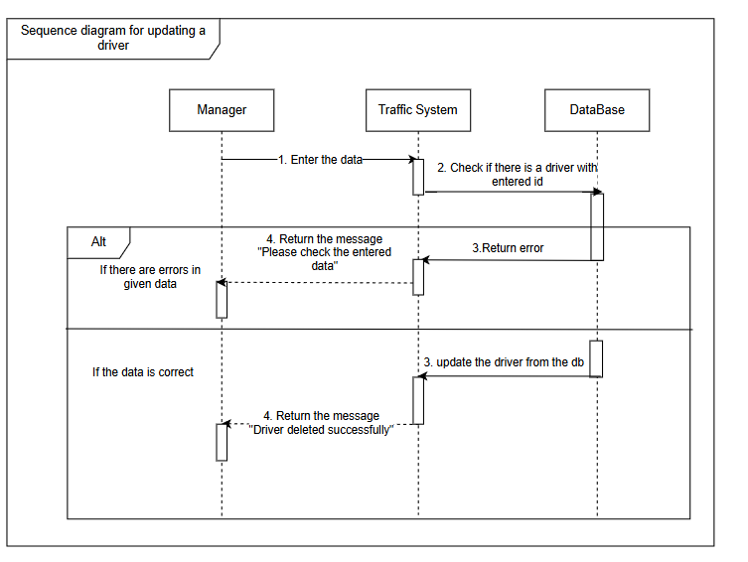
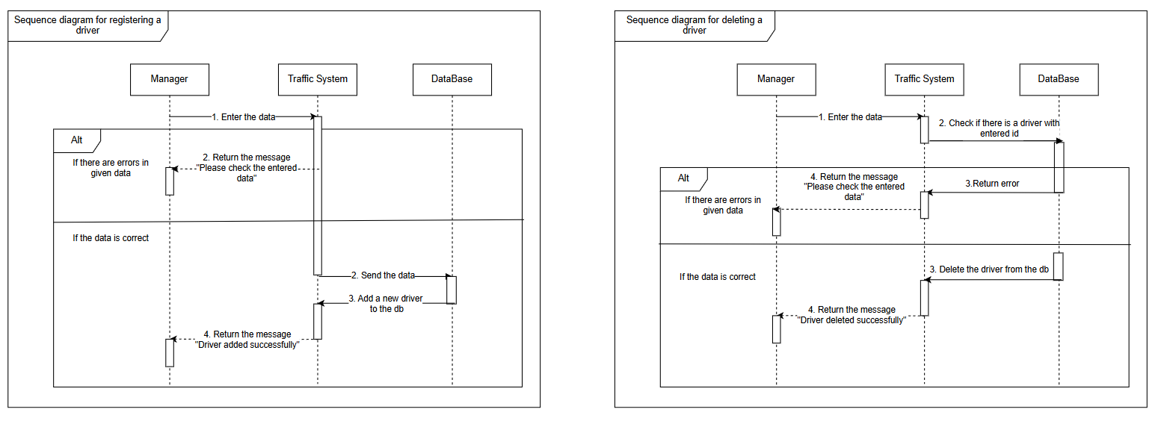
Sequence UML
Added new functions

Slide 7
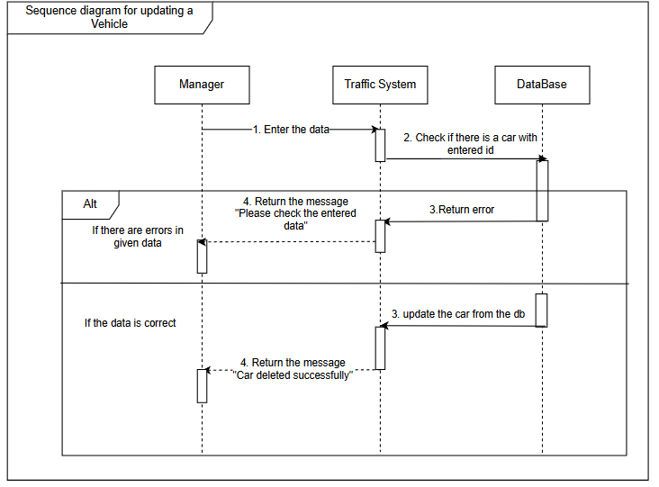
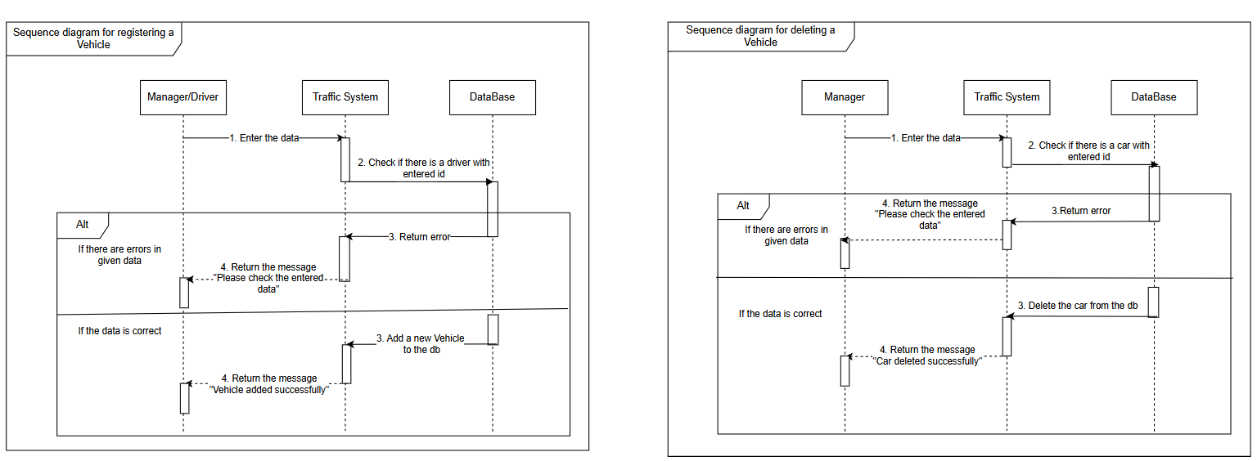
Sequence UML
Added new functions

Slide 8
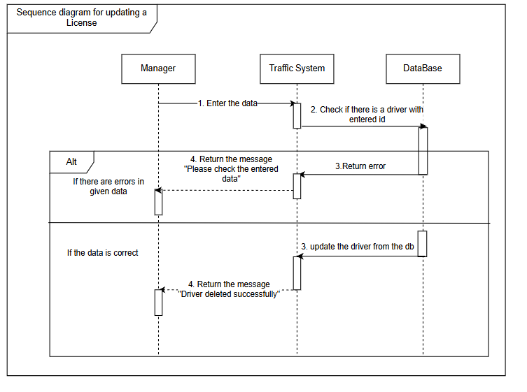
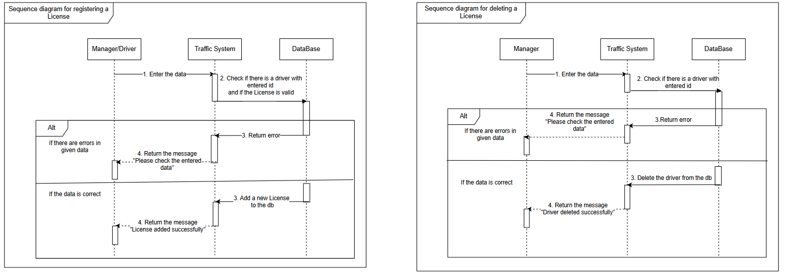
Sequence UML
Added new functions

Slide 9
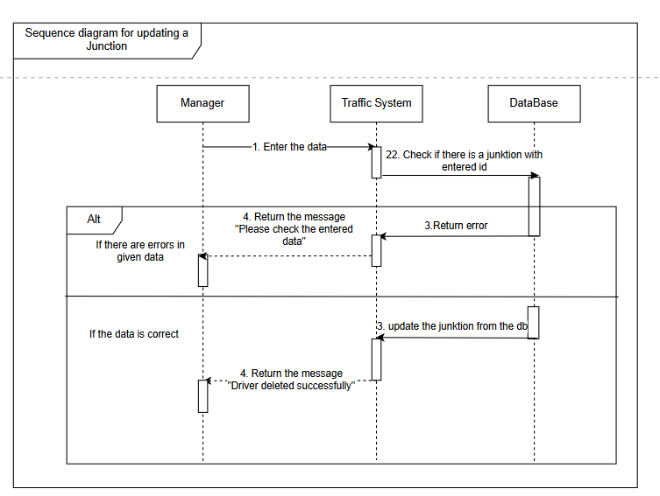
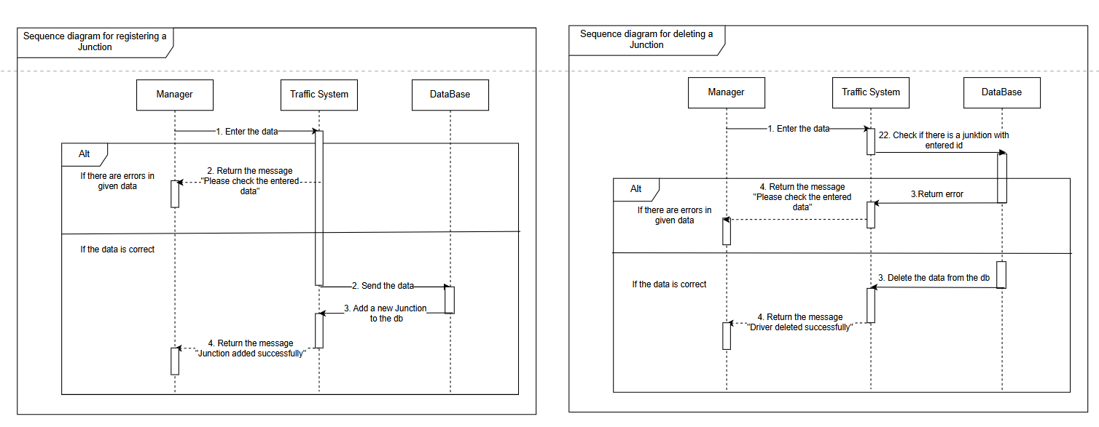
Sequence UML
Added new functions

