Slide 1

Weekly Project Update
Ruochen Liao
Daniil Karbukov
Hazal
Notes:
更多模板请关注：https://haosc.taobao.com

Slide 2
Work done this week.
01 Updated UMLs
02 Add missing templates
Add new UMLs and expand existing UMLs with new functions
enhance functions and create templates
03 Add new functions
Create junction_logs car_enter_junction car_leave_junction make_fine functions as well as tests

Slide 3
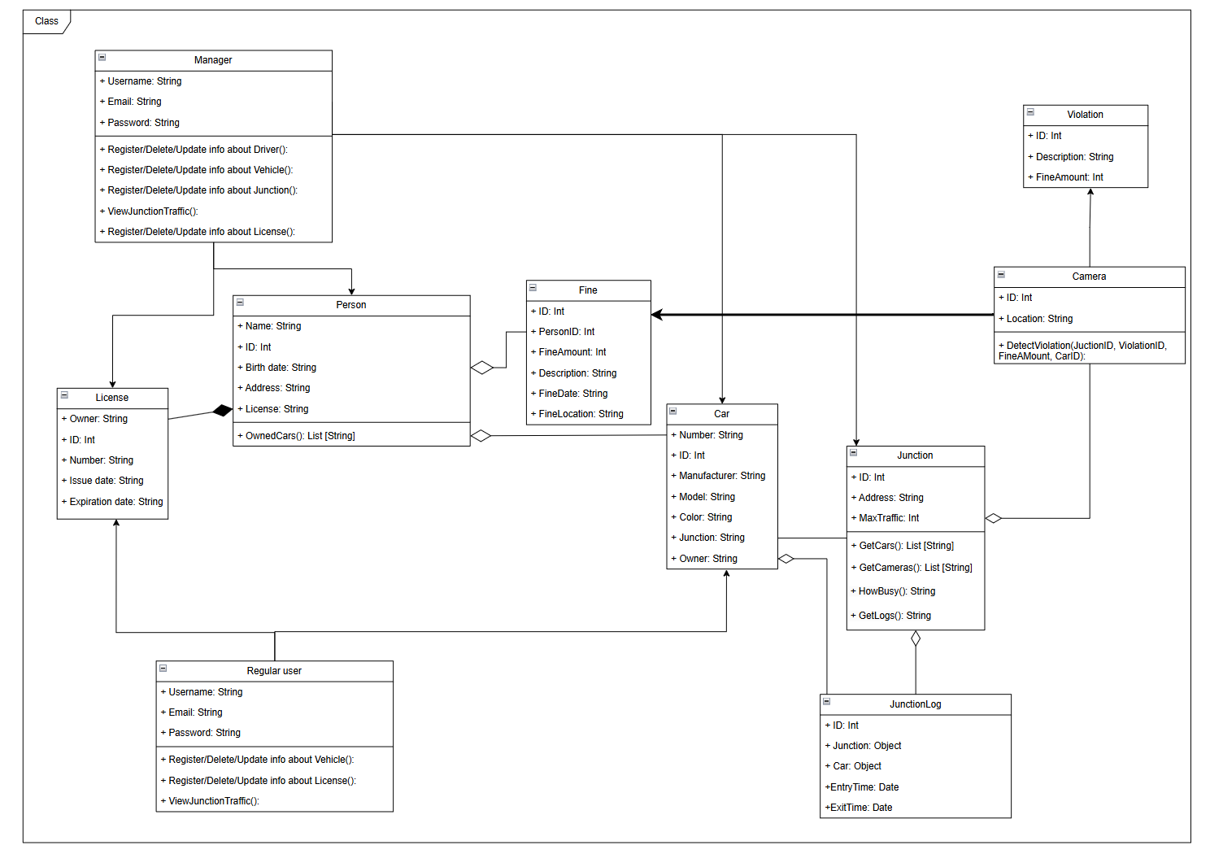
Class
diagram
Add Violation, Camera
And junctionlog

Slide 4
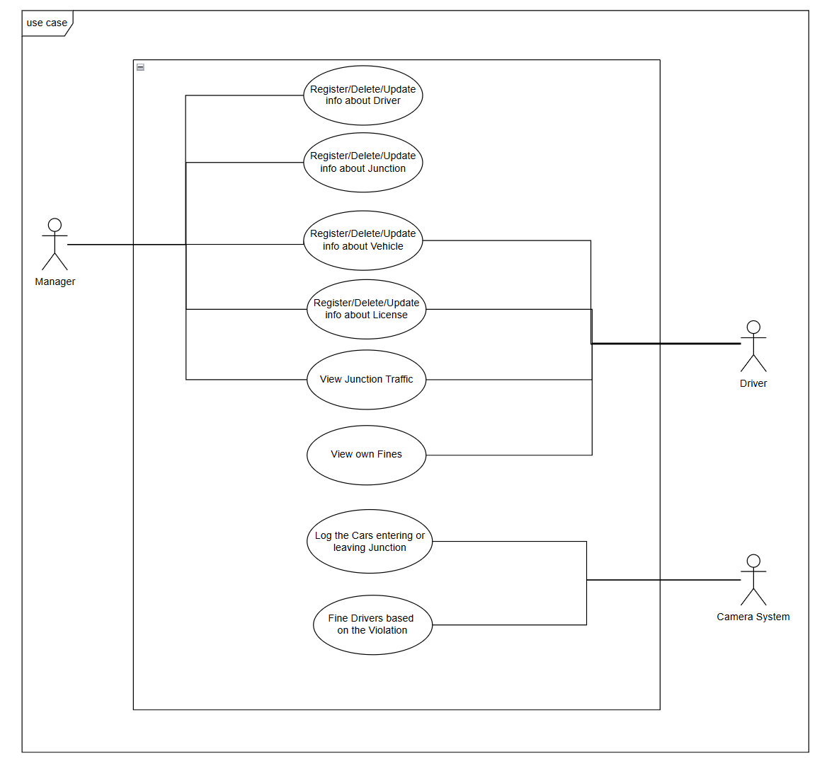
Use case
diagram
Add camera system and some new use cases

Slide 5
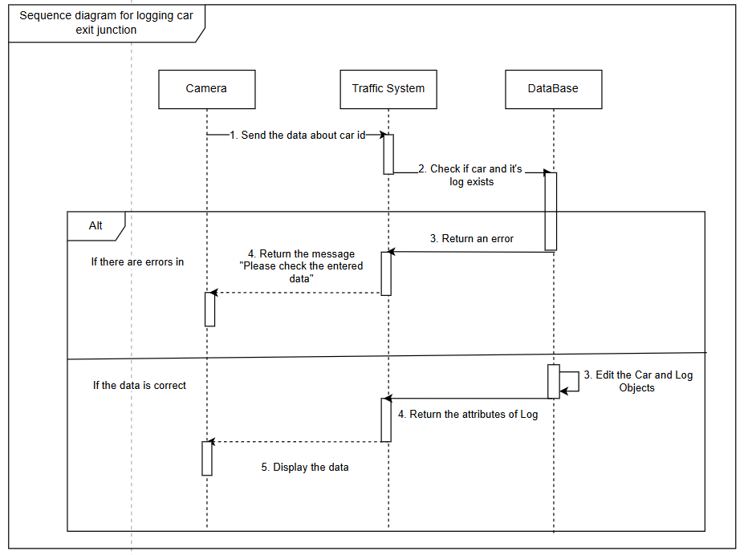
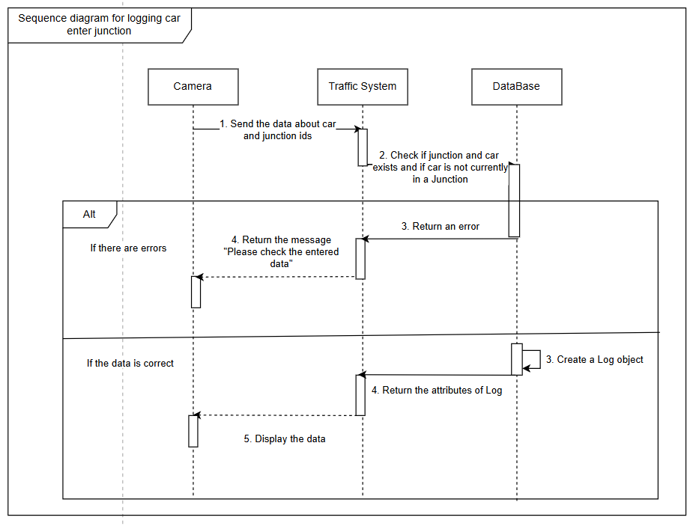
sequence diagram
About junctionlog

Slide 6
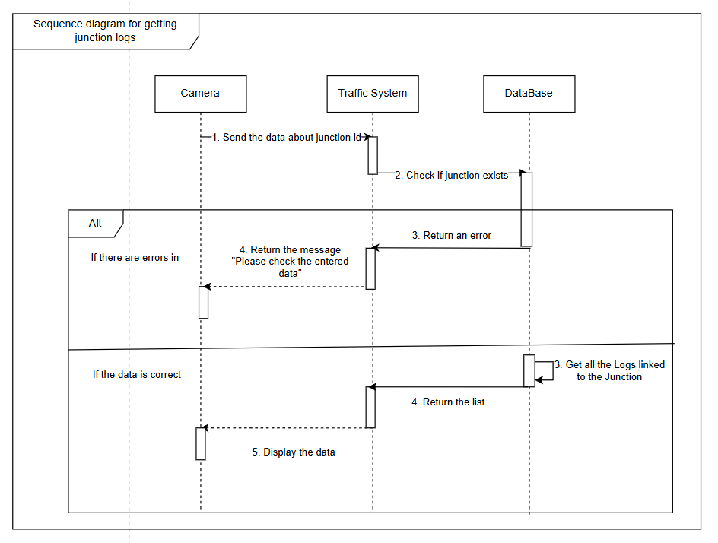
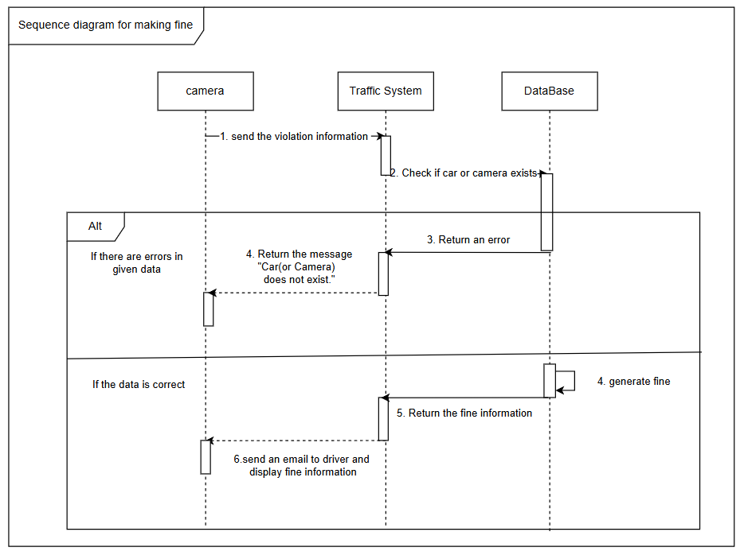
sequence diagram

Slide 7
demo
Notes:
更多模板请关注：https://haosc.taobao.com

