Slide 1

Weekly Project Update
Ruochen Liao
Daniil Karbukov
Hazal Cansever
Notes:
更多模板请关注：https://haosc.taobao.com

Slide 2
Work done this week.
01 Update UMLs
02 Add new functions
Add new UMLs and expand existing UMLs with new functions
Create send_congestion_alert congestion_prediction
traffic_flow_analysis
as well as tests
03 Update the templates
Update the templates based on new functions

Slide 3
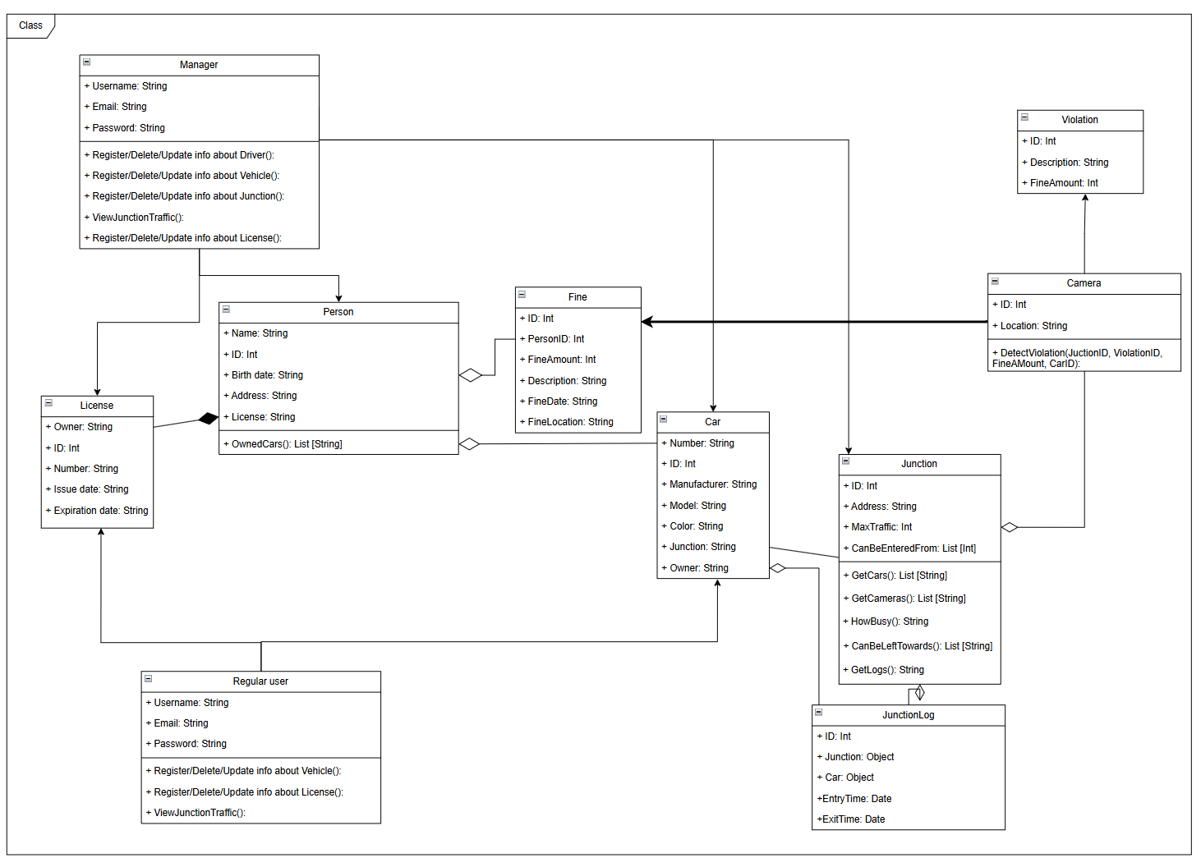
Class
diagram

Slide 4
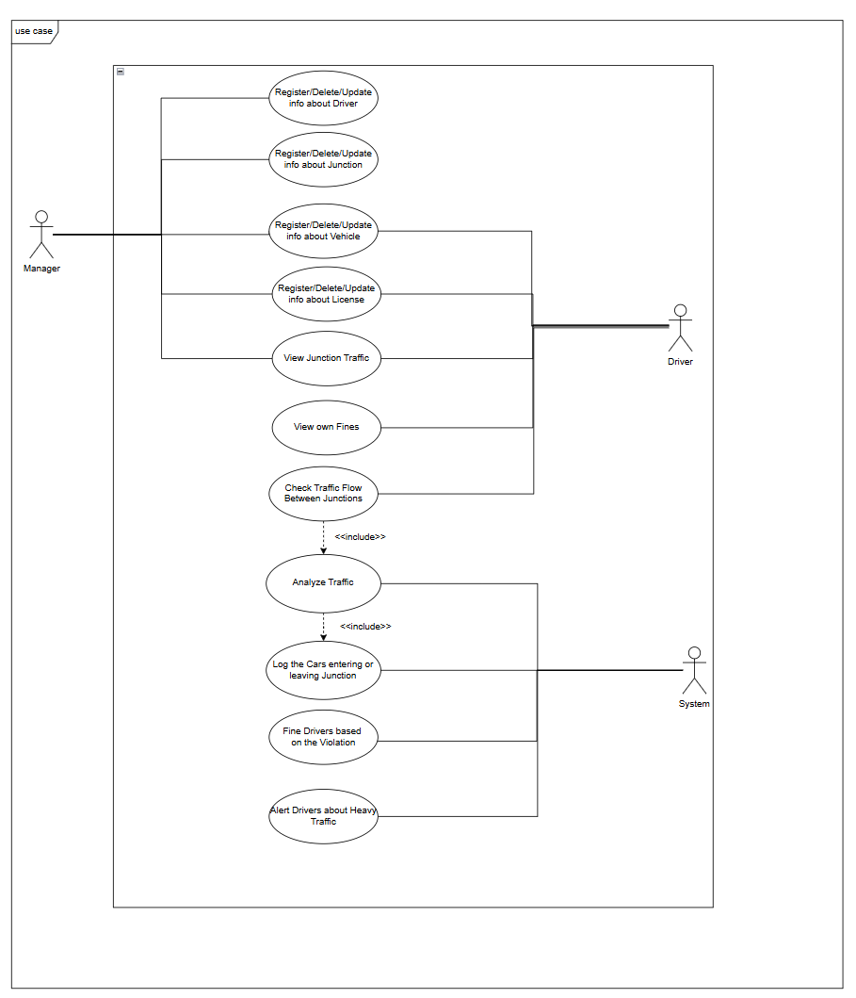
Use case
diagram
Change the actor and add some new use cases

Slide 5
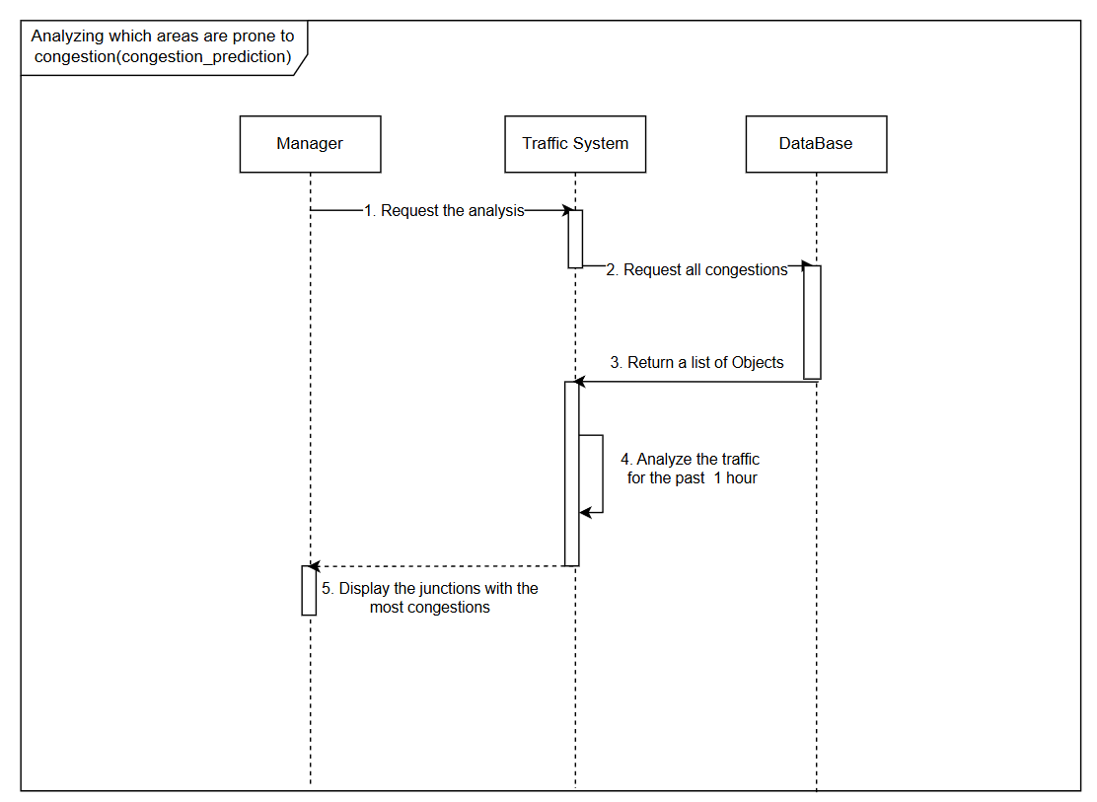
sequence diagram

Slide 6
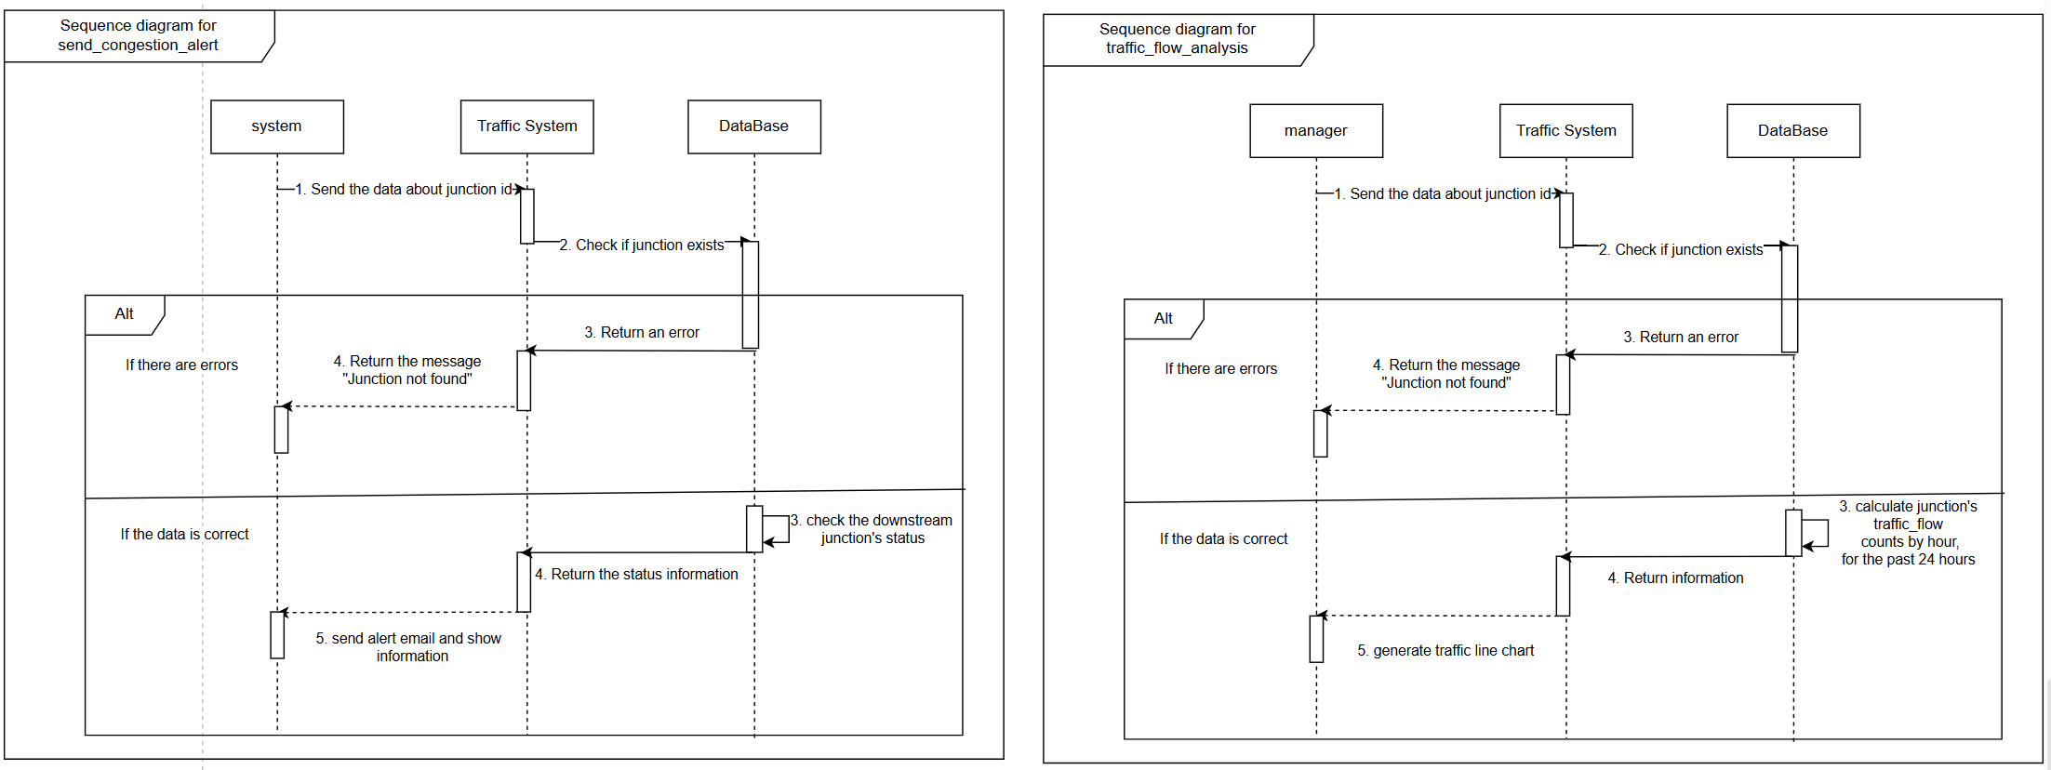
sequence diagram

Slide 7
demo
Notes:
更多模板请关注：https://haosc.taobao.com

