Slide 1

Weekly Project Update
Ruochen Liao
Daniil Karbukov
Hazal Cansever
Notes:
更多模板请关注：https://haosc.taobao.com

Slide 2
Work done this week.
01 Update UMLs
02 Update existing functions
Add new attributes and expand existing UMLs with new functions
Update car_enter_junction and car_leave_junction to add alert functions
03 Add new functions
04 Update the templates
Add change_emergency_status _send_emergency_alert
activate_emergency_signals
restore_normal_signals functions
Update the templates based on new functions

Slide 3
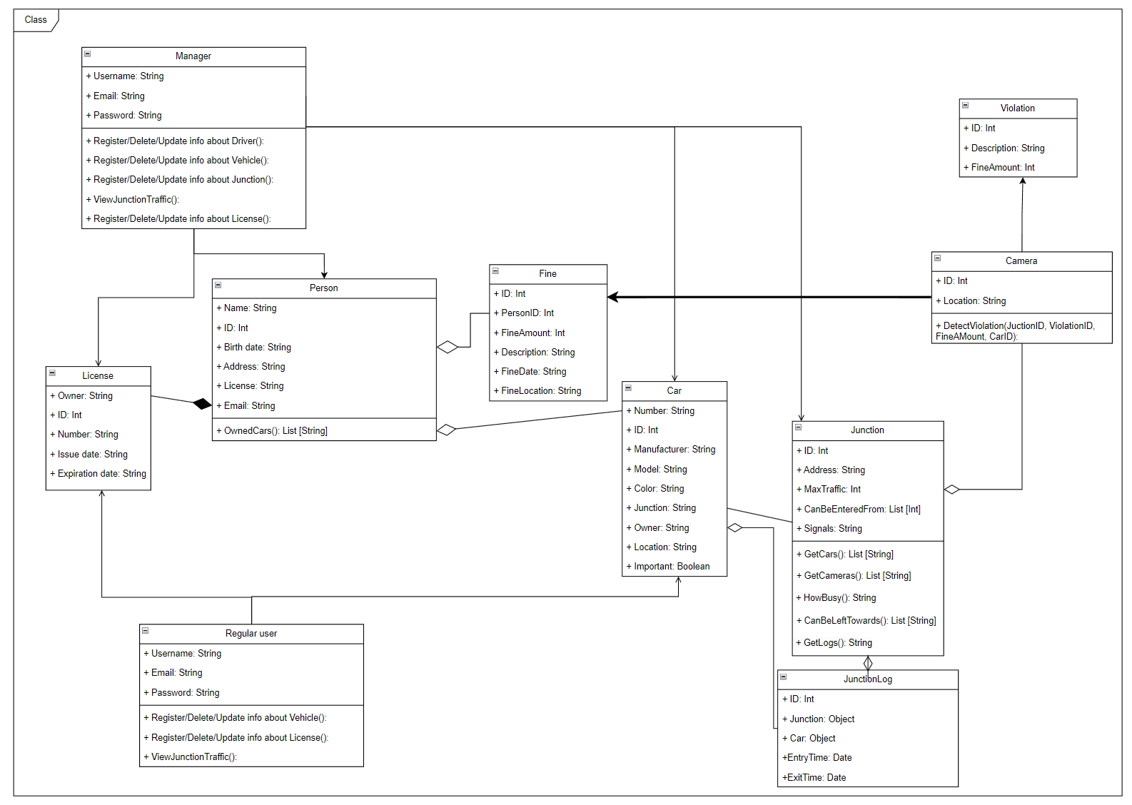
Class
diagram

Slide 4
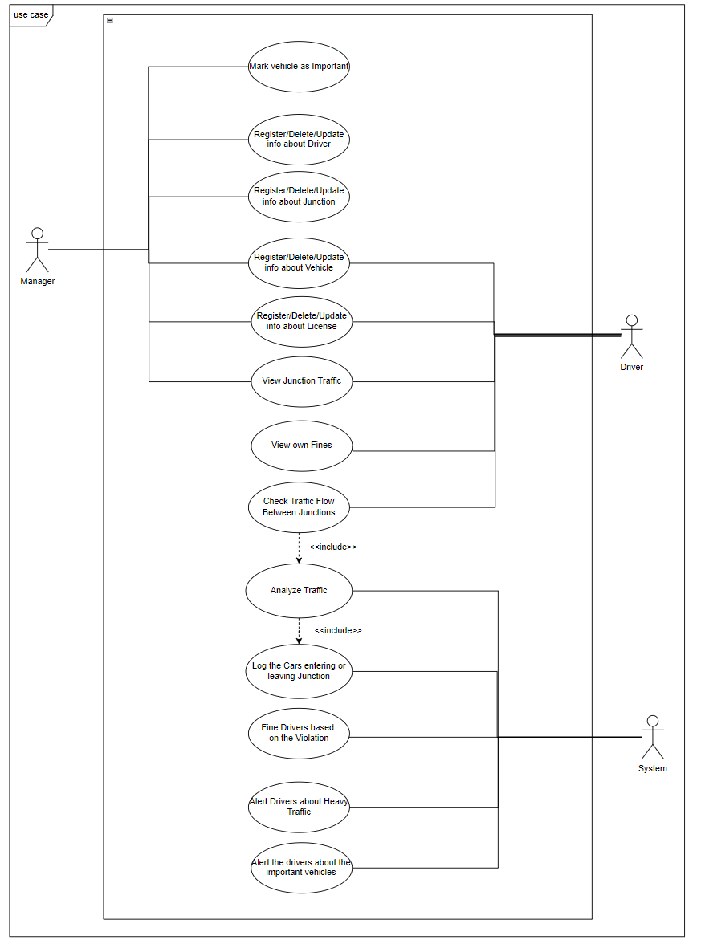
Use case
diagram

Slide 5
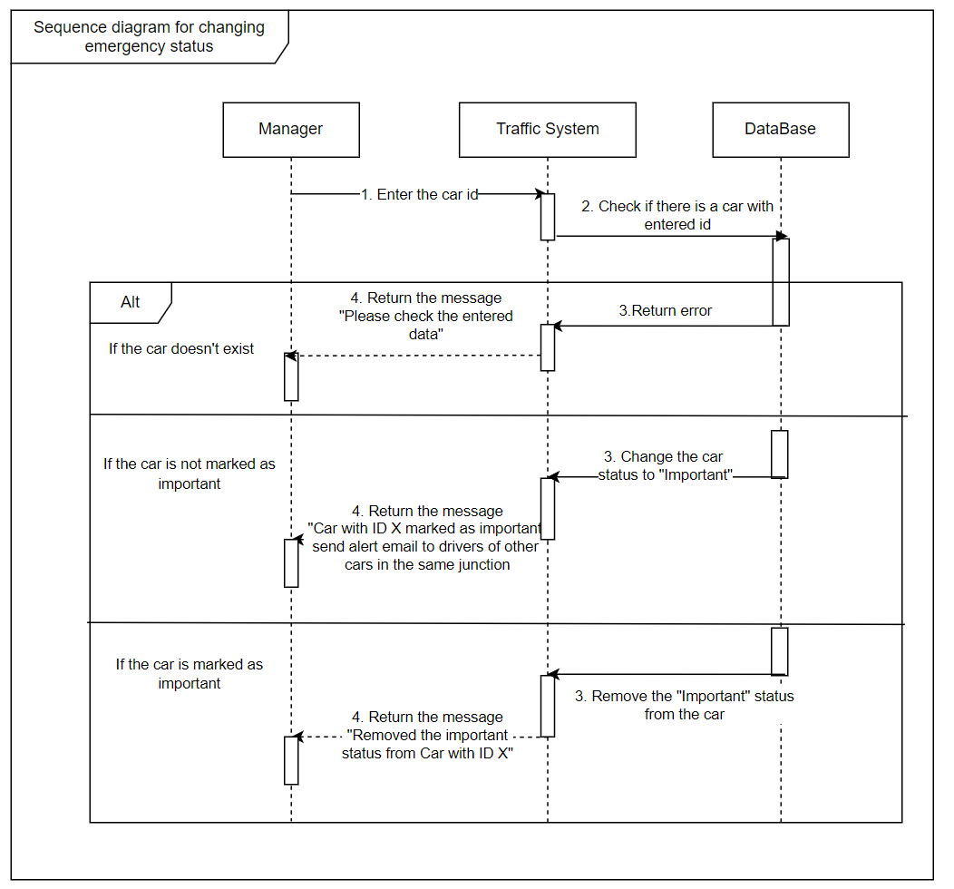
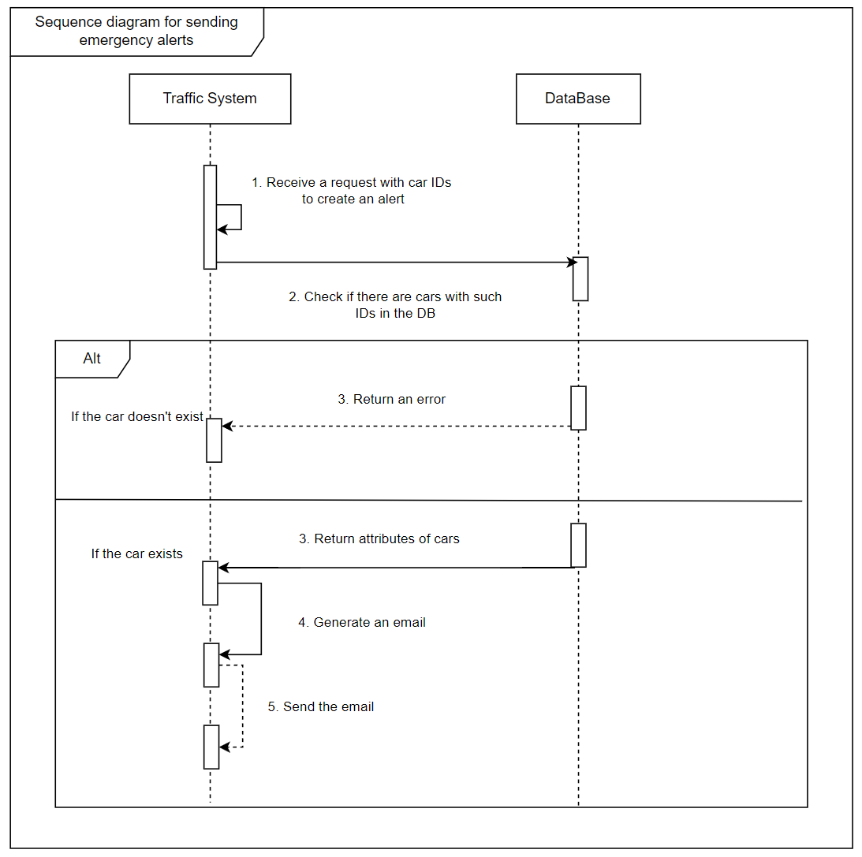
sequence diagram

Slide 6
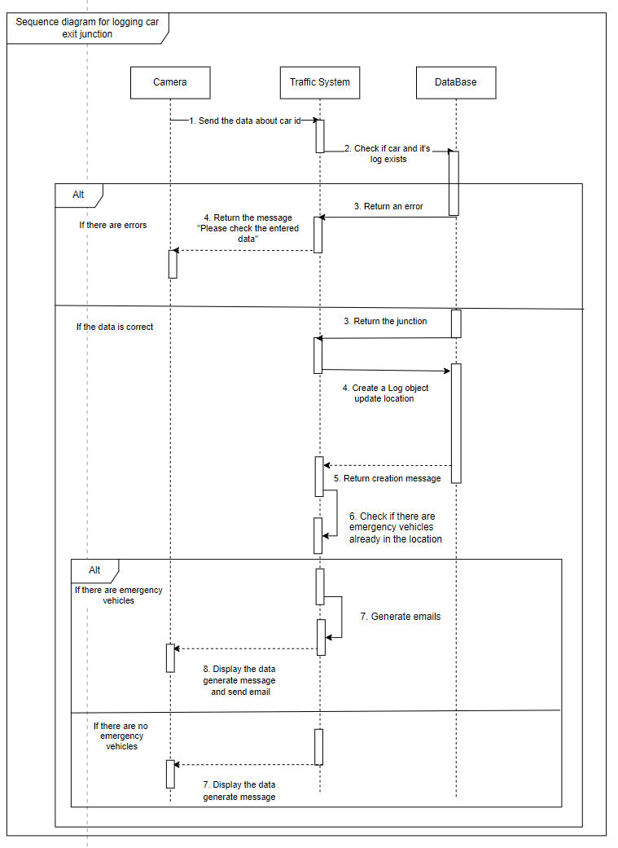
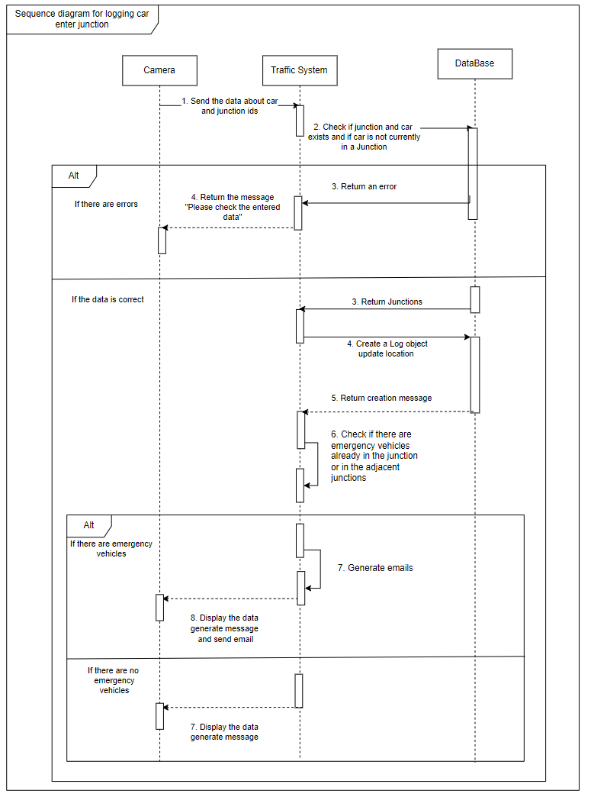

Slide 7
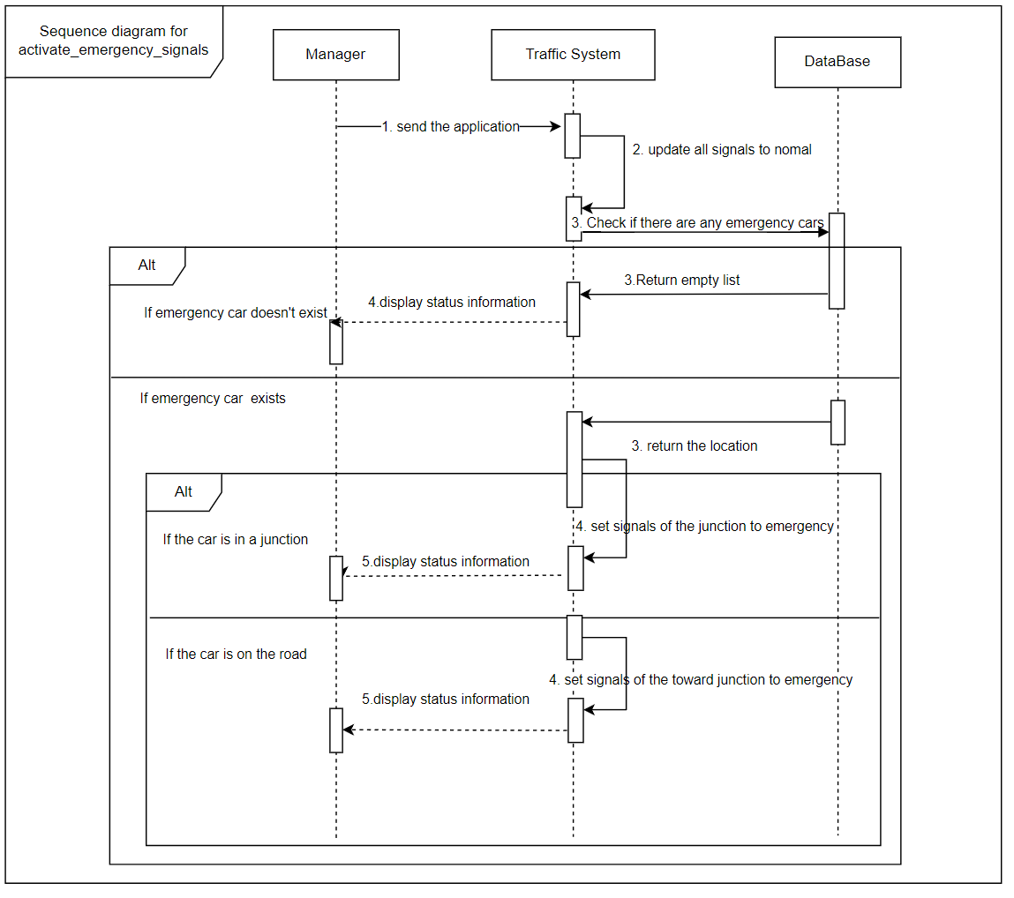

Slide 8
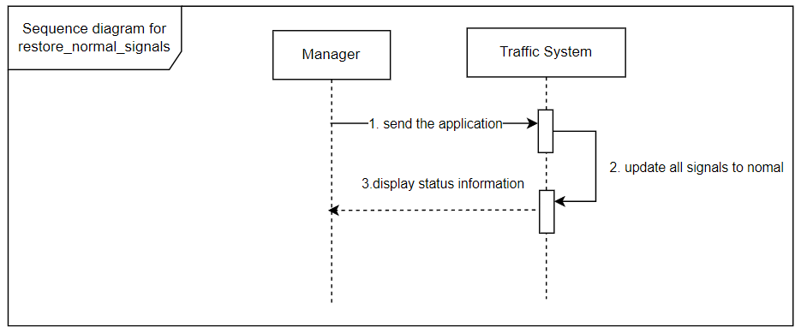

Slide 9
demo
Notes:
更多模板请关注：https://haosc.taobao.com

