Slide 1
Weekly Project Update
Daniil Karbukov
Ruochen Liao
Jalal Mammadov

Slide 2
Work done this week
01
02
03
04
Created initial UMLs
Set up a repository
Created a Django with base classes
Created CRUD functions

Slide 3
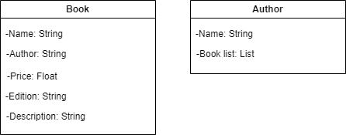
Class UML

Slide 4
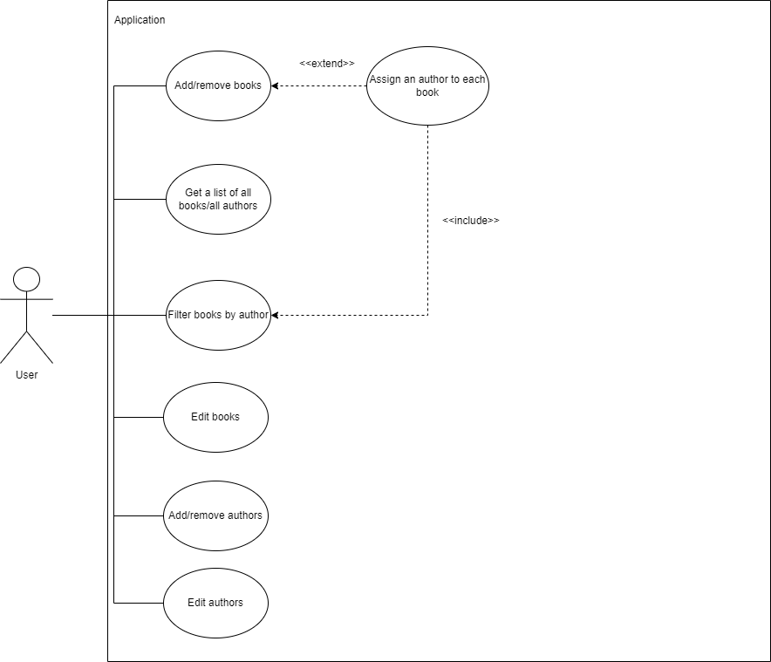
Use case UML

Slide 5
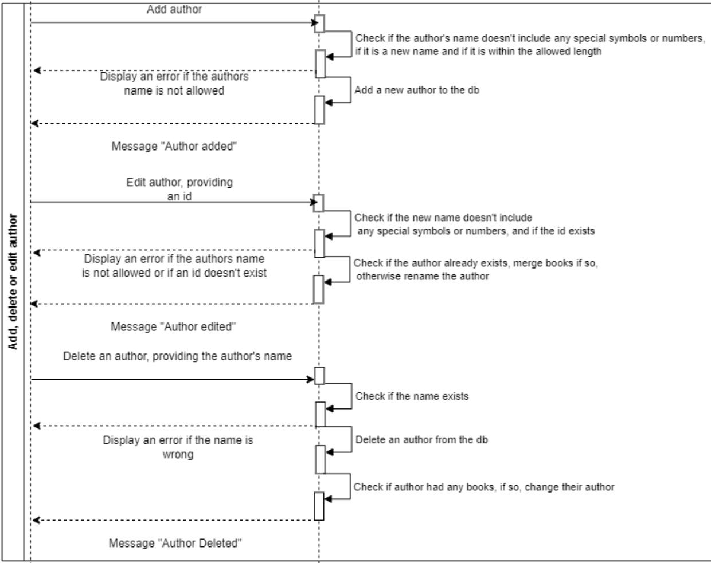
Sequence UMLs

