Slide 1
Weekly Project Update
Daniil Karbukov
Ruochen Liao
Jalal Mammadov

Slide 2
Work done this week
01
02
03
04
Added additional UMLs
Connected to the Google API
Updated Django classes
Added additional functions

Slide 3
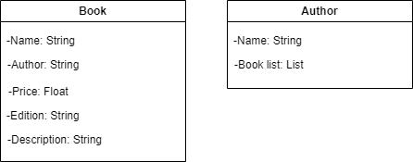
Class UML

Slide 4
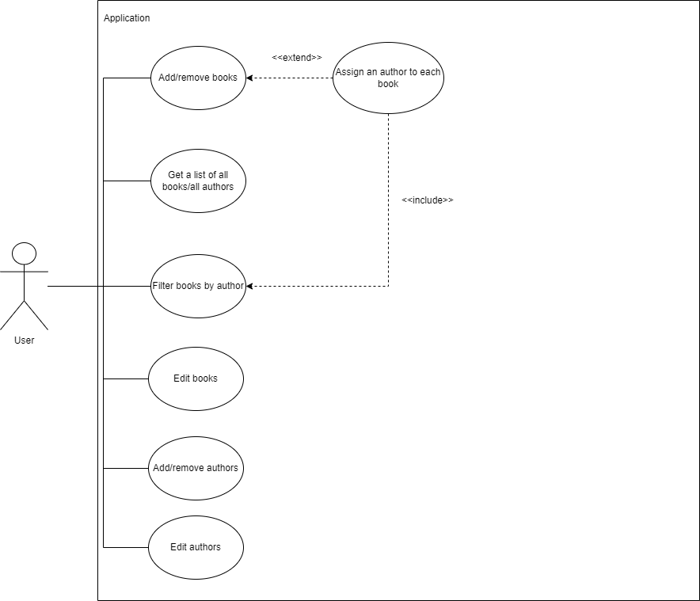
Use case UML

Slide 5
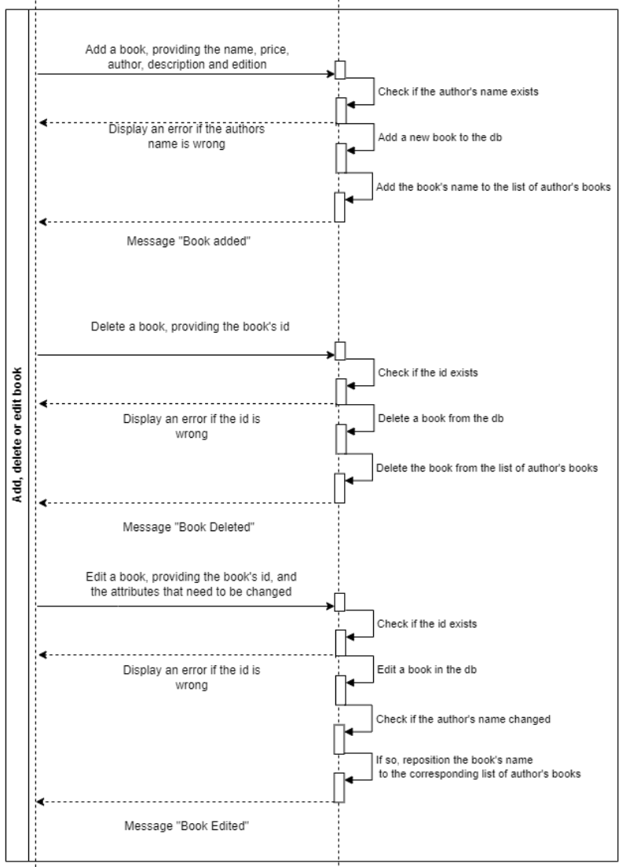
Sequence UMLs

Slide 6
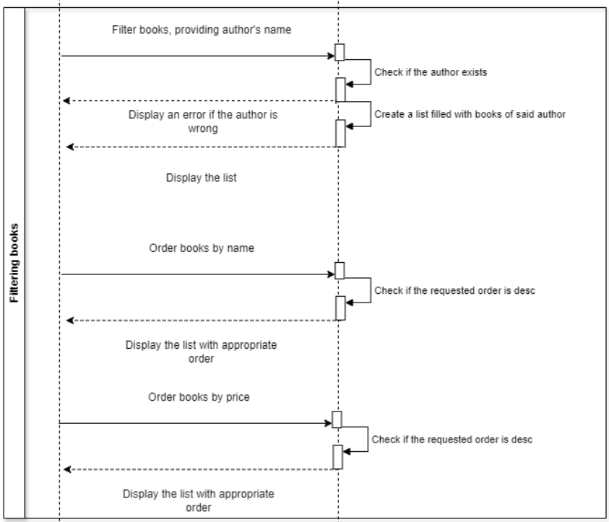
Sequence UMLs

Slide 7
Sequence UMLs

Slide 8
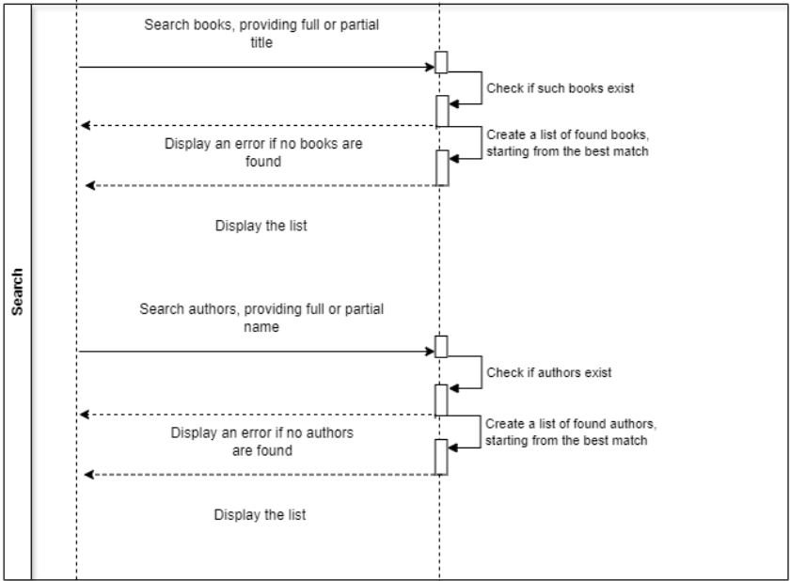
Sequence UMLs

Slide 9
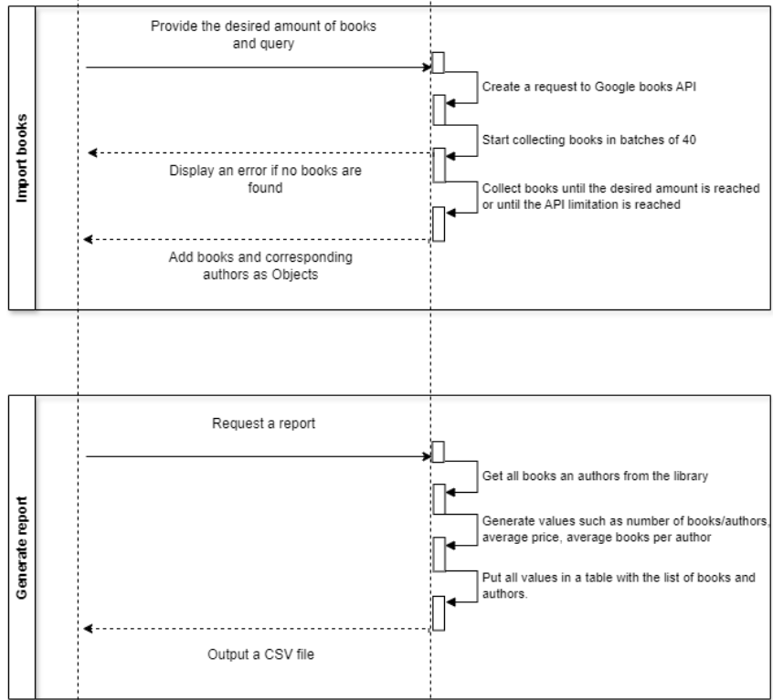
Sequence UMLs

Slide 10
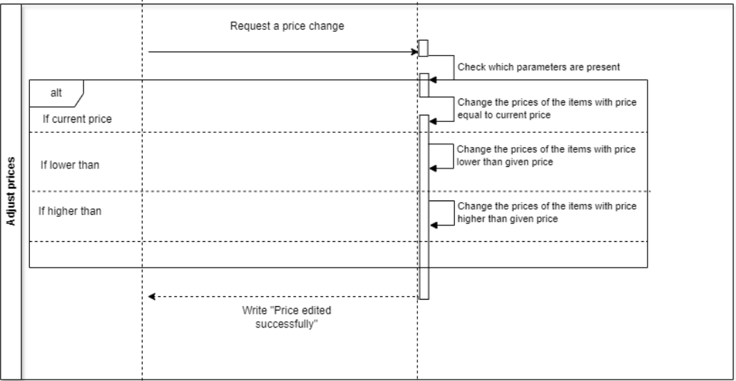
Sequence UMLs

