Slide 1
Weekly Project Update
Daniil Karbukov
Jalal Mammadov
Ruochen Liao

Slide 2
Work done this week
01
02
03
04
Updated UMLs
Created a README file
Expanded existing UMLs with new functions
Added a README file to our github repository
Added missing functions
Added new functions
Created the addbook, showauthors, and addauthor functions that were missing last time
Created the editbook, editauthor, deletebook, deleteauthor functions as well as a couple of tests

Slide 3
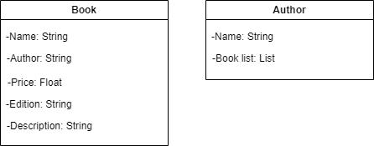
Class UML
The Book list attribute is created automatically by user adding new books or editing the existing ones.

Slide 4
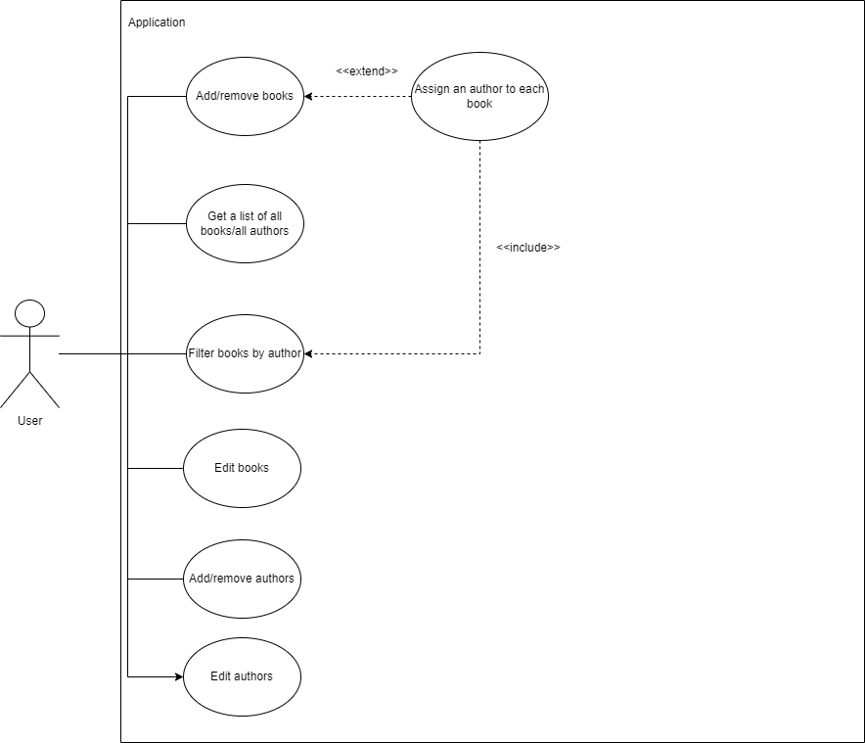
Use case UML
Added new functions

Slide 5
Sequence UML
Added new functions and greatly expanded the description of existing ones

