Slide 1
Weekly Project Update
Daniil Karbukov
Jalal Mammadov
Ruochen Liao

Slide 2
Work done this week
01
02
03
Updated UMLs
Expanded and improved the sequence UML
Added bulk price change functions
The function is able to change the price of books that suit a certain condition
Added import and export functions
It is now possible for user to add several books at once using Google books API. It is also possible to generate a report that contains current library

Slide 3
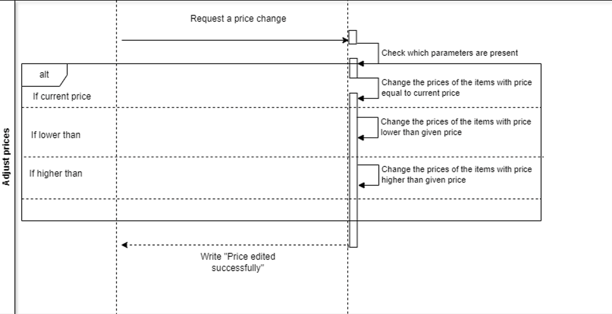
Sequence UML

