Slide 1


GraphService:Topology-aware Constructor
for Large-scale Graph Applications
A Topology-aware Constructor for Large-scale Graph Applications
Xinbiao Gan
National University of Defense Technology
汇报人：薛远识
Notes:
大家好，今天我将为大家介绍我们最新的研究成果——GraphService，一个面向大规模图应用的拓扑感知构造器。随着图数据规模的爆炸式增长，如何高效地构建和处理这些图数据成为了一个关键挑战。我们的工作旨在解决这一问题，通过创新的设计显著提升大规模图应用的服务质量。

Slide 2





CONTENTS
01
Research Background and Problem Statement
02
Related Technical Background
03
Core Design of GraphService
04
Experimental Evaluation and Results
05
Conclusion and Future Work
Notes:
本次报告将分为五个部分。首先，我会介绍研究的背景以及我们发现的核心问题。接着，会简要回顾相关的技术背景知识。然后，将详细阐述GraphService的核心设计思路和实现方法。之后，我们会展示一系列实验结果来验证GraphService的有效性。最后，对全文进行总结并展望未来的研究方向。

Slide 3
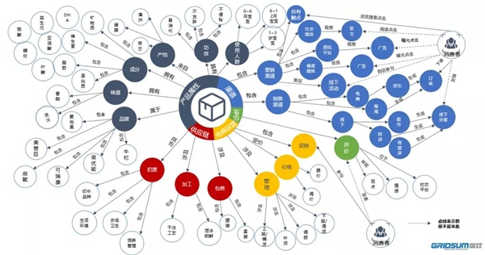


Research Background: The Importance of Graph Services
Widespread Application Scenarios
Graph services have been deeply integrated into daily life, covering social networks, recommendation systems, knowledge graphs, and other fields.
Key to Quality of Service (QoS)
Quality of Service (QoS) is a key metric for measuring graph services, including throughput, response time, etc.
Distributed Needs Driven by Massive Data
Figure: Schematic of a complex knowledge graph (showing scale and association)
As the scale of graph data (vertices/edges) grows rapidly, a single machine can no longer handle it, and distributed systems are a must.
Notes:
First, let's look at the research background. Graph services, such as social networks, e-commerce recommendation systems, and knowledge graphs, have become an integral part of our lives. The performance of these services, or Quality of Service (QoS), is directly related to user experience. However, with the explosive growth of data volume, such as the Sogou graph with trillions of edges, the processing capacity of a single machine has been far exceeded, and distributed systems must be used for storage and computation.

Slide 4



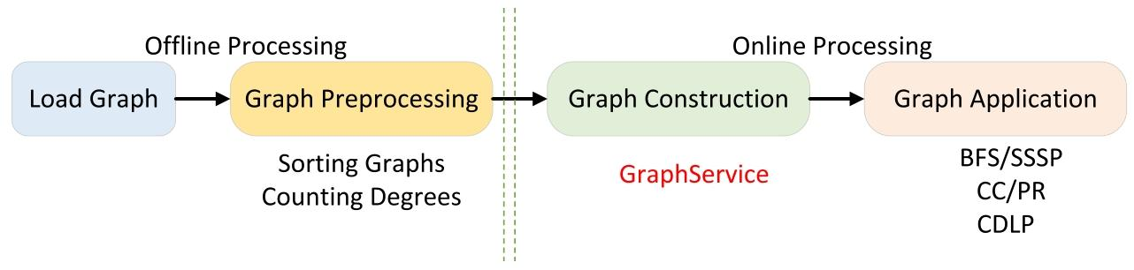
Problem Statement: Bottleneck of Graph Construction
Traditional systems focus too much onhigh throughputof operators (BFS/SSSP), but ignore the huge overhead of the construction phase.
Graph construction time (τ_c) is typically3-5 orders of magnitudehigher than operator time (τ_g), a key bottleneck.
Communication costs account forover 80%of the construction phase, the core cause of high latency.
Graph Processing Pipeline: Construction is the critical entry point of online processing
Notes:
In distributed graph processing, a complete workflow includes loading, preprocessing, construction, and application phases. Current research mainly focuses on the throughput of graph applications. However, the time spent on graph construction (distributing graph data to compute nodes) is often thousands of times longer than the actual computation time. Inter-node communication cost is the main bottleneck, accounting for the vast majority of the construction time.

Slide 5
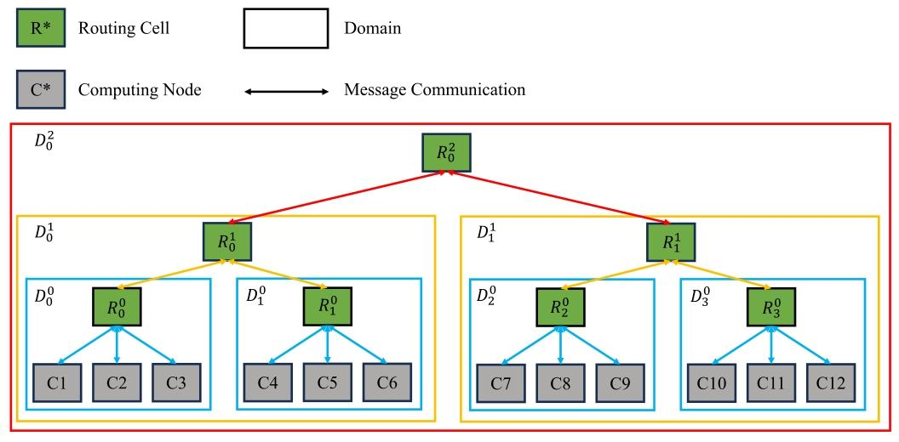



Core Problem: Neglect of Communication Topology
Algorithm Limitation: Ignoring Underlying Characteristics
Current graph partitioning algorithms focus only on the graph's sparsity, ignoring the physical communication hierarchy of the underlying HPC system.
Hardware Feature: Hierarchical Communication Latency
HPC networks have strict hierarchies; cross-cabinet/room latency is much higher than intra-level communication.
Schematic of HPC Hierarchical Communication Topology
Performance Bottleneck: High Cross-domain Overhead
Neglecting topology causes unnecessary cross-domain traffic, drastically increasing latency and reducing efficiency.
Notes:
What is the core of the problem? Existing graph partitioning methods (e.g., XTree) only consider the graph's structure (e.g., tight vertex connections) but ignore a critical fact: the HPC network running these programs is hierarchical.
Look at the left diagram, a typical HPC communication topology. Compute nodes are organized into different Domains and Routing Cells. Intra-cabinet communication is fast, but cross-cabinet/room communication is much slower.
Ignoring this hardware topology leads to costly cross-domain communication, the root cause of low graph construction efficiency.

Slide 6
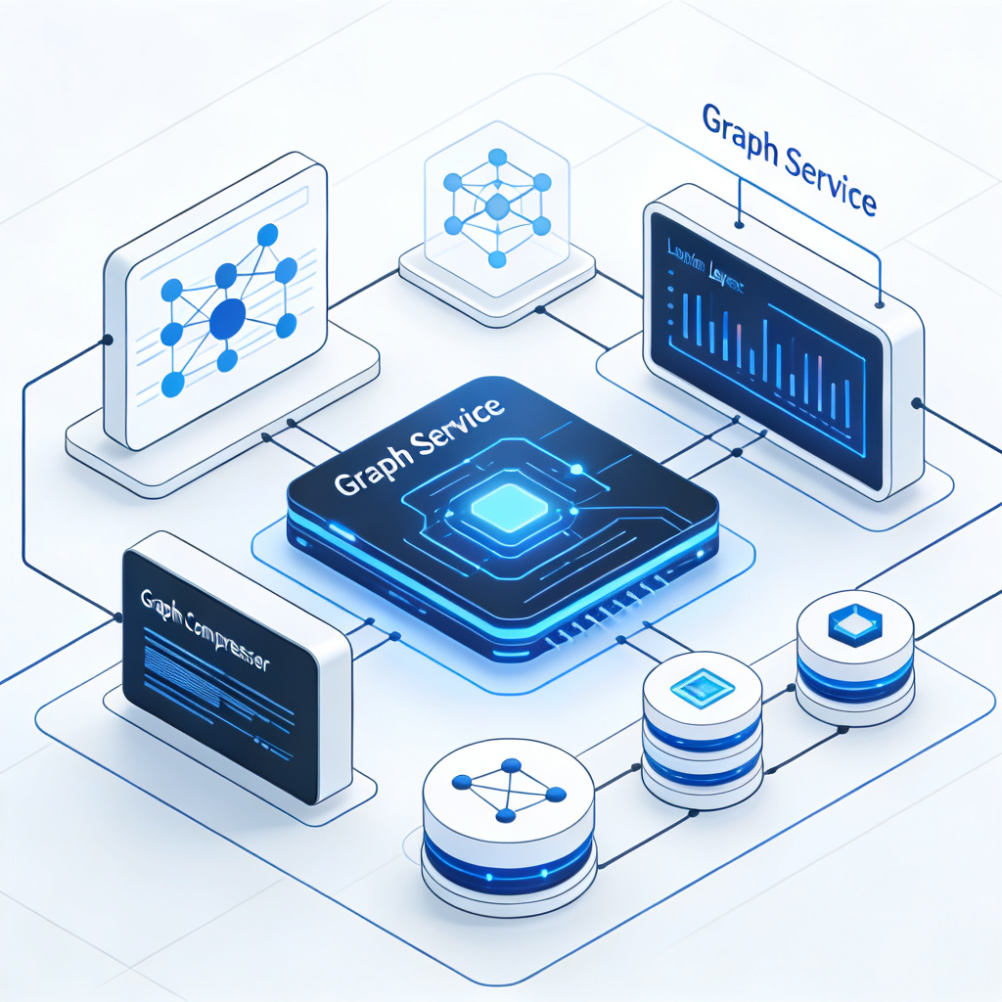

Solution: Introduction to GraphService
To solve the above problems, we propose GraphService, a flexible and efficient graph constructor. Its core ideas include two aspects:
Hierarchy-aware Graph Partitioner
Utilizes the communication topology information of the target HPC system to distribute graph data as much as possible within the same communication domain, thereby minimizing communication costs.
Space-time Efficient Graph Compression
Accelerates graph construction and reduces memory usage by identifying and grouping a large number of vertices with the same degree in the graph for batch memory access.
GraphService Overall Architecture Diagram
Notes:
To solve this problem, we designed GraphService. Its core ideas are twofold:
First, we propose a hierarchy-aware graph partitioner that "understands" the underlying network topology and places closely related graph data in the same communication domain as much as possible to reduce cross-domain communication.
Second, we found that many graphs contain a large number of vertices with the same degree. We leverage this for graph compression, which not only saves memory but also accelerates the graph construction process through batch processing.

Slide 7

Background: HPC Communication Topology
Hierarchical Connection Architecture
Large-scale HPC systems connect compute nodes through routing units (RC) to form hierarchical communication domains.
Multi-level Domain Division
Communication domains are divided into different levels, such as leaf domains, level-1 domains, level-2 domains, etc.
Communication Latency
Communication latency between nodes within the same communication domain is much lower than cross-domain communication.
Figure 1: Hierarchical Communication Topology of HPC System
Core Optimization Goal
The optimization goal is to place related graph data within the same communication domain to minimize communication overhead.
Notes:
To better understand our design, let's briefly introduce the HPC communication topology. As shown in the figure, compute nodes are organized into different communication domains connected by routing units. For example, C1, C2, C3 belong to one leaf domain, while C4, C5, C6 belong to another. Communication within the same domain is very fast, while cross-domain communication (e.g., from C1 to C4) is much slower. Our goal is to leverage this structure to match the distribution of graph data with the communication hierarchy of the hardware.

Slide 8
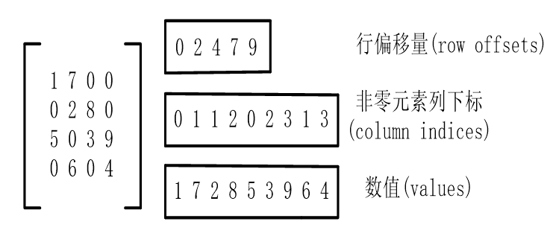



Background: CSR and Graph Distribution
CSR Storage Standard
CSR is a standard format for storing sparse graph data, representing the graph through three arrays (val, col_idx, row_ptr).
Distributed Graph Partitioning
In distributed graph processing, vertices and edges are distributed to different compute nodes.
CSR (Compressed Sparse Row) storage format for sparse matrices
Key Performance Factors
Partitioning strategy determines communication patterns and efficiency, a critical step in distributed processing.
Notes:
Another basic concept is graph storage and distribution. We typically use the CSR format to efficiently store sparse graphs. In a distributed environment, we need to "split" this large graph and distribute it across different machines, a process known as graph partitioning. The quality of partitioning directly affects how much data needs to be exchanged between nodes during subsequent computations, i.e., communication volume, so it is crucial for performance.

Slide 9

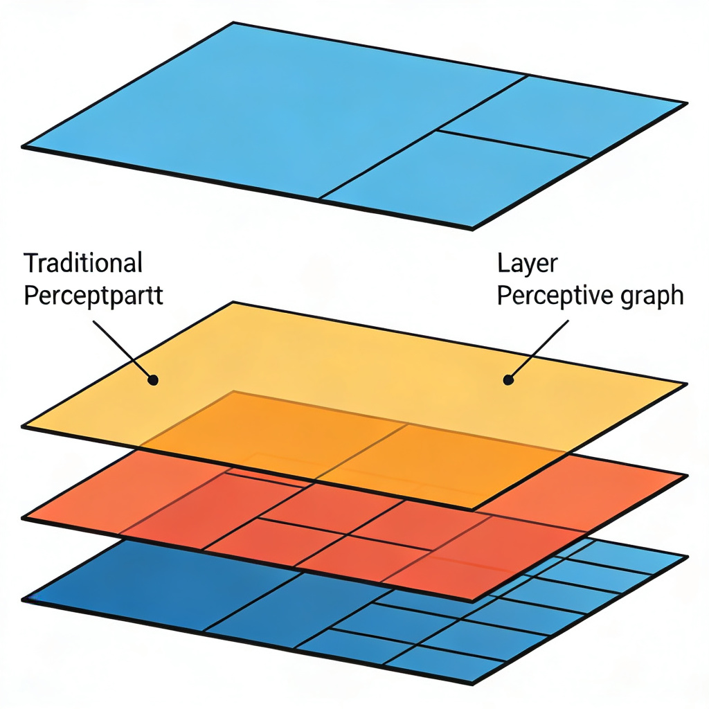
Core Design 1: Hierarchy-aware Graph Partitioner
Design Philosophy
Allocate vertices and edges of the graph as much as possible within the same communication domain to reduce cross-domain communication.
Specific Strategy
Uses HPC system's communication topology to guide partitioning, aligning results with hardware hierarchy.
Core Advantage
Reduces communication cost and time by minimizing expensive cross-domain communication.
Fig: Hierarchy-aware vs Traditional Strategy
Notes:
Now let's look at our first core design: the Hierarchy-aware Graph Partitioner. Traditional partitioning may split related vertices into different cabinets, causing heavy cross-domain traffic. Our method references the hardware communication topology, placing closely related vertices in the same domain (e.g., cabinet). This turns most communication into fast intra-domain traffic, greatly reducing overhead.

Slide 10
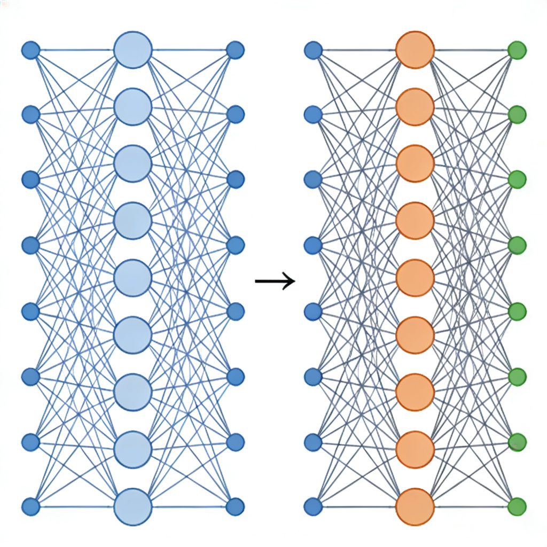

Core Design 2: Space-time Efficient Graph Compression
Key Observation
In real-world graphs, there are a large number of vertices with the same degree.
Compression Method
Groups vertices with the same degree for storage/indexing, avoiding duplicate structural metadata.
Dual Advantages
Time Efficiency:Batch memory access accelerates graph construction.
Space Efficiency:Reduces redundant storage & memory usage.
Fig: Grouped Compression of Same-degree Vertices
Notes:
The second core design is space-time efficient graph compression. We observe that many vertices share the same degree in real-world graphs (e.g., users with few friends in social networks). By grouping and processing these vertices together, we not only save memory space but also enable batch operations, significantly accelerating graph construction.

Slide 11

Experimental Setup: Testbed & Datasets
Large-scale Distributed Testbed
Comparison with Mainstream Systems
Deployed on 3 HPC systems with up to79,024compute nodes to validate scalability.
Compared with Gemini, Gluon, GraphScope, and top Graph500 supercomputing systems.
Dataset Details
Dataset | Vertices | Edges | Type
Twitter-2010 | 41.6M | 1.47B | Real-world
Kronecker (scale=42) | 4.4T | 70.4T | Synthetic
Sogou | 271.8B | 12.3T | Real-world
Notes:
To verify the performance of GraphService, extensive experiments were conducted. We tested on three HPC systems of varying scales, utilizing up to nearly 80,000 compute nodes. The datasets included real-world social graphs like Twitter, large-scale synthetic graphs like Kronecker, and web graphs like Sogou. We compared GraphService with mainstream systems such as Gemini and GraphScope, as well as top supercomputers on the Graph500 list.

Slide 12
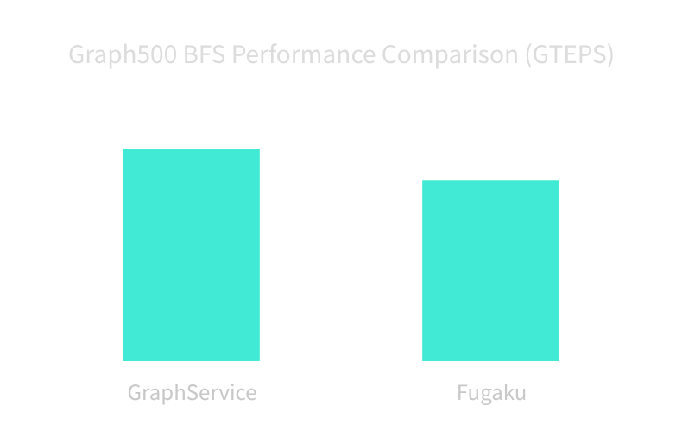
Experimental Results 1: Graph500 Performance Comparison
BFS Throughput
162,494 GTEPS(17% higher than champion)
SSSP Throughput
23,021 GTEPS
Graph Construction Time
Reduced by >4 orders(vs Fugaku)
Summary: GraphService demonstrates exceptional computing performance in the authoritative Graph500 benchmark. It not only surpasses the former champion Fugaku in throughput but also achieves a disruptive breakthrough in graph construction efficiency.
Notes:
First, let's look at the Graph500 test results, an authoritative benchmark for supercomputing graph capabilities. Our GraphService achieved a throughput of 162,494 GTEPS in the BFS test, 17% higher than the then-champion Fugaku. More importantly, our graph construction time is over 10,000 times faster than Fugaku, fully proving the effectiveness of our method.

Slide 13
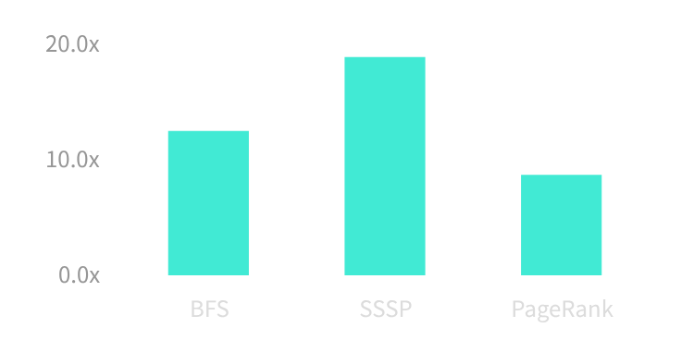
Experimental Results 2: Real-world Graph Performance
Core Findings
Performance Speedup (vs. Best Comparison System)
On real-world graph datasets (Twitter, Sogou), GraphService outperforms Gemini, Gluon, GraphScope.
Across different graph algorithm workloads, the speedup of GraphService is up to18.9x.
Notes:
On real-world graph datasets (Twitter, Sogou), GraphService significantly outperforms mainstream systems like Gemini and GraphScope. Across BFS, SSSP, and PageRank algorithms, it achieves speedups of several times, up to nearly 19x.

Slide 14
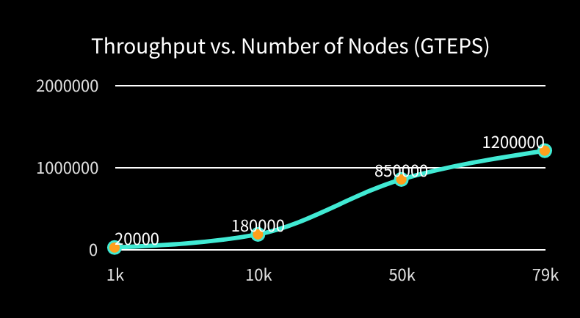
Experimental Results 3: Scalability Analysis
Excellent Linear Scalability
GraphService demonstrates excellent scalability. As the number of compute nodes scales from thousands to tens of thousands, the system's throughput grows nearly linearly.
Significant Improvement in Construction Efficiency
The growth rate of graph construction time is much lower than the growth rate of the number of nodes, proving its efficiency on large-scale clusters.
Conclusion: GraphService can continuously improve processing capacity by adding machines, fully meeting future demands for ultra-large-scale graph data.
Notes:
Scalability is a critical metric for distributed systems. Our experiments show that GraphService's throughput grows almost linearly as the number of compute nodes increases.
As clearly shown in the line chart on the right, when the number of nodes increases from 1,000 to 79,000, throughput jumps from 20,000 to 1,200,000 GTEPS, a very significant increase.
This means we can continuously improve system processing capacity by simply adding machines, which is crucial for handling even larger graph datasets in the future. Meanwhile, the growth rate of graph construction time is much lower than that of the number of nodes, ensuring efficiency.

Slide 15


Experimental Results 4: Compression Effect Analysis
Memory Usage Significantly Reduced
Avg compression rate>70%, releasing system resources.
Graph Construction Time Reduced
Speed increased by30%~50%via batch memory access.
Conclusion: Graph compression solves the memory bottleneck for large-scale graphs and brings significant performance gains through batch access.
Notes:
Our graph compression technology delivers tangible benefits. Experiments show it reduces memory usage by over 70%, critical for memory-constrained clusters. Meanwhile, batch memory access speeds up graph construction by 30% to 50%.

Slide 16
Related Work Comparison
The comparison shows that GraphService surpasses existing work in comprehensive performance, especially with significant advantages in graph construction efficiency and utilization of communication topology.
System | Hierarchy-aware Part. | Graph Comp. | Graph500 Perf. | Real Graph Perf.
Gemini | ❌ | ❌ | - | Baseline
Gluon | ❌ | ❌ | - | Baseline
GraphScope | ❌ | ❌ | - | Baseline
GraphService | ✅ | ✅ | 1.17x | Up to 18.9x
Core Advantages:Unique "Hierarchy-aware Partitioning" and "Graph Compression" enable an order-of-magnitude performance breakthrough on real-world graph datasets.
Notes:
We compare GraphService with other related work. As can be seen, most existing systems do not consider communication topology or adopt our proposed graph compression method. With these two key technologies, GraphService has achieved significant performance leadership on both Graph500 and real-world graph data.

Slide 17

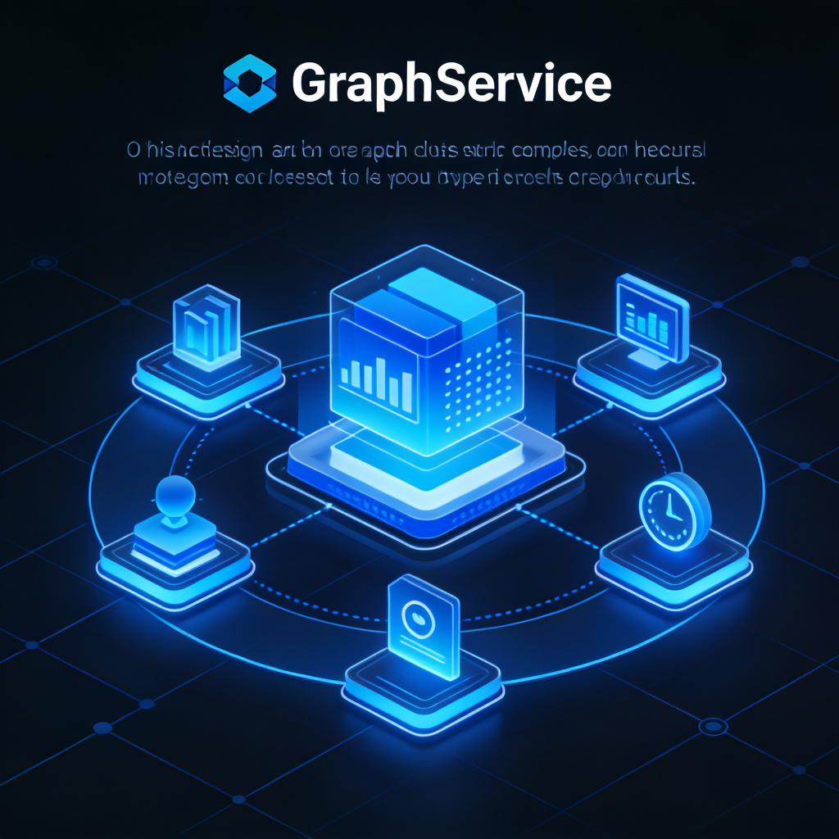

Conclusion
Core Contribution: GraphService Constructor
Proposed a topology-aware graph constructor for large-scale graph applications, addressing traditional construction pain points.
Key Tech: Hierarchy-aware & Compression
Employed hierarchy-aware partitioning and efficient compression to eliminate communication bottlenecks.
Superior Performance: Order of Magnitude
Surpassed existing systems on Graph500 benchmarks and real-world data, achieving breakthrough performance.
GraphService Core Architecture Diagram
Notes:
In summary, our work makes three key contributions: First, we present GraphService, a system dedicated to optimizing the graph construction process. Second, we design a hierarchy-aware partitioner and efficient graph compression techniques, effectively solving the communication bottleneck. Finally, extensive experiments demonstrate that GraphService comprehensively outperforms existing systems, providing an efficient solution for large-scale graph processing.

Slide 18


Future Work
Extend Application Scenarios & Algorithm Support
Extend GraphService to more types of graph algorithms and a wider range of application scenarios, breaking the limitations of single applications and releasing the potential of graph computing.
Optimize Process with GNN Training Frameworks
Explore integration with Graph Neural Network (GNN) training frameworks to optimize the end-to-end process from graph construction to model training, improving overall efficiency.
Optimize Compression for Dynamic Structures
Further optimize the graph compression algorithm to adapt to more complex and dynamically changing graph structures, addressing bottlenecks in large-scale graph storage and transmission.
Notes:
In future work, we plan to extend GraphService to more graph algorithms and scenarios. We also aim to integrate it with GNN training frameworks to optimize the end-to-end process from graph construction to model training. Additionally, we will continue exploring advanced graph compression techniques to address future challenges with complex graph data.

Slide 19


Acknowledgements
This work is supported by the National Natural Science Foundation of China and the PDL Innovation Research Fund.
Thanks to the contributions and collaboration of all team members.
2026 · Research Project Closing
Notes:
最后，我要感谢国家自然科学基金等项目对本研究的资助，以及团队成员们的辛勤付出和紧密合作。

Slide 20

Q&A
Thank You
感谢聆听 · 欢迎提问
Notes:
我的报告到此结束，感谢大家的聆听。现在是问答环节，欢迎大家提问。

