Slide 1

Bitcoin Network Analysis
Julissa Melo & Maopin Yan

Slide 2
Outline
Introduction
Data collection and explanation
Network analysis ---- methods used
Results and findings
Limitations and future work

Slide 3
Introduction
Our Goal:
We want to do a Bitcoin network analysis based on the Bitcoin actors and connections.
We will discuss the background of Bitcoin, data collection, data explanation, network analysis, the methodologies used, and our findings.

Slide 4
Introduction
Background:
Bitcoin is the first and most widely recognized cryptocurrency (Forbes, 2021), and began use in 2009.
It is a form of digital currency that exists independently of any government, state, or financial institution.
Bitcoin enables peer-to-peer exchange of value in the digital world using a decentralized system. It is more unrestrained and more private for transactions.
The funds are not tied to real-world entities but rather bitcoin addresses, all transactions on the blockchain are public.

Slide 5

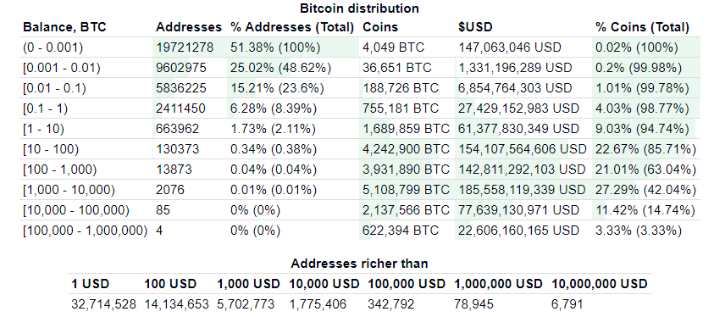
What the bitcoin actors look like?
Sample Bitcoin actors/address

Slide 6
Data Collection and explanation
We downloaded the cleaned Bitcoin dataset from Kaggle
Elliptic Data Set, Elliptic, www.elliptic.co. https://www.kaggle.com/ellipticco/elliptic-data-set/discussion
Sample Data Set
Actors
From
Actors
To
Actors
Classifications
Each transaction is a tie
Illicit actors
Licit actors
Unknown actors
1
2
unknown

Slide 7
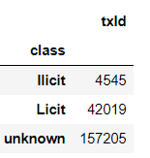
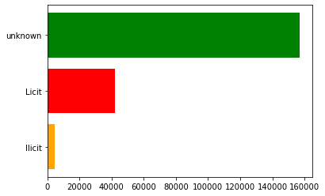
Data collection, Cont.
Total data:
203, 770 Actors
234,357 ties

Slide 8
Methodology
Our network analysis include methodologies as follows:
We do the bitcoin network graph analysis
The degree analysis under Licit and Illicit network.
The centrality analysis for the whole bitcoin network.

Slide 9
Bitcoin network graphs
We will show the Bitcoin network graphs as follows:
Ilicit Bitcoin network graphs
Whole illicit Bitcoin network graph
Actors with the largest degree in the ilicit network.
Licit Bitcoin network graphs
Sample licit Bitcoin network graph
Actors with the largest degree in the licit network.

Slide 10

Illicit Bitcoin network graphs
Whole illicit Bitcoin network graph
Subgraph of actors with the largest degree in the illicit network.

Slide 11
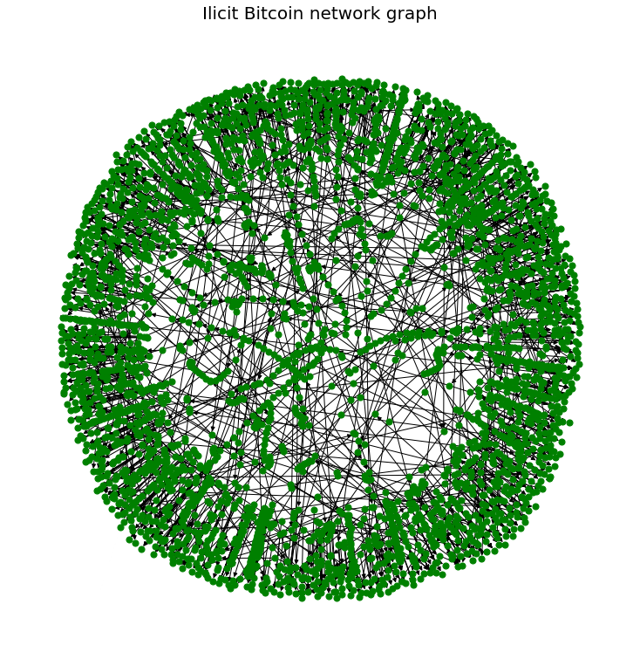
Whole ilicit Bitcoin network graph
The whole illicit Bitcoin network graph.
The graph contains 3988 illicit actors and 3371 ties.
It is a directed network, pointing from illicit actors to illicit, licit and unknown actors.

Slide 12
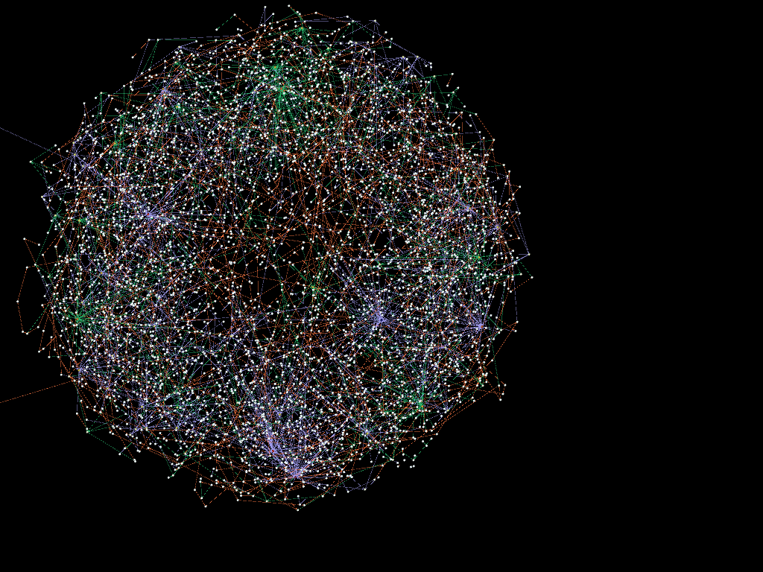

Whole illicit Bitcoin network graph
The graph contains 3988 illicit nodes and 3371 edges.
Graph made by Gephi
From illicit nodes to unknown nodes
From illicit nodes to illicit nodes
From illicit nodes to licit nodes
Illicit Bitcoin network

Slide 13
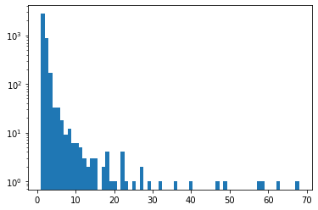
Degree analysis of Illicit network graph
Top five actors with the largest degrees:
355174807: 68 Category of the node is unknown
339502544: 63
139273997: 59
355238405: 58
73160850: 49
Degrees of all illicit actors
Frequencies of log degrees
Degree
Only 4 degrees larger than 50
Majority of degrees are less than 10

Slide 14
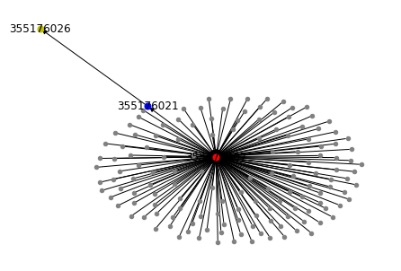

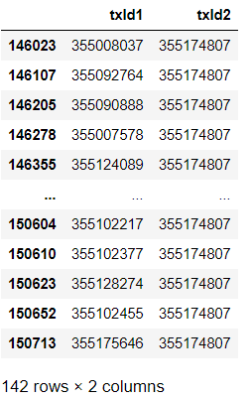


Subgraph of actors with the largest degree in the illicit network
From To
355174807
The actor (355174807) has the largest degree(68). It has 142 in-degrees, which means, there are 142 ties of transactions from other actors to 355174807. It has only one out-degree, the actor of the out-degree is 355176021.
The actor 355176021 only has one out-degree as well, the actor of the out-degree is 355176026. And this is the end of the subgraph, with no other transaction ties.
The right order for the transactions ties is: 142 nodes --> 355174807 --> 355176021 --> 355176026.

Slide 15
Licit Bitcoin network graphs
Sample licit Bitcoin network graph
Subgraph of actors with the largest degree in the licit network.

Slide 16
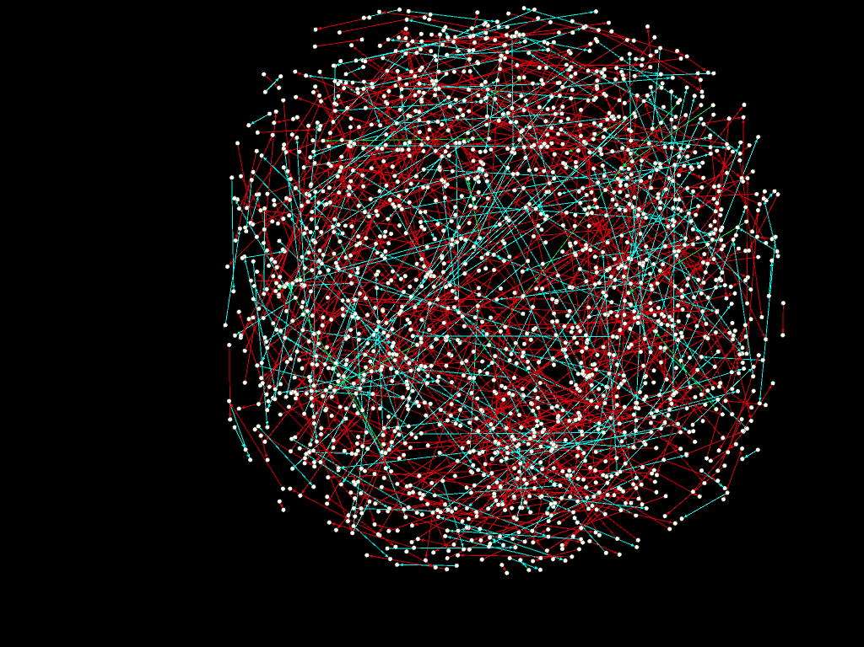


sample licit Bitcoin network graph
The whole licit network has 50379 nodes, and 49827 edges.
Graph made by Gephi
Sample size of licit nodes = 1000
From licit nodes to licit nodes
From licit nodes to unknown nodes
From licit nodes to illicit nodes
Sample licit Bitcoin network

Slide 17
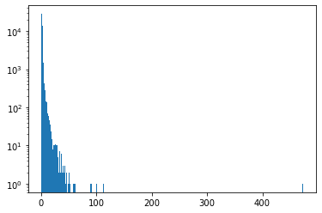
whole licit Bitcoin network graph
For the whole licit bitcoin network, there are 50379 actors, and 49827 ties.
Degree analysis:
Degrees of licit actors
Top five actors with the largest degrees:
2984918: 473 This is a licit node
89273: 289
3181: 113
7952: 100
565334: 91
Frequencies log of degrees
Degree
Only one degree larger than 400
Majority of degrees are less than 10

Slide 18
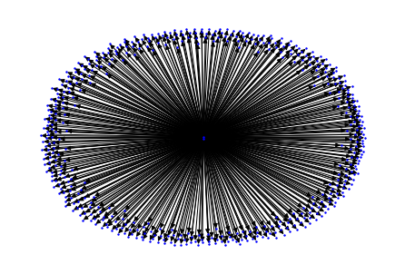
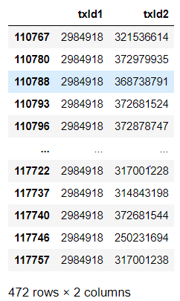


Subgraph of actors with the largest degree in the licit network
Subgraph of the licit node with the largest degree
From To
2984918
From 106651741to 2984918 to 472 different actors.

Slide 19
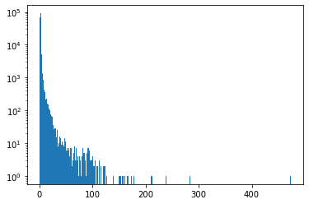
Subgraph of actors with the largest degree in the whole network
For the whole licit bitcoin network, there are 203, 770 Actors, and 234,357 ties.
Degree analysis:
Top actors with the largest degrees:
2984918: 473
89273: 289
43388675: 284
68705820: 247
30699343: 241
96576418: 239
225859042: 212
279187194: 211
Frequencies of log degrees
Degrees of all actors
Degree
Majority of degrees are less than 100
Only 8 degrees larger than 200

Slide 20
Centrality Analysis
degree_centrality | closeness_centrality | betweenness_centrality
2984918 (Licit): 0.0023212673236229437 89273: 0.0014182796121078873 43388675: 0.0013937419025558478 68705820: 0.0012121628518707548 30699343: 0.0011827176004083075 | 73279924 (Licit): 0.0013435982296480303 45555339: 0.0012489702030842088 73405590: 0.0012259299803948512 70245040: 0.001193706135152973 96576418: 0.0011007844566372977 | 1. 245736770 (unknown): 9.37776499093078e-06 245736765: 9.377740906844984e-06 3. 245736776: 9.377740906844984e-06 245736761: 9.377668654587596e-06 245736986: 9.377668654587596e-06

Slide 21

Centrality Analysis
Degree centrality: 2984918. This actor has the largest number of links to others. This actor is in the ‘Licit’ class.
Closeness centrality: 73279924. This actor can quickly interact with other actors. This actor is in the ‘Licit’ class.
Betweenness centrality: 245736770. The ties are important in the network. This actor is in the ‘unknown’ class.

Slide 22
Centralities for licit and illicit nodes in the Bitcoin network
 | All licit nodes |  |  | All illicit nodes
Statistic | Degree Centrality (%) | Closeness Centrality (%) | Betweenness Centrality (%) | Degree Centrality (%) | Closeness Centrality (%) | Betweenness Centrality (%)
Max | 0.9389 | 0.1625 | 2.0842 e-6 | 1.7055 | 1.6548 | 0.13
25th percentile | 1.9850 e-5 | 0.0 | 0.0 | 0.0251 | 0.0502 | 0.0
Median (50th) | 1.9850 e-5 | 1.9850 e-5 | 0.0 | 0.0251 | 0.0976 | 0.0
75th percentile | 3.9700 e-5 | 3.9700 e-5 | 3.9703 e-10 | 0.0502 | 0.2272 | 5.3485 e-7

Slide 23
Limitations and Future work
Because the Bitcoin network is peer-to-peer exchange, most of the time, the two connected actors are in a so-called block, they have no connections with others. So, it is not good for the geodesic's analysis. And it is meaningless to do the density analysis in the whole network. However, it is possible to do the geodesic's analysis and density analysis in the subgroups of the network.
We are not doing the ‘unknown’ class network analysis. There might be some interesting findings in the “unknown” network analysis.
The licit, illicit, and unknown classes are not opposing. For example, in the licit network graph, the ‘source’ actors are all licit actors, however, the ‘target’ actors include licit, illicit and unknown actors. In the future work, we can find how these three classes interact with each other.

Slide 24
Thank you!

