Slide 1


In-Building Navigation System
Jake Wierszewski
Michael Opiola
Garrett Naschak
Blair Sibu
Richard Pingle
Dan LaRocca
Neal Settle
Notes:
Richard
Presenting: Richard

Slide 2
In-Building Navigation System
Project Overview
Your first day at University can be overwhelming, and finding your lecture hall should be the least of your concerns. Our proposed solution will provide students web access to a mapping tool for the building of their choice. This will allow them to display their current location, and route to another selected location in the building, through a convenient web-based tool.
Notes:
Richard
Presenting: Richard

Slide 3
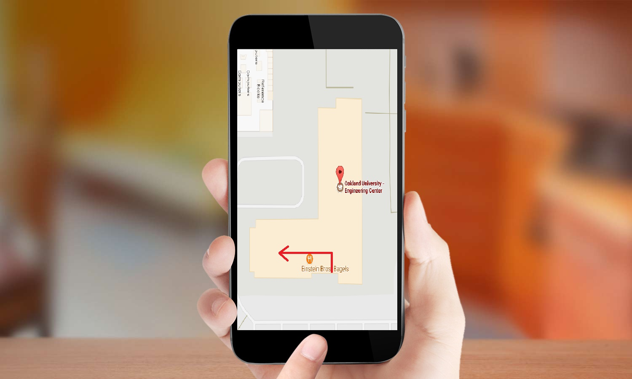
In-Building Navigation System
Project Overview
Notes:
Garrett
Presenting: Garrett

Slide 4


In-Building Navigation System
UI and Usability Features
Simple UI
Map displaying location
Map displaying shortest route
Starting location
Detected via Phone
Manual entry option otherwise
Destination
Pull Bar List
Click on displayed map location
Notes:
Garrett
Presenting: Garrett

Slide 5
In-Building Navigation System
Project Requirements - Users
User must be able to view their location
User must be able to select a destination from a list or the map
User must be able to see locations near them on the map
User must be able to register an account
User must be able to securely login to the service
User must be able to save routes
User must be able to manage user profile
User must be able to change password
User must be able to recover forgotten password
Notes:
Richard
Presenting: Dan

Slide 6
In-Building Navigation System
Project Requirements - Administration
Must have secure access to management system
Must be able to add/remove locations
Must be able to edit locations
Must be able to create locations that expire for events
Notes:
Richard
Presenting: Dan

Slide 7
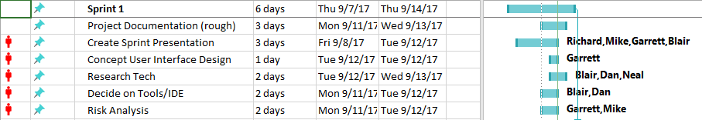
In-Building Navigation System
Project Plan Sprint 1
Notes:
Mike
Presenting: Mike

Slide 8
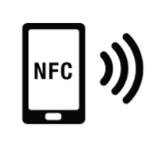

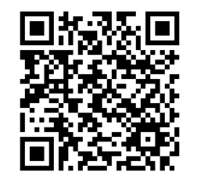


In-Building Navigation System
Tool Chain
Possible Tools/API Solutions
Google maps API
MapsIndoor API
Possible Beacon Solutions:
WiFi
BLE
NFC
QR
Notes:
Richard - QR Option
Jake - images, animation
Presenting: Blair

Slide 9
In-Building Navigation System
Navigation Solutions
WiFi
Pros
Wide range, Infrastructure already exists
Cons
Needs to be placed by an energy source, Sparsely located, Radio interference
BLE
Pros
Wide range (1m to 70 m), Battery powered, Portability, Scalable, Relatively cheap ($14)
Cons
Radio interference
NFC
Pros
Inexpensive, excellent security, Cheap ($17 for 50pcs)
Cons
Close range (10 cm), Programming all those tags
QR code option
Pros
Inexpensive, Easily integrated into existing room placards
Cons
Close range
Notes:
Blair
Jake - images
Presenting: Blair

Slide 10




In-Building Navigation System
Language
Proposed Programming Languages:
HTML 5
CSS
JavaScript
PHP
MySQL
Notes:
Richard
Jake - images, animation
Presenting: Neal

Slide 11
In-Building Navigation System
Configuration Management
Git Hub - Coding/Web Page
Change tracking
Google Drive - Documentation
Multi-platform access to documentation
Microsoft Project
For tracking of project tasks, dependencies, deadlines, and team resource management.
Notes:
Dan -slide
Presenting: Neal

Slide 12


In-Building Navigation System
Development Environment
Cloud 9 Devlopment Platform
Web Hosting
Database Hosting
PHP/Javascript Support
All-in-one Solution
Google Maps API
Notes:
Richard - Itemized points
Jake - images
Presenting: Jake

Slide 13
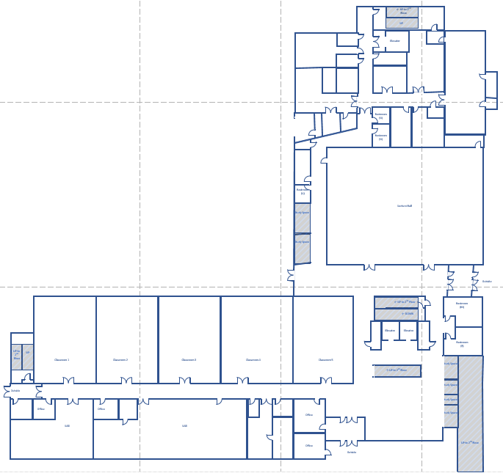
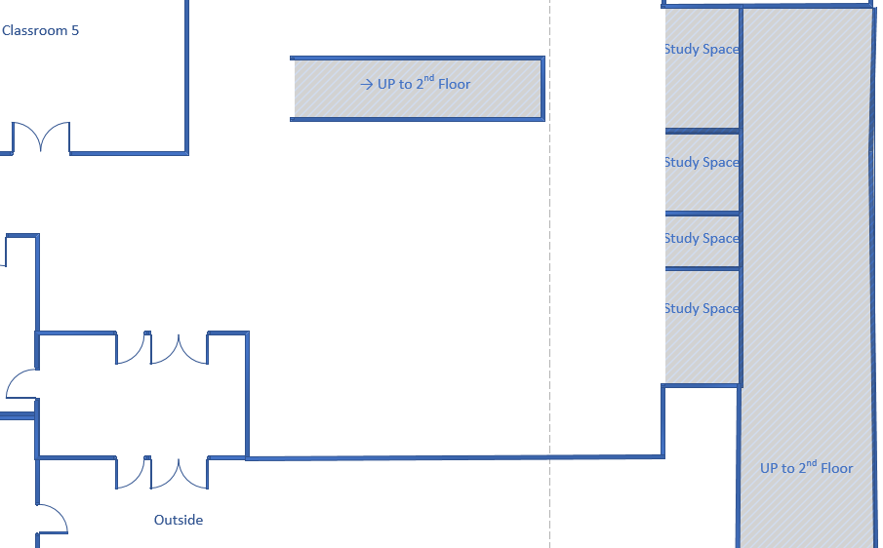
Map for User Interface
Notes:
Jake -Slide, map images, animation
Presenting: Jake

Slide 14
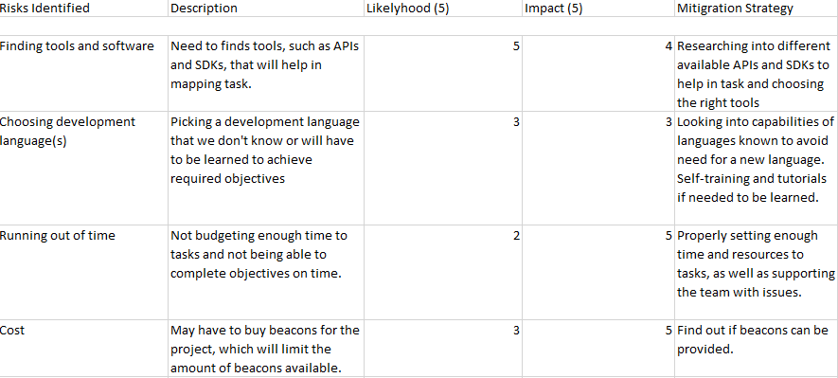
Sprint 1 Risk Analysis
Notes:
Mike - slide
Presenting: Mike

Slide 15
Project Risk Analysis
Placing beacons in every hallway
about 30 feet apart
Beacon Bluetooth range = 30 feet
Wide area - less beacons needed
Narrow area - need more beacons
Costly beacons for whole building
May not have the authorization to implement this system in secured areas
Notes:
Garrett - Slide
Presenting: Garrett

Slide 16
In-Building Navigation System
Objectives for Sprint 2
User Account Creation
User Registration
Role Management
Profile Update
Locking/Unlocking of User Accounts
Email Verification
Starting on Project Documentation
Notes:
Richard - slide
Presenting: Richard

Slide 17

Questions?
Notes:
Jake - slide
Presenting: Everyone

Slide 18
Thank You
Notes:
Jake - slide
Presenting: Everyone

