Slide 1
Supervised learning results

Slide 2
Building model from labeled crowdturfers and labeled good actors

Slide 3

Summary:
Crowdturfers
Good actors

Slide 4
Influential features

Slide 5
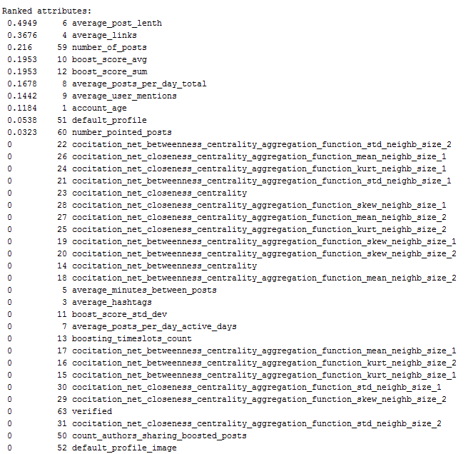
Ranked attributes:

Slide 6
Finding author_type

Slide 7
5 top features

Slide 8
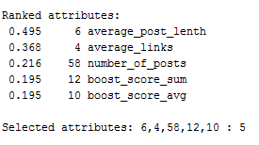
Ranked attributes:

Slide 9
Bad actors’ pilot (cont.)
I used 10-fold cross validation.
I used as evaluator: InfoGainAttributeEval
Search as Ranker
Classifier as J48
Class: author_type

Slide 10
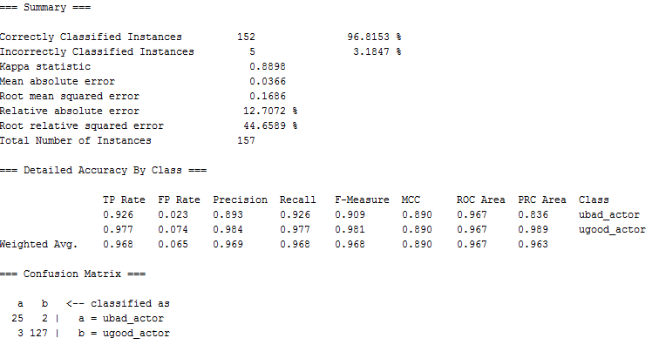
Summary:

Slide 11
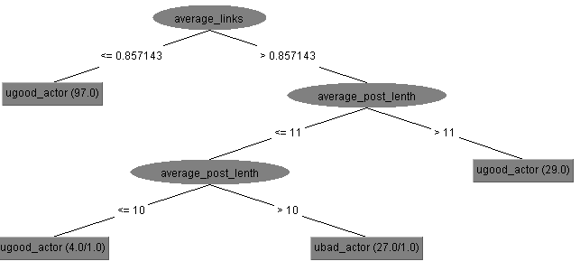
Decision tree:

Slide 12
Running test set

Slide 13
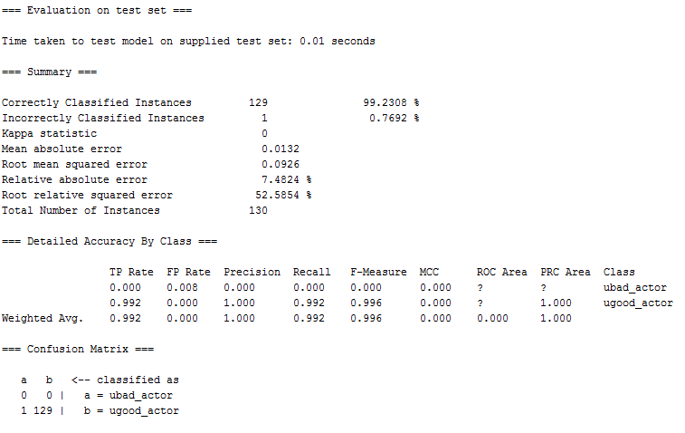
Summary:

Slide 14
3 top features

Slide 15
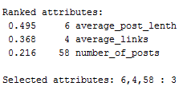
Ranked attributes:

Slide 16
Bad actors’ pilot (cont.)
I used 10-fold cross validation.
I used as evaluator: InfoGainAttributeEval
Search as Ranker
Classifier as J48
Class: author_type

Slide 17
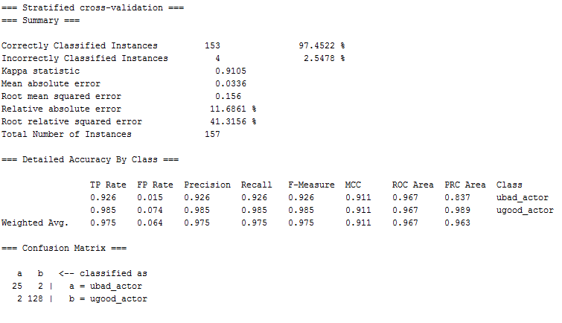
Summary:

Slide 18
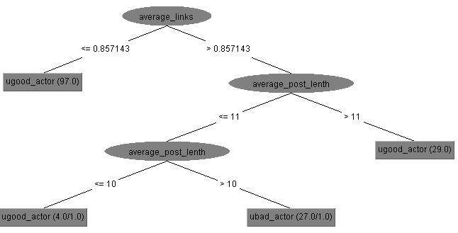
Decision tree:

Slide 19
Running test set

Slide 20

Summary:

Slide 21
2 top features

Slide 22
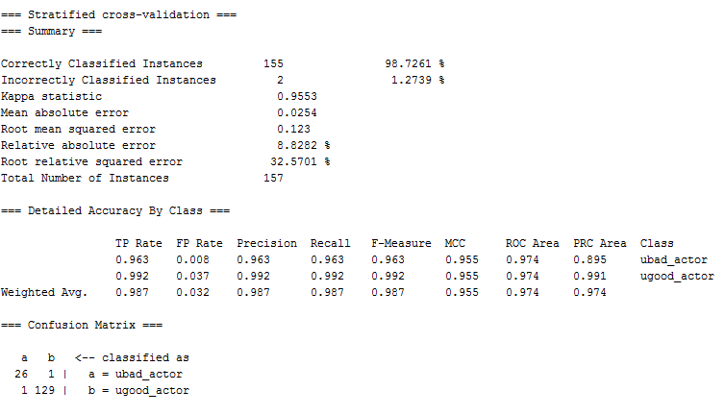
Summary:

Slide 23
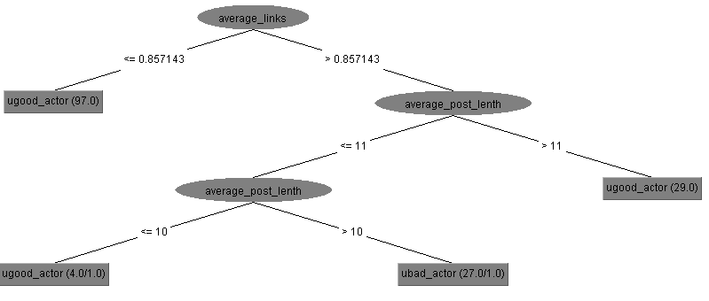
Decision tree:

Slide 24
Running test set

Slide 25
Summary:

Slide 26
Finding author_sub_type

Slide 27
Influential features

Slide 28
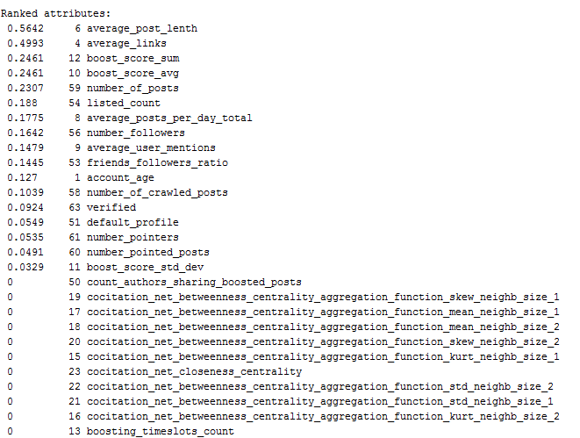
Ranked attributes:

Slide 29
5 top features

Slide 30
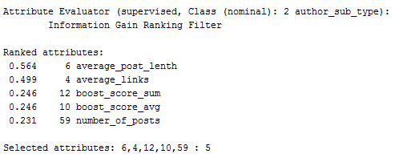
Ranked attributes:

Slide 31
Bad actors’ pilot (cont.)
I used 10-fold cross validation.
I used as evaluator: InfoGainAttributeEval
Search as Ranker
Classifier as J48
Class: author_sub_type

Slide 32
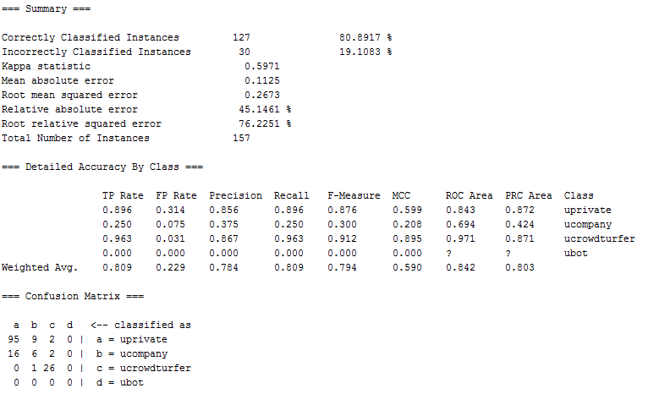
Summary:

Slide 33
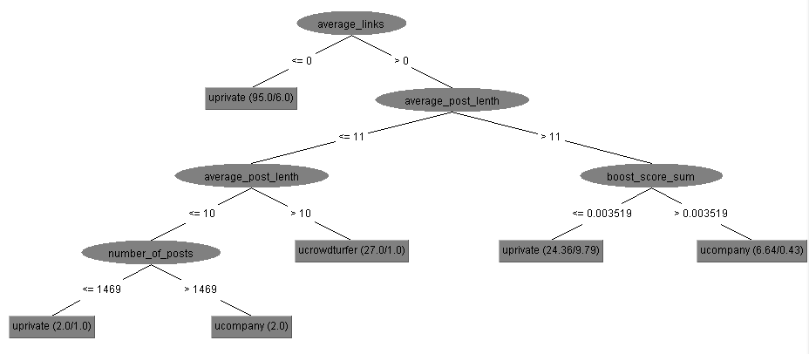
Decision tree:

Slide 34
Running test set

Slide 35
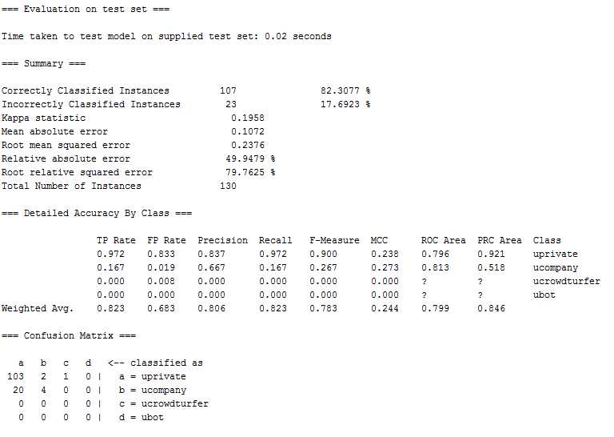
Summary:

Slide 36
3 top features

Slide 37
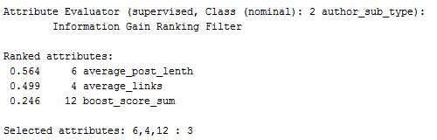
Ranked attributes:

Slide 38
Bad actors’ pilot (cont.)
I used 10-fold cross validation.
I used as evaluator: InfoGainAttributeEval
Search as Ranker
Classifier as J48
Class: author_sub_type

Slide 39

Summary:

Slide 40
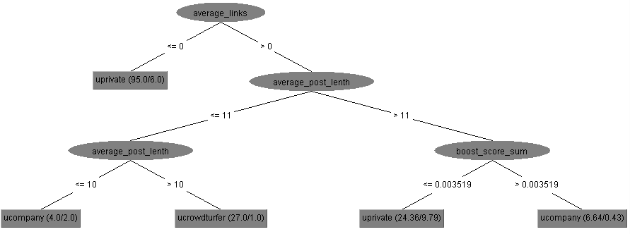
Decision tree:

Slide 41
Running test set

Slide 42
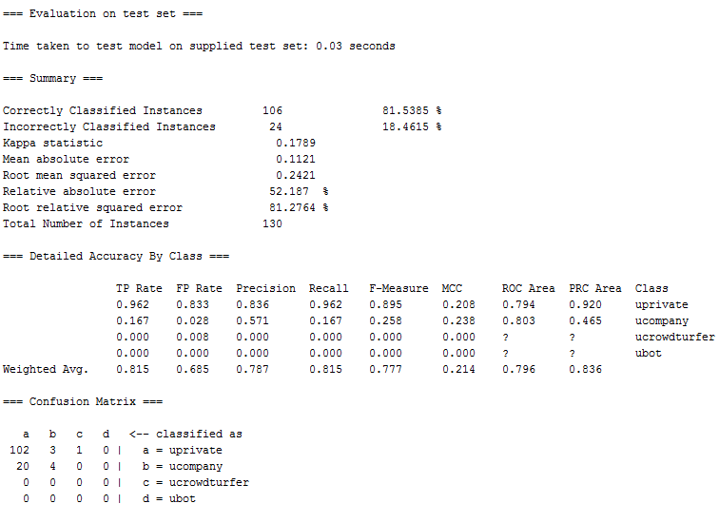
Summary:

Slide 43
2 top features

Slide 44
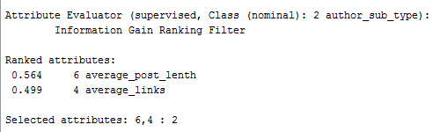
Ranked attributes:

Slide 45
Bad actors’ pilot (cont.)
I used 10-fold cross validation.
I used as evaluator: InfoGainAttributeEval
Search as Ranker
Classifier as J48
Class: author_sub_type

Slide 46
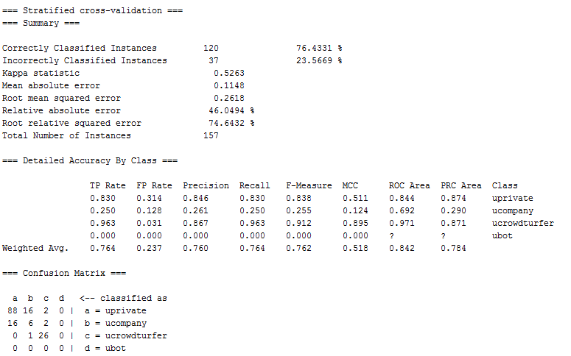
Summary:

Slide 47
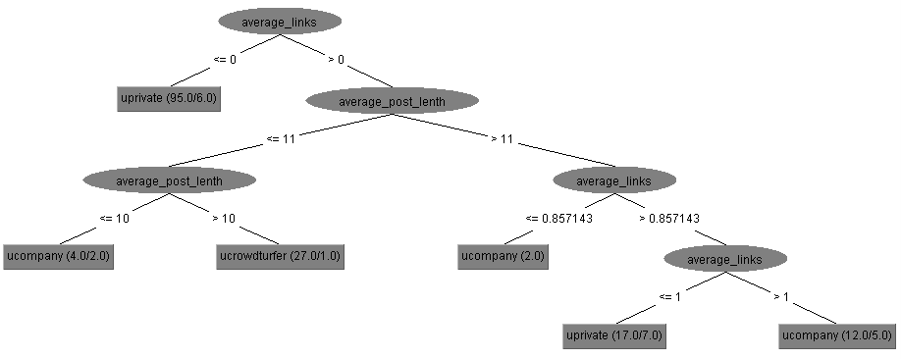
Decision tree:

Slide 48
Running test set

Slide 49
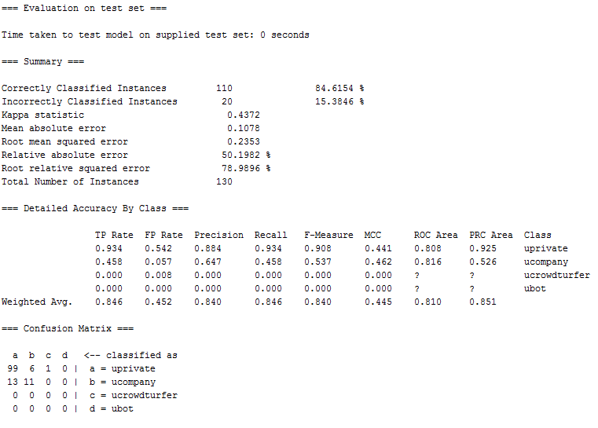
Summary:

Slide 50
Building model from labeled crowdturfers and labeled good actors, and automatic bots

Slide 51

Summary:
Crowdturfers + bots
Good actors

Slide 52
Finding author_type

Slide 53
Influential features

Slide 54
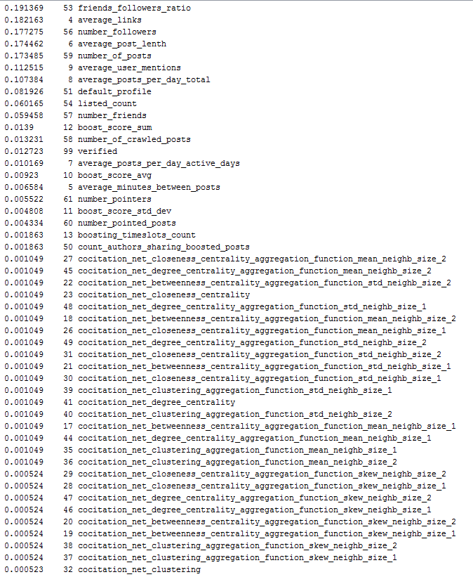
Ranked attributes:

Slide 55
5 top features

Slide 56
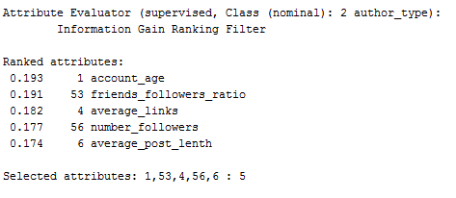
Ranked attributes:

Slide 57
Bad actors’ pilot (cont.)
I used 10-fold cross validation.
I used as evaluator: InfoGainAttributeEval
Search as Ranker
Classifier as J48
Class: author_type

Slide 58
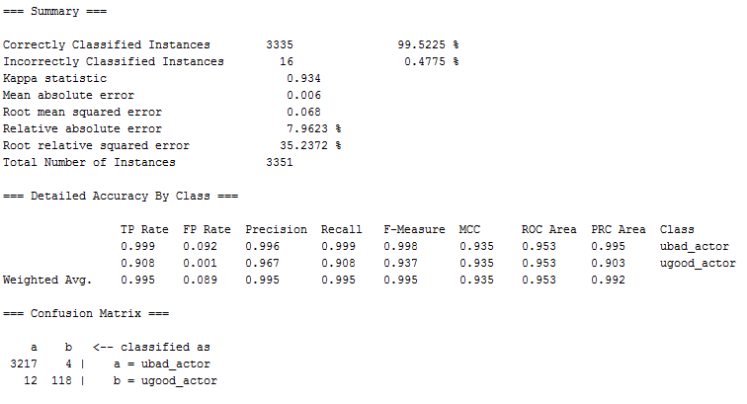
Summary:

Slide 59
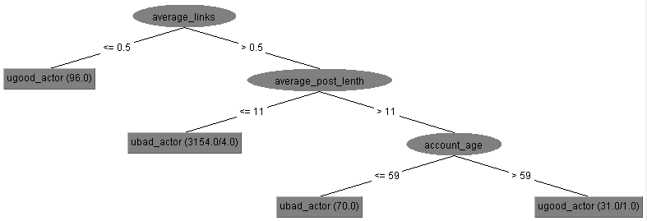
Decision tree:

Slide 60
Running test set

Slide 61
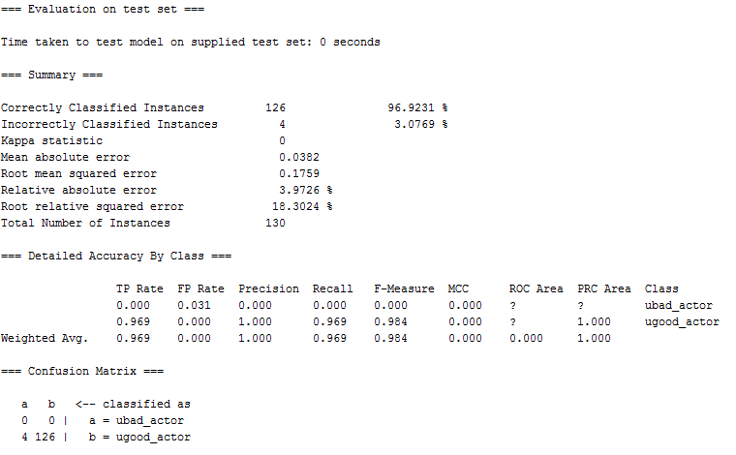
Summary:

Slide 62
3 top features

Slide 63
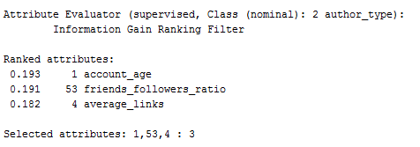
Ranked attributes:

Slide 64
Bad actors’ pilot (cont.)
I used 10-fold cross validation.
I used as evaluator: InfoGainAttributeEval
Search as Ranker
Classifier as J48
Class: author_type

Slide 65
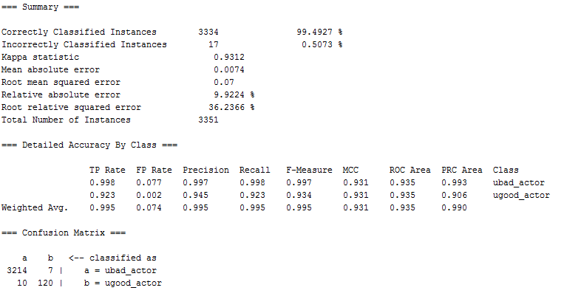
Summary:

Slide 66
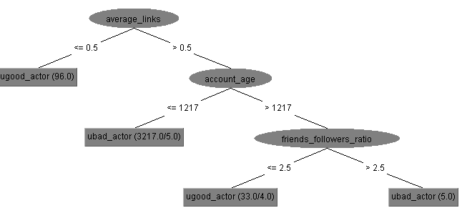
Decision tree:

Slide 67
Running test set

Slide 68
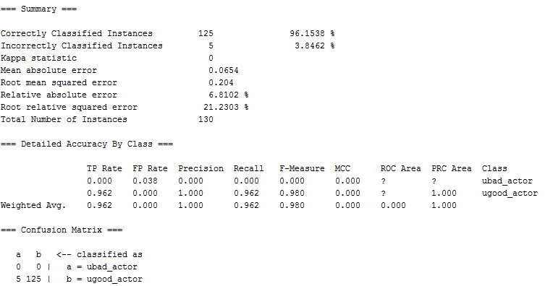
Summary:

Slide 69
2 top features

Slide 70
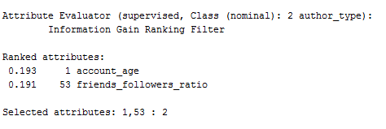
Ranked attributes:

Slide 71
Bad actors’ pilot (cont.)
I used 10-fold cross validation.
I used as evaluator: InfoGainAttributeEval
Search as Ranker
Classifier as J48
Class: author_type

Slide 72
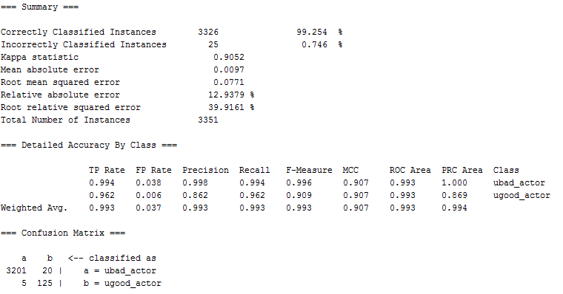
Summary:

Slide 73
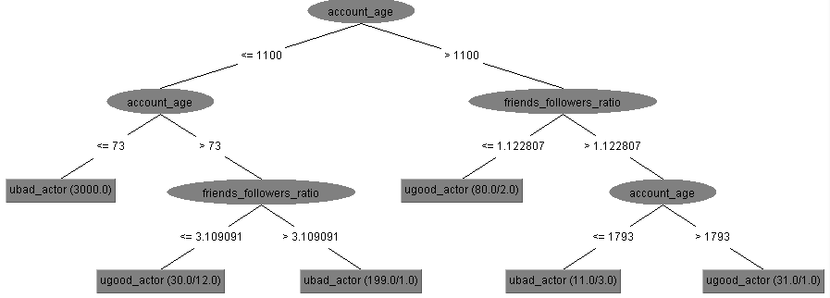
Decision tree:

Slide 74
Running test set

Slide 75
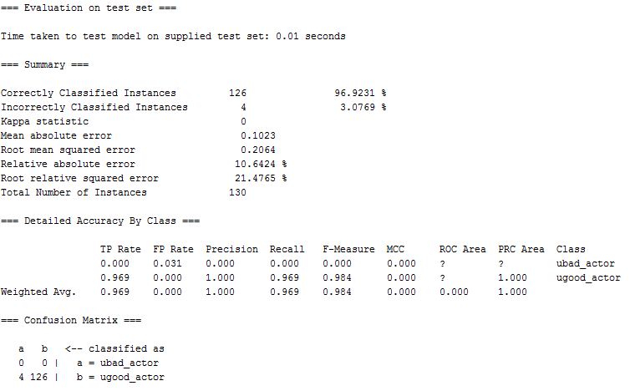
Summary:

Slide 76
Finding author_sub_type

Slide 77

Summary:
Privates
Companies
Crowdturfers
bots

Slide 78
Influential features

Slide 79
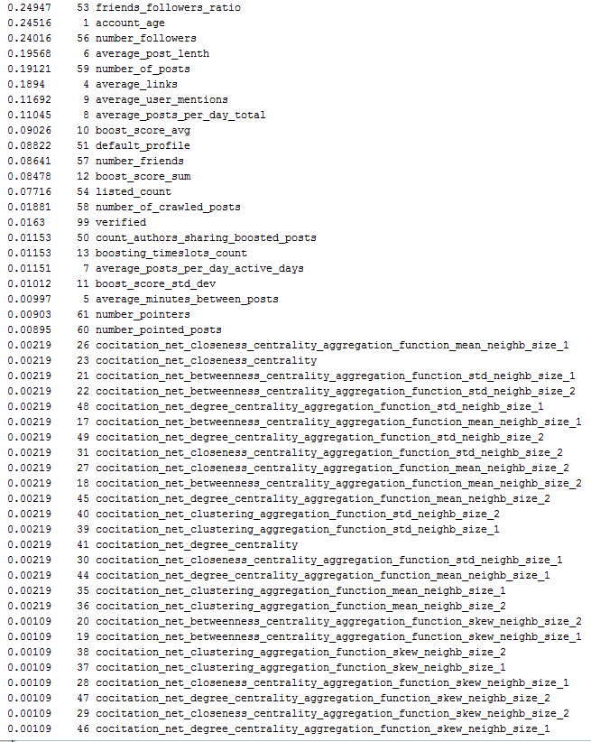
Ranked attributes:

Slide 80
5 top features

Slide 81
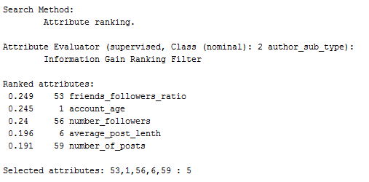
Ranked attributes:

Slide 82
Bad actors’ pilot (cont.)
I used 10-fold cross validation.
I used as evaluator: InfoGainAttributeEval
Search as Ranker
Classifier as J48
Class: author_sub_type

Slide 83
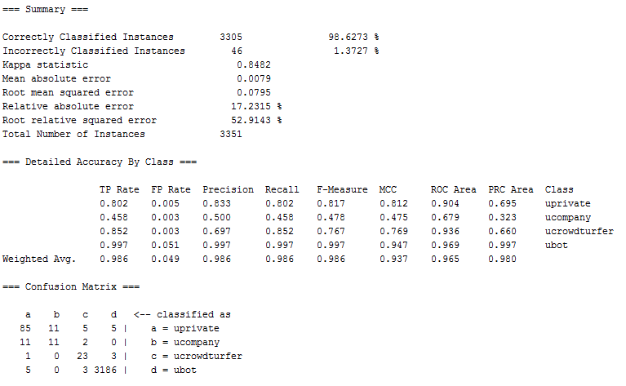
Summary:

Slide 84
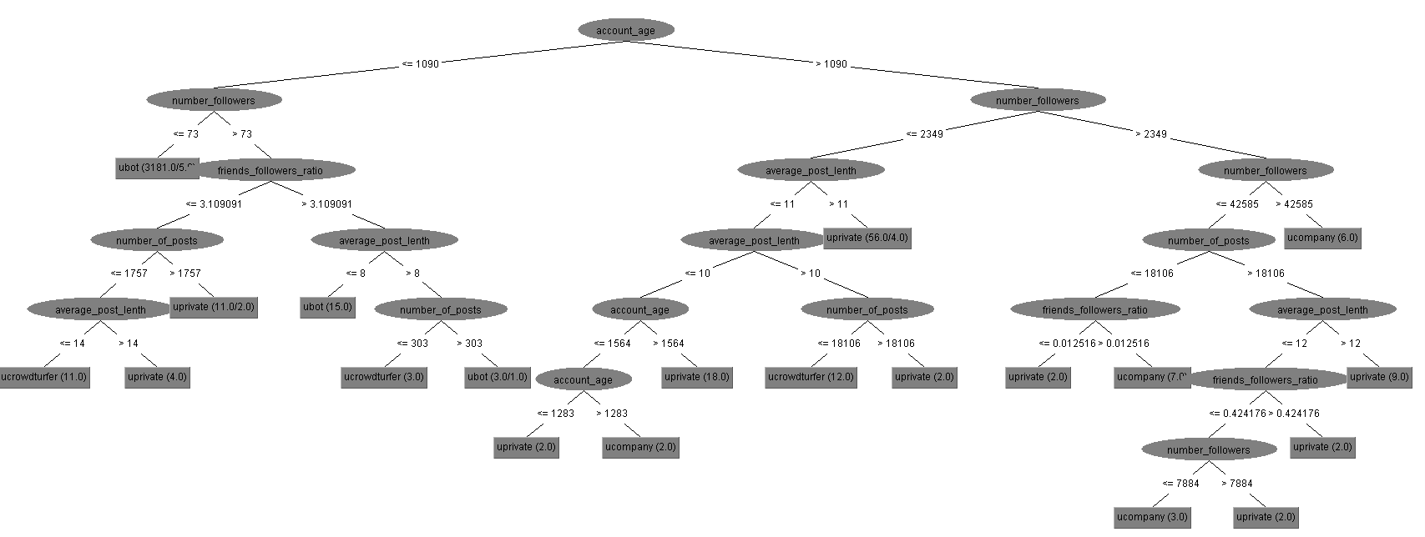
Decision tree:

Slide 85
Running test set

Slide 86
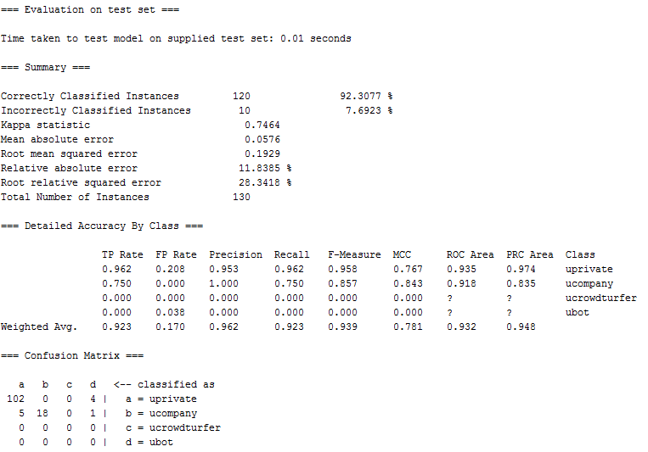
Summary:

Slide 87
3 top features

Slide 88
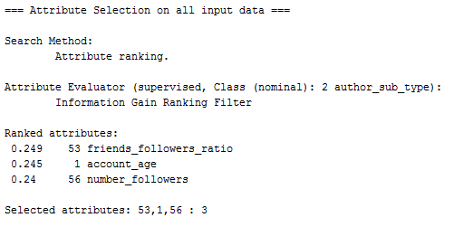
Ranked attributes:

Slide 89
Bad actors’ pilot (cont.)
I used 10-fold cross validation.
I used as evaluator: InfoGainAttributeEval
Search as Ranker
Classifier as J48
Class: author_sub_type

Slide 90
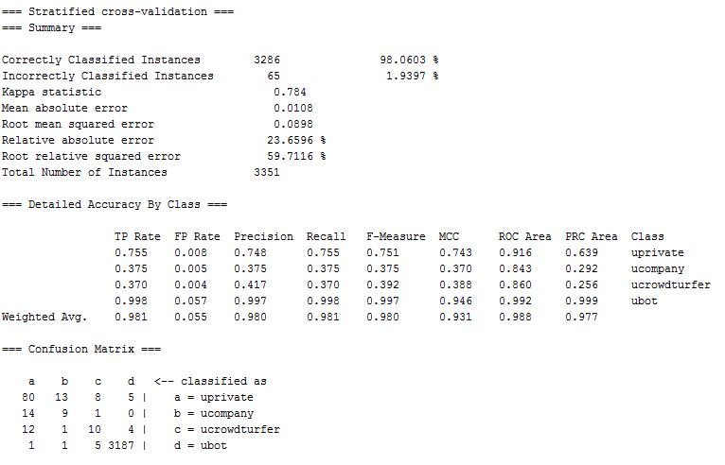
Summary:

Slide 91
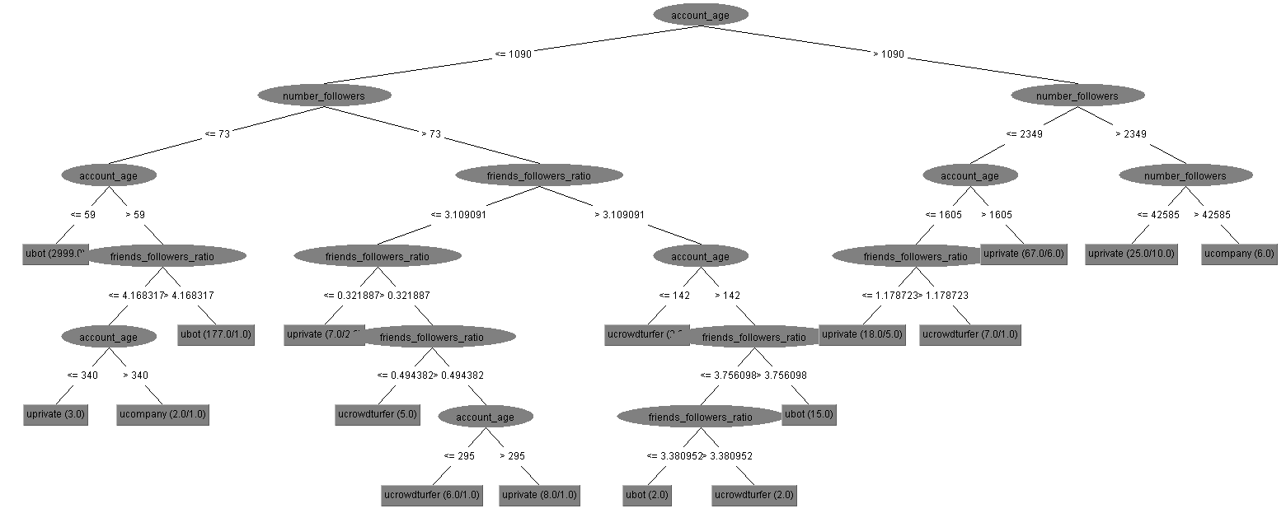
Decision tree:

Slide 92
Running test set

Slide 93
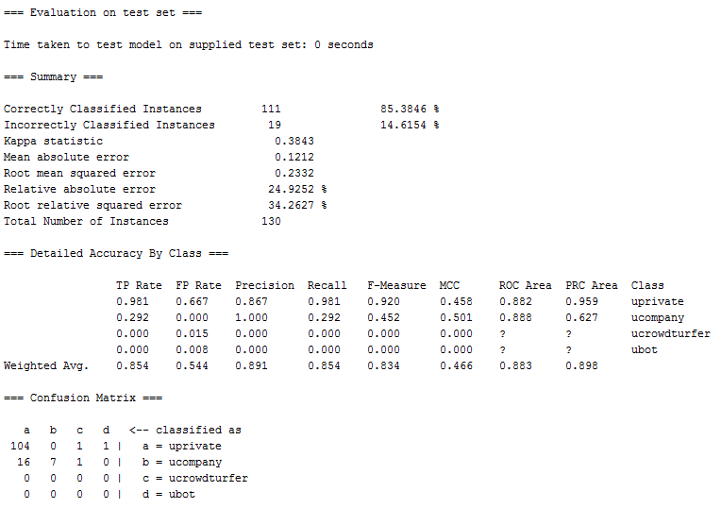
Summary:

Slide 94
2 top features

Slide 95
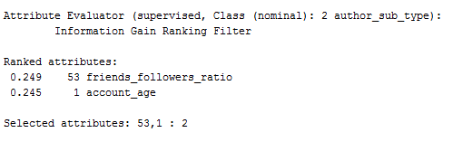
Ranked attributes:

Slide 96
Bad actors’ pilot (cont.)
I used 10-fold cross validation.
I used as evaluator: InfoGainAttributeEval
Search as Ranker
Classifier as J48
Class: author_sub_type

Slide 97
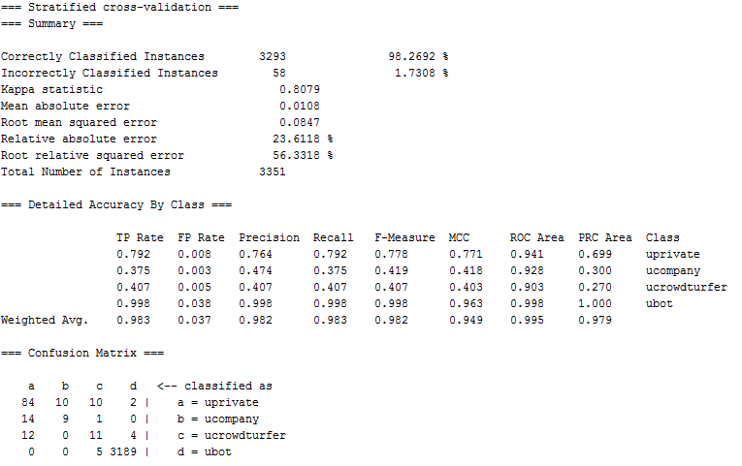
Summary:

Slide 98
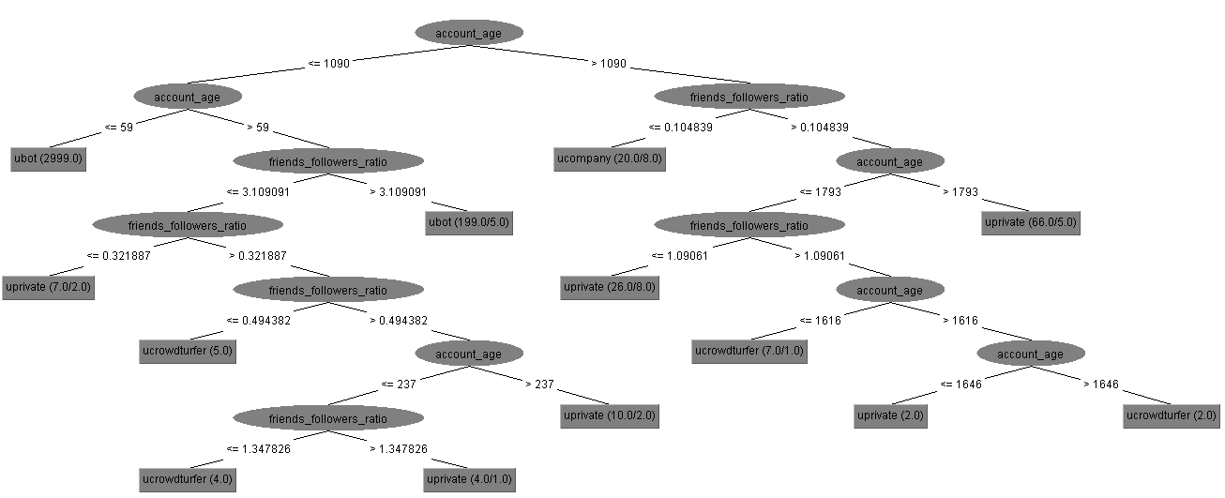
Decision tree:

Slide 99
Running test set

Slide 100
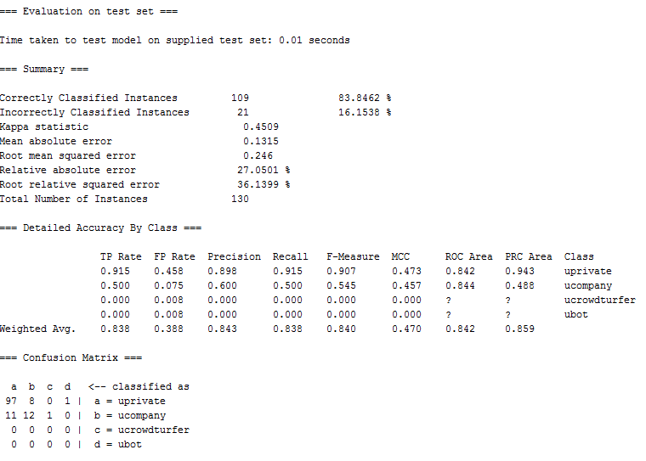
Summary:

Slide 102
Finding author_type (author sub type attribute is included)

Slide 103
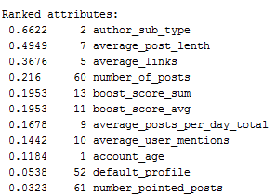
Ranked attributes:

Slide 104
5 top features

Slide 105
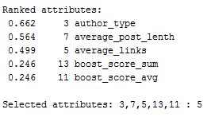
Ranked attributes:

Slide 106
Bad actors’ pilot (cont.)
I used 10-fold cross validation.
I used as evaluator: InfoGainAttributeEval
Search as Ranker
Number of features: 5
Classifier as J48
Class: author_type

Slide 107

Summary:

Slide 108

Decision tree:

Slide 109
Running test set

Slide 110

Summary:

Slide 111
3 top features

Slide 112

Ranked attributes:

Slide 113
Bad actors’ pilot (cont.)
I used 10-fold cross validation.
I used as evaluator: InfoGainAttributeEval
Search as Ranker
Number of features: 3
Classifier as J48
Class: author_type

Slide 114
Summary:

Slide 115
Decision tree:

Slide 116
Running test set

Slide 117
Summary:

Slide 118
2 top features

Slide 119

Ranked attributes:

Slide 120
Bad actors’ pilot (cont.)
I used 10-fold cross validation.
I used as evaluator: InfoGainAttributeEval
Search as Ranker
Number of features: 2
Classifier as J48
Class: author_type

Slide 121
Summary:

Slide 122
Decision tree:

Slide 123
Running test set

Slide 124
Summary:

Slide 125
Bad actors’ pilot (cont.)
I used 10-fold cross validation.
I used as evaluator: InfoGainAttributeEval
Search as Ranker
Classifier as J48
Class: author_sub_type

Slide 126

Summary:

Slide 127

Decision tree:

Slide 128
Running test set

Slide 129

Summary:

Slide 130
Finding author_sub_type (author type attribute is included)

Slide 131
3 top features

Slide 132
Bad actors’ pilot (cont.)
I used 10-fold cross validation.
I used as evaluator: InfoGainAttributeEval
Search as Ranker
Classifier as J48
Class: author_sub_type

Slide 133

Ranked attributes:

Slide 134

Summary:

Slide 135

Decision tree:

Slide 136
Running test set

Slide 137

Summary:

Slide 138
2 top features

Slide 139
Bad actors’ pilot (cont.)
I used 10-fold cross validation.
I used as evaluator: InfoGainAttributeEval
Search as Ranker
Classifier as J48
Class: author_sub_type

Slide 140
Ranked attributes:

Slide 141

Summary:

Slide 142

Decision tree:

Slide 143
Running test set

Slide 144

Summary:

