Slide 1
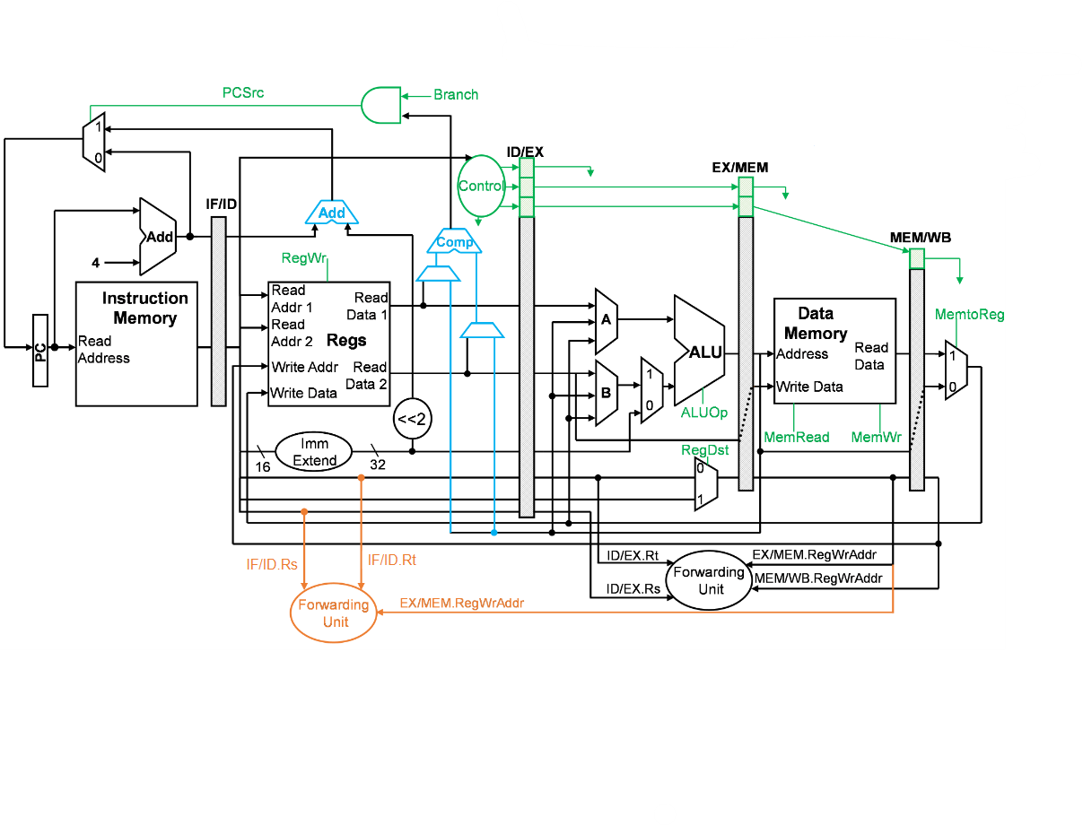

0
1
Branch
Predictor
Instr
Likely
Branch
ID_PC
PC
BTB
PC
Hit
ID_PC
Branch
Addr
Target Addr

