Slide 1
Forge-Poker
Forge web research group
Lori Zhang
2012/10/11

Slide 2
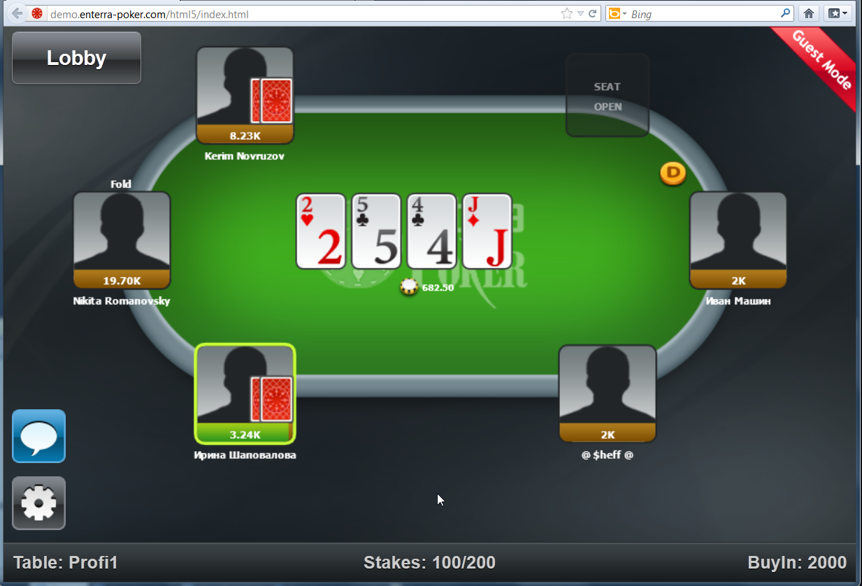
A big picture

Slide 3
Intents
Improve web/cloud/mobile skills
From front-end to back-end
Build a web app - online Poker Game
Use HTML5 for graphics (canvas)
Online, real time, chart (web socket)
HTML5 Mobile app (phone-gap, stretch)
Cloud storage (Amazon, stretch)

Slide 4
Technology
Front-end
HTML5 Canvas/CSS/JS
JQuery/Boostrap/paper.js, etc.
Back-end
Node.js/MongoDB/Socket.io
More (stretch)
Phone-gap, cloud storage, etc.

Slide 5
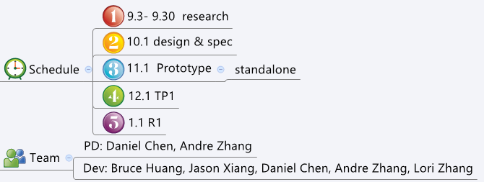
More
Some Info
Open source at here in github.com

Slide 6
Thank you

