Slide 1
Developing Ajax Web Apps with GWT
Session I

Slide 2
Contents
Introduction
  Traditional Web
  RIAs
  Emergence of Ajax
Ajax
Google Web Toolkit (GWT)‏
Installing and Setting up GWT in Eclipse
The Project Structure
Running the Application

Slide 3
Introduction
The traditional web
  Document oriented
  Web Apps
Rich Internet Applications (RIAs)‏
Emergence of Ajax
  XHTML, CSS
  Javascript
  Document formats – XML, JSON
  RIAs
  Webservices

Slide 4
The Traditional Web
Document Oriented
  In 1991, Tim Berners Lee invented the web for the purpose of sharing documents easily
  Hypertext Markup Language (HTML)‏
  Cascading Style Sheet (CSS)‏
Web Apps
  Web starts advancing to applications, e.g Yahoo in 1994
  Communication with server through CGI (Perl script)‏
  Forms, Javascript

Slide 5
Rich Internet Applications (RIAs)‏
Adobe Flash and Flex
  Most successful browser plugin—installed on 98 percent of Internet-enabled desktops.
  Relatively small download size and fast performance
  Graphic-designer-friendly development tool used to construct SWF files.
  Flex is geared toward software developers and provides data services such as remoting and messaging solutions to communicate to a Java 2 Enterprise Edition (J2EE) server.
Microsoft Silverlight
  Announced by Microsoft in 2007 its own RIA
JavaFX
  Sun Microsystems announced Java FX at JavaOne in May 2007,
  Consists of a Script and a Mobile module that run on a standard JRE

Slide 6
Emergence of Ajax
XHMTL
Similar expression to HTML but also conforms to XML
CSS
Language used to describe the presentation of document written in markup language comonly HTML
Javascript
Client side scripting language interpreted by the browser
  Netscape (ECMA Script)‏
DOM (Document Object Model)
Model for representing and interacting with objects in HTML, XHTML and XML documents
XML
General-purpose specification for creating custom markup languages
XMLHttpRequest
(Javascript) API used to send an HTTP request directly to a web server and load the server response data directly back into the scripting language
Webservices
Web based applications that use open, XML-based standards and transport protocols to exchange data with clients
Ajax Libraries
Dojo toolkit, Scriptaculous, Yahoo User Interface (YUI) library

Slide 7
Asynchronous Javascript and XML (Ajax)‏
In February 2005, Jesse James Garrett of Adaptive Path coined the term Ajax (Asynchronous JavaScript and XML)
Ajax comprises of a set of technologies which made it possible for web applications to be interactive and rich close to that of desktop applications. Each individual element of a web page can be updated without reloading the entire page.

Slide 8
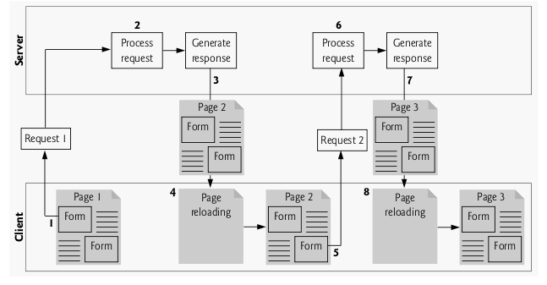
Traditional Web Application Interaction with the Server
Source: Deitel and Deitel; Ajax, Rich Internet Applications and Web Development for Programmers; 2008

Slide 9
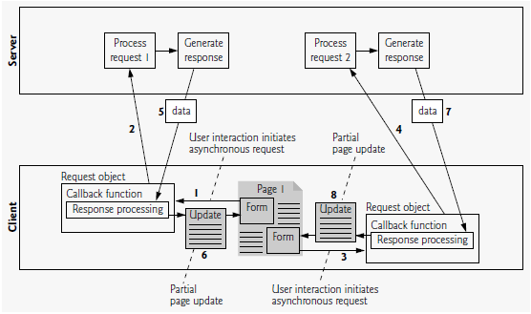
Ajax-based Web Application Interaction with the Server
Source: Deitel and Deitel; Ajax, Rich Internet Applications and Web Development for Programmers; 2008

Slide 10
Example of Ajax-based Applications
Google Maps
Gmail
New Yahoo Mail
Facebook, Facebook Chat
Youtube

Slide 11
GWT (Google Web Toolkit)‏
      With the increase use of Ajax technologies to develop rich Internet applications, re-usability and maintenance becomes necessary
      Difficult to achieve with raw Ajax technologies
      JavaScript code compatibility issues across all platforms
      Non-typed nature of JavaScript makes it difficult for write and debug instantly.
      GWT is launched in May 2006 by Google to address these issues
      It is a set of development tools, programming utilities and widgets for developing Ajax-based rich Internet applications using Java
      instead of JavaScript. GWT then cross-compiles the Java code into optimized JavaScript that automatically works across all major browsers
      Can be debugged and stepped through line by line.
      The Java source code is compiled into stand-alone JavaScript files .

Slide 12
GWT cont'd
Existing JavaScript libraries can be included
Native Javascript codes can also be included using Javascript Native Interface (JSNI)
Only web standards; doesn't require any new runtimes or plugins.
Provides libraries that simplifies communication with server-side technologies
Code re-usability, management and maintenance were thus achieved just as any other Java code would be.
The current version of GWT is 1.6.

Slide 13
GWT and Software Engineering
Model
From the developers' perspective, building Ajax-based Web Applications is like building any other Java Application (very similar to Swing applications). The object oriented nature of Java thus makes it possible to use models llike UML in analysis and design
Documentation
Standard-based documentations can be used
Tools
Application development process can leverage high-quality software engineering tools such as JUnit for test-driven development and IDEs like Eclipse that provide superior debugging support and compile-time error checking on the fly.
Re-usability
Re-usable widgets for user interface can be created
Maintainability
Maintainable codes can be developed through the use of object oriented design patterns.

Slide 14
GWT Showcase
http://ongwt.googlecode.com/svn/trunk/com.google.gwt.sample.showcase.Showcase/Showcase.html
Smart GWT showcase – Rich widgets built using GWT
http://www.smartclient.com/smartgwt/showcase/

Slide 15
Benefits of GWT in Summary
Building Rich Interfaces with Widgets and Panels
Getting Better Performance with Asynchronous Communication
Providing interoperation through Web Standards and Web Services
Speeding Development Using Java Tools

Slide 16
Installing and Setting up GWT
In this tutorial we would setup and install GWT 1.6, the latest version released in April, 2009.
Eclipse IDE and GWT plugin for Eclipse would be used.
Java Development Kit (JDK) 1.5 or higher is required
Download URLs
  JDK (http://java.sun.com/javase/downloads)‏
  Eclipse 3.4 Ganymede IDE (http://www.eclipse.org/downloads/)‏
  GWT
  Google Eclipse Plugin (http://code.google.com/eclipse/docs/install-eclipse-3.4.html)*
  * We would install GWT and the plugin using the Eclipse IDE Software updater tool, so you don't need to download both the GWT and the plugin separately

Slide 17
Installing JDK and Eclipse
It is assumed that you already have JDK 1.5 or higher installed on your system. If it is not installed, you may download and install from this URL (http://java.sun.com/javase/downloads)
Also download Eclipse from http://www.eclipse.org/downloads/ and extract it in any location.
  Note: For the purpose of this training, all required applications are available in the CD provided.

Slide 18
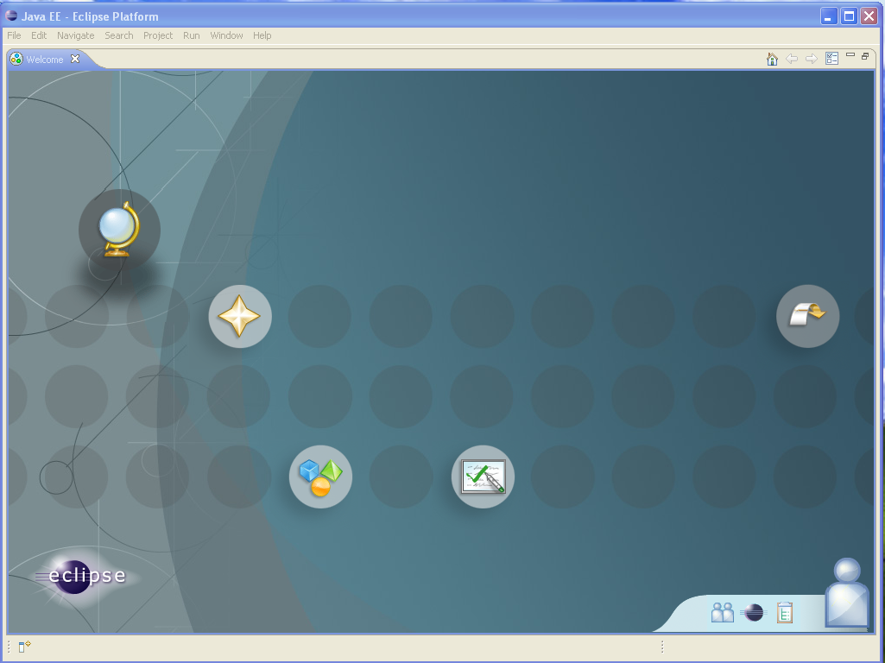
Running Eclipse
You can start the IDE by clicking on the eclipse executable file located in the eclipse folder you extracted.

Slide 19
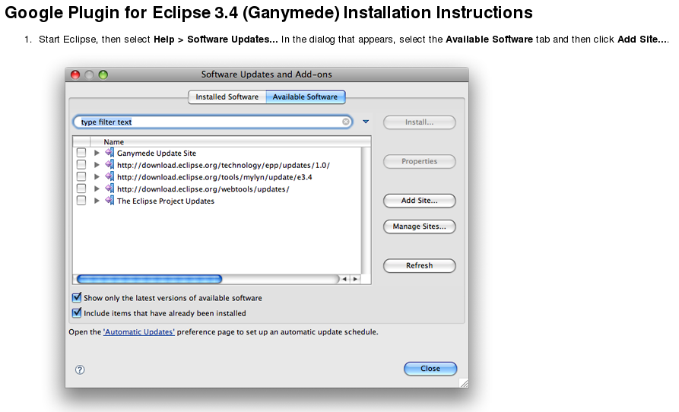
Installing the Google Plugin
This installation notes are extracted from the GWT website: http://code.google.com/eclipse/docs/install-eclipse-3.4.html

Slide 20
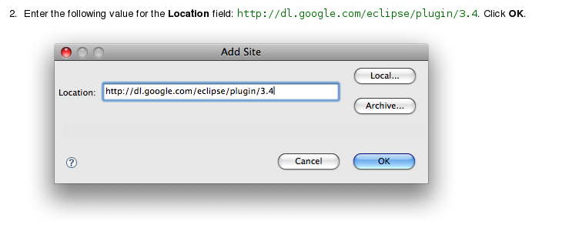
Installing the Google Plugin – cont’d

Slide 21
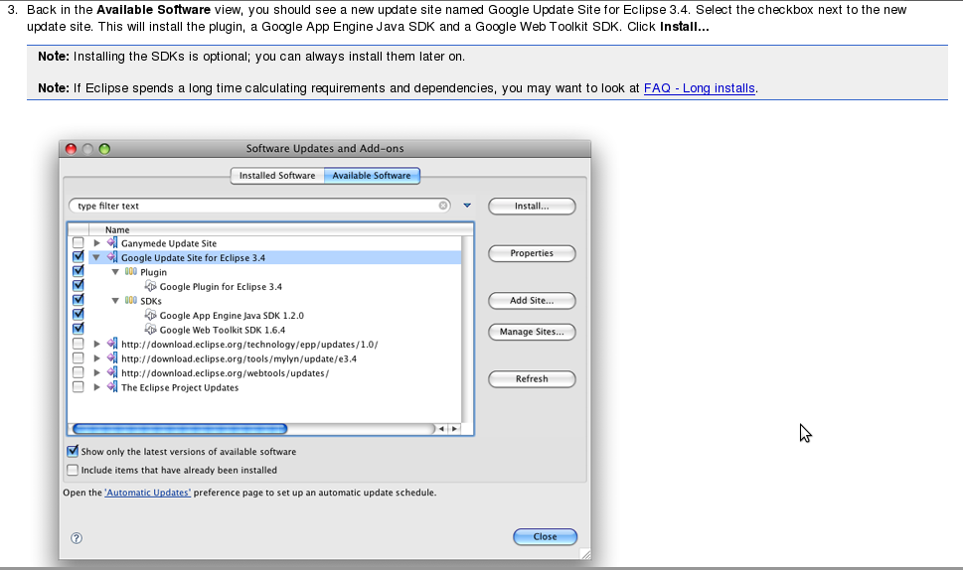
Installing the Google Plugin – cont’d

Slide 22
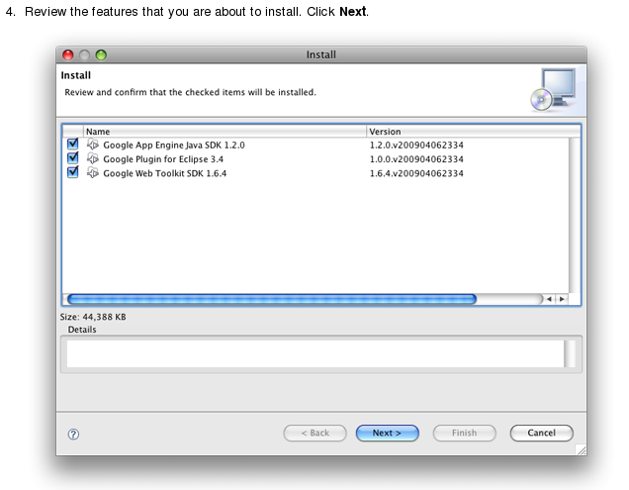
Installing the Google Plugin – cont’d

Slide 23
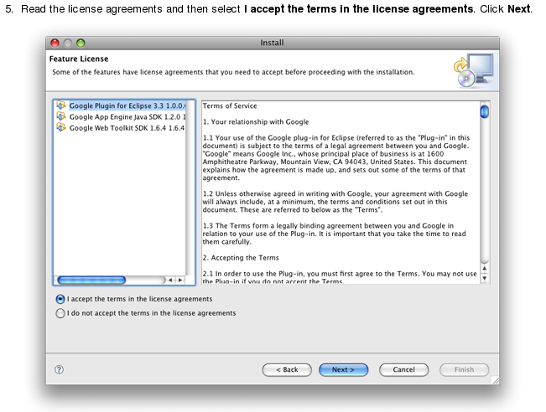
Installing the Google Plugin – cont’d

Slide 24
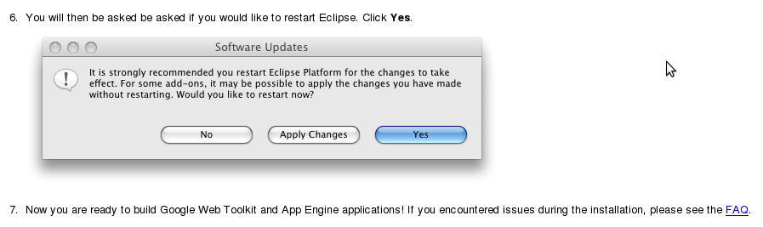
Installing the Google Plugin – cont’d

Slide 25
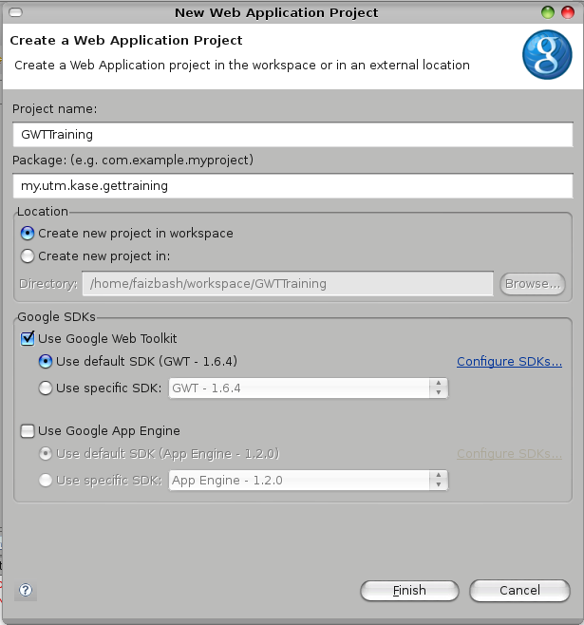
Creating a New Project with Eclipse
Select File > New > Web Application Project
Input GWTTraining in the Project name field
Input my.utm.kase.gwttraining in the Package field
Leave the location as the default (Create new project in workspace)‏
Uncheck the Use Google App Engine (This only appears if you have installed the Google App Engine plugin for Eclipse)‏
Click Finish to create the project.

Slide 26
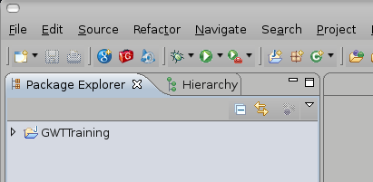
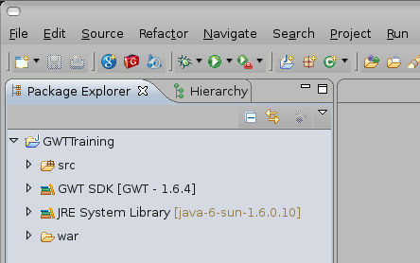
The Project Structure
The GWTTraining project is shown in the Package Explorer
Expand the GWTTraining to view the contents of the project structure
Four items are created for the project:
  src: Source files
  GWT SDK: GWT libraries
  JRE System Library: Java Runtime library
  war:

Slide 27
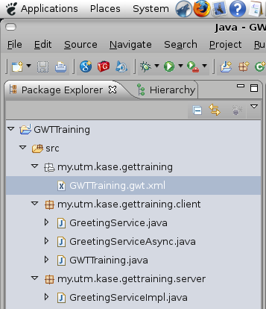
The src Folder
The src folder contains the main GWT configuration file for the project and source codes.
The configuration file (GWTTraining.gwt.xml) is located under the main package, my.utm.kase.gwttraining.
A package for client-related codes is created under the main package (my.utm.kase.gwttraining.client). All client codes are required to be in this package.
A package for server-related codes is created under the main package (my.utm.kase.gwttraining.server). This is the default created by Eclipse, but it is not mandatory.

Slide 28
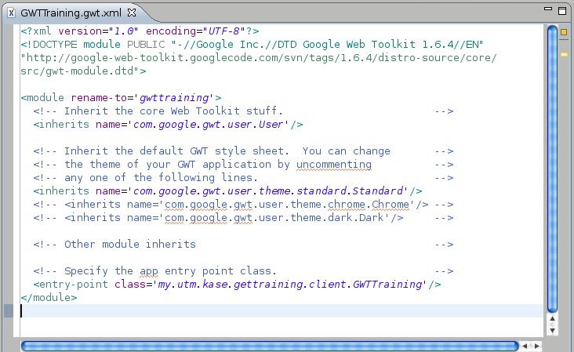
GWT Application Configuration file
This file specifies the application’s configuration options for the GWT compiler
The com.google.gwt.user.User module is inherited which is required for the User Interface
com.google.gwwt.usser.theme.standard.Standard is specified to be used as the theme for this application. You may select the Chrome or Dark theme by un-commenting the corresponding <inherits> tag.
The GWT compiler needs to know the entry-point of the application (i.e. main class). This is specified in the <entry-point> tag.

Slide 29
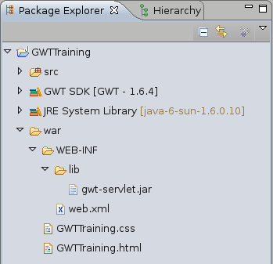
The war Folder
The war folder structured in the standard Java web app "expanded war" format to simplify application deployment.
It contains the compiler output and handwritten static resources that should be included included in the web application alongside GWT modules.
The file /war/WEB-INF/web.xml is used for configuring server-side codes using the standard Java servlet configuration.
Libraries used in the server-side are placed in the into /war/WEB-INF/lib folder. The gwt-servlet.jar is required for the GWT RPC servlets.
GWTTraining.css and GWTTraining.html are static files for the apllications' main style definition and html respectively.
Further reading (http://code.google.com/webtoolkit/doc/1.6/ReleaseNotes_1_6.html)‏

Slide 30
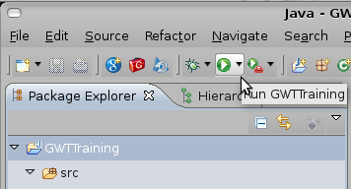
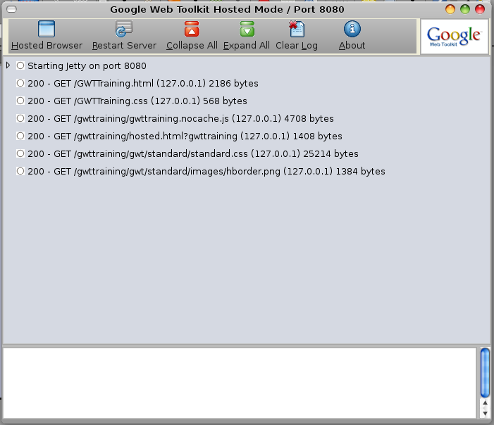
Running the Application
Select GWTTraining from the Package Explorer
Click the Run button ( ) on the toolbar
The Application is run on a hosted mode for easy debugging and testing which be deployed to the main server that will host it when ready.
Two windows are displayed: the log window which displays information about the running application and a browser that runs the application

Slide 31
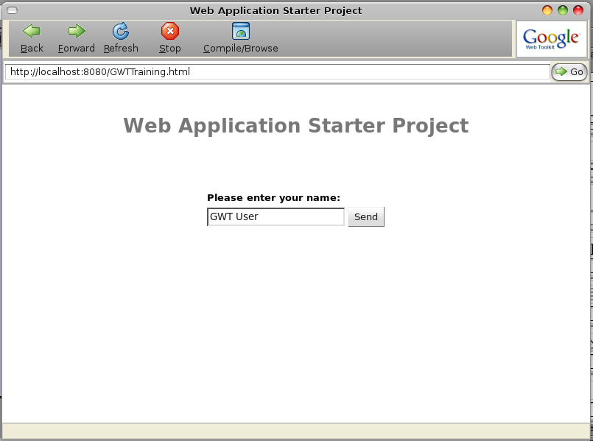
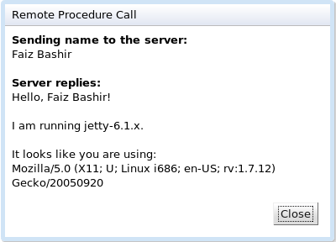
Running the Application – cont’d
You may try the application by entering your name and clicking enter.
A dialog box displaying the server version and browser information would be displayed

Slide 32
End of Session I
Session II of this tutorial would take us through building the client side of Web application using GWT. We would explore the available user interface widgets available in GWT library and learn how to use them.
Thank you.

