Slide 1

Google Web Toolkit
An Open Handset Alliance Project

Slide 2
Overview
What is Google Web Toolkit?
GWT Architecture.
Why use GWT?
Using GWT
GWT File Structure.
GWT Features.
GWT RPC Demonstration.

Slide 3
What is Google Web Toolkit ?
An open source Java development framework that lets you escape the matrix of technologies that make writing AJAX applications so difficult and error prone.
You can develop and debug AJAX applications in the Java language using the Java development tools of your choice.
When you deploy your application to production, the GWT compiler translates your Java application to browser-compliant JavaScript and HTML.

Slide 4
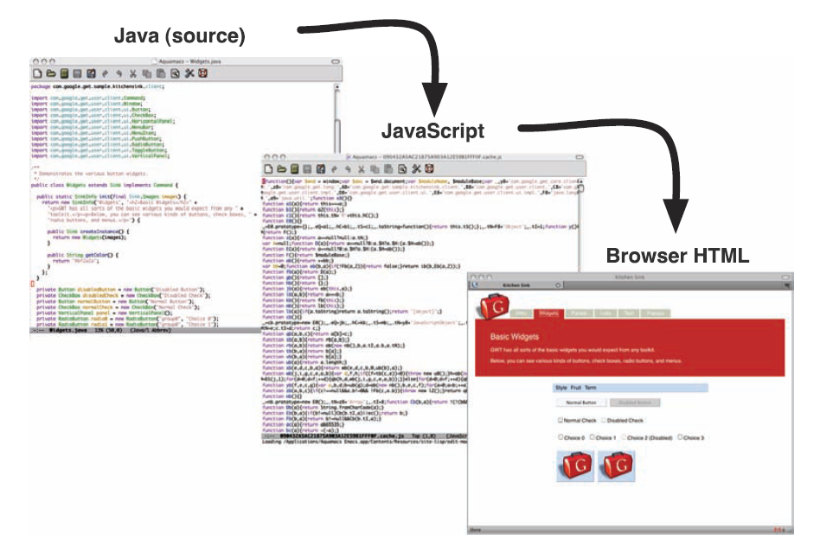
What is Google Web Toolkit

Slide 5
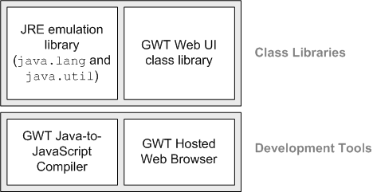
Google Web Toolkit Architecture
GWT has four major components: a Java-to-JavaScript compiler, a "hosted" web browser, and two Java class libraries:

Slide 6
Why Use Google Web Toolkit
High performance JavaScript.
GWT produces AJAX apps that:
* Load faster than hand-written JavaScript apps
* Use smaller, more compact, cacheable code
* Automatically support IE, Firefox, Mozilla, Safari, and Opera
* Use the browser's "back" button correctly

Slide 7
Why Use Google Web Toolkit
Better development tools.
Since you're writing in Java, you can use:
* IDEs that you love like Eclipse, IntelliJ, and NetBeans
* Full-featured debugging, with variable watches and breakpoints
* Unit tests (based on JUnit) both in a debugger and in a browser

Slide 8
Why Use Google Web Toolkit
Google APIs & reusable UI Components.
GWT comes equipped with useful libraries:
* Built-in UI components serve as cross-browser building blocks for your app
* RPC helps with client-server interaction
* JavaScript Native Interface (JSNI) simplifies integrating GWT code with existing JavaScript code

Slide 9
Using Google Web Toolkit
1. Download Google Web Toolkit (we are using 1.5 RC1 for this Demo)
2. Set Environment variables under User > PATH > add the directory of GWT
3. Create a Project using projectCreator (if you are using Eclipse, if not omit this step)
projectCreator -eclipse [projectName] -out [dir]
4. Generate GWT files and directories using applicationCreator (you can omit the -eclipse if you are using a different IDE)
applicationCreator -eclipse [projectName] [packages.client.urClass] -out [dir]
* for using other IDE just make a directory and use it for the applicationCreator to which it will generate the files inside this directory

Slide 10
GWT File Structures
Under the client folder :
DemoGWT.java
DemoGWT.gwt.xml
Under the public folder :
DemoGWT.html
DemoGWT.css *optional for styling
Under the root project :
DemoGWT-compile
DemoGWT-shell
DemoGWT.launch

Slide 11
Showcasing Features
Google Web Toolkit Features
“Faster AJAX than you can write by hand”

Slide 12
Demonstration
GWT RPC

