Slide 1
GWT Training – Session II
Client-Side Implementation

Slide 2
Contents
The User Interface
  Static widgets
  Form widgets
  Complex widgets
  Panels
This are slides are based from the book “Google Web Toolkit Applications” by Ryan Desbury, 2008, Pearson Education

Slide 3
The User Interface
GWT contains classes for building dynamic re-usable components (called widgets) based upon web browser's user interface features
The user interface framework is similar to Java AWT/Swing
For the purpose of this tutorial, we divide the different types of widgets into four categories – Static widgets, form widgets, complex widgets and panels

Slide 4
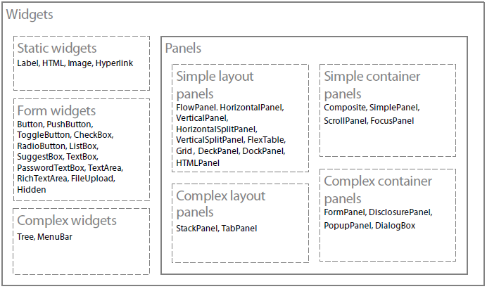
The User Interface Groups

Slide 5
Static Widgets
They do not have any internal state or change dynamically on their own
Can be part of a dynamic user interface in which the user interface code can change their properties and location at runtime, but not as a result of user actions
Includes
  Label
  HTML
  Image
  Hyperlink

Slide 6
The Entry-Point Class
Before we start building our user interface, we need to understand the Entry-Point Class
Think of this class as the main class of your application with the java main() method that the JVM invokes first
The Entry-Point class contains onModuleLoad() method which is the method that the GWT compiler calls first
The class implements com.google.gwt.core.client.EntryPoint interface
For the GWTTraining project, GWTTraining.java is the Entry-Point class (which is defined in the application's GWT configuration file)‏
import com.google.gwt.core.client.EntryPoint
public class GWTTraining implements EntryPoint {
  public void onModuleLoad() {
    //your initial code goes here
  }
}

Slide 7
Label
A widget that contains arbitrary text, not interpreted as HTML. This widget uses a <div> element, causing it to be displayed with block layout
Open the GWTTraining project in Eclipse
Create a new Entry Point class called GWTTrainingWidget under File > New. We would use this entry class for our widgets tutorial.
In the GWTTraining.gwt.xml configuration file, delete the entry-point definition for my.utm.kase.gettraining.client.GWTTraining. We only want to display the GWTTrainingWidgets entry-point when we run the applicaiton.
Also edit the GWTTraining.html and delete the contents of the <body> tag so that we start from an empty page.
Add the following import statements
import com.google.gwt.user.client.ui.Label;
import com.google.gwt.user.client.ui.RootPanel;
Add the following code in the onModuleLoad() method
Label label = new Label("Welcome to CASE, UTM");
RootPanel.get().add(label);
The code creates a new label widget and adds it to the root panel
A simple text “Welcome to CASE, UTM” is displayed when you run the application.

Slide 8
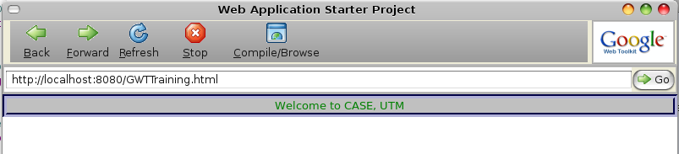
Label – Embellishing with CSS
A great feature of GWT is letting you to achieve great presentations using CSS
GWT widgets have default CSS names that let you set their style
The label widget CSS is .gwt-Label { }
Add the following to the /war/GWTTraining.css to change the appearance of the label widget:
.gwt-Label{
background-color:silver;
color:green;
text-align-center;
border-style:groove;
border-width:thick;
border-color:navy;
}

Slide 9
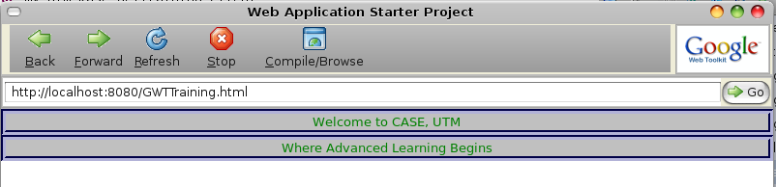
Label – Embellishing with CSS
If you use the default GWT CSS names for the widgets, all widgets of the same class are affected.
To demonstrate this, let's create another label widget by adding the following code in the GWTTrainingWidgets.java file:
Label label2 = new Label("Where Advanced Learning Begins"); RootPanel.get().add(label2);
label2 also has the same appearance as the first label because it also inherits from .gwt-Label CSS name.

Slide 10
Label – Embellishing with CSS
We can apply a different style for a particular label instead of the general class definition
To demonstrate that add the following custom CSS definition in GWTTraining.css
.label2 {
background-color:orange;
border-style:ridge;
border-width:thick;
border-color:navy;
}
Add the following code to set the style to label2 (before adding it to the root panel:
label2.setStylePrimaryName("label2");
When you refresh the browser you will see that label2 now has its own customized style.
Styling with CSS is the same for all the other widgets in GWT. The default style names of the widgets can be found in the GWT API Java documentation.
Info: CSS is a very powerful language that gives the web great look and feel. Because it is separated from the content (usually HTML), customizing the pages becomes very flexible. For further reading you may want to check: The Ultimate CSS reference

Slide 11
Customizing programatically
Some properties of the Label (and other widgets as well) can be customized programatically

Slide 12
HTML Widget
Used for rendering HTML
Add the following codes to GWTTrainingWidgets.java
RootPanel.get().add(new HTML("<hr/>")); //add a horizontal line break
RootPanel.get().add(new HTML("<b>CASE in bold</>")); //add bold text
RootPanel.get().add(new HTML("<a href='http://www.case.utm.my'>Find more about CASE</a>"));
RootPanel.get().add(new HTML("<hr/>")); //add a horizontal line break
Add import statement for com.google.gwt.user.client.ui.HTML
Refresh the browser to view the changes
The HTML widget can be customized using CSS just like the Label widget. The default CSS name is .gwt-HTML

Slide 13
The Image Widget
Accepts a URL pointing to an image file and renders it
Create images folder: /war/gwttraining/images.
Add case_logo.jpg to the folder which is provided in the training resources CD
Add the following code:
String url = GWT.getModuleBaseURL() + "images/case_logo.jpg";
Image image = new Image(url);
RootPanel.get().add(image);
CSS default style name is .gwt-Image

Slide 14
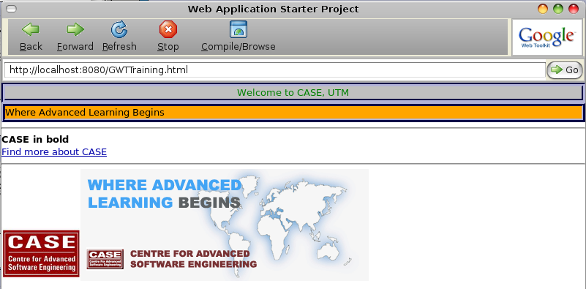
The Image Widget
Add the following code to display image from an external server:
RootPanel.get().add(new Image("http://www.case.utm.my/v2/images/intro_pic/case_intro_pic_1%20copy.gif"));
The following output should be displayed when the browser is refreshed

Slide 15
The Form Widgets
Widgets typically used with HTML forms
Unlike traditional HTML forms, data is submitted to the server asynchrnously without refreshing the page
GET form widgets can be used in ways similar to desktop applications and not necessarily inside a HTML form
The widgets include:
  Button, CheckBox, RadioButton, ListBox, TextBox
  PasswordTextBox, TextArea, FileUpload, Hiddein
  ToggleButton, PushButton, SuggestBox and RichTextArea

Slide 16
The Button Widget
Wraps the HTML form input with the type button (<input type=”button”>)‏
Can be used to invoke any action in the application
To see the Button widget in action add the following code:
Button alertButton = new Button("Alert"); //create the button
alertButton.addClickHandler( new ClickHandler() { //handle event
@Override
public void onClick(ClickEvent event) {
//handle button event here
Window.alert("Alert button clicked!");
}
});
//add alertButton to root widget
RootPanel.get().add(new HTML("<hr/>")); //add a horizontal line
RootPanel.get().add(alertButton); //add button to root panel
Just like other GWT widgets, the Button widget events are handled using the Observer pattern
The observer (Event handler) observes the state of the subject (the user interface, e.g Button). When the subject’s state changes, the observer is notified.
The default CSS name is .gwt-Button

Slide 17
ToggleButton and PushButton Widget
Both similar to Button widget
When ToggleButton is clicked it remains in a 'pressed state' until clicked again
A PushButton supports customization of its look based on its state
  //toggle and push buttons
  ToggleButton toggleButton = new ToggleButton("Toggle me");
  PushButton pushButton = new PushButton("I'm a push button");
  pushButton.setSize("150", "40");
  RootPanel.get().add(toggleButton);
  RootPanel.get().add(pushButton);
You can set some widget properties “programmatically” without using CSS definition just as is done above in setting the size of the PushButton. However using CSS is the most recommended because it separates the presentation from the Java code which improves flexibility and maintainability.

Slide 18


Button Widgets with Images
You may create buttons (Button, ToggleButton or PushButton) with images instead of text captions
ToggleButton can be created with two images so that they can be represented in pressed and released states.
    ToggleButton imgToggleButton = new ToggleButton(
      new Image(GWT.getModuleBaseURL() + "images/h_toggle.jpg"),
      new Image(GWT.getModuleBaseURL() + "images/v_toggle.jpg")‏
    );
    imgToggleButton.setSize("60", "60");
    RootPanel.get().add(new HTML("<hr/>")); //add a horizontal line
    RootPanel.get().add(imgToggleButton); //add imgToggleButton to //root panel
Copy the h_toggle.jpg and v_toggle.jpg to /war/gwttraining/images
Released State
Pressed State

Slide 19
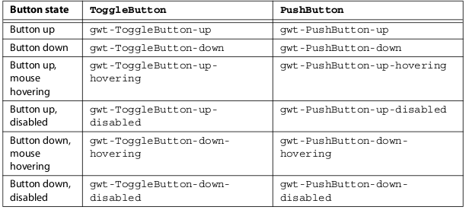
Styling Button States with Css
You can use CSS to generate different styles for ToggleButton and PushButton based on their states
The default names for the states are shown in table below:

Slide 20
Checkbox Widget
Wraps HTML’s check box input tag (<input type=”button”>)‏
Has two states - Checked/Unchecked
You can programmatically set the state with the setChecked method by passing true for checked or false for unchecked
Supports focus behavior and click events
Default CSS name is .gwt-Checkbox

Slide 21
Checkbox Widget - Code Sample
//checkbox widget
final CheckBox checkBox = new CheckBox("Do u love GWT?");
checkBox.addClickHandler( new ClickHandler() {
  @Override
  public void onClick(ClickEvent event) {
    //handle event
    if( checkBox.getValue() ) {
      Window.lert("Yeah, welcome to the world of GWT");
    }
    else {
      Window.alert("Sorry, u are missing a lot. U gotta think again");
    }
  }
  });
RootPanel.get().add(new HTML("<hr/>")); //add a horizontal break line
RootPanel.get().add(checkBox);

Slide 22

RadioButton Widget
Usually belongs to a group of other RadioButtons so that only one selection can be made

Slide 23
RadioButton Widget – Sample Code
//radio button widget
final RadioButton redButton = new RadioButton("color", "red");
final RadioButton orangeButton = new RadioButton("color", "orange");
final RadioButton greenButton = new RadioButton("color", "green");
final Label label3 = new Label("");
label3.setSize("25", "25");
label3.setStylePrimaryName("label3");
ClickHandler radioButtonsHandler = new ClickHandler() {
  @Override
  public void onClick(ClickEvent event) {
    if( event.getSource() == redButton ) {
      label3.setStylePrimaryName("red");
    }
    else if( event.getSource() == orangeButton ) {
      label3.setStylePrimaryName("orange");
    }
    else {
      label3.setStylePrimaryName("green");
    }
  }
};

Slide 24
RadioButton Widget – Sample Code (cont'd)‏
redButton.addClickHandler(radioButtonsHandler);
orangeButton.addClickHandler(radioButtonsHandler);
greenButton.addClickHandler(radioButtonsHandler);
RootPanel.get().add(new HTML("<hr/>")); //add a horizontal break line
//add to root panel
RootPanel.get().add(label3);
RootPanel.get().add(redButton);
RootPanel.get().add(orangeButton);
RootPanel.get().add(greenButton);
CSS Stlye
.label3 {
border-style:groove;
width: 25px;
height: 25px;
}
.red {
  background-color:red;
}
.orange {
  background-color:orange;
}
.green {
  background-color:green;
}

Slide 25

ListBox Widget
A group of options in a form of list in which only one option can be selected
Two forms:
  Normal list
  Drop down list

Slide 26
ListBox Widget – Sample Code
final ListBox colorList = new ListBox();
colorList.addItem("Red");
colorList.addItem("Orange");
colorList.addItem("Green");
colorList.addChangeHandler( new ChangeHandler() {
  @Override
  public void onChange(ChangeEvent event) {
    if( colorList.getSelectedIndex() == 0 ) {
      label3.setStylePrimaryName("red");
      redButton.setValue(true);
    }
    else if( colorList.getSelectedIndex() == 1 ) {
      label3.setStylePrimaryName("orange");
      orangeButton.setValue(true);
    }
    else {
      label3.setStylePrimaryName("green");
      greenButton.setValue(true);
    }
  }
});
RootPanel.get().add(new HTML("<hr/>")); //add a horizontal break line
RootPanel.get().add(colorList);

Slide 27
ListBox Sample Code – cont'd
The previous code displays the drop down format of the ListBox
Use the following code to change to the normal format:
  //change the list box format
  colorList.setVisibleItemCount(3);

Slide 28
SuggestBox Widget
A text box with drop-down suggestions based on the word that you type
Usually used when the list of items are too much to be displayed at a time
E.g. Google Suggest
Uses SuggestOracle instance to plug in dynamic results from datasource on the server
MultiWordSuggestOracle can be used if the suggest list is generated at the client side

Slide 29
SuggestBox – Sample Code
//SuggestBox
String suggestString = "The Faculty of Computer Science and Information "
  + "Systems, UTM provides specialist teaching and conducts research "
  + "in fundamental and applied computer science, software "
  + "engineering, artificial intelligence and cognitive science. "
  + "We are proud to deliver outstanding undergraduate and "
  + "postgraduate education that offers varied and exciting "
  + "career opportunities around the world.";
String words[] = suggestString.split(" ");
MultiWordSuggestOracle suggestOracle = new MultiWordSuggestOracle();
suggestOracle.addAll(Arrays.asList(words));
SuggestBox suggestBox = new SuggestBox(suggestOracle);
RootPanel.get().add(new HTML("<hr/>")); //add a horizontal break line
RootPanel.get().add(suggestBox);
CSS Styles
.gwt-SuggestBox {}
.gwt-SuggestBoxPopup { border: 2px solid #C3D9FF; background-color:#E8EEF7; }
.gwt-SuggestBoxPopup .item { }
.gwt-SuggestBoxPopup .item-selected { background-color:#C3D9FF;}

Slide 30
TextBox Widget
Encapsulates HTML’s input tag with type input (<input type=”input”>)
Typically used for capturing small text input from user
//TextBox widget
  final TextBox emailBox = new TextBox();
  emailBox.setText("<Enter your email>");
  emailBox.setStylePrimaryName("emailBox-blank");
  //add focus gain handler
  emailBox.addFocusHandler( new FocusHandler() {
    @Override
    public void onFocus(FocusEvent event) {
      String emailText = emailBox.getText();
      if( emailText.equals("<Enter your email>")) {
        emailBox.setText("");
      }
      emailBox.removeStyleName("emailBox-blank");
    }
  });

Slide 31
TextBox Widget – cont'd
//add focus lost handler
emailBox.addFocusListener(new FocusListenerAdapter() {
public void onLostFocus(Widget sender) {
      String emailText = emailBox.getText();
      if( emailText.equals("")) {
        emailBox.setStylePrimaryName("emailBox-blank");
        emailBox.setText("<Enter your email>");
      }
}
});
RootPanel.get().add(new HTML("<hr/>")); //add a horizontal break line
RootPanel.get().add(emailBox);

Slide 32
PasswordTextBox Widget
Similar to TextBox but its contents are hidden to protect sensitive data
//PasswordTextBox widget
  PasswordTextBox passwordBox = new PasswordTextBox();
  RootPanel.get().add(new HTML("<hr/>"));
  RootPanel.get().add(passwordBox);

Slide 33
TextArea Widget
Similar to TextBox but contents can span multiple pages
//TextArea widget
  TextArea textArea = new TextArea();
  textArea.setCharacterWidth(80);
  textArea.setVisibleLines(10);
  RootPanel.get().add(new HTML("<hr/>"));
  RootPanel.get().add( textArea );

Slide 34
FileUpload Widget
Encapsulates HTML’s input tag with its type attribute set to file (<input type='file'>)‏
Allows users to select a file from their local file system, usually to be uploaded to the server
  //FileUpload widget
  FileUpload fileUpload = new FileUpload();
  RootPanel.get().add(new HTML("<hr/>"));
  RootPanel.get().add( fileUpload );

Slide 35
Hidden Widget
Encapsulates HTML’s input tag of type hidden (<input type='hidden'>)‏
It is used with the FormPanel to submit a form asynchronously to the server.

Slide 36
Complex Widgets
User interface widgets in web pages that do not have HTML tag equivalents.
They are created by compositing HTML tags
together and handling user events through JavaScript to emulate more
sophisticated widgets.
GWT has some complex widgets in its library
Advanced custom widgets can also be built with GWT

Slide 37
Tree Widget
Displays a hierarchical view of data that can be expanded and collapsed similar to tree widgets in desktop applications typically
You can add simple text or widgets as children of the tree
The TreeItem widget can be used to achieve several levels of hierarchy

Slide 38
TreeWidget – Sample Code
//Tree Widget
Tree rootTree = new Tree();
TreeItem treeItem1 = new TreeItem("Contact 1");
treeItem1.addItem(new Image(GWT.getModuleBaseURL() + "images/contact.jpg"));
treeItem1.addItem(new Image(GWT.getModuleBaseURL() + "images/mail.jpeg"));
TreeItem treeItem2 = new TreeItem("Contact 2");
treeItem2.addItem(new Image("images/contact.jpg"));
treeItem2.addItem(new Image("images/mail.jpeg"));
rootTree.addItem(treeItem1);
rootTree.addItem(treeItem2);
RootPanel.get().add(new HTML("<hr/>"));
RootPanel.get().add( rootTree );
CSS Style Rules
.gwt-Tree {}
.gwt-Tree .gwt-TreeItem {}
.gwt-Tree .gwt-TreeItem-selected {}

Slide 39
MenuBar Widget
Similar to menu bars on desktop applications
Displays list of menus to be selected
  //MenuBar widget
  MenuBar lecturerMenu = new MenuBar(true); //orient vertically
  lecturerMenu.addItem("Save Records" , new Command() {
    public void execute() {
      Window.alert("Saved");
    }
  });
  MenuBar studentMenu = new MenuBar(true); //orient vertically
  studentMenu.addItem("Register" , new Command() {
    public void execute() {
      //add register event
    }
  });

Slide 40
MenuBar Widget – cont'd
studentMenu.addItem("View Records" , new Command() {
  public void execute() {
    //view records event
  }
});
MenuBar menu = new MenuBar();
menu.addItem("Lecturer", lecturerMenu);
menu.addItem("Student", studentMenu);
RootPanel.get().add(menu, 0, 0);

Slide 41
MenuBar Widget – CSS Styles
.gwt-MenuBar {
background-color:#F3F5F6;
border: 1px;
}
.gwt-MenuBar .gwt-MenuItem {
font-size: 9pt;
cursor:hand;
cursor:pointer;
padding:2px 5px 2px 5px;
margin:0px;
}
.gwt-MenuBar .gwt-MenuItem-selected {
background-color:#316AC5;
color:white;
}

Slide 42
Simple Layout Panels
Panels are used to organize the layout of the various widgets we have covered so far.
GWT has several layout widgets that provide this functionality
The simple Layout Panels include:
  FlowPanel
  VerticalPanel
  HorizontalPanel

Slide 43
FlowPanel
It functions like the HTML layout
Child widgets of the FlowPanel are displayed horizontally and then wrapped to the next row down when there is not enough horizontal room left
  //FlowPanel
  FlowPanel flowPanel = new FlowPanel();
  for( int i = 1; i <= 20; i++ ) {
    flowPanel.add(new Button("Button " + String.valueOf(i)));
  }
  RootPanel.get().add(flowPanel);

Slide 44

FlowPanel – cont'd
If you run the code and resize the browser window smaller, you will see that the child widgets (buttons) are displaced to the next row when the space becomes insufficient to display in one row
The result is opposite if you resize the window bigger

Slide 45
HorizontalPanel and VerticalPanel
HorizontalPanel is similar to FlowPanel but uses scrollbar to display its widgets if there is no enough room instead of displacing to the next row
VerticalPanel organizes its child widgets in a vertical orientation

Slide 46
HorizontalSplitPanel and VerticalSplitPanel
They are divided into two panels that be resized

Slide 47
FlexTable and Grid Widgets
Encapsulates HTML's table tag (<table />)‏
They display child widgets in a grid spanning vertically and horizontally.
The Grid widget enforces an explicitly set number of rows and cells for each row.
The FlexTable is more flexible, allowing cells to be added as needed, rows to have a variable number of cells, and cells to span multiple rows or columns

Slide 48
FlexTable and Grid Widgets – cont'd
//Grid
Grid grid = new Grid(3,3);
for( int i = 0; i < 3; i++) {
  for( int j = 0; j < 3; j++ ) {
    grid.setWidget(i,j,new Image(GWT.getModuleBaseURL() + "images/tree2.jpg"));
  }
}
//FlexTable
FlexTable flexTable = new FlexTable();
flexTable.setWidget(0,0, new HTML("Flex Table Widget"));
flexTable.getFlexCellFormatter().setColSpan(0, 0, 4);
for( int i = 0; i < 4; i++ ) {
  flexTable.setWidget(1, i, new Image(GWT.getModuleBaseURL() + "images/tree.jpeg"));
}

Slide 49
FlexTable and Grid Widgets – cont'd
flexTable.setWidget(2,0, new Image(GWT.getModuleBaseURL() + "images/tree2.jpg"));
flexTable.setWidget(2,1, new Image(GWT.getModuleBaseURL() + "images/tree2.jpg"));
flexTable.getFlexCellFormatter().setColSpan(2, 0, 2);
flexTable.getFlexCellFormatter().setColSpan(2, 1, 2);
flexTable.setWidget(3, 0, new Image(GWT.getModuleBaseURL() + "images/tree_big.png"));
flexTable.getFlexCellFormatter().setColSpan(3, 0, 4);
HorizontalSplitPanel hSplitPanel = new HorizontalSplitPanel();
hSplitPanel.setLeftWidget(flexTable);
hSplitPanel.setRightWidget(grid);
RootPanel.get().add(hSplitPanel);

Slide 50
Customizing the Widgets
HorizontalSplitPanel hSplitPanel = new HorizontalSplitPanel();
hSplitPanel.setLeftWidget(flexTable);
hSplitPanel.setRightWidget(grid);
RootPanel.get().add(hSplitPanel);
//vertical panel 2
VerticalPanel vPanel2 = new VerticalPanel();
vPanel2.add(rootTree);
vPanel2.add(flowPanel);
RootPanel.get().add(vPanel2);

Slide 51
Customizing the Widgets – cont'd
//vertical panel 3
HorizontalPanel hPanel2 = new HorizontalPanel();
hPanel2.add(checkBox);
hPanel2.add(label3);
hPanel2.add(redButton);
hPanel2.add(orangeButton);
hPanel2.add(greenButton);
hPanel2.add(colorList);
VerticalPanel vPanel4 = new VerticalPanel();
vPanel4.add(textArea);
vPanel4.add(fileUpload);
RootPanel.get().add(vPanel4);

Slide 52
TabPanel
Displays just one of its child widgets at a time and provides controls to select the child to display
  //TabPanel
  TabPanel tabPanel = new TabPanel();
  tabPanel.add(vPanel2, "Buttons");
  tabPanel.add(hPanel2, "Options");
  tabPanel.add(vPanel4, "Text");
  tabPanel.setSize("100%", "100%");
  RootPanel.get().add(tabPanel);

Slide 53
Other Widgets
DeckPanel
DockPanel
StackPanel
HTMLPanel
LazyPanel
Composite
SimplePanel
ScrollPanel
FocusPanel
FormPanel
DisclosurePanel
PopupPanel
DialogBox

Slide 54
This brings us to the end of the 2nd session of the GWT Training. In the next session we would learn how to establish communication between the client and server.
Thank you

