Slide 1
Electroosmotic Flow through a Cylindrical Nanopore in a Charged Membrane of Finite Thickness
Mao Mao¹, Sandip Ghosal^{1,2}, John Sherwood³
¹Department of Mechanical Engineering and ²Department of Engineering Science and Applied Mathematics, Northwestern University
³Department of Applied Mathematics and Applied Physics, University of Cambridge
NIH Grant No.4R01HG004842
Notes:
Good afternoon, everyone. In this presentation I’d like to talk about electroosmotic flow through a cylindrical nanopore in a charged membrane of finite thickness.

Slide 2
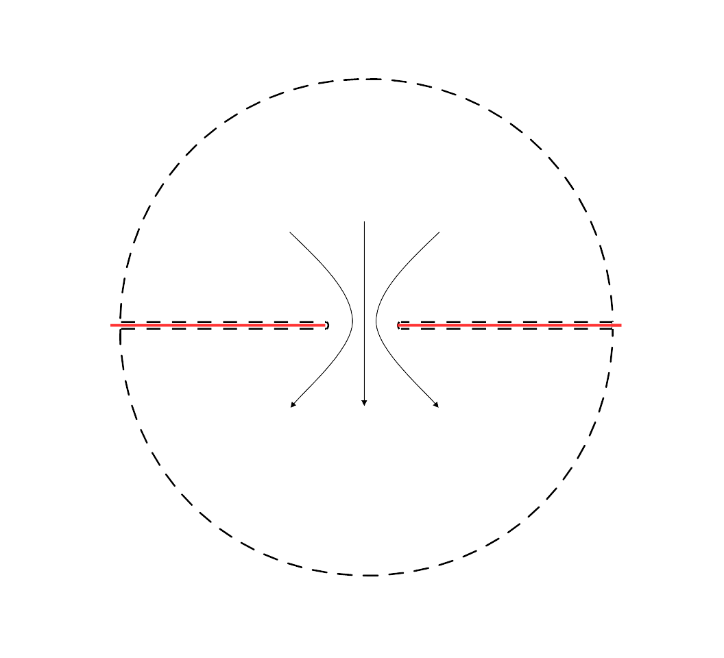



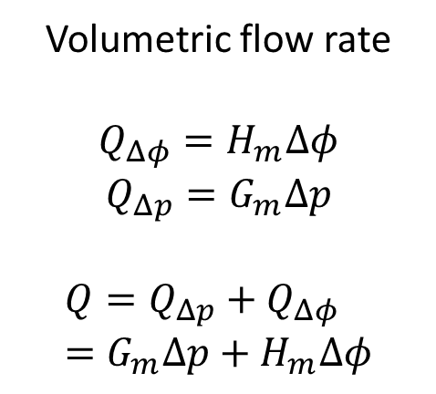
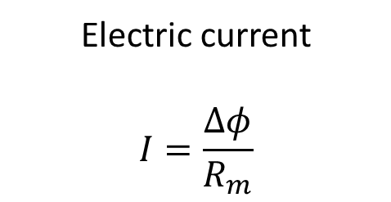
Nanopore in a membrane of zero thickness
$Δφ/2$,$Δp/2$
Electric current
$$I=\frac{Δφ}{R_{m}}$$
Volumetric flow rate
$$Q_{Δφ}=H_{m}Δφ$$
$$Q_{Δp}=G_{m}Δp$$
$$Q=Q_{Δp}+Q_{Δφ}=G_{m}Δp+H_{m}Δφ$$
$Q$, $I$
$−Δφ/2$, $−Δp/2$
Notes:
In the previous talk, we presented an analytical solution of electroosmotic flow through a nanopore in a membrane of zero thickness. To recapture, we have a charged, zero-thickness membrane with a hole of radius a on it submerged in an electrolyte solution. A potential difference of delta phi and a pressure difference delta p generates volumetric flow rate Q through the hole.
The electric current is delta phi divided by access resistance Rm.
The flow rate generated by delta phi alone is Q sub delta phi. It is proportional to delta phi by a coefficient, we call Hm here.
The flow rate generated by delta p alone is Q sub delta p. It is proportional to delta p by a coefficient we call Gm.
Suffix m means membrane.
In the linear regime, if both delta p and delta phi are present, the total flow rate is the sum of the two.

Slide 3
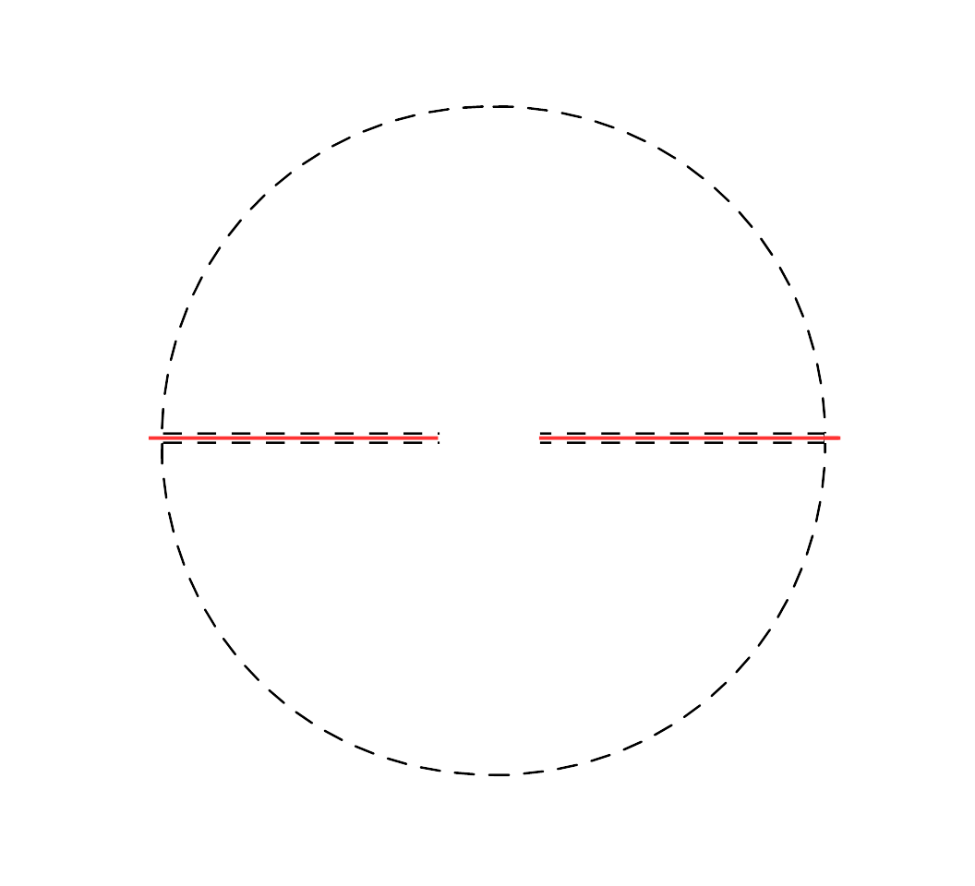
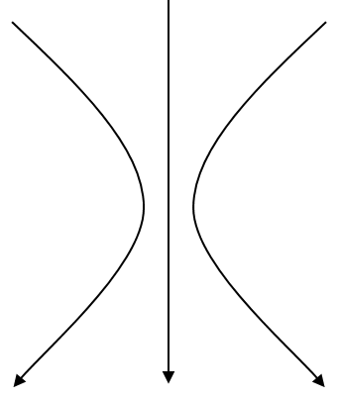




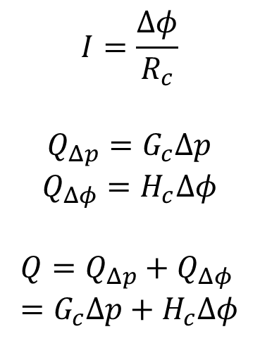
Zero to finite thickness
$Δφ/2$, $Δp/2$
1/2 membrane
$$I=\frac{Δφ}{R_{c}}$$
$$Q_{Δp}=G_{c}Δp$$
$$Q_{Δφ}=H_{c}Δφ$$
$$Q=Q_{Δp}+Q_{Δφ}=G_{c}Δp+H_{c}Δφ$$
$Q$, $I$
cylinder
$$h$$
1/2 membrane
$−Δφ/2$, $−Δp/2$
Notes:
Now we look at the case when we have a nanopore sitting in a charged, dielectric membrane of finite thickness h. We model this system as 3 things lying in series: half a membrane, a cylindrical channel and the other half of a membrane. By half membrane we mean we use the upper or lower half of our zero thickness membrane solution, and combine with the solution of a long cylindrical channel.
For a long cylinder, electric current I is equal to delta phi divided by Rc ,Rc being the resistance of the cylinder. Voltage difference delta phi alone generates flow rate Q sub delta phi. By the same fashion we define its ratio to delta phi as Hc. Similarly Gc is defined for pressure driven flow. If both are present, the total flow rate is the sum of the two.
Suffix c here represents cylinder.

Slide 4






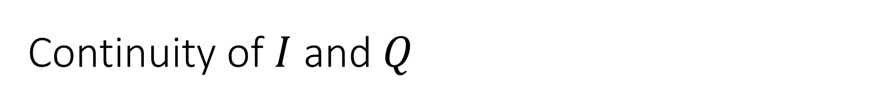

Continuity of $I$ and $Q$
$φ_{1}/2$, $p_{1}/2$
$$I=\frac{{\frac{1}{2}(φ}_{1}−φ_{2})}{{\frac{1}{2}R}_{m}}=\frac{φ_{2}}{R_{c}}$$
$$Q={2G}_{m}\frac{\left(p_{1}−p_{2}\right)}{2}+{2H}_{m}\frac{\left(φ_{1}−φ_{2}\right)}{2}=G_{c}p_{2}+H_{c}φ_{2}$$
1/2 membrane
$φ_{2}/2$, $p_{2}/2$
cylinder
$$2a$$
$$h$$
${−φ}_{2}/2$, $−p_{2}/2$
1/2 membrane
$−φ_{1}/2$, $−p_{1}/2$
Notes:
Now consider the potential difference across the pore to be phi1 and pressure difference p1. If continuity of I and Q are enforced, potential and pressure difference are induced at both ends of the cylinder. Here we assume them to be p2 and phi 2.
We equate the current from solution of upper half membrane to the current through a cylinder and get this equation.
Likewise, we equate flow rate from the upper half membrane solution to the flow rate through a cylinder and get this equation.

Slide 5
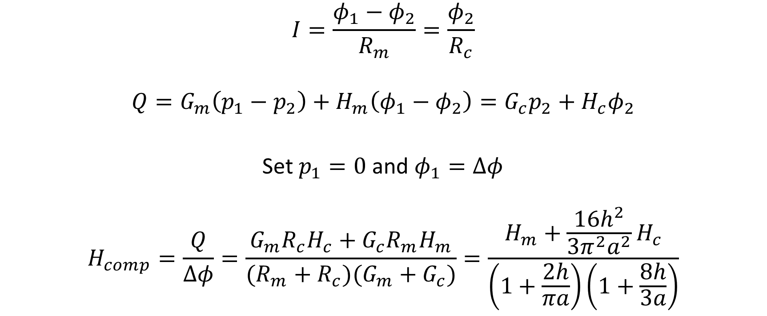
Composite electroosmotic conductance
$$I=\frac{φ_{1}−φ_{2}}{R_{m}}=\frac{φ_{2}}{R_{c}}$$
$$Q=G_{m}\left(p_{1}−p_{2}\right)+H_{m}\left(φ_{1}−φ_{2}\right)=G_{c}p_{2}+H_{c}φ_{2}$$
Set $p_{1}=0$ and $φ_{1}=Δφ$
$$H_{comp}=\frac{Q}{Δφ}=\frac{G_{m}R_{c}H_{c}+G_{c}R_{m}H_{m}}{(R_{m}+R_{c})(G_{m}+G_{c})}=\frac{H_{m}+\frac{16h^{2}}{3π^{2}a^{2}}H_{c}}{\left(1+\frac{2h}{πa}\right)\left(1+\frac{8h}{3a}\right)}$$
Notes:
The two continuity equations are simplified and shown here again.
We are interested in Q from potential delta phi alone, so we set p1 equal to 0, and phi1 to delta phi.
We can determine phi 2 and p2 from continuity equations, and write the ratio of the volumetric flow rate Q to the potential difference delta phi, like this. We call it the composite electroosmotic conductance.
Then we plug in formulas for Gm, Gc, Rm, Rc, and get the equation on the right hand side.
Note that the dependence on the Debye length is implicit in Hm and Hc.

Slide 6

$$H_{m}=\frac{2a^{3}}{πμ}\int_{0}^{π/2}{dη\int_{0}^{∞}{ρ_{0}}}\frac{\cos^{2}{η\sin{η}}}{\cosh{ξ}}dξ$$
$$H_{c}=\frac{2πa^{3}σ_{c}}{μh}\left[\frac{1}{2κa}\frac{I_{0}(κa)}{I_{1}(κa)}−\frac{1}{{\left(κa\right)}^{2}}\right]$$
Journal of Fluid Mechanics 749, 167-183
Langmuir 30 (31), 9261-9272
Notes:
Hm and Hc are given here for your reference.

Slide 7
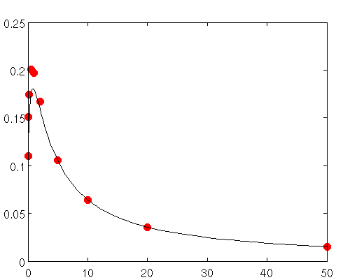
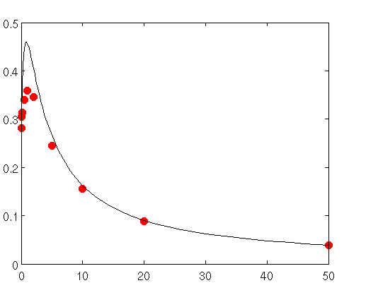






Results
$$κa=10$$
$$κa=2$$
$$H/H_{0}$$
$$H/H_{0}$$
$$h/a$$
$$h/a$$
Notes:
We compare our composite electroosmotic conductance H with the full simulation of PNP-Stokes equation at different cylinder thickness h and different Debye length. Here kappa is the inverse of Debye length.
The solid lines are the model, and the points are from numerical simulation computed using the OpenFOAM CFD library.
From these two figures we see that our model agrees with numerical simulations when Debye length is small. When the thickness h is large, or the end effects are less important, the agreement is very good.

Slide 8
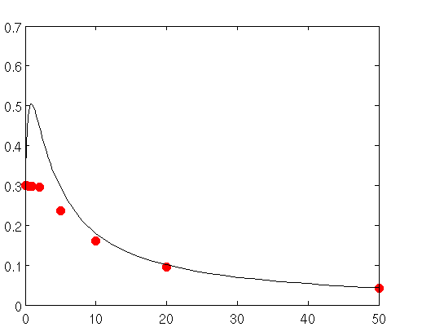
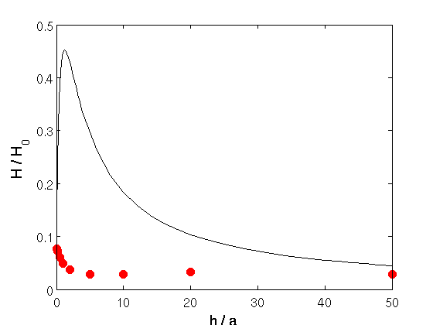


Results
$$κa=1$$
$$κa=0.1$$
$$H/H_{0}$$
$$H/H_{0}$$
$$h/a$$
$$h/a$$
Notes:
Unfortunately, our model does not agree with simulation at all when Debye length is large.
We can see clearly from the right figure here, when Debye length is 10 times the radius of the pore, our model does not even predict the trend correctly.

Slide 9


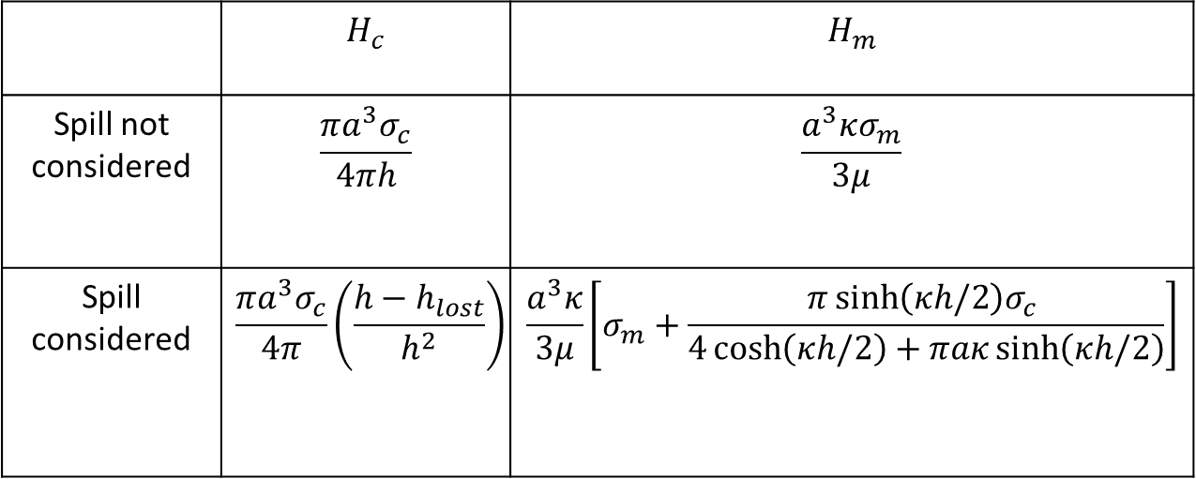
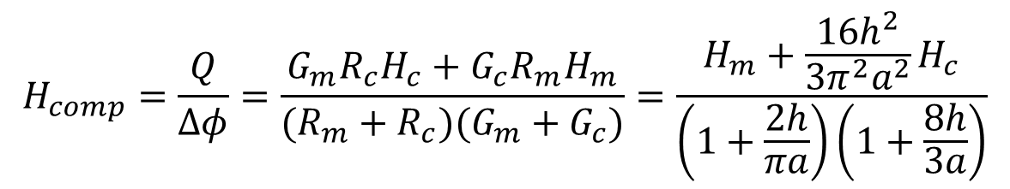



End effects: charge spill when $aκ$ small
$$H_{comp}=\frac{Q}{Δφ}=\frac{G_{m}R_{c}H_{c}+G_{c}R_{m}H_{m}}{(R_{m}+R_{c})(G_{m}+G_{c})}=\frac{H_{m}+\frac{16h^{2}}{3π^{2}a^{2}}H_{c}}{\left(1+\frac{2h}{πa}\right)\left(1+\frac{8h}{3a}\right)}$$
$$σ_{m}$$
$$σ_{c}$$
$$2a$$
$$h$$
 | $$H_{c}$$ | $$H_{m}$$
Spill not considered | $$\frac{πa^{3}σ_{c}}{4πh}$$ | $$\frac{a^{3}κσ_{m}}{3μ}$$
Spill considered | $$\frac{πa^{3}σ_{c}}{4π}\left(\frac{h−h_{lost}}{h^{2}}\right)$$ | $$\frac{a^{3}κ}{3μ}\left[σ_{m}+\frac{π\sinh\left(κh/2\right)σ_{c} }{4\cosh\left(κh/2\right)+πaκ\sinh\left(κh/2\right)}\right]$$
Langmuir 30 (31), 9261-9272;
Notes:
So what could be wrong.
Let’s get back to our model. The idea behind this composite theory is that the system can be divided very well into 3 regions, 2 half membranes and one cylinder, whose radius is simply radius a and length h. Unfortunately this treatment is too good to be true in certain cases. When Debye length is large, the cylinder is basically filled with the thick, overlapping double layer. At the two ends, we do not have a well-defined border between the half pore and the cylinder any more. The charge cloud within the pore will spill out into the half pores.
Due to charge spill effects more charges are outside the pore than before, and the electroosmotic conductance Hm increased.
On the other hand, the cylindrical channel lost a part of its charge cloud due to the charge spill effect, the electroosmotic conductance will decrease.
We did some modeling of this charge spill effects. Without giving mathematical details, I’ll just give the results here, Hc is decreased, quantified by a equivalent length we call hlost, and Hm is increased due to gaining charge from inside the cylinder.
Here sigma is the surface charge density of the membrane surfaces, c means the part inside the cylinder, m means the part outside the cylinder.

Slide 10
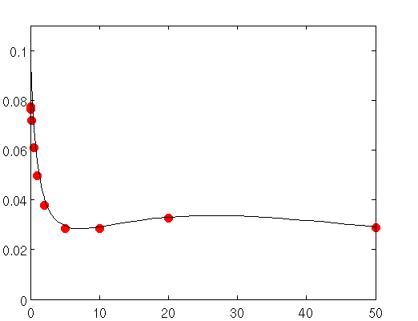


Results – effects of charge spill
$$κa=0.1$$
$$κa=0.1$$
$$H/H_{0}$$
$$H/H_{0}$$
$$h/a$$
$$h/a$$
Notes:
We plug in the modified Hc and Hm into our composite model, and compare modified model with numerical simulations again.
The left figure is the one before the modification at thick Debye length, where we have failed miserably.
After the modification, in the right figure, the agreement with numerical simulation is restored.

Slide 11
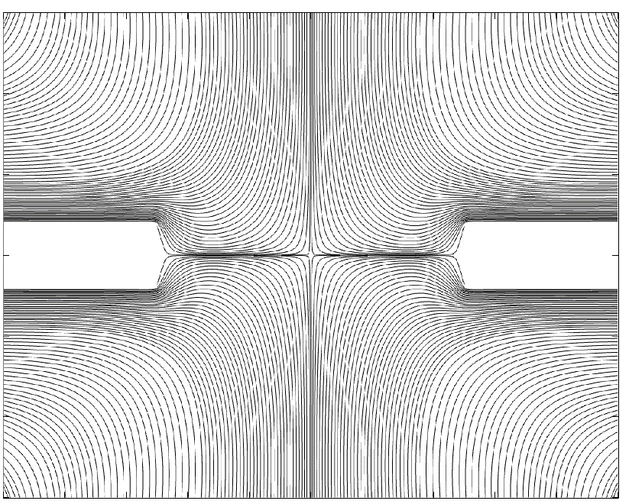
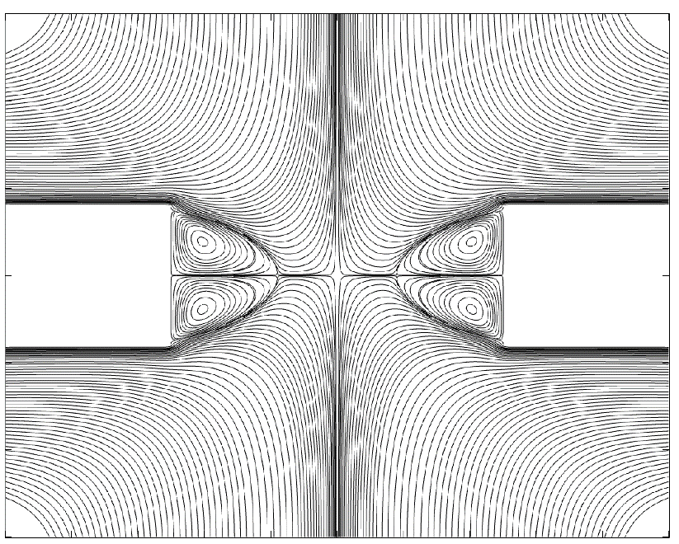
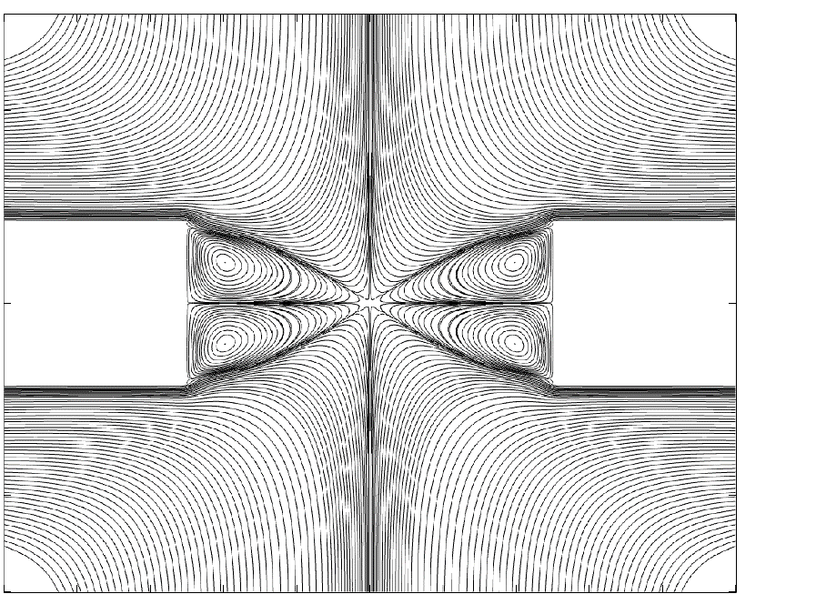
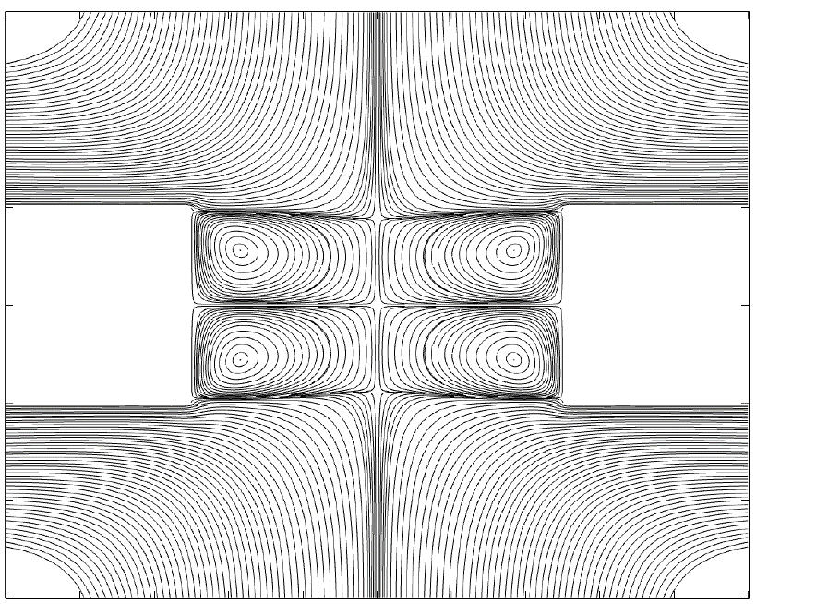
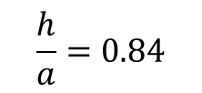
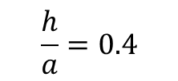
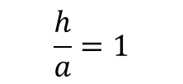
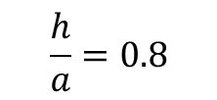
Eddies
$$\frac{h}{a}=0.4$$
$$\frac{h}{a}=0.8$$
$$\frac{h}{a}=0.84$$
$$\frac{h}{a}=1$$
Physics of Fluids (in press)
Notes:
One thing to note is that when the membranes are not charged, or sigma = 0, the system has symmetry and no net flow will be generated by a potential difference. This does not mean no flow at all. Instead, we will have the induced charge electroosmosis, possibly leading to pairs of eddies within the pore. The shape of these eddies change with the geometry of the pore. Here we fix a and change h.
As h increases, this interesting topology of toroidal eddies form within the pore. Keep in mind that we are in cylindrical coordinates and this is a cross section. The pairs of eddies gradually meet within the nanopore, and bifurcates again. A particular interesting case is when the streamlines meet at one single stagnation point. These eddies have possible effects if a particle is transporting through the nanopore.

Slide 12
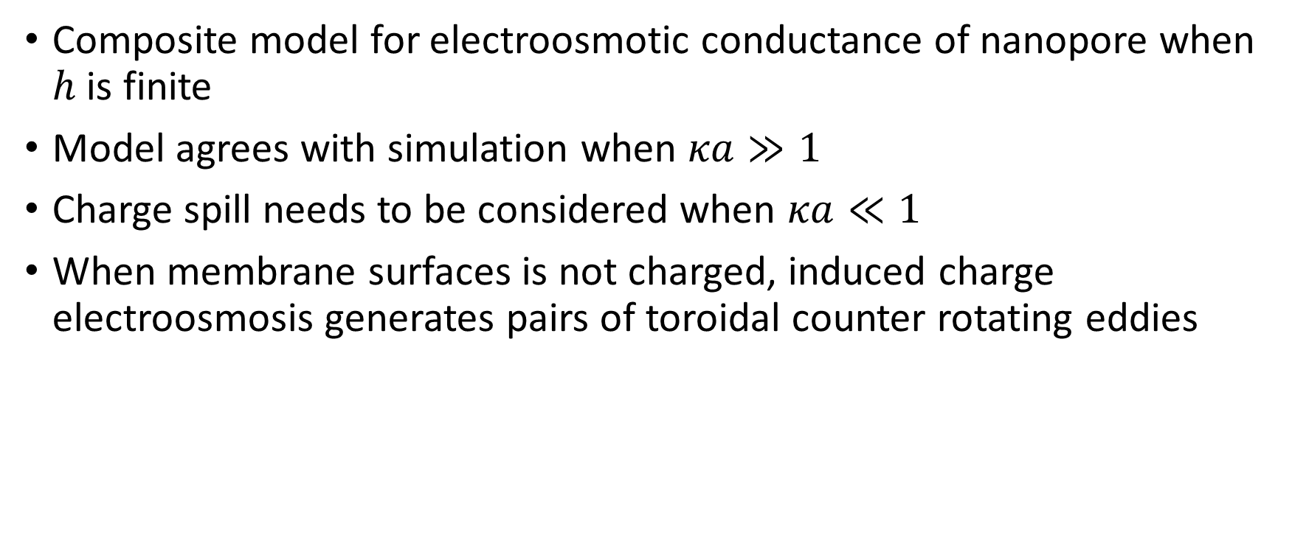
Conclusion
Composite model for electroosmotic conductance of nanopore when $h$ is finite
Model agrees with simulation when $κa≫1$
Charge spill needs to be considered when $κa≪1$
When membrane surfaces is not charged, induced charge electroosmosis generates pairs of toroidal counter rotating eddies
References
Journal of Fluid Mechanics 749, 167-183;
Langmuir 30 (31), 9261-9272;
Physics of Fluids (in press).
Notes:
So in conclusion, we present a composite model for electroosmotic conductance of nanopore in a membrane of finite thickness, by extending our zero-thickness solution. The model agrees with simulation at thin Debye length limit, but needs to be modified at thick Debye length limit by taking into account the charge spill effects. We also showed the toroidal eddies generated by ICEO when membrane surface is not charged.
This completes my presentation. Thank you for your attention, and I’ll take questions.

