Slide 1
Electroosmotic Access Resistance of a Nanopore
Sandip Ghosal^{1,2}, John Sherwood³, Mao Mao¹
¹Department of Mechanical Engineering and ²Department of Engineering Science and Applied Mathematics, Northwestern University
³Department of Applied Mathematics and Applied Physics, University of Cambridge
NIH Grant No.4R01HG004842

Slide 2
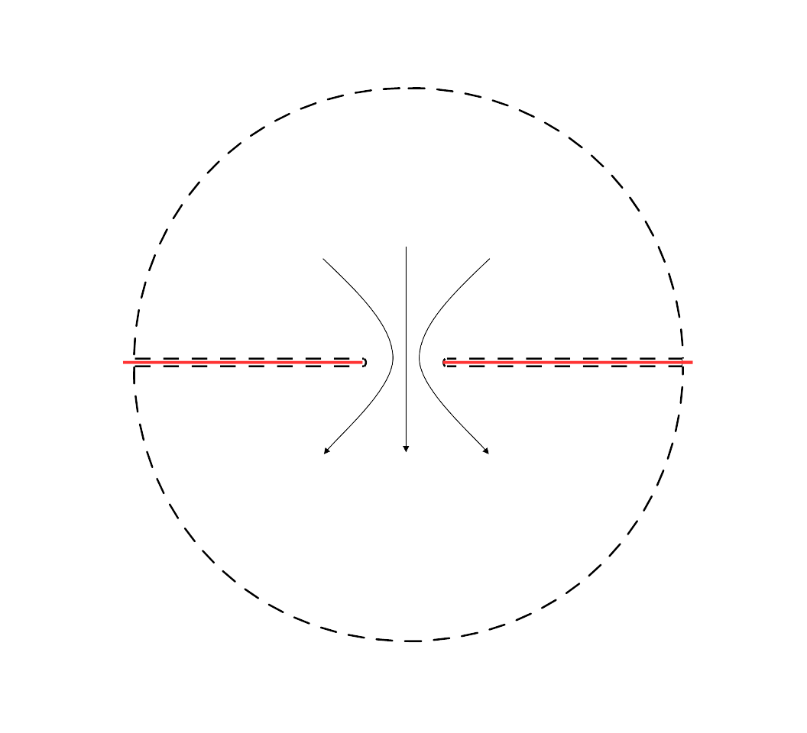

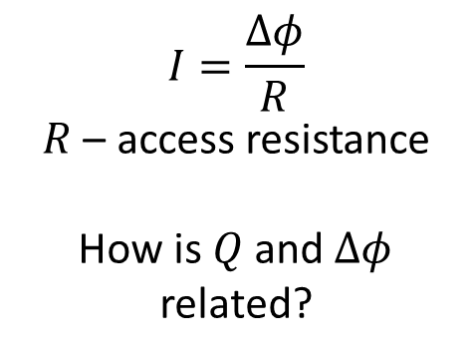



Nanopore in a zero-thickness membrane
$$Δφ/2$$
$$I=\frac{Δφ}{R}$$
$R$ – access resistance
How is $Q$ and $Δφ$ related?
$Q$, $I$
$$σ_{m}$$
$$−Δφ/2$$
Notes:
The system we are interested in is a tiny hole sitting on a thin membrane. The radius of the hole is only a few nanometers, so it is a nanopore. This structure has application in biological sensing and sequencing.
The membrane surface is charged with surface charge density sigmam, and the system is in an electrolyte environment.
Upon applying a voltage difference delta phi, we will generate electric current I and electroosmotic flow Q through the pore.
As we know, I is equal to delta phi divided by the access resistance. Here we are trying to answer the question, how is Q and delta phi related. First we look at the case when the membrane thickness is zero.

Slide 3

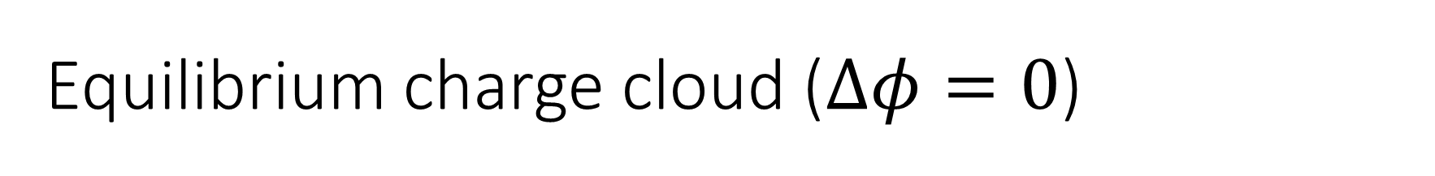



Equilibrium charge cloud ($Δφ=0$)
$$z$$
$$κ^{−1}$$
$$2a$$
$$r$$
$$ρ_{0}=\left(−σ_{m}\right)κe^{−κz}−\left(−σ_{m}\right)κ^{2}a\int_{0}^{∞}{\frac{J_{1}\left(as\right)J_{0}\left(rs\right)}{{\left(κ^{2}+s^{2}\right)}^{1/2}}e^{−{\left(κ^{2}+s^{2}\right)}^{1/2}z}ds}$$
Stone & Sherwood, 1995
Notes:
As the membrane is charged, double layers form around the membrane. The thickness of the double layer is characterized by Debye length, which is the inverse of Kappa. we would like to determine the equilibrium space charge distribution in the absence of any applied field.
In the linear regime, meaning the Poisson Boltzmann equation can be linearized, the space charge distribution is the charge distribution above a large flat plate, subtract the charge distribution around a disc with the same shape as the hole.
When the hole is circular, the charge distribution around a circular disc has been worked out by Howard Stone and John Sherwood. We can then write the equilibrium charge distribution around a circular hole as the following. This part corresponds to a flat plate, this part is the Stone-Sherwood solution.

Slide 4

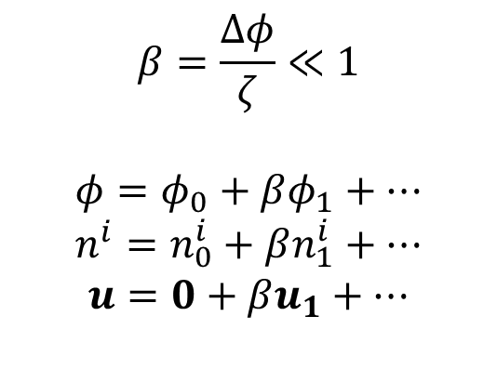
Electric force – an asymptotic expansion
$$Δφ/2$$
$$β=\frac{Δφ}{ζ}≪1$$
$$φ=φ_{0}+βφ_{1}+…$$
$$n^{i}=n_{0}^{i}+βn_{1}^{i}+…$$
$$u=0+βu_{1}+…$$
$$F={−ρ}_{0}∇χ$$
$$∇^{2}χ=0$$
$$n⋅∇χ=0$$
$$z=\operatorname{asinh}{ξ\cos{η}}$$
$$r=\operatorname{acosh}{ξ\sin{η}}$$
$$χ=\frac{Δφ}{2}\left[1−\frac{2}{π}\tan^{−1}\left(\frac{1}{\sinh{ξ}}\right)\right]$$
$$−Δφ/2$$
Notes:
When we apply an electric potential delta phi across the pore, the potential field, ionic species distribution and flow field will be perturbed from equilibrium.
We assume the applied field is weak comparing to the equilibrium electric field, so that these perturbations are small. We do an asymptotic expansion about the equilibrium.
We found that the net electric body force acting on the fluid can be written as the equilibrium charge distribution rho0 times the gradient of chi, where chi is the solution of the Laplace equation in this very same system. The classic solution of chi is available in the oblate spherical coordinates xi and eta.

Slide 5


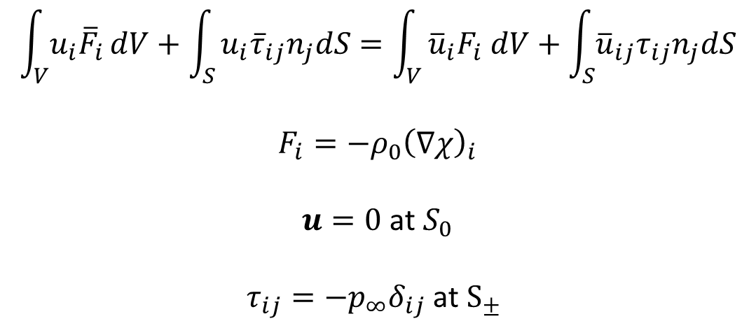
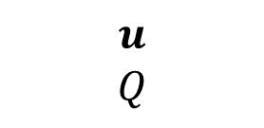




Reciprocal theorem
$$Δφ/2$$
$$\int_{V}{u_{i}{\overline{F}}_{i}}dV+\int_{S}{u_{i}{\overline{τ}}_{ij}n_{j}dS=\int_{V}{{\overline{u}}_{i}F_{i} dV+\int_{S}{{\overline{u}}_{ij}τ_{ij}n_{j}dS}}}$$
$$F_{i}={−ρ}_{0}{\left(∇χ\right)}_{i}$$
$u=0$ at $S_{0}$
$τ_{ij}={−p}_{∞}δ_{ij}$ at $S_{±}$
$$S_{+}$$
$$u$$
$$Q$$
$$S_{0}$$
$$S_{0}$$
$$S_{−}$$
$$−Δφ/2$$
Notes:
The electric body force drives an electroosmotic flow field u. As a result a net flow rate Q goes through the hole. Here we present a method to determine Q without having to solve u. We utilize the reciprocal theorem.
The reciprocal theorem says that if we have two flow field in a same domain, the work of stress 1 acting on flow field 2 is equal to the work of stress 2 acting on flow field 1.
We choose flow field 1 to be the electroosmotic flow generated by delta phi. We know that the body force F is rho0 times gradient of chi. We have no slip condition at the membrane surface. Pressure is the same at infinity. These two conditions lead to the fourth term 0.

Slide 6
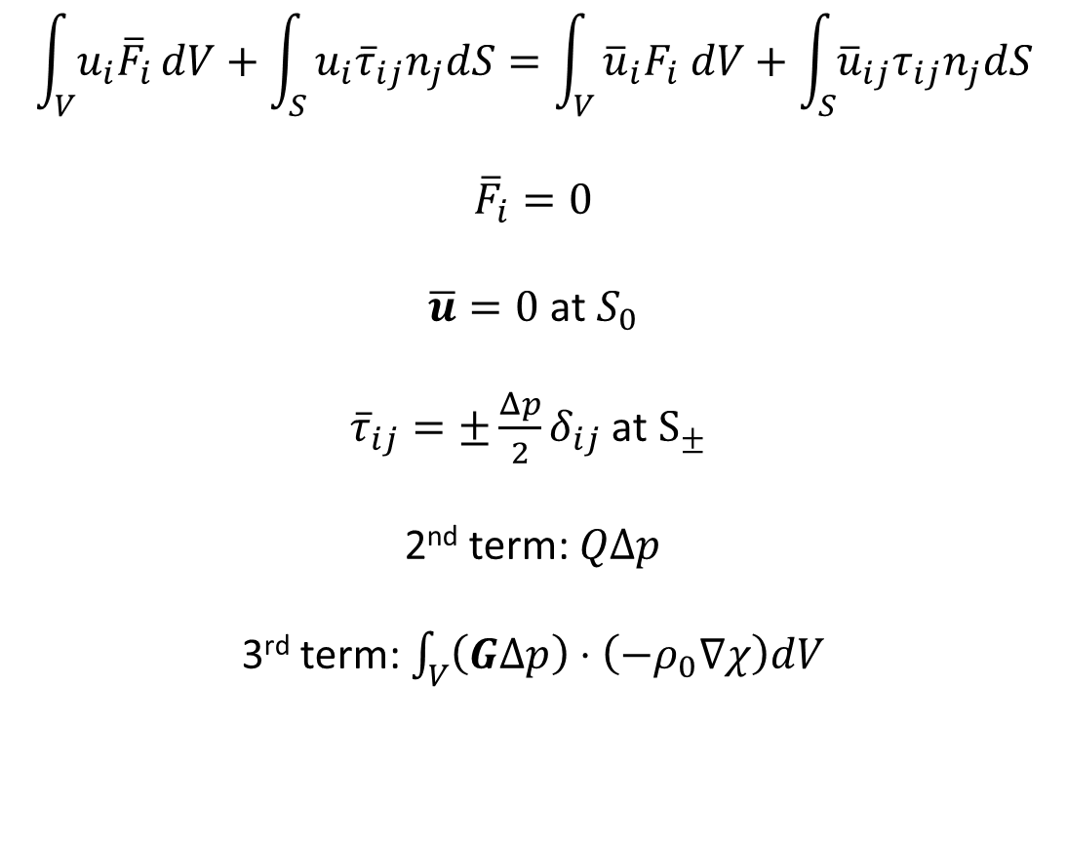



Reciprocal theorem
$$Δp/2$$
$$\int_{V}{u_{i}{\overline{F}}_{i}}dV+\int_{S}{u_{i}{\overline{τ}}_{ij}n_{j}dS=\int_{V}{{\overline{u}}_{i}F_{i} dV+\int_{S}{{\overline{u}}_{ij}τ_{ij}n_{j}dS}}}$$
$${\overline{F}}_{i}=0$$
$\overline{u}=0$ at $S_{0}$
${\overline{τ}}_{ij}=±{\frac{Δp}{2}δ}_{ij}$ at $S_{±}$
2nd term: $QΔp$
3rd term: $\int_{V}{\left(GΔp\right)⋅\left(−ρ_{0}∇χ\right)dV}$
$$S_{+}$$
$$\overline{u}=GΔp$$
$$S_{0}$$
$$S_{0}$$
$$S_{−}$$
$$−Δp/2$$
Notes:
We choose the flow field 2 to be pressure driven flow through a hole. This problem has an analytical solution, u bar equal to G times delta p. For flow field 2, body force is 0, hence we have the first term 0.
We have the same no-slip boundary condition at S0, and pressure is equal to the applied pressure at infinity.
The second term, if we plug in these two conditions, is the flow rate of flow field 1, times delta p. The 3rd term, if we plug in what we know, is this equation here. We can therefore cancel delta p from both sides, and eventually we arrive at behold

Slide 7

Volumetric flow rate
$$Q=−\int_{V}{ρ_{0}G⋅∇χ dV}$$
$$ρ_{0}=\left(−σ_{m}\right)κe^{−κz}−\left(−σ_{m}\right)κ^{2}a\int_{0}^{∞}{\frac{J_{1}\left(as\right)J_{0}\left(rs\right)}{{\left(κ^{2}+s^{2}\right)}^{1/2}}e^{−{\left(κ^{2}+s^{2}\right)}^{1/2}z}ds}$$
$$χ=\frac{Δφ}{2}\left[1−\frac{2}{π}\tan^{−1}\left(\frac{1}{\sinh{ξ}}\right)\right]$$
$G_{ξ}=−\frac{{acos}^{2}{η }}{2πμ\cosh{ξ{\left(\cosh^{2}{ξ−\sin^{2}{η}}\right)}^{1/2}}}$, $G_{η}=0$
$ρ_{0}≈−σ_{m}κ$ as $κ→0$
$H=\frac{Q}{Δφ}\sim \frac{−a^{3}κσ_{m}}{3μ}=κa\left(−\frac{a^{2}σ_{m}}{3μ}\right)=κaH_{0}$ as $κ→0$
Journal of Fluid Mechanics 749, 167-183
Notes:
This equation.
We did not solve for the flow field, yet we get a formula for total volumetric flow rate, as an integral.
Note that every element in this integral has been worked out by now.
At the thick Debye length limit, or kappa goes to 0, rho 0 can be approximated as –sigmam times kappa. In this limit, Q can be worked out as a closed form.

Slide 8

Volumetric flow rate
$$H=\frac{Q}{Δφ}=\frac{2a^{2}σ_{m}}{μπ}\left[−aκI_{2}+{\left(aκ\right)}^{2}\int_{0}^{π/2}{dη\int_{0}^{∞}{I_{1}\frac{\cos^{2}{η\sin{η}}}{\cosh{ξ} }dξ}}\right]$$
$$I_{1}=\int_{0}^{∞}{\frac{J_{1}\left(t\right)J_{0}(\overline{r}t)}{\sqrt{x^{2}+t^{2}}}\exp\left[−\sqrt{x^{2}+t^{2}}\overline{z}\right]dt}$$
$$I_{2}=\int_{0}^{1}{t^{2}\left[ci\left(aκt\right)\sin\left(aκt\right)−si\left(aκt\right)\cos\left(aκt\right)\right]dt}$$
Journal of Fluid Mechanics 749, 167-183
Notes:
In other cases, Q has to be calculated numerically. Details are given in our JFM paper.
We choose to present the ratio of Q to delta phi instead. We call this ratio electroosmotic conductance.

Slide 9
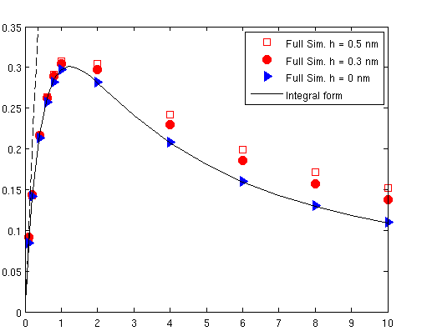


Results
$$H/H_{0}$$
$$κa$$
Notes:
We calculate the values of integral for all \kappa a using MATLAB, and compared the results with full numerical simulation of PNP-Stokes equations. Our full simulation is conducted using a self-developed solver in OpenFOAM. The solid line is our model, the triangle is simulation for a zero-thickness membrane.
At small kappa a, the slope of the curve is indeed 1. The model agrees with full simulation. What is interesting is that the curve predicts a maximum. This flow has potential impact on the transport of molecules and polymers through a nanopore.
Another thing to note here is that we also simulated the case when the membrane thickness is nonzero. Here the results for h=0.3 and h=0.5 nm are shown. If we further increase thickness h, we recover the case of a long cylinder channel, and the electroosmotic conductance is known to be proportional to 1/h.
Here our theory shows that if we decrease h from infinity to 0, the electroosmotic conductance does not go to infinity as predicted by the 1/h dependence. Rather it approaches some finite value. In analogy to access resistance of a hole in electrostatics, we call the inverse of capital H the electroosmotic access resistance of a nanopore, in analogy to the access resistance of a hole in electrostatics.

Slide 10
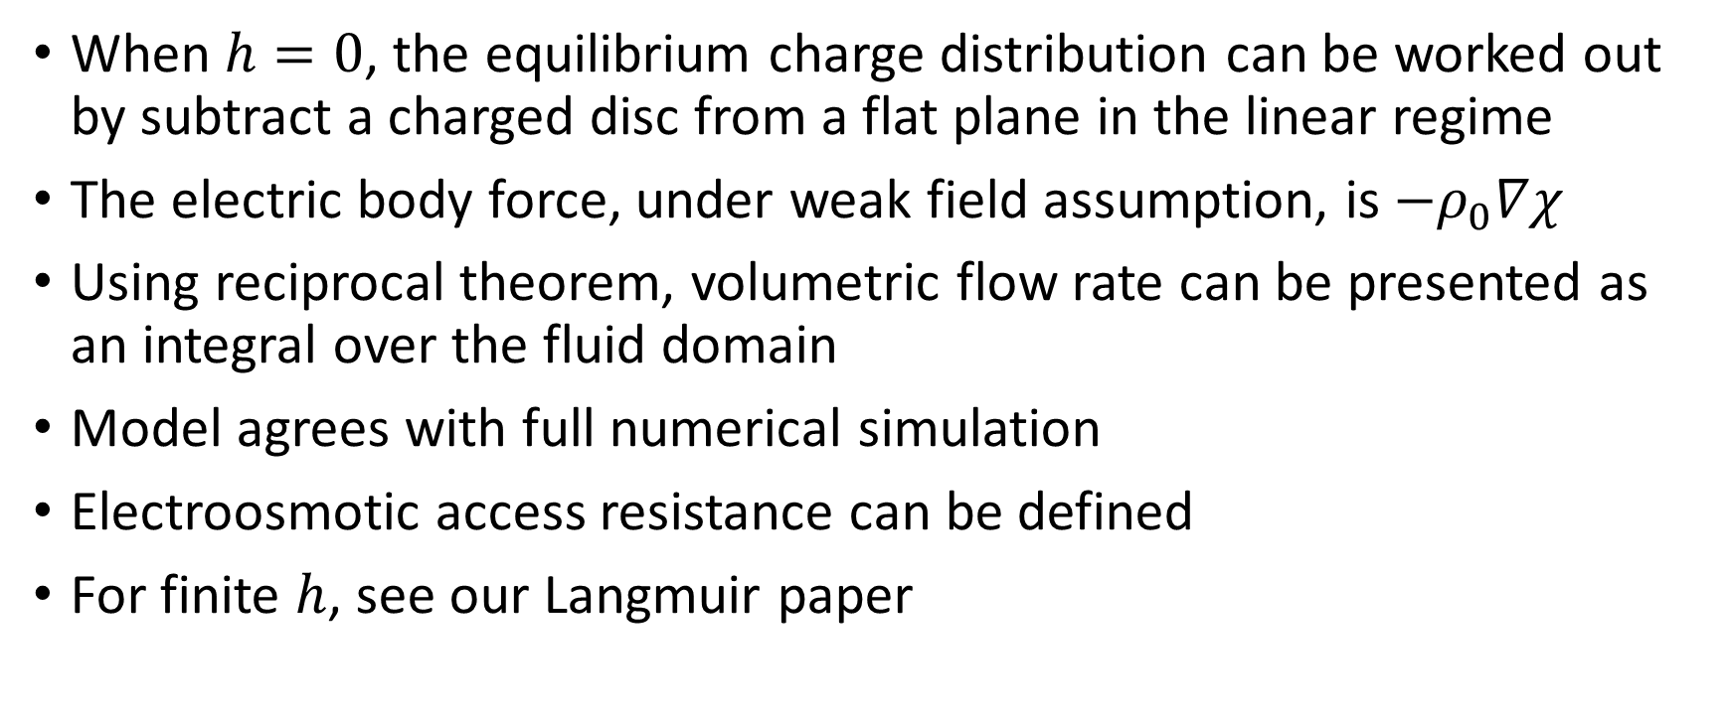
Conclusion
When $h=0$, the equilibrium charge distribution can be worked out by subtract a charged disc from a flat plane in the linear regime
The electric body force, under weak field assumption, is $−ρ_{0}∇χ$
Using reciprocal theorem, volumetric flow rate can be presented as an integral over the fluid domain
Model agrees with full numerical simulation
Electroosmotic access resistance can be defined
For finite $h$, see our Langmuir paper
References
Journal of Fluid Mechanics 749, 167-183;
Langmuir 30 (31), 9261-9272;

