Slide 1
Electroosmotic Flow through a Cylindrical Nanopore in a Charged Membrane of Finite Thickness
Mao Mao¹, Sandip Ghosal^{1,2}, John Sherwood³
¹Department of Mechanical Engineering and ²Department of Engineering Science and Applied Mathematics, Northwestern University
³Department of Applied Mathematics and Applied Physics, University of Cambridge
NIH Grant No.4R01HG004842
Leverhulme Trust
Notes:
Good afternoon, everyone. In this presentation I will share the research regarding electroosmotic flow through a cylindrical nanopore in a charged membrane of finite thickness. This work is again carried out by Dr. Ghosal, Dr. Sherwood and myself. And we acknowledge NIH and Leverhulme Trust for funding our research.

Slide 2
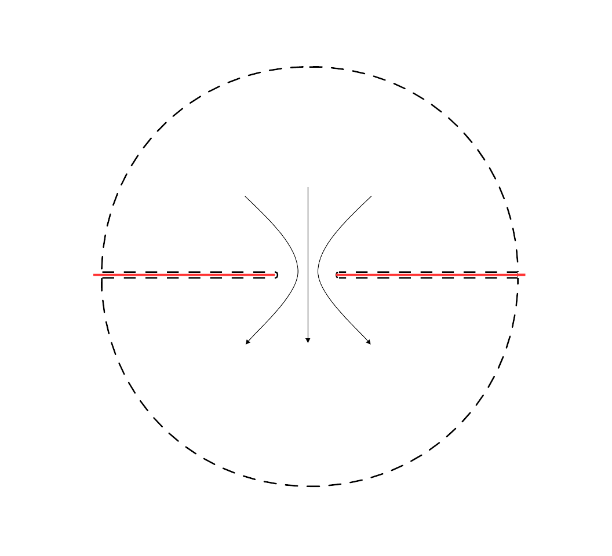



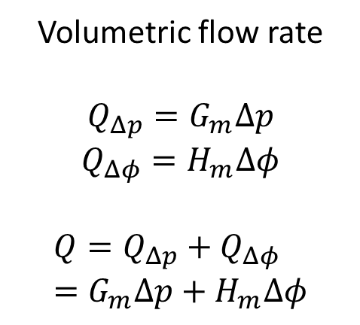
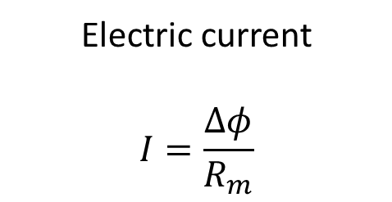
Nanopore in a membrane of zero thickness
$Δφ/2$,$Δp/2$
Electric current
$$I=\frac{Δφ}{R_{m}}$$
Volumetric flow rate
$$Q_{Δp}=G_{m}Δp$$
$$Q_{Δφ}=H_{m}Δφ$$
$$Q=Q_{Δp}+Q_{Δφ}=G_{m}Δp+H_{m}Δφ$$
$Q$, $I$
$−Δφ/2$, $−Δp/2$
Notes:
In the previous talk, we have already presented an analytical solution of electroosmotic flow through a nanopore in a membrane of zero thickness. To recapture, if we apply a voltage difference of delta phi across the nanopore, we get an electric current I and an electroosmotic flow rate Q.
I is equal to delta phi divided by the resistance rm, which is the classic access resistance. M here represents membrane. Q, on the other hand, is equal to Hm times delta phi, Hm being the electroosmotic conductance, and we have presented the analytical solution for that. Note that volumetric flow rate can also be generated by applying a pressure difference across the pore. In the same fashion, the volumetric flow rate Q is equal to a coefficient, we call it Gm here, times delta p. If both potential and pressure difference are present, the total flow rate is the sum of the two.

Slide 3
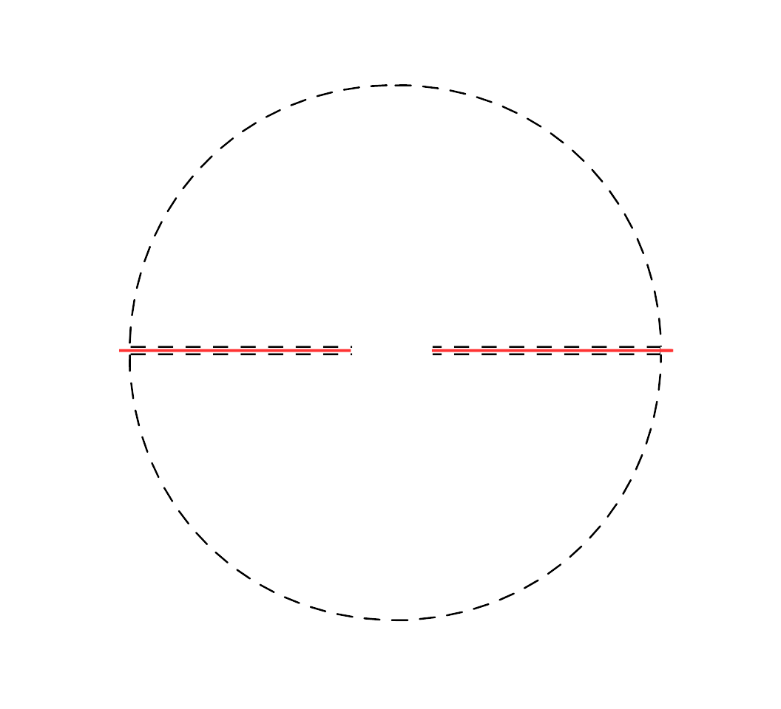
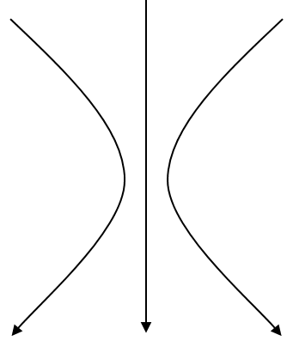
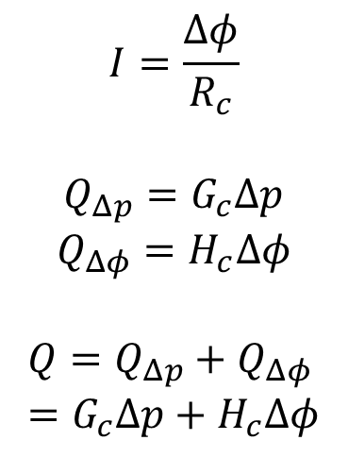



Zero to finite thickness
$Δφ/2$, $Δp/2$
$$I=\frac{Δφ}{R_{c}}$$
$$Q_{Δp}=G_{c}Δp$$
$$Q_{Δφ}=H_{c}Δφ$$
$$Q=Q_{Δp}+Q_{Δφ}=G_{c}Δp+H_{c}Δφ$$
1/2 pore
$Q$, $I$
Cylindrical channel
$$h$$
1/2 pore
$−Δφ/2$, $−Δp/2$
Notes:
Now what happens when the thickness of the membrane is finite? Here we present a model to calculate the volumetric flow rate Q. We have a nanopore sitting in a finite thickness membrane, and we model this system as 3 things lying in series: half a pore, a cylindrical channel and the other half of a pore. We combine the zero thickness solution with the classic solution of an infinitely long cylindrical channel. For a cylindrical channel, electric current I is equal to delta phi divided by Rc ,Rc being the resistance of a cylinder. Classic solution exists for electroosmotic flow in a cylindrical channel, we can write it in the form Hc times \delta phi, and of cource pressure driven flow in a cylinder is the Poiseulli flow, we can write it in the same fashion Gc times delta p. c here stands for cylinder.

Slide 4



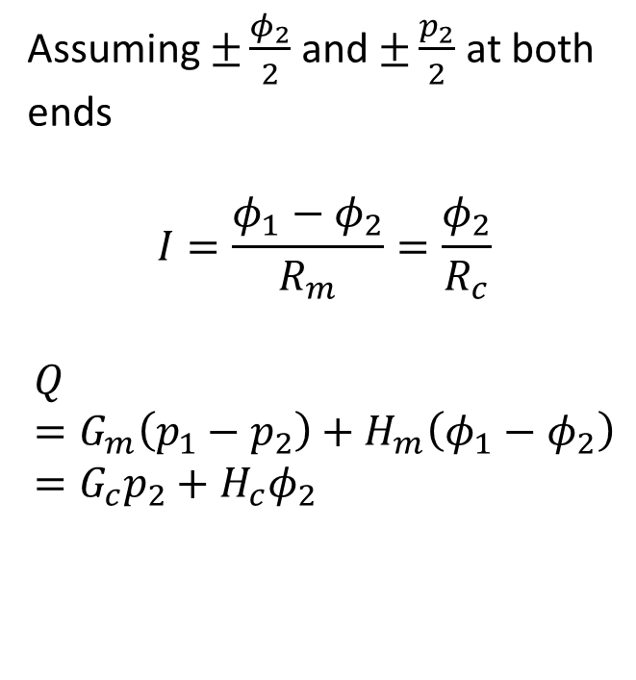



Continuity of $I$ and $Q$
$φ_{1}/2$, $p_{1}/2$
Assuming $±\frac{φ_{2}}{2}$ and $±\frac{p_{2}}{2}$ at both ends
$$I=\frac{φ_{1}−φ_{2}}{R_{m}}=\frac{φ_{2}}{R_{c}}$$
$$Q=G_{m}\left(p_{1}−p_{2}\right)+H_{m}\left(φ_{1}−φ_{2}\right)=G_{c}p_{2}+H_{c}φ_{2}$$
1/2 pore
$φ_{2}/2$, $p_{2}/2$
Cylindrical channel
$$h$$
$$2a$$
${−φ}_{2}/2$, $−p_{2}/2$
1/2 pore
$−φ_{1}/2$, $−p_{1}/2$
Notes:
Now consider the potential difference across the pore to be phi1 and pressure difference p1. We assume that potential and pressure are uniform at the two ends of the cylindrical channel, being plus minus phi2 and p2. The 3 regions connecting in series gives us the continuity of electric current, which leads to this equation, and continuity of volumetric flow rate Q, which leads to this equation. The first term is pressure driven flow through a pore, the second term is voltage driven flow through a pore; likewise the 3rd term is pressure driven flow through a cylinder, the 4th term is voltage driven flow through a cylinder.

Slide 5
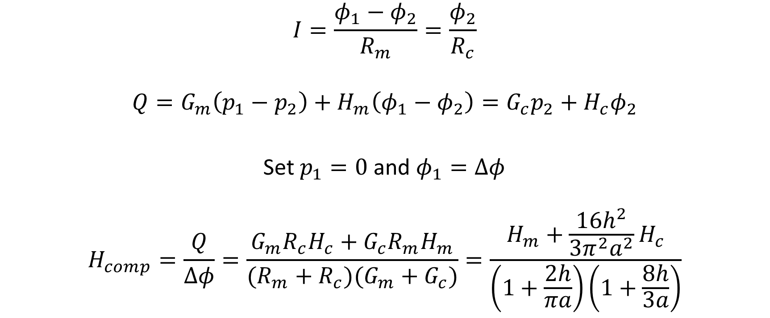
Composite electroosmotic conductance
$$I=\frac{φ_{1}−φ_{2}}{R_{m}}=\frac{φ_{2}}{R_{c}}$$
$$Q=G_{m}\left(p_{1}−p_{2}\right)+H_{m}\left(φ_{1}−φ_{2}\right)=G_{c}p_{2}+H_{c}φ_{2}$$
Set $p_{1}=0$ and $φ_{1}=Δφ$
$$H_{comp}=\frac{Q}{Δφ}=\frac{G_{m}R_{c}H_{c}+G_{c}R_{m}H_{m}}{(R_{m}+R_{c})(G_{m}+G_{c})}=\frac{H_{m}+\frac{16h^{2}}{3π^{2}a^{2}}H_{c}}{\left(1+\frac{2h}{πa}\right)\left(1+\frac{8h}{3a}\right)}$$
Notes:
The two continuity equations are shown here again, if we set p1 equal to 0, and phi1 to delta phi, we recover the situation we are interested in, that is voltage driven flow through a nanopore in a finite thickness membrane. We can present ratio of the volumetric flow rate Q and the potential difference delta phi as the composite electroosmotic conductance, which is the equation here, if you plug in formulas for Gm, Gc, Rm, Rc, you will get the equation on the right hand side. Note that the dependence of H composite on the Debye length is implicit in Hm and Hc.

Slide 6
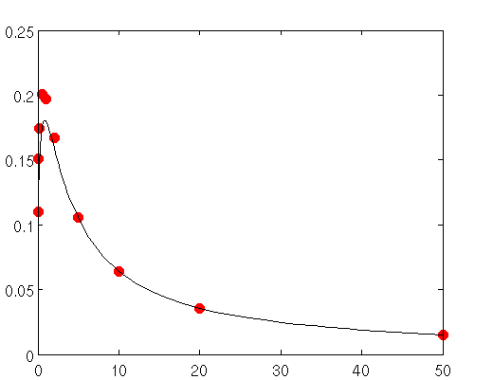
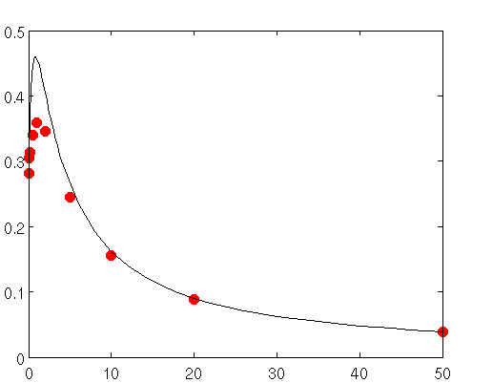






Results
$$κa=10$$
$$κa=2$$
$$H/H_{0}$$
$$H/H_{0}$$
$$h/a$$
$$h/a$$
Notes:
We compare our composite electroosmotic conductance H with the full simulation of PNP-Stokes equation at different cylinder thickness h. The solid lines are the model, and the points are from numerical simulation. From these two figures we see that our model agrees with numerical simulations quite well when Debye length is small. Especially when the thickness h is large, or when the end effects are less important.

Slide 7
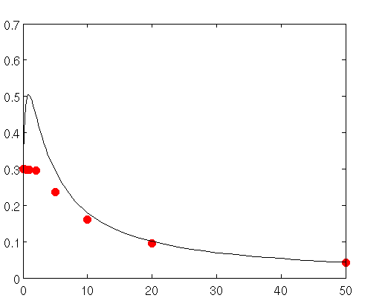
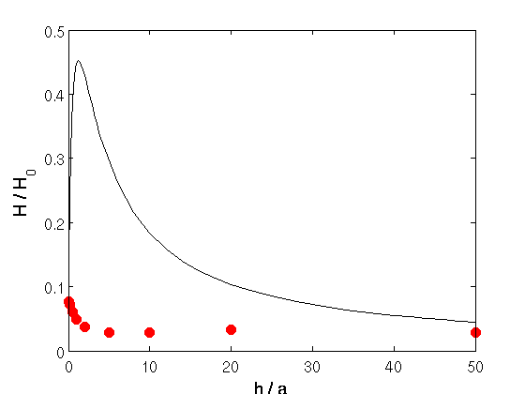


Results
$$κa=1$$
$$κa=0.1$$
$$H/H_{0}$$
$$H/H_{0}$$
$$h/a$$
$$h/a$$
Notes:
Unfortunately, our model does not agree with simulation at all when Debye length is large. We can see clearly from the right figure here, when Debye length is 10 times the radius of the pore, our model does not even predict the trend correctly.

Slide 8


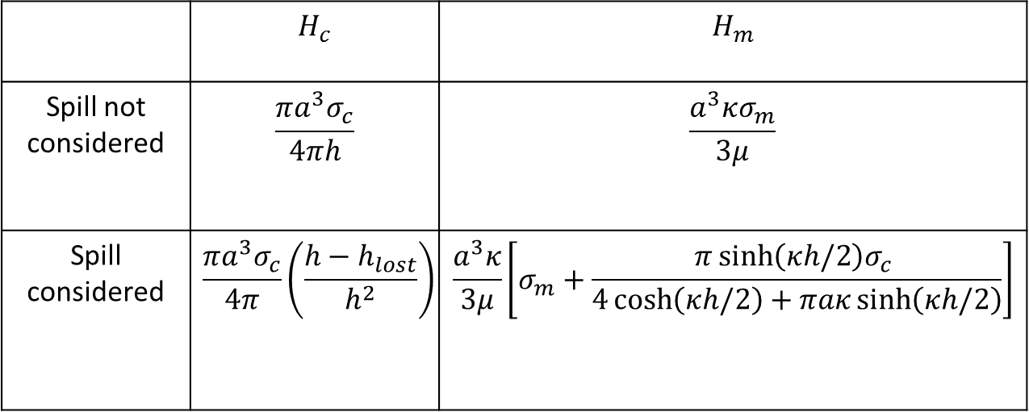
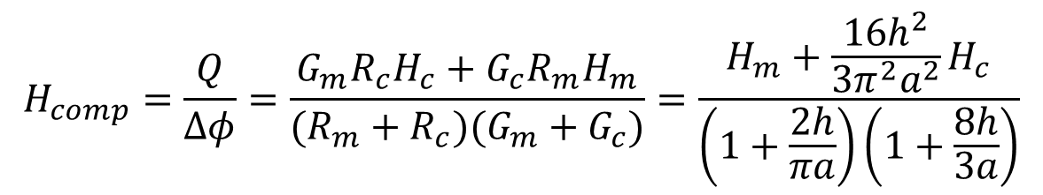



End effects: charge spill when $aκ$ small
$$H_{comp}=\frac{Q}{Δφ}=\frac{G_{m}R_{c}H_{c}+G_{c}R_{m}H_{m}}{(R_{m}+R_{c})(G_{m}+G_{c})}=\frac{H_{m}+\frac{16h^{2}}{3π^{2}a^{2}}H_{c}}{\left(1+\frac{2h}{πa}\right)\left(1+\frac{8h}{3a}\right)}$$
$$2a$$
$$h$$
 | $$H_{c}$$ | $$H_{m}$$
Spill not considered | $$\frac{πa^{3}σ_{c}}{4πh}$$ | $$\frac{a^{3}κσ_{m}}{3μ}$$
Spill considered | $$\frac{πa^{3}σ_{c}}{4π}\left(\frac{h−h_{lost}}{h^{2}}\right)$$ | $$\frac{a^{3}κ}{3μ}\left[σ_{m}+\frac{π\sinh\left(κh/2\right)σ_{c} }{4\cosh\left(κh/2\right)+πaκ\sinh\left(κh/2\right)}\right]$$
$$σ_{c}$$
$$σ_{m}$$
Notes:
So what could be wrong. Let’s get back to our model. The idea behind this composite theory is that the system can be divided very well into 3 regions, 2 half pores and one cylinder. Especially, the cylinder is simply radius a and length h. Unfortunately this treatment is too good to be true in certain cases. Let’s look at when Debye length is large compare to a. The cylinder is basically filled with the thick, overlapping double layer, and at the two ends, we do not have a well-defined border between the half pore and the cylinder any more. The charge cloud within the pore will spill out into the half pores. In other words, if we look at our composite model again, the electroosmotic conductance of a pore is not what it was any more. Due to charge spill effects more charges are outside the pore than before, and the electroosmotic conductance should be increased. On the other hand, the cylindrical channel lost a part of its charge cloud due to the charge spill effect, the electroosmotic conductance will decrease. We did some modeling of this charge spill effects. Without boring you with details, I’ll just give the results here, Hc is decreased, quantified by a equivalent length we call hlost, and Hm is increased due to gaining charge from inside the cylinder. Here sigma is the surface charge density of the membrane surfaces, c means the surface of the part inside the cylinder, m means the surface of the part outside the cylinder.
We plug in these modified Hc and Hm into the composite model

Slide 9
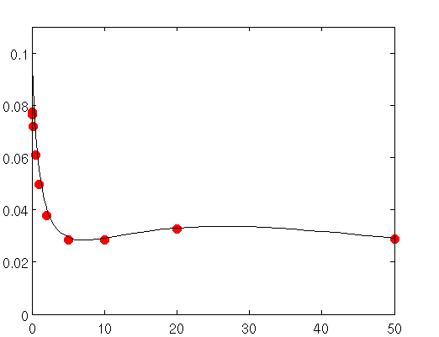


Results – spill taken into account
$$κa=0.1$$
$$κa=0.1$$
$$H/H_{0}$$
$$H/H_{0}$$
$$h/a$$
$$h/a$$
Notes:
After this modification, we compare the model with numerical simulations again. The left figure is the one before the modification, where we have failed miserably. After the modification, the agreement with numerical simulation becomes much better, as you can see from the right figure.

Slide 10
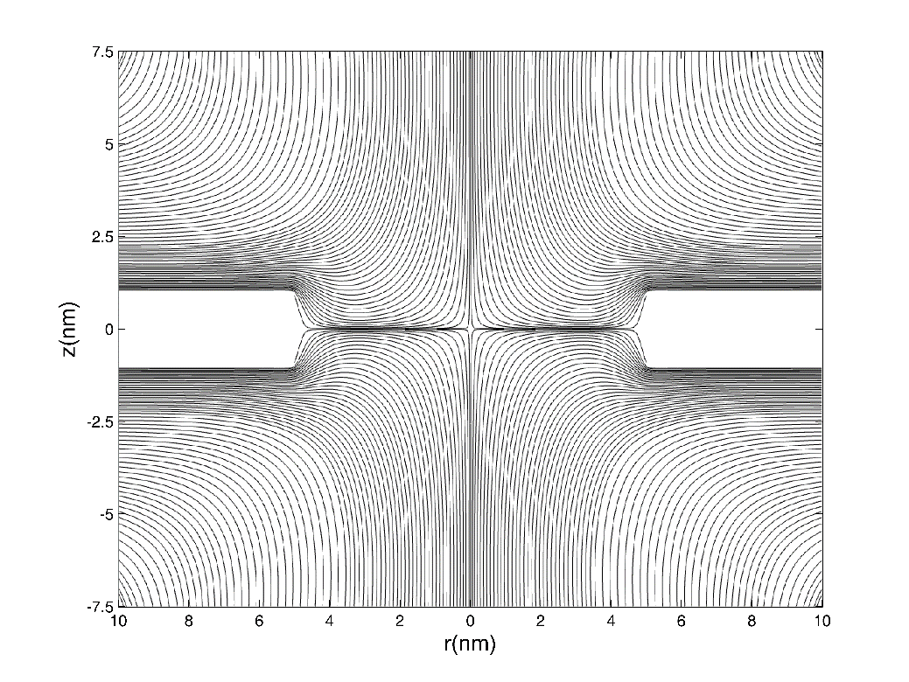
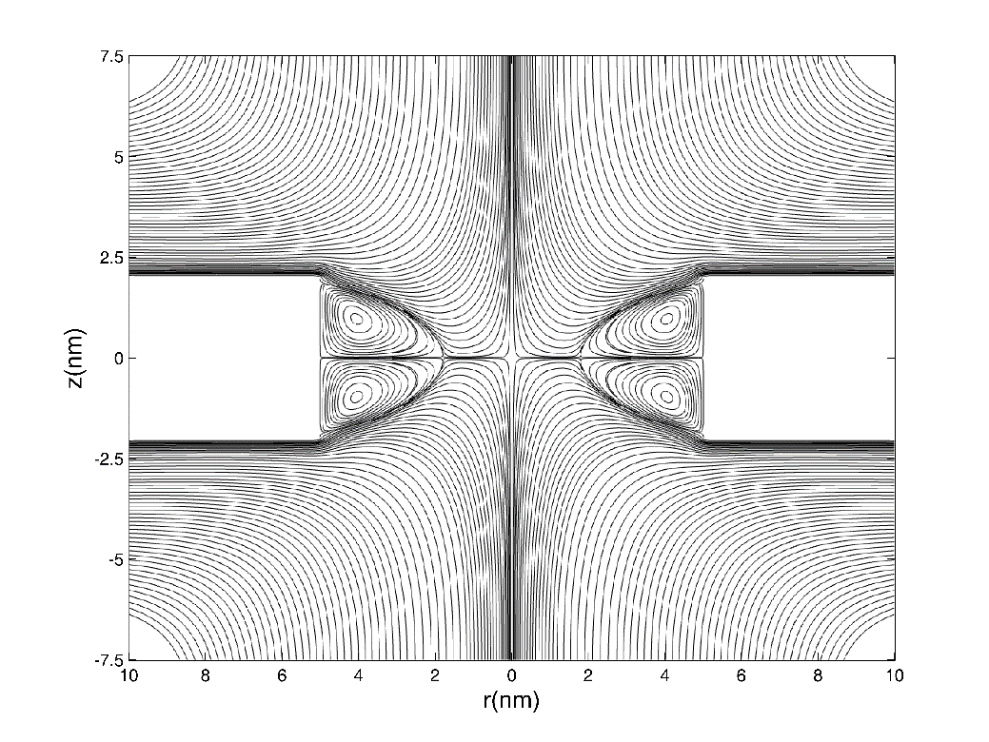
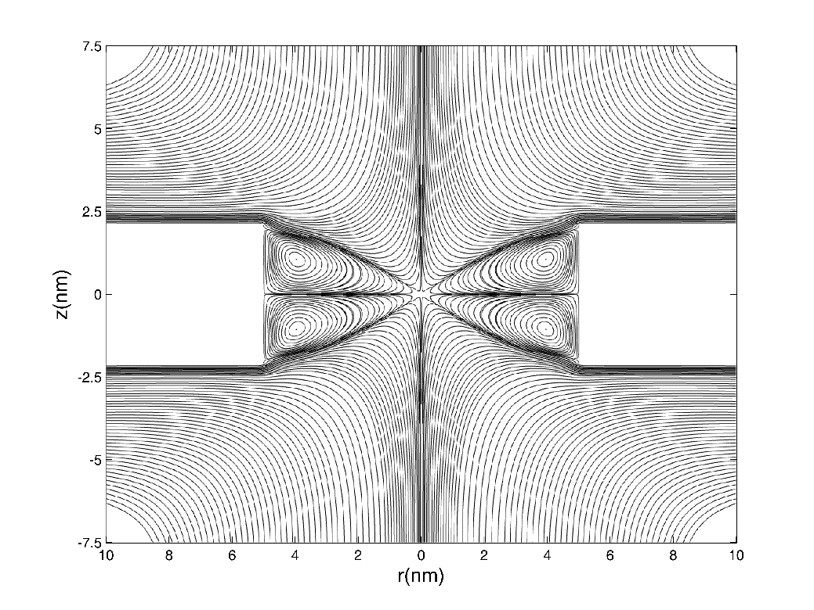
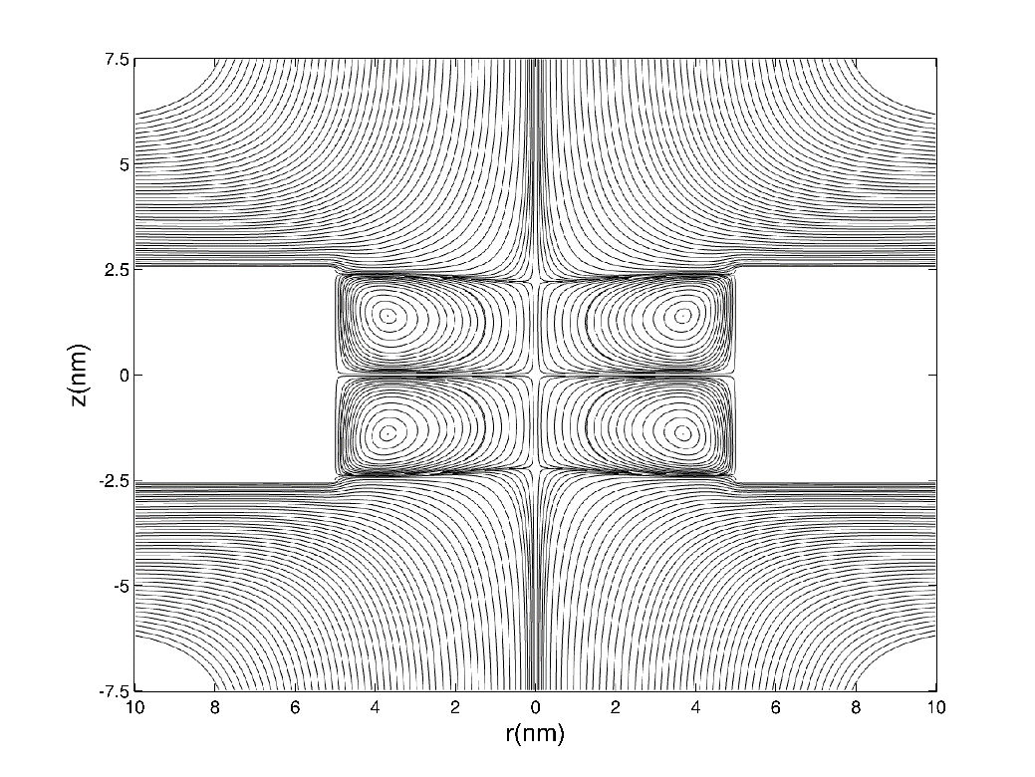
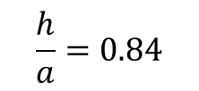
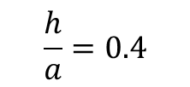
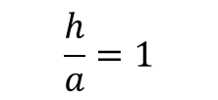
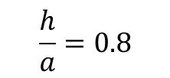
Eddies
$$\frac{h}{a}=0.4$$
$$\frac{h}{a}=0.8$$
$$\frac{h}{a}=0.84$$
$$\frac{h}{a}=1$$
Notes:
One thing to note is that when the membranes are not charged, or sigma = 0, the system has symmetry and no net flow will be generated by a potential drop. This does not mean no flow at all. Instead, we will have the induced charge electroosmosis, possibly leading to pairs of eddies within the pore. The shape of these eddies change with the geometry of the pore. Here we fix a and change h, and see that as h increases the eddies graduate meet at the center of the pore. There is one particular interesting case, when the 4 eddies meet at a single stagnation point. These figures are taken from numerical simulations. We have done theoretical analysis for this problem as well. Due to limited time I can only refer you to our Physics of Fluids paper.

Slide 11
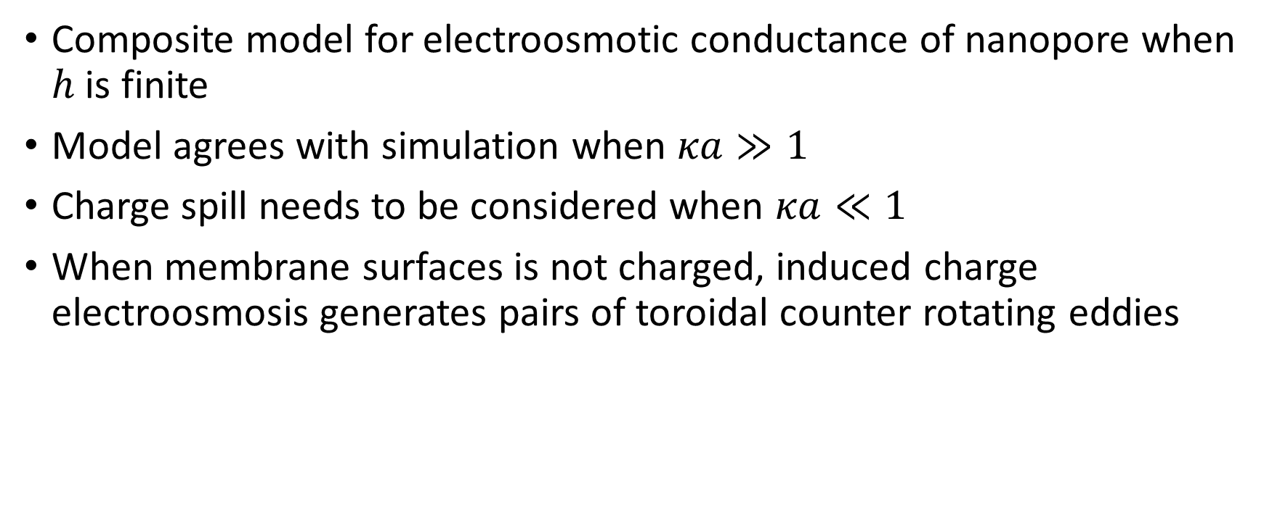
Conclusion
Composite model for electroosmotic conductance of nanopore when $h$ is finite
Model agrees with simulation when $κa≫1$
Charge spill needs to be considered when $κa≪1$
When membrane surfaces is not charged, induced charge electroosmosis generates pairs of toroidal counter rotating eddies
References
Journal of Fluid Mechanics 749, 167-183;
Langmuir 30 (31), 9261-9272;
Physics of Fluids (in press).
Notes:
So in conclusion, we present a composite model for electroosmotic conductance of nanopore in a membrane of finite thickness, by extending our zero-thickness theory. The model agrees with simulation at thin Debye length limit, but needs to be modified at thick Debye length limit by taking into account the charge spill effects. We also showed the toroidal eddies generated by ICEO when membrane surface is not charged.
This completes my presentation. Thank you for your attention, and I’ll take questions.

