Slide 1
Electroosmotic Flow through a Cylindrical Nanopore in a Charged Membrane of Finite Thickness
Mao Mao¹, Sandip Ghosal^{1,2}, John Sherwood³
¹Department of Mechanical Engineering and ²Department of Engineering Science and Applied Mathematics, Northwestern University
³Department of Applied Mathematics and Applied Physics, University of Cambridge
NIH Grant No.4R01HG004842
Leverhulme Trust

Slide 2
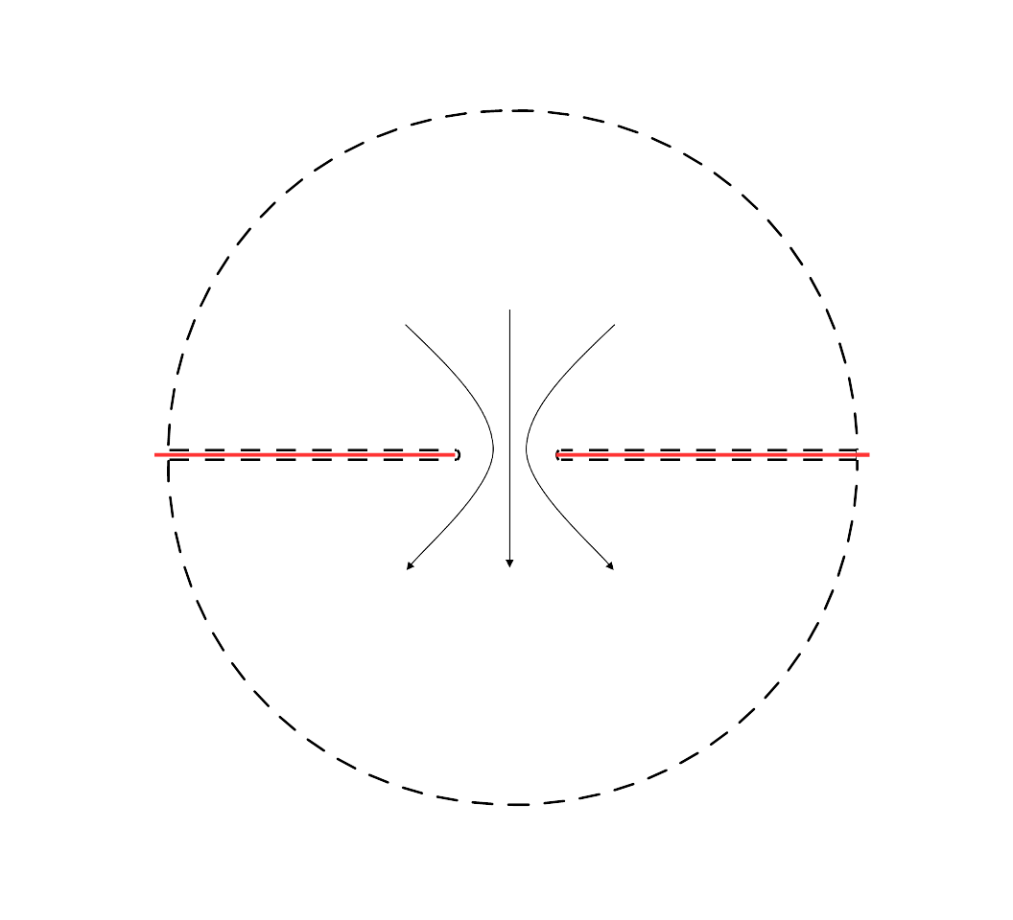
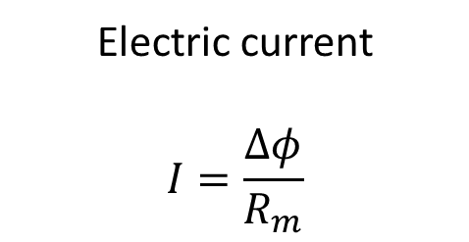



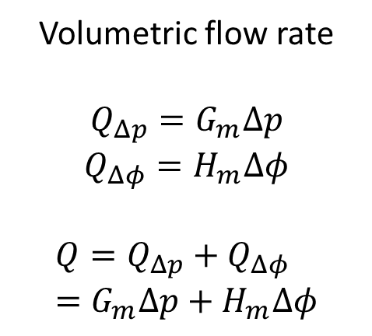
Nanopore of zero thickness
$Δφ/2$, $p_{1}/2$
Electric current
$$I=\frac{Δφ}{R_{m}}$$
Volumetric flow rate
$$Q_{Δp}=G_{m}Δp$$
$$Q_{Δφ}=H_{m}Δφ$$
$$Q=Q_{Δp}+Q_{Δφ}=G_{m}Δp+H_{m}Δφ$$
$Q$, $I$
$−Δφ/2$, $−p_{1}/2$

Slide 3
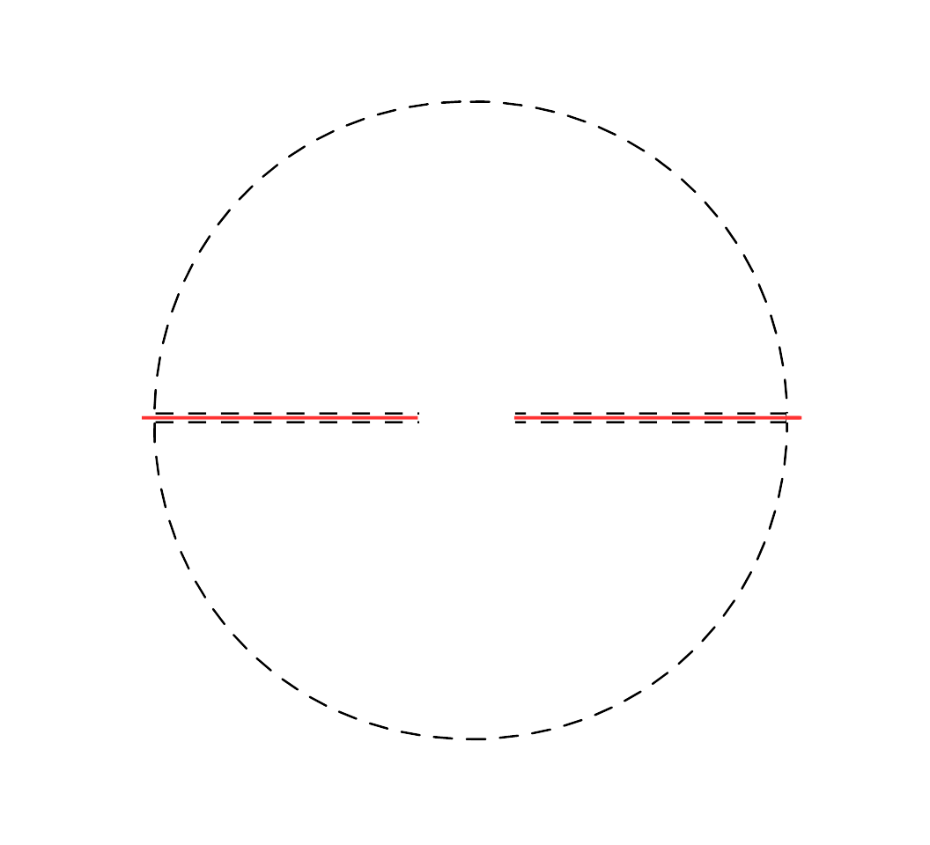
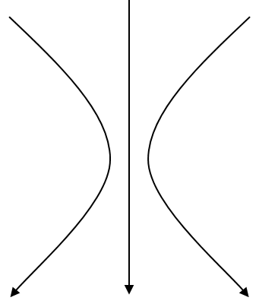


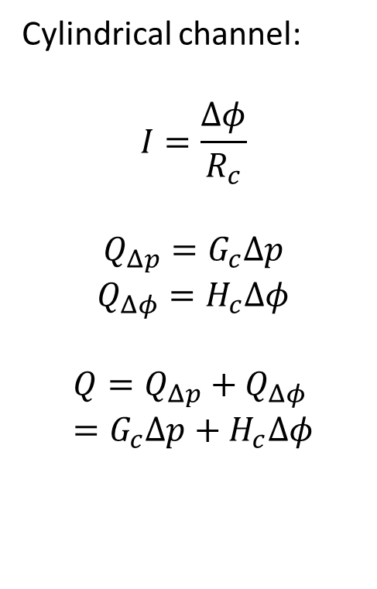

Zero to finite thickness
$φ_{1}/2$, $p_{1}/2$
Cylindrical channel:
$$I=\frac{Δφ}{R_{c}}$$
$$Q_{Δp}=G_{c}Δp$$
$$Q_{Δφ}=H_{c}Δφ$$
$$Q=Q_{Δp}+Q_{Δφ}=G_{c}Δp+H_{c}Δφ$$
1/2 pore
$Q$, $I$
Cylindrical channel
$$h$$
1/2 pore
$−φ_{1}/2$, $−p_{1}/2$

Slide 4

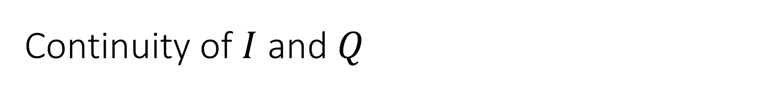

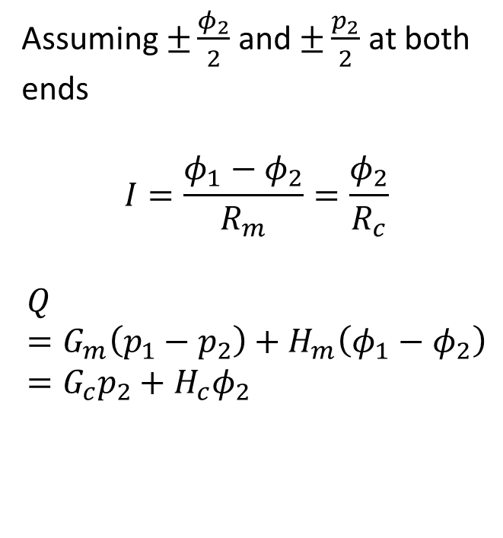

Continuity of $I$ and $Q$
$φ_{1}/2$, $p_{1}/2$
Assuming $±\frac{φ_{2}}{2}$ and $±\frac{p_{2}}{2}$ at both ends
$$I=\frac{φ_{1}−φ_{2}}{R_{m}}=\frac{φ_{2}}{R_{c}}$$
$$Q=G_{m}\left(p_{1}−p_{2}\right)+H_{m}\left(φ_{1}−φ_{2}\right)=G_{c}p_{2}+H_{c}φ_{2}$$
1/2 pore
$φ_{2}/2$, $p_{2}/2$
Cylindrical channel
$$h$$
$$2a$$
${−φ}_{2}/2$, $−p_{2}/2$
1/2 pore
$−φ_{1}/2$, $−p_{1}/2$

Slide 5
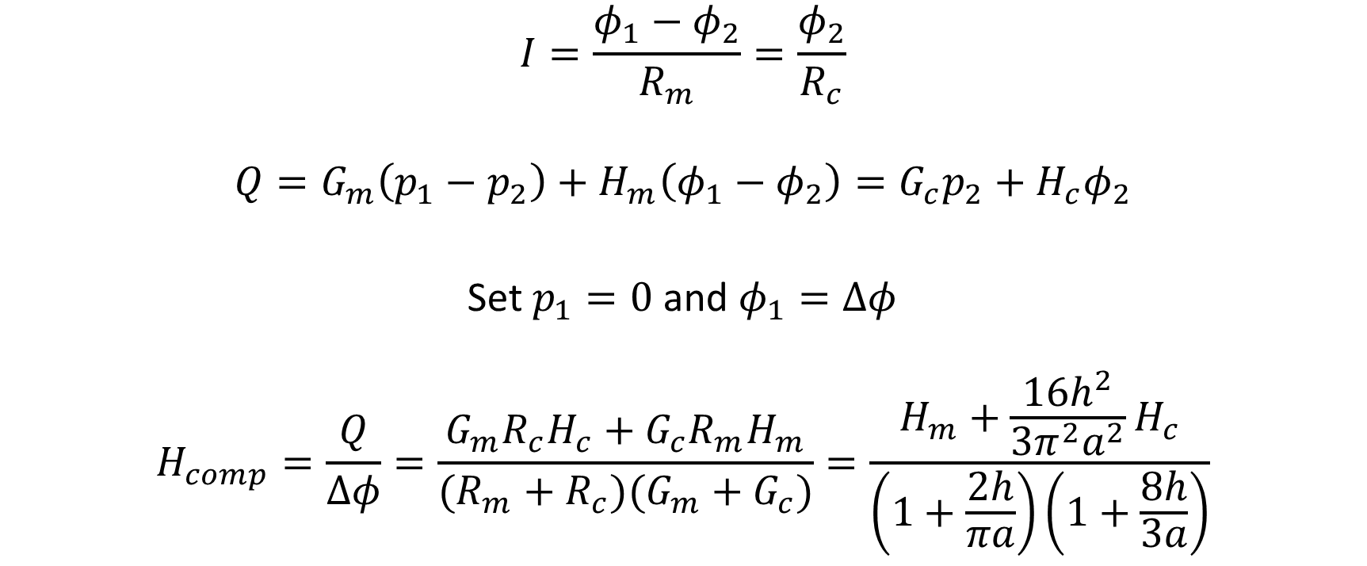
Conjugate electroosmotic conductance
$$I=\frac{φ_{1}−φ_{2}}{R_{m}}=\frac{φ_{2}}{R_{c}}$$
$$Q=G_{m}\left(p_{1}−p_{2}\right)+H_{m}\left(φ_{1}−φ_{2}\right)=G_{c}p_{2}+H_{c}φ_{2}$$
Set $p_{1}=0$ and $φ_{1}=Δφ$
$$H_{comp}=\frac{Q}{Δφ}=\frac{G_{m}R_{c}H_{c}+G_{c}R_{m}H_{m}}{(R_{m}+R_{c})(G_{m}+G_{c})}=\frac{H_{m}+\frac{16h^{2}}{3π^{2}a^{2}}H_{c}}{\left(1+\frac{2h}{πa}\right)\left(1+\frac{8h}{3a}\right)}$$

Slide 6
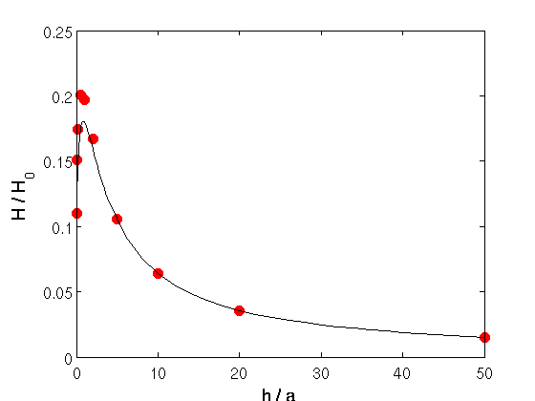
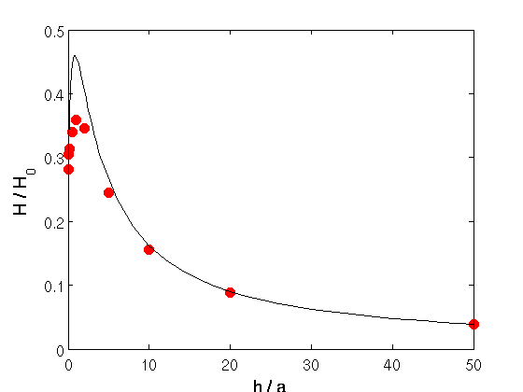


Results
$$κa=10$$
$$κa=2$$

Slide 7
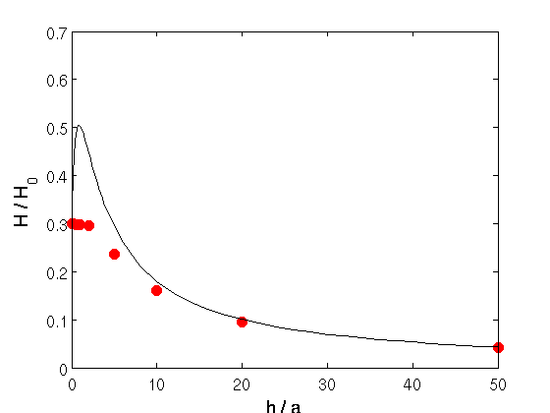
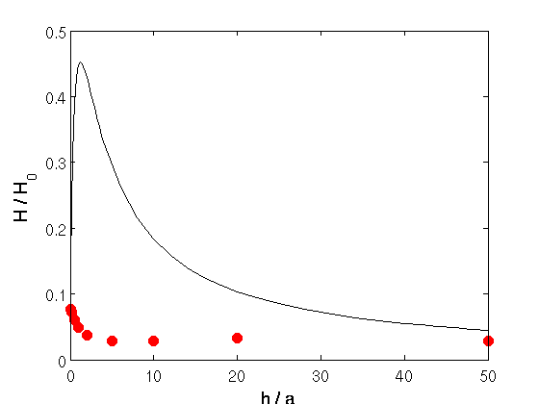


Results
$$κa=1$$
$$κa=0.1$$

Slide 8

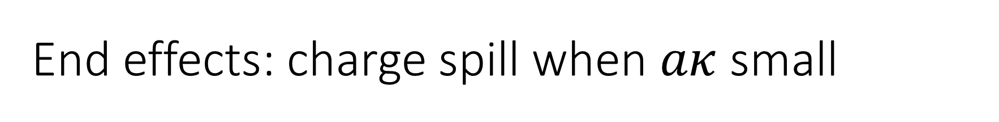
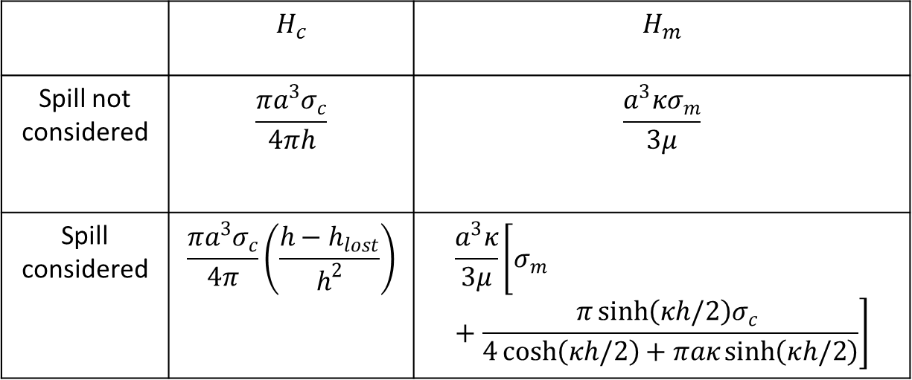
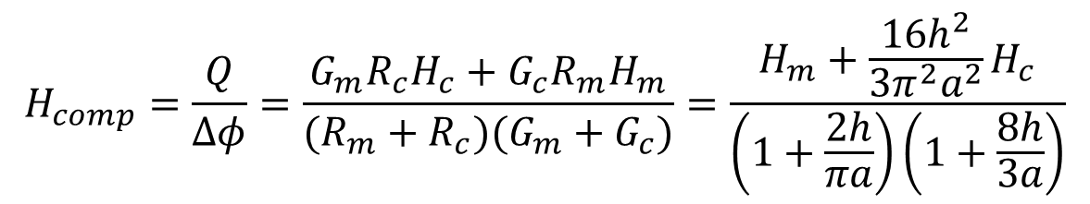

End effects: charge spill when $aκ$ small
$$H_{comp}=\frac{Q}{Δφ}=\frac{G_{m}R_{c}H_{c}+G_{c}R_{m}H_{m}}{(R_{m}+R_{c})(G_{m}+G_{c})}=\frac{H_{m}+\frac{16h^{2}}{3π^{2}a^{2}}H_{c}}{\left(1+\frac{2h}{πa}\right)\left(1+\frac{8h}{3a}\right)}$$
$$2a$$
$$h$$
 | $$H_{c}$$ | $$H_{m}$$
Spill not considered | $$\frac{πa^{3}σ_{c}}{4πh}$$ | $$\frac{a^{3}κσ_{m}}{3μ}$$
Spill considered | $$\frac{πa^{3}σ_{c}}{4π}\left(\frac{h−h_{lost}}{h^{2}}\right)$$ | $$\frac{a^{3}κ}{3μ}\left[σ_{m}+\frac{π\sinh\left(κh/2\right)σ_{c} }{4\cosh\left(κh/2\right)+πaκ\sinh\left(κh/2\right)}\right]$$

Slide 9
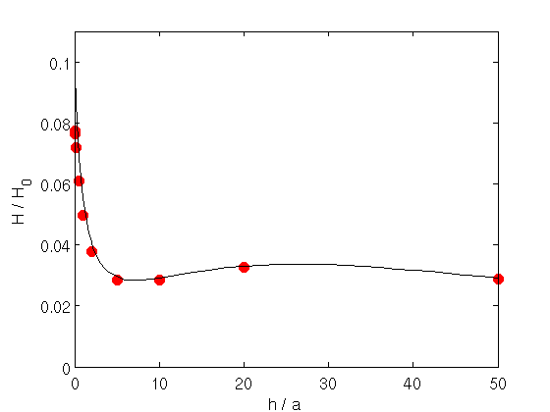
Results – spill taken into account

Slide 10
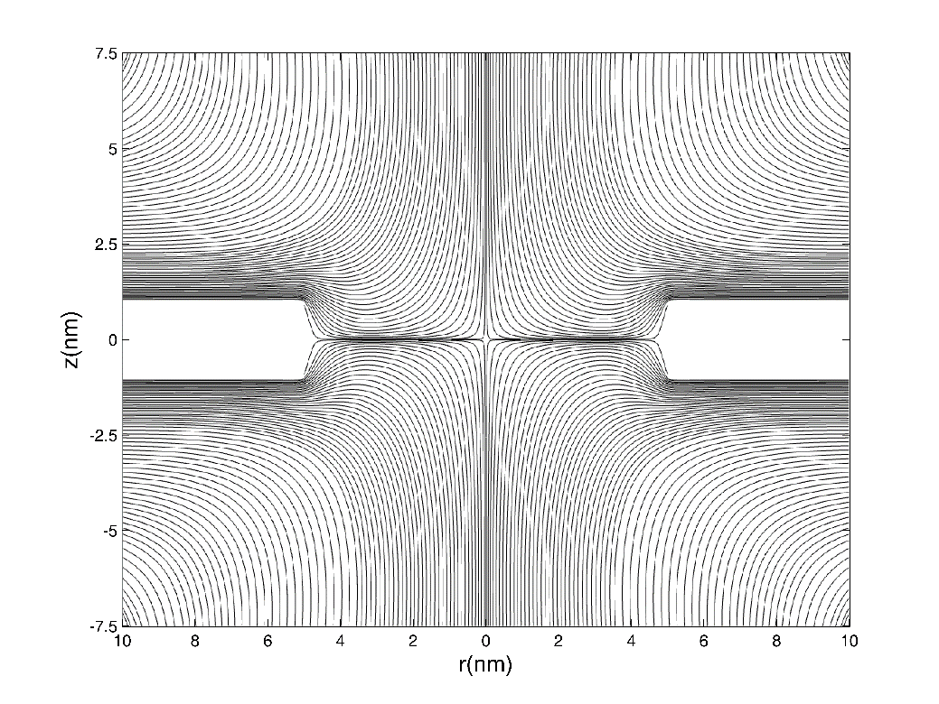
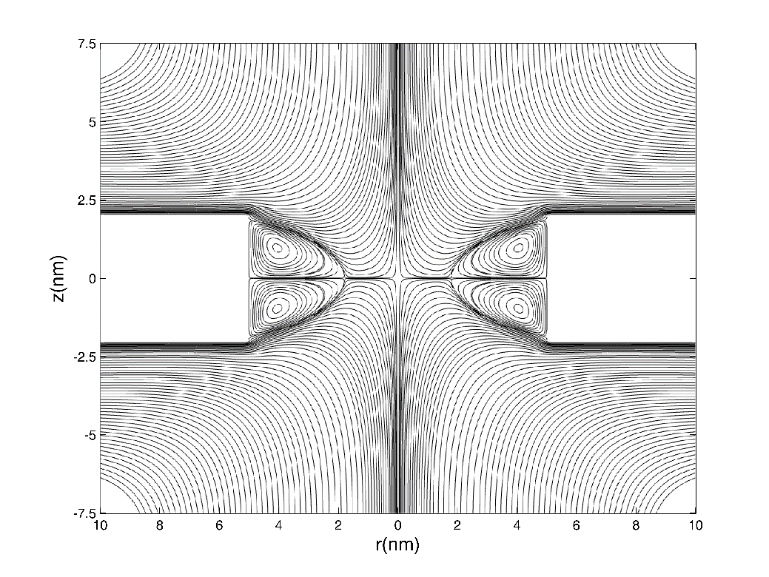
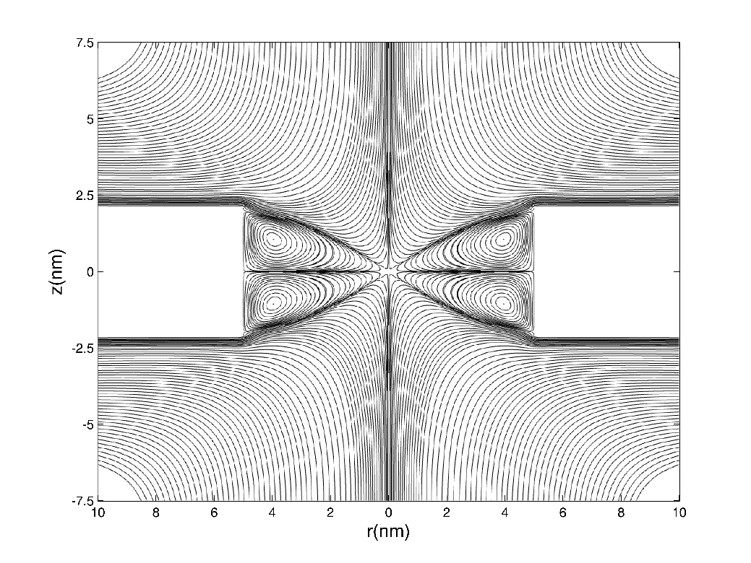
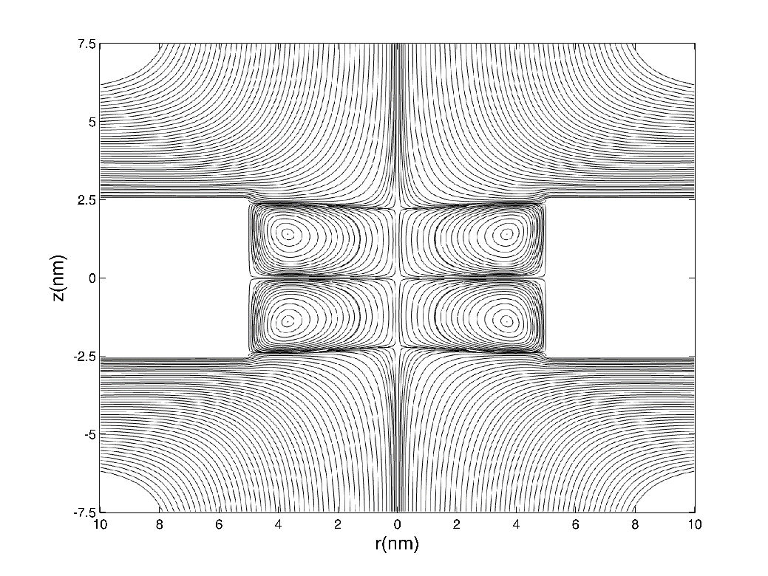
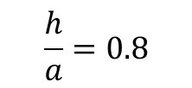
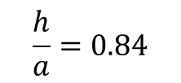
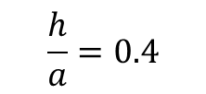
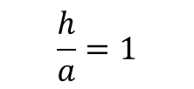
Eddies
$$\frac{h}{a}=0.4$$
$$\frac{h}{a}=0.8$$
$$\frac{h}{a}=0.84$$
$$\frac{h}{a}=1$$

Slide 11
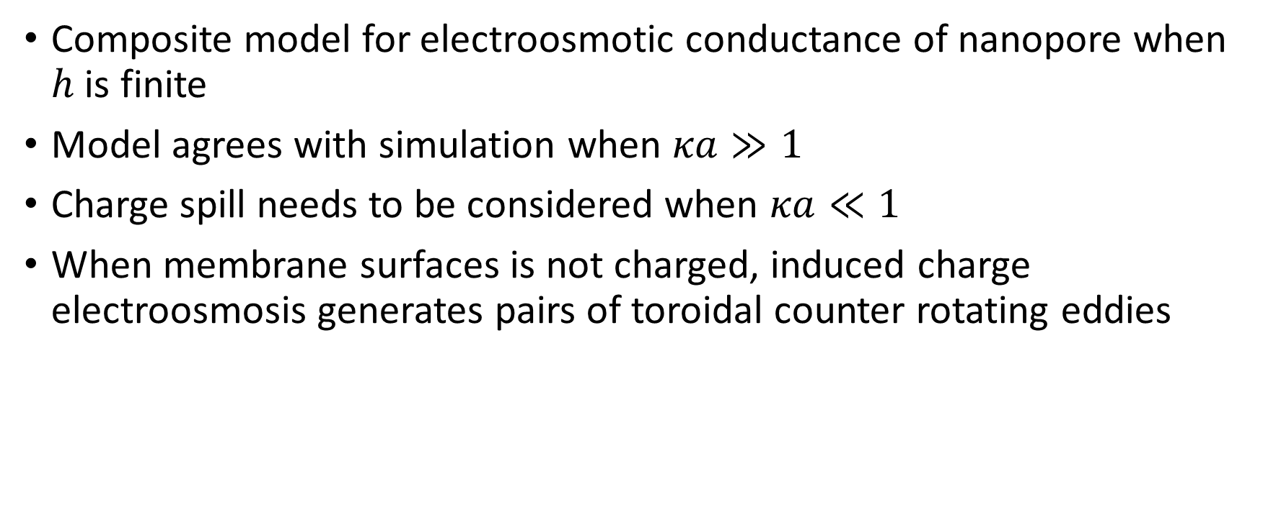
Conclusion
Composite model for electroosmotic conductance of nanopore when $h$ is finite
Model agrees with simulation when $κa≫1$
Charge spill needs to be considered when $κa≪1$
When membrane surfaces is not charged, induced charge electroosmosis generates pairs of toroidal counter rotating eddies
References
Journal of Fluid Mechanics 749, 167-183;
Langmuir 30 (31), 9261-9272;
Physics of Fluids (in press).

