Slide 1
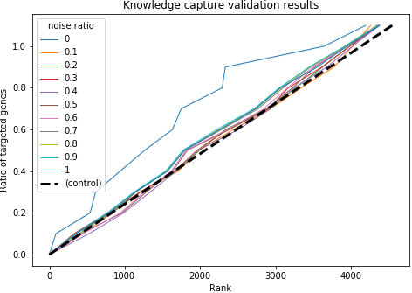
SRX1638996 | SRX1638997 | SRX1638999 | …
0.62 | 0.29 | 0.46
0.75 | 0.13 | 0.06
… | … | …
0.99 | 0.38 | 0.24
0.62 | 0.47 | 0.25
Wildtype | Δfur
0.46 | 0.46
0.44 | 0.06
… | …
0.69 | 0.24
0.55 | 0.25
abs(log (Δfur/Wildtype))
0
0.87
…
0.46
0.45
Rank
1500
10
…
100
150
Wildtype:
SRX1638996
SRX1638997
Δfur mutant:
SRX1638999
Take average for selected conditions
Calculate absolute log of the fold change
Calculate corresponded rank
Rank
1500
10
…
100
150
Rank
10
…
100
Genes regulated by fur:
Flagellar genes
SPI1 genes
SPI2 genes
Pick the rank of the specified genes
Plot the cumulative density function (cdf) of selected rank.
Adding noise with different noise ratio to compendium can generate different cdf.
The diagonal line is the baseline – the cdf of uniform distribution

