Slide 1
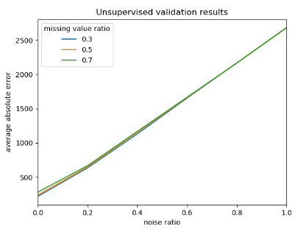
Truth | Imputed
0.42 | 0.39
0.91 | 0.85
0.84 | 0.90
0.56 | 0.56
0.51 | 0.49
0.08 | 0.03
0.30 | 0.33
0.13 | 0.77 | 0.02 | 0.36 | 0.33
0.64 | 0.30 | 0.23 | 0.78 | 0.51
0.21 | 0.42 | 0.95 | 0.19 | 0.08
0.82 | 0.91 | 0.52 | 0.29 | 0.10
0.89 | 0.54 | 0.90 | 0.56 | 0.10
0.47 | 0.06 | 0.55 | 0.53 | 0.38
0.75 | 0.84 | 0.31 | 0.38 | 0.30
0.13 | 0.77 | 0.02 | 0.36 | 0.33
0.64 | 0.30 | 0.23 | 0.78 | NA
0.21 | NA | 0.95 | 0.19 | NA
0.82 | NA | 0.52 | 0.29 | 0.10
0.89 | 0.54 | 0.90 | NA | 0.10
0.47 | 0.06 | 0.55 | 0.53 | 0.38
0.75 | NA | 0.31 | 0.38 | NA
0.13 | 0.77 | 0.02 | 0.36 | 0.33
0.64 | 0.30 | 0.23 | 0.78 | 0.49
0.21 | 0.39 | 0.95 | 0.19 | 0.03
0.82 | 0.85 | 0.52 | 0.29 | 0.10
0.89 | 0.54 | 0.90 | 0.56 | 0.10
0.47 | 0.06 | 0.55 | 0.53 | 0.38
0.75 | 0.90 | 0.31 | 0.38 | 0.33
Remove some values randomly in transcription profiles with added noise in different noise ratio
Impute the missing values
Compare the truth values and imputed values. The less difference (error) may imply the compendium capture the gene expression pattern better so that the imputation can recover the values correctly
The higher noise ratio, the more difficult for recovering the missing value. For high quality compendium, the error of low noise ratio should be significantly lower than the error of high noise ratio

