Slide 1
2025 ETH Quantum Hackaton ZuriQ challenge
The “Penny Guys (and girl” Team

Slide 2
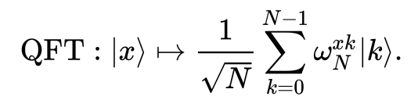
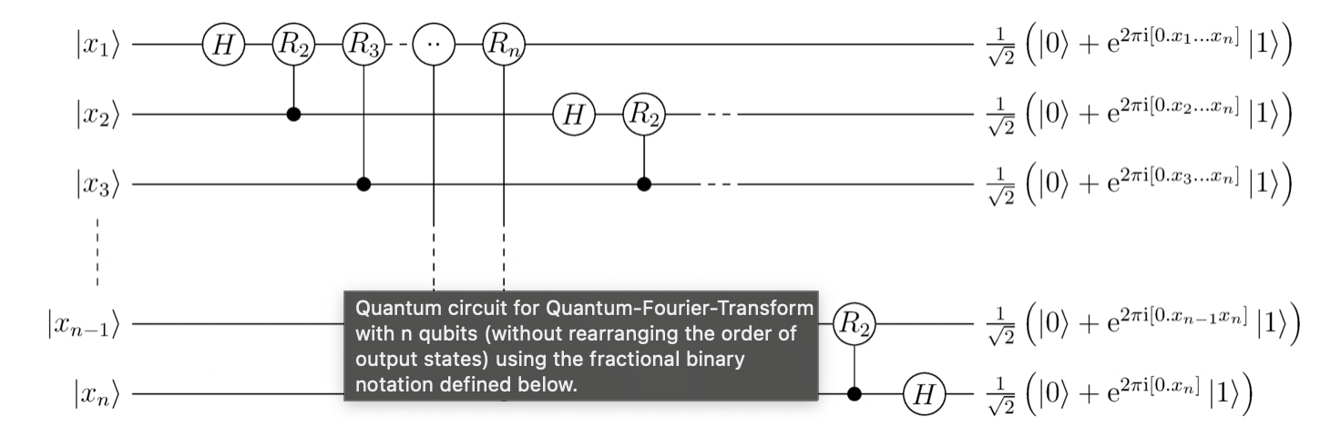
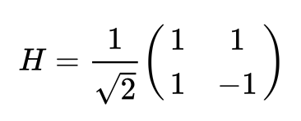
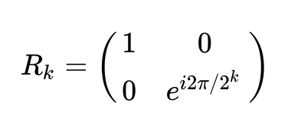
A qft8 circuit:
We want to do the same, but using {RX, RY, MS} as universal gate set

Slide 3
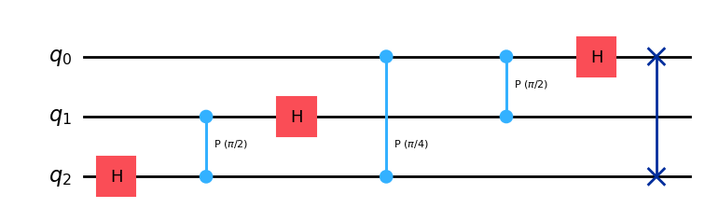
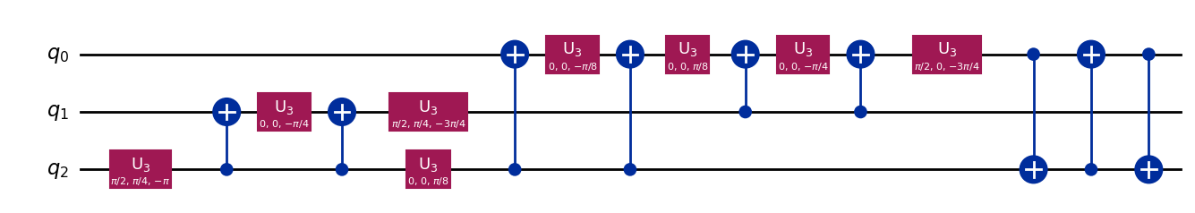
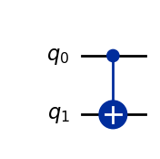
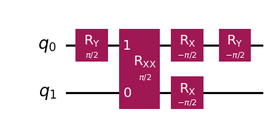
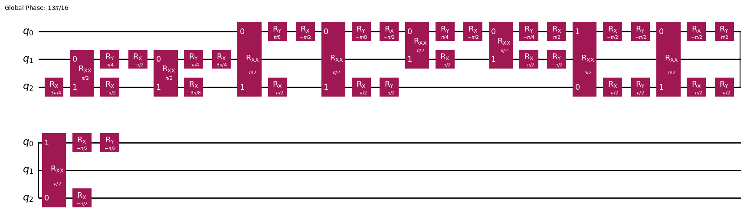
Qiskit transpiler
Use:
=
And more qiskit magic

Slide 4
Okay this looks pretty dandy but how do we translate it into moving ions in Penning traps and lasers?
The routing + scheduling problem:

Slide 5
The routing + scheduling problem:
We decided to tackle the problem in two complementary ways

