Slide 1
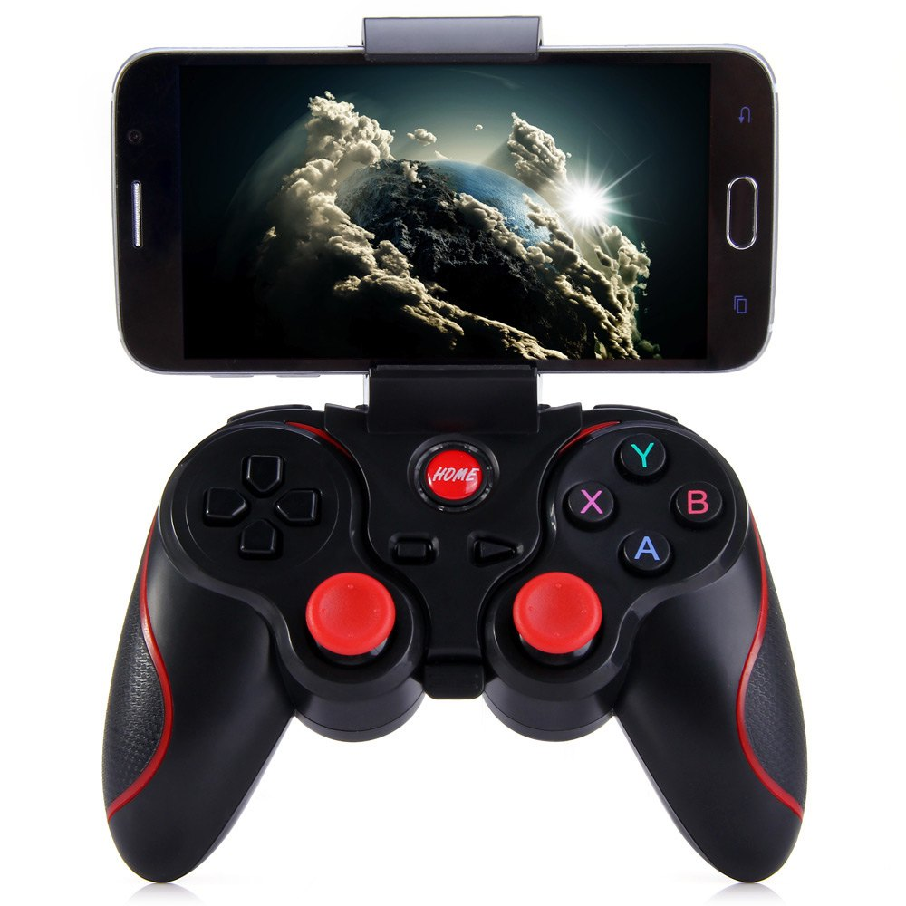
Engage Autopilot
Drive
Directional
buttons
Neutral
Reverse

