Slide 1

Mapbender3
Workshop
Astrid Emde
FOSS4G-Europe 2017
Paris Marne-la-Vallée

Slide 2

Mapbender Developer Team
Astrid Emde
Mapbende Developer Team since 2004
Mapbender PSC (Project Steering Commitee)
Project management and development, Trainings for MapServer, PostgreSQL/PostGIS, Mapbender, GeoServer
Testing, Documentation, Release
WhereGroup Bonn

Slide 3

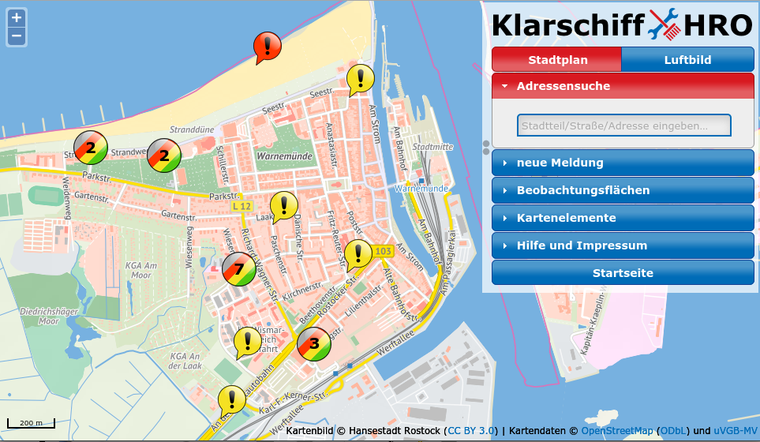


WhereGroup

Slide 4
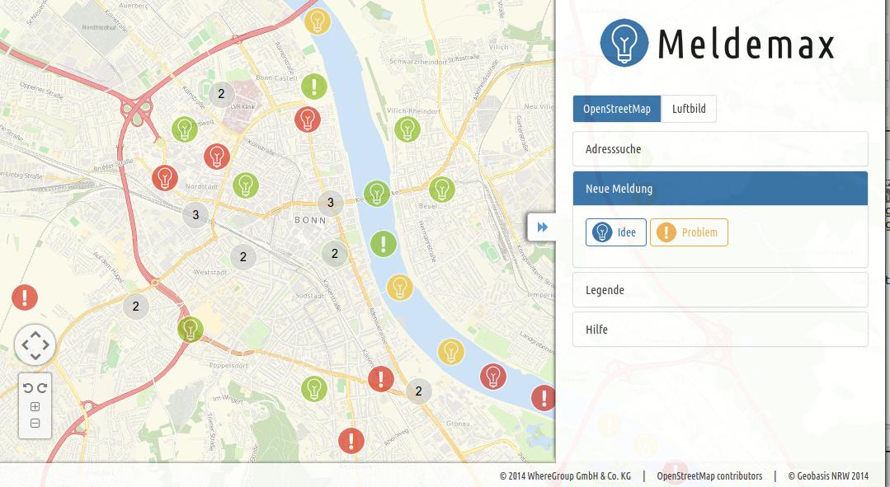
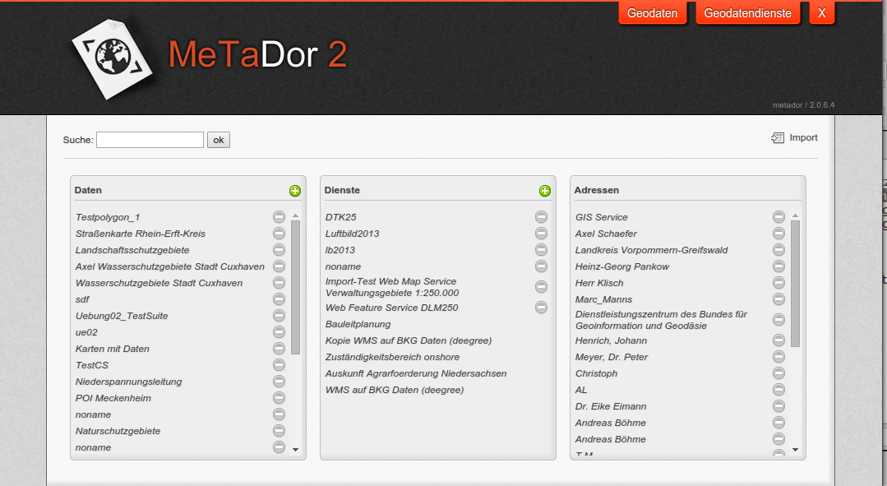
WhereGroup
Meldemax
Platform for
ideas & problems
in your town
MetaDor2
Metadateneditor
Consulting, Training
& more

Slide 5
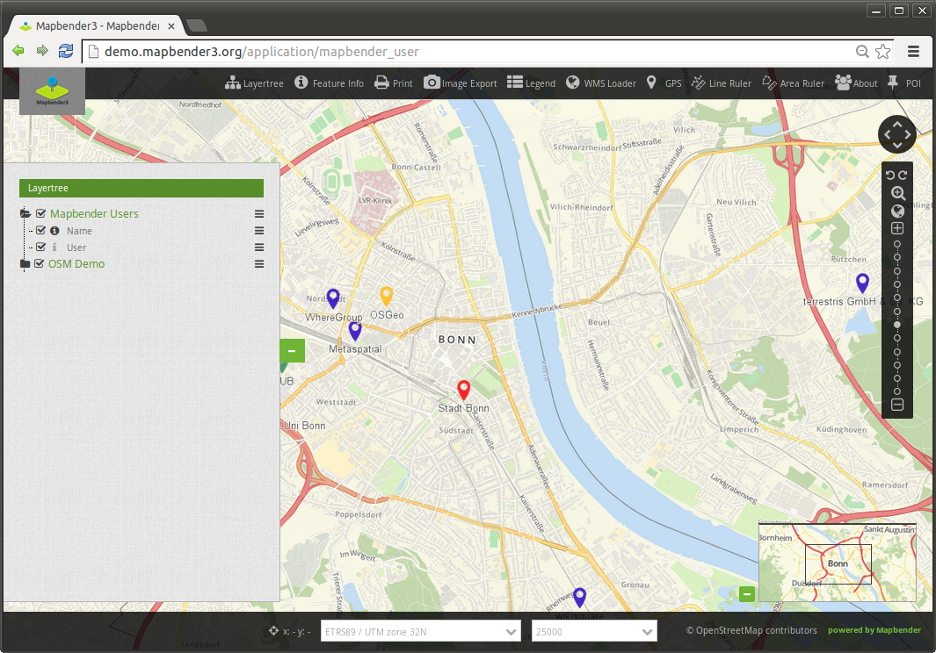
Mapbender-User Demo
Notes:
Basisdienste
Karte
Navigationsleiste (Drag & Drop)
Einfache Diensteübersicht

Slide 6
Workshop
What does Mapbender do?
Architecture and Installation
Register Services
Create your own application
User and group security management
Design adjustments, template printing
Search module and digitizer

Slide 7
What does Mapbender do?

Slide 8
WebGIS Client Suite
with administration web interface

Slide 9
Create a geoportal without writing a single line of code!

Slide 10
Create and maintain an OWS repository

Slide 11
Distribute configured services among applications

Slide 12
Grant users and groups access to
applications and services

Slide 13

Which components does Mapbender3 use?
Symfony2 as PHP framework
  Doctrine, Twig, Monolog, Bootstrap...
  Bundles
OpenLayers2
MapQuery
jQuery
SQLite, PostgreSQL, MySQL, Oracle database

Slide 14

Systemrequirements
>= PHP 5.5.5 (php5)
PHP CLI interpreter (php5-cli)
PHP SQLite extension (php5-sqlite)
PHP PostgreSQL extension (php5-pgsql)
PHP cURL extension (php5-curl)
PHP Internationalization-extension (php5-intl)
PHP GD (php5-gd) (Print)
PHP FileInfo (Print)
PHP Zip
APACHE mod_rewrite
OpenSSL
See requirements

Slide 15
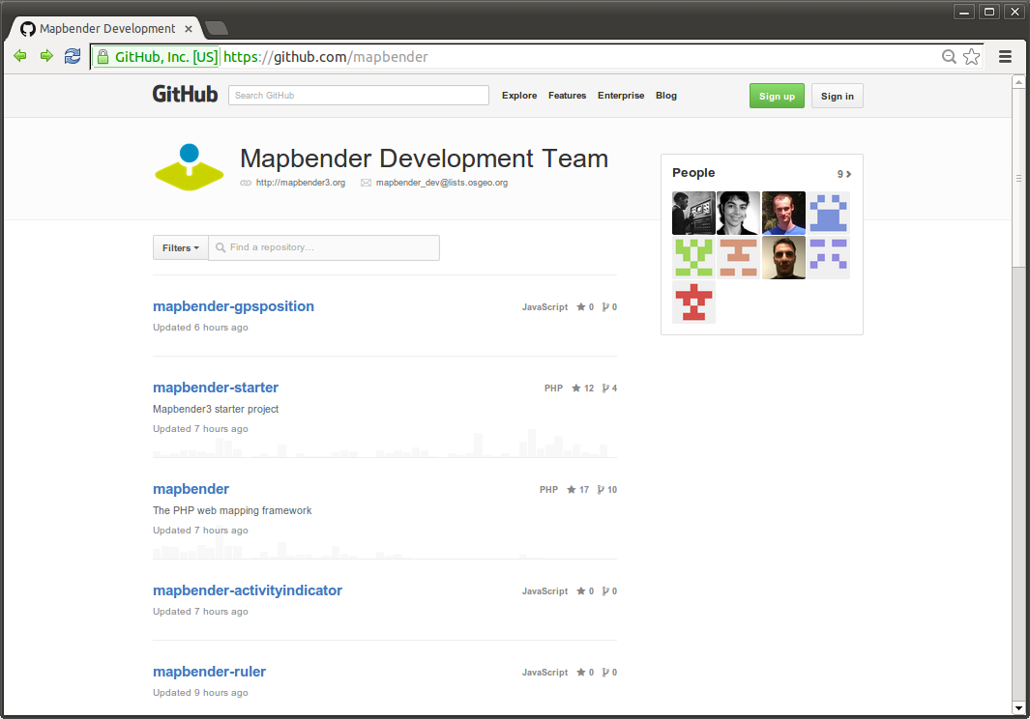
Mapbender3 Code in Git

Slide 16
Installation
Documentation of the Installation
Workshop Installation install_mapbender3.sh of OSGeo-Live
Download http://mapbender3.org/en/download
Or use the code from GitHubhttps://github.com/mapbender/mapbender-starter

Slide 17
Start Mapbender3
Symfony2 test configuration
http://localhost/mapbender3/config.php
Developer mode http://localhost/mapbender3/app_dev.php
Productive mode
http://localhost/mapbender3/app.php

Slide 18
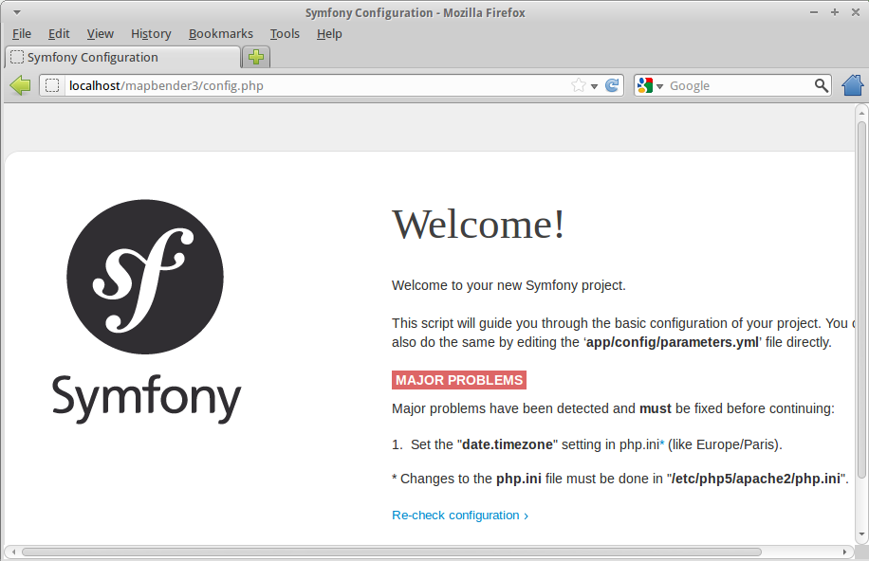
Symfony2 config.php

Slide 19
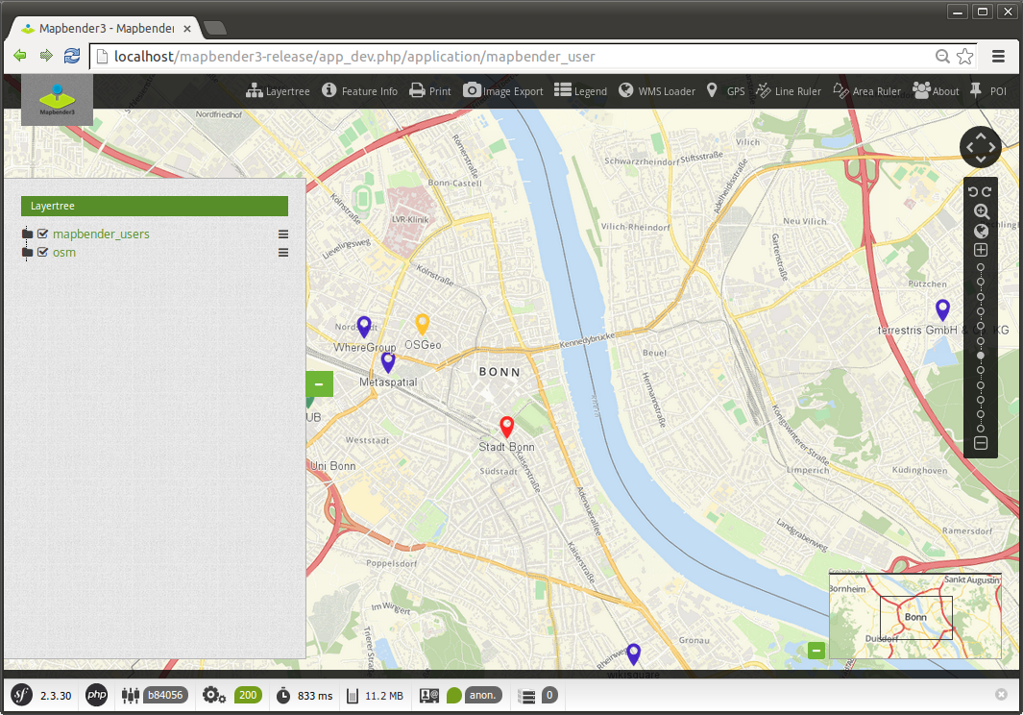
The Symfony Profiler
/app_dev.php

Slide 20
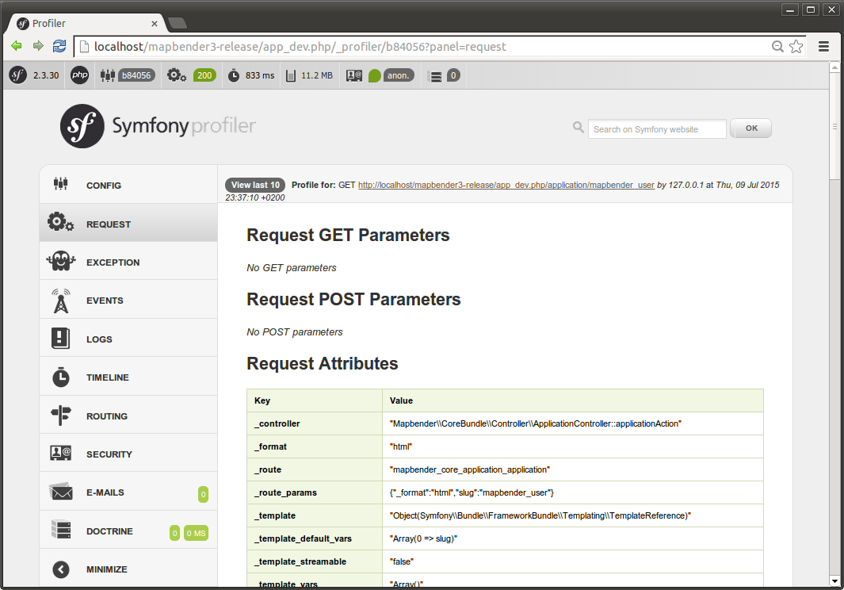
Unterstützung durch den Symfony Profiler

Slide 21
Find Mapbender3 on OSGeo-Live?
ALIAS mapbender3 refers to:
/var/www/html/mapbender3/web/
app_dev.php → mapbender3/web/app_dev.php
Mapbender:
mapbender3/mapbender/src/Mapbender/CoreBundle

Slide 22
YAML
Symfony configuration in YAML
Mapbender3 application can be defined in YAML
  /app/config/mapbender.yml
  Define your application and services
Mapbender3 configure database, language, mailer & more
  parameters.yml
  config.yml

Slide 23
Mapbender3 database
PostgreSQL, Sqlite, ORACLE, MySQL, MS SQL
Tables for WMS, User, Group, Layers etc.
Doctrine integrated in Symfony provides database abstraction layer

Slide 24
Templating
Template → Reference in mapbender.yml:
  Mapbender\CoreBundle\Template\Fullscreen
Css-File
FOM/CoreBundle/Resources/public/css/frontend/
  mapbender3_theme.css → Colour, Icons, Fonts
  fullscreen.scss
Twig Template
Mapbender/CoreBundle/Resources/views/fullscreen.html.twig

Slide 25

Application Overview
Application overview
Call sets Session to Anonymous User
View title, description, screenshot
Start Application

Slide 26
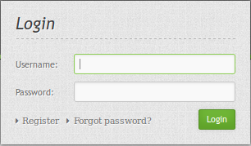
Login
root user is created on installation
You can provide Register and Forgot password functionality

Slide 27
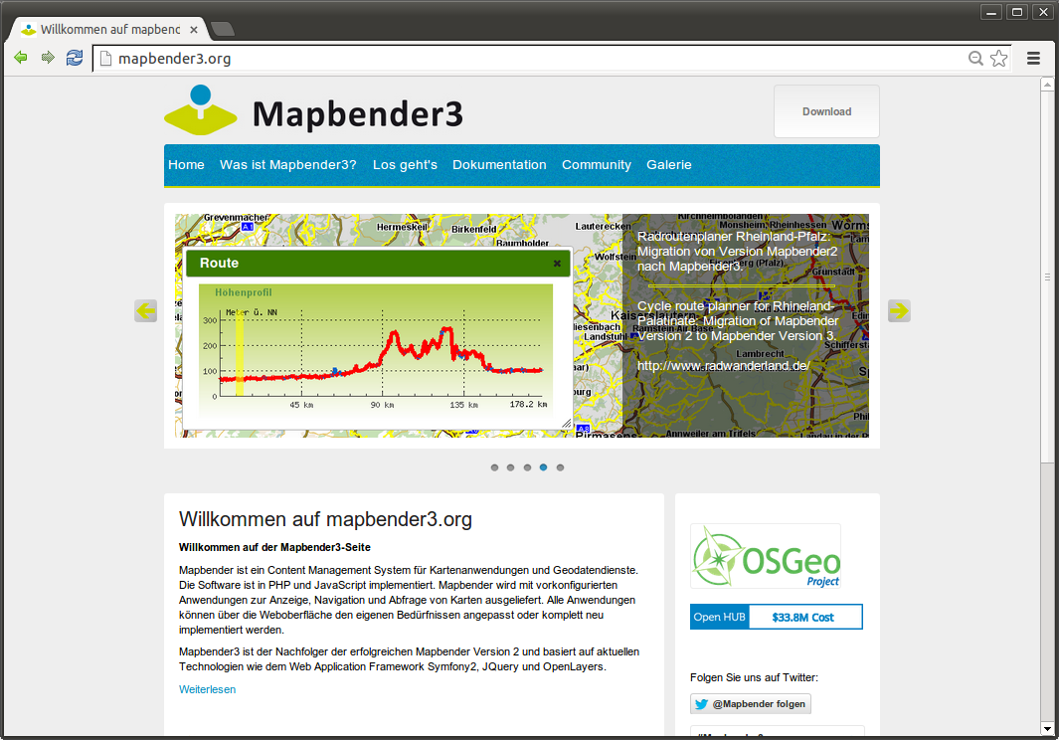

Slide 28
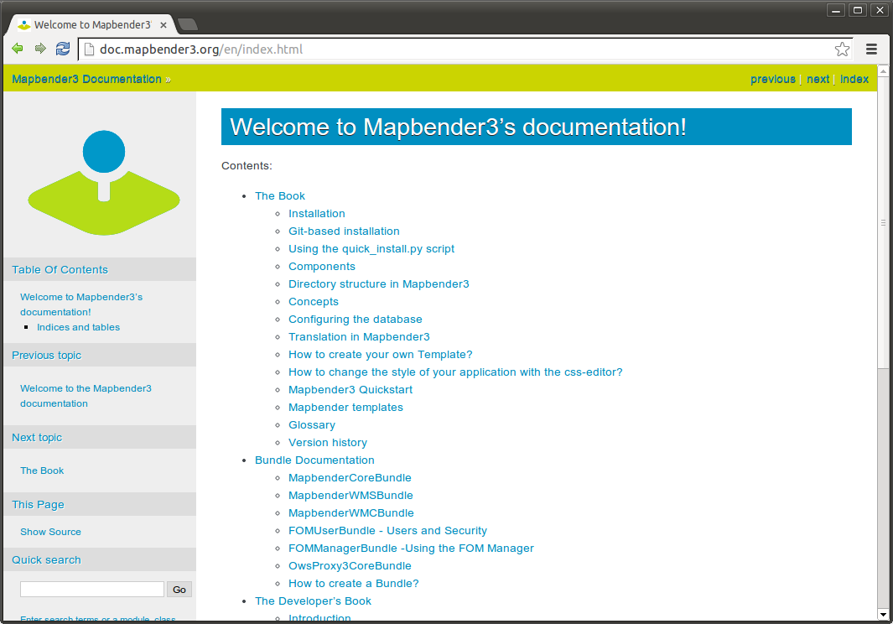

Slide 29
Hands on

Slide 30
Hands on – Part I
Load WMS
Create your own Application
Populate application with Services
Get elements for your application
Create user and groups
Assign application to user and groups
Assign element access to user and groups

Slide 31
Hands on – Part II
Print
Define an individual Design
Create your own bundle
Setup a Search module
Setup a Digitizer module

Slide 32
Mapbender3 Quickstart
http://doc.mapbender3.org/en/book/quickstart.html
element documentation
http://doc.mapbender3.org/en/bundles/Mapbender/CoreBundle/index.html

Slide 33
Load WMS Europe & France
http://osm-demo.wheregroup.com/service?REQUEST=GetCapabilities&Service=WMS&Version=1.3.0
http://wms.wheregroup.com/cgi-bin/germany_workshop.xml?VERSION=1.1.1&REQUEST=GetCapabilities&SERVICE=WMS
France
http://geoservices.brgm.fr/geologie?SERVICE=WMS&VERSION=1.1.1&REQUEST=GetCapabilities
http://geoservices.brgm.fr/risques?SERVICE=WMS&VERSION=1.3.0&REQUEST=GetCapabilities
http://georisques.gouv.fr/services?&SERVICE=WMS&VERSION=1.3.0&REQUEST=GetCapabilities

Slide 34
Load WMS NRW (Germany)
GEOportal.NRW
https://www.geoportal.nrw.de/application-geokatalog/start/index.php
http://www.wms.nrw.de/geobasis/wms_nw_dtk?SERVICE=WMS&VERSION=1.3.0&Request=getCapabilities
http://www.wms.nrw.de/geobasis/wms_nw_alkis_gelb?REQUEST=GetCapabilities&Service=WMS&Version=1.3.0
http://www.wms.nrw.de/geobasis/wms_nw_dop40??SERVICE=WMS&VERSION=1.3.0&Request=getCapabilities

Slide 35
Load WMS
GDI-DE
Search earthquake and geology
http://www.geoportal.rlp.de/mapbender/php/wms.php?inspire=1&layer_id=26216&REQUEST=GetCapabilities&SERVICE=WMS
http://www.wms.nrw.de/gd/GK100?REQUEST=GetCapabilities&SERVICE=WMS

Slide 36
Create your own Application
Generate an application called FOSS4G
Switch to tab Layout
Insert Map-Element in region content
  SRS EPSG:4326
  MAX EXTENT France
    lower left -4.6 42.4 – upper right 9.1 51.4
  Start Extent Paris / Marne-le-Vallé
    lower left 2.5846 48.839
    upper right 2.5904 48.8436

Slide 37
Populate application with Services
Switch to tab Layersets
Create a layerset for the main map and a layerset for the overview map or layersets for different topics
Add WMS to your layersets
If necessary configure the services

Slide 38
Activate Layersets in Map-Element
Go back to layout to your map-Element
Choose the layerset/s you would like to display in the main map

Slide 39
Add elements to your application
Find information about the elements in the documentation
http://doc.mapbender3.org/en/bundles/Mapbender/CoreBundle/
Try to integrate some Elements:
Scaleselect, Navigation Toolbar, Scaledisplay, ShowCoordinates, Overview
Layertree, Legend, Redlining in the sidepane

Slide 40
Discover more elements
Find information about the elements in the documentation
http://doc.mapbender3.org/en/bundles/Mapbender/CoreBundle/
Measure, FeatureInfo, Image Export, LoadWMS
Notice: Some elements need a button to get activated
HTML element
BaseSourceSwitcher
PrintClient

Slide 41
Easy way to get an application
Copy an existing application
reorder elements and delete everything you do not need
add your own services

Slide 42
Create user
Create user foss4ge
User control → User → New User
Define user name, email and password

Slide 43
Assign application to user
Application → pen → Application Security
+ → Select user → Give permission view
Access Control List
Test the permission by registering as user foss4g
Note: You can assign access to single elements

Slide 44
Create a group
Create a group called workshop
User control → Groups → New Group
Add your user foss4ge to the group workshop
Assign an application to your group workshop

Slide 45
CSS Editor
Default style can be overwritten
Switch to tab css-Editor
Define a different background color
Examples:
http://doc.mapbender3.org/en/book/css.html

Slide 46
Try the workshop bundle
Find a workshop bundle at https://github.com/mapbender/mapbender-workshop
http://doc.mapbender3.org/en/book/templates.html
Change the title of the twig file
Change css parameter in the scss file

Slide 47
Search
Define search with SearchRouter
SQL Search
http://doc.mapbender3.org/en/bundles/Mapbender/CoreBundle/elements/search_router.html
Setup a database connection in parameters.yml and config.yml
Define the search form as YAML definition

Slide 48
Digitizer
Define digitze functionality
Edit directly on a database table
YAML definition
http://doc.mapbender3.org/en/bundles/Mapbender/CoreBundle/elements/digitizer.html

Slide 49
More about Mapbender3
http://mapbender3.org
Mapbender3 Code http://github.com/mapbender
Version History http://doc.mapbender3.org/en/book/versions.html
Milestones / Bugtracker https://github.com/mapbender/mapbender/issues

Slide 50
How can I participate?
Testing
Reporting Feedback and Bugs
Documentation
Programming (Git-Code)
Mailing lists
Translation - Join the Translation Sprint is week !!!

Slide 51

Thanks you for your attention!
If you have any question please contact us
Astrid Emde (astrid.emde@wheregroup.com)
or
mapbender-users@list.osgeo.org
With the kind support of
Creative Commons Share Alike License 3.0
Copyright © 2017: Astrid Emde

