Slide 1



Mapbender3
Presentation and Status Report
Astrid Emde
FOSS4G 2017 Paris Marne-la-Vallée (France)

Slide 2



Astrid Emde
Mapbender Team
WhereGroup Bonn (Germany)
FOSSGIS e.V. (OSGeo local chapter)
OSGeo Charter Member since 2010
Involved in
Notes:
Major Mapbender sponsor
Company in Bonn, Germany with 18 employees
Service provider with experience in all fields of spatial data management with free software: WebGIS, SDI, database, relevant standards, trainings, conferences
Open Source projects: Mapbender, PostNAS

Slide 3

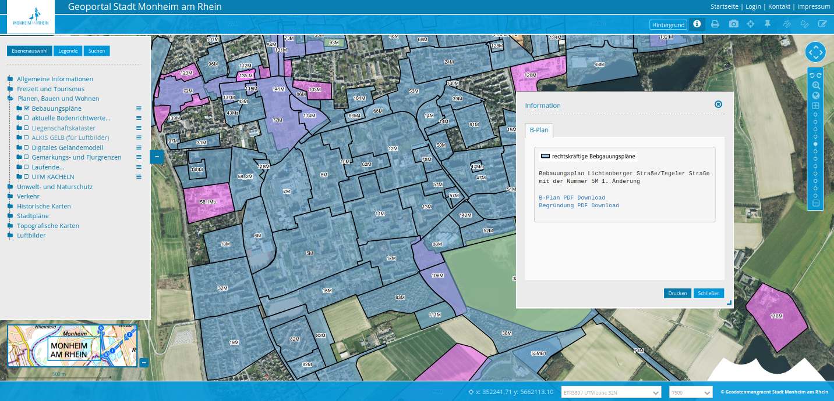


WhereGroup
Notes:
Major Mapbender sponsor
Company in Bonn, Germany with 18 employees
Service provider with experience in all fields of spatial data management with free software: WebGIS, SDI, database, relevant standards, trainings, conferences
Open Source projects: Mapbender, PostNAS

Slide 4
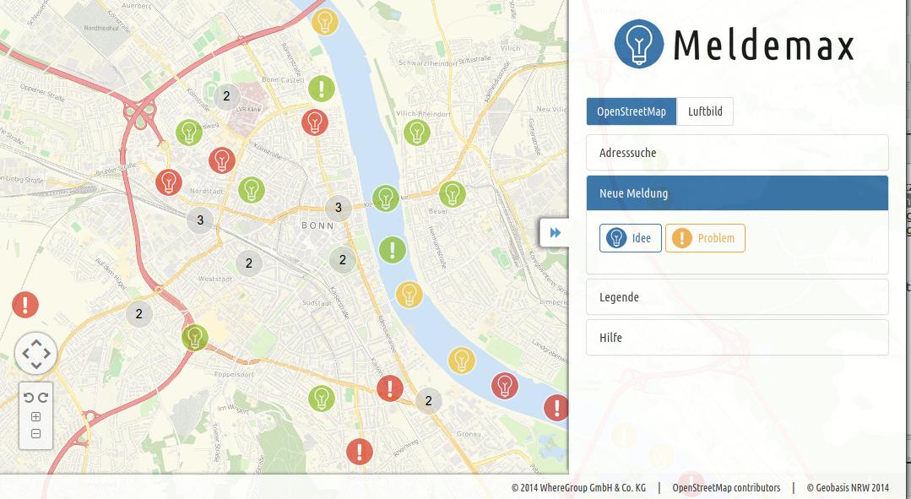
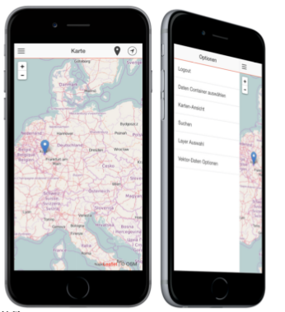
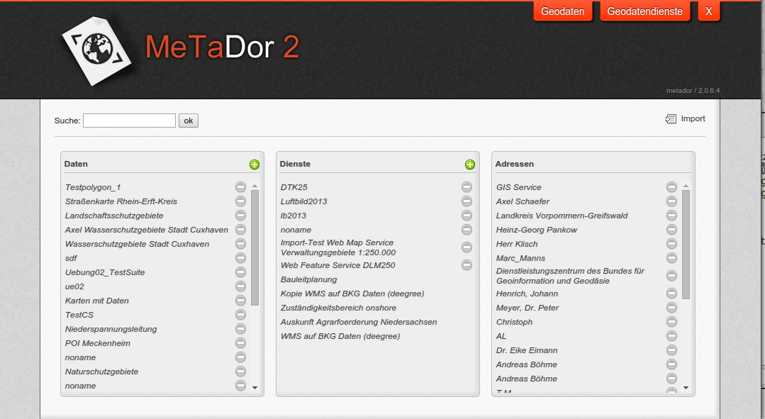
WhereGroup
Meldemax for ideas & problems
Mobile Maps - offline Client
MetaDor2 Metadataeditor
OSM, Consulting, Training
& more
Notes:
Major Mapbender sponsor
Company in Bonn, Germany with 18 employees
Service provider with experience in all fields of spatial data management with free software: WebGIS, SDI, database, relevant standards, trainings, conferences
Open Source projects: Mapbender, PostNAS

Slide 5

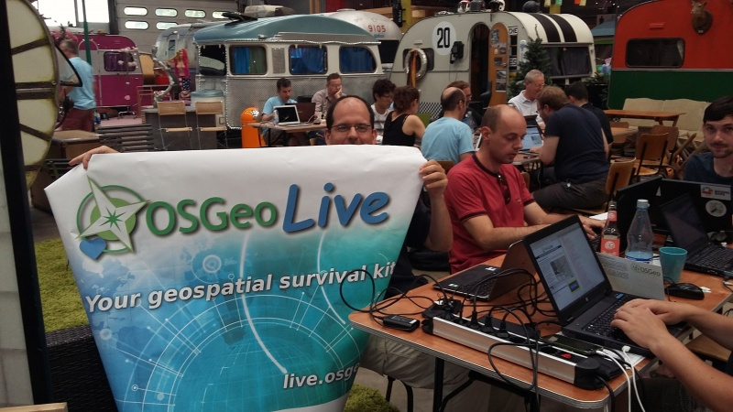
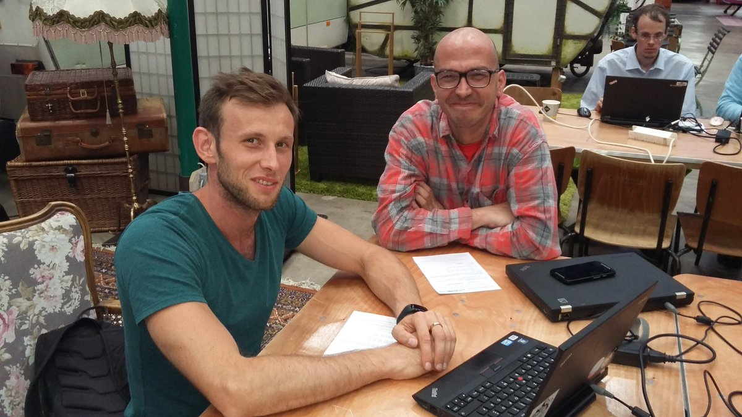
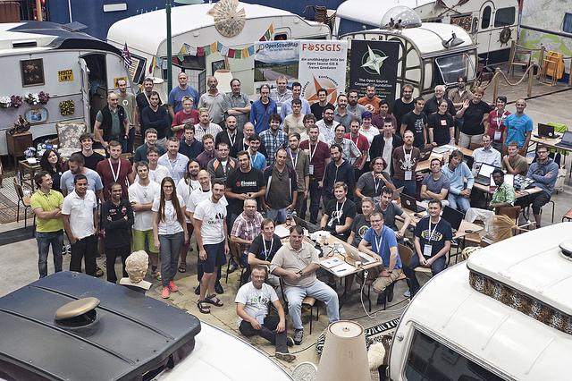
@FOSS4G Code Sprint Basecamp Bonn 2016

Slide 6


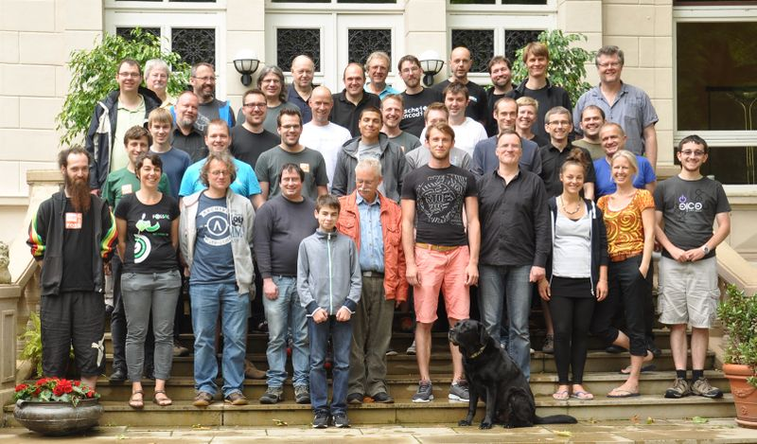




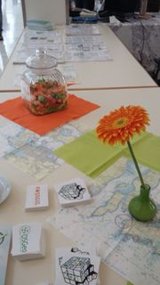
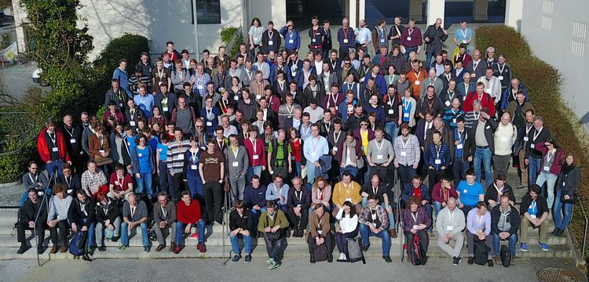

@FOSSGIS Hacking
at Linuxhotel
@Bolsena OSGeo Code Sprint 2010

Slide 7
What does Mapbender do?

Slide 8
Why so many
WebMapping Clients?

Slide 9
What does Mapbender do?

Slide 10
WebGIS Client Suite
with administration web interface

Slide 11
Create a geoportal without writing a single line of code!

Slide 12
Create and maintain an OWS repository

Slide 13
Distribute configured services among applications

Slide 14
Grant users and groups access to
applications and services

Slide 15
The Mapbender components
Applications
Services
Roles

Slide 16
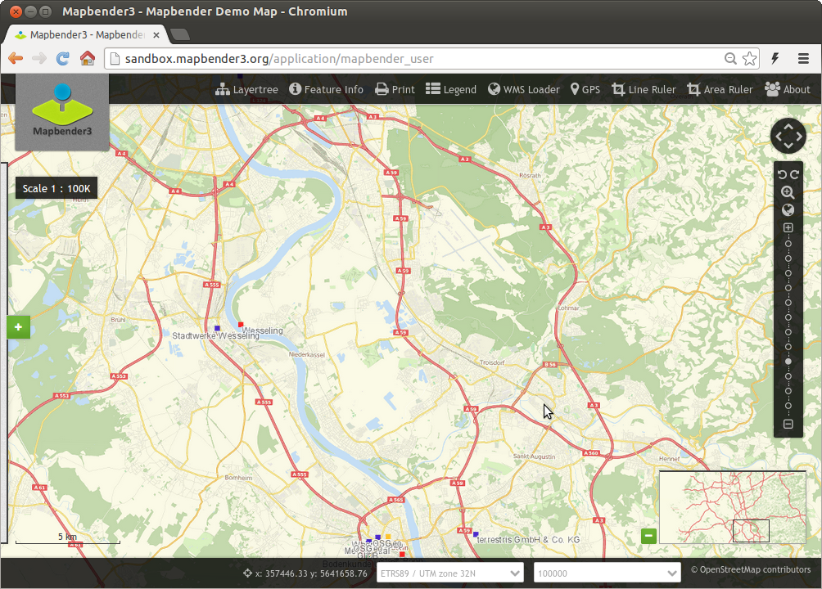
Notes:
Basisdienste
Karte
Navigationsleiste (Drag & Drop)
Einfache Diensteübersicht

Slide 17
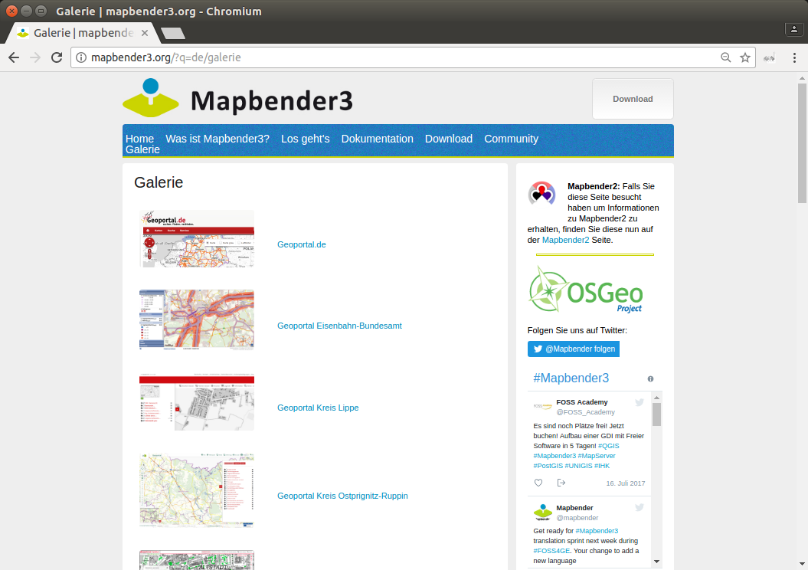

Slide 18
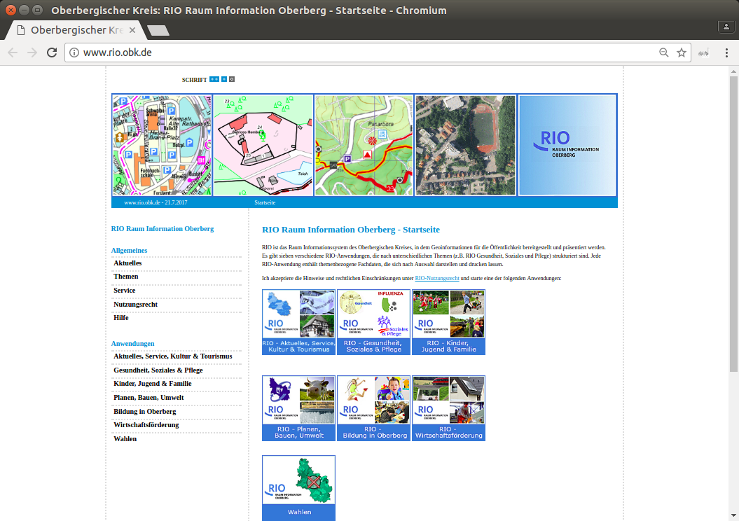

Slide 19
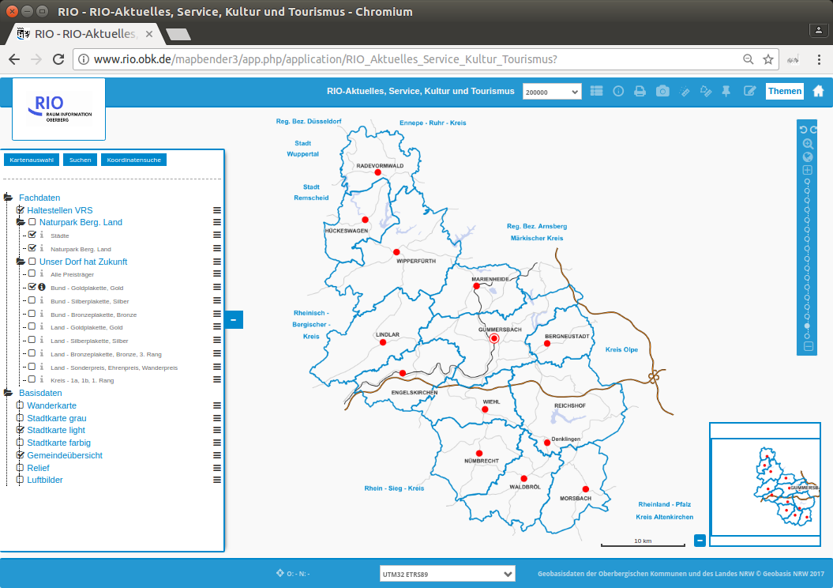

Slide 20


Slide 21
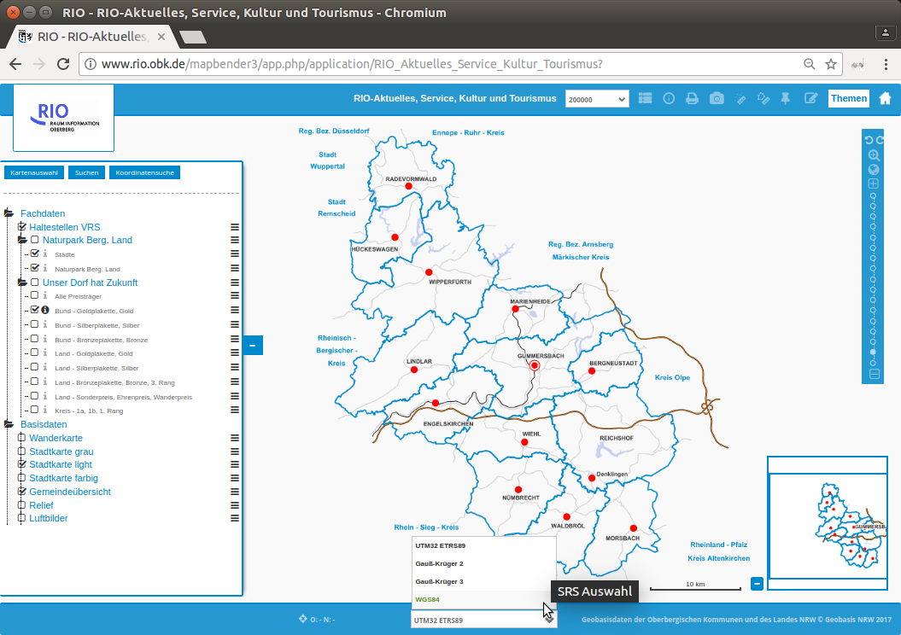

Slide 22
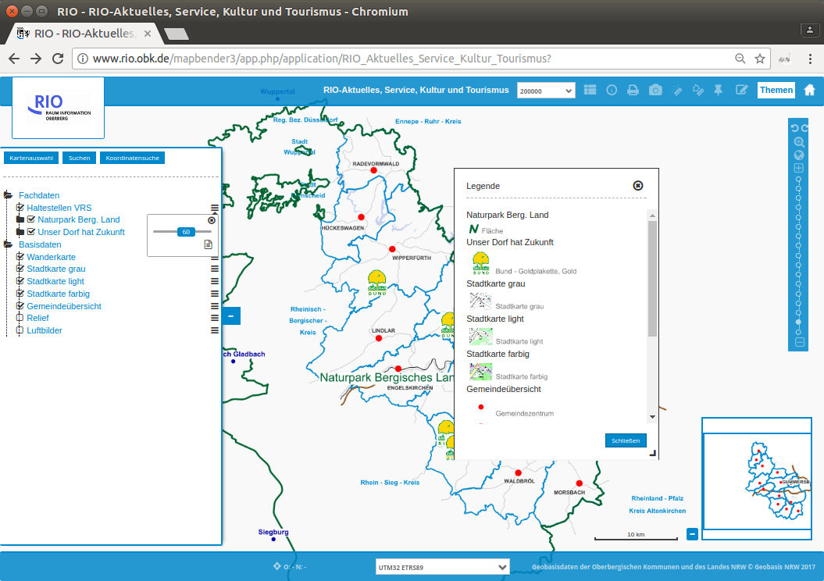

Slide 23
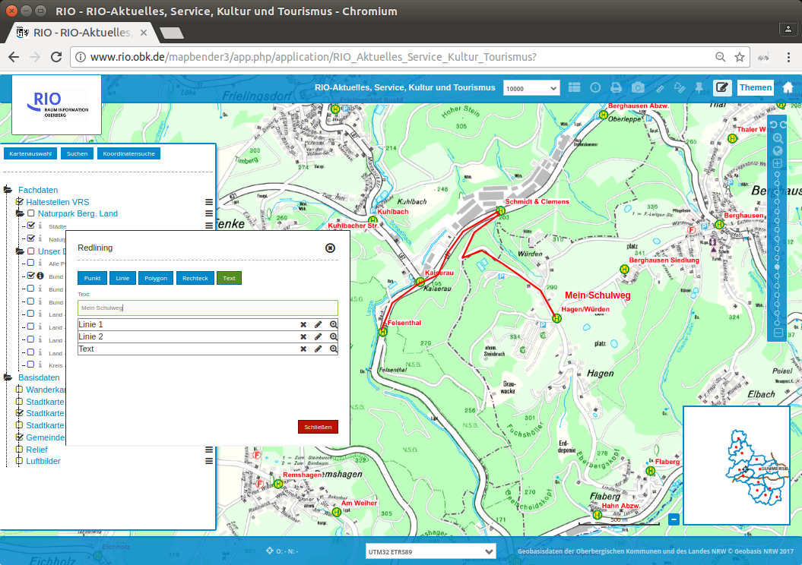

Slide 24
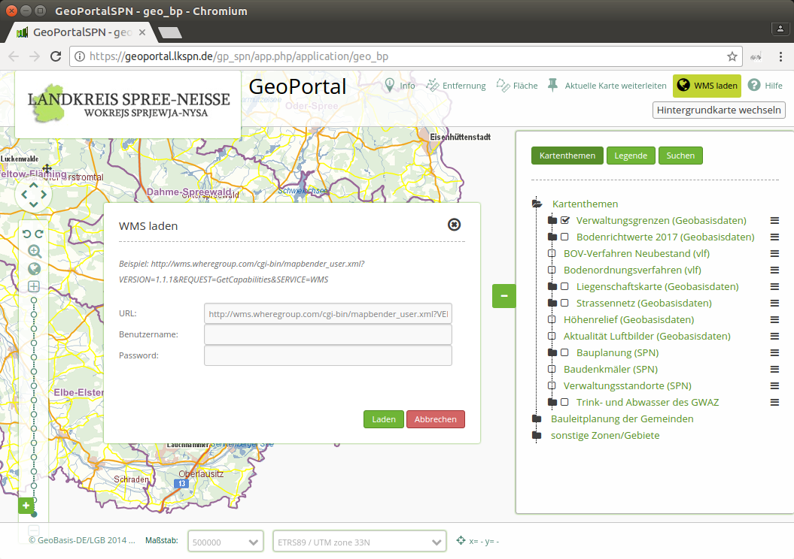

Slide 25
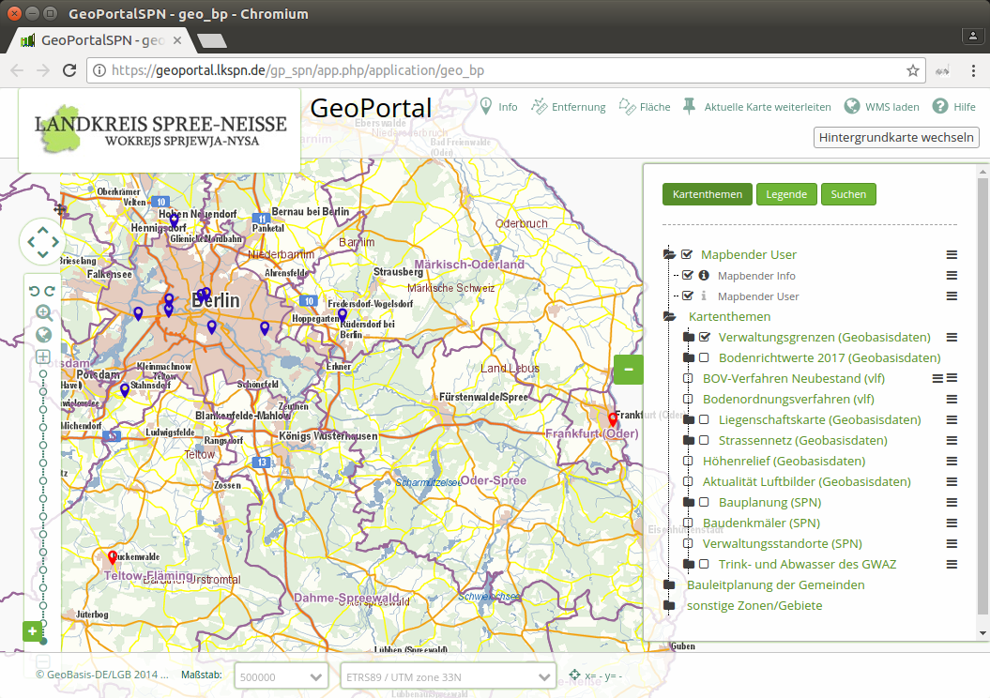

Slide 26
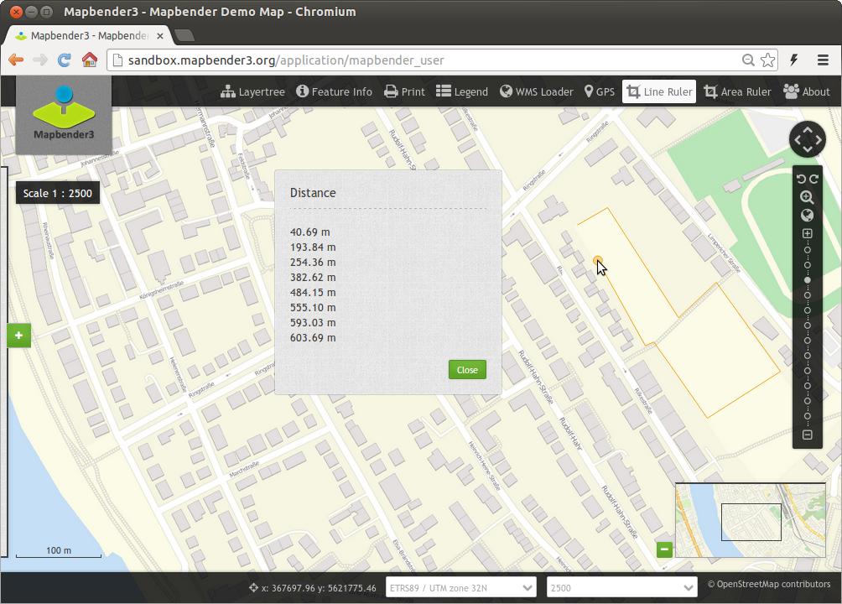

Slide 27
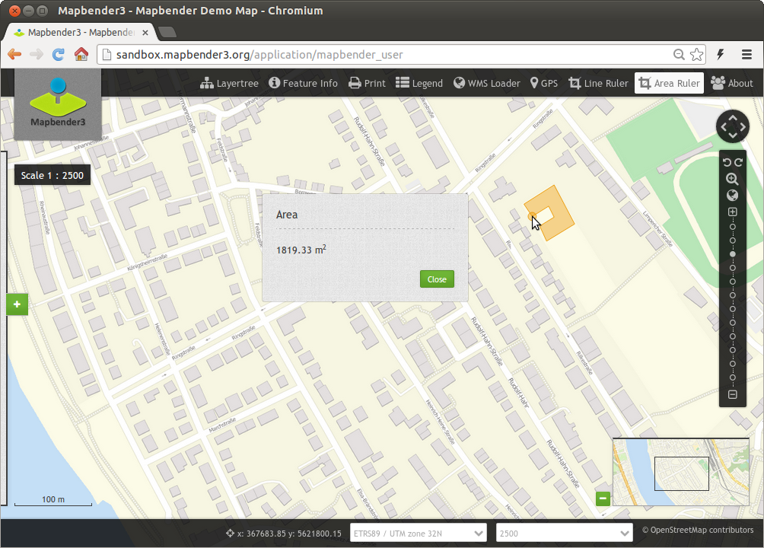

Slide 28
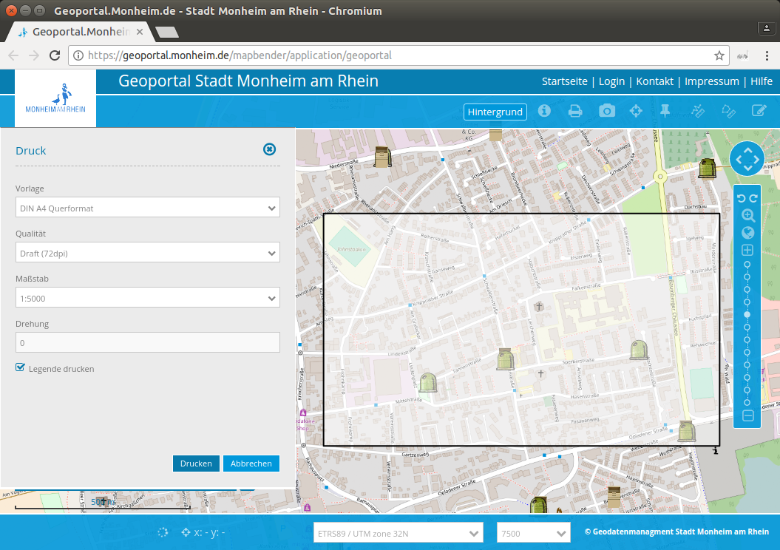

Slide 29
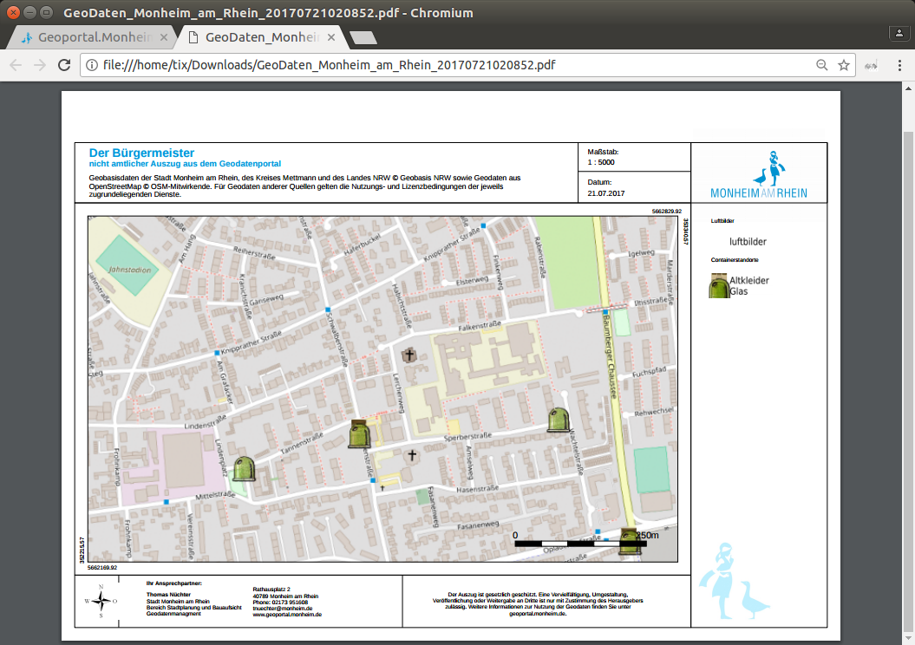

Slide 30
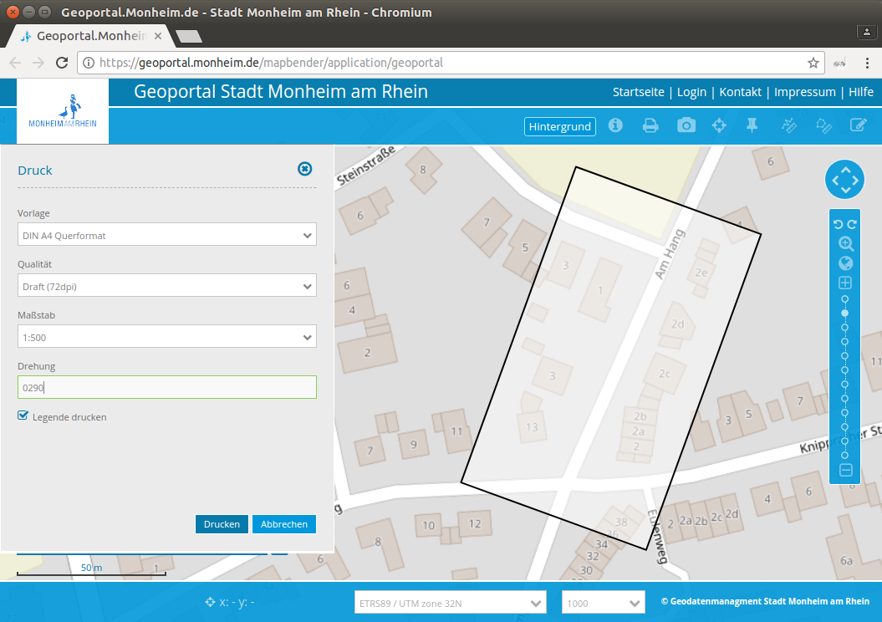

Slide 31
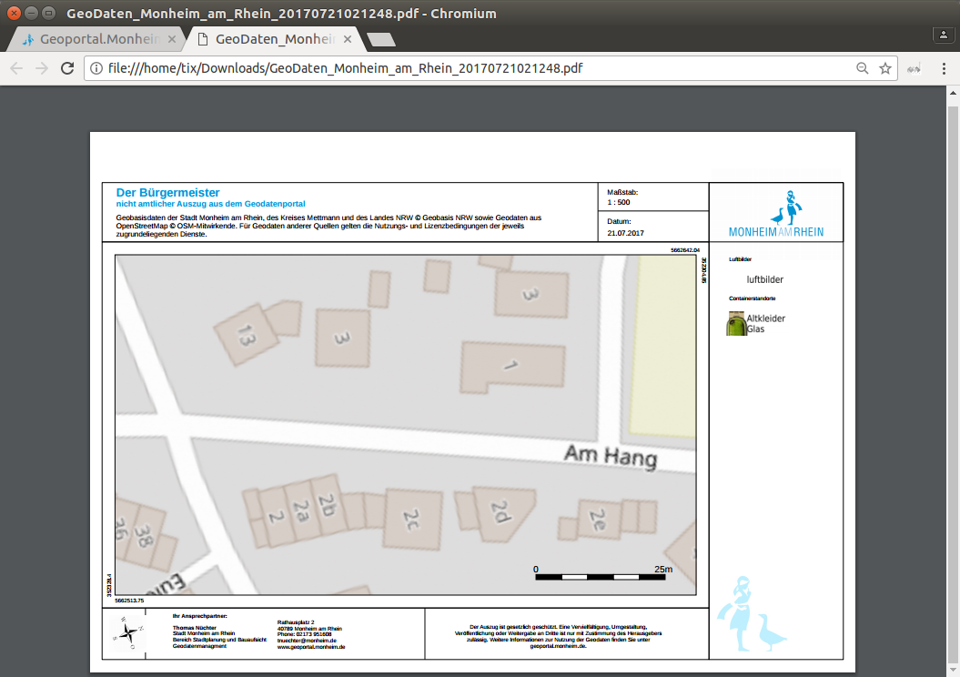

Slide 32
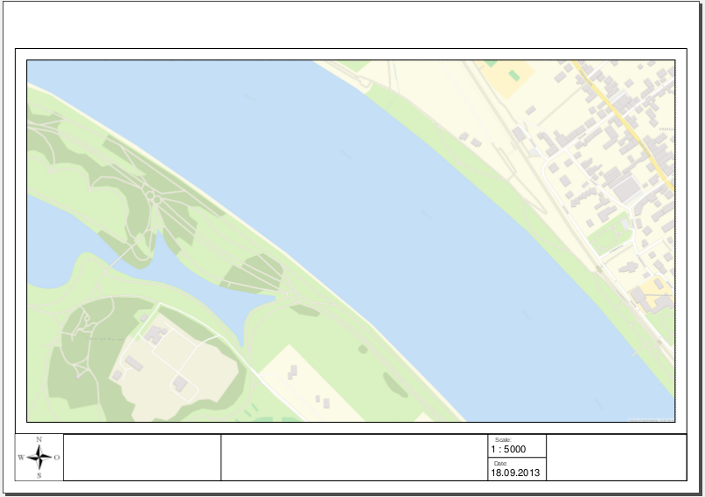

Slide 33
Set up your own application

Slide 34
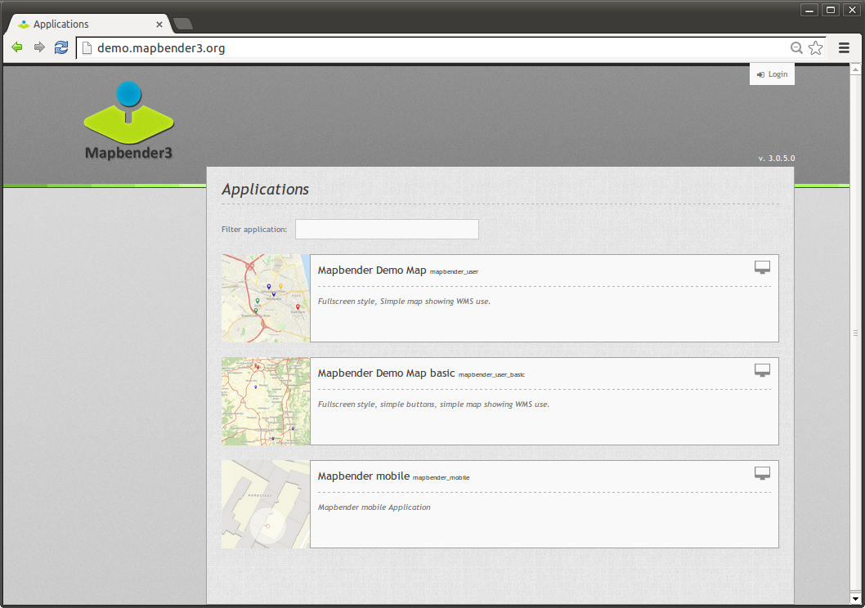

Slide 35
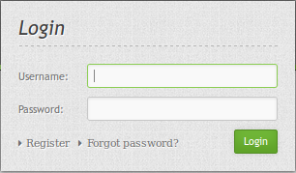
Login
root user is created on installation
You can provide register and Forgot password functionality

Slide 36
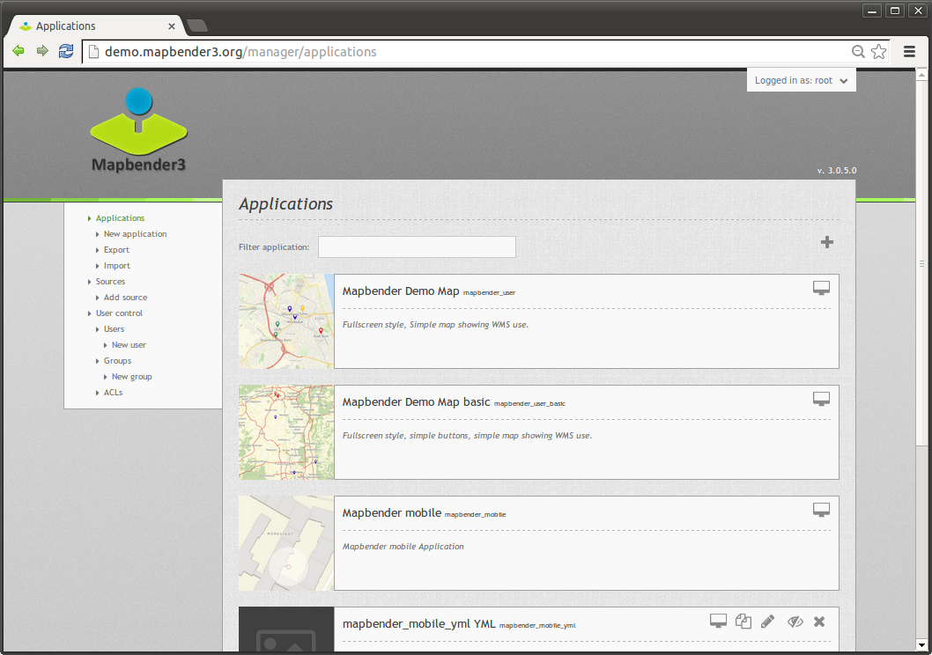

Slide 37
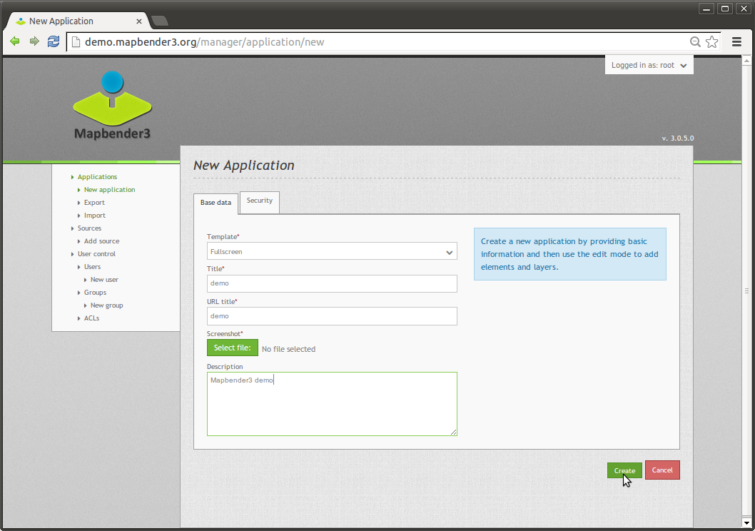

Slide 38
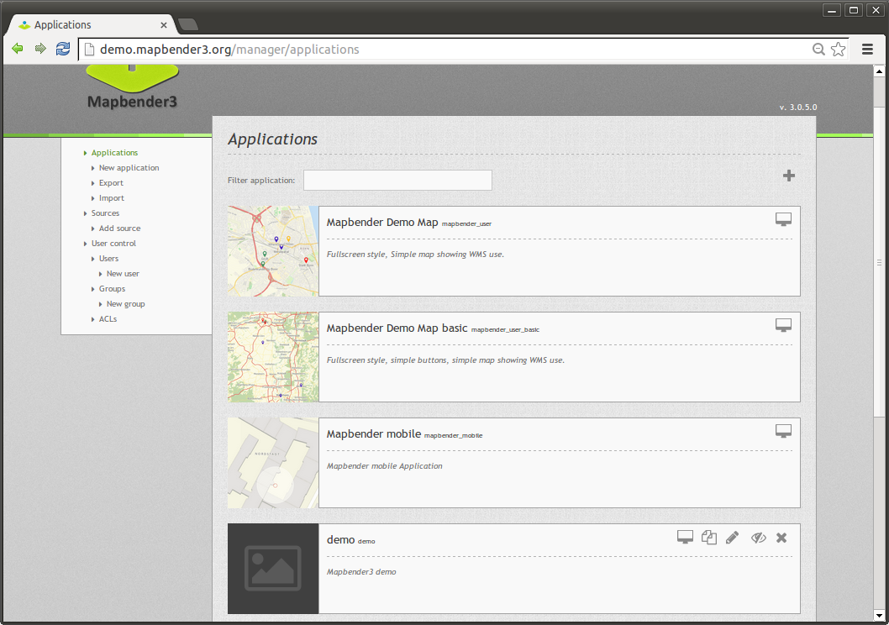

Slide 39
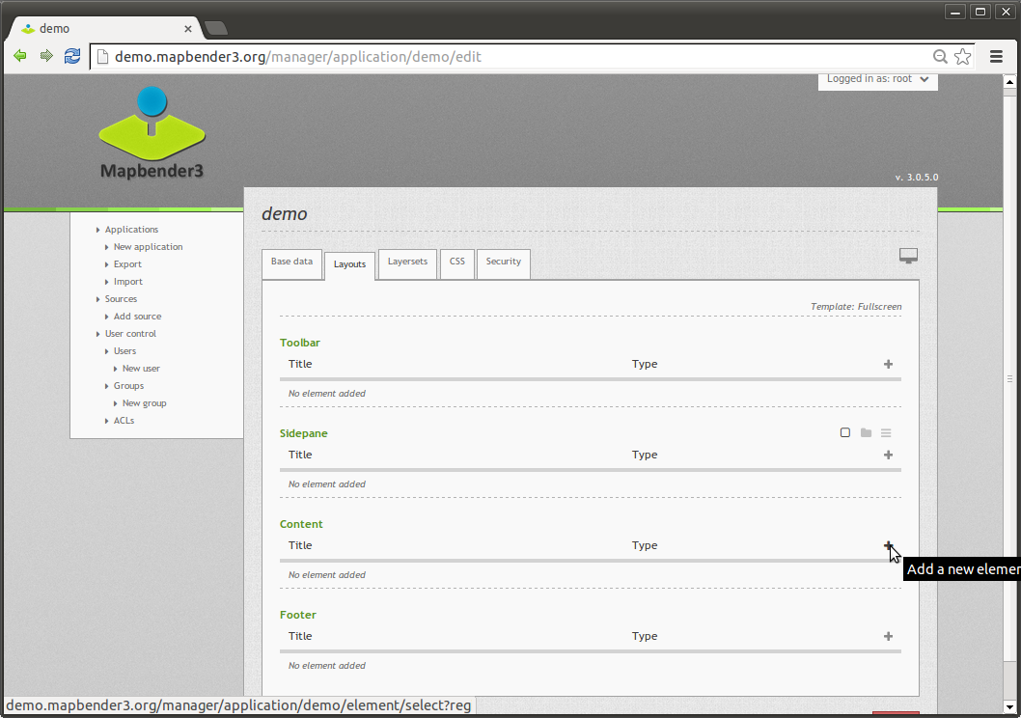

Slide 40
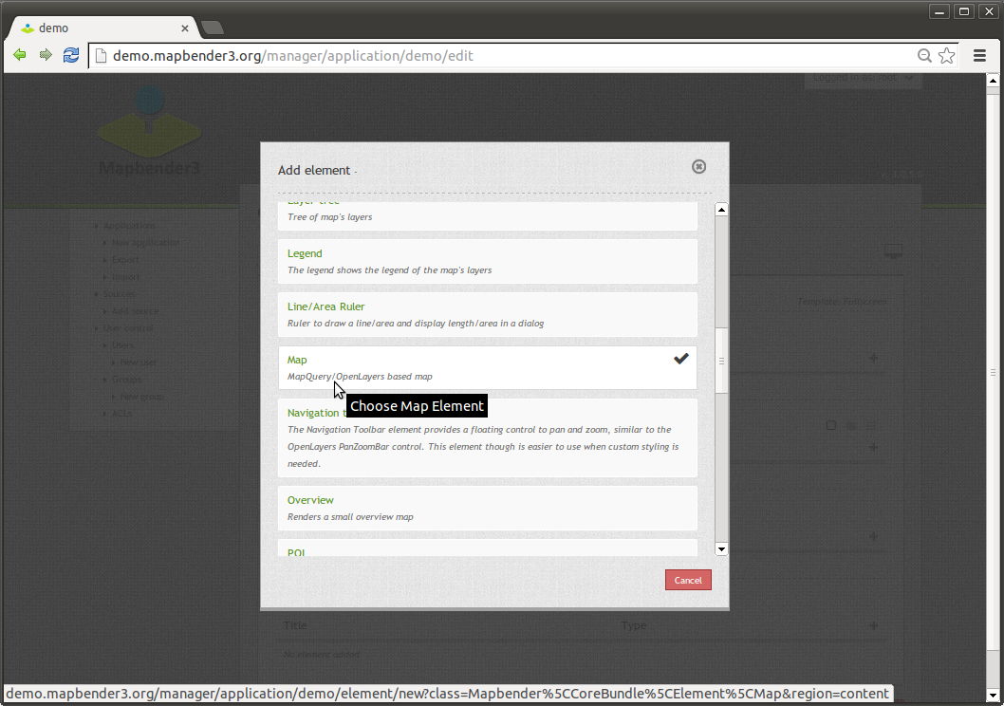

Slide 41
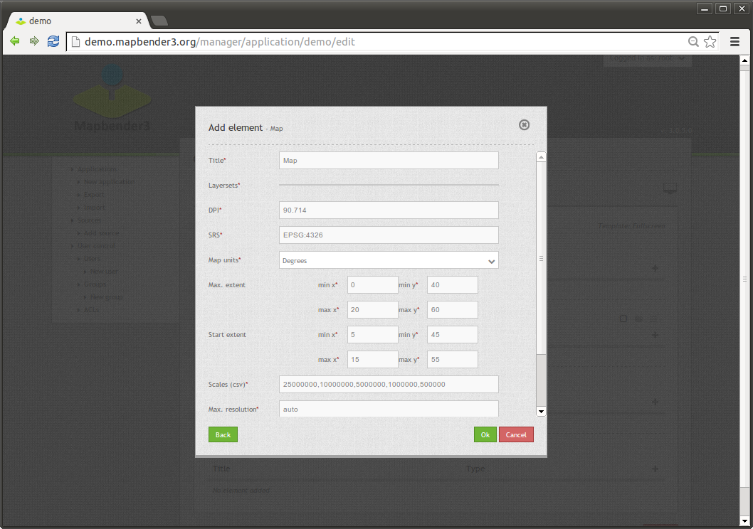

Slide 42
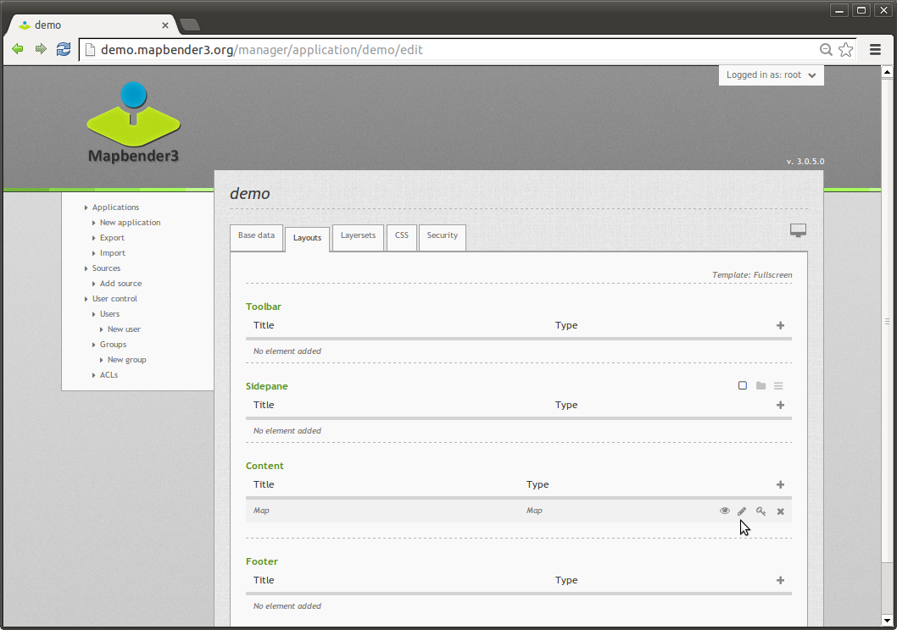

Slide 43
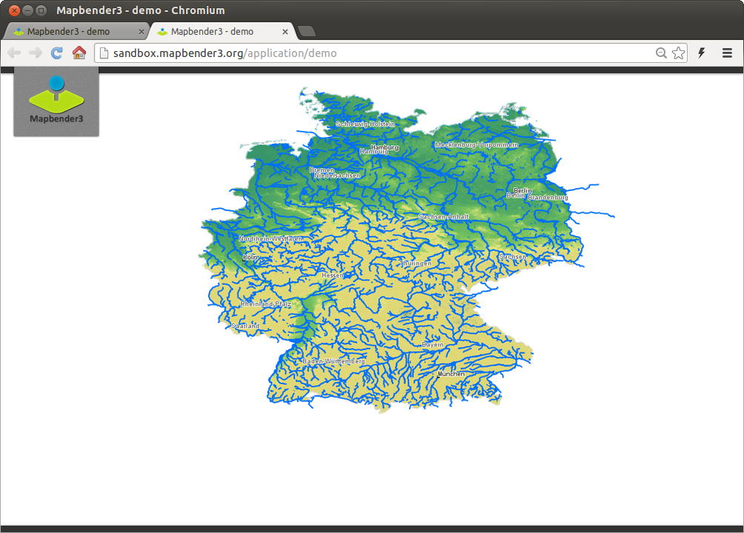

Slide 44
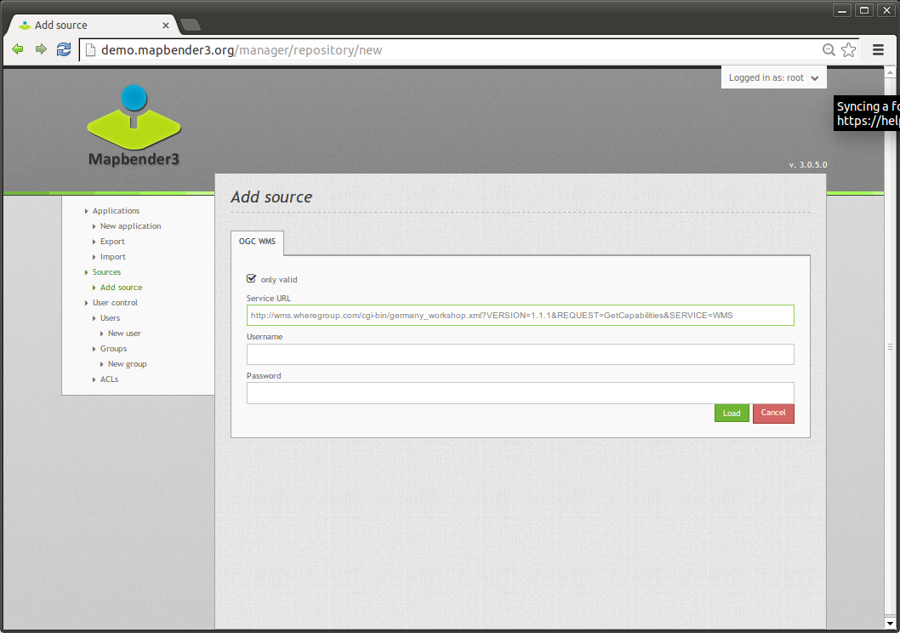

Slide 45
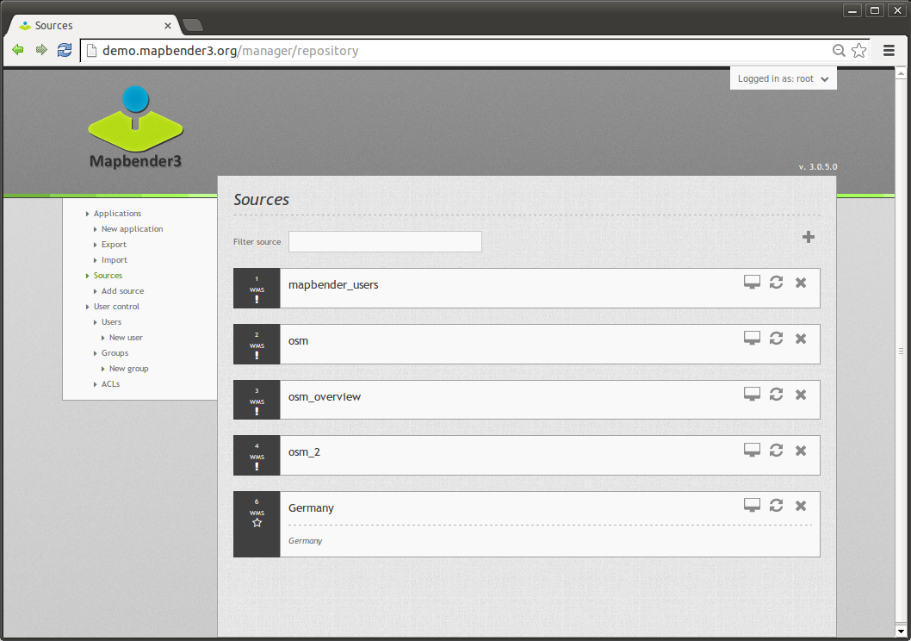

Slide 46
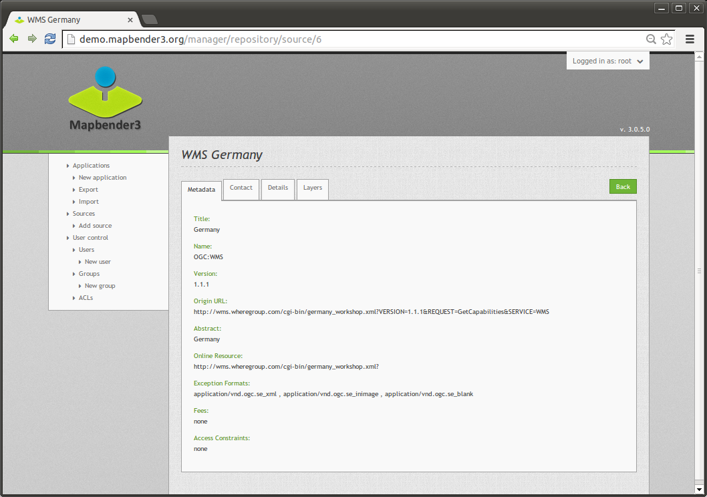

Slide 47
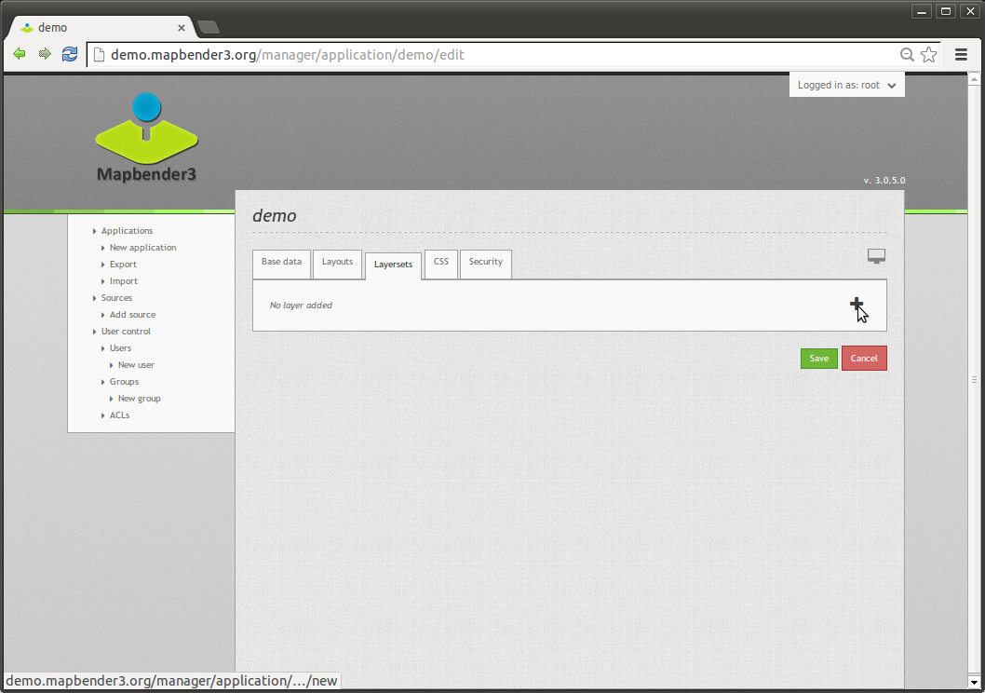

Slide 48
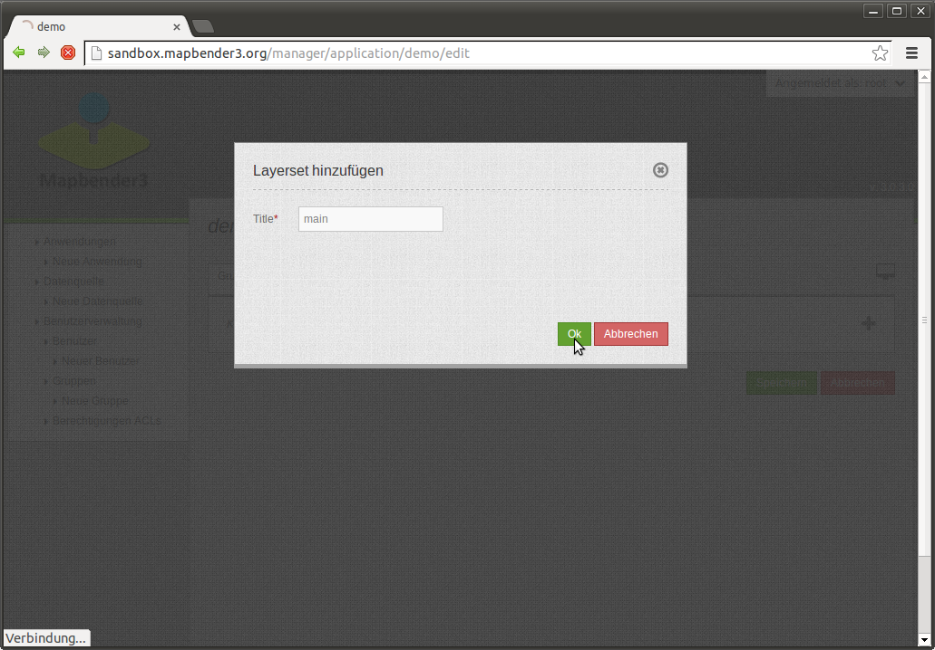

Slide 49
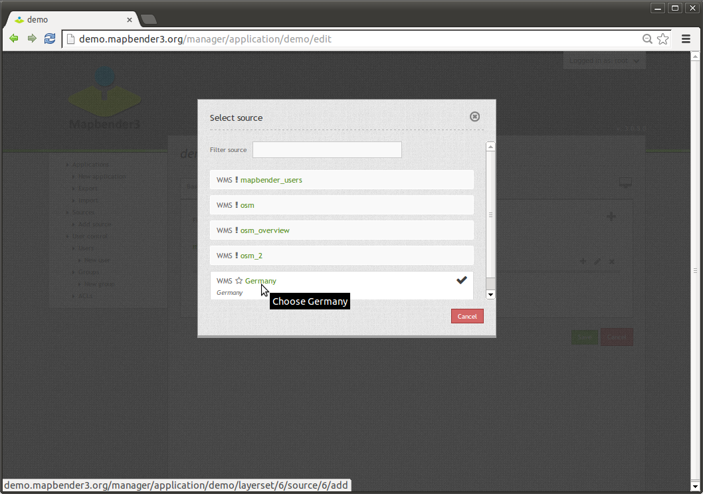

Slide 50
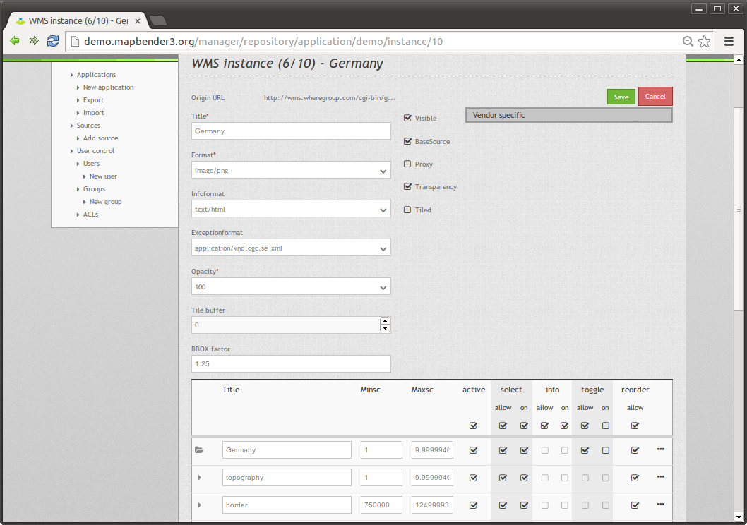

Slide 51
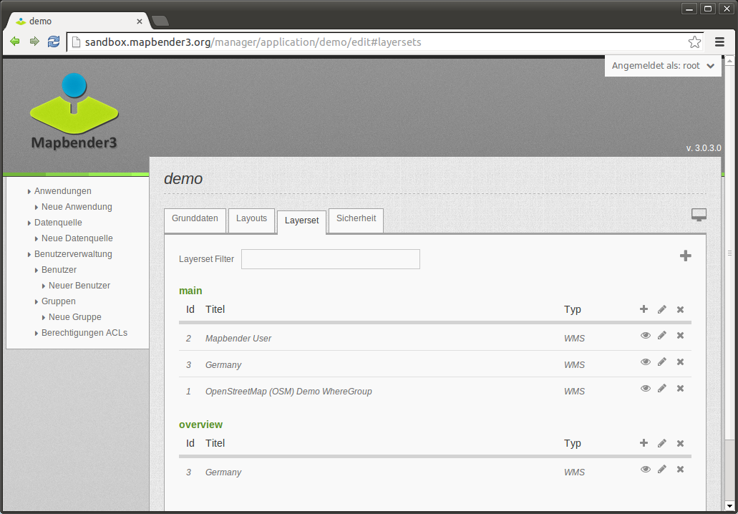

Slide 52
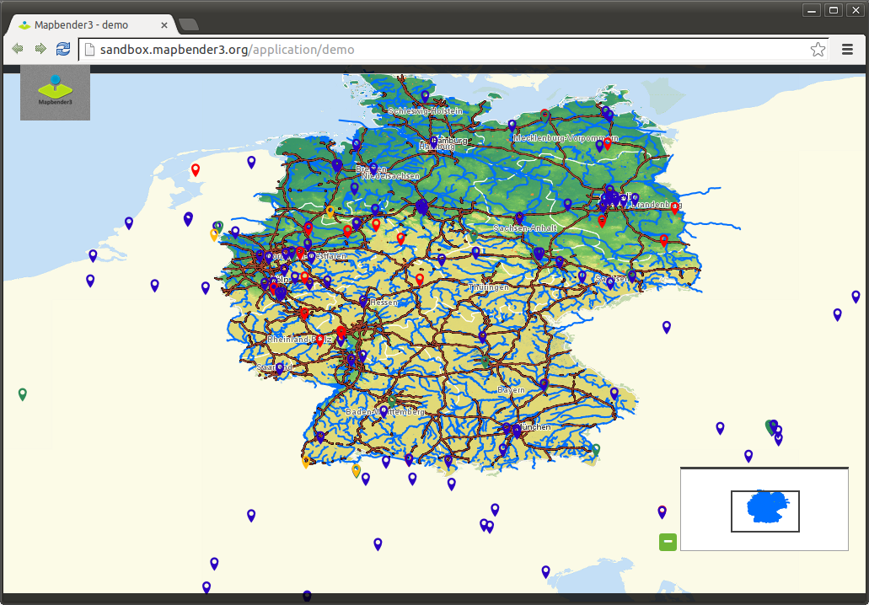

Slide 53
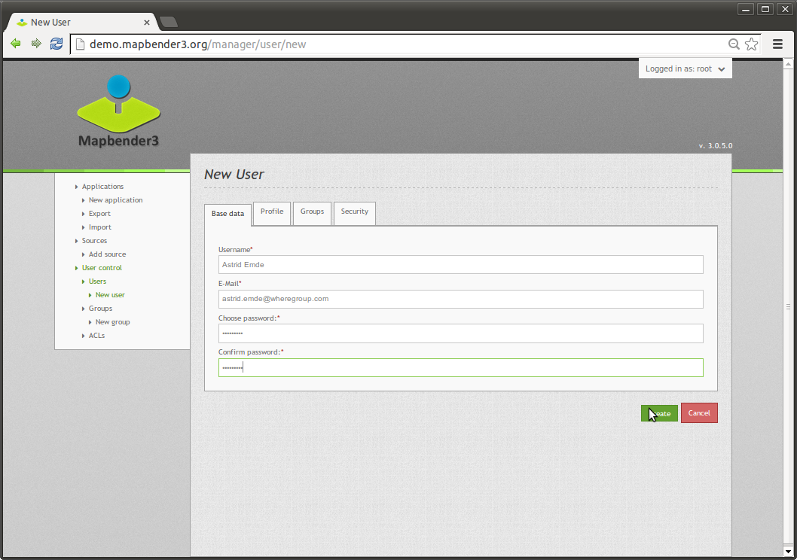

Slide 54
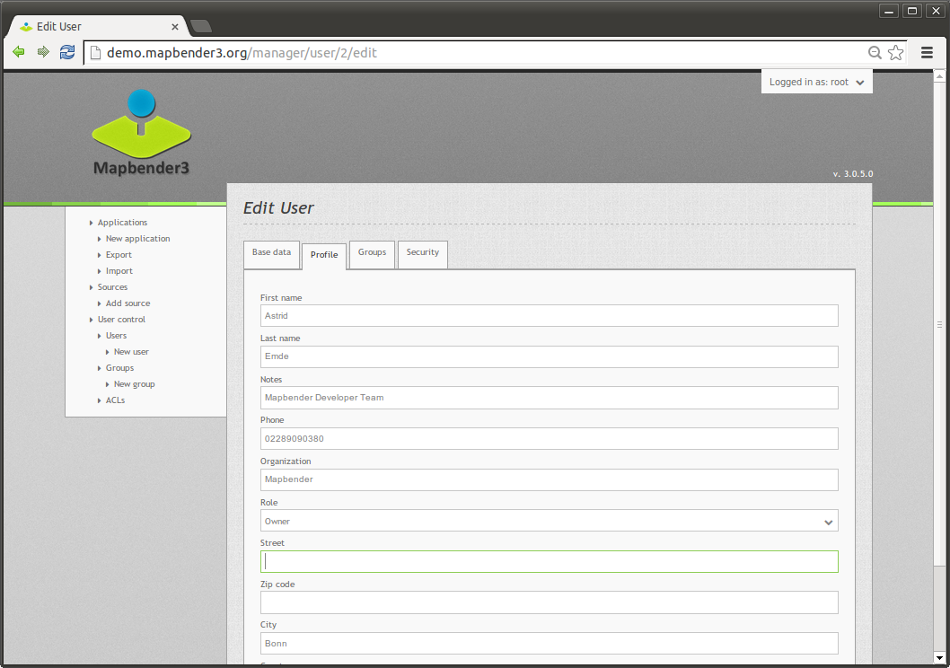

Slide 55
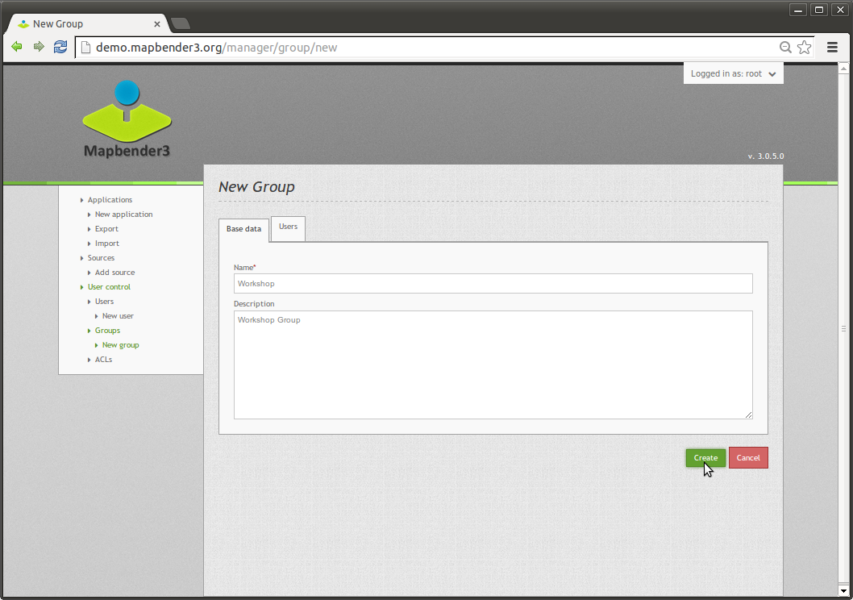

Slide 56
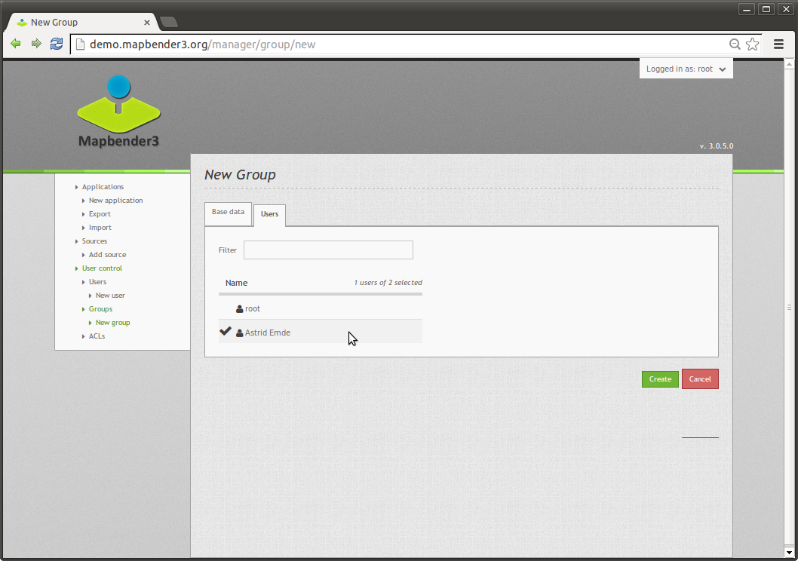

Slide 57
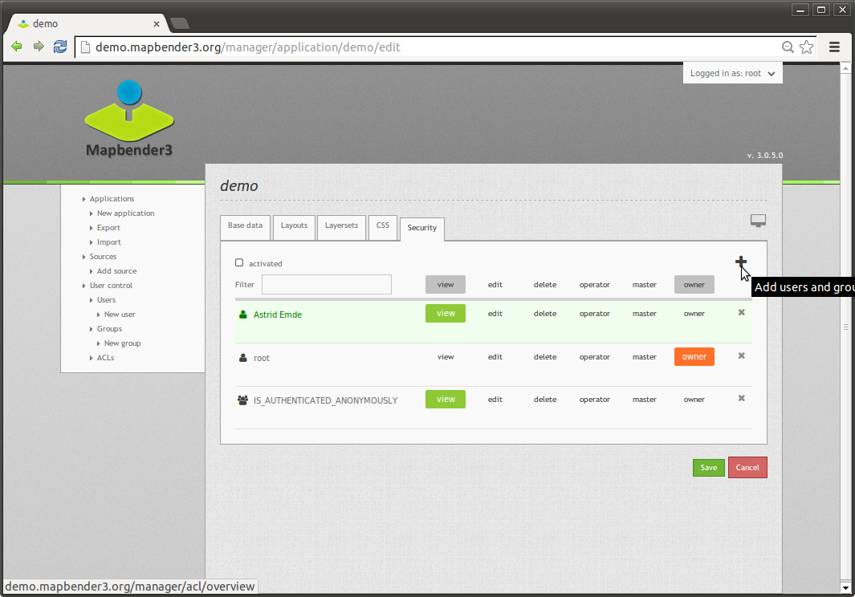

Slide 58


Slide 59


Slide 60

https://demo.mapbender3.org/application/foss4g_europe_2017?poi%5Bpoint%5D=2.58738%2C48.84092&poi%5Bscale%5D=5000&poi%5Bsrs%5D=EPSG%3A4326&poi%5Blabel%5D=FOSS4G+Europe+2017

Slide 61


Slide 62


Slide 63


Slide 65

Configuration SearchRouter
class: Mapbender\CoreBundle\Component\SQLSearchEngine
class_options:
connection: search_db
relation: ortschaften
attributes:
- gid
- ortsname
geometry_attribute: geom
form:
ortsname:
type: text
options:
required: true
compare: exact
results:
view: table
count: true
headers:
gid: ID
ortsname: Name
callback:
event: click
….

Slide 66

Solr Search

Slide 67

Solr Search
SimpleSearch

Slide 68

Basesource Switcher

Slide 69


Slide 70


Slide 71


Slide 72


Slide 73


Slide 74

Stadtplan Troisdorf

Slide 75



Slide 76



Slide 77

Mobile Template

Slide 78

Editing data with the Digitizer

Slide 79

View in Table
Tabular display of objects
scroll through the data
View only the objects of the current extent
Definition of table columns to display the results
Allow delete and edit
Search in data
Notes:
Symfony2 – Web Application Framework
Doctrine – Datenbankabstraktion
OpenLayers – Kartenansicht
JQuery UI – Anwendungswidgets (Dialoge, Tabs, etc)
MapQuery – Verbindung OpenLayers/jQuery

Slide 80
Digitalization
Point, Line and Area
Different functionalities related to the geometry type
drawRectangle
drawCircle
drawEllipse
drawPoint
drawLine
drawPolygon
drawDonut
modifyFeature
moveFeature
selectFeature
removeSelected
Notes:
Symfony2 – Web Application Framework
Doctrine – Datenbankabstraktion
OpenLayers – Kartenansicht
JQuery UI – Anwendungswidgets (Dialoge, Tabs, etc)
MapQuery – Verbindung OpenLayers/jQuery

Slide 81

Digitalization

Slide 82


Slide 83

Which components does Mapbender3 use?
MIT licensed
Symfony2 as PHP framework
  Doctrine, Twig, Monolog, Bootstrap...
  Bundles
OpenLayers2
MapQuery
jQuery
SQLite, PostgreSQL, MySQL, Oracle database
Notes:
Symfony2 – Web Application Framework
Doctrine – Datenbankabstraktion
OpenLayers – Kartenansicht
JQuery UI – Anwendungswidgets (Dialoge, Tabs, etc)
MapQuery – Verbindung OpenLayers/jQuery

Slide 84
Version 3.0.6.2 was release yesterday!
Thanks to the Mapbender3 team!
Bugfix Release with some fixes
We make Releases more often – every 2-3 month
Notes:
Symfony2 – Web Application Framework
Doctrine – Datenbankabstraktion
OpenLayers – Kartenansicht
JQuery UI – Anwendungswidgets (Dialoge, Tabs, etc)
MapQuery – Verbindung OpenLayers/jQuery

Slide 85
Version 3.0.6.0
Major release with many changes & refactoring
5. May 2017
Symfony 2.8
No submodules, integration with composer
Support of PHP 7
Easy installer with bootstrapping script
Some new features
https://doc.mapbender3.org/en/book/versions.html
Notes:
Symfony2 – Web Application Framework
Doctrine – Datenbankabstraktion
OpenLayers – Kartenansicht
JQuery UI – Anwendungswidgets (Dialoge, Tabs, etc)
MapQuery – Verbindung OpenLayers/jQuery

Slide 86


Mapbender3 3.0.6.1 on OSGeo-Live 11.0
3.0.6.1 was released
24. May 2017
Ready for FOSS4G
Boston
We use OSGeo-Live
in our workshops
& at conferences
Great for usage
& promotion!

Slide 87
Mapbender3 3.0.6.1 on MS4W 3.2.2
Released 13. 7. 2017 with MapServer 7.0.6
MS4W - MapServer For Windows
Provided by Jeff McKenna. Big thanks to Jeff!
Mapbender is part of it since several years
About 200 downloads in 2 days after the release

Slide 88

Docker image for Mapbender3
We have a docker image for Mapbender3
https://hub.docker.com/u/mapbender/
Ask Arne Schubert for more information

Slide 89
Activities in the team
Chair Axel Schaefer is new Chair
Architect Andriy Oblivantsev
PSC
    Olaf Knopp
    Arash Rashid Pour
    Astrid Emde
    David Patzke
    Rolf Neuberger
    Frederik Häfker

Slide 90
Activities in the team
Regular meetings in Bonn
  pros: face-to-face, good discussions, milestones, releases more often, clean up
  cons: in german, not very transparent
Ticket system on GitHub is used as major system
Many developer, many user
Many contributions
We are working an reincubation – we will check whether we still follow the rules

Slide 91

Mapbender User Reference Map
Try digitizer and add yourself as Mapbender3 User
https://demo.mapbender3.org/application/mapbender_user_reference

Slide 92
Version 3.0.7
Feature Release
Translations from translation sprint will come
UTFGrid
LDAP directly from Symfony – ask Arne Schubert
Some more elements – feature freeze has to be defined
Notes:
Symfony2 – Web Application Framework
Doctrine – Datenbankabstraktion
OpenLayers – Kartenansicht
JQuery UI – Anwendungswidgets (Dialoge, Tabs, etc)
MapQuery – Verbindung OpenLayers/jQuery

Slide 93

Digitizer - Clustering
in progress
poi:
...
clustering:
- scale: 10000
distance: 60
- scale: 2500
distance: 40
- scale: 1000
distance: 20
- scale: 500
distance: 1
disable: true
distance: Distance between features in meters to start the clustering
disable: Disables the clustering

Slide 94

Digitizer - Context menu
in progress
poi:
...
useContextMenu: true
….

Slide 95

Edit data without geometry
in progress
e.g. tree species, interests

Slide 96

Query_Builder for evaluation
in progress
Embed, view and edit SQL queries
Export results

Slide 97


Pick on klick or Zoom to coordinate
in progress

Slide 98
Join us on Saturday
Join us at OSGeo Codesprint at FOSS4G Europe 2017
Saturday 2017-07-22
Translation sprint is going on this week!
Debian package for Mapbender3
Update docker to new version 3.0.6.2
& more
You can meet us in irc at irc.freenode.net #mapbender or #osgeo

Slide 99


Adding OpenLayers4 Support
Prototyp was created

Slide 100
Adding OpenLayers4 Support
Add a new Map element that supports OL4
Adopt or write the existing
elements
Update always possible
Old Applications still work
and user can try the new once

Slide 101
Connection Mapbender to Offline Client
Plan is to select data in Mapbender3 and trigger the preparation of the geopackage for your new offline client Mops (Mobile Offline Maps)

Slide 102
Translation Sprint is going on
This week is translation sprint
We have yml files with translations
Help us to translate Mapbender3 to other languages
Meet us at the FOSS4GE Code Sprint
Or do it from home

Slide 103



You are welcome to get involved!
@WhereGroup Bonn this morning
2017
@FOSS4G Code Sprint Basecamp Bonn 2016

Slide 104

Mapbender3 Demo
Try it yourself
http://mapbender3.org/demo/
Try OSGeo-Live 11.0
with
Mapbender 3.0.6.1

Slide 105
Thank you
Astrid Emde astrid_emde@osgeo.org
mapbender-users@list.osgeo.org
With friendly support by:
Creative Commons Share Alike License 3.0
Copyright © 2017: Astrid Emde

