Slide 1


Get to know Mapbender
create web applications without
writing a single line of code
Astrid Emde, WhereGroup
FOSS4G 2018 Dar es Salaam (Tanzania)

Slide 2




Astrid Emde
Mapbender Team
WhereGroup Bonn (Germany)
FOSSGIS e.V. (OSGeo local chapter)
OSGeo Charter Member since 2010
OSGeo Board Member since 2017
Sol Katz Award Winner 2018
Involved in Marketing &
Notes:
Major Mapbender sponsor
Company in Bonn, Germany with 18 employees
Service provider with experience in all fields of spatial data management with free software: WebGIS, SDI, database, relevant standards, trainings, conferences
Open Source projects: Mapbender, PostNAS

Slide 3
WhereGroup
> 30 employees - developers, consultants & geospatial experts
Working with Open Source Software for more than 15 years
Company behind Mapbender, Metador & Mops
Bonn – Berlin - Freiburg
FOSSGIS e.V. member & OSGeo sponsor
We are hiring!

Slide 4

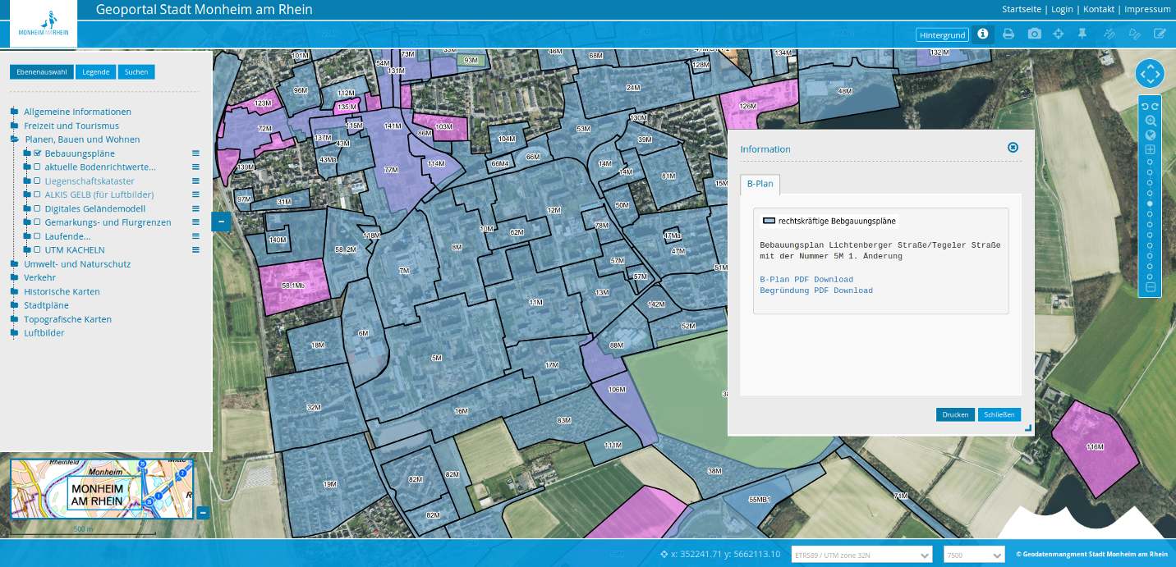


WhereGroup
Notes:
Major Mapbender sponsor
Company in Bonn, Germany with 18 employees
Service provider with experience in all fields of spatial data management with free software: WebGIS, SDI, database, relevant standards, trainings, conferences
Open Source projects: Mapbender, PostNAS

Slide 5
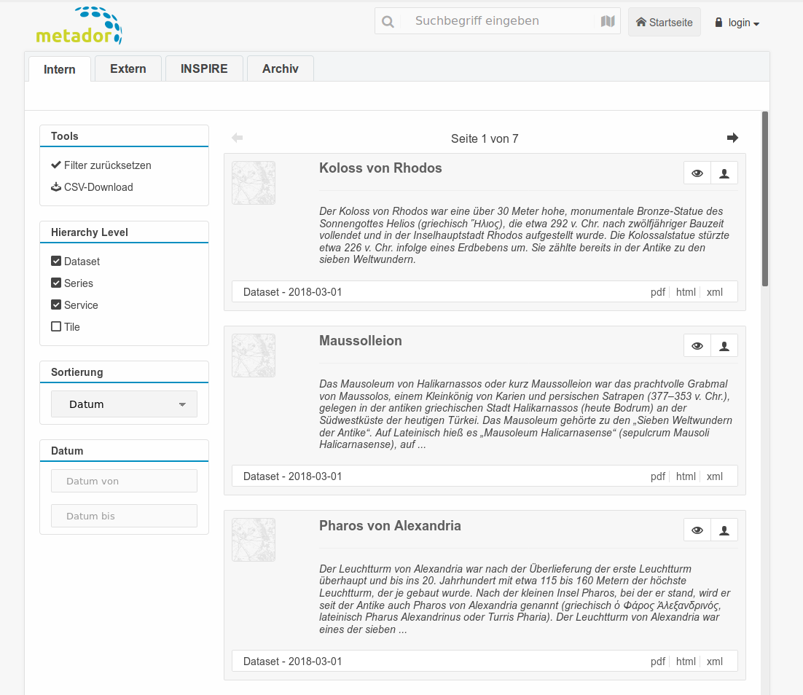
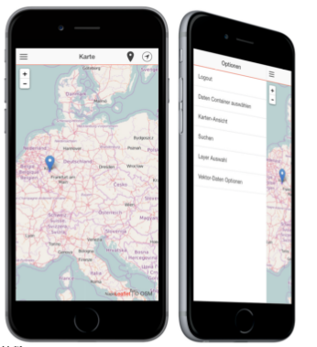

WhereGroup
Metador - Metadataeditor
offline Client, Yaga, Leaflet
Notes:
Major Mapbender sponsor
Company in Bonn, Germany with 18 employees
Service provider with experience in all fields of spatial data management with free software: WebGIS, SDI, database, relevant standards, trainings, conferences
Open Source projects: Mapbender, PostNAS

Slide 6

Consulting & training
https://www.foss-academy.com/
Courses in german language
QGIS, QGIS Server, MapServer, GeoServer, PostgreSQL/PostGIS, Mapbender, MapProxy, OSM, Python
Summer- & Winterschool with IHK Certificate
Credits for courses at UNIGIS Salzburg

Slide 7
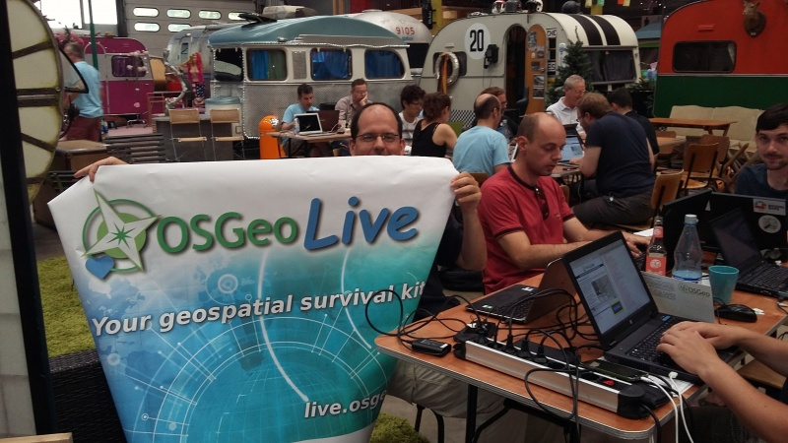

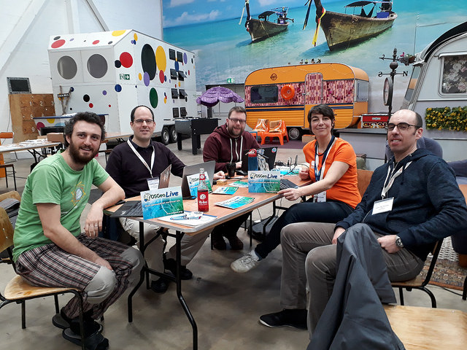
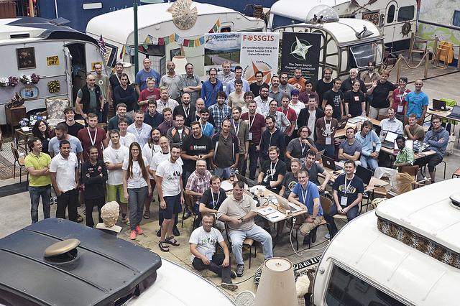
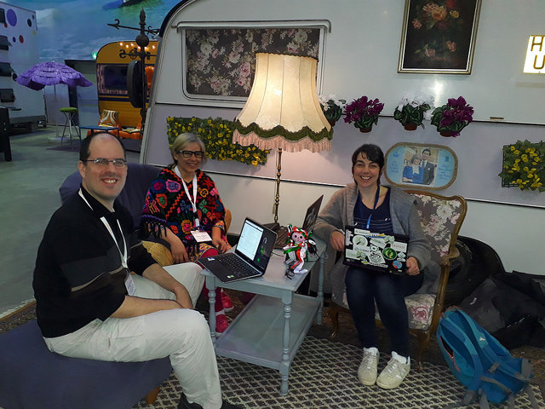
@FOSS4G Code Sprint BaseCamp Bonn 2016
@FOSS4G Code Sprint BaseCamp
Bonn 2018

Slide 8

https://www.fossgis-konferenz.de/2019/

Slide 9
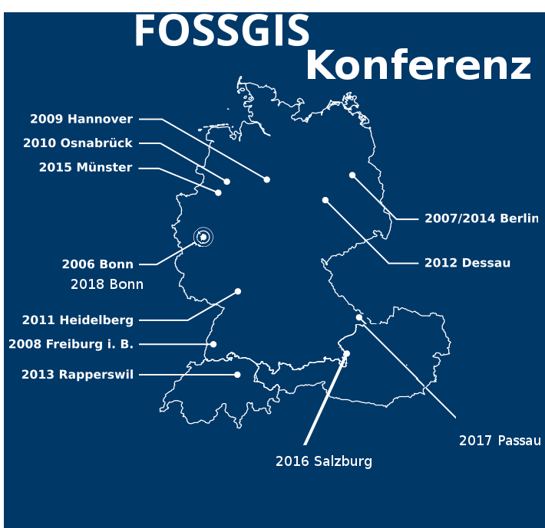

1. FOSSGIS Konferenz
March 2006 in Bonn
mit 350 Participants
2003-2005 MapServer
Anwendertreffen
2018 Bonn
Dresden

Slide 10
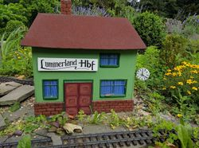
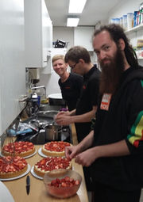
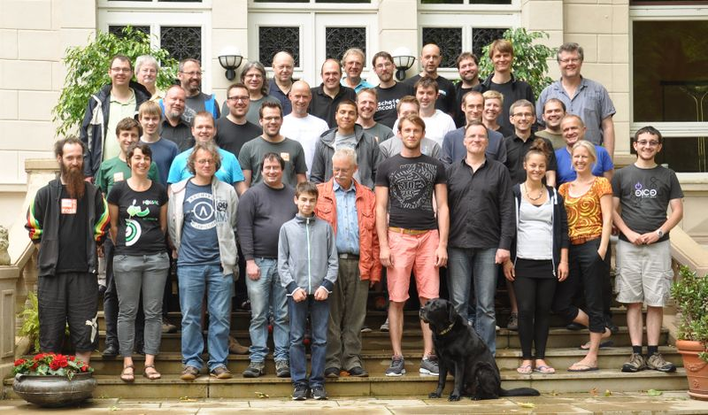
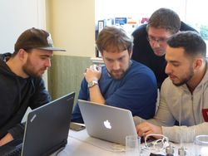
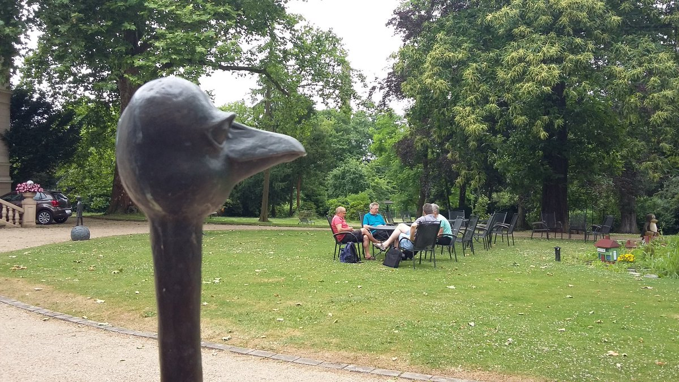

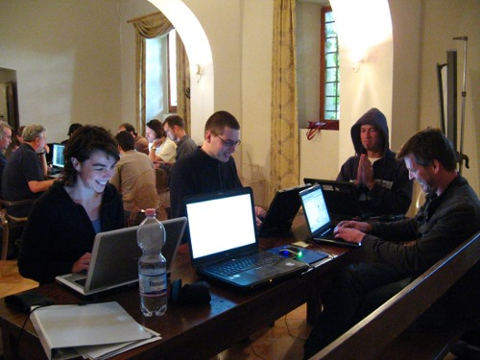
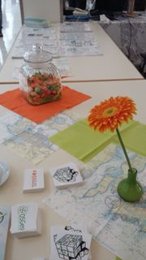
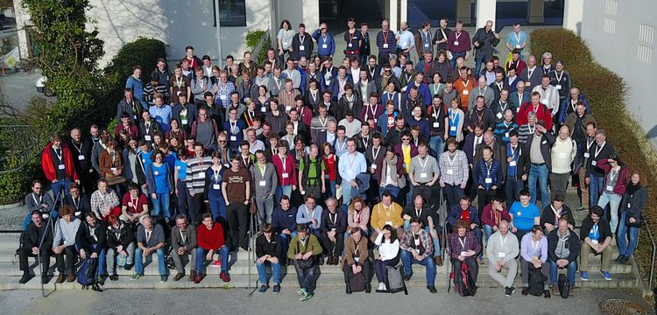

@FOSSGIS Hacking
at Linuxhotel
@Bolsena OSGeo Code Sprint 2010

Slide 11
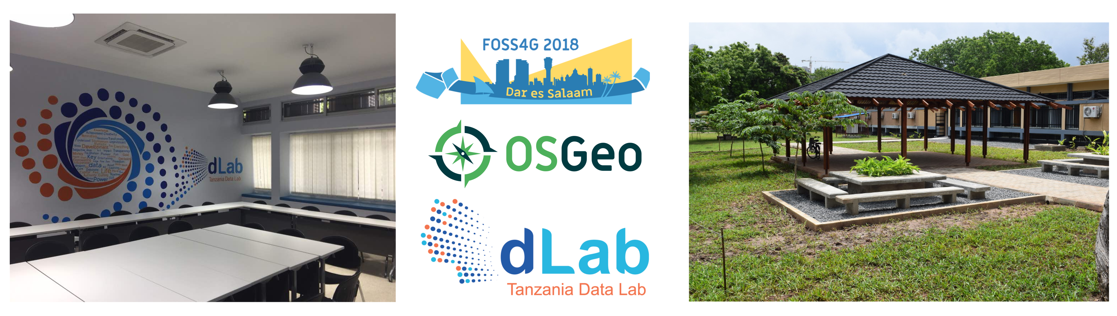
FOSS4G Community Sprint 2018
Don‘t miss it!
Saturday & Sunday 1.-2.9.2018 8am to 5pm
dLab Dar es Salaam
https://www.osgeo.org/events/foss4g-2018-community-sprint-2018/

Slide 12
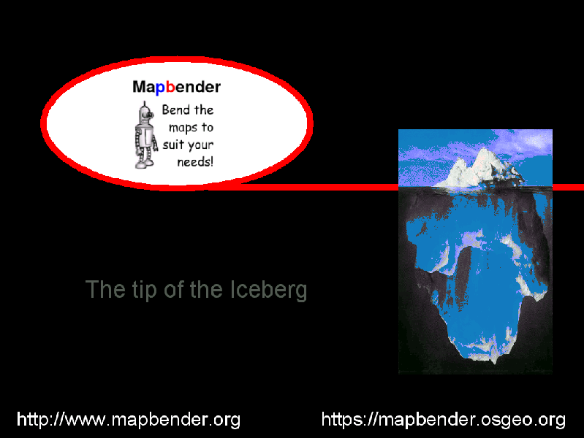
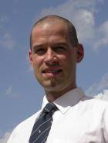
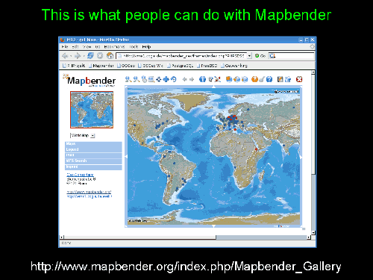
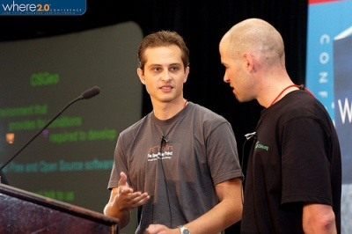
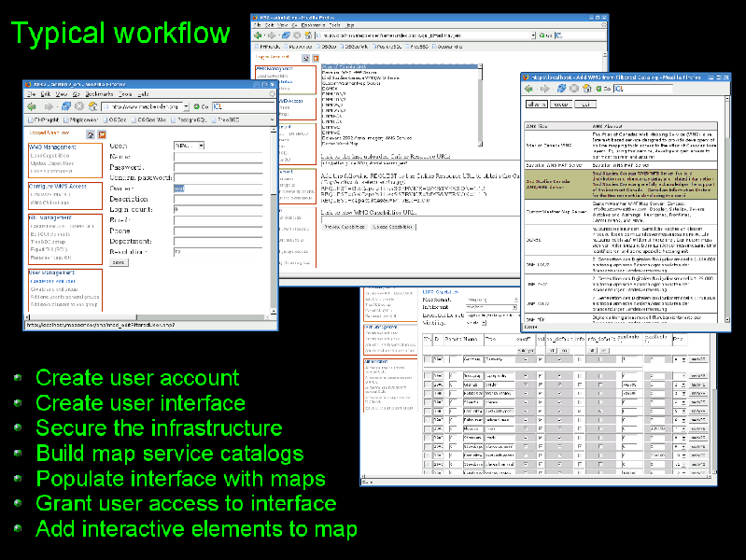
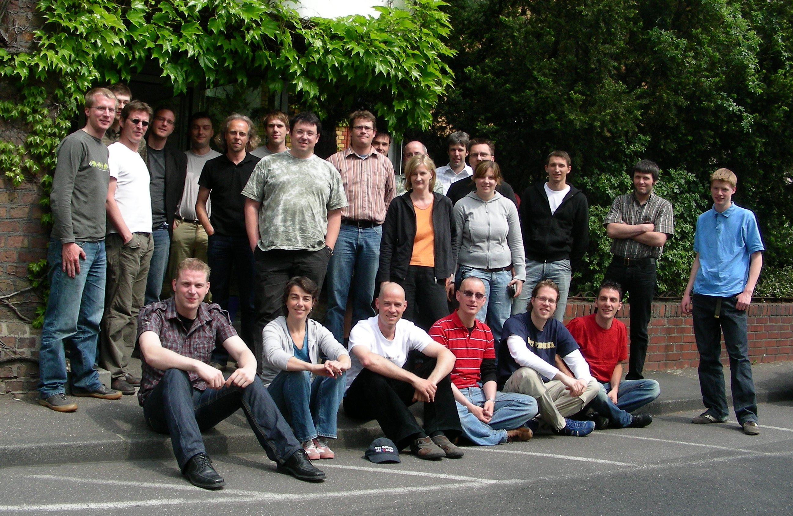

Slide 13
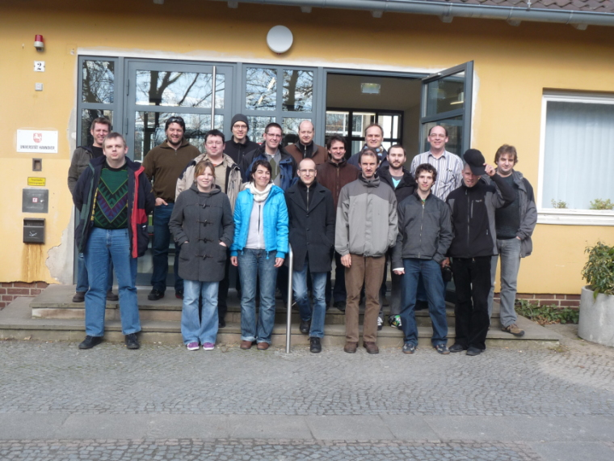
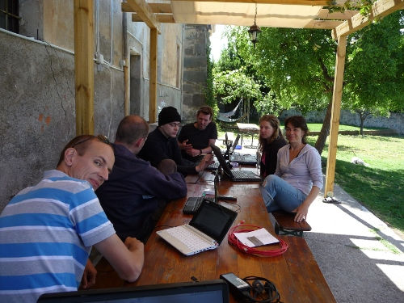
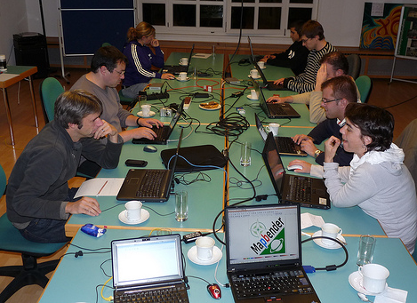
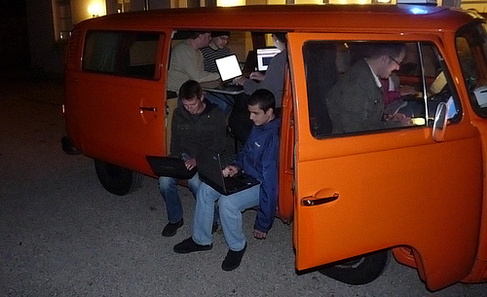

Slide 14


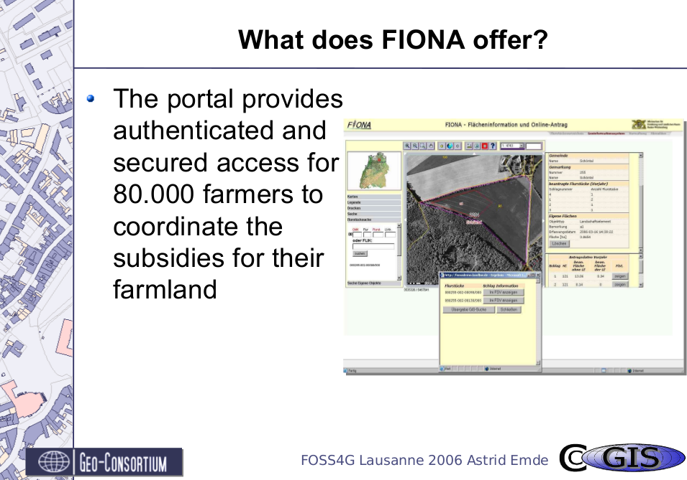
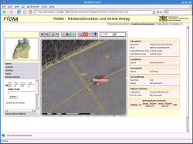
Lausanne (Switzerland)

Slide 15
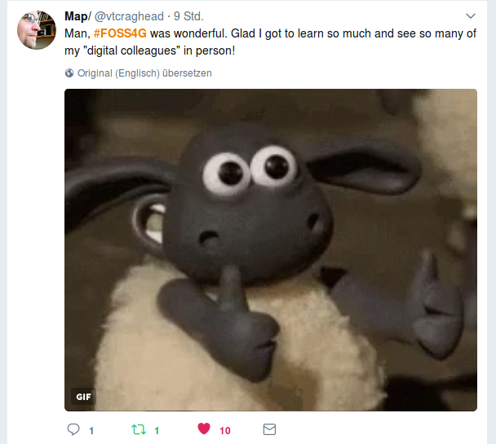


Slide 16
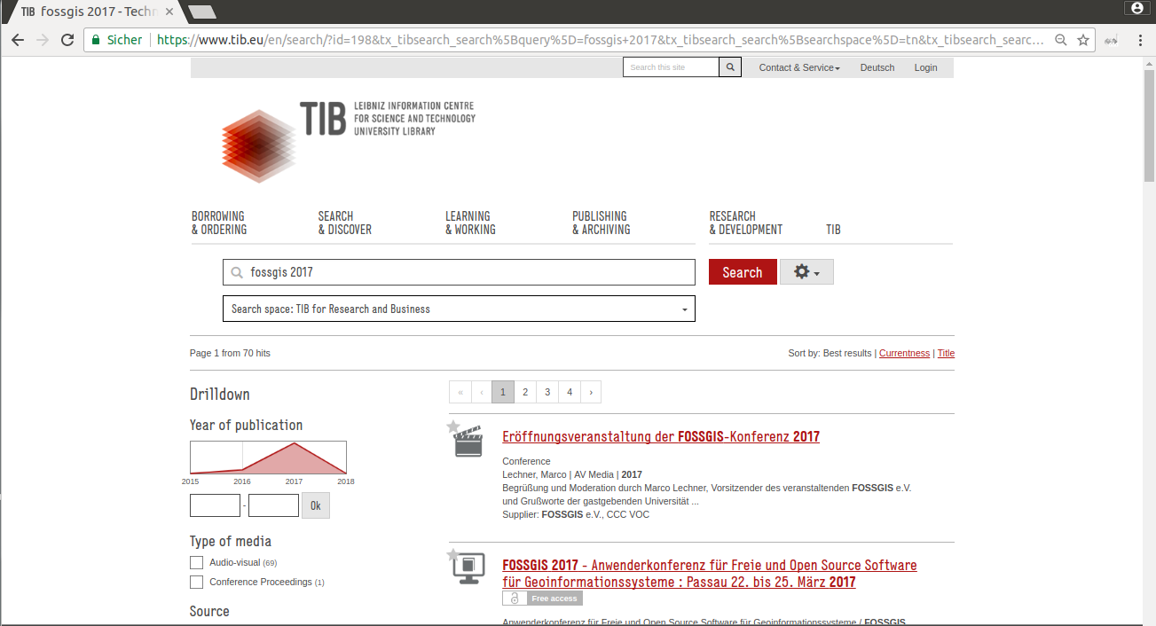
TIB AV Portal
Videos from FOSSGIS, FOSS4G, FOSDEM & GRASS & …
https://www.tib.eu/en/

Slide 17
What does Mapbender do?

Slide 18
WebGIS Client Suite
with administration web interface

Slide 19
Create a geoportal without writing a single line of code!

Slide 20
Create and maintain an OWS repository

Slide 21
Distribute configured services among applications

Slide 22
Grant users and groups access to
applications and services

Slide 23
The Mapbender components
Applications
Services
Roles

Slide 24
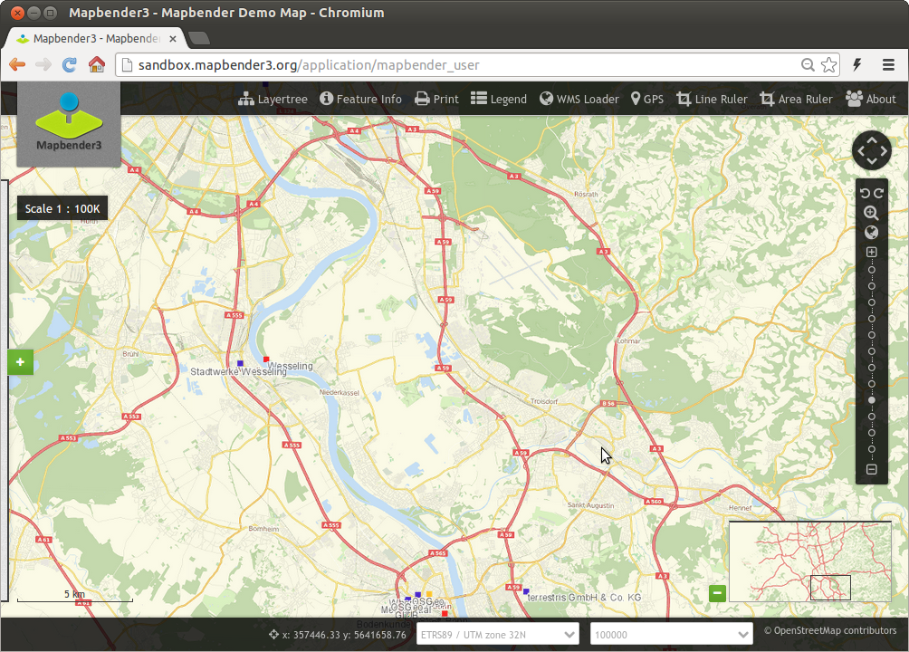
Notes:
Basisdienste
Karte
Navigationsleiste (Drag & Drop)
Einfache Diensteübersicht

Slide 25
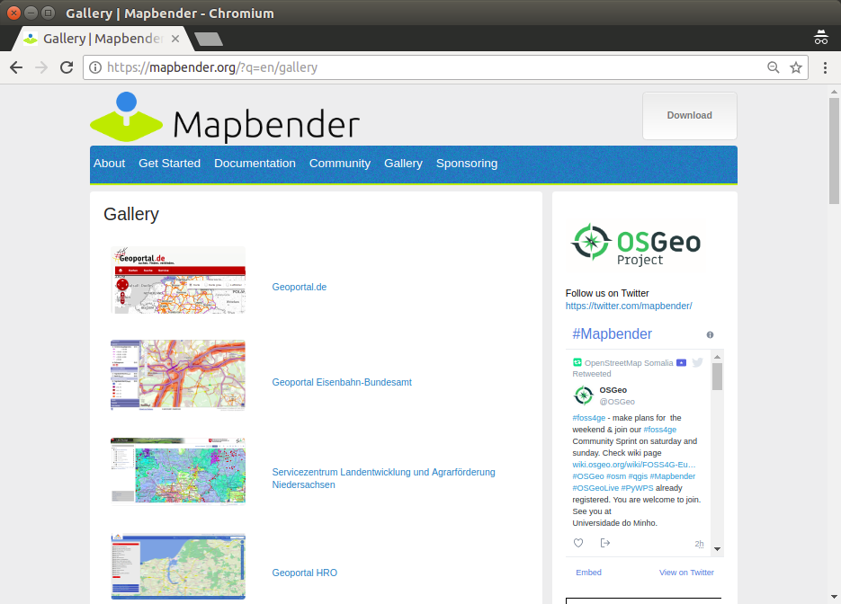

Slide 26
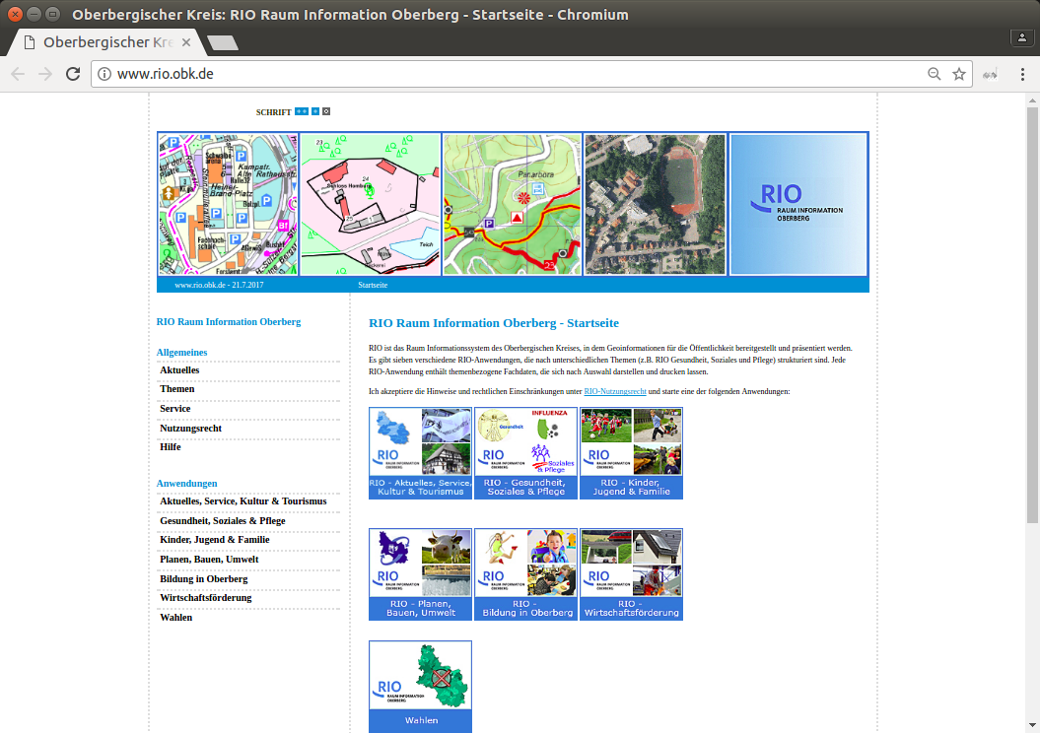

Slide 27
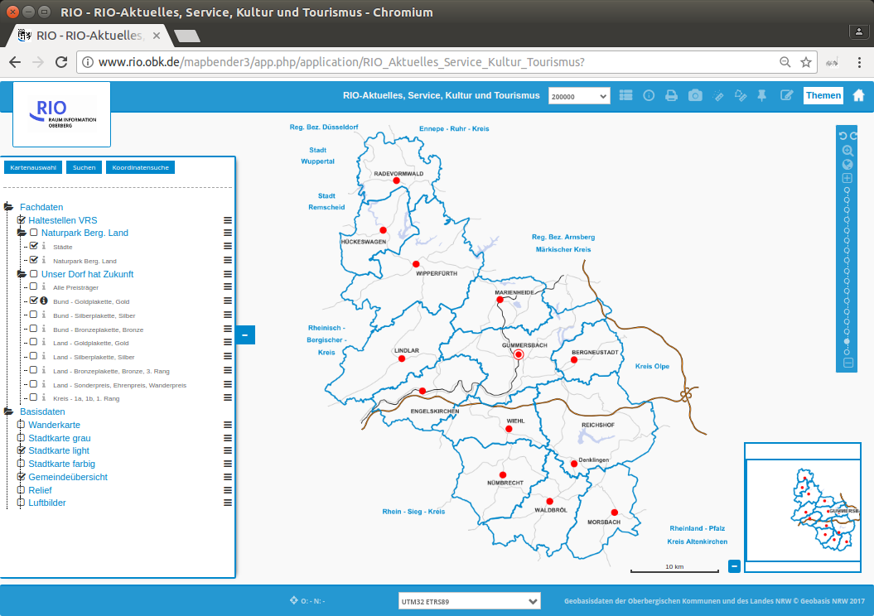

Slide 28


Slide 29
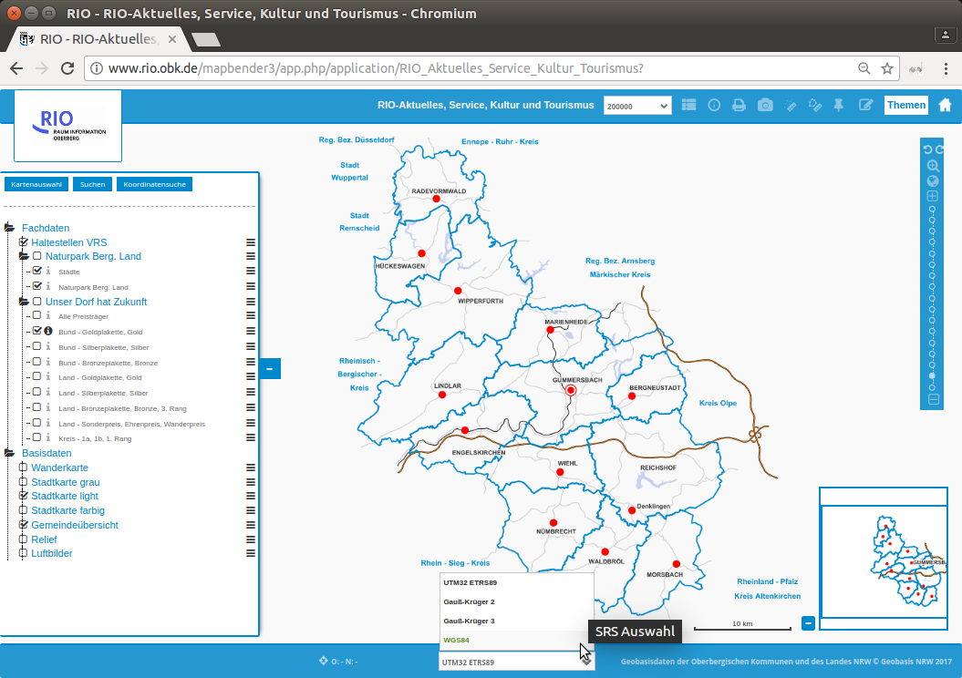

Slide 30
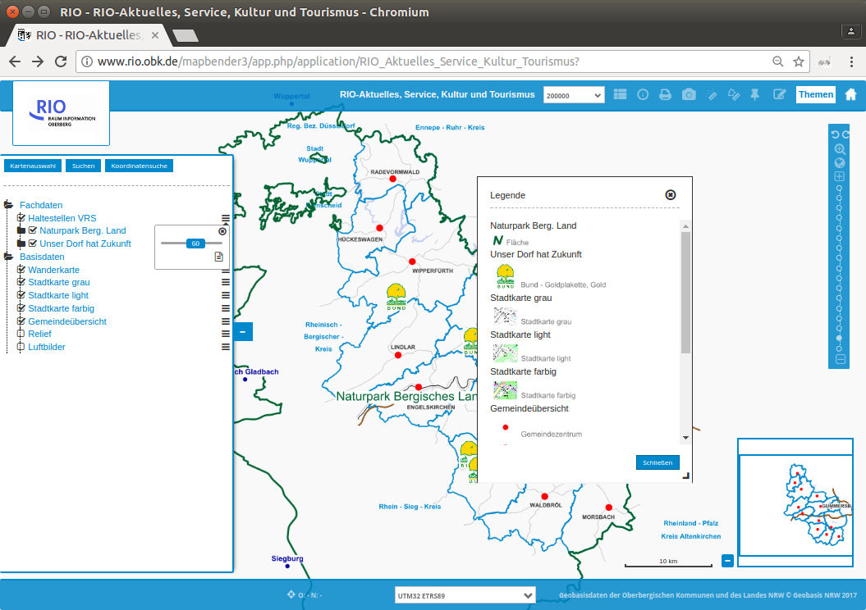

Slide 31
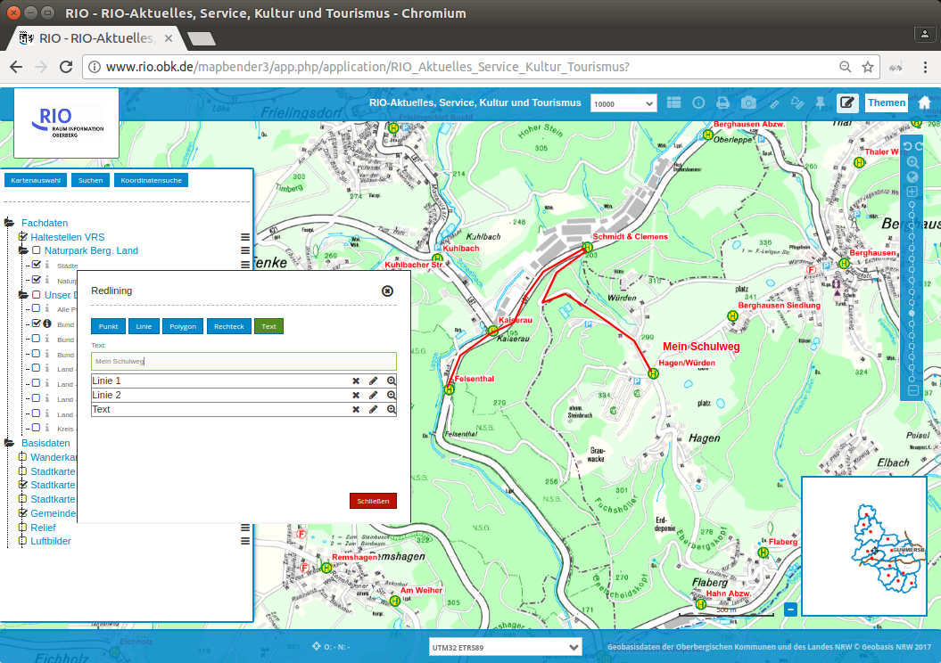

Slide 32
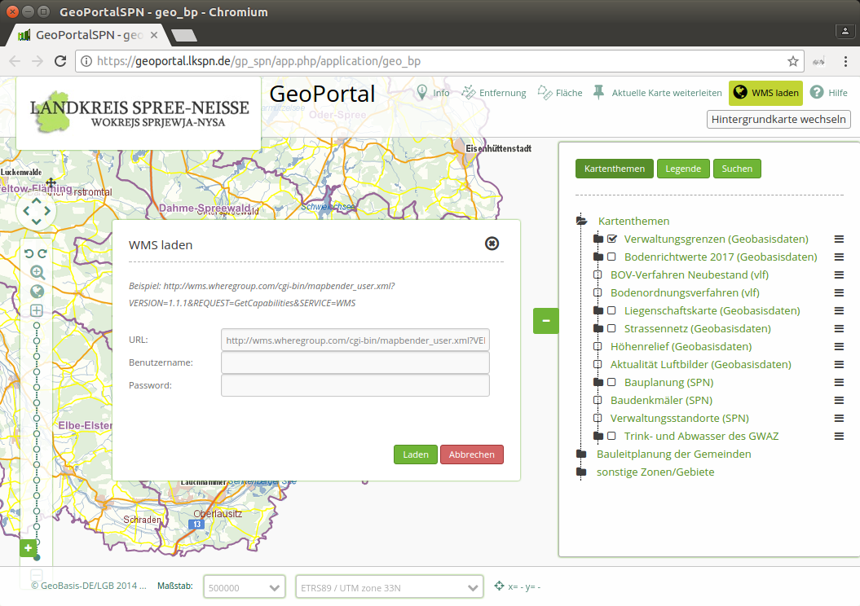

Slide 33
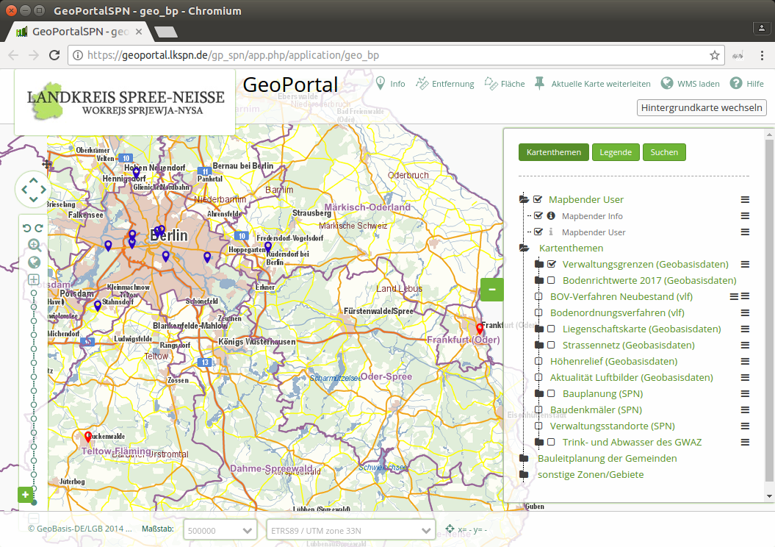

Slide 34
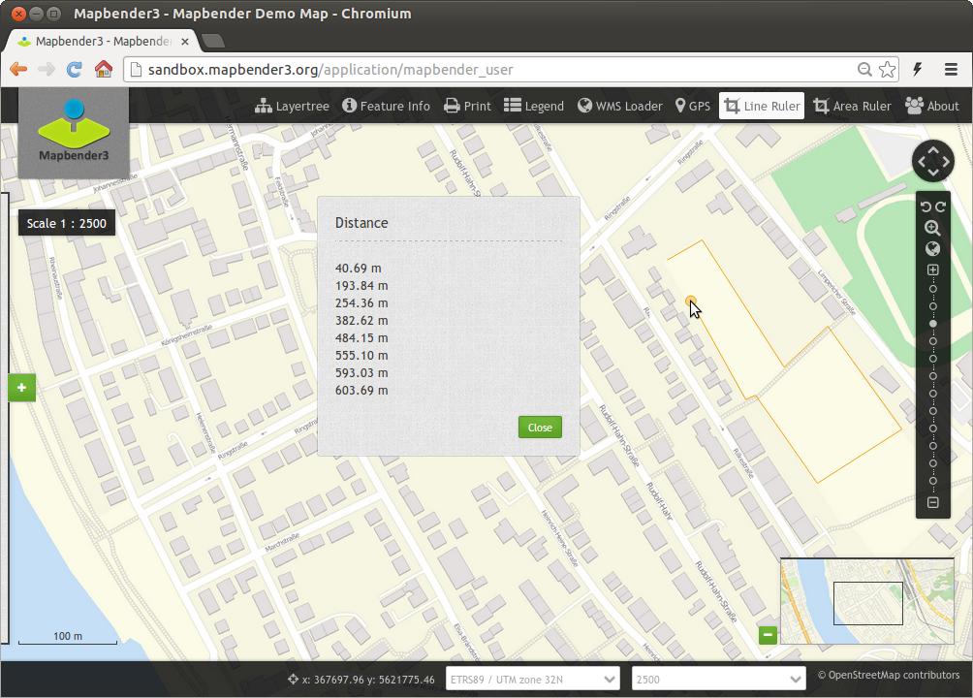

Slide 35
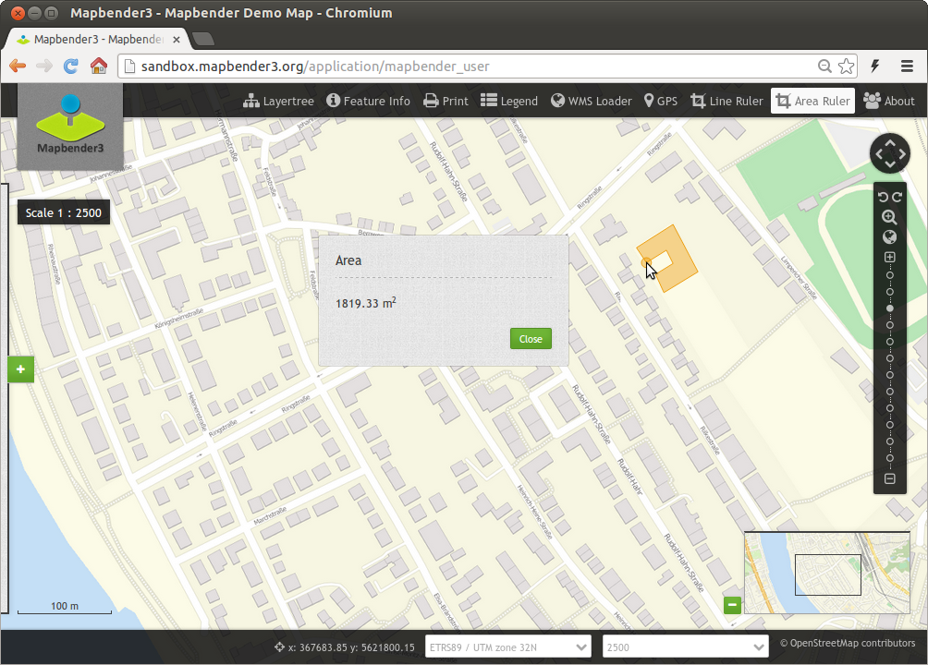

Slide 36
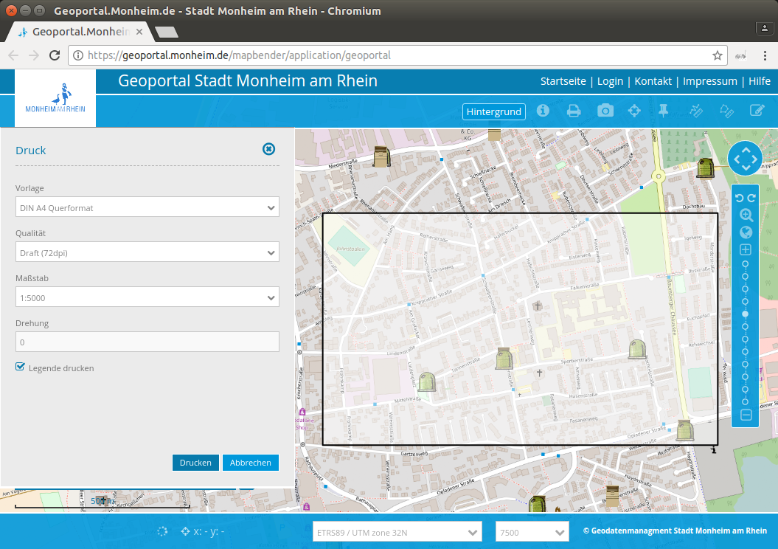

Slide 37
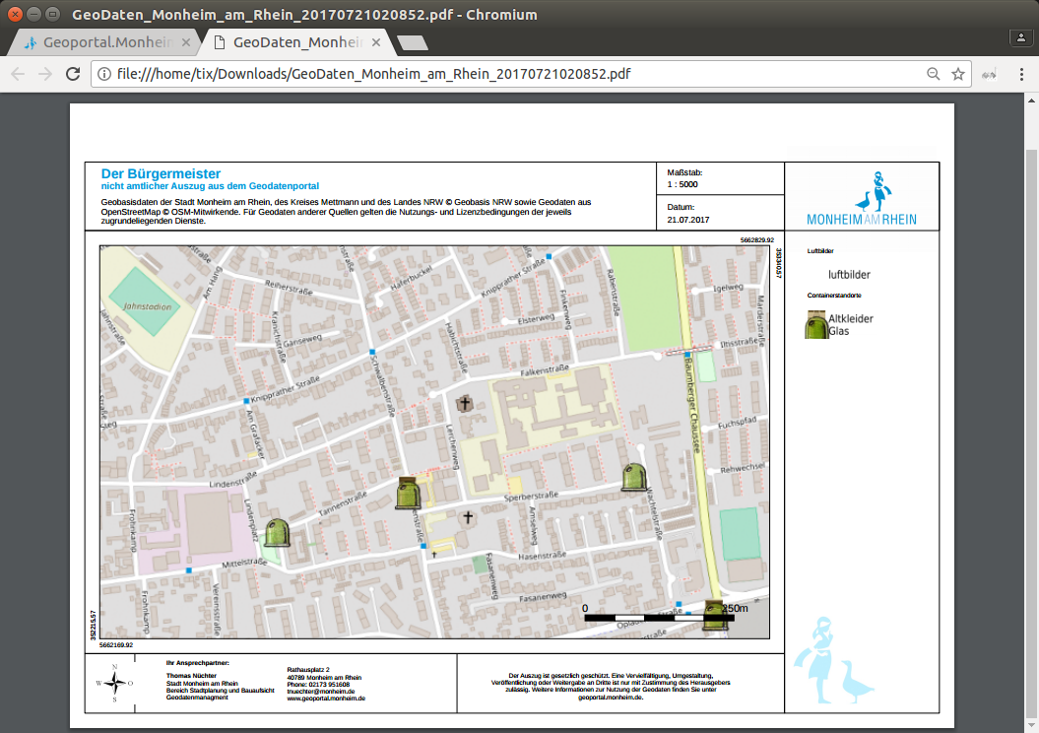

Slide 38
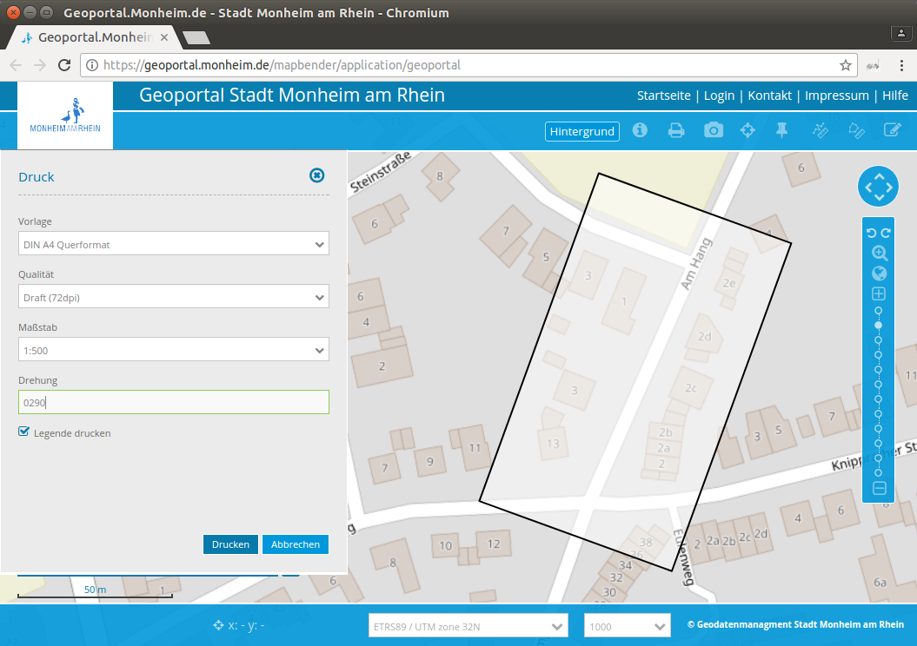

Slide 39
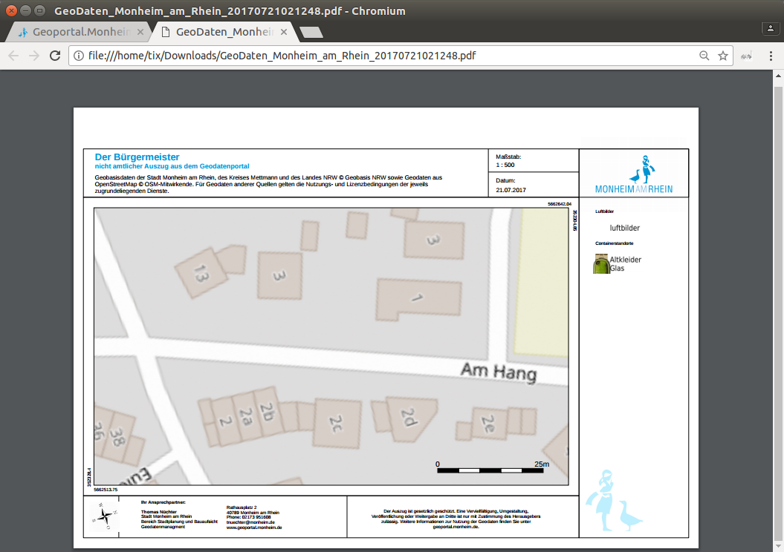

Slide 40
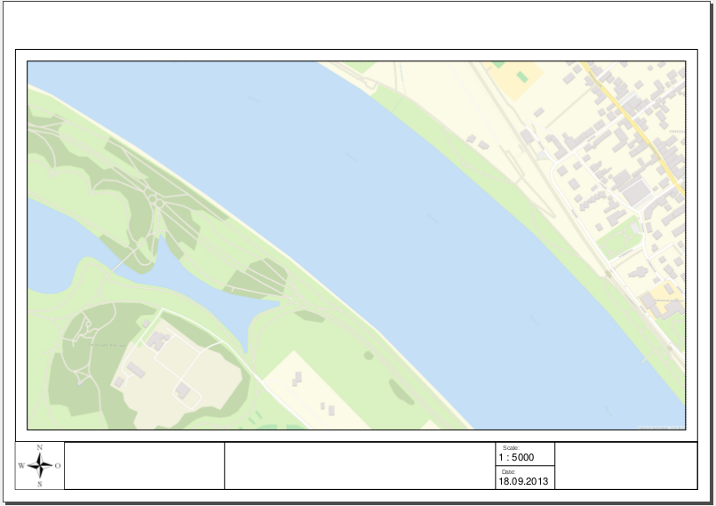

Slide 41
Set up your own application

Slide 42
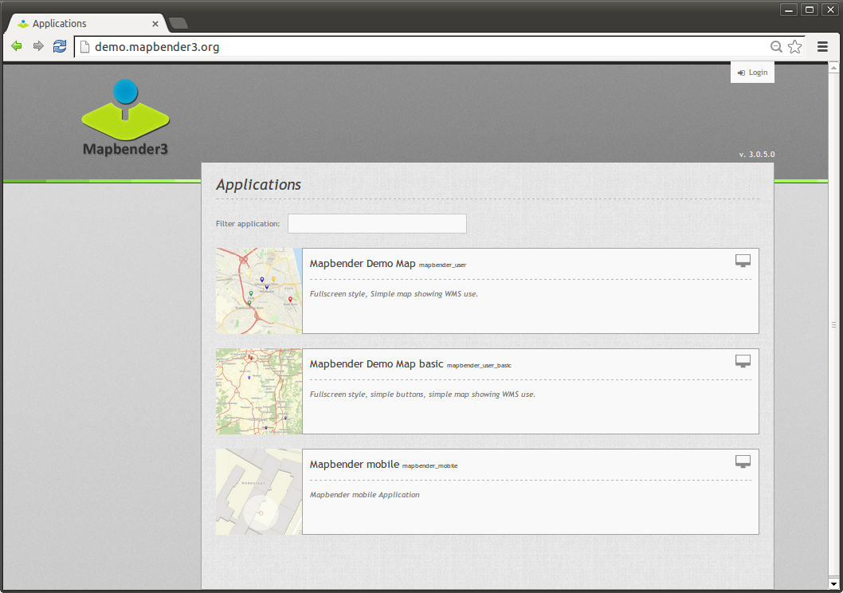

Slide 43
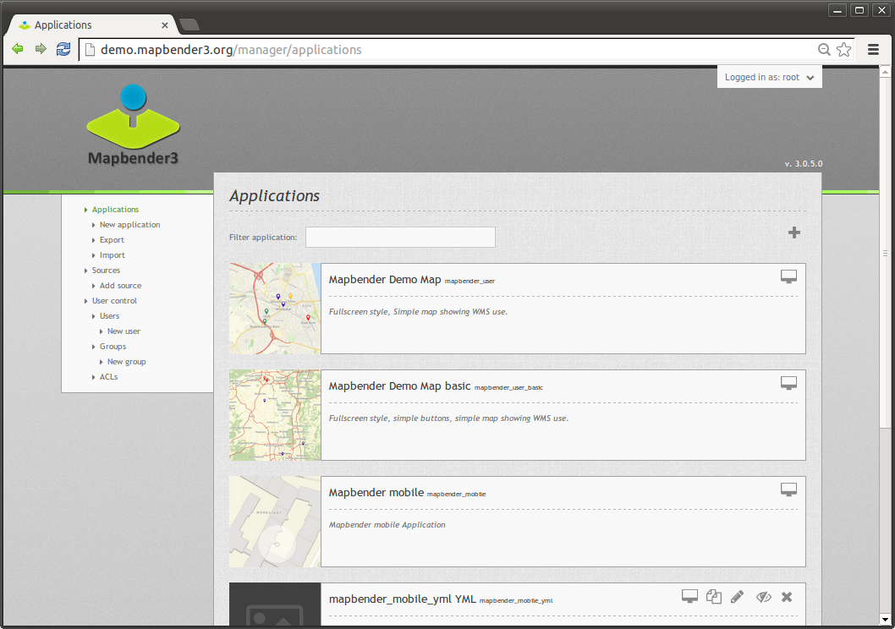

Slide 44
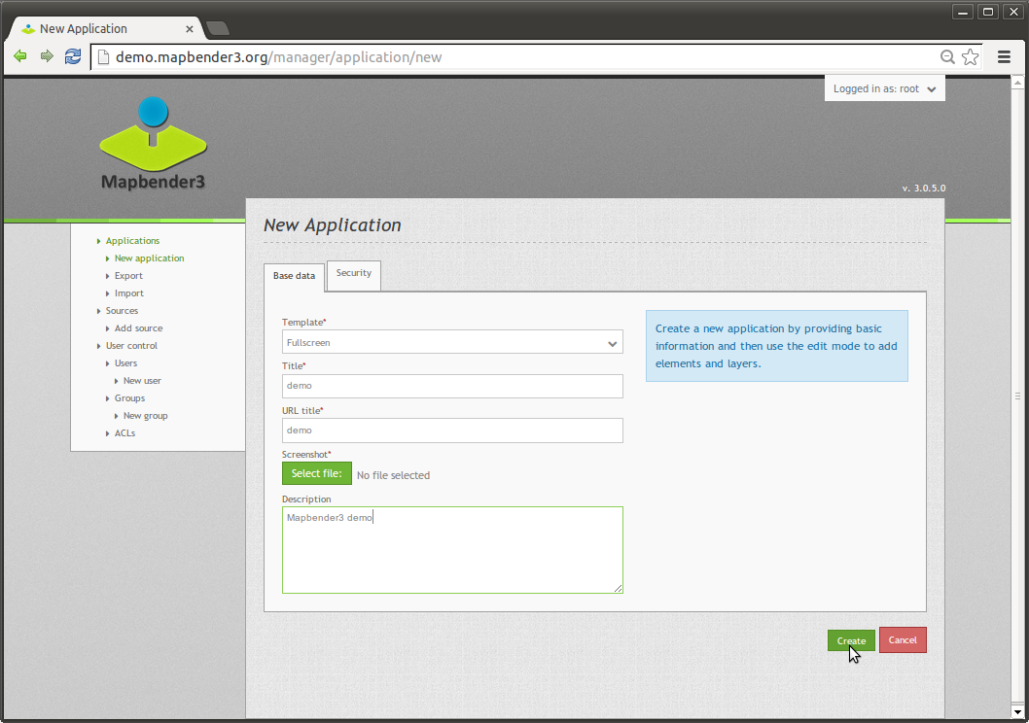

Slide 45


Slide 46


Slide 47


Slide 48


Slide 49


Slide 50


Slide 51


Slide 52


Slide 53


Slide 54


Slide 55


Slide 56


Slide 57


Slide 58


Slide 59


Slide 60


Slide 61


Slide 62


Slide 63


Slide 64


Slide 65


Slide 66


Slide 67

https://demo.mapbender3.org/application/foss4g_europe_2017?poi%5Bpoint%5D=2.58738%2C48.84092&poi%5Bscale%5D=5000&poi%5Bsrs%5D=EPSG%3A4326&poi%5Blabel%5D=FOSS4G+Europe+2017

Slide 68


Pick on klick or Zoom to coordinate

Slide 69


Slide 70


Slide 71


Slide 73

Configuration SearchRouter
class: Mapbender\CoreBundle\Component\SQLSearchEngine
class_options:
connection: search_db
relation: ortschaften
attributes:
- gid
- ortsname
geometry_attribute: geom
form:
ortsname:
type: text
options:
required: true
compare: exact
results:
view: table
count: true
headers:
gid: ID
ortsname: Name
callback:
event: click
….

Slide 74

Solr Search

Slide 75

Solr Search
SimpleSearch

Slide 76

Basesource Switcher

Slide 77


Slide 78


Slide 79


Slide 80


Slide 81


Slide 82

Stadtplan Troisdorf

Slide 83



Slide 84



Slide 85

Mobile Template

Slide 86

Editing data with the Digitizer

Slide 87

View in Table
Tabular display of objects
scroll through the data
View only the objects of the current extent
Definition of table columns to display the results
Allow delete and edit
Search in data
Notes:
Symfony2 – Web Application Framework
Doctrine – Datenbankabstraktion
OpenLayers – Kartenansicht
JQuery UI – Anwendungswidgets (Dialoge, Tabs, etc)
MapQuery – Verbindung OpenLayers/jQuery

Slide 88
Digitalization
Point, Line and Area
Different functionalities related to the geometry type
drawRectangle
drawCircle
drawEllipse
drawPoint
drawLine
drawPolygon
drawDonut
modifyFeature
moveFeature
selectFeature
removeSelected
Notes:
Symfony2 – Web Application Framework
Doctrine – Datenbankabstraktion
OpenLayers – Kartenansicht
JQuery UI – Anwendungswidgets (Dialoge, Tabs, etc)
MapQuery – Verbindung OpenLayers/jQuery

Slide 89

Digitalization

Slide 90

https://mapbender.org

Slide 91

Which components does Mapbender use?
MIT licensed
Symfony2 as PHP framework
  Doctrine, Twig, Monolog, Bootstrap...
  Bundles
OpenLayers2
MapQuery
jQuery
SQLite, PostgreSQL, MySQL, Oracle database
Notes:
Symfony2 – Web Application Framework
Doctrine – Datenbankabstraktion
OpenLayers – Kartenansicht
JQuery UI – Anwendungswidgets (Dialoge, Tabs, etc)
MapQuery – Verbindung OpenLayers/jQuery

Slide 92
Version 3.0.7.3
Major release with many changes & refactoring
2018-07-13
https://doc.mapbender3.org/en/book/versions.html
Notes:
Symfony2 – Web Application Framework
Doctrine – Datenbankabstraktion
OpenLayers – Kartenansicht
JQuery UI – Anwendungswidgets (Dialoge, Tabs, etc)
MapQuery – Verbindung OpenLayers/jQuery

Slide 93

Docker image for Mapbender
We have a docker image for Mapbender
https://hub.docker.com/u/mapbender/

Slide 94
Activities in the team
Chair Axel Schaefer
Architect Rolf Neuberger
PSC Olaf Knopp
  Arash Rashid Pour
  Astrid Emde
  David Patzke
  Frederik Häfker
about 8 more developer working on Mapbender

Slide 95

Activities in the team
Regular meetings in Bonn
  pros: face-to-face, good discussions, milestones, releases more often, clean up
  cons: in german, not very transparent
Ticket system on GitHub is used as major system
Many developer, many user
Many project work is done and internal contributions
We focus an development for projects – payed work

Slide 96

Mapbender User Reference Map
Try digitizer and add yourself as Mapbender User – sorry was shut down due to GDPR (DSGVO)
https://demo.mapbender.org/application/mapbender_user
Focus of users in
Germany & Europe

Slide 97
Mapbender3 3.0.7.3 on MS4W 3.2.2
Work on getting it into the next version with MapServer 7.x
MS4W - MapServer For Windows
Provided by Jeff McKenna. Big thanks to Jeff!
Mapbender is part of it since several years
http://www.ms4w.com/

Slide 98


Mapbender 3.0.7.3 on OSGeoLive 12.0
Ready for FOSS4G
Dar Es Salaam
Tansania
We use OSGeoLive
in our workshops
& at conferences
Great for usage
& promotion!

Slide 99

WMS Layer ordering

Slide 100


Routing
pgRouting & GraphHopper
Implemented for Deutsche Bahn and Stadt Frankfurt
Schoolpath analysis for public transprot ticket
Routing to facilities

Slide 101

Routing

Slide 102

Routing

Slide 103

Routing configuration

Slide 104

Edit data without geometry
plugable
e.g. tree species, interests

Slide 105

Query_Builder for evaluation
plugable
Embed, view and edit SQL queries
Export results

Slide 106


Adding OpenLayers5 Support
OL2 and OL5 should be available parallel
Update has to be always possible
Old Applications should still work
and user can try the new once

Slide 107
Adding OpenLayers4/5 Support
We started a sponsoring call and raised money
In July 2018 we had 2 weeks of very successfull Open Layers Sprint in Bonn
All Elements were analysed and modified to work with OpenLayers5
Goal: we want to finish within this year
https://mapbender.org/?q=en/sponsoring-en

Slide 108


Slide 109


Slide 110
Thank you
Astrid Emde
astrid.emde@wheregroup.com
mapbender-users@list.osgeo.org

