Slide 1


Mapbender to create web application easily
Astrid Emde
FOSS4G-Europe 2018
Guimarães (Portugal)

Slide 2

Astrid Emde
Mapbende Developer Team since 2004
Mapbender PSC (Project Steering Committee)
Project management and development, trainings for MapServer, PostgreSQL/PostGIS, Mapbender, GeoServer
Concept, Testing, Documentation
OSGeoLive PSC since 2017
OSGeo Board since 2017
WhereGroup Bonn

Slide 3
WhereGroup
> 30 employees - developers, consultants & geospatial experts
Working with Open Source Software for more than 15 years
Company behind Mapbender, Metador & Mops
Bonn – Berlin - Freiburg
FOSSGIS e.V. member & OSGeo sponsor
We are hiring!

Slide 4

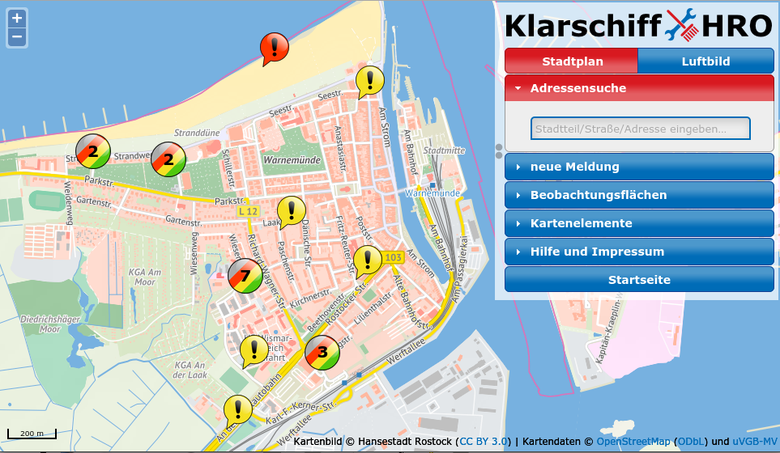


WhereGroup

Slide 5
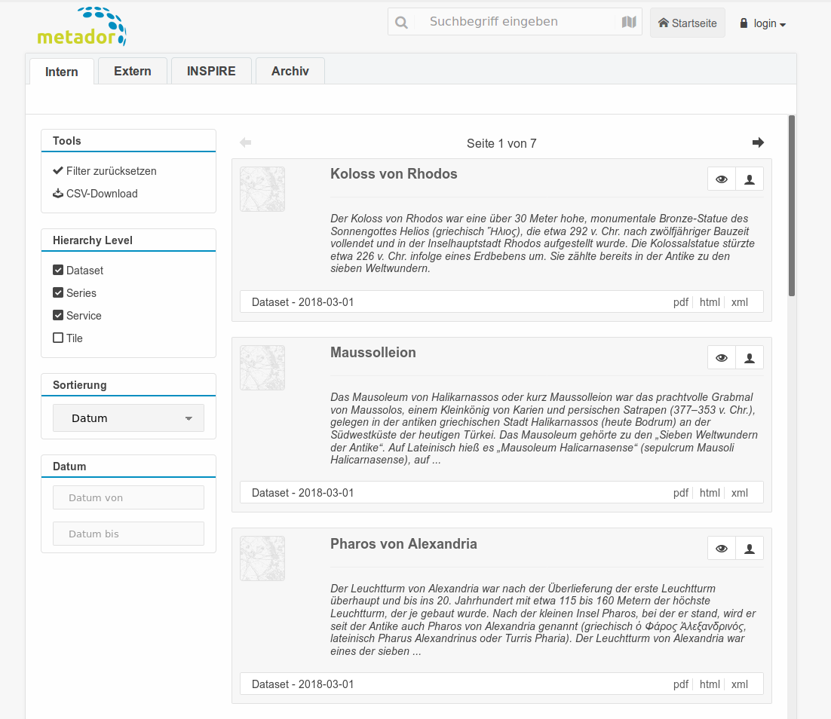
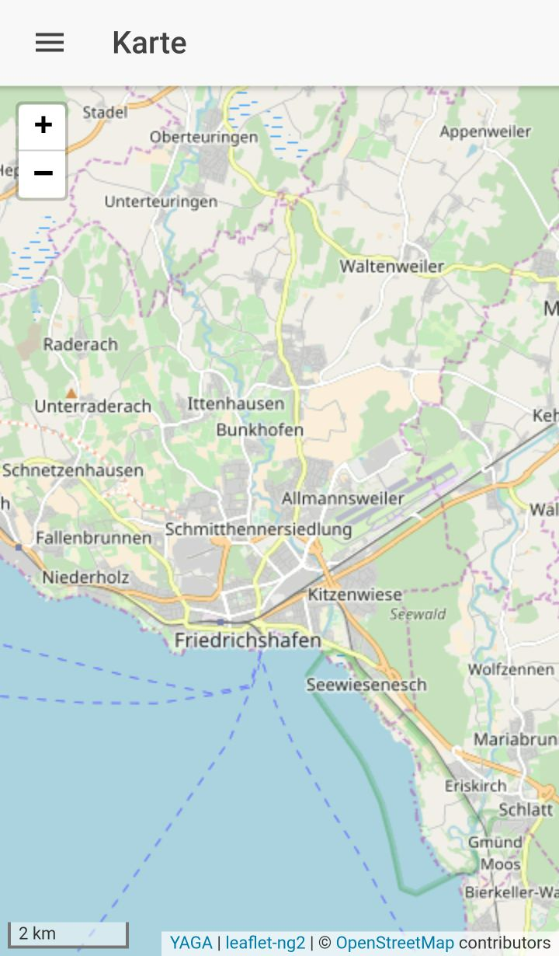

WhereGroup
Metador
Metadata editor
Offline Client, YAGA
Consulting, Training & more

Slide 6
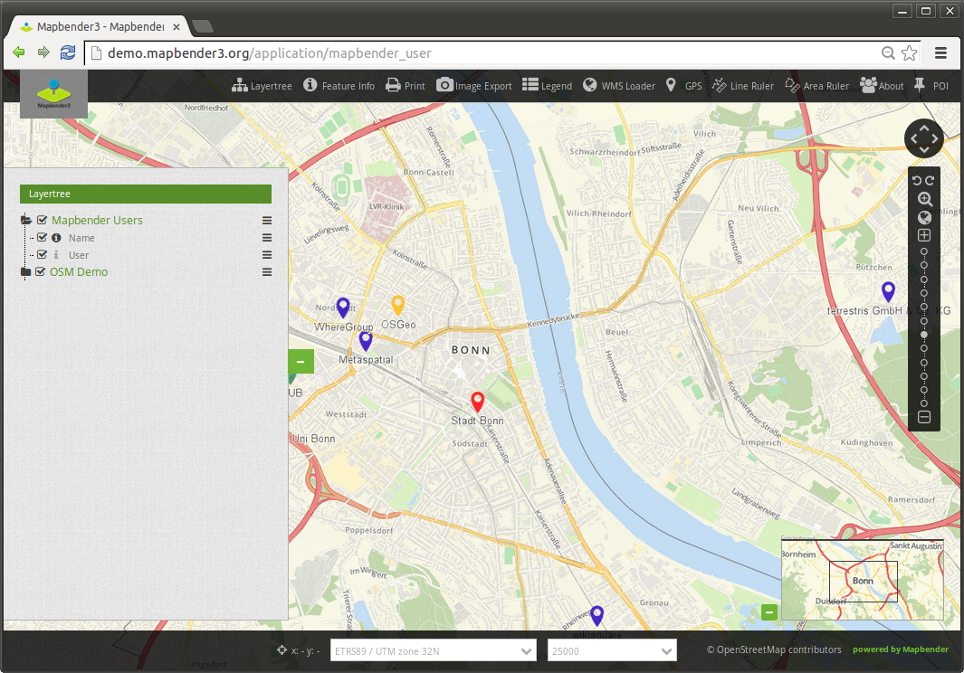
Mapbender-User Demo
Notes:
Basisdienste
Karte
Navigationsleiste (Drag & Drop)
Einfache Diensteübersicht

Slide 7
Workshop
What does Mapbender do?
Architecture and Installation
Register Services
Create your own application
User and group security management
Design adjustments, template printing
Search module and digitizer

Slide 8
What does Mapbender do?

Slide 9
WebGIS Client Suite
with administration web interface

Slide 10
Create a geoportal without writing a single line of code!

Slide 11
Create and maintain an OWS repository

Slide 12
Distribute configured services among applications

Slide 13
Grant users and groups access to
applications and services

Slide 14

Which components does Mapbender use?
Symfony2 as PHP framework
  Doctrine, Twig, Monolog, Bootstrap...
  Bundles
OpenLayers2
MapQuery
jQuery
SQLite, PostgreSQL, MySQL, Oracle database

Slide 15

Systemrequirements
>= PHP 5.6 (php5)
PHP CLI interpreter (php5-cli)
PHP SQLite extension (php5-sqlite)
PHP PostgreSQL extension (php5-pgsql)
PHP cURL extension (php5-curl)
PHP Internationalization-extension (php5-intl)
PHP GD (php5-gd) (Print)
PHP FileInfo (Print)
PHP Zip
APACHE mod_rewrite
OpenSSL
See requirements

Slide 16
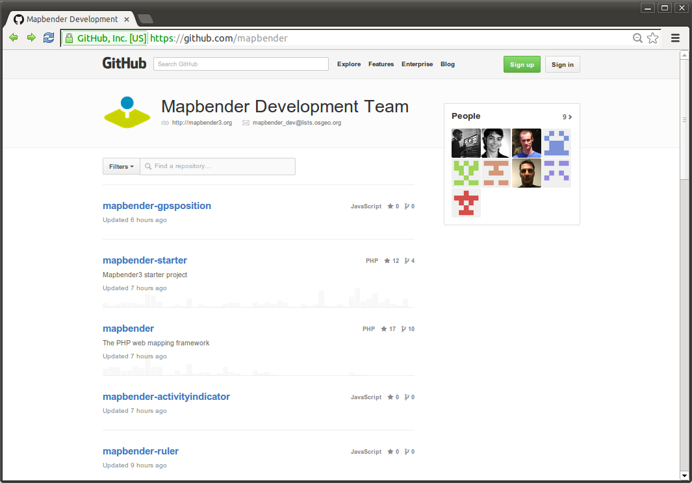
Mapbender Code on GitHub

Slide 17
Installation
Read about Mapbender installation
Workshop Installation install_mapbender.sh of OSGeo-Live
Download http://mapbender.org/en/download
Or use the code from GitHubhttps://github.com/mapbender/mapbender-starter

Slide 18
Start Mapbender
Symfony2 test configuration
http://localhost/mapbender3/config.php
Developer mode http://localhost/mapbender3/app_dev.php
Productive mode
http://localhost/mapbender3/app.php

Slide 19
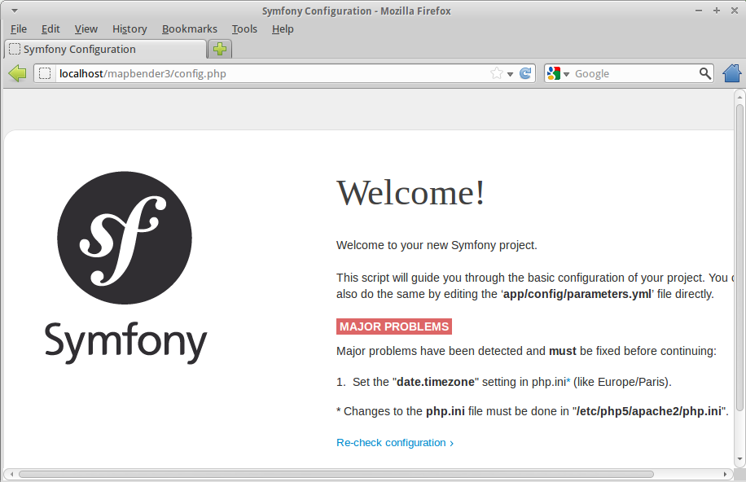
Symfony2 config.php

Slide 20
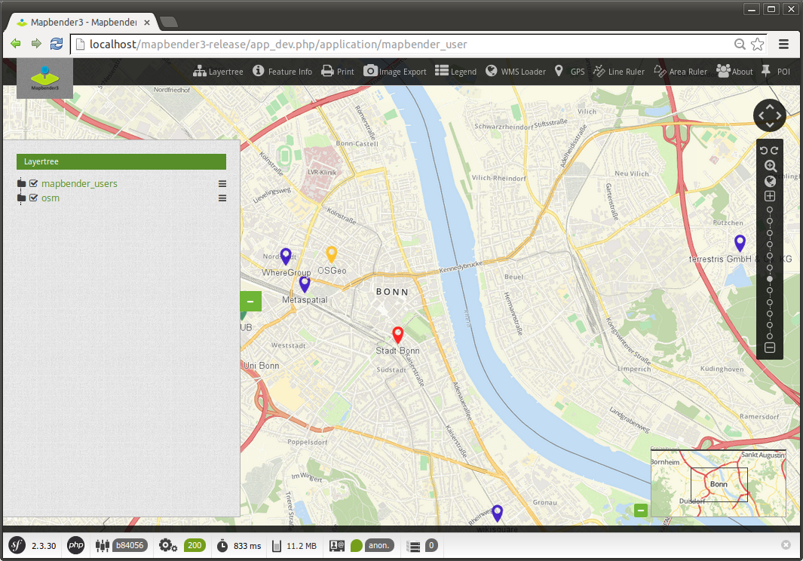
The Symfony Profiler
/app_dev.php

Slide 21
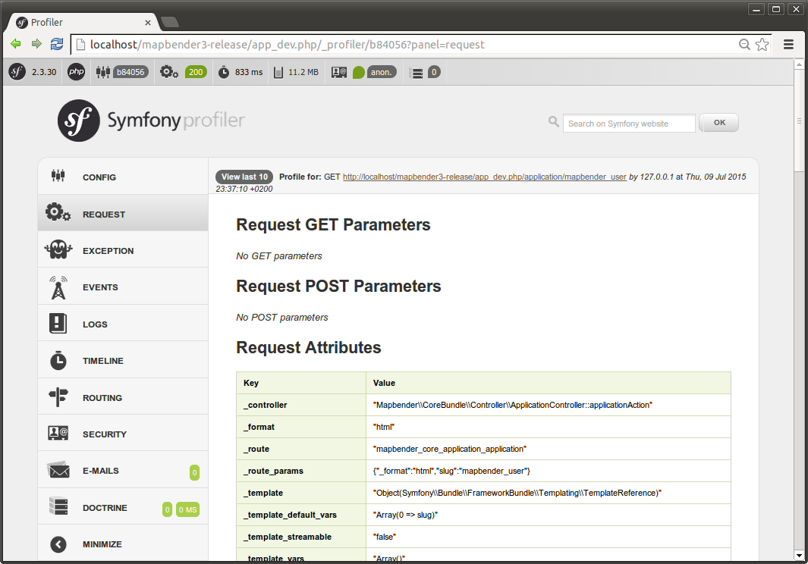
Unterstützung durch den Symfony Profiler

Slide 22
Find Mapbender on OSGeo-Live?
ALIAS mapbender3 refers to:
/var/www/html/mapbender3/web/
app_dev.php → mapbender3/web/app_dev.php
Mapbender:
mapbender3/mapbender/src/Mapbender/CoreBundle

Slide 23
YAML
Symfony configuration in YAML
Mapbender application can be defined in YAML
  /app/config/mapbender.yml
  Define your application and services
Mapbender configure database, language, mailer & more
  parameters.yml
  config.yml

Slide 24
Mapbender database
PostgreSQL, Sqlite, ORACLE, MySQL, MS SQL
Tables for WMS, User, Group, Layers etc.
Doctrine integrated in Symfony provides database abstraction layer

Slide 25
Templating
Template → Reference in mapbender.yml:
  Mapbender\CoreBundle\Template\Fullscreen
Css-File
FOM/CoreBundle/Resources/public/css/frontend/
  mapbender3_theme.css → Colour, Icons, Fonts
  fullscreen.scss
Twig Template
Mapbender/CoreBundle/Resources/views/fullscreen.html.twig

Slide 26

Application Overview
Application overview
Call sets Session to Anonymous User
View title, description, screenshot
Start Application

Slide 27
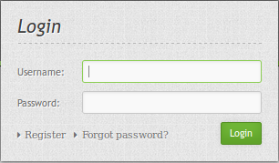
Login
root user is created on installation
You can provide Register and Forgot password functionality

Slide 28
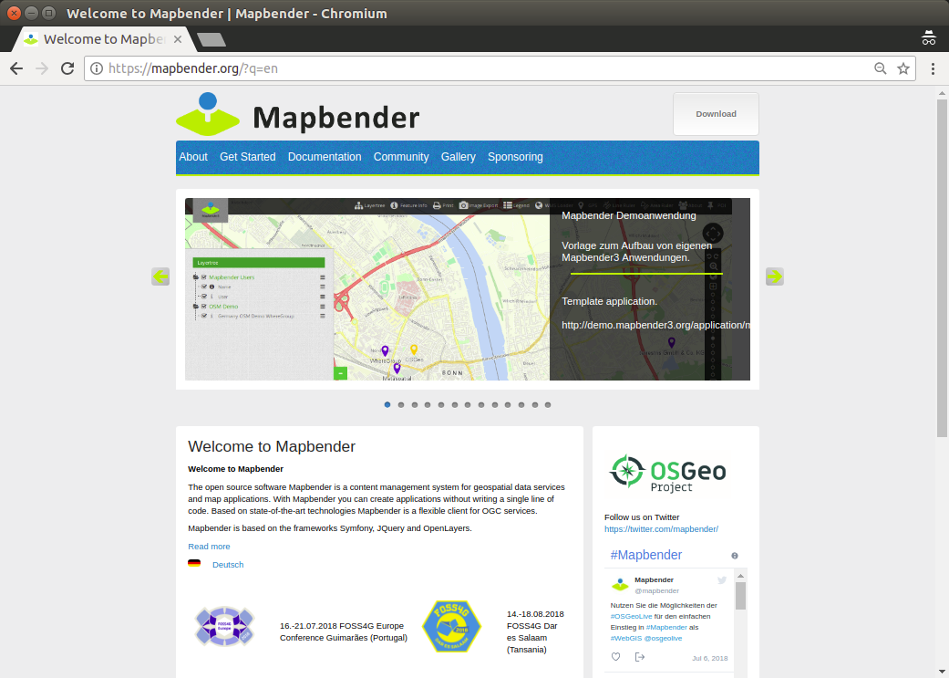

Slide 29
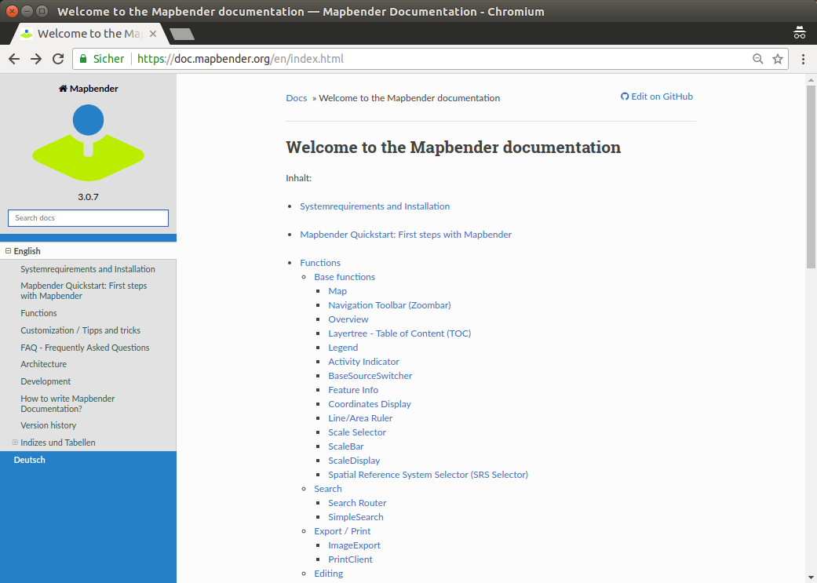

Slide 30
Hands on

Slide 31
Hands on – Part I
Load WMS
Create your own Application
Populate application with Services
Get elements for your application
Create user and groups
Assign application to user and groups
Assign element access to user and groups

Slide 32
Hands on – Part II
Print
Define an individual Design
Create your own bundle
Setup a Search module
Setup a Digitizer module

Slide 33
Mapbender Documentation
Mapbender Quickstart https://doc.mapbender.org/en/quickstart.html
Element documentation
https://doc.mapbender.org/en/functions.html

Slide 34
Load WMS Europe & Portugal
http://osm-demo.wheregroup.com/service?REQUEST=GetCapabilities&Service=WMS&Version=1.3.0
Portugal
http://mapas.dgterritorio.pt/geoportal/catalogo.html
http://snig.dgterritorio.pt/portal/index.php?option=com_wrapper&view=wrapper&Itemid=354&lang=pt
http://www.igeo.pt/dadosabertos/listagem.aspx

Slide 35
WMS Portugal
http://mapas.dgterritorio.pt/ows/caop/continente?service=wms&request=getcapabilities&version=1.3.0
http://mapas.dgterritorio.pt/wms/mdt50m?service=wms&request=getcapabilities
http://www.igeo.pt/WMS/PDM/GUIMARAES?SERVICE=WMS&REQUEST=GetCapabilities&Version=1.3.0
http://www.igeo.pt/WMS/PNPOT?SERVICE=WMS&REQUEST=GetCapabilities&Version=1.3.0
http://mapas.dgterritorio.pt/wms/atlasurbano2006?service=wms&request=getcapabilities
Taken from http://mapas.dgterritorio.pt/geoportal/catalogo.html

Slide 36

Create your own Application
Generate an application FOSS4G (Fullscreen Template)
Switch to tab Layout
Insert Map-Element in region content
  SRS EPSG:4326
  MAX EXTENT of Portugal
  lower left -12 36 – upper right -3 43
  Start Extent Guimarães
  lower left -8.32 41.42 upper right -8.28 41.46
  Add some more scales

Slide 37
Load Services to Mapbender Repository
Load Services to your Mapbender Repository
Source → Add Source
Load WMS http://osm-demo.wheregroup.com/service
Load other Services from Portugal

Slide 38
Populate application with Services
Switch to tab Layersets
Create a layerset for the main map and a layerset for the overview map or layersets for different topics
Add WMS to your layersets
If necessary configure the services

Slide 39
Activate Layersets in Map-Element
Go back to layout to your map-Element
Choose the layerset/s you would like to display in the main map

Slide 40
Add elements to your application
Find information about the elements in the documentation
https://doc.mapbender.org/en/functions.html
Try to integrate some Elements:
Scaleselect, Navigation Toolbar, Scaledisplay, ShowCoordinates, Overview
Layertree, Legend, Redlining in the sidepane

Slide 41
Discover more elements
Find information about the elements in the documentation
https://doc.mapbender.org/en/functions.html
Measure, FeatureInfo, Image Export, LoadWMS
Notice: Some elements need a button to get activated
HTML element
BaseSourceSwitcher
PrintClient

Slide 42
Easy way to create an application
Copy an existing application
reorder elements and delete everything you do not need
add your own services

Slide 43
Create user
Create user foss4g
User control → User → New User
Define user name, email and password

Slide 44
Assign application to user
Application → pen → Application Security
+ → Select user → Give permission view
Access Control List
Test the permission by registering as user foss4g
Note: You also can assign access to single elements

Slide 45
Create a group
Create a group called workshop
User control → Groups → New Group
Add your user foss4g to the group workshop
Assign an application to your group workshop

Slide 46
CSS Editor
Default style can be overwritten
Switch to tab css-Editor
Define a different background color
Examples:
https://doc.mapbender.org/en/customization/css.html

Slide 47
Try the workshop bundle
Find a workshop bundle at https://github.com/mapbender/mapbender-workshop
https://doc.mapbender.org/en/customization/templates.html
Change the title of the twig file
Change css parameter in the scss file

Slide 48
Search
Define search with SearchRouter
SQL Search https://doc.mapbender.org/en/customization/templates.html
Setup a database connection in parameters.yml and config.yml
Define the search form as YAML definition

Slide 49
Digitizer
Define digitze functionality
Edit directly on a database table
YAML definition
https://doc.mapbender.org/en/functions/editing/digitizer.html

Slide 50
More about Mapbender
https://mapbender.org/
Mapbender Code http://github.com/mapbender
Version History https://doc.mapbender.org/en/versions.html
Milestones / Bugtracker https://github.com/mapbender/mapbender/issues

Slide 51
How can I participate?
Testing
Reporting Feedback and Bugs
Documentation
Programming
Mailing lists
Translation – Join us during the code sprint!!

Slide 52
Thanks you for your attention!
If you have any question please contact us
Astrid Emde (astrid.emde@wheregroup.com)
or
mapbender-users@list.osgeo.org
With the kind support of
Creative Commons Share Alike License 4.0

Slide 53
More about Mapbender
https://mapbender.org/
Mapbender Code http://github.com/mapbender
Version History https://doc.mapbender.org/en/versions.html
Milestones / Bugtracker https://github.com/mapbender/mapbender/issues

