Slide 1



Create web applications
with Mapbender
Astrid Emde, WhereGroup
FOSS4G 2019 Bucharest (Romania)

Slide 2

Astrid Emde
Mapbender Team & PSC member
Bonn (Germany)
Project management and less development, trainings for MapServer, PostgreSQL/PostGIS, Mapbender, GeoServer
Mapbender Concept, Testing, Documentation
OSGeoLive PSC since 2017
OSGeo Board since 2017
Notes:
Major Mapbender sponsor
Company in Bonn, Germany with 18 employees
Service provider with experience in all fields of spatial data management with free software: WebGIS, SDI, database, relevant standards, trainings, conferences
Open Source projects: Mapbender, PostNAS

Slide 3
WhereGroup
> 40 employees - developers, consultants & geospatial experts
Working with Open Source Software for more than 15 years
Company behind Mapbender, Metador & Mops
Bonn – Berlin - Freiburg
FOSSGIS e.V. member & OSGeo sponsor
We are hiring!

Slide 4

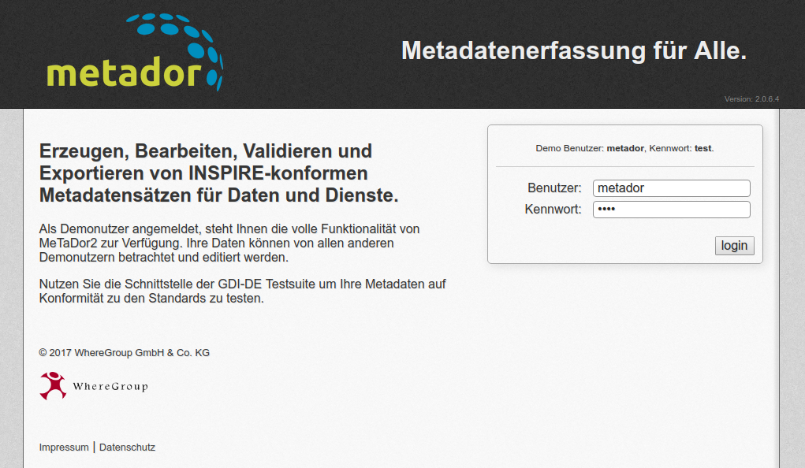

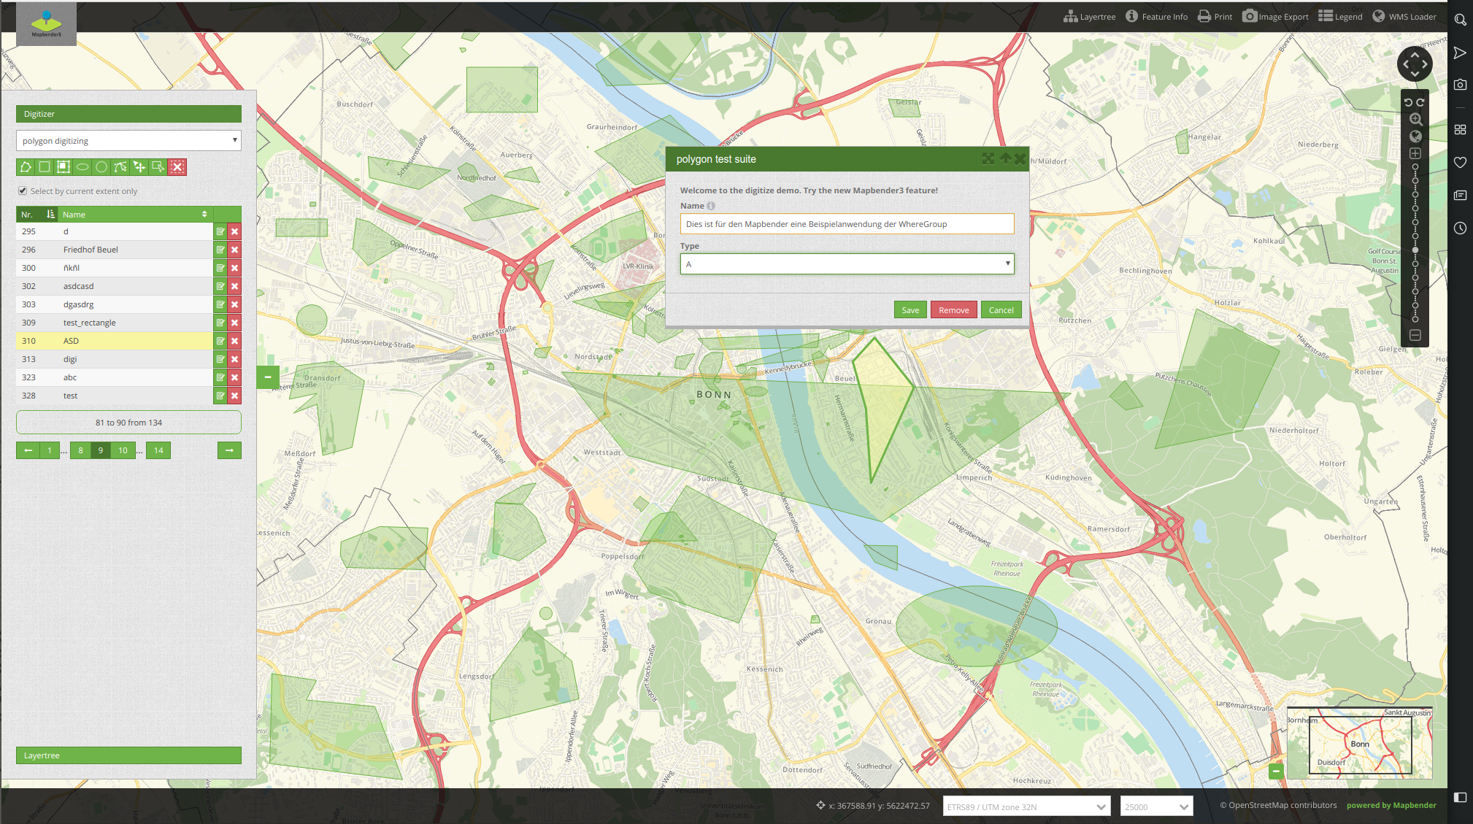

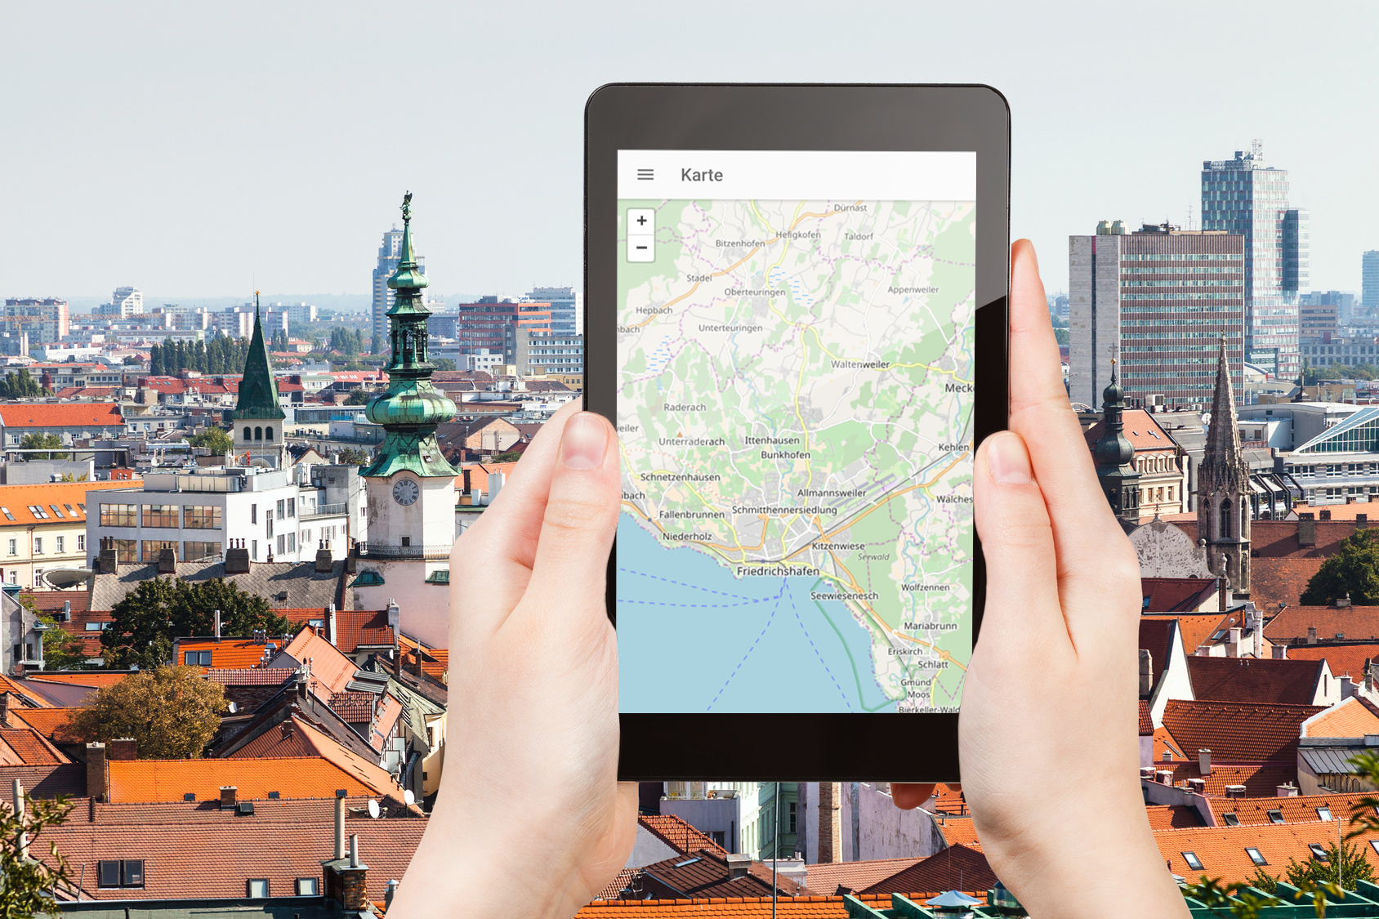
WhereGroup
Notes:
Major Mapbender sponsor
Company in Bonn, Germany with 18 employees
Service provider with experience in all fields of spatial data management with free software: WebGIS, SDI, database, relevant standards, trainings, conferences
Open Source projects: Mapbender, PostNAS

Slide 5
FOSS4G Community Sprint 2019
Don‘t miss it!
Saturday 31.8.2019
https://wiki.osgeo.org/wiki/FOSS4G_2019_Community_Sprint

Slide 6
What does Mapbender do?

Slide 7
WebGIS Client Suite
with administration web interface

Slide 8
Create a geoportal without writing a single line of code!

Slide 9
Create and maintain an OWS repository

Slide 10
Distribute configured services among applications

Slide 11
Grant users and groups access to
applications and services

Slide 12
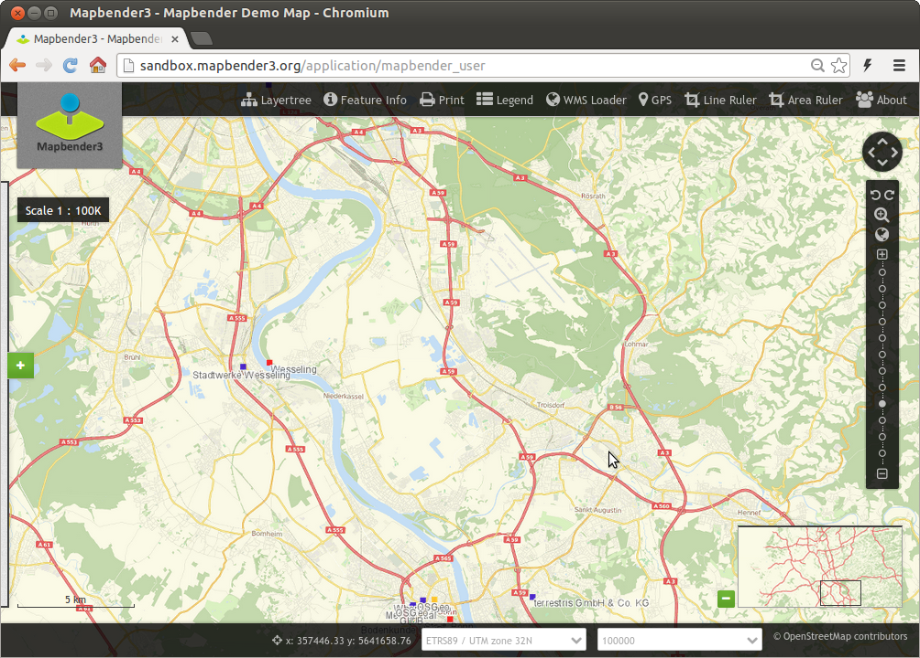
Notes:
Basisdienste
Karte
Navigationsleiste (Drag & Drop)
Einfache Diensteübersicht

Slide 13
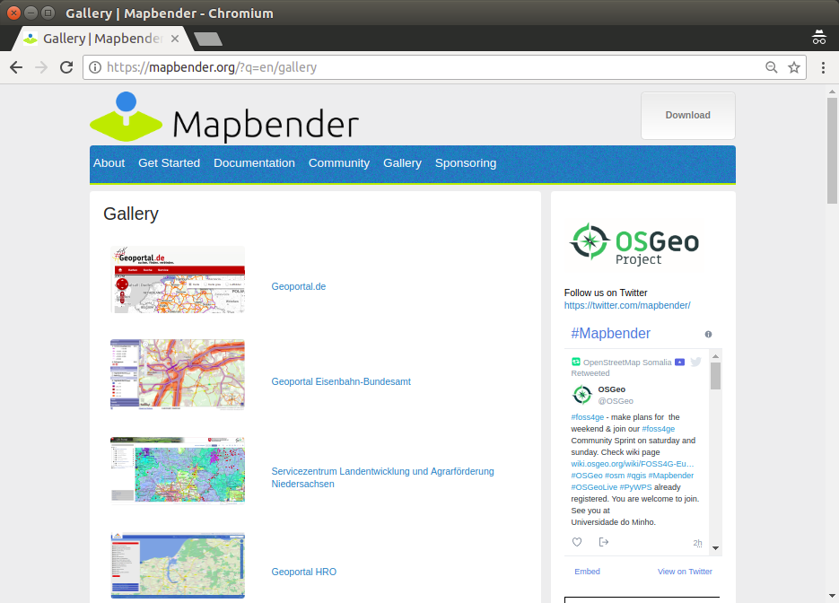

Slide 14
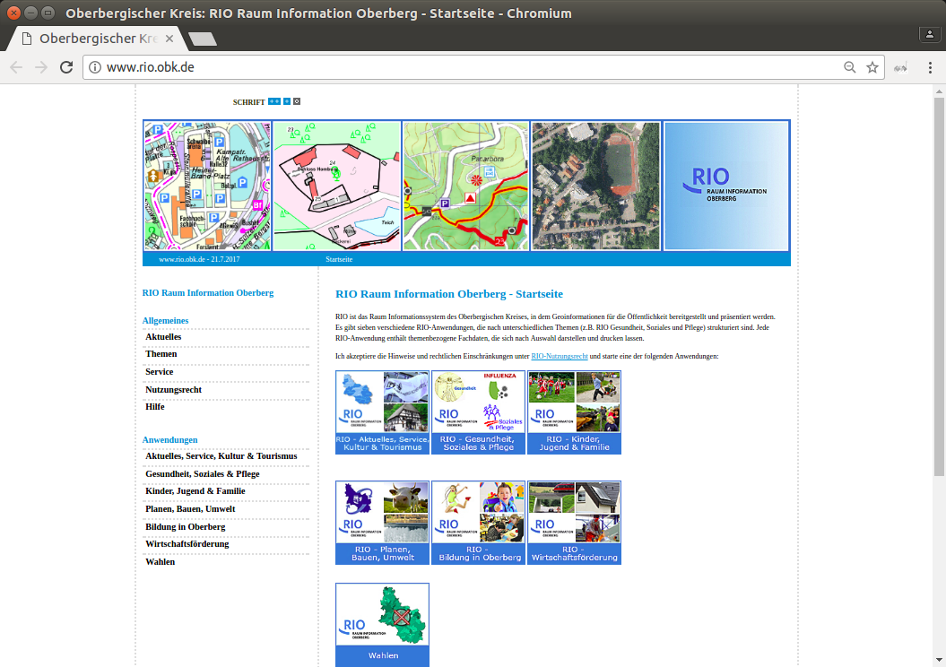

Slide 15
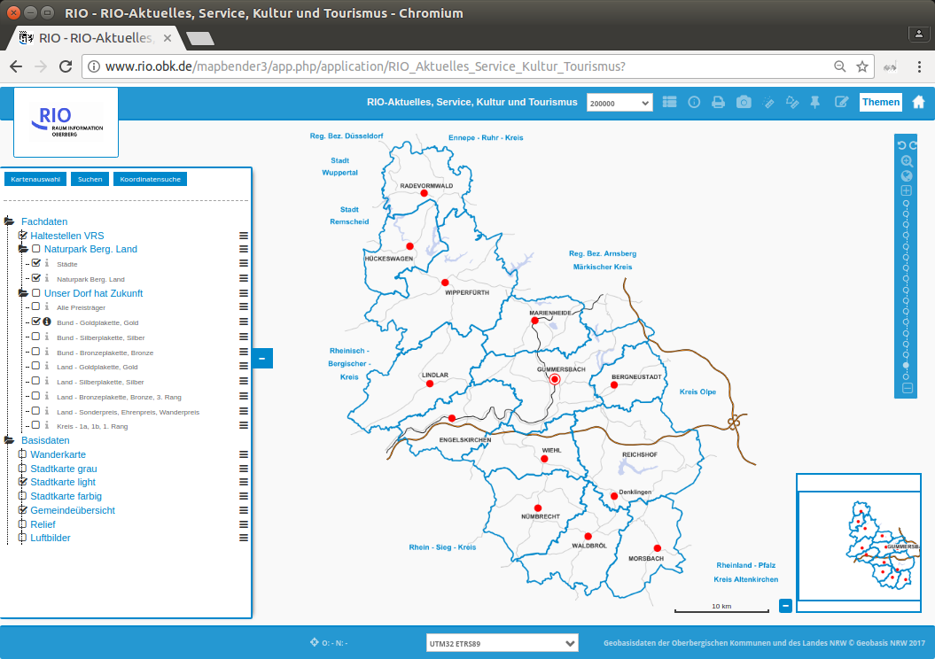

Slide 16


Slide 17
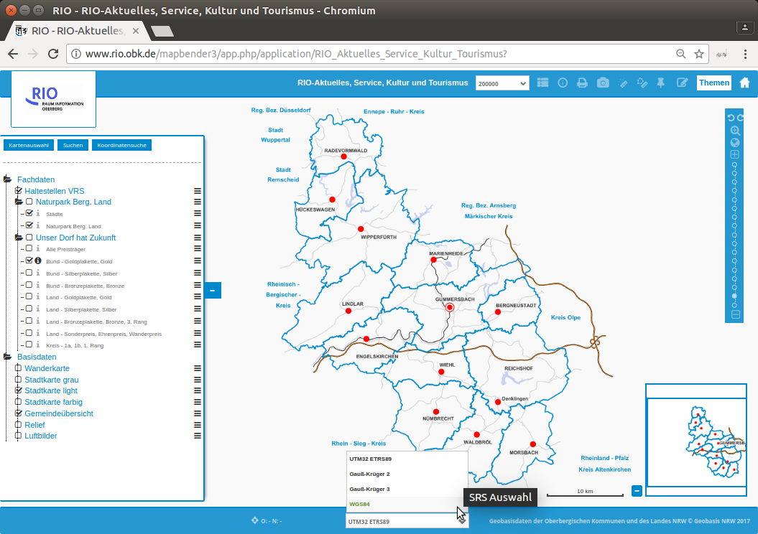

Slide 18
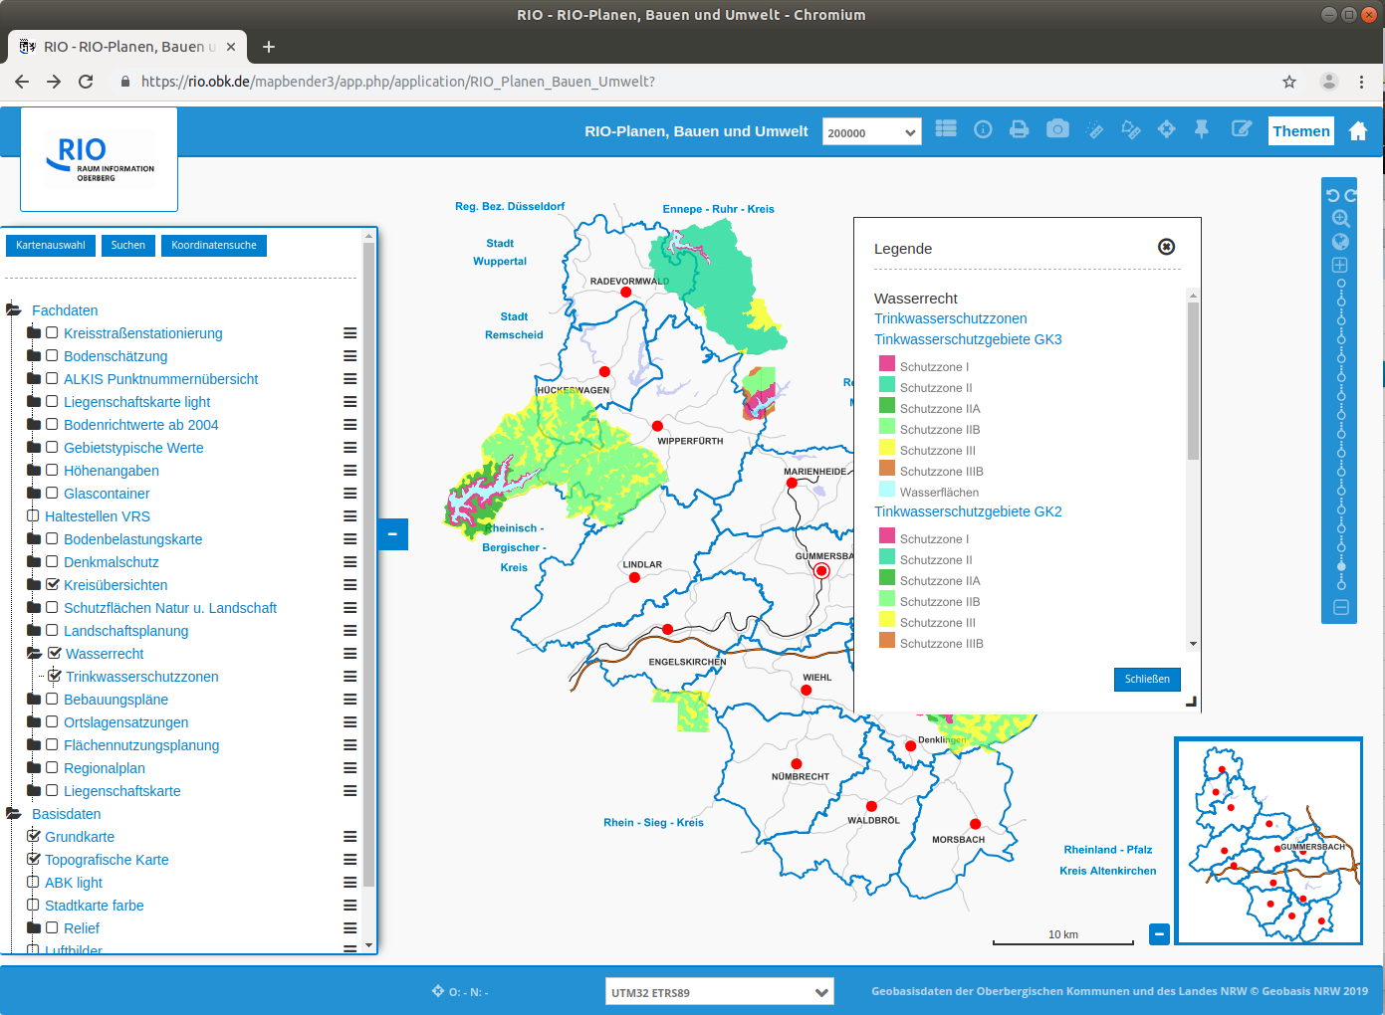

Slide 19
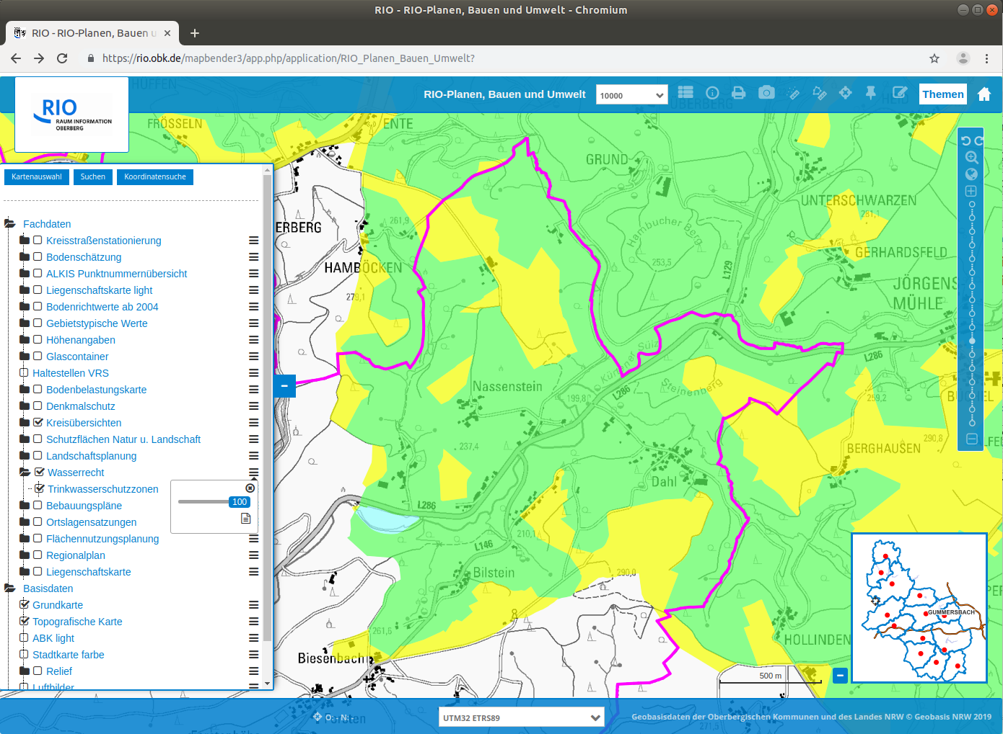

Slide 20
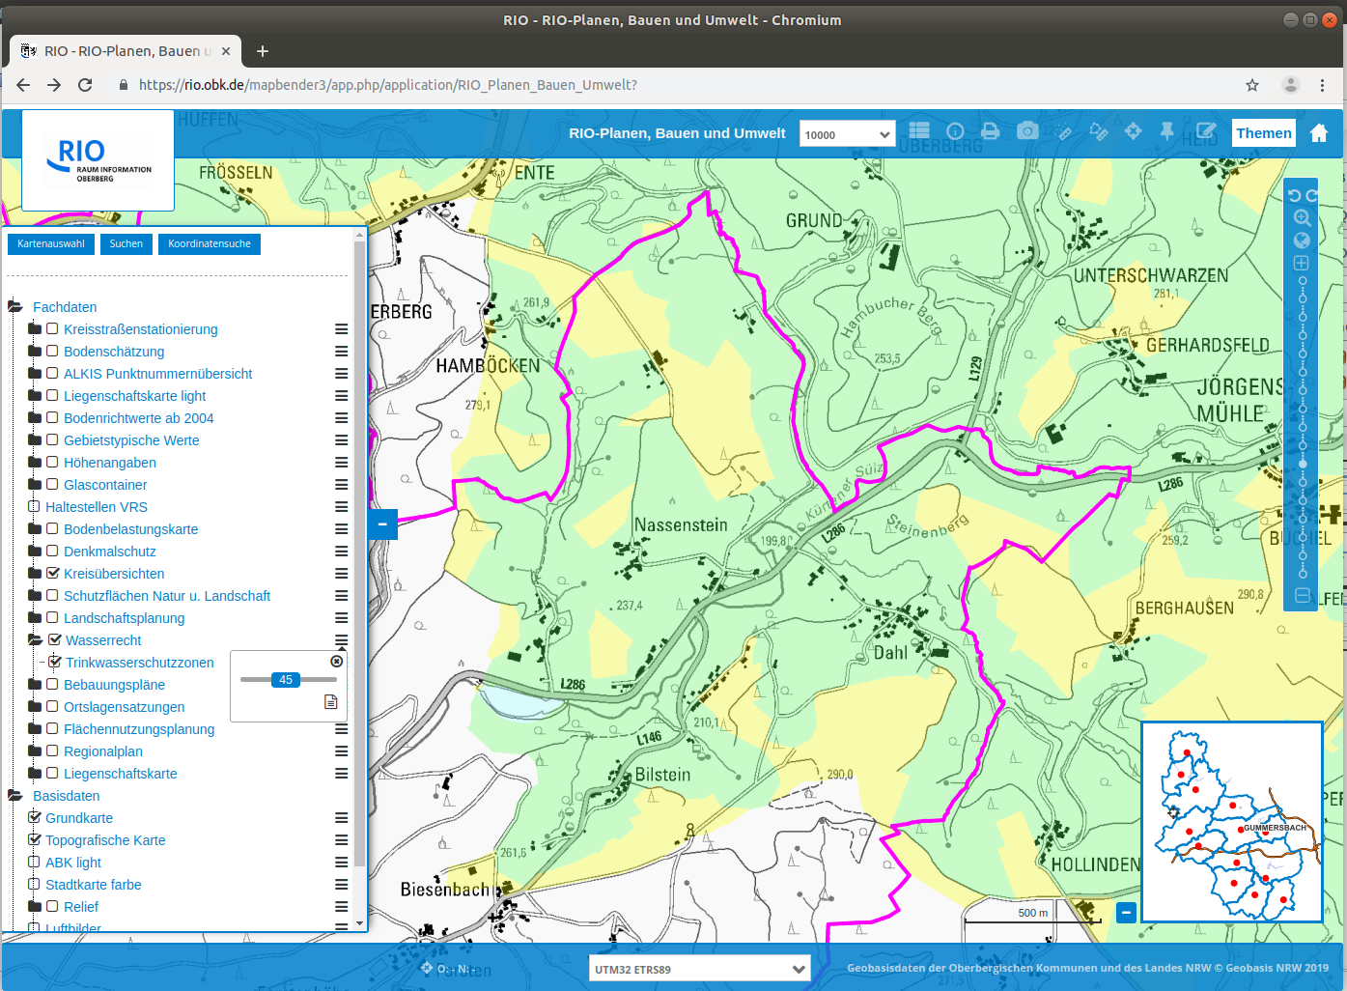

Slide 21
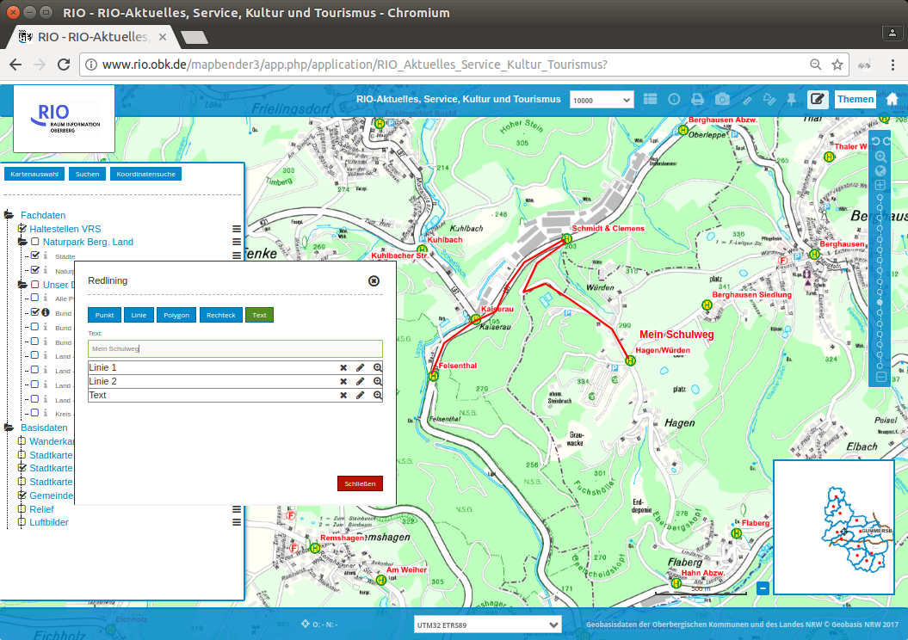

Slide 22
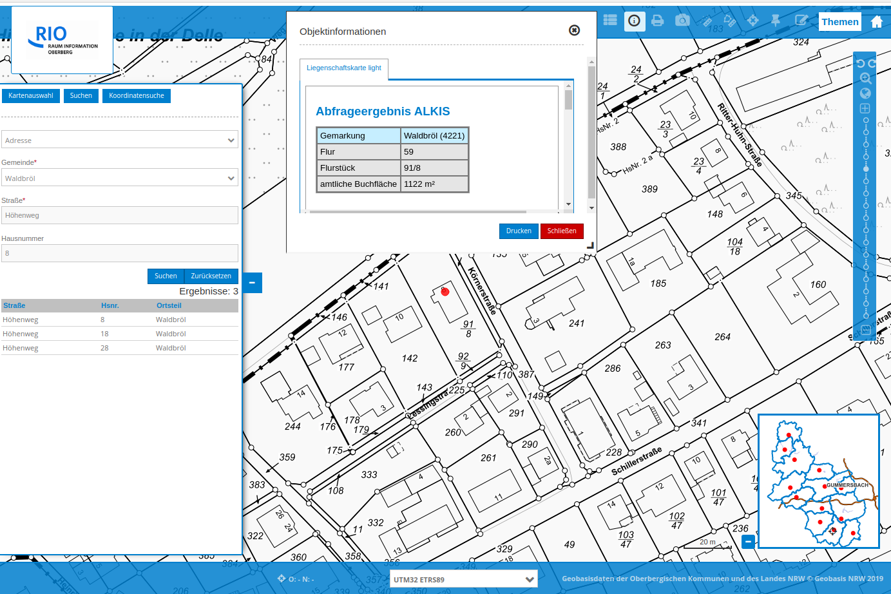

Slide 23
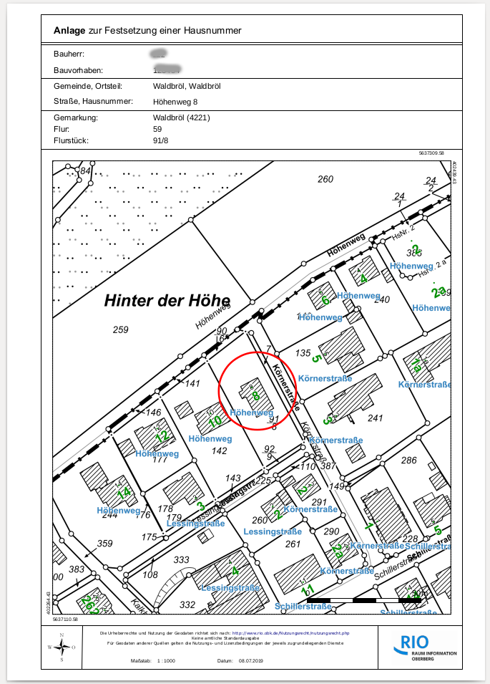

Slide 24
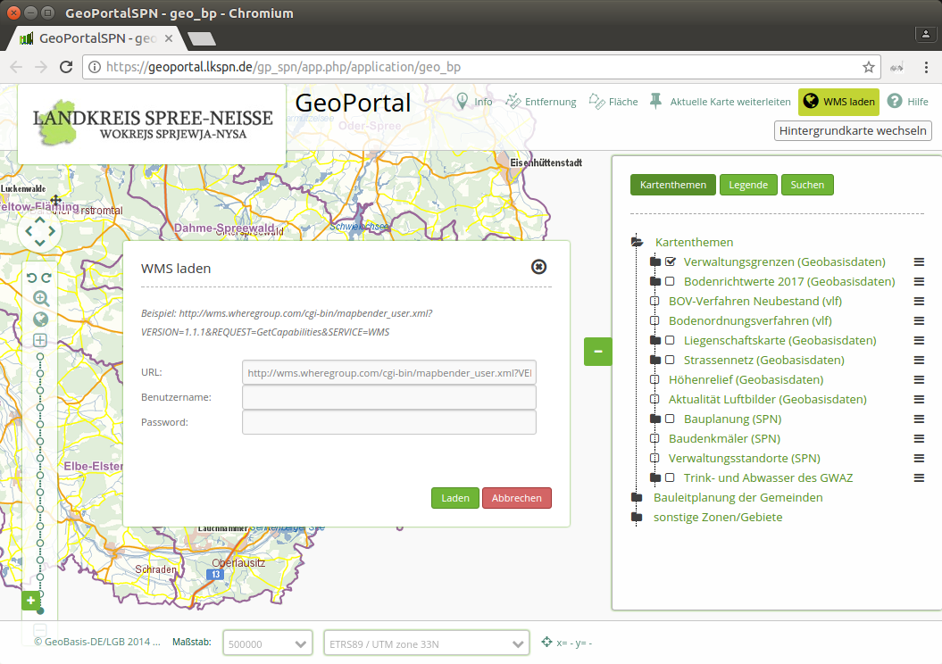

Slide 25
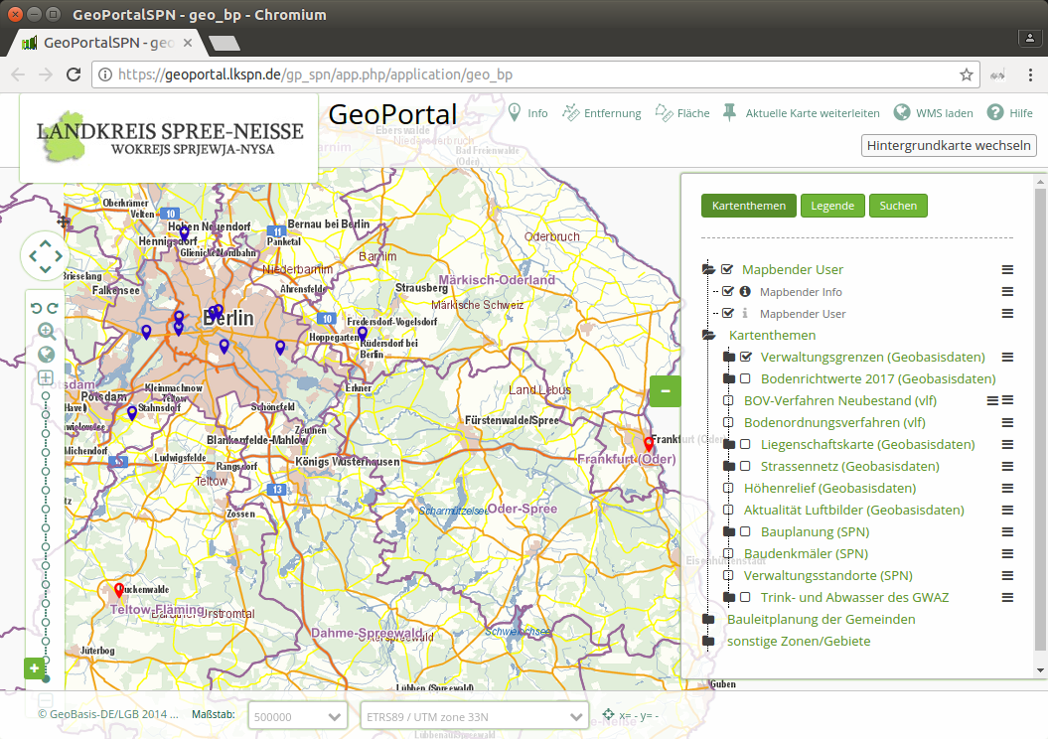

Slide 26
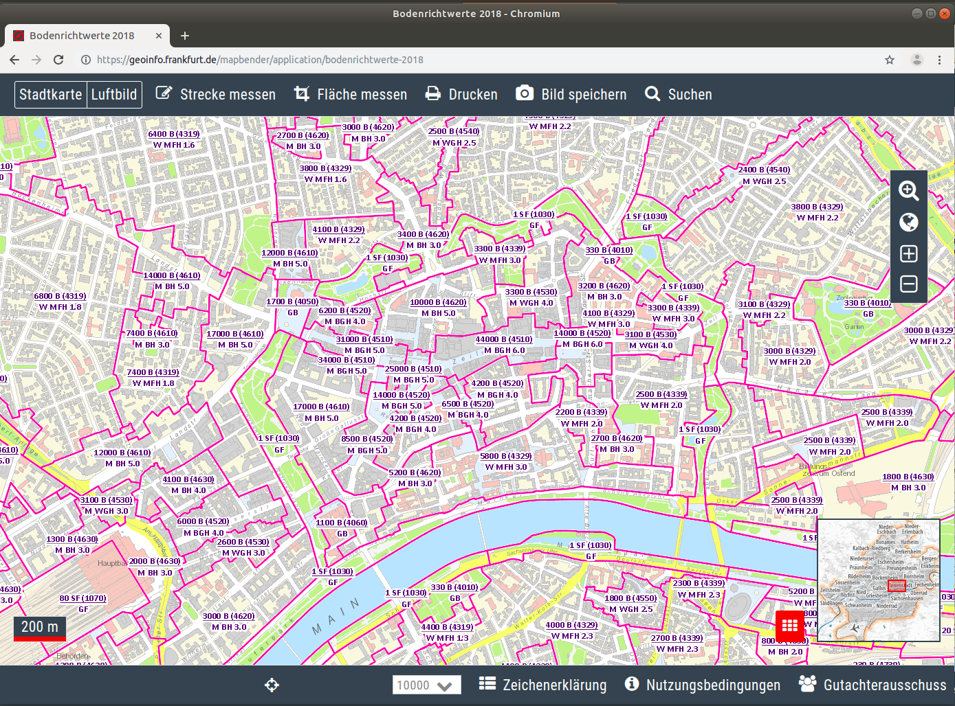

Slide 27
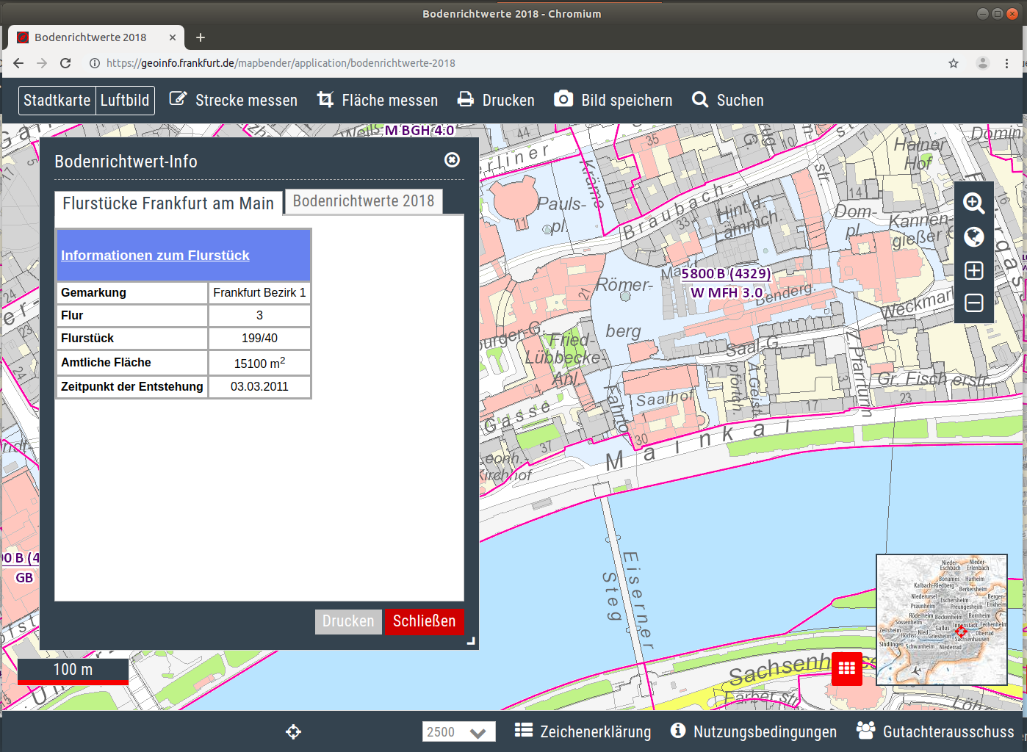

Slide 28
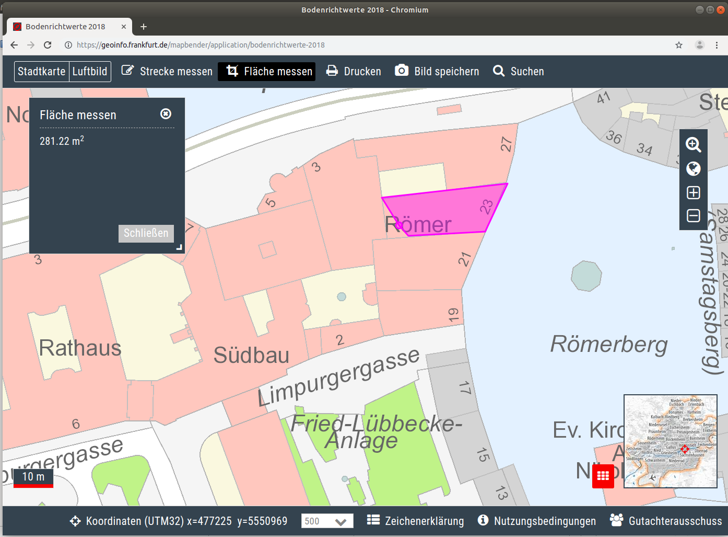

Slide 29
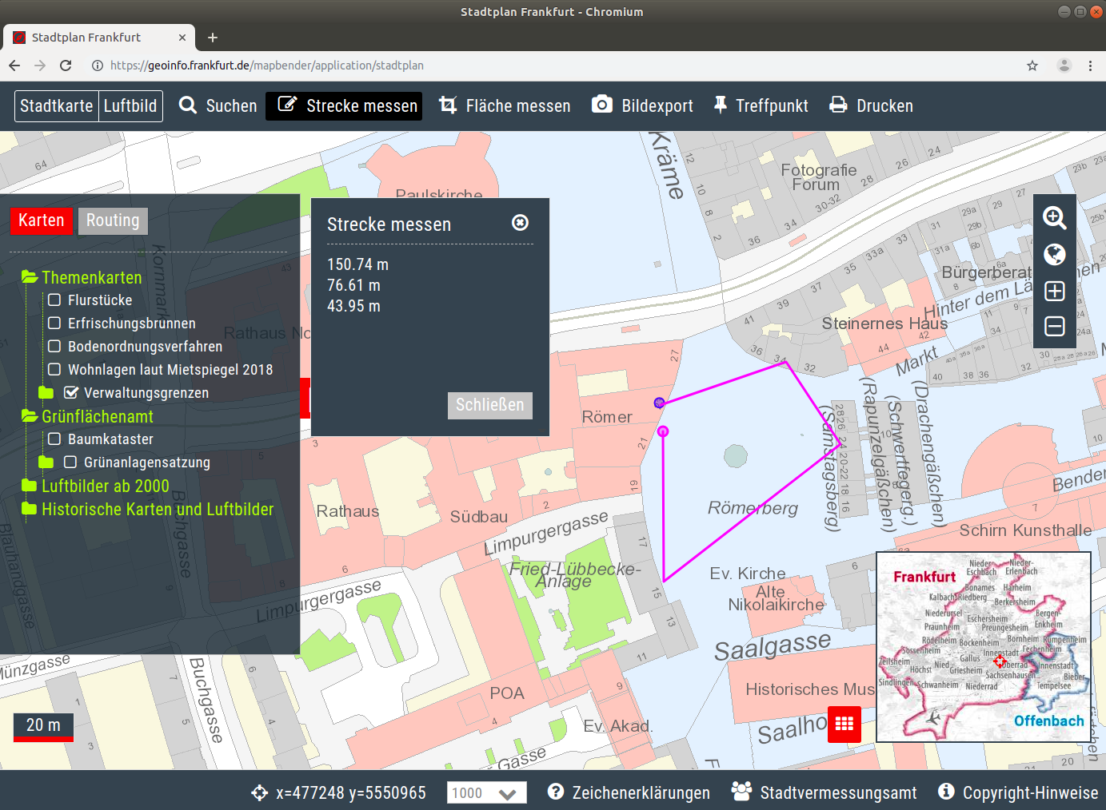

Slide 30
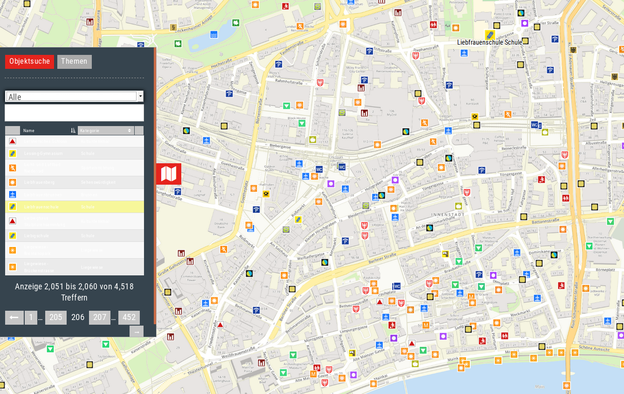

Slide 31
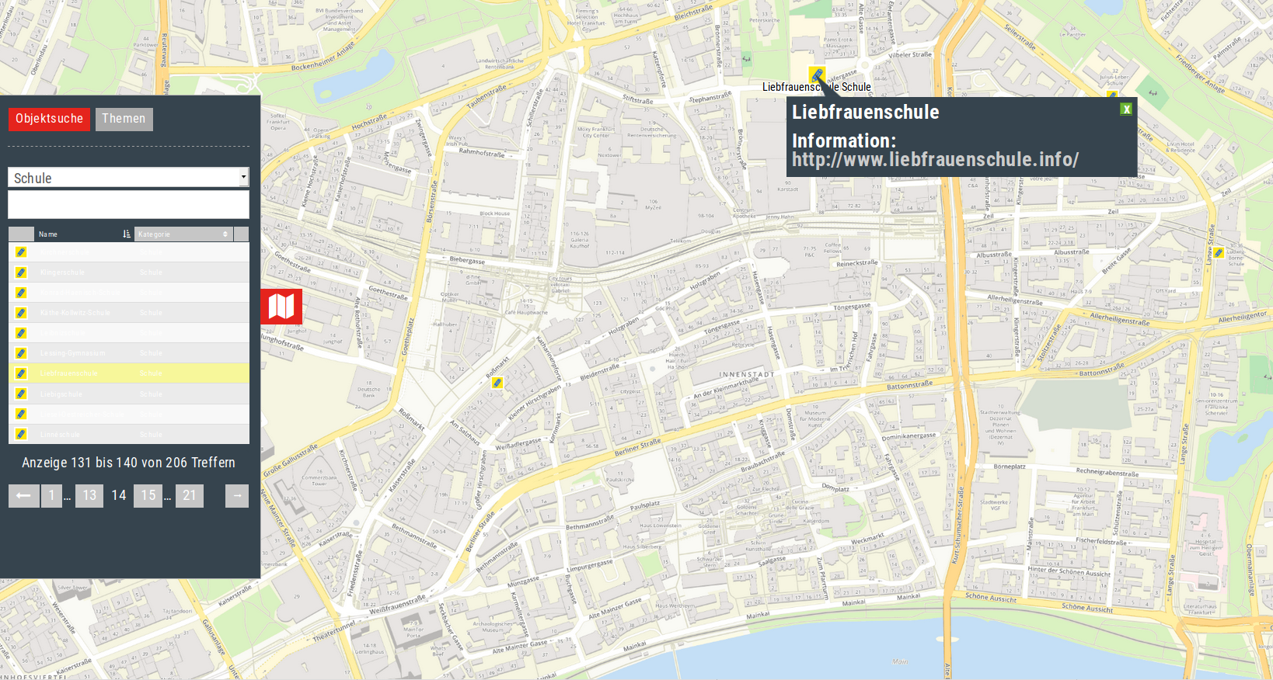

Slide 32
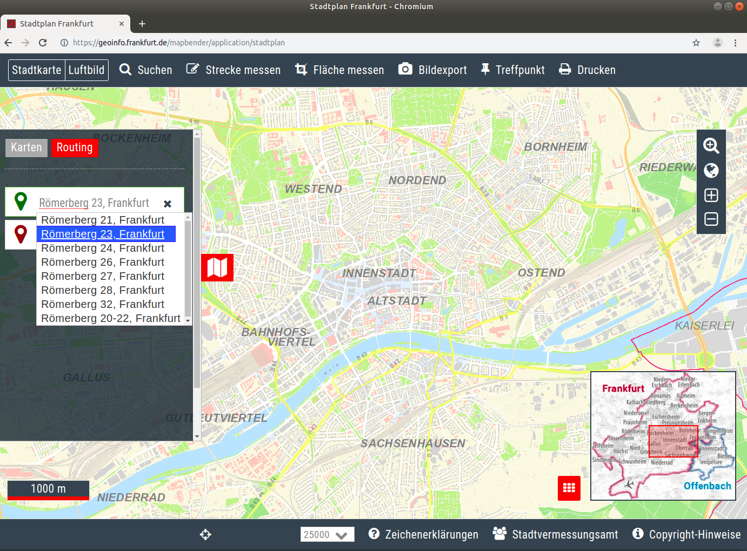

Slide 33
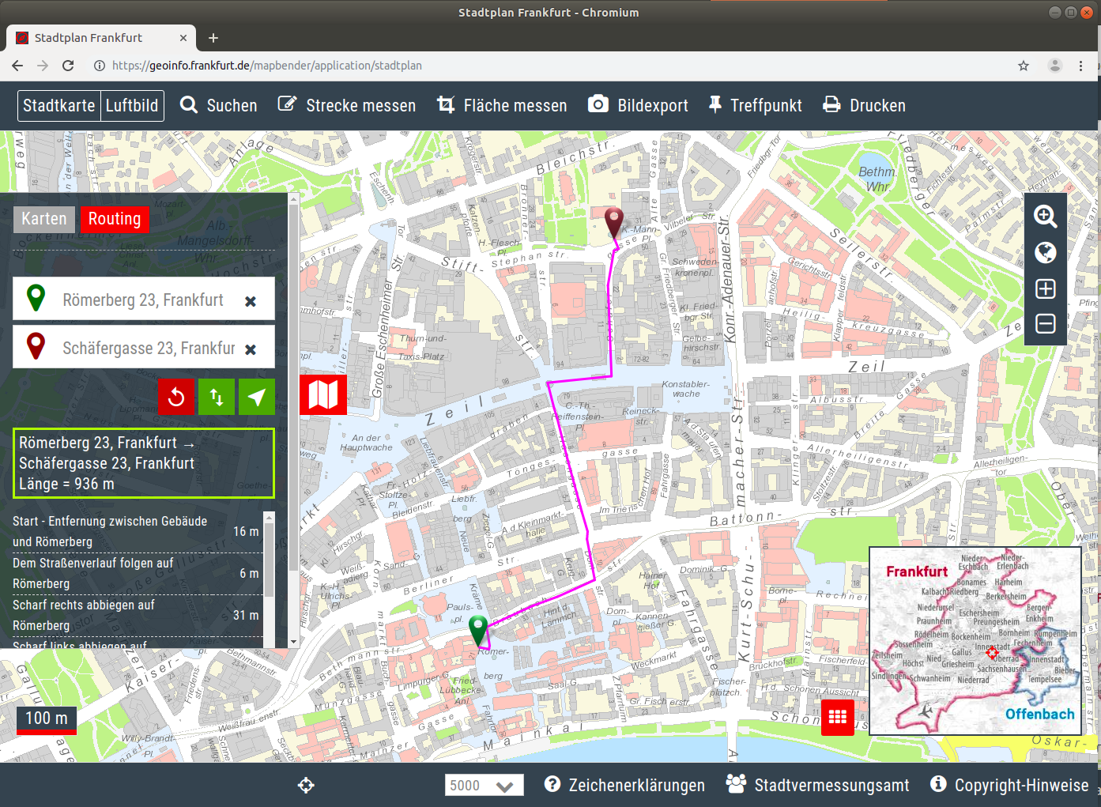

Slide 34


Slide 35
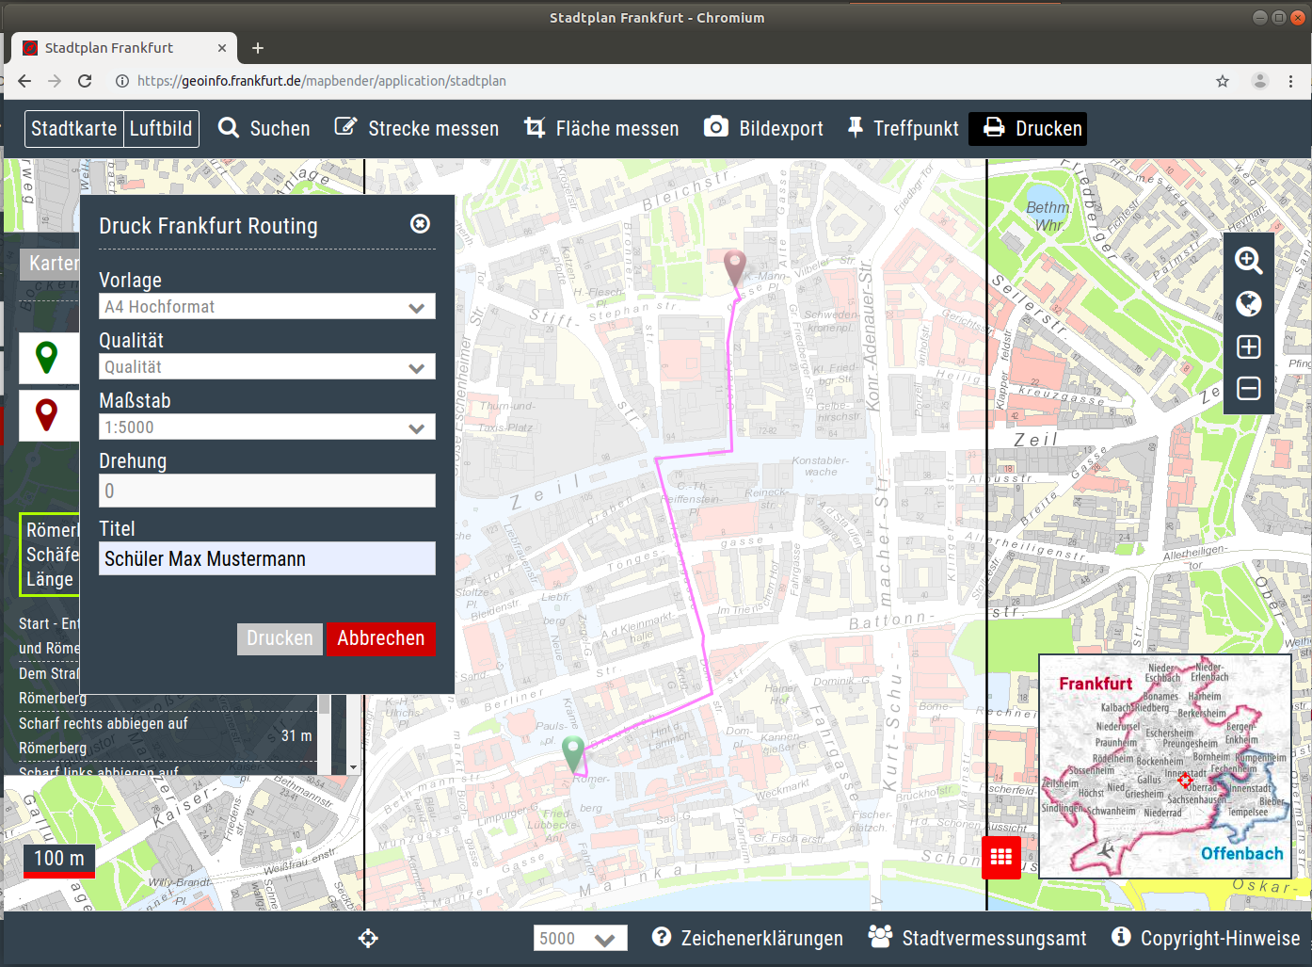

Slide 36
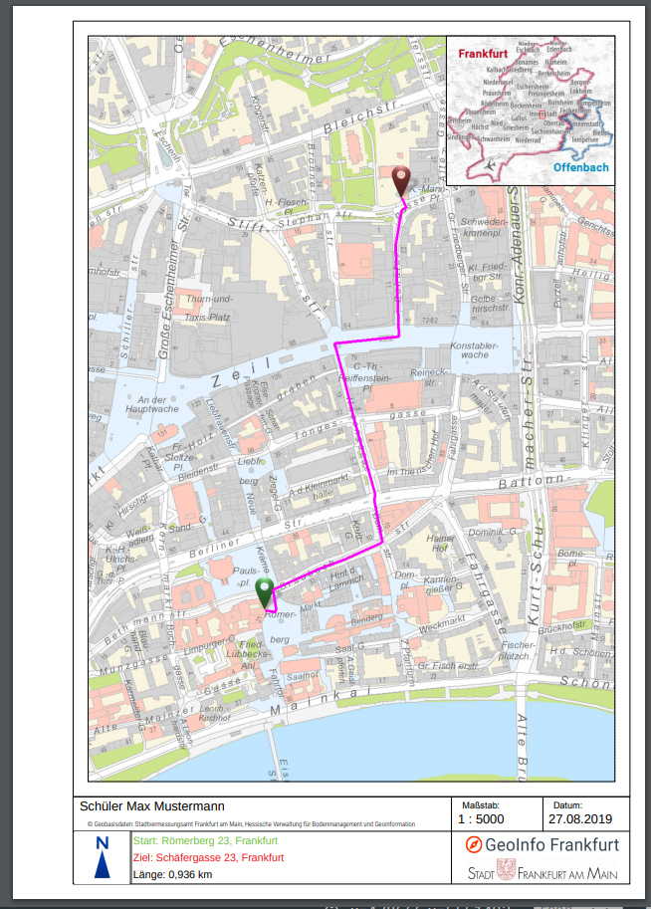
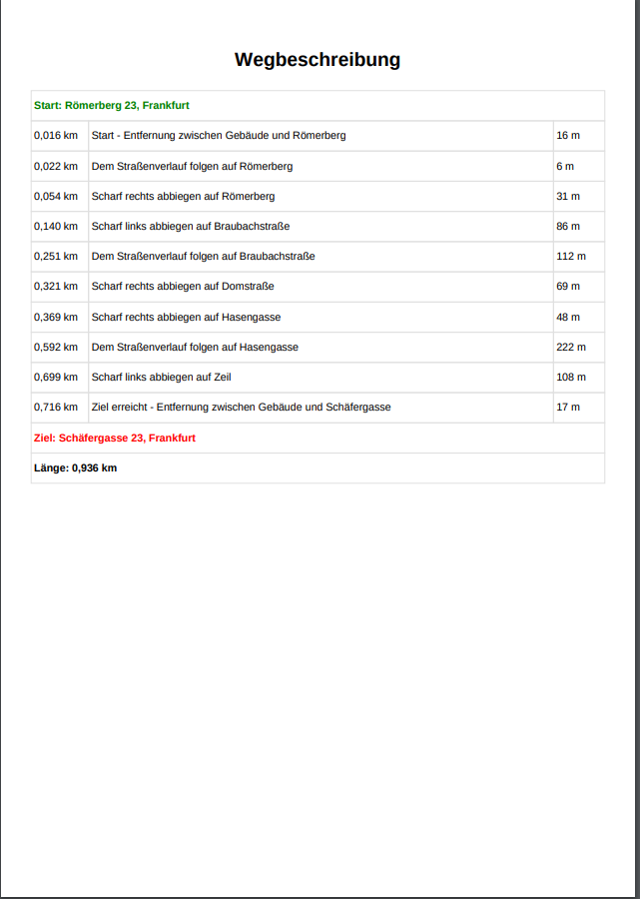

Slide 37


Routing
pgRouting & GraphHopper
Implemented for Deutsche Bahn and Stadt Frankfurt
Schoolpath analysis for public transport ticket
Routing to facilities

Slide 38
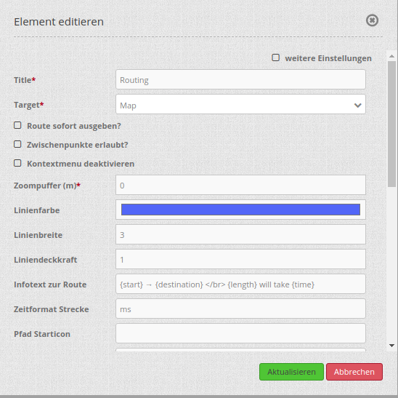
Routing configuration

Slide 39
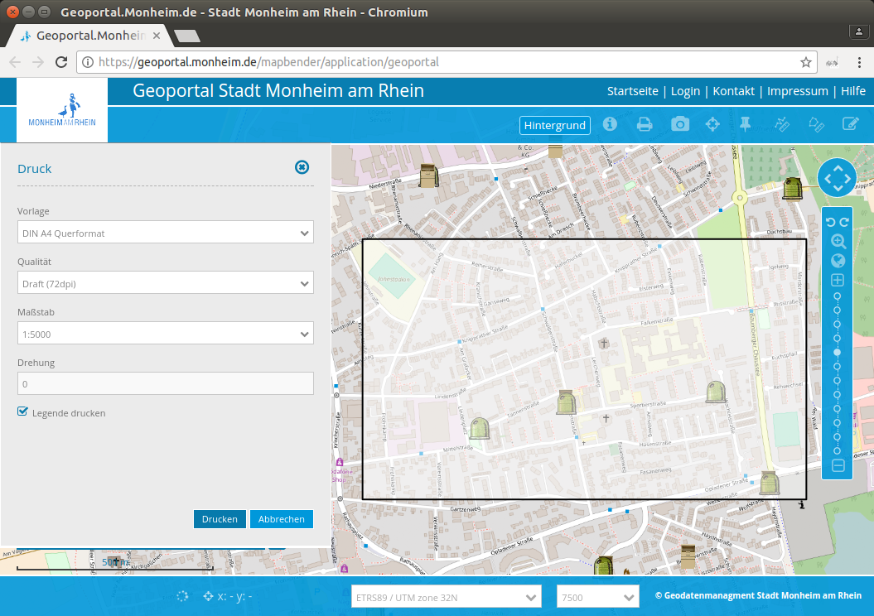

Slide 40
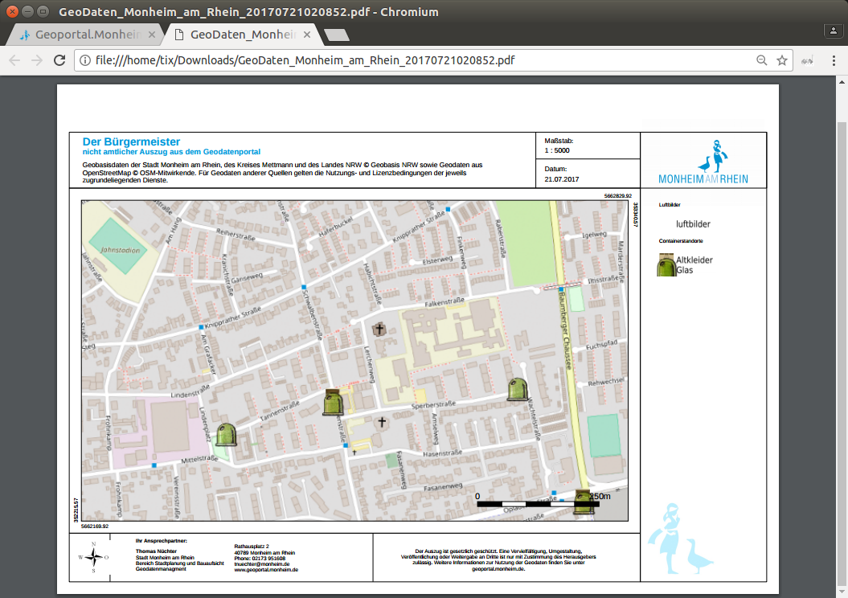

Slide 41
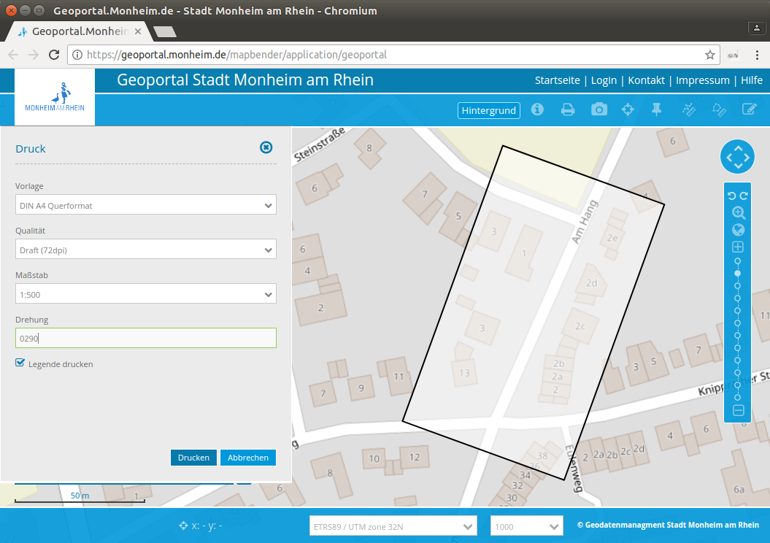

Slide 42
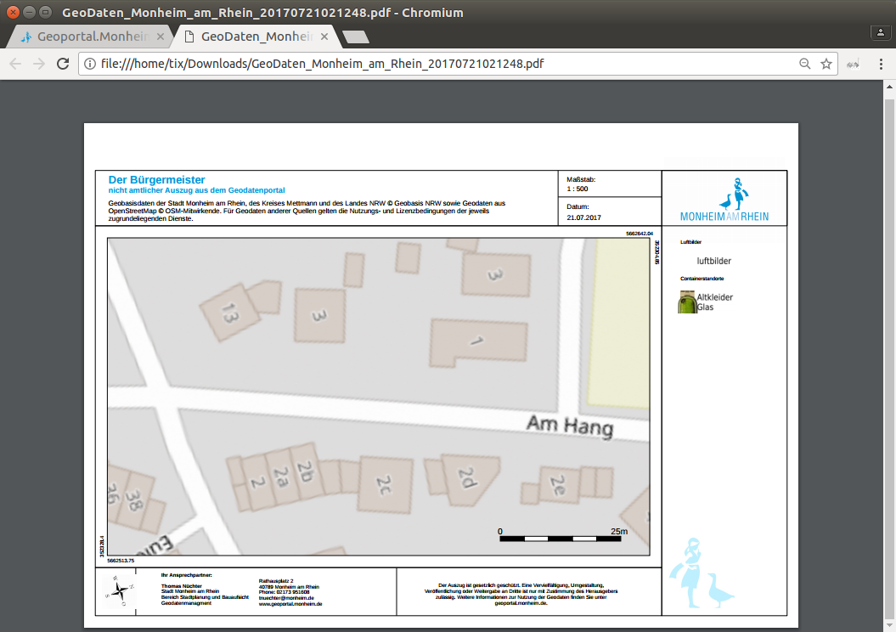

Slide 43
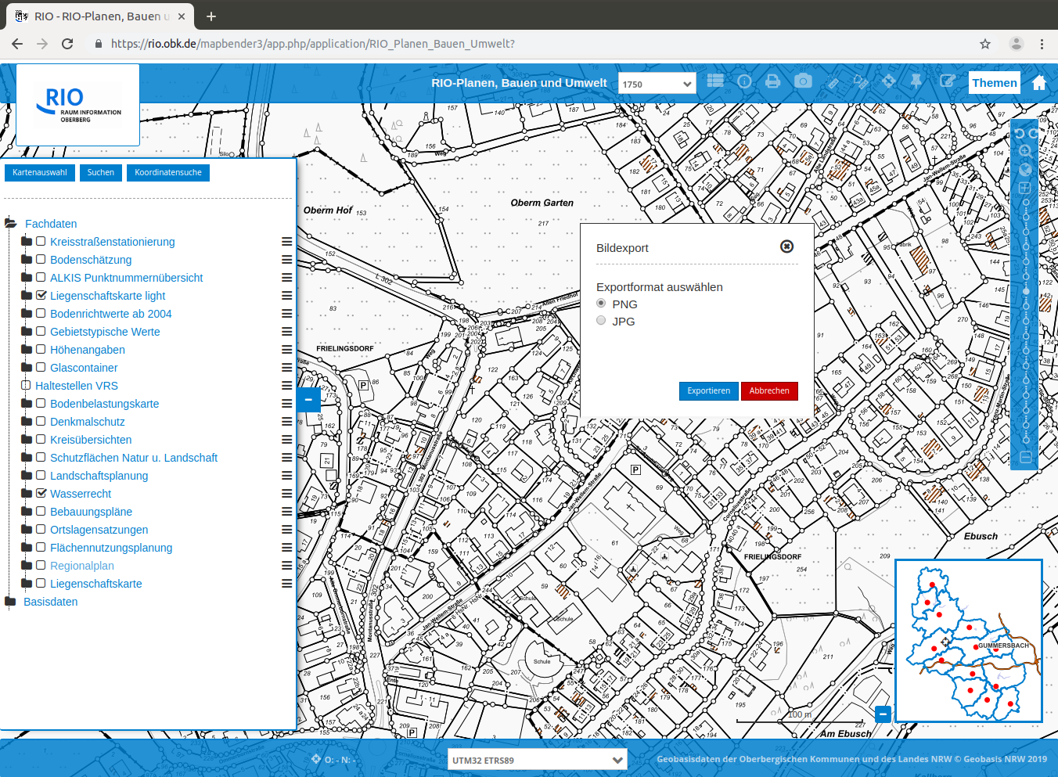

Slide 44
Set up your own application

Slide 45
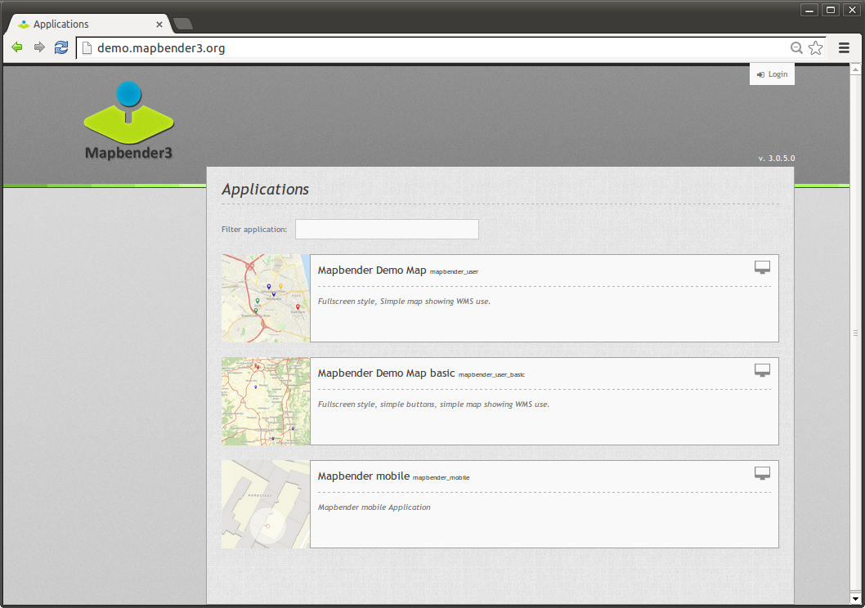

Slide 46
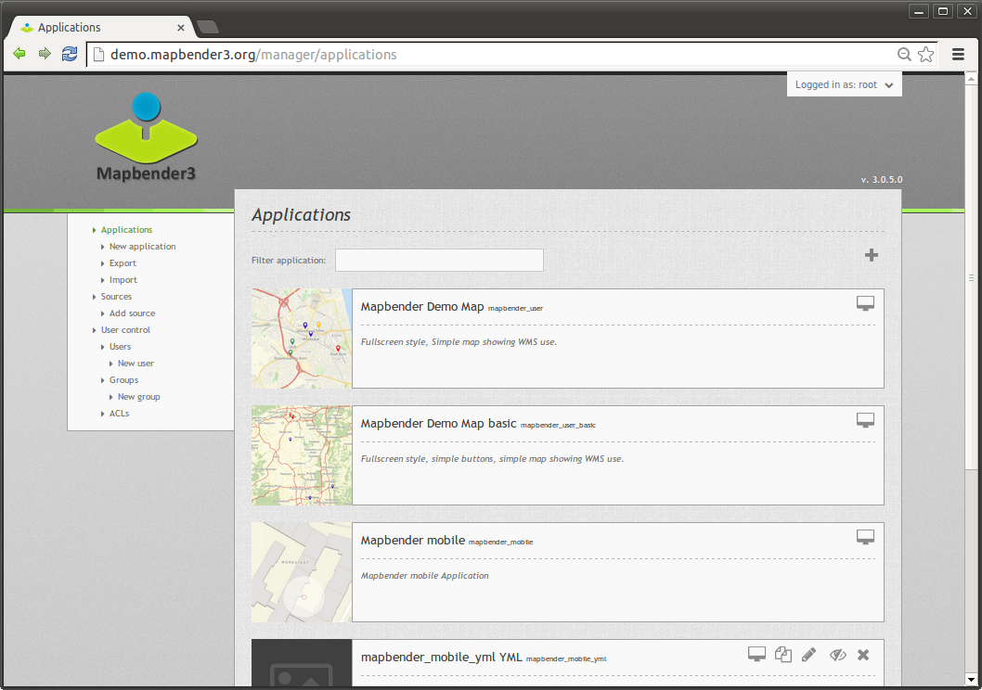

Slide 47
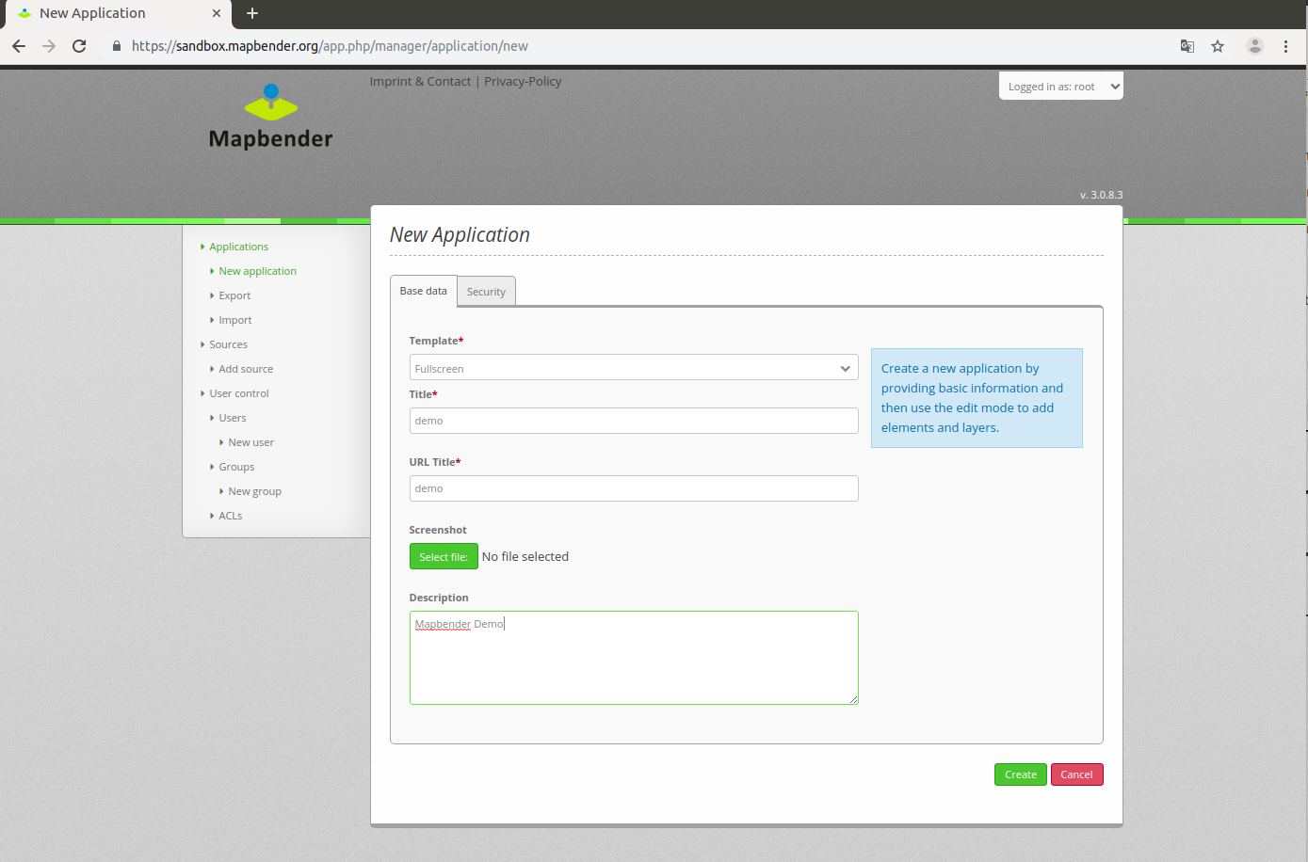

Slide 48
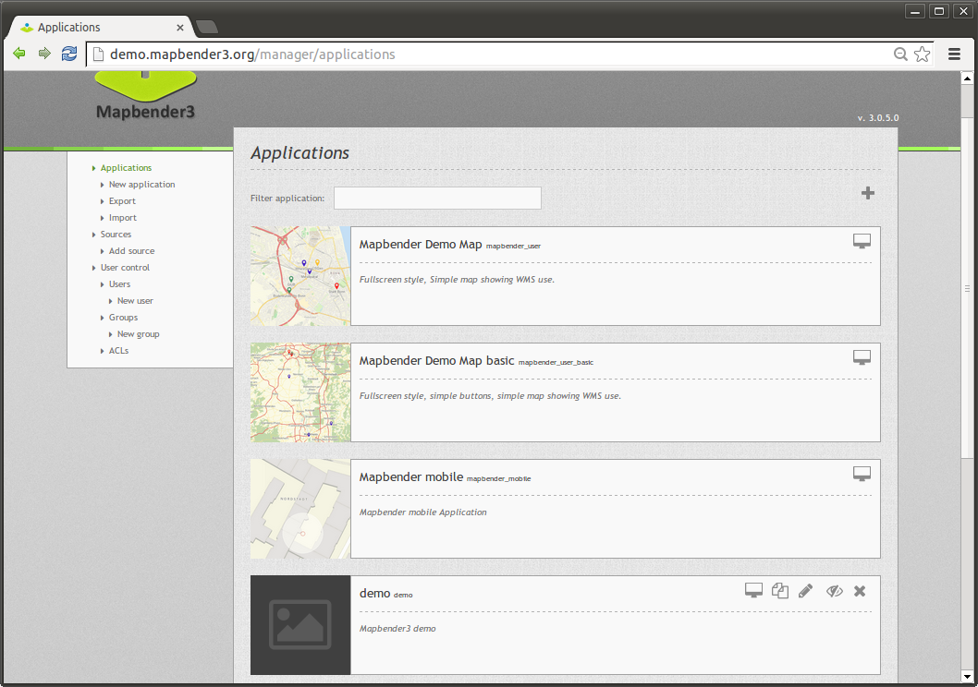

Slide 49
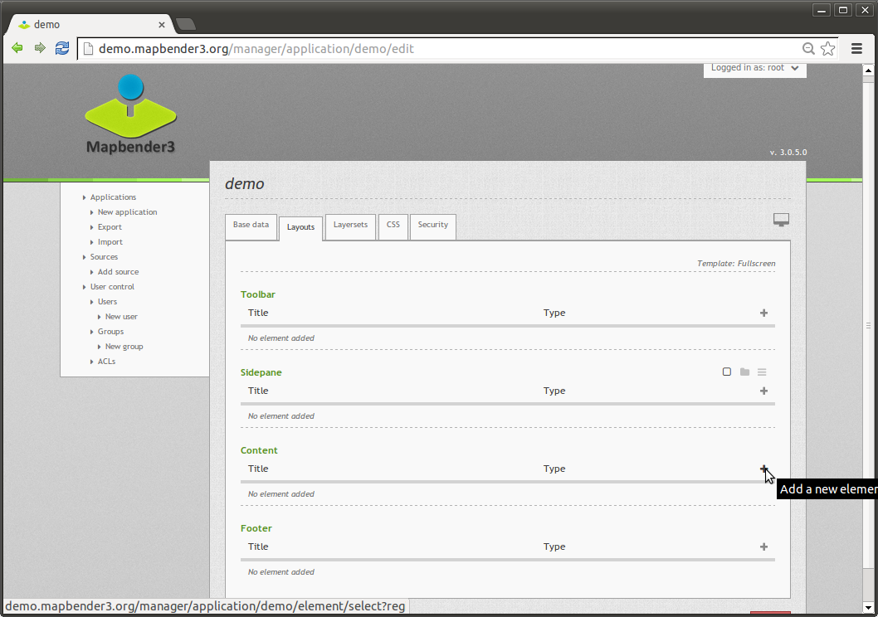

Slide 50
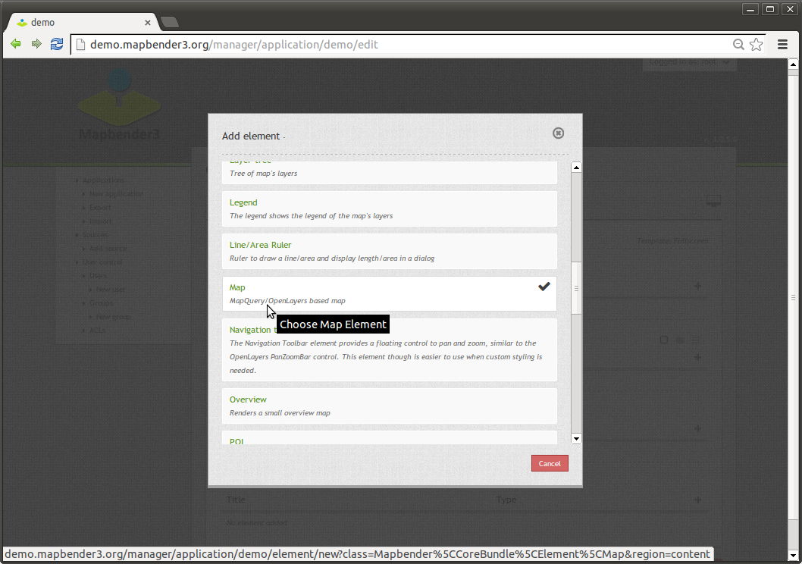

Slide 51
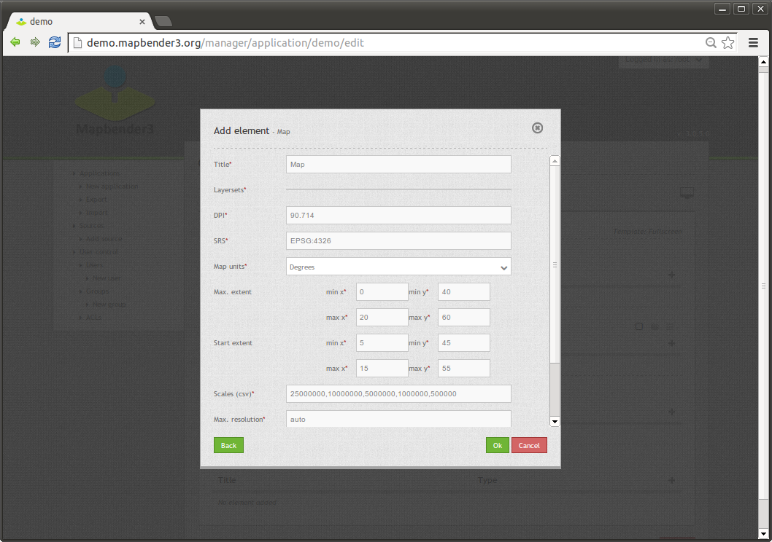

Slide 52
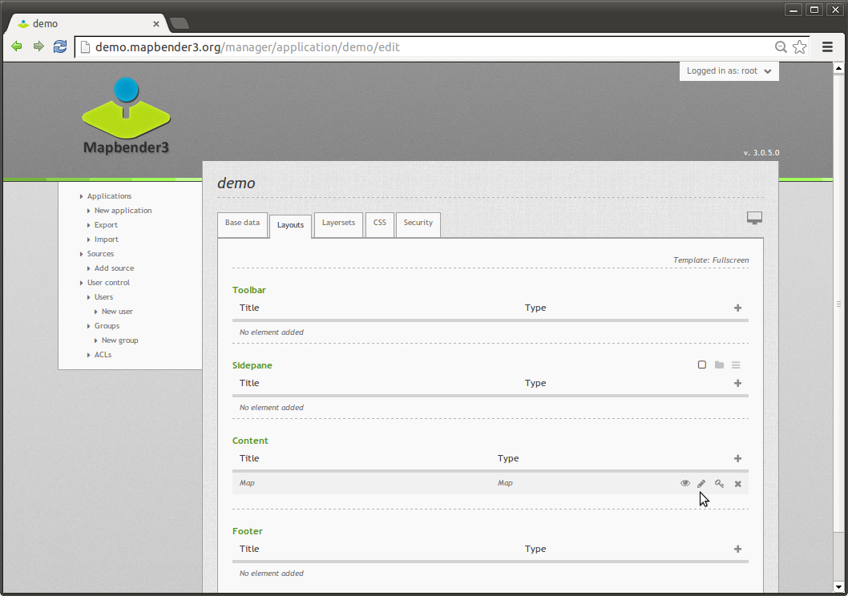

Slide 53
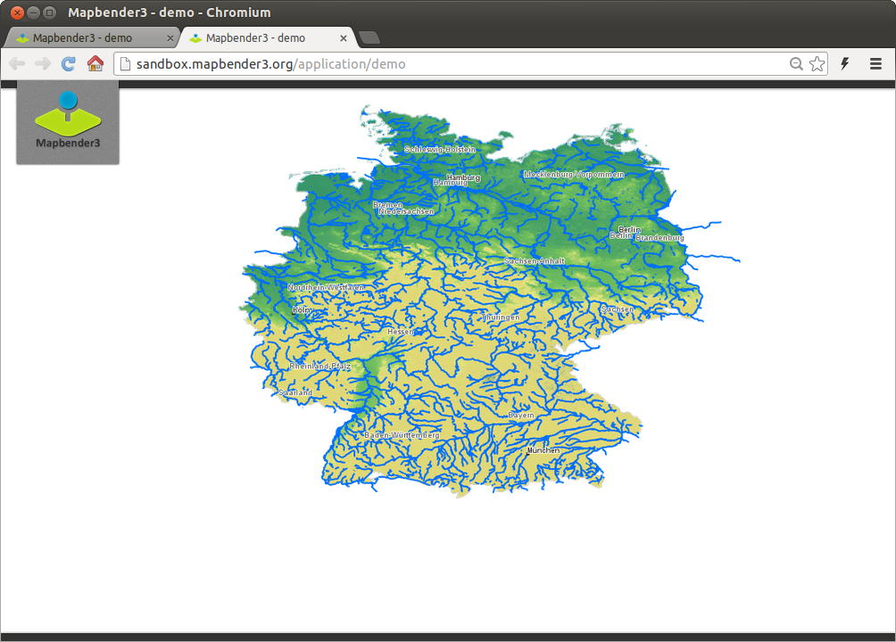

Slide 54
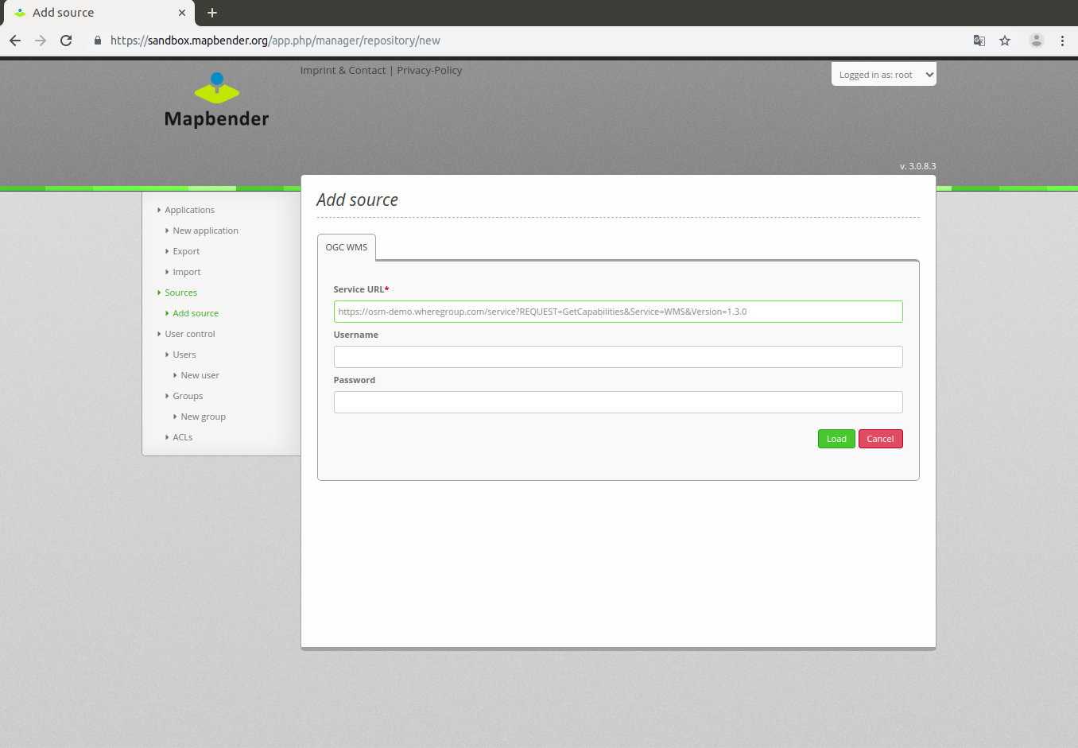

Slide 55
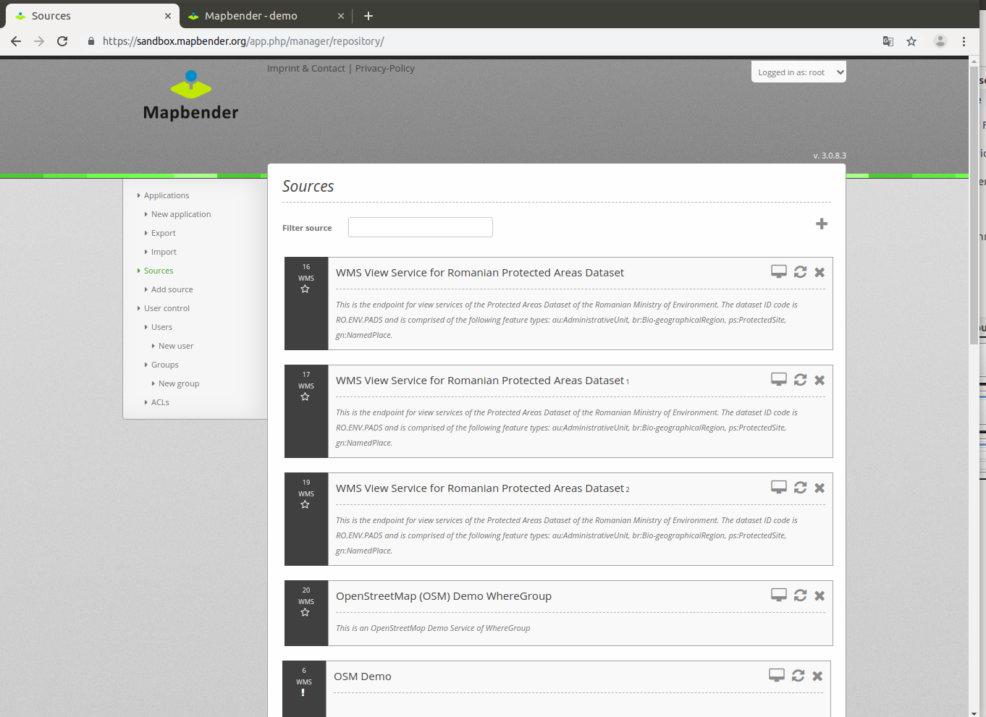

Slide 56
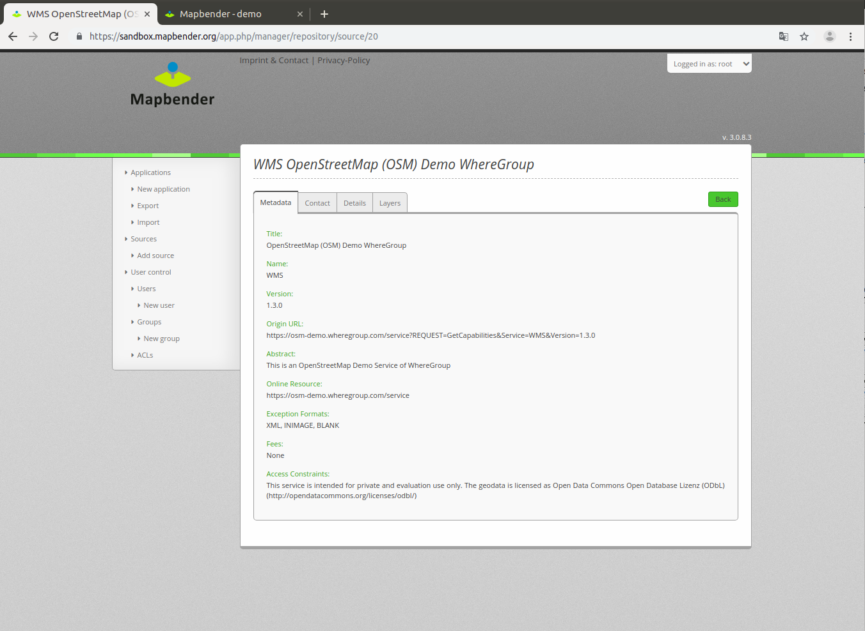

Slide 57
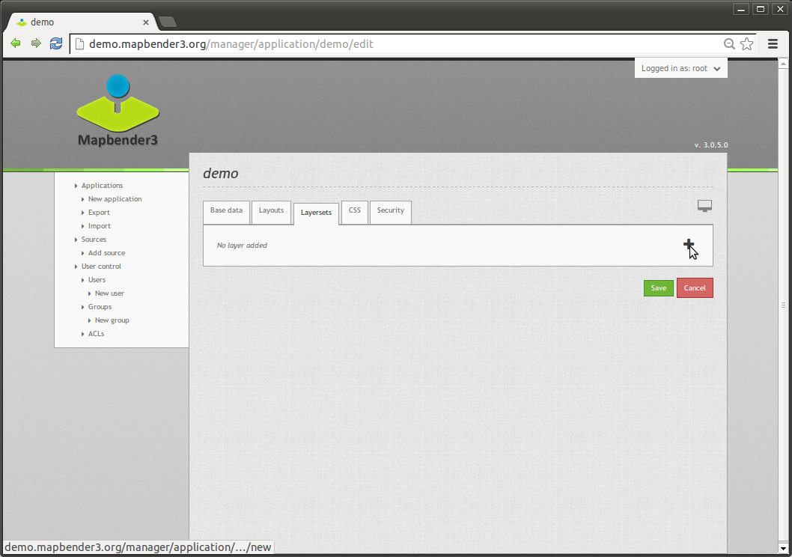

Slide 58
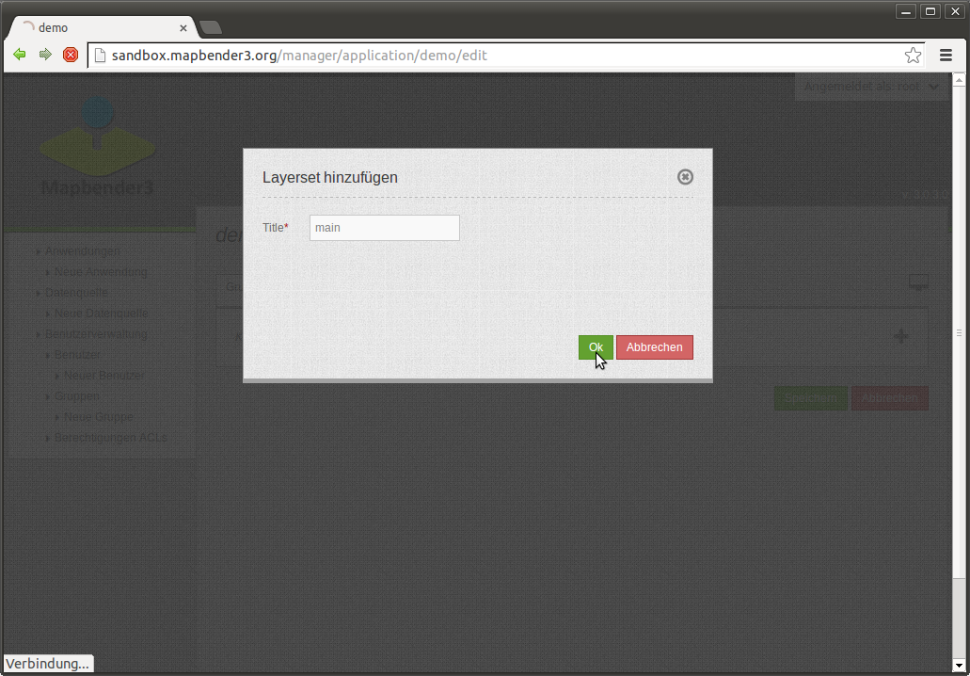

Slide 59
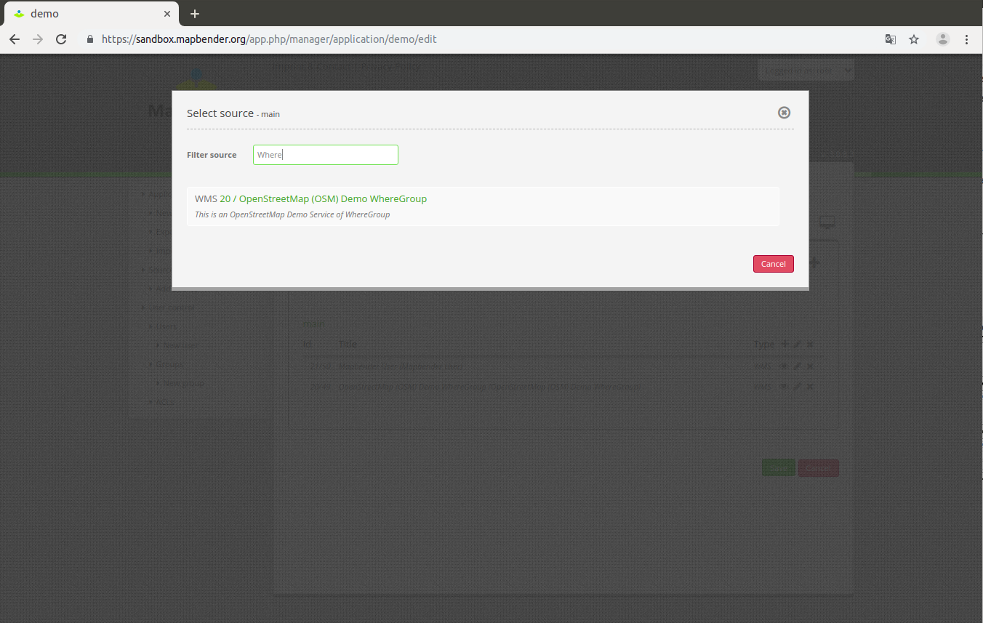

Slide 60
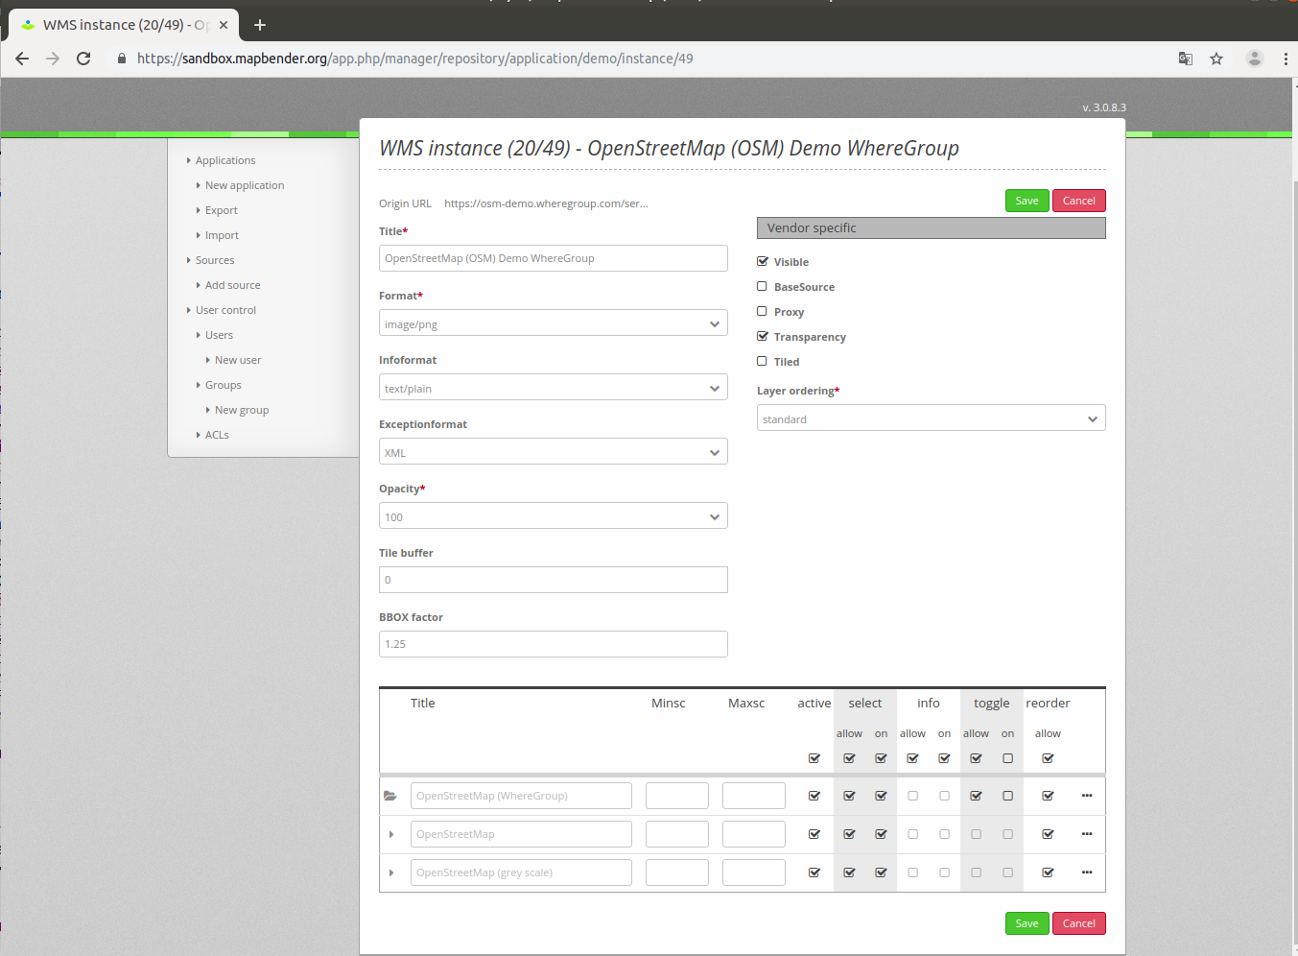

Slide 61
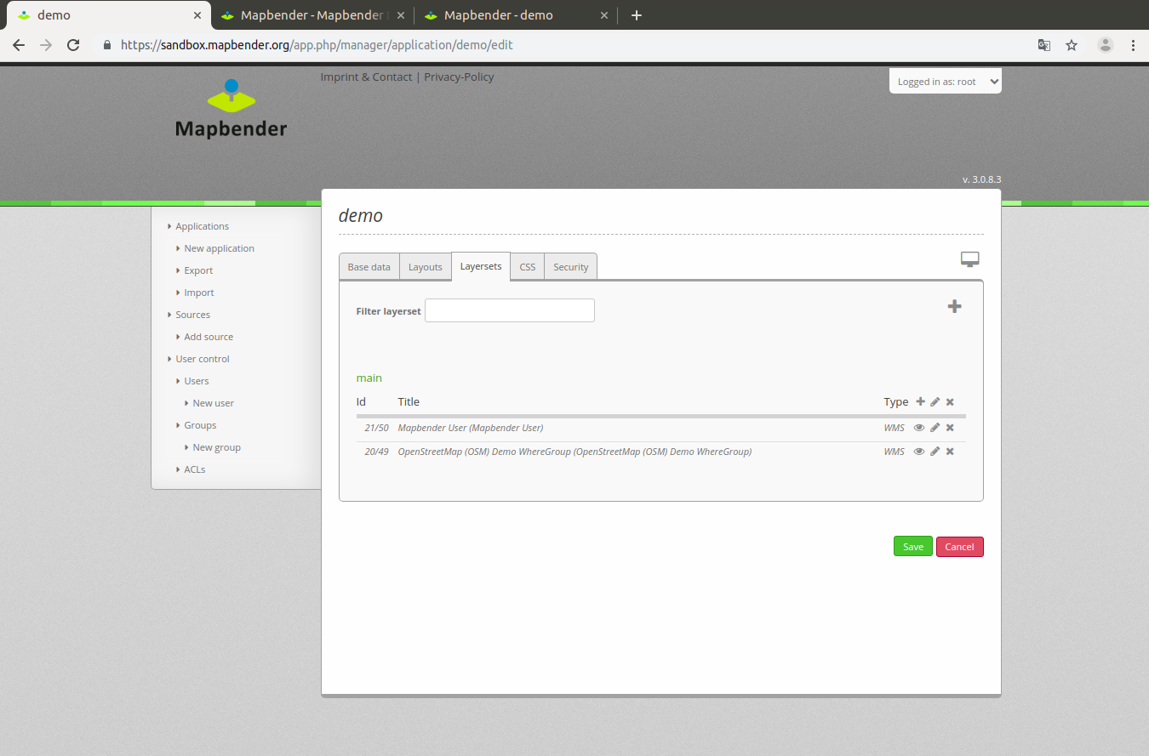

Slide 62


Slide 63


Slide 64



Slide 65


Slide 66


Slide 67


Slide 68


Slide 69


Slide 70

Coordinate Tool

Slide 71


Slide 72


Slide 73


Slide 75

Configuration SearchRouter
class: Mapbender\CoreBundle\Component\SQLSearchEngine
class_options:
connection: search_db
relation: ortschaften
attributes:
- gid
- ortsname
geometry_attribute: geom
form:
ortsname:
type: text
options:
required: true
compare: exact
results:
view: table
count: true
headers:
gid: ID
ortsname: Name
callback:
event: click
….

Slide 76

Solr Search

Slide 77

Solr Search
SimpleSearch

Slide 78

Basesource Switcher

Slide 79


Slide 80


Slide 81


Slide 82

Stadtplan Troisdorf

Slide 83



Slide 84

Mobile Template

Slide 85

Editing data with the Digitizer

Slide 86
Digitizer is very popular
You can use it for all sorts of usecases
Complex and simple formulars

Slide 87

Digitalization

Slide 88

Dimensions Handler
Support of WMS Time
Adds slider to your application
Dynamic maps & FeatureInfo for selected time
https://wheregroup.com/de/unternehmen/infobrief/infobrief-01-19-zeitliche-dimensionen.html

Slide 89

Dimensions Handler
Referenz to the time period
Referenz to the time column

Slide 90

Check configuration
Check your configuration
Database
PHP configuration & extensions
System Requirements
FastCGI und Apache mod_rewrite
Access rights

Slide 91

Edit data without geometry
plugable
e.g. tree species, interests

Slide 92

Query_Builder for evaluation
plugable
Embed, view and edit SQL queries
Export results

Slide 93

https://mapbender.org

Slide 94

Which components does Mapbender use?
MIT licensed
Symfony as PHP framework
  Doctrine, Twig, Monolog, Bootstrap...
  Bundles
OpenLayers
jQuery
SQLite, PostgreSQL, MySQL, Oracle database
Notes:
Symfony2 – Web Application Framework
Doctrine – Datenbankabstraktion
OpenLayers – Kartenansicht
JQuery UI – Anwendungswidgets (Dialoge, Tabs, etc)
MapQuery – Verbindung OpenLayers/jQuery

Slide 95

Mapbender 3.0.8.1 on OSGeoLive 13.0
Ready for FOSS4G 2019
Bucharest
We use OSGeoLive
in our workshops
& at conferences
Great for usage
& promotion!

Slide 96
Version 3.0.8.4
Bugfix release
September 2019
https://doc.mapbender3.org/en/book/versions.html
Notes:
Symfony2 – Web Application Framework
Doctrine – Datenbankabstraktion
OpenLayers – Kartenansicht
JQuery UI – Anwendungswidgets (Dialoge, Tabs, etc)
MapQuery – Verbindung OpenLayers/jQuery

Slide 97

Docker image for Mapbender
We have a docker image for Mapbender
https://hub.docker.com/u/mapbender/

Slide 98


Adding OpenLayers4 Support
OL2 and OL4 should be available parallel
Update has to be always possible
Old Applications should still work
and user can try the new once

Slide 99
3.1
Goal: Release 3.1 in 2019
Support for OpenLayer4
Symfony update to 3.4
Focus on Responsive Design with mobile first approach
Two map elements (one for OL2, one for OL4)

Slide 100


Slide 101
After 3.1
Webside Relaunch
Resuable Service instances
Integration of Routing

Slide 102
Join us at the Member Meeting
10. Oktober 2019 (10:00 - 17:00)
Universitätsclub Bonn e.V. - Bonn (Germany)
Sponsored by OSGeo
https://mapbender.org/?q=de/node/49

Slide 103
Thank you
Astrid Emde
astrid.emde@wheregroup.com
mapbender-users@list.osgeo.org

