Slide 1
Classification and regression trees – a primer
Jim Savage

Slide 2
What’s the problem?
The world is complex! A policy may work on one group, but not another
How do I know which groups are which?
As our work moves closer to implementation-ready advice, we need to think deeply about this stuff.
Most of the standard statistical techniques fail to identify which groups will respond to a policy shift
It’s generally not enough to just say that a certain school, or hospital, or super fund category will respond differently.
What if there are categories that are particularly likely to respond differently buried within the existing hierarchy?

Slide 3
Classification trees as a step towards better research
Classification and regression trees (CART) group observations that are similar to one another
Aim to group observations that are similar on one variable (say, income)
However, ideally we’d want a model that can group observations without knowing the value of the grouping variable (income)
Otherwise we would just cheat by putting observations with similar income together
Want to define the grouping using a set of TRUE/FALSE rules which apply to the other information we have about each observation

Slide 4
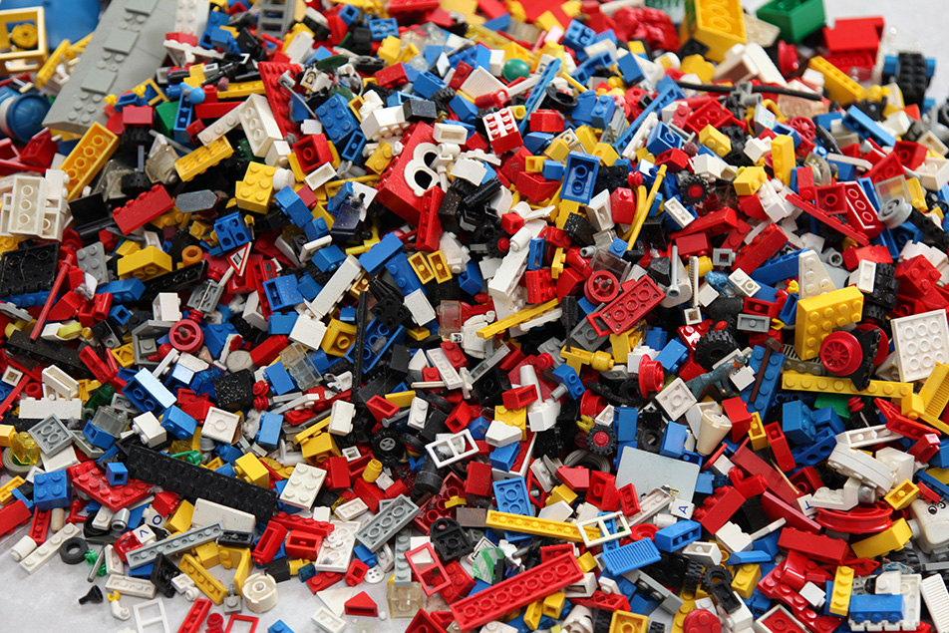
An example – sorting Lego blocks into colour

Slide 5
Sorting Lego with CART
Aim: create piles of Lego that are the same colour, while blindfolded.
You have a friend who can tell you a few things about each block (but not the colour)
What year it was purchased
What kit it belongs to
You can also touch the Lego pieces, determine the shape, number of plugs/bumps, etc.
How do you make the decision?

Slide 6
Training set vs. test set
Of course, it’s impossible to do this without first relating each of these attributes to the colour.
Training set – a small bucket of the whole pile of Lego that you are allowed to examine without a blindfold
Test set – the remaining Lego, which you must sort while blindfolded.
The process of learning about the relationship between the attributes of the blocks and their colours is ‘building a model’. In the case below, we call it ‘growing a tree’.

Slide 7
Introduction to impurity
Let’s say there are only two colours in the pile, red and blue
Impurity
0% red, 100% blue
50% red, 50% blue
100% red, 0% blue

Slide 8
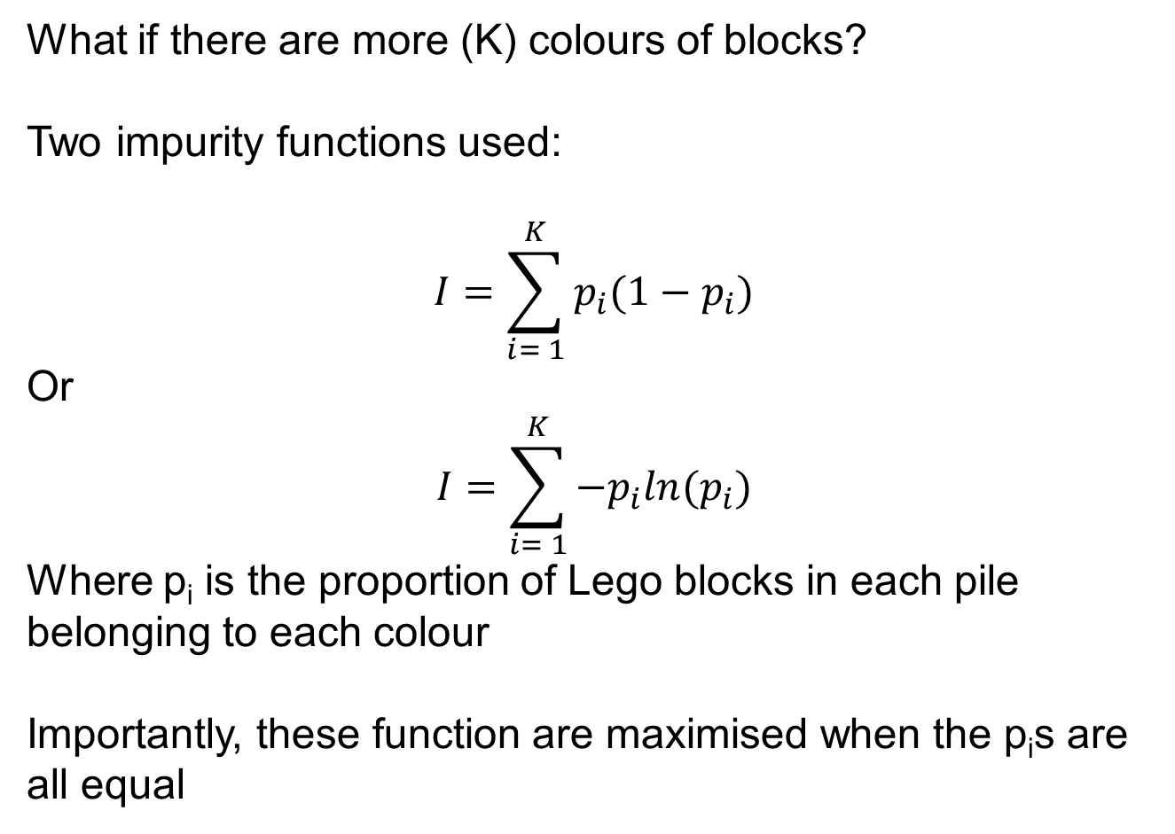
Introduction to impurity
What if there are more (K) colours of blocks?
Two impurity functions used:
$$I=\sum_{i= 1}^{K}{p_{i}(1−p_{i})}$$
Or
$$I=\sum_{i= 1}^{K}{{−p}_{i}ln(p_{i})}$$
Where p_{i} is the proportion of Lego blocks in each pile belonging to each colour
Importantly, these function are maximised when the p_{i}s are all equal

Slide 9
Introduction to impurity
The rules of impurity:
Very heterogeneous samples have high impurity
A pile of blocks the same colour will have an impurity of 0
So, what we want to do is define rules that split up the pile of Lego into smaller piles so that these smaller piles are less impure than the initial pile
How is this done?
For continuous dependent variables, we use variance rather than impurity

Slide 10
Demonstration with data
Colour | Shape | Year purchased | Kit | # of bumps
Red | Rectangular | 1992 | Generic | 6
Grey | Hull | 2007 | Spaceship | 27
White | Rectangular | 2004 | Generic | 2
Grey | Wheel | 2007 | Spaceship | 4
Blue | Rectangular | 2001 | Generic | 12
Black | Windshield | 2007 | Spaceship | 6

Slide 11
Demonstration with data
Colour | Shape
Grey | Hull
Red | Rectangular
White | Rectangular
Blue | Rectangular
Grey | Wheel
Black | Windshield
Colour | Year purchased
Red | 1992
Blue | 2001
White | 2004
Grey | 2007
Grey | 2007
Black | 2007
Colour | Kit
Red | Generic
White | Generic
Blue | Generic
Grey | Spaceship
Grey | Spaceship
Black | Spaceship
Split up with each covariate and sort by the covariate

Slide 12
Demonstration with data
Colour | Year purchased
Red | 1992
Blue | 2001
White | 2004
Grey | 2007
Grey | 2007
Black | 2007
Beginning impurity = 0.78
Impurity if split at 1992 = 0 left and 0.72 right
Gain in purity = 0.06
Calculate the improvement in impurity if we make the split along each value of year purchased

Slide 13
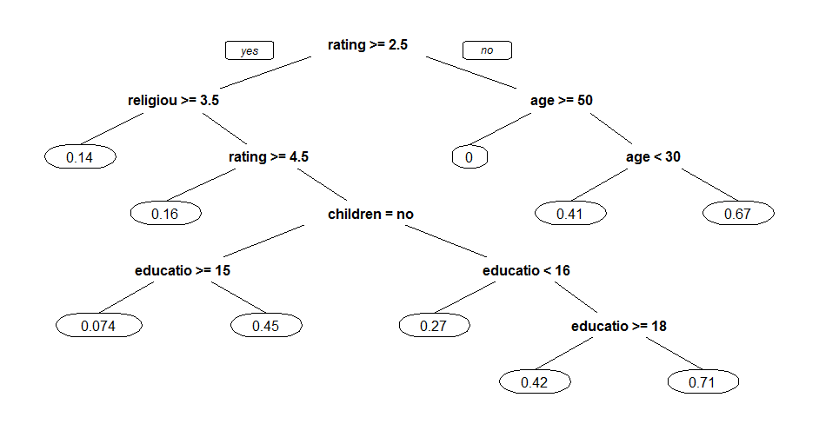
What does a tree look like?
affairs | gender | age | yearsmarried | children | religiousness | education | occupation | rating
0 | male | 37 | 10 | no | 3 | 18 | 7 | 4
0 | female | 27 | 4 | no | 4 | 14 | 6 | 4
0 | female | 32 | 15 | yes | 1 | 12 | 1 | 4
0 | male | 57 | 15 | yes | 5 | 18 | 6 | 5
3 | male | 27 | 1.5 | no | 3 | 18 | 4 | 4
3 | female | 27 | 4 | yes | 3 | 17 | 1 | 5

Slide 14
CART leaves define groups
When multiple observations fall in a leaf, we know that they are similar in the attributes that help to predict the dependent variable.
One could make a small leap of faith to suggest that members of each group may feel the effect of a policy to similar degrees. Likewise, there may be significant differences across the groups.
Notes:
Note(s):
Source(s):
Spreadsheet file path:

