Slide 1

Environmental Science for Social Change
ESSC is a Jesuit research institute that promotes environmental sustainability and social justice through the integration of scientific methodologies and social processes
ESSC also networks across the Asia Pacific region in moving an agenda of science for sustainability.
http://essc.org.ph

Slide 2
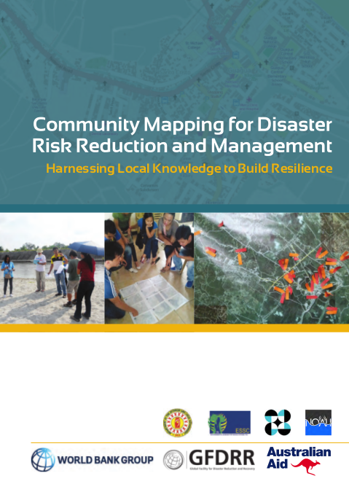
Assisting local governments through mapping and use of decision support tools for disaster risk reduction
http://bit.ly/1FUpOnz

Slide 3
Overview
Key elements of the initiative
Tools (OpenStreetMap, InaSAFE)
Capacity building activities
Observations and recommendations

Slide 4
Key elements
Capacity building and partnerships
(inclusive mapping participation, formal and informal partnerships)
Open source and open data
(OPEN - technical, legal, collaboration)
Building upon previous work
(ESSC's community mapping especirence, local OSM response, Haiti, Indonesia)
Replicable methods and tools

Slide 5

OpenStreetMap
"Wikipedia of Maps"
A project to
map the whole world!
http://osm.org

Slide 6
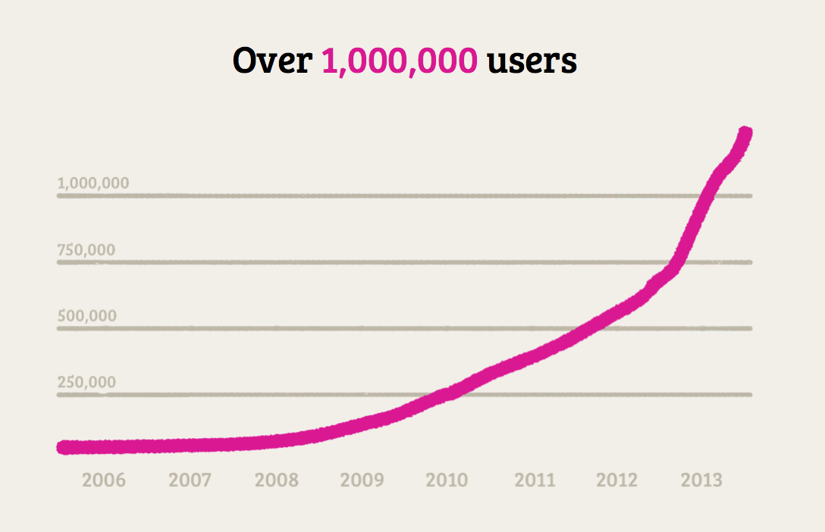
2,000,000

Slide 7
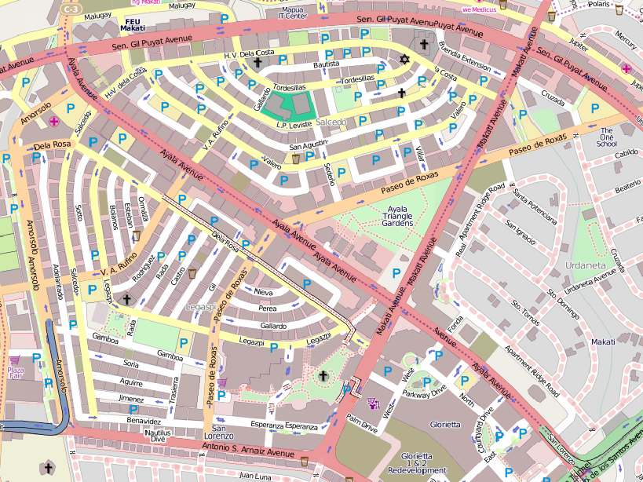

Slide 8
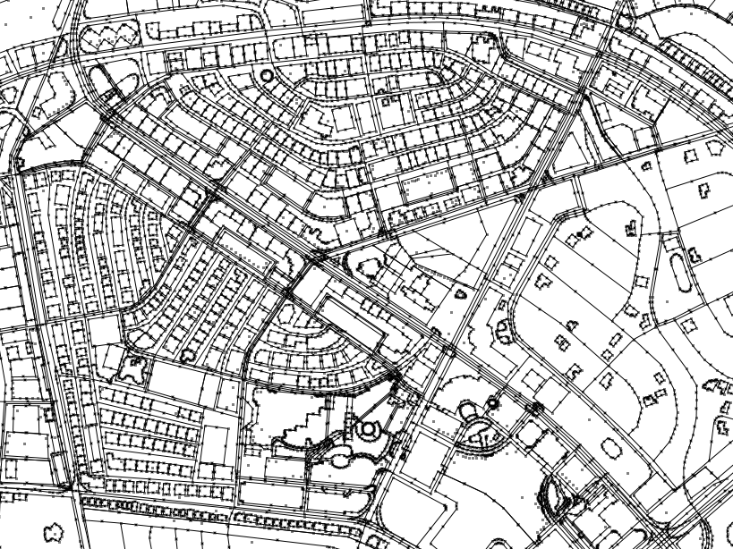

Slide 9
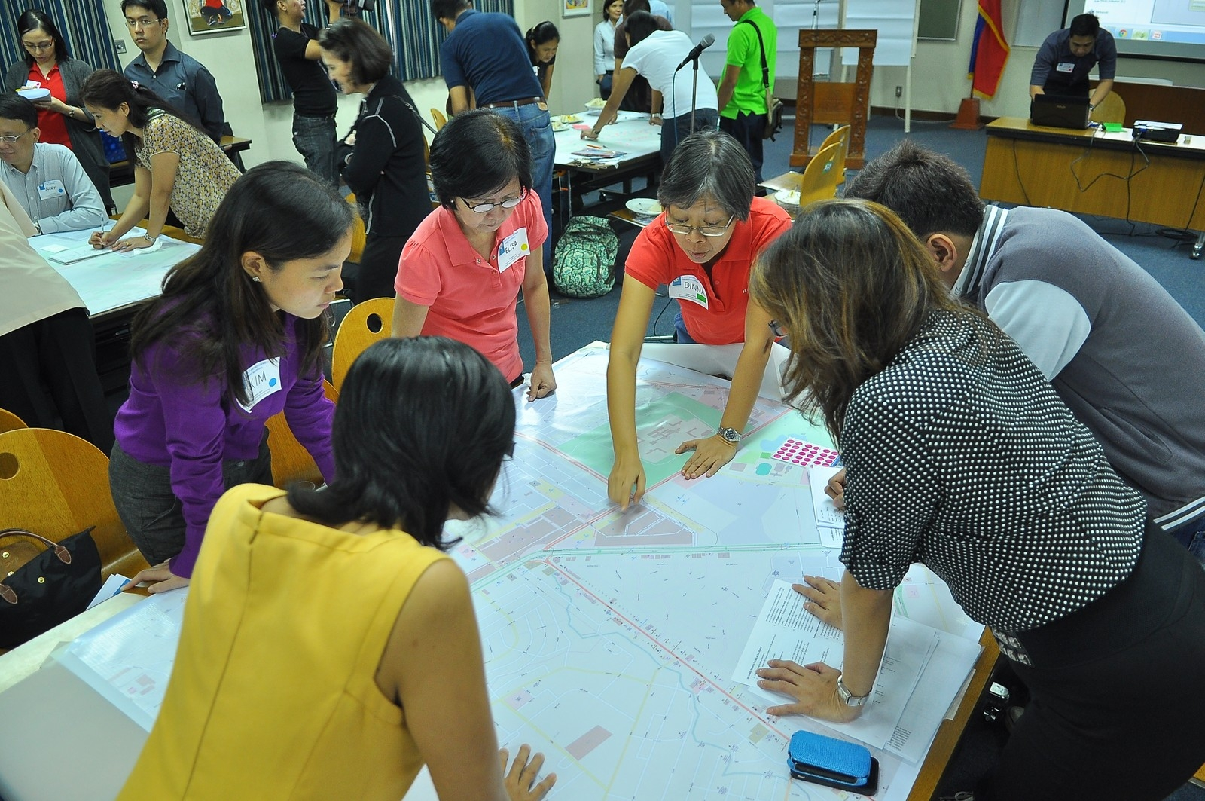
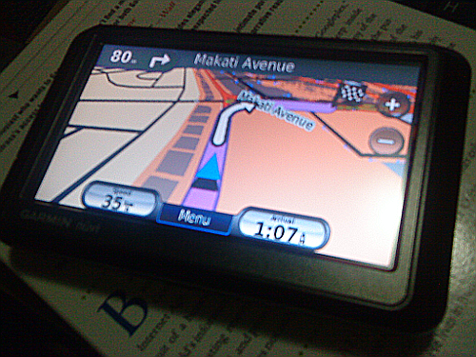
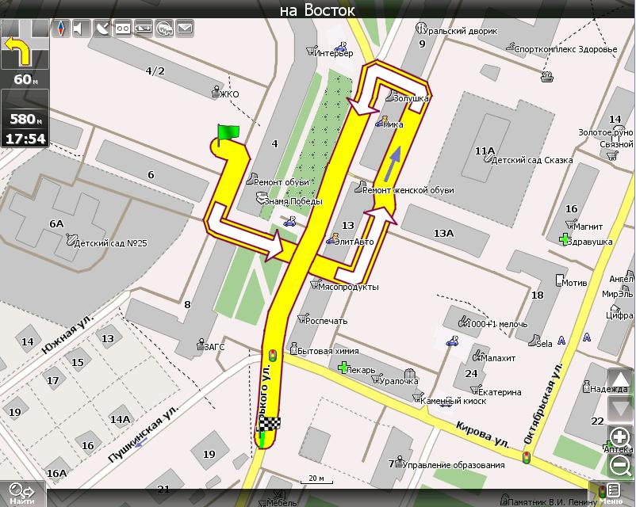
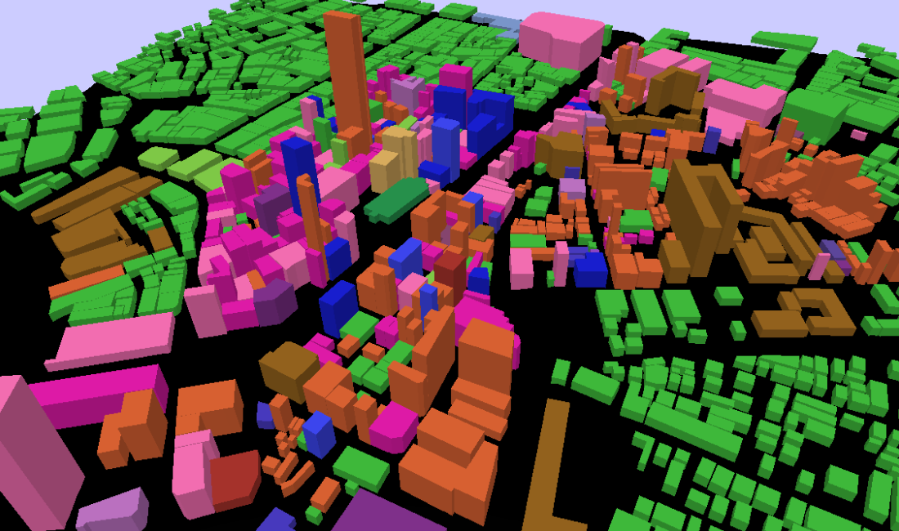
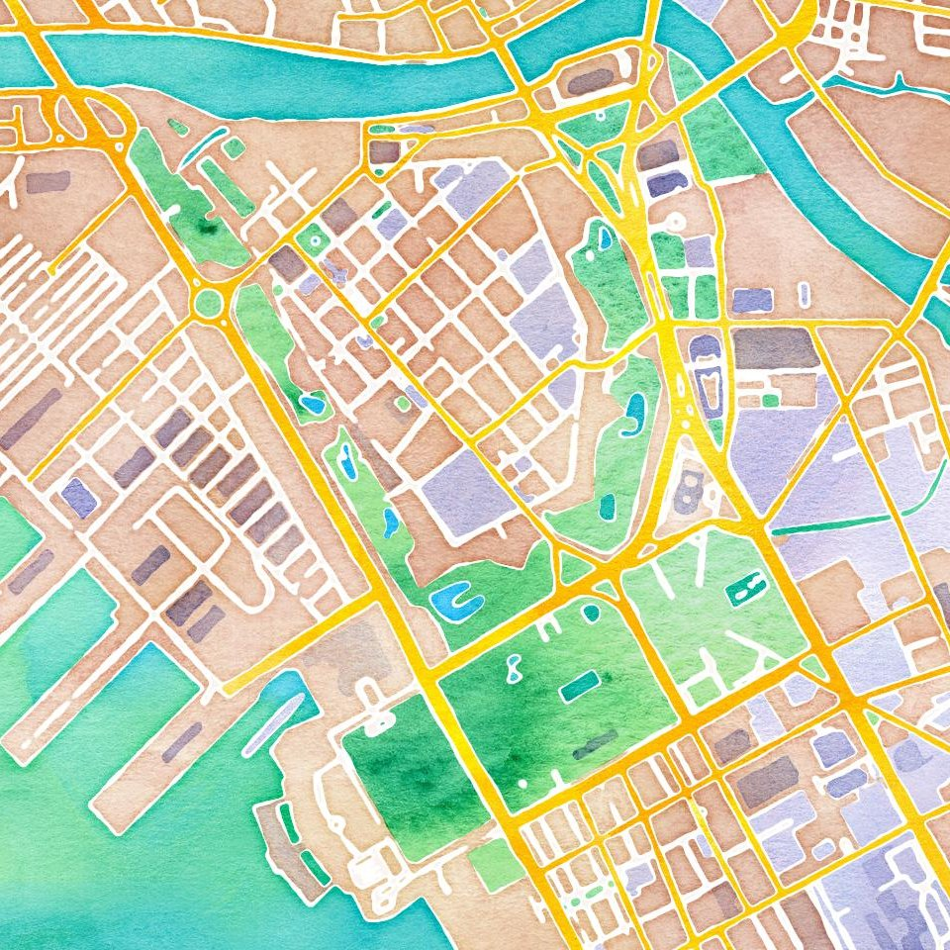
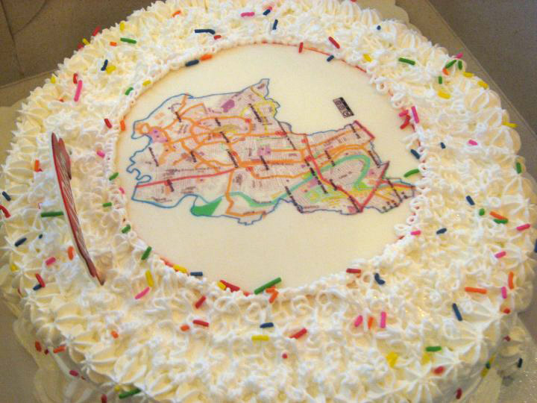
Use data in fun and exciting ways

Slide 10
OpenStreetMap for
Disaster Response in the PH

Slide 11
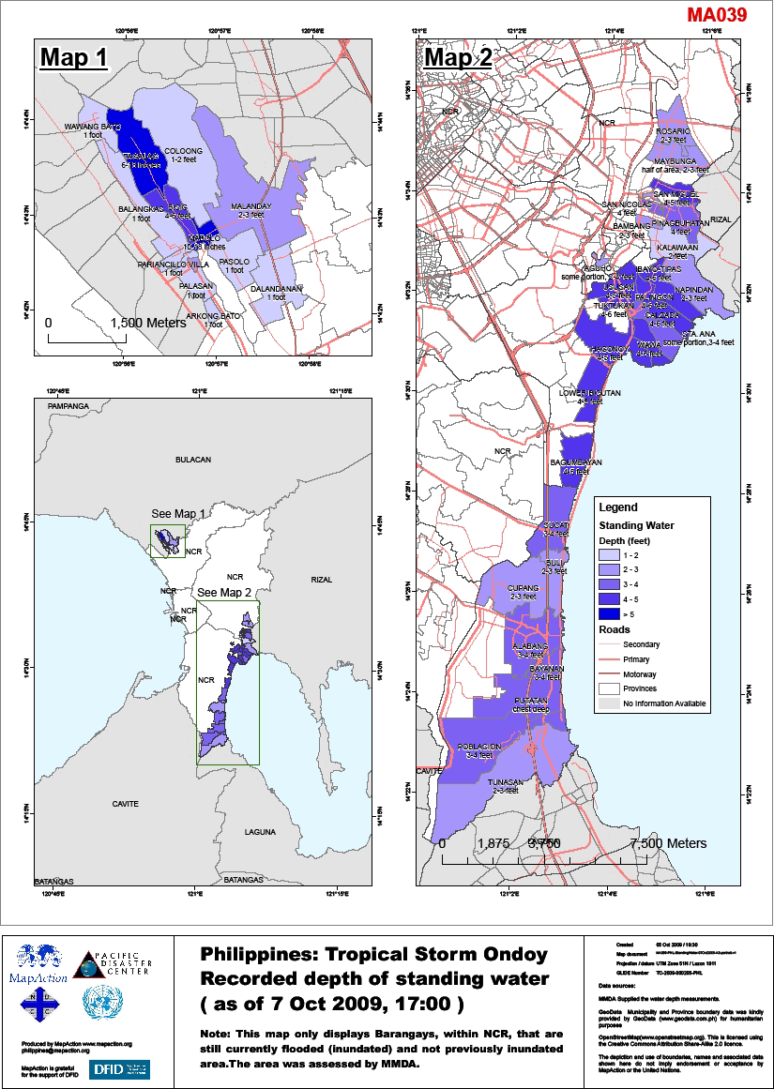
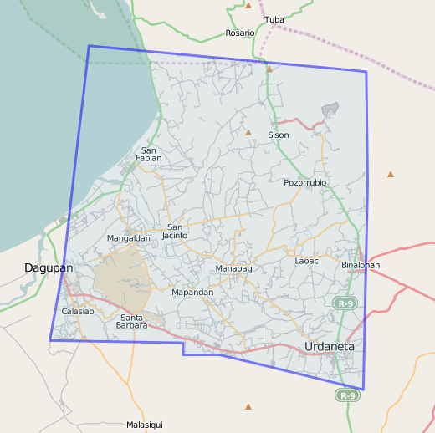
Typhoon Ondoy and Pepeng 2009
http://wiki.openstreetmap.org/wiki/Humanitarian_OSM_Team/philippines_ondoy

Slide 12
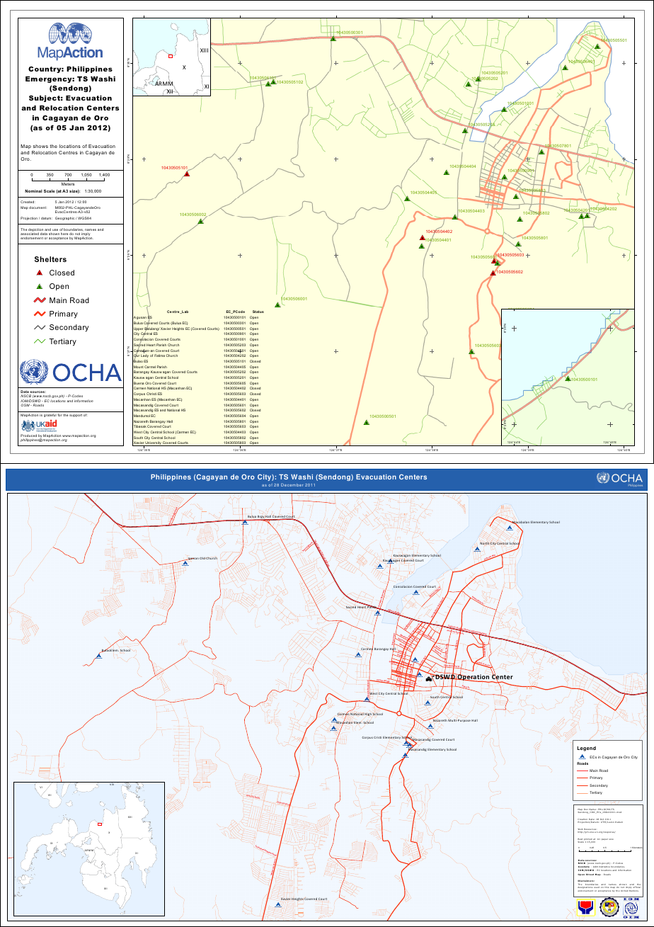
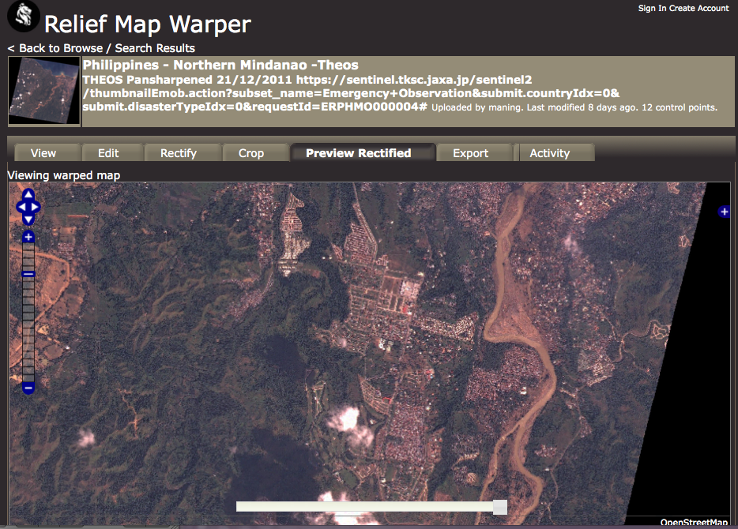
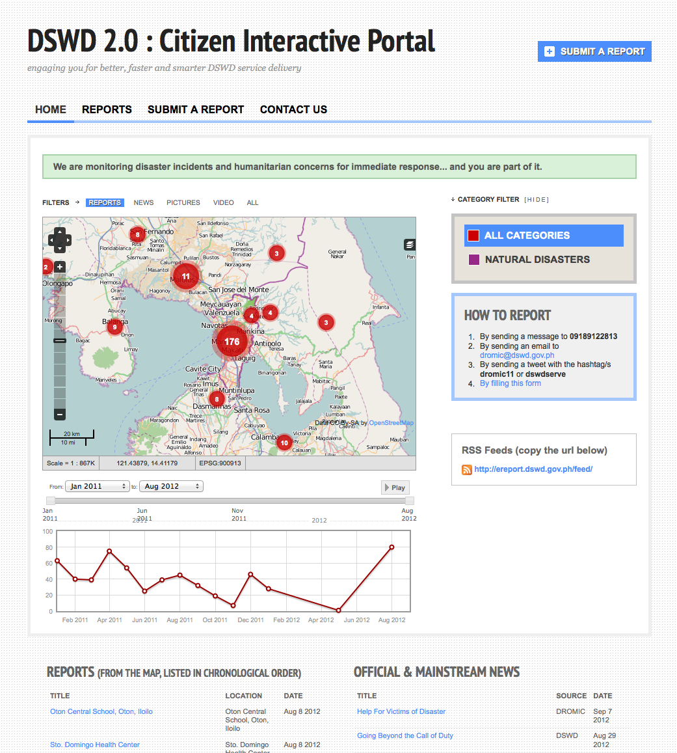
Typhoon Sendong 2011
http://hot.openstreetmap.org/updates/2012-01-25_hot_mapping_for_flash_flood_affected_areas_in_northern_mindanao_philippines

Slide 13
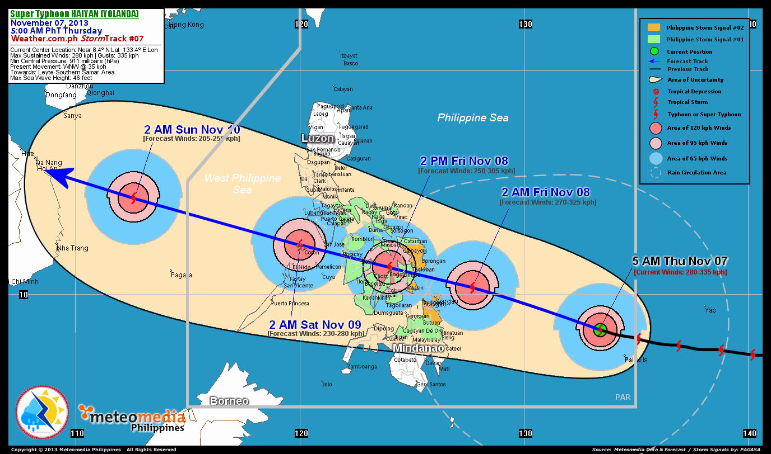

Slide 14
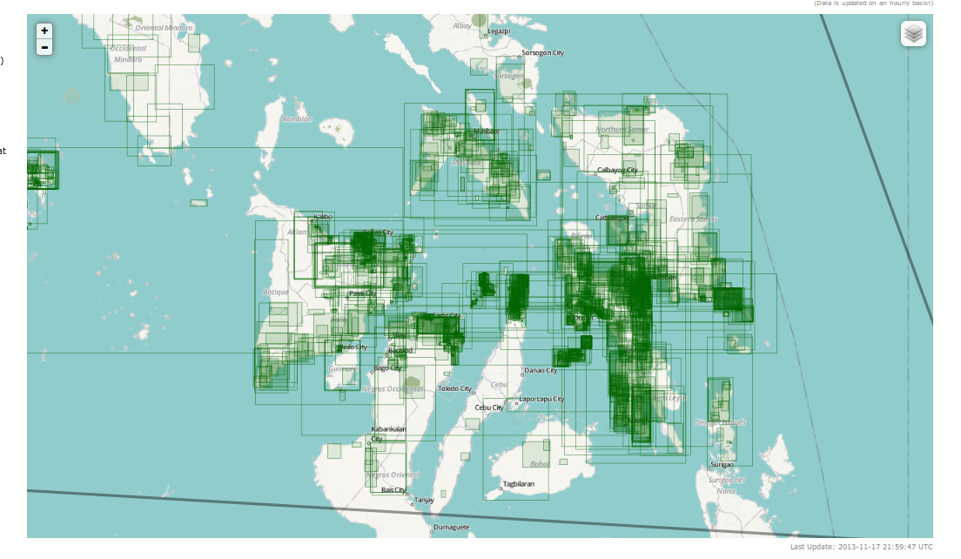

Slide 15
22 days
~1,500 volunteers
82 countries
4.2 millions of changes
448,797 buildings; 34,713 roads; 7,857 residential areas; 4,060 rivers (as of 2013-11-30)

Slide 16
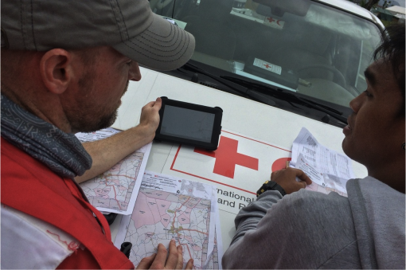

Slide 17
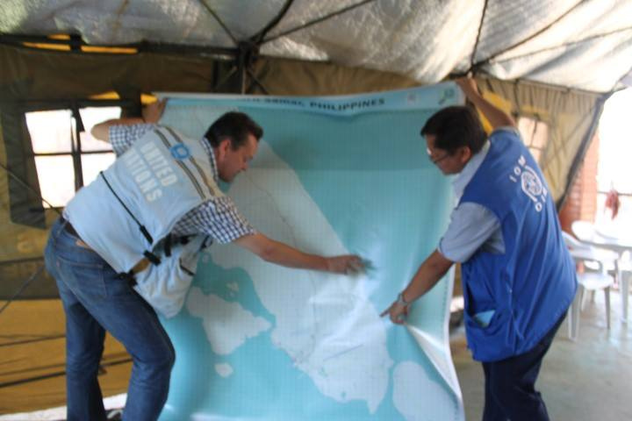
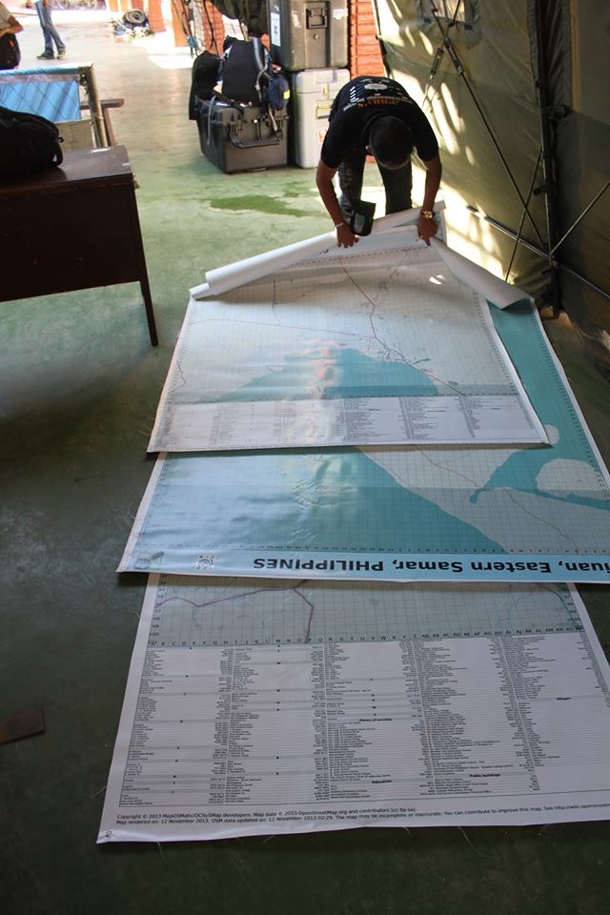
IOM staff showing the large OpenStreetMap
posters in the DSWD Operations Center in
Tacloban Airport. Photo by Joe Lowry
http://www.flickr.com/photos/esambale/10937514315/

Slide 18
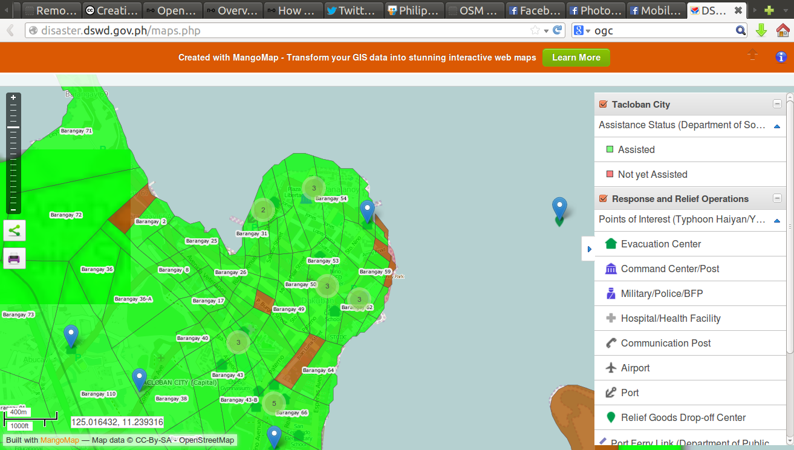
http://disaster.dswd.gov.ph/maps.php

Slide 19
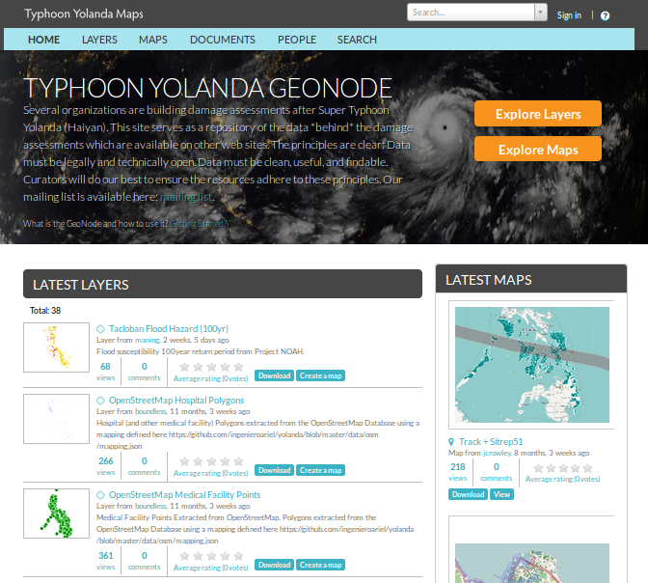
http://yolandadata.org/

Slide 20
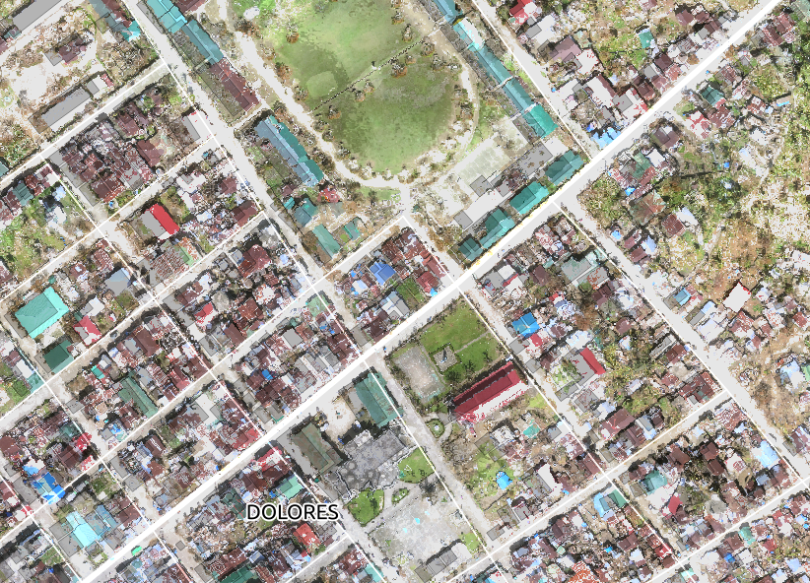
Typhoon Ruby/Hagupit 2014
Imagery from SkyEye, Inc. Dec 2014. Creative Commons

Slide 21

Assisting local governments through mapping and use of decision support tools for disaster risk reduction

Slide 22
Objectives
Support growth of the OpenStreetMap (OSM) community
Support customization of InaSAFE

Slide 23
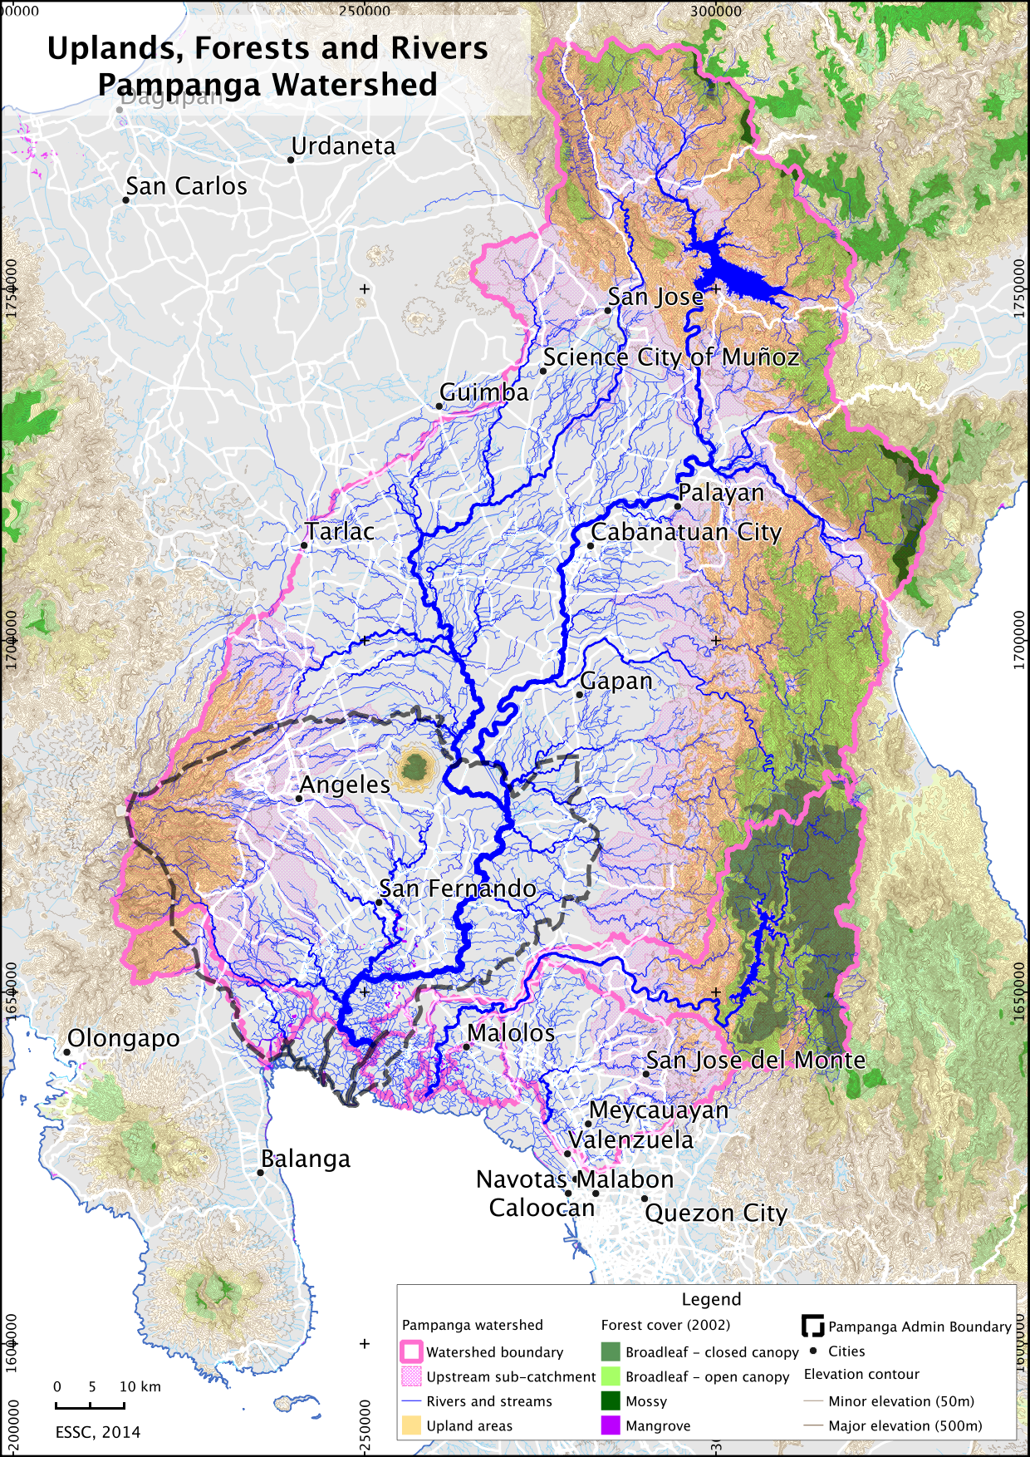
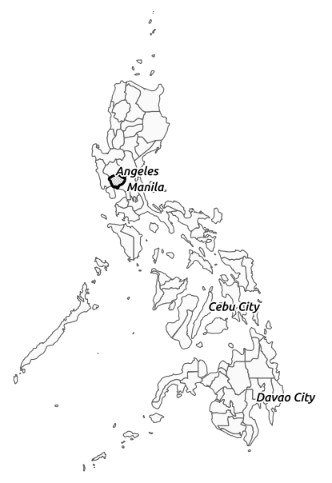

Slide 24
Activities and Components

Slide 25
Basemapping updates using OpenStreetMap
Candaba, Guagua, Lubao in Pampanga

Slide 26
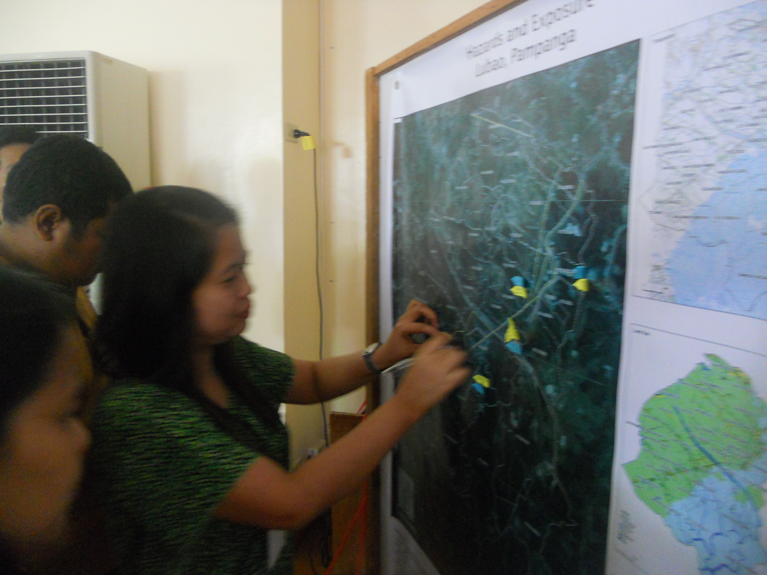
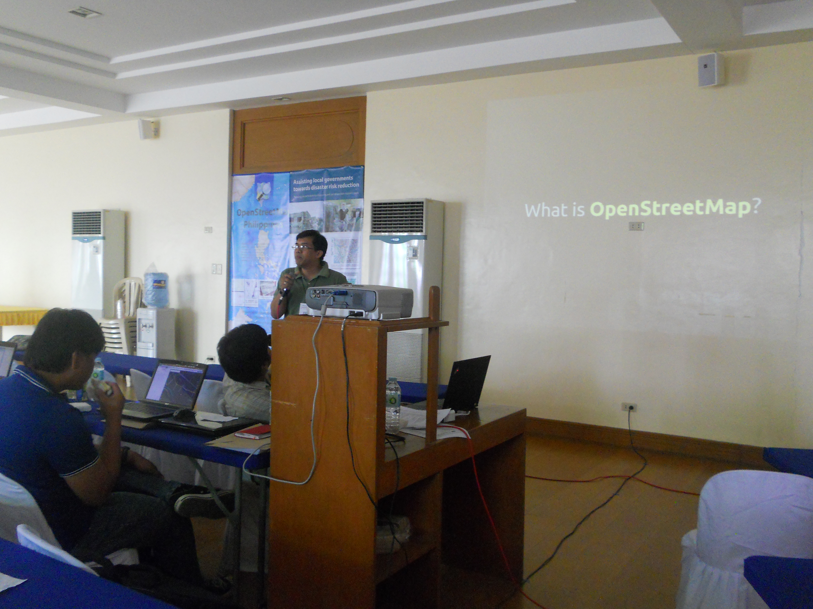
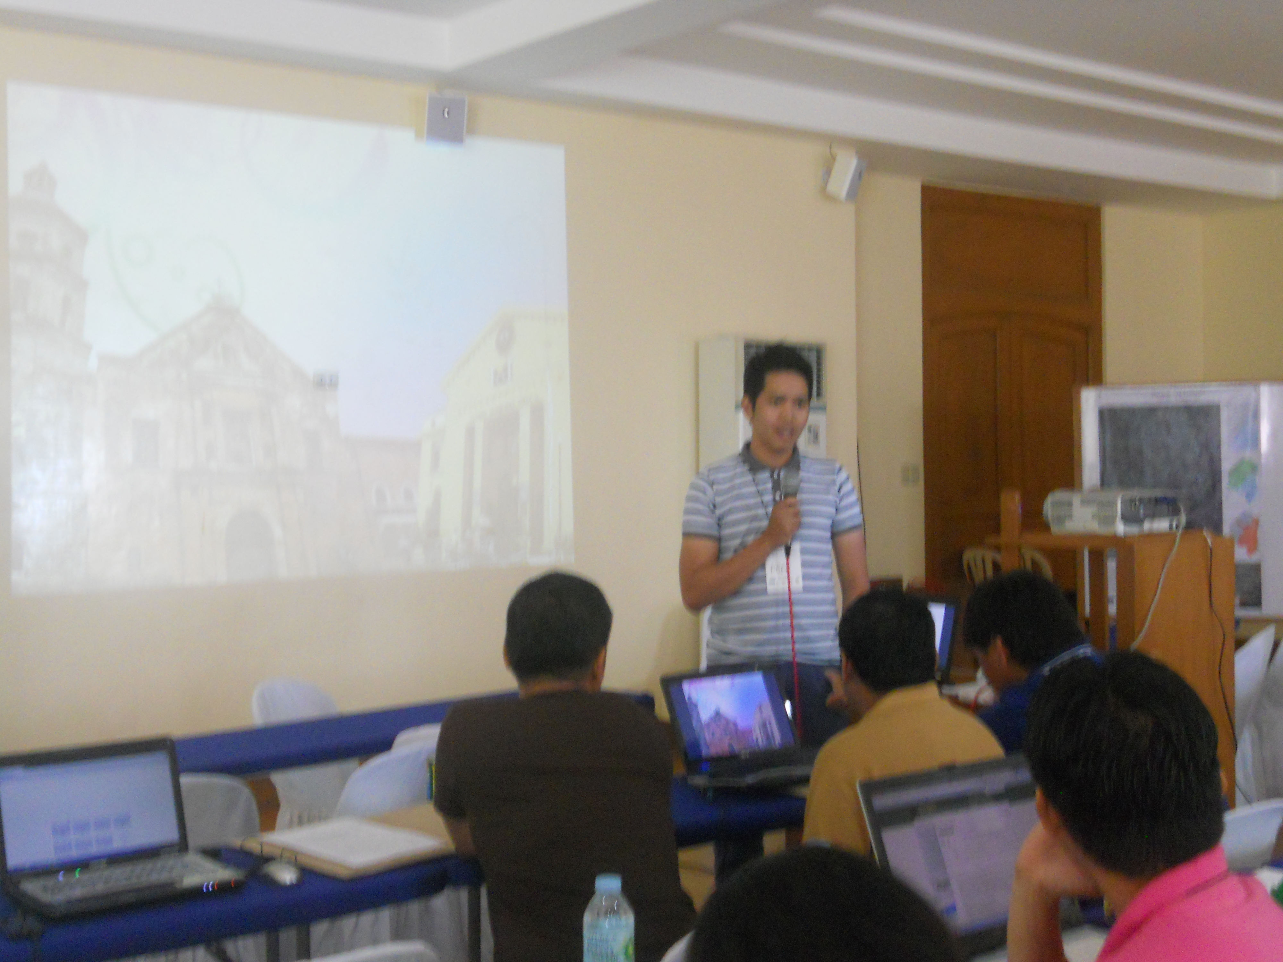
Initial situationer of the Municipality
Understanding the tools of mapping

Slide 27
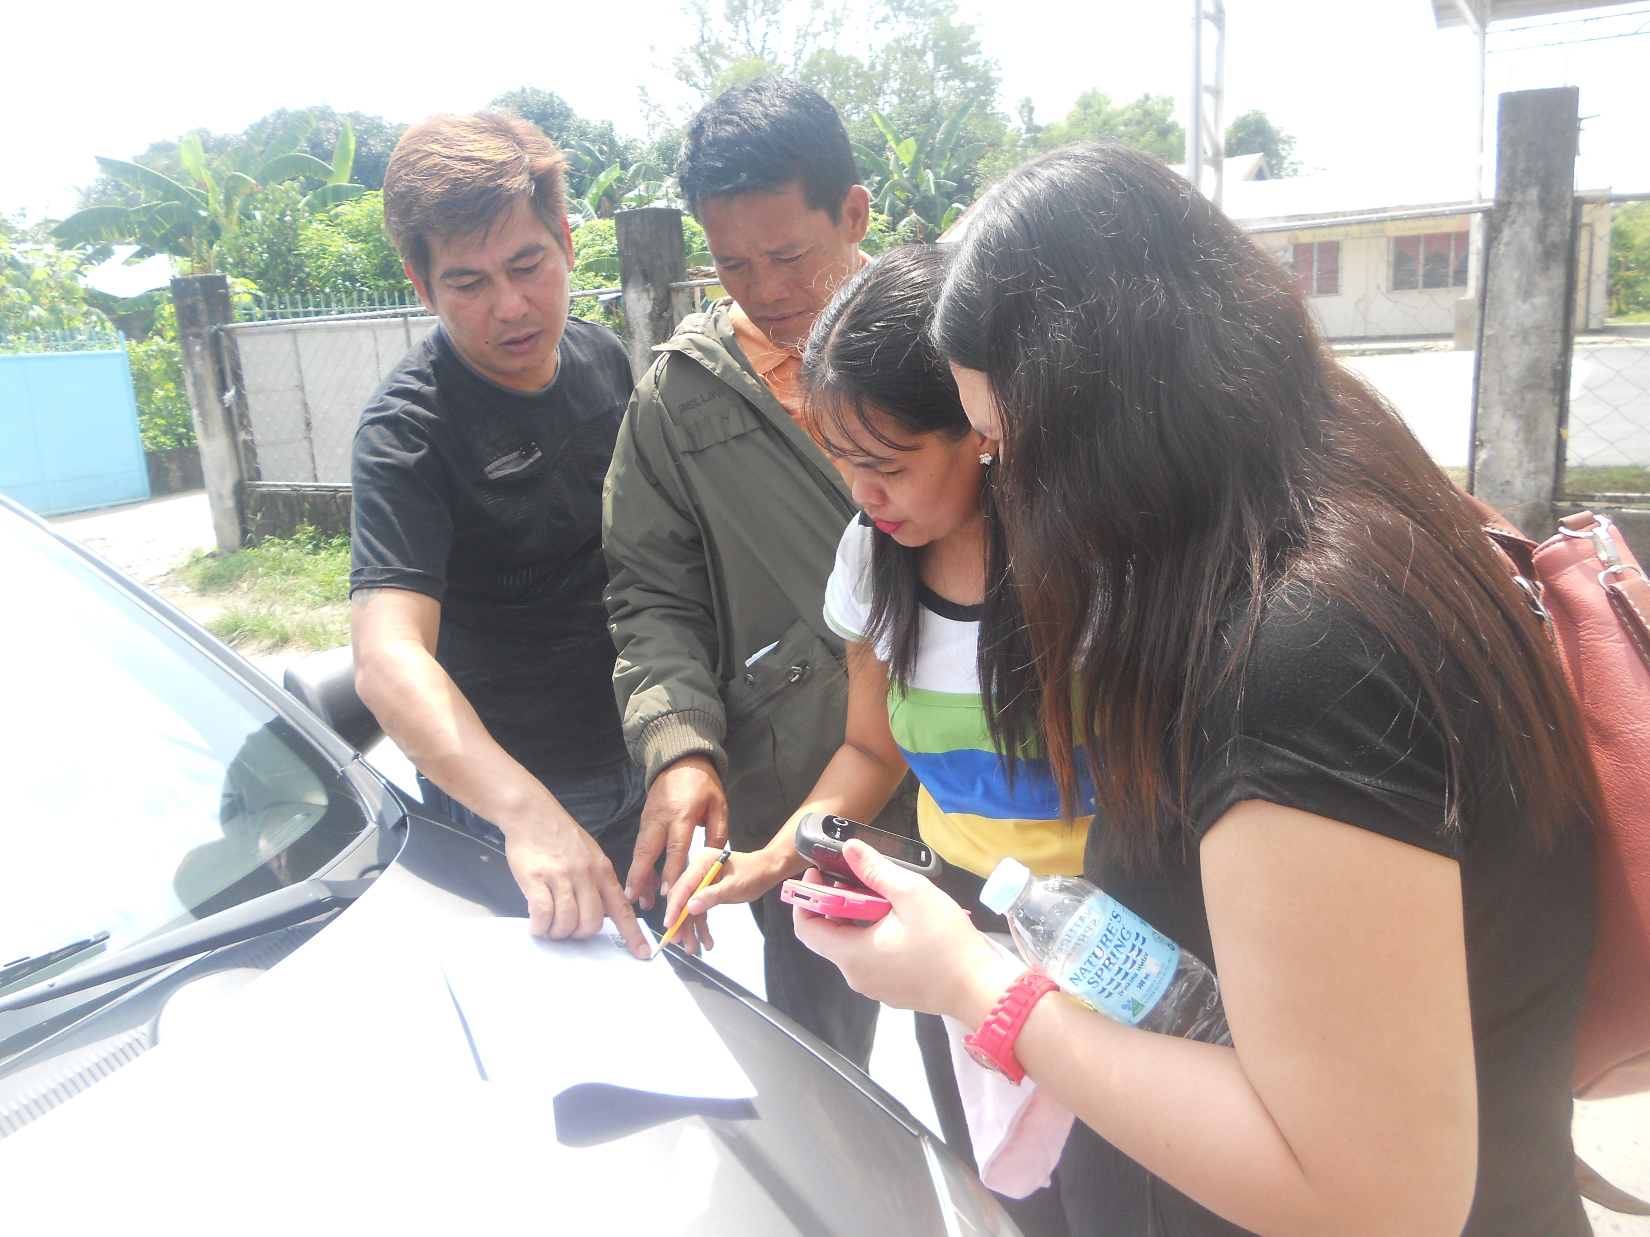
Fieldwork
Validating the data on the ground
GPS, Phone, Notes

Slide 28
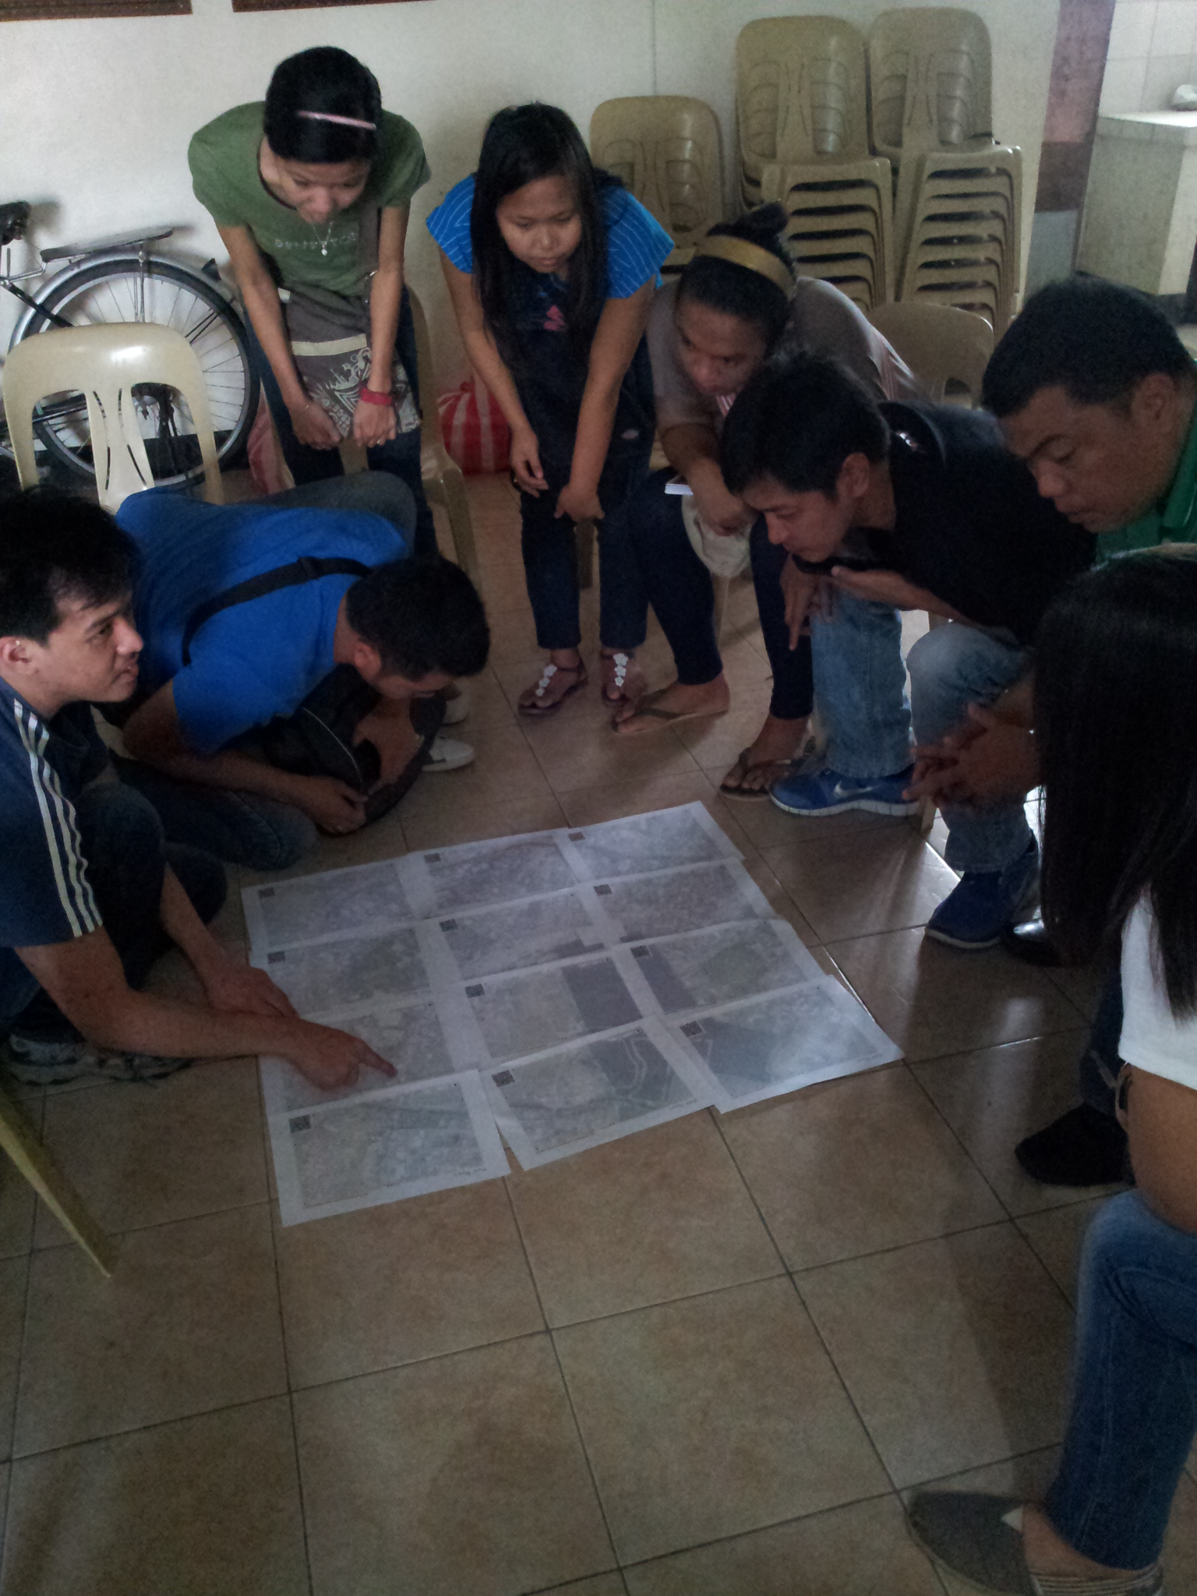
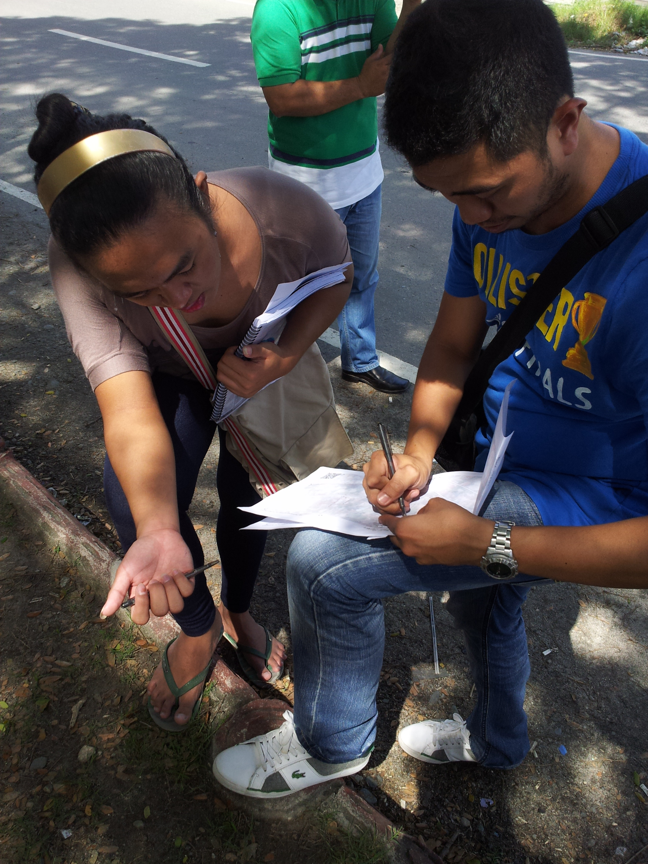

Slide 29
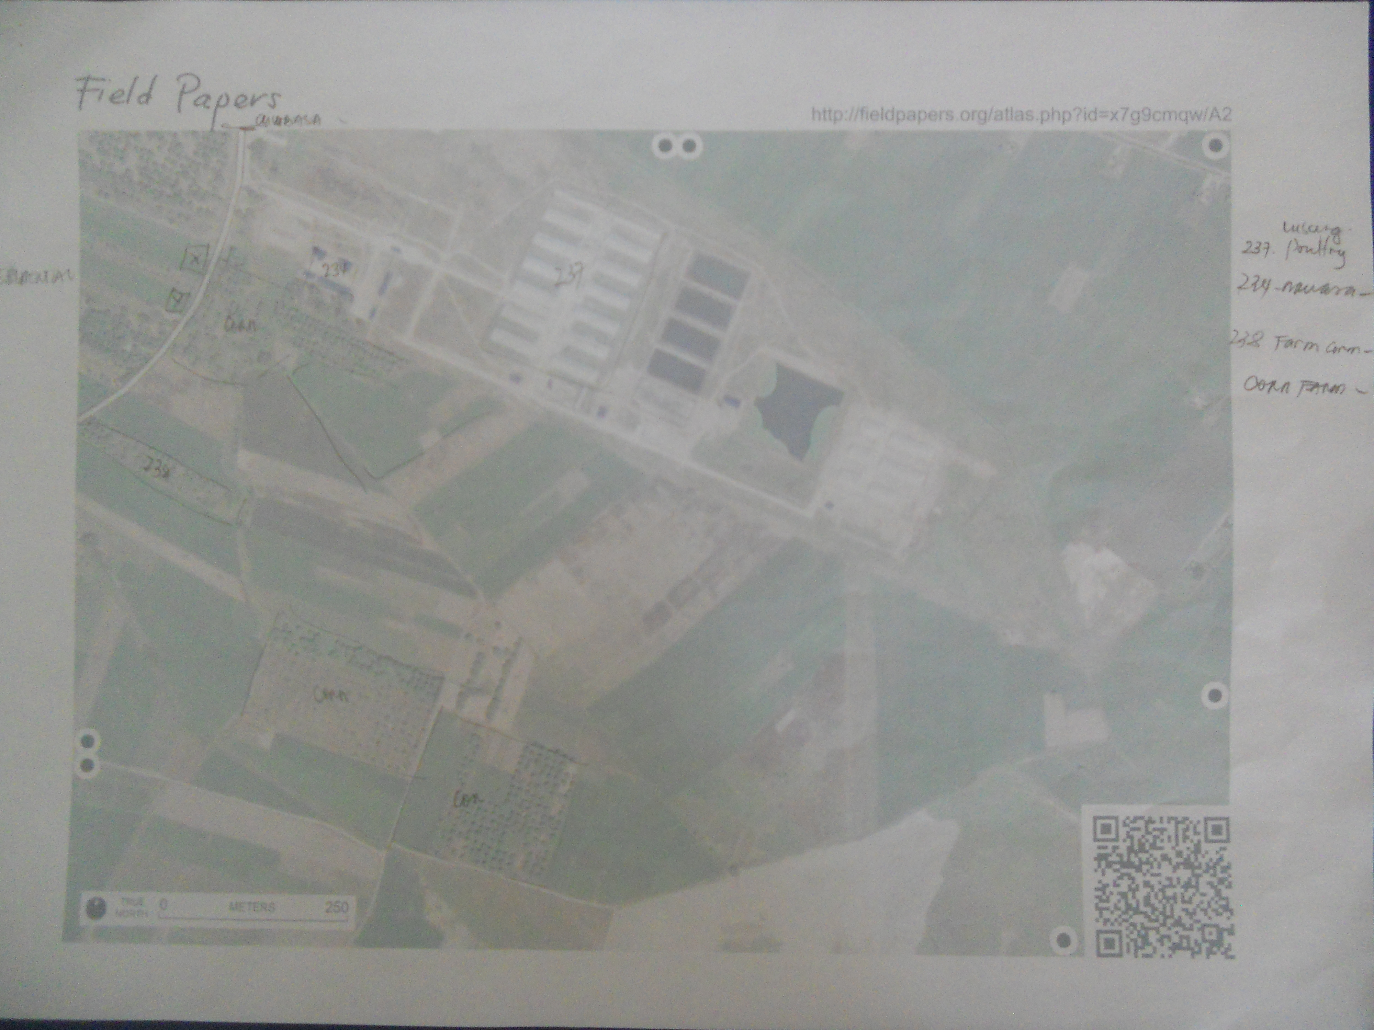
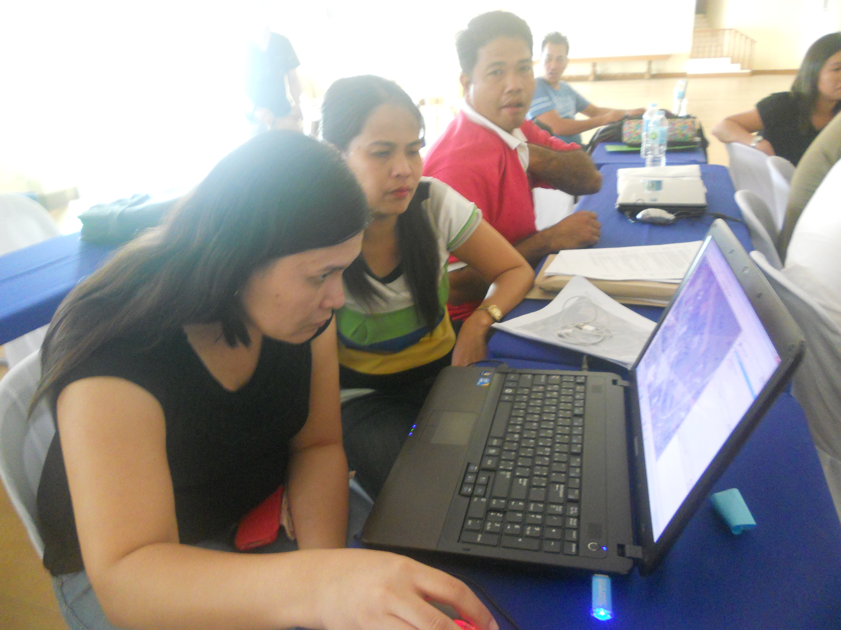
Quality editing
Division of mapping tasks
Future plans

Slide 30
Data collection outcomes
Roads including road classification and names
Waterways such as rivers, streams, and irrigation canals
Public facilities (schools, open spaces, barangay halls, public buildings, place of worships) that serve as evacuation centers during calamities
Land use (agriculture, commercial, and residential areas)
Administrative boundaries (municipal and barangay levels)

Slide 31
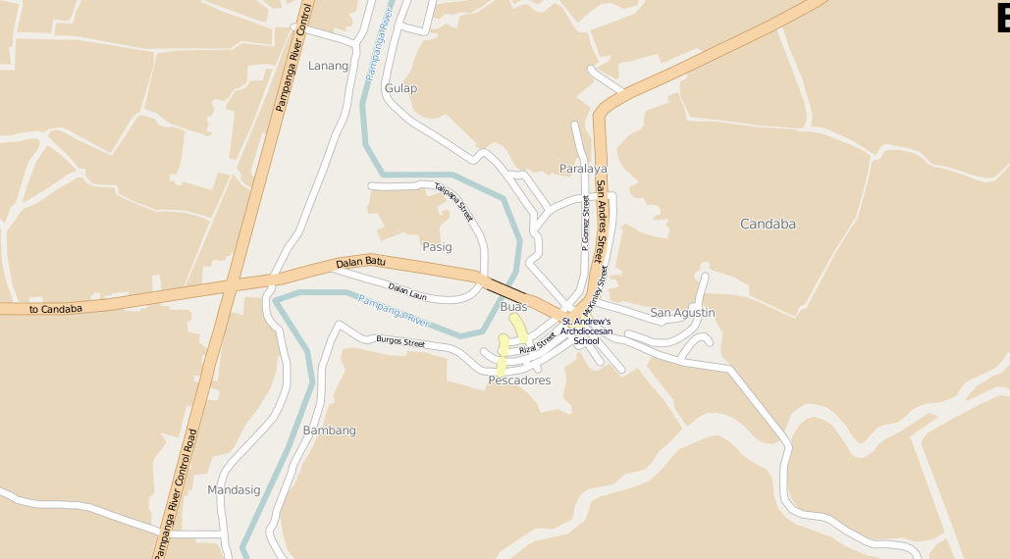
Candaba - Before

Slide 32
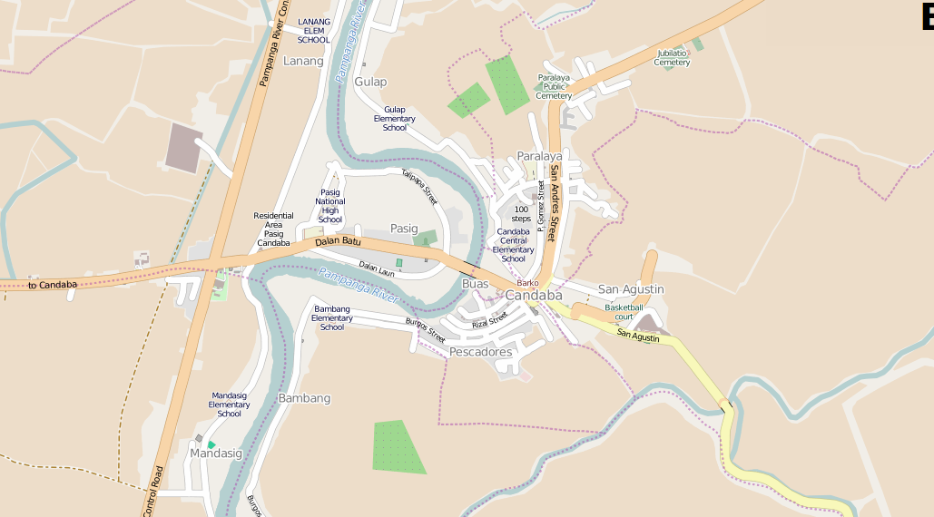
Candaba - After

Slide 33
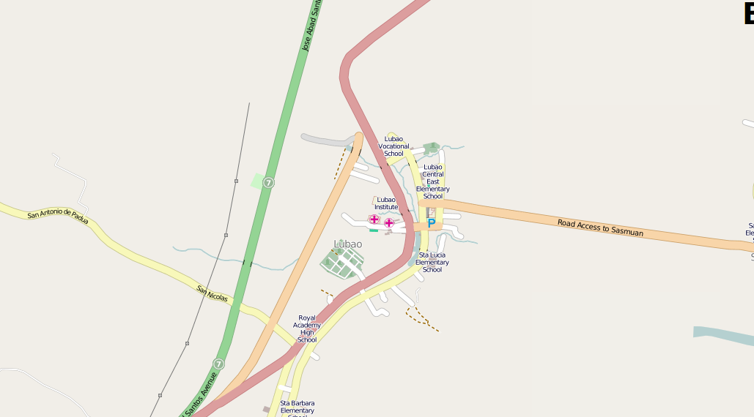
Lubao - Before

Slide 34
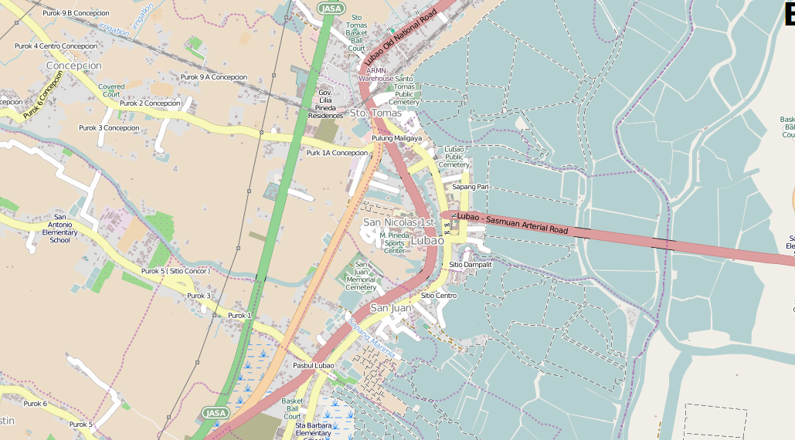
Lubao - After

Slide 35
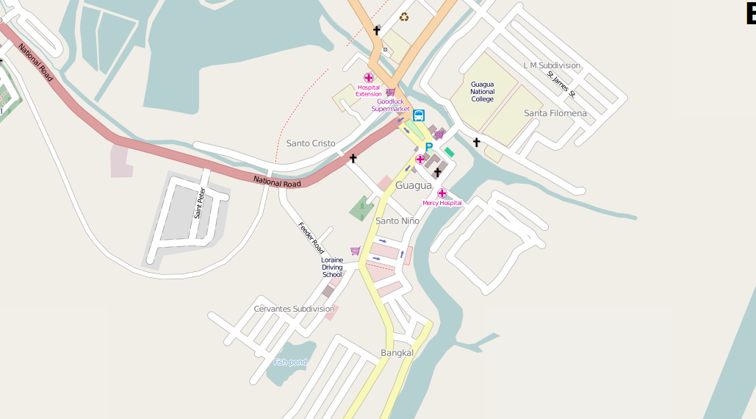
Guagua - Before

Slide 36
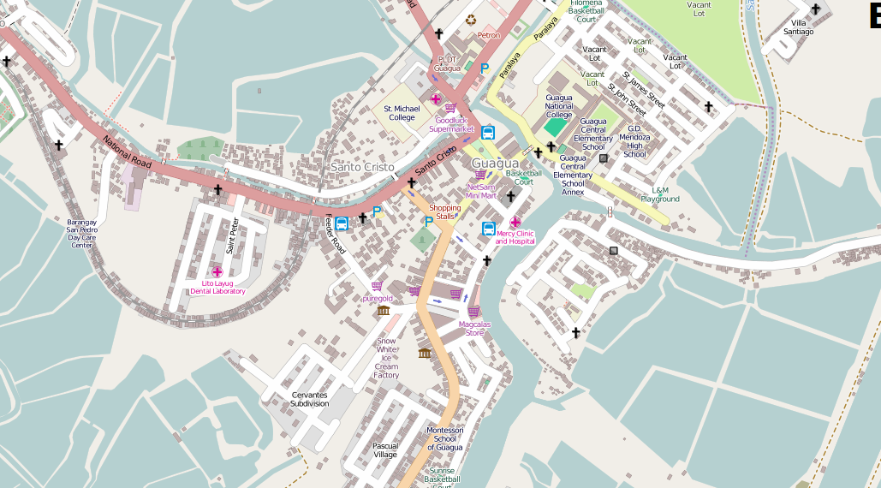
Guagua - After

Slide 37
Basic GIS and
Impact Scenario Assessment
QGIS and InaSAFE

Slide 38

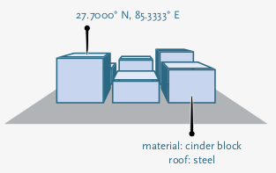

Impact Scenario Assessment
Hazard levels
Exposure information
Authoritative information on earthquake ground shaking, inundation, landslide, etc. from
government, academic and research institutions
Population densities, building surveys, road network from local data or community led data sources like OpenStreetMap.
Impact
estimate
http://inasafe.org/

Slide 39
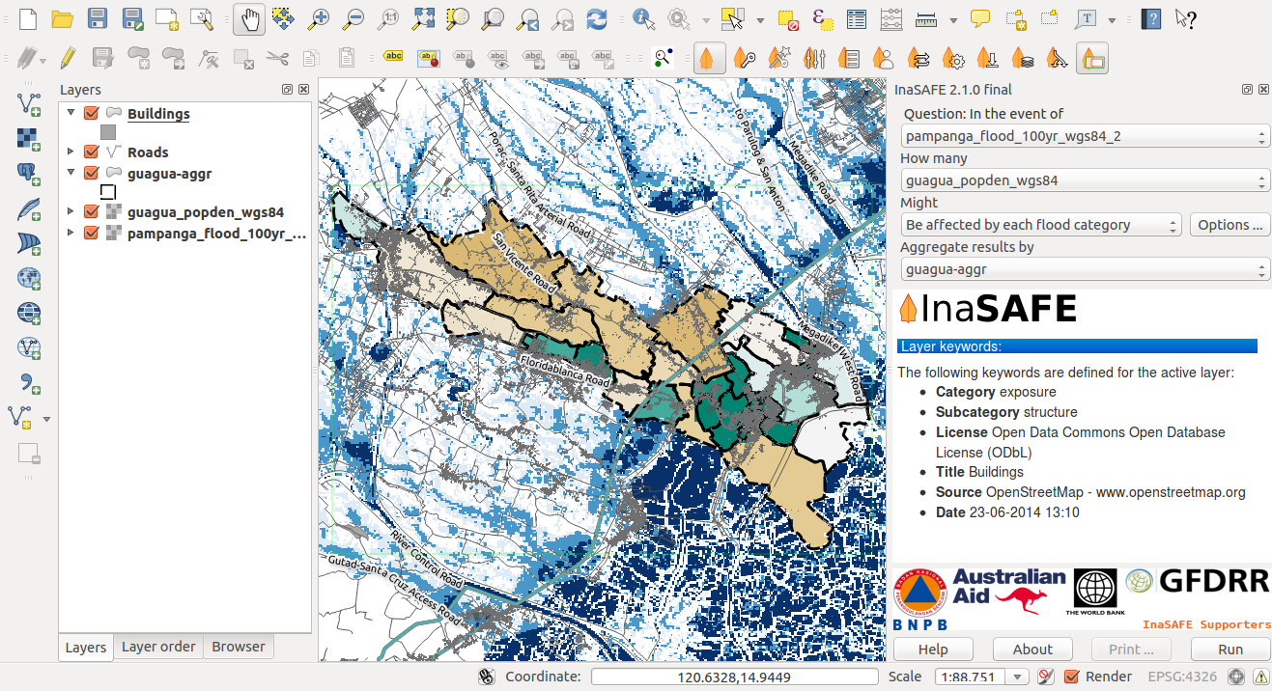
Hazard (flood) and
Exposure (population)
data
InaSAFE
interface

Slide 40
In the event of a 100-year flood, how many people might be affected?

Slide 41
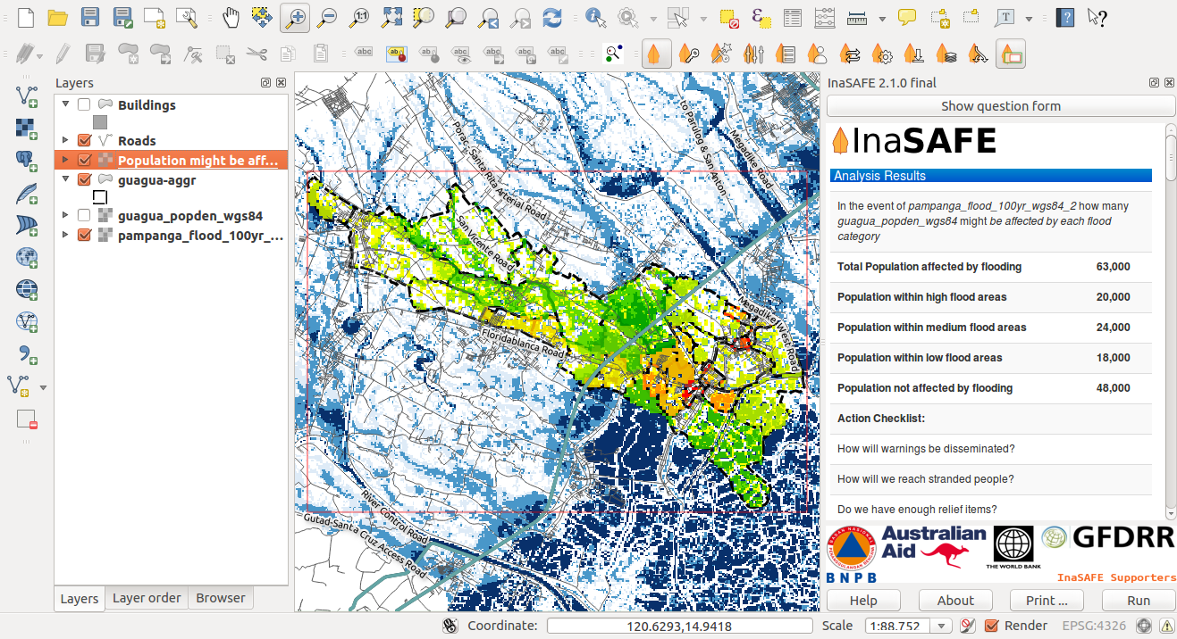

Slide 42
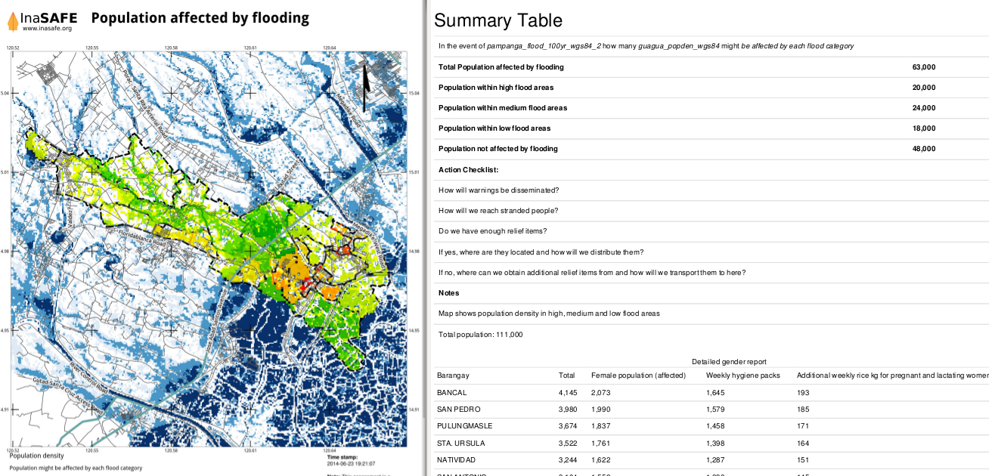

Slide 43
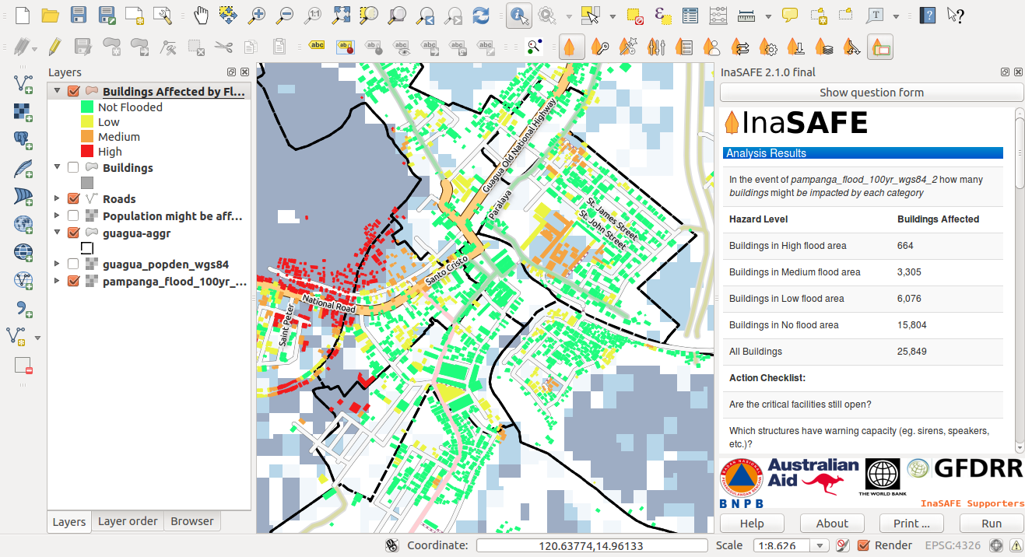
In the event of a 100-year flood, how many buildings might be flooded?

Slide 44
How many schools will be closed?
What buildings are high enough to serve as evacuation centers?
How many women and children needs to be evacuated?
How many rice (kg), family kit, medicine should be prepared?

Slide 45
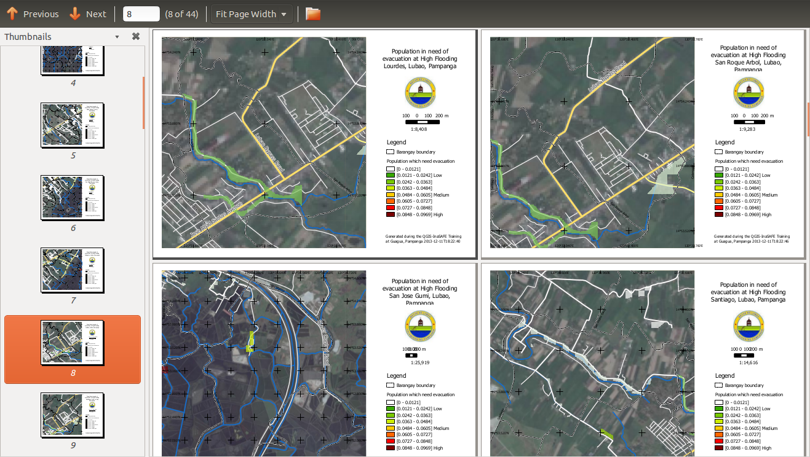

Slide 46
Observations and Recommendations

Slide 47
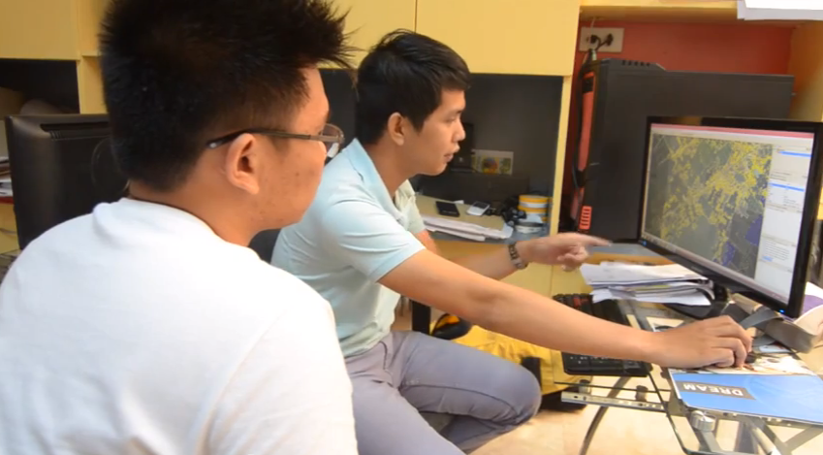
Continuous basemap updates (through OSM) should become part of the
work of the LGU.

Slide 48
Planning for local DRRM actions needs to include a broader
understanding of the dynamics within the context of a watershed and consider coordination at various levels that could promote collaboration between municipalities.

Slide 49
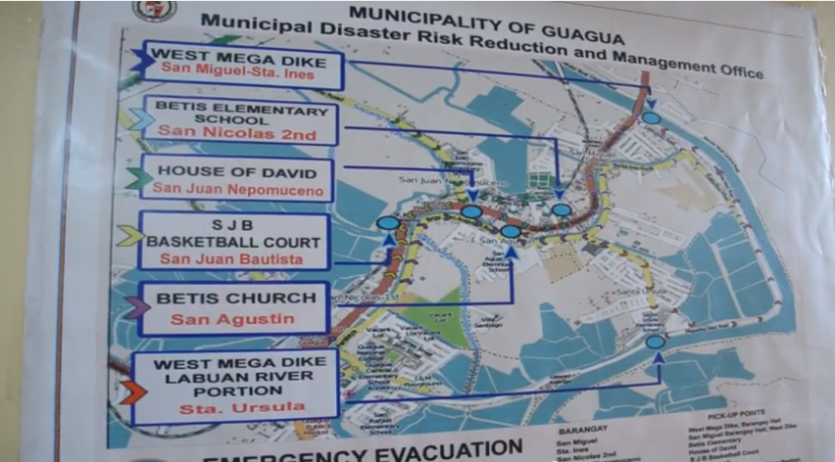
Different levels of information should be translated to actionable response.

Slide 50
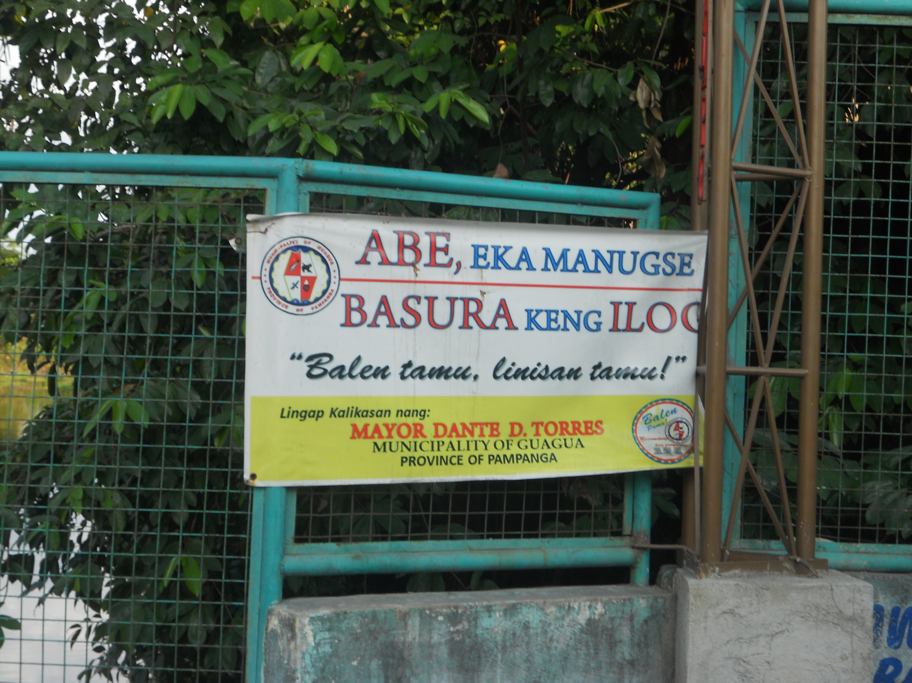
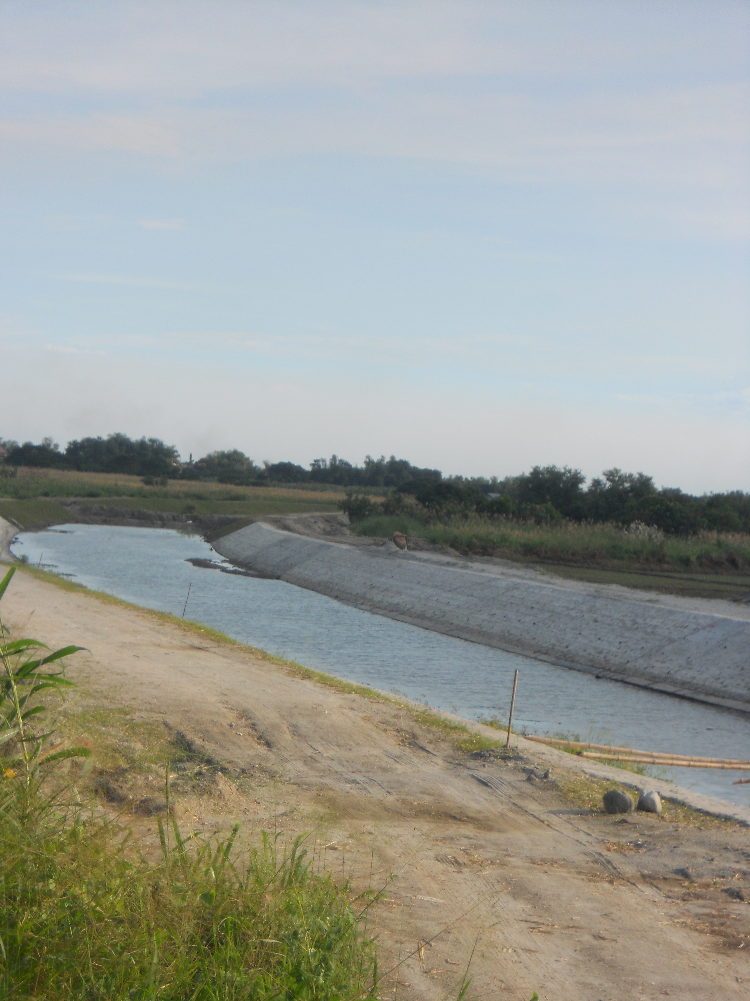
Prioritize management, maintenance, and clearing of rivers and streams

Slide 51
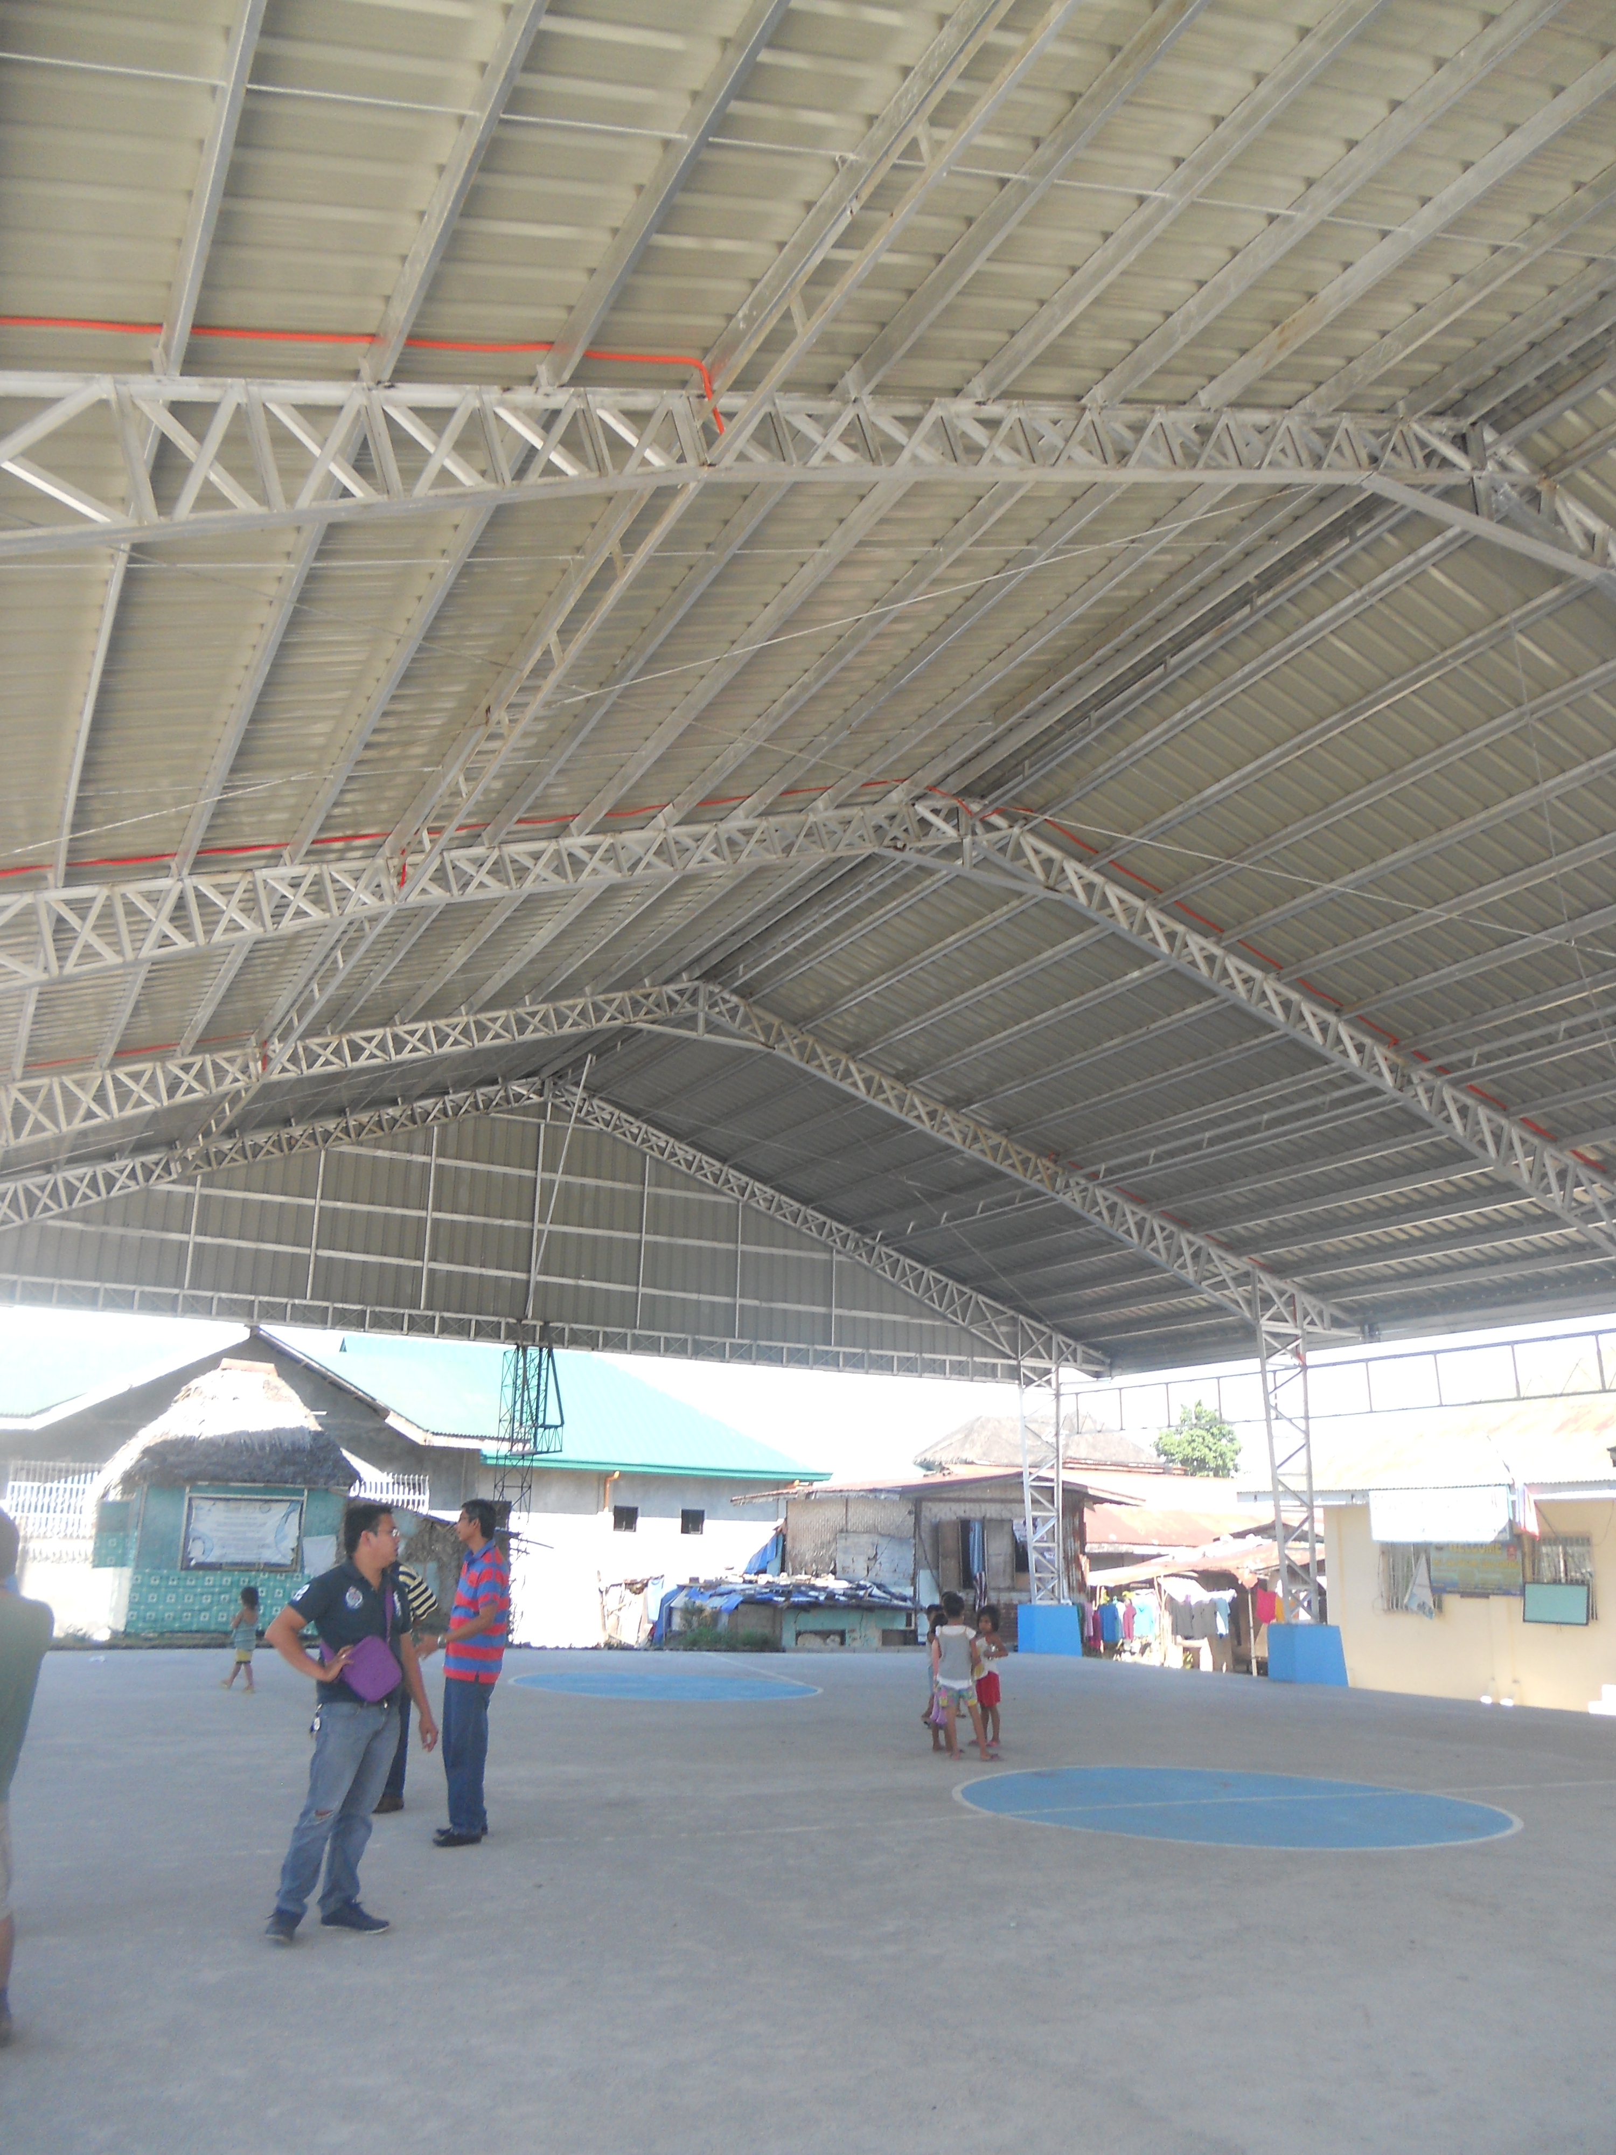
Evaluate the quality and capacity of evacuation centers.
type of disaster
structural integrity
number of evacuees it can accommodate
length of time of the evacuees to stay depending on the resources available
Newly constructed covered court
as evacuation center appropriate only for flooding.

Slide 52

Prioritize for accessibility during emergencies.
Elevated roadways to facilitate access during emergencies.

Slide 53


Document and share local wisdom and adaptation.
Houses on stilts in
Candaba, Pampanga

Slide 54
“When Typhoon Glenda struck we were able to use the updated maps to support evacuations in our coastal barangays. The mapping process helped us to identify better access roads and to capture this in our maps.”
Edgar Dabu, Disaster Risk Reduction & Management Officer of Lubao

Slide 55
Maning Sambale emmanuelsambale@essc.org.ph emmanuel.sambale@gmail.com
OpenStreetMap Philippines http://openstreetmap.org.ph
Environmental Science for Social Change http://www.essc.org.ph

