Slide 1
ingress
Michiki Hara Tsukito Nakano

Slide 2
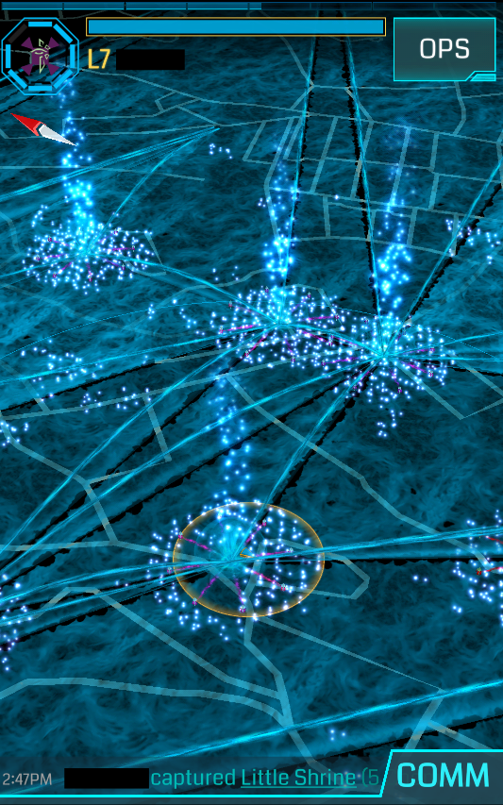

Slide 3
proposal
Why there is no cooperative play to the functions of the Ingress?
↓
We want a function of cooperative!

Slide 4
Specific function
1. Friend function

Slide 5
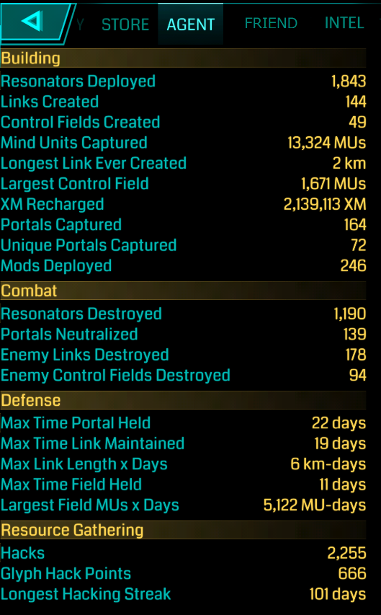

Slide 7
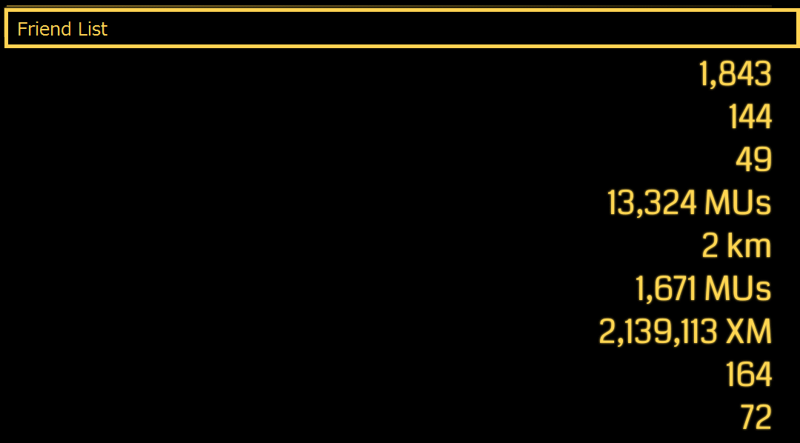
ID: Temporary Agent
Agent Level
Control Fields Created
Mind Units Captured
Longest Ever Created
Largest Control Field
XM Recharged
Portals Captured
Unique Portals Captured

Slide 8
Specific function
2. Attack with friends

Slide 9
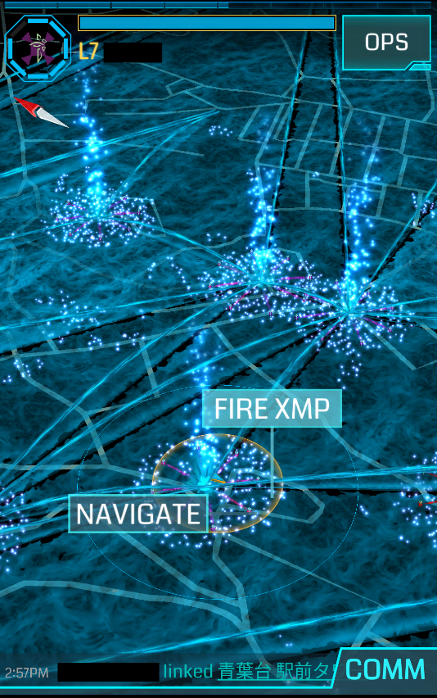

Slide 10
Specific EFEECT
3.Ranking

Slide 11
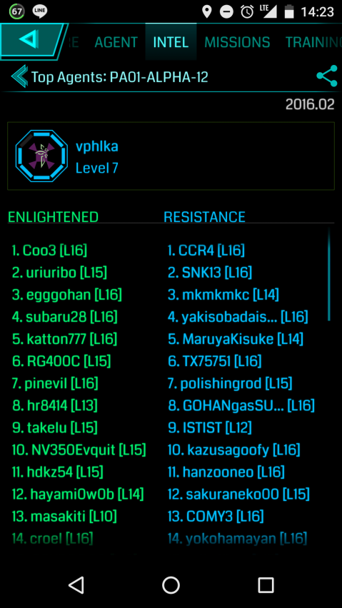

Slide 12
Propose
4.EVENT

Slide 13


Playing ingress
with your friends

Slide 14



Slide 15
THANK YOU FOR LISTENING

