Slide 1
International Information Technology University · Faculty of Computer Technology and Cybersecurity
ICS Anomaly Detection for Cyber-Physical Security
Diploma Project · Educational Program 6B06303 — Network Security
Team lead: Zainiddin Danial
Imankozhayeva Laura
Bekisheva Galiya
Research advisor: Nurlybayev T. A.
Almaty 2026
Notes:
0:00–0:40 — Greet the committee, read the topic, introduce the three of us and our advisor. Danial leads the talk.

Slide 2
Team composition & roles
Three students, three contributions of the thesis
Member | Role | Owns
Zainiddin Danial (team lead) | ML Engineering | Unified AnomalyDetector interface; the six detectors; experiment infrastructure & reproducibility (YAML configs, config hash)
Imankozhayeva Laura | Data & Evaluation | Data loaders & preprocessing (scaler-leak guard); three time-aware metrics; cross-testbed transfer + within-HAI LOPO study
Bekisheva Galiya | Attribution & Delivery | Per-sensor attribution + SHAP; FastAPI demo web app; thesis writing and figures
Nurlybayev T. A. | Research advisor | Scope, methodology review, defense readiness
ICS Anomaly Detection for Cyber-Physical Security · IITU 2026 · 2/18
Notes:
0:40–1:30 — Who did what. Each role maps to one of the three contributions: detection benchmark, cross-dataset transfer, attribution.

Slide 3
Why this matters: attacks on physical plants
Industrial Control Systems run water, power, gas, chemicals
Sensors (pressure, flow, valve, motor)
ICS / PLC control logic
Actuators (pumps, valves, breakers)
→
→
Anomaly detection lives in the monitoring layer: learn what "normal" looks like → alarm on "not normal"
• Stuxnet (2010) — malware physically destroyed centrifuges while screens showed normal readings
• Ukraine power grid (2015) — attackers tripped breakers, ~225,000 customers blacked out in winter
• Maroochy Shire (2000) — stolen radio opened sewage valves, ~1 million litres spilled
• In every case the attack was visible in the sensor data — if someone watched the right pattern.
ICS Anomaly Detection for Cyber-Physical Security · IITU 2026 · 3/18
Notes:
1:30–2:40 — Set the stakes: ICS attacks have physical consequences. The premise of the field: teach a model 'normal', flag 'abnormal'.

Slide 4
Task statement
What the diploma sets out to prove and build
Thesis: ICS detectors report high F1 on their training dataset, but (a) their rankings change under time-aware metrics and (b) they fail to generalize across testbeds. We quantify both effects on HAI and Morris, and add per-sensor attribution to evaluate detection AND localization.
• 1. Survey ICS anomaly-detection methods, datasets, and time-aware evaluation metrics
• 2. Implement six detectors under one AnomalyDetector interface (fit / score / attribute)
• 3. Implement three metrics with unit tests; reproduce published baselines within tolerance
• 4. Cross-testbed transfer HAI ↔ Morris (source- vs target-calibrated) + within-HAI leave-one-process-out
• 5. Per-sensor attribution vs HAI process-level attack labels, with multi-seed sensitivity
• 6. Findings, practical recommendations, and a reproducible apparatus
ICS Anomaly Detection for Cyber-Physical Security · IITU 2026 · 4/18
Notes:
2:40–3:50 — The argument in one box, then the six concrete objectives straight from the assignment. This frames everything that follows.

Slide 5
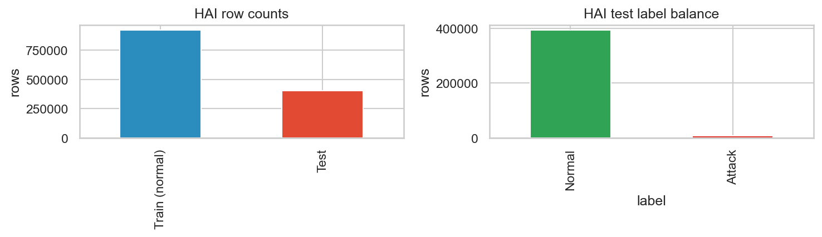
The two testbeds
Deliberately dissimilar — that is the point
 | HAI 21.03 | Morris (gas pipeline)
Domain | Power-plant (boiler, turbine, water) | Gas-pipeline Modbus RTU
Features | 79 sensor channels | 16 features (leak cols removed)
Processes | 4 interconnected (P1–P4) | Single pipeline
Rate | 1 Hz, timestamped | Sub-second, no timestamps
Format | Folder of CSVs | ARFF file
Shared sensors | — none in common — | — none in common —
HAI process overview — 79 channels across four physical loops
ICS Anomaly Detection for Cyber-Physical Security · IITU 2026 · 5/18
Notes:
3:50–4:40 — Two factories that don't speak the same language: 79 power-plant sensors vs 16 gas-pipeline Modbus features, zero shared sensors. This is what makes cross-dataset transfer hard.

Slide 6
Six detectors, one interface
Two classical · two autoencoders · two transformer-era SOTA
Model | Family | Year | Core idea
Isolation Forest | Classical | 2008 | Random splits isolate outliers faster
One-Class SVM | Classical | 2001 | Boundary around the normal region
Dense Autoencoder | Autoencoder | — | High reconstruction error = anomaly
LSTM Autoencoder | Autoencoder | 2016 | Sequence reconstruction over time
USAD | SOTA | 2020 | Adversarially-trained autoencoder pair
TranAD | SOTA | 2022 | Transformer with attention + adversarial loss
ICS Anomaly Detection for Cyber-Physical Security · IITU 2026 · 6/18
Notes:
4:40–5:30 — The lineup spans 20+ years. The whole point of the shared interface is that swapping any of these is a one-line config change — apples-to-apples by construction.

Slide 7
Three time-aware metrics
How you score a detector changes who wins
Point-wise F1
Point-adjust F1
eTaPR
Standard per-timestep precision/recall/F1.
Honest but unforgiving on short events.
If the model flags ANY point in an attack, the whole attack counts as detected.
Inflated — a random flagger beats real detectors (Kim et al., AAAI 2022).
Event-aware: rewards how much of each attack you catch and how fast.
The honest metric we trust for ranking.
ICS Anomaly Detection for Cyber-Physical Security · IITU 2026 · 7/18
Notes:
5:30–6:30 — The metric is not neutral. Point-adjust over-credits a single lucky hit; eTaPR grades on coverage and speed. We report all three because the ranking changes between them — and that change is a finding.

Slide 8
System architecture
Config-driven, reproducible, no hidden state
Raw data (HAI / Morris)
data_loader → unified schema
preprocessing scale + window
Model fit · score · attribute
evaluation 3 metrics
summary.parquet + figures
→
→
→
→
→
• One AnomalyDetector base class — fit / score / attribute / save / load — every model obeys it
• Every experiment is a YAML config; the runner is model-agnostic
• Each run records a 12-char config hash + seed + timestamp → one row in summary.parquet
• Notebooks only plot. If a number is in the thesis, a tested function in src/ produced it
ICS Anomaly Detection for Cyber-Physical Security · IITU 2026 · 8/18
Notes:
6:30–7:30 — Trace one number end to end. The discipline — config hash, seeds, tests, notebooks-only-plot — is what lets a reviewer trust the numbers.

Slide 9
Bridging two testbeds: the type vector
If they share no sensors, compare sensor TYPES
HAI 79 features
Shared 6-dim type space
pressure
pump_state
setpoint
valve_position
control_signal
system_state
Morris 16 features
→
→
• Each sensor hand-tagged by TYPE in data/feature_types.yaml (pressure, valve, control signal…)
• Both datasets projected onto the shared 6-dim type vector → models become transferable
• Transfer the scoring function, not the raw weights — methodologically the cleanest option
ICS Anomaly Detection for Cyber-Physical Security · IITU 2026 · 9/18
Notes:
7:30–8:20 — The core methodological move. We don't match 'sensor 47' to 'sensor 11'; we match 'pressure behaviour' to 'pressure behaviour'.

Slide 10
Software & reproducibility
Tooling and the build-everything-from-config rule
• Languages & ML
– Python 3.11 · PyTorch 2.3 (deep models) · scikit-learn 1.4 (classical) · NumPy / pandas
• Explainability & app
– SHAP (classical attribution) · FastAPI + vanilla JS demo web app · joblib artifacts
• Quality & docs
– pytest 8.0 (13 test modules) · ruff · pre-commit · LaTeX (thesis + this deck's figures)
• Reproducibility contract
– python -m experiments.run <config.yaml> → one row in results/metrics/summary.parquet
– ~48 YAML configs · 12-char config hash · seeds 7 / 42 / 123 · Parquet for nested metrics
ICS Anomaly Detection for Cyber-Physical Security · IITU 2026 · 10/18
Notes:
8:20–9:00 — The stack, and the one rule that makes it a research artifact: every number reproducible from a committed config. Quick — keep moving to results.

Slide 11
Implementation — key points
The interface contract and the anti-leakage guard
src/models/base.py — every model obeys this
src/preprocessing.py — scaler-leak guard
class AnomalyDetector(ABC):
@abstractmethod
def fit(self, X_train, X_val=None):
# Fit on normal-only data.
# Must never see attack rows.
...
@abstractmethod
def score(self, X):
# per-sample anomaly score
...
def attribute(self, X):
# per-feature contribution
...
def scale_bundle(bundle):
# #1 cause of inflated ICS results:
# fitting the scaler on attack rows.
# Crash rather than trust callers.
bundle.assert_no_attack_in_train_val()
scaler = MinMaxScaler(clip=True)
scaler.fit(X_train) # normal only
return ScaledArrays(...)
Demo web app (FastAPI + vanilla JS)
Upload a CSV → pick a trained artifact → see per-row anomaly scores. The CLI and the app are thin wrappers around one function: score_dataframe(artifact, df).
ICS Anomaly Detection for Cyber-Physical Security · IITU 2026 · 11/18
Notes:
9:00–10:00 — Two code excerpts that ARE the argument: the shared interface (left) and the assertion that crashes on data leakage (right). Plus the demo app that turns a trained model into something you can click.

Slide 12
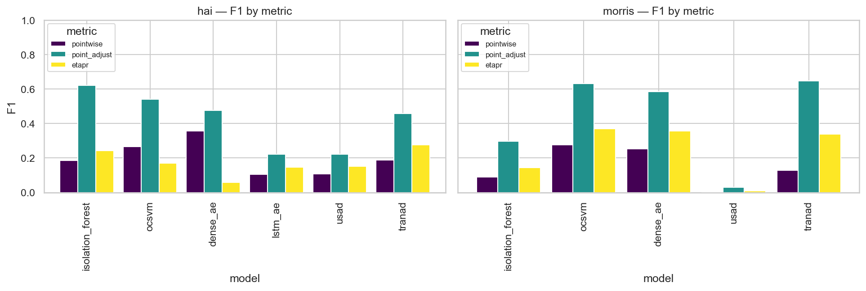
Results — same-dataset detection
Point-wise F1 / ROC-AUC, scaler fit on normal only
Model | HAI F1 | HAI AUC | Morris F1 | Morris AUC
Dense AE | 0.524 | 0.859 | 0.737 | 0.751
Isolation Forest | 0.208 | 0.770 | 0.734 | 0.658
One-Class SVM | 0.307 | 0.757 | 0.653 | 0.629
LSTM AE | 0.148 | 0.670 | 0.9997 | —
• Dense AE leads on HAI; absolute F1 is modest (0.52) even at home
• High Morris F1 partly reflects its ~91% windowed attack rate — a warning sign
Six-model comparison across metrics
ICS Anomaly Detection for Cyber-Physical Security · IITU 2026 · 12/18
Notes:
10:00–10:55 — Baseline detection. Note nobody hits the 0.95 the literature advertises once leakage is closed. Morris's high F1 is a base-rate artifact — foreshadows the transfer finding.

Slide 13
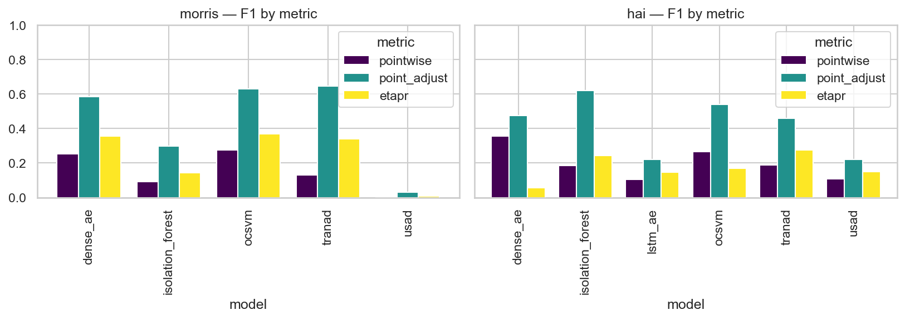
Results — metric sensitivity
The same models, re-ranked by the metric
• Rankings shuffle
– between point-wise, PA-F1, eTaPR
• PA-F1 inflates
– classical detectors most
• Takeaway
– a single-metric leaderboard is unreliable
Metric choice reorders the leaderboard
ICS Anomaly Detection for Cyber-Physical Security · IITU 2026 · 13/18
Notes:
10:55–11:40 — Contribution 2 in one chart: who 'wins' depends on the metric. Point-adjust flatters the weak classical models the most.

Slide 14
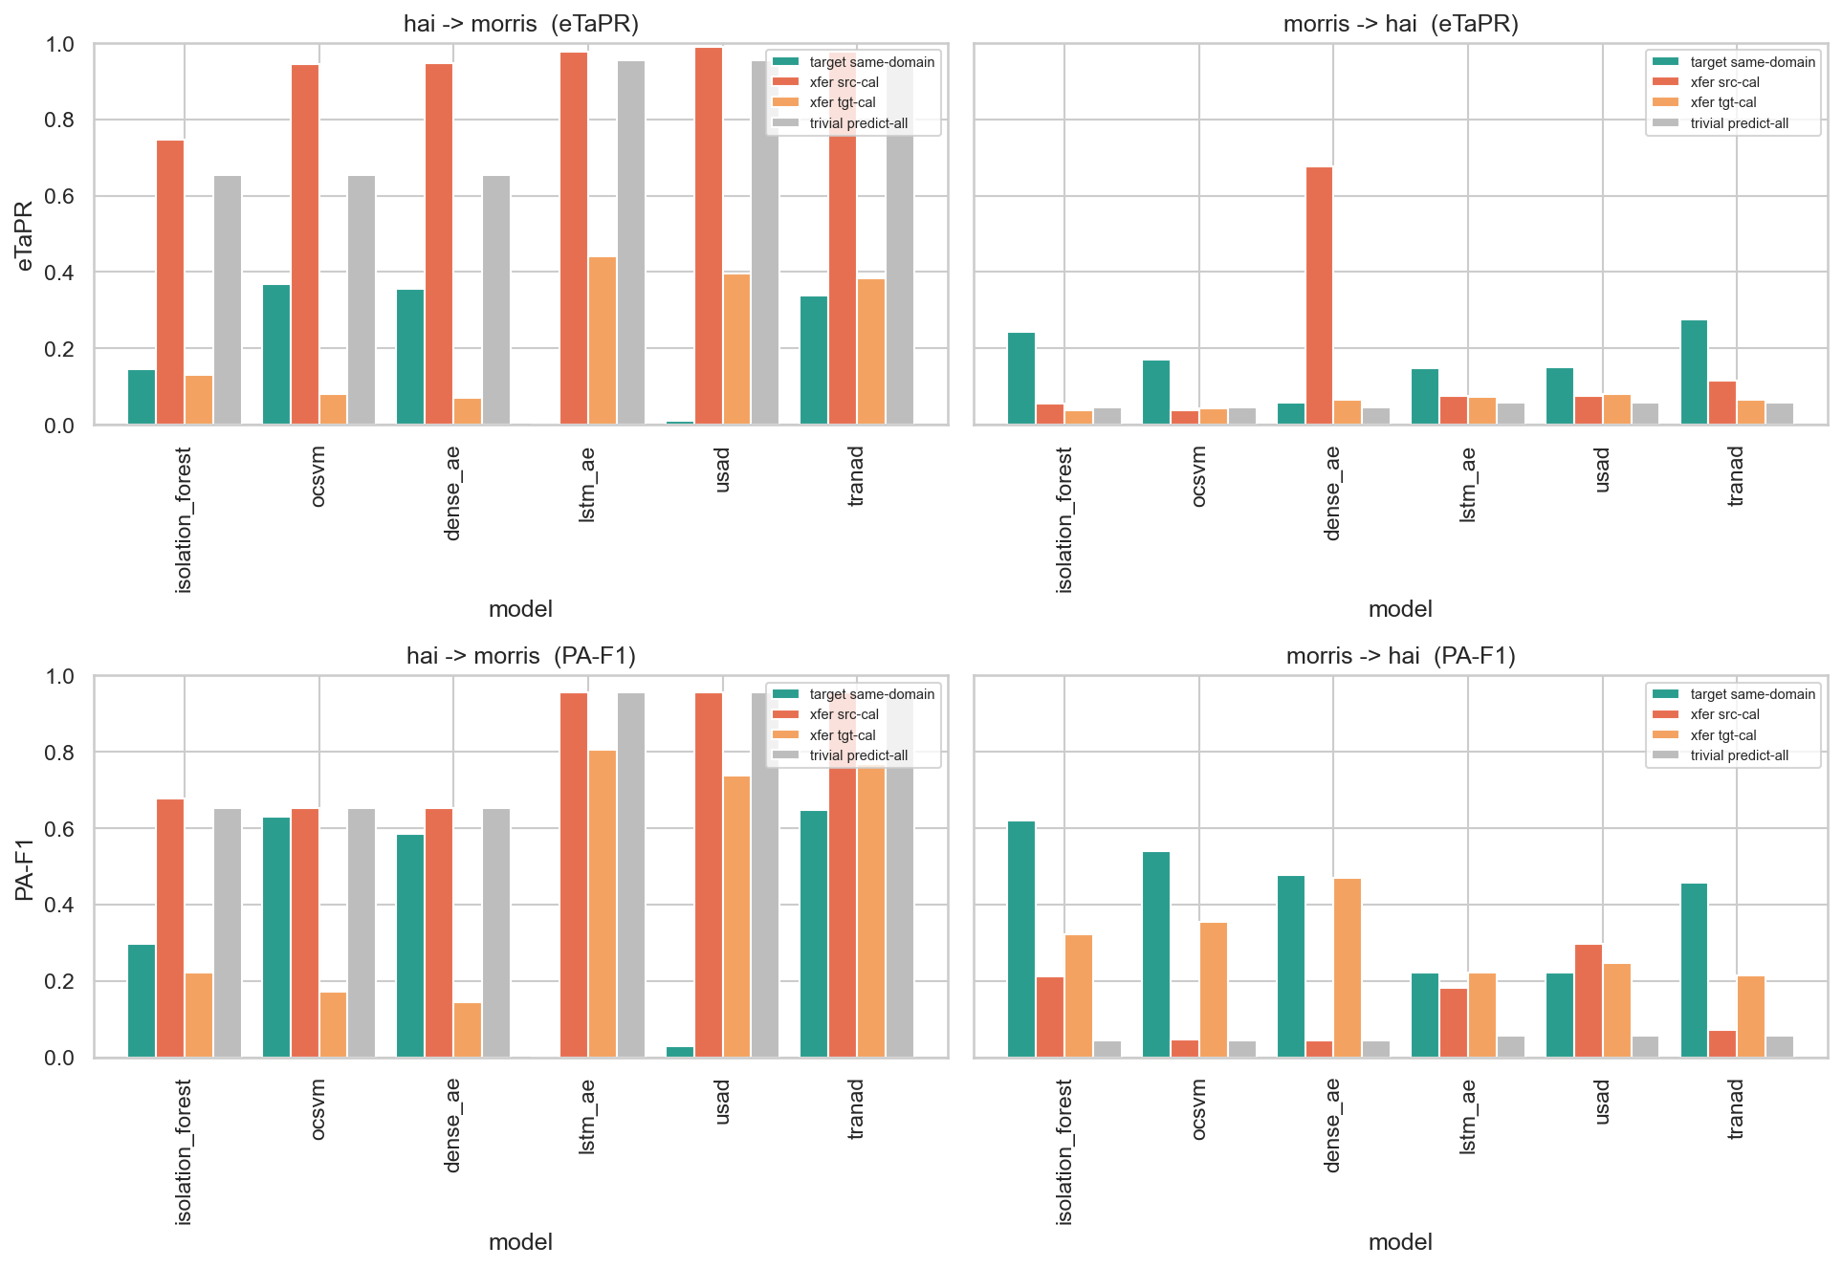
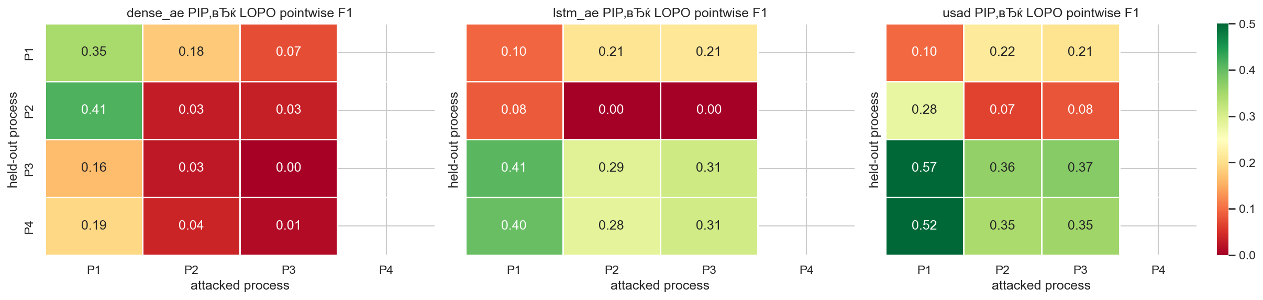
Results — cross-testbed transfer (headline)
Calibration, not the model, decides whether transfer means anything
• Source-calibrated transfer collapses every detector to the target's class-prior baseline (F1≈0.95 on Morris, ≈0.05 on HAI) — the number reflects base rates, not intelligence.
• Target-calibrating the threshold on normal target data restores meaning: SOTA reaches 0.38–0.44 eTaPR (HAI→Morris) while classical baselines stay below 0.13.
• Within-HAI LOPO (right): hiding a process's sensors causes targeted blindness, not uniform decay.
ICS Anomaly Detection for Cyber-Physical Security · IITU 2026 · 14/18
Notes:
11:40–12:55 — The core novelty. Left: naive transfer is a coin flip dressed up as 0.95. Recalibrate on target normal and a real modern-vs-classical gap appears. Right: LOPO shows blindness is localized to the removed subsystem.

Slide 15
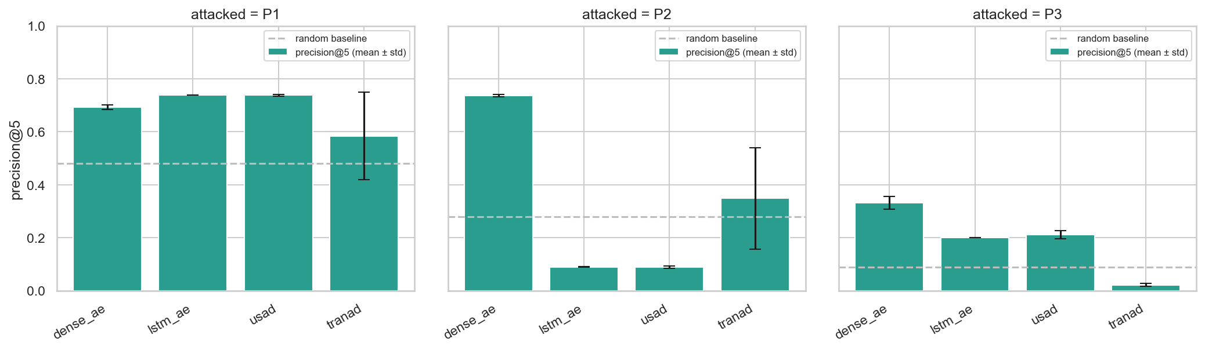
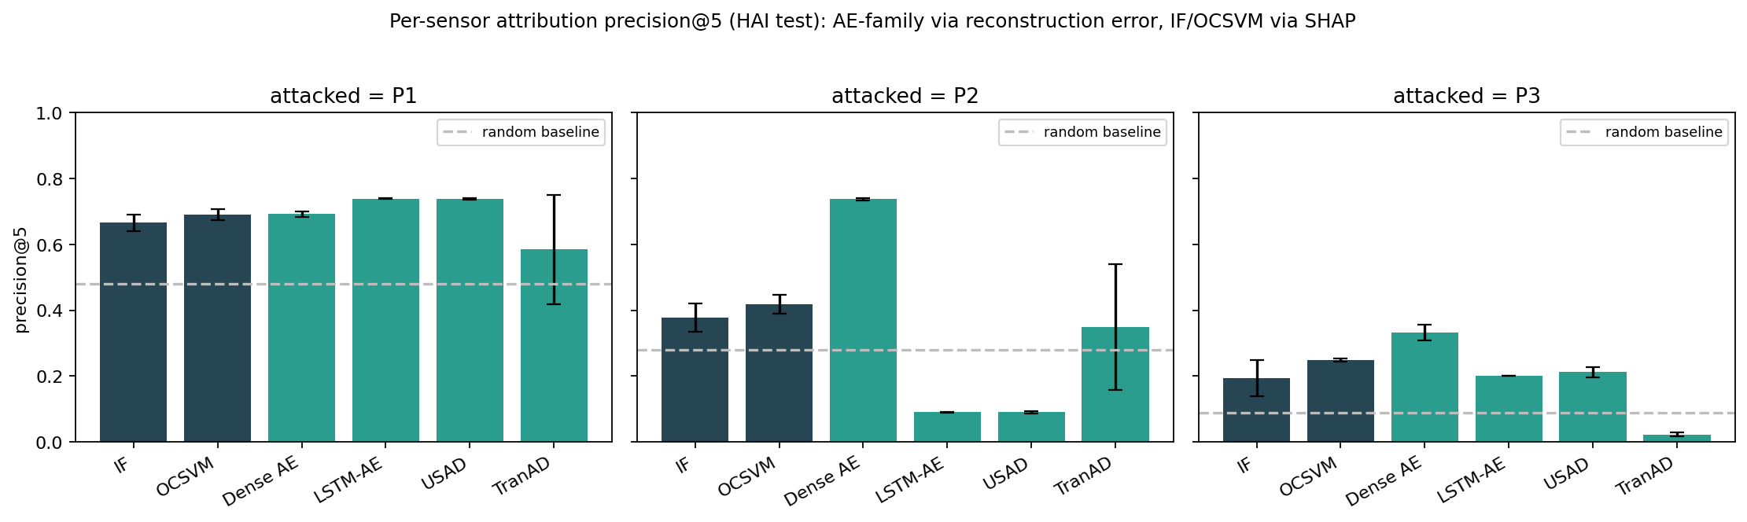
Results — attribution & localization
"We caught it" ≠ "here's which sensor"
• Detection-vs-localization inversion: the Dense AE — weakest by F1 — is the only windowed/AE model above random on all three attacked HAI processes.
• Attention rollout (TranAD) is numerically identical to reconstruction error — a null result.
• SHAP lifts the two classical baselines above random too (right).
ICS Anomaly Detection for Cyber-Physical Security · IITU 2026 · 15/18
Notes:
12:55–13:50 — Contribution 3. The best detector is often the worst localizer. The fancy attention explanation adds nothing over plain reconstruction error.

Slide 16
Key findings & recommendations
Three findings → three things a security team should do
Findings
1. Naive cross-factory transfer collapses to coin-flipping (class-prior baseline).
2. Hiding one subsystem's sensors causes targeted blindness, not global decay.
3. The worst detector (Dense AE) is the best localizer; attention explanations are null.
Recommendations
✓ Calibrate the threshold on target-domain normal data before deploying a transferred detector.
✓ Report multiple time-aware metrics (incl. eTaPR); distrust single-metric rankings.
✓ Audit attribution alongside detection — consider a SOTA detector + Dense-AE/SHAP localizer hybrid.
ICS Anomaly Detection for Cyber-Physical Security · IITU 2026 · 16/18
Notes:
13:50–14:30 — Tie the three findings to three concrete, actionable rules. This is the 'so what' for a practitioner or reviewer.

Slide 17
Conclusion
A measurement project, shipped reproducibly
• Benchmarked six detectors on HAI and Morris under three time-aware metrics
• Separated representation transfer from threshold transfer — exposing how published F1 misleads
• Established a detection-vs-localization tradeoff via per-sensor attribution
• Contributions:
– A reproducible benchmarking protocol — every number rebuilds from a committed YAML
– An open-source implementation under one detector interface (7th model = one class)
– A recommendation to the field: report the full grid — metrics × calibration × attribution — not a single headline F1
ICS Anomaly Detection for Cyber-Physical Security · IITU 2026 · 17/18
Notes:
14:30–14:55 — Restate what we did and the single message: report the grid, not the headline. Mention the apparatus outlives the thesis.

Slide 18
Thank you for your attention
ICS Anomaly Detection for Cyber-Physical Security
Zainiddin Danial · Imankozhayeva Laura · Bekisheva Galiya
Advisor: Nurlybayev T. A. · IITU, Almaty 2026
Notes:
14:55–15:00 — Thank the committee. Invite questions.

