Slide 1


Technological university degree in Computing
Creation of architecture for deployment of services IoT and an application
within the framework of people in loss of autonomy
Under the leadership:
M. Huynh Huu Hung – Internship supervisor
Mme. Marie-Agnès Péraldi - IUT tutor
Sébastien SAEZ
13/06/2017
Notes:
Bonjour
Je mappel
Je vais vous présentez mon stage de fin d etu pour obtention
L’intitulé de ce stage est :

Slide 2
Summary
DNIIT Institute & Research project MIRE
Context of the intership
Presentation of the subject
Analysis and Design
Development
Results
Notes:
Nous allons aborder les differents points

Slide 3
DNIIT
What is it ?
The result of the international cooperation of scientific research between teachers & researchers of two universities
Between whom ?
University Côte d’Azur
University of Danang
In what purpose?
Strengthen the development of teaching and research activities at the level of higher education.
Notes:
En moyenne, il y a plus de 10 échanges par an de personnel, de conférenciers et d'étudiants entre les deux universités dans le cadre de divers programmes de coopération.
Refoncer le developpment de l’activité d’ensignement et recherche u nivo de l’enseig sup

Slide 4
Research project MIRE
What is it ?
MIRE (Maison de l’Invention et de la Recherche) is a research collaboration project between the University Côte d'Azur (UCA) and the University of Danang (UD).
Goals :
The university staff training of the UD by the implementation of common doctoral thesis
The support of the programs of master's degree of the UCA by creating remote courses to Danang
The promotion of collaborative research projects between UCA and UD
Projects: PAPioT, EMOTICA, POSCA, SLEGO
Notes:
La formation du personnel de UD grace mise en place these doctoral commune
Le soutien de programme de maitrise de UCA grace creation cours distance
Promo de porjet de recherche collab

Slide 5
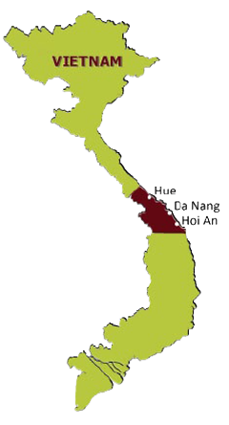
Context of the intership
SLEGO
Specific domain Language for Experience Global Orchestration
Collaborative project with 3 topics
Composition :
2 students from GEII department
2 students from Computer Science department
Goals :
Developement of an application for monitoring for people in loss of autonomy
Notes:
Cadre slego
Comprennant 3 sujet colab
5/6min ici

Slide 6




Presentation of the subject
SLEGO SERVEUR
Raspberry Pi Software Application
SmartData
SmartSensor
SQL
Sensor 1
MQTT
FRAMES
ONLINE / OFFLINE
DB REPLICATION
Raspberry Pi
Gateway
MQTT
Dispatcher
Activity
Controller
Router
Sensor 2
…
Activity Result
Tracking
SQL
SQL
Fichier CSV
RawData
Notes:
Architecture logiciel
2 cas d’usage
Salle de bain
Maison tracking
4/5.30min

Slide 7
Essential needs
Acquisition of the data sensors
Implemented of the application on Raspberry Pi
Broker's use of data MQTT of type publish-subscribe for the recovery of the data
Writing of sensors' tracks and storage of this one in a file CSV
Treatment, conversion of the raw data in intelligent data
Storage in bases of data internal/external of all the data
Other :
Display on a web page of the activity of the person
Notes:
6 besoins essentiels sont ressortie

Slide 8
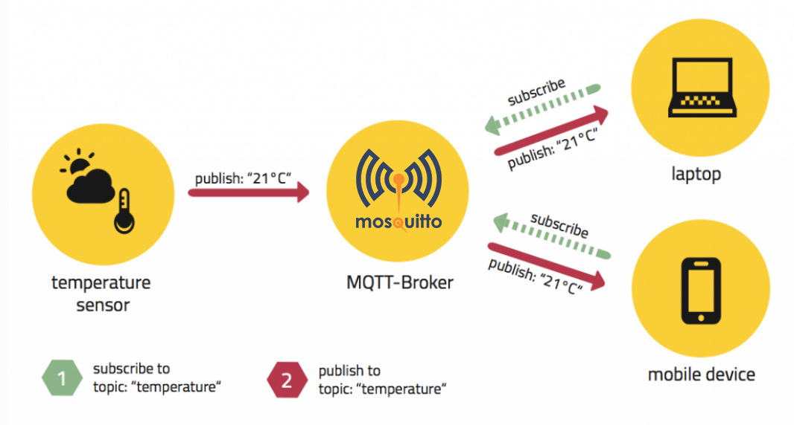
Protocol of transmission MQTT
Recovery of a weft on a topic :
Home/Bathroom/Humidity
Home/+/Humidity
Home/Bathroom/#
Notes:
On explique le systeme des boites
Aborscence fichier

Slide 9
Format of the frame
Version : 100, 101, XXX…
UserId
Timezone : UTC +6…
Date : yyyy-mm-dd
Hours
Samplekind : Interrup / Periodic
IdSensor
NameSensor
DataSensor
UnitSensor
TypeSensor
Location
Notes:
Une trame MQTT est composé de

Slide 10
Development environment
Used languages :
Java for programming the application
SQL for database management
HTML, CSS, PHP for the realization of the HMI
Used IDE :
Eclipse
Bracket
Notes:
IDE assez couramment utilisé

Slide 11
Libraries
Use of MQTT
org.eclipse.paho.mqtt.utility
org.eclipse.paho.client.view
Use of SQL for java
mysql-connector-java
hsqldb

Slide 12
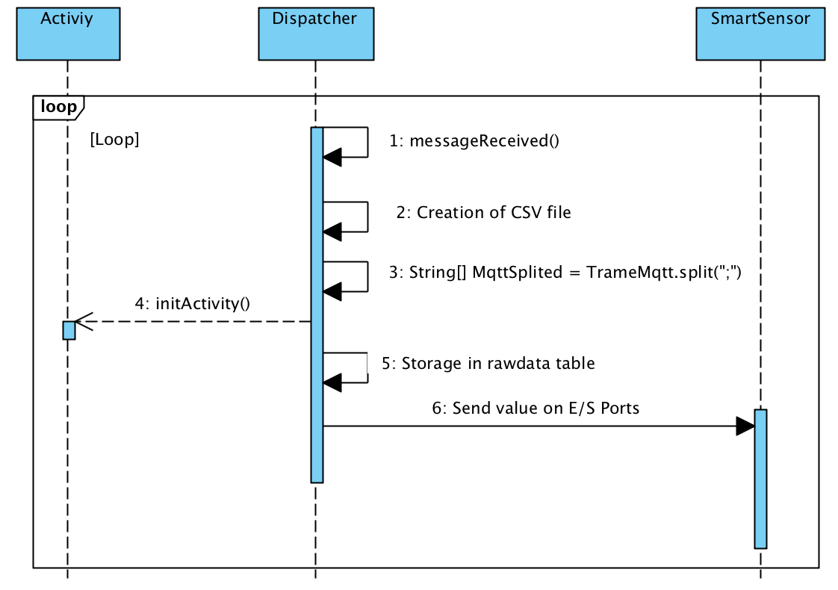
MQTTDispatcher
His role ?
Retrieve the data of the frame and send to SmartSensor
Notes:
+ stocke dans la base de donnée

Slide 13
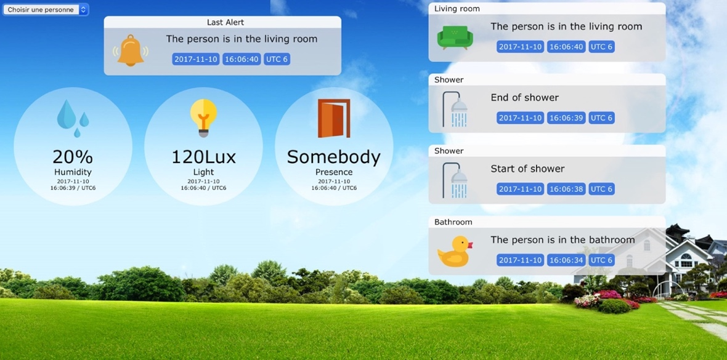
Human Machine Interface
Notes:
Nous avons les différents capteurs se trouvant dans la douche
Et sur le cote l’activité de la personne
Et en haut la derniere alerte levée

Slide 14
Encountered difficulties
- Format MQTT frame
- Database replication
Notes:
16/18min

Slide 15
Provisional schedule
 | Weeks
Tasks | 1 | 2 | 3 | 4 | 5 | 6 | 7 | 8 | 9 | 10 | 11 | 12
Handling of Gemoc
Analysis
Specification
Design
Developement + Test
Deployment
Internship report
Notes:
Premier planning
en parallele

Slide 16
Final schedule
 | Weeks
Tasks | 1 | 2 | 3 | 4 | 5 | 6 | 7 | 8 | 9 | 10 | 11 | 12
Handling of Gemoc
Analysis
Specification
Design
Developement + Test
Deployment
Internship report

Slide 17
Quantification
Number of lines
JAVA | HTML, CSS, PHP | Commentaires | Number of class | Number of methods
1274 | 386 | 192 | 8 | 49

Slide 18
Conclusion
End of the project :
objectives are achieved
Resumption of the development easier
Possible Improvements concerning data confidentiality
Experience gained :
Work in a group with different specialties
Rewarding experience
Notes:
Possibilité de poursuite aisée du développement grace aux commentaire

Slide 19

Do you have any questions ?

