Slide 1
周报
方航
2021-10-6

Slide 2
今日工作
精读paper：
What and How Well You Performed? A Multitask Learning Approach to Action Quality Assessment.（搞清楚每一句话，每一个词）
搞清楚这篇文章的代码
调研视频流的mutil-view的paper
数据集check

Slide 3
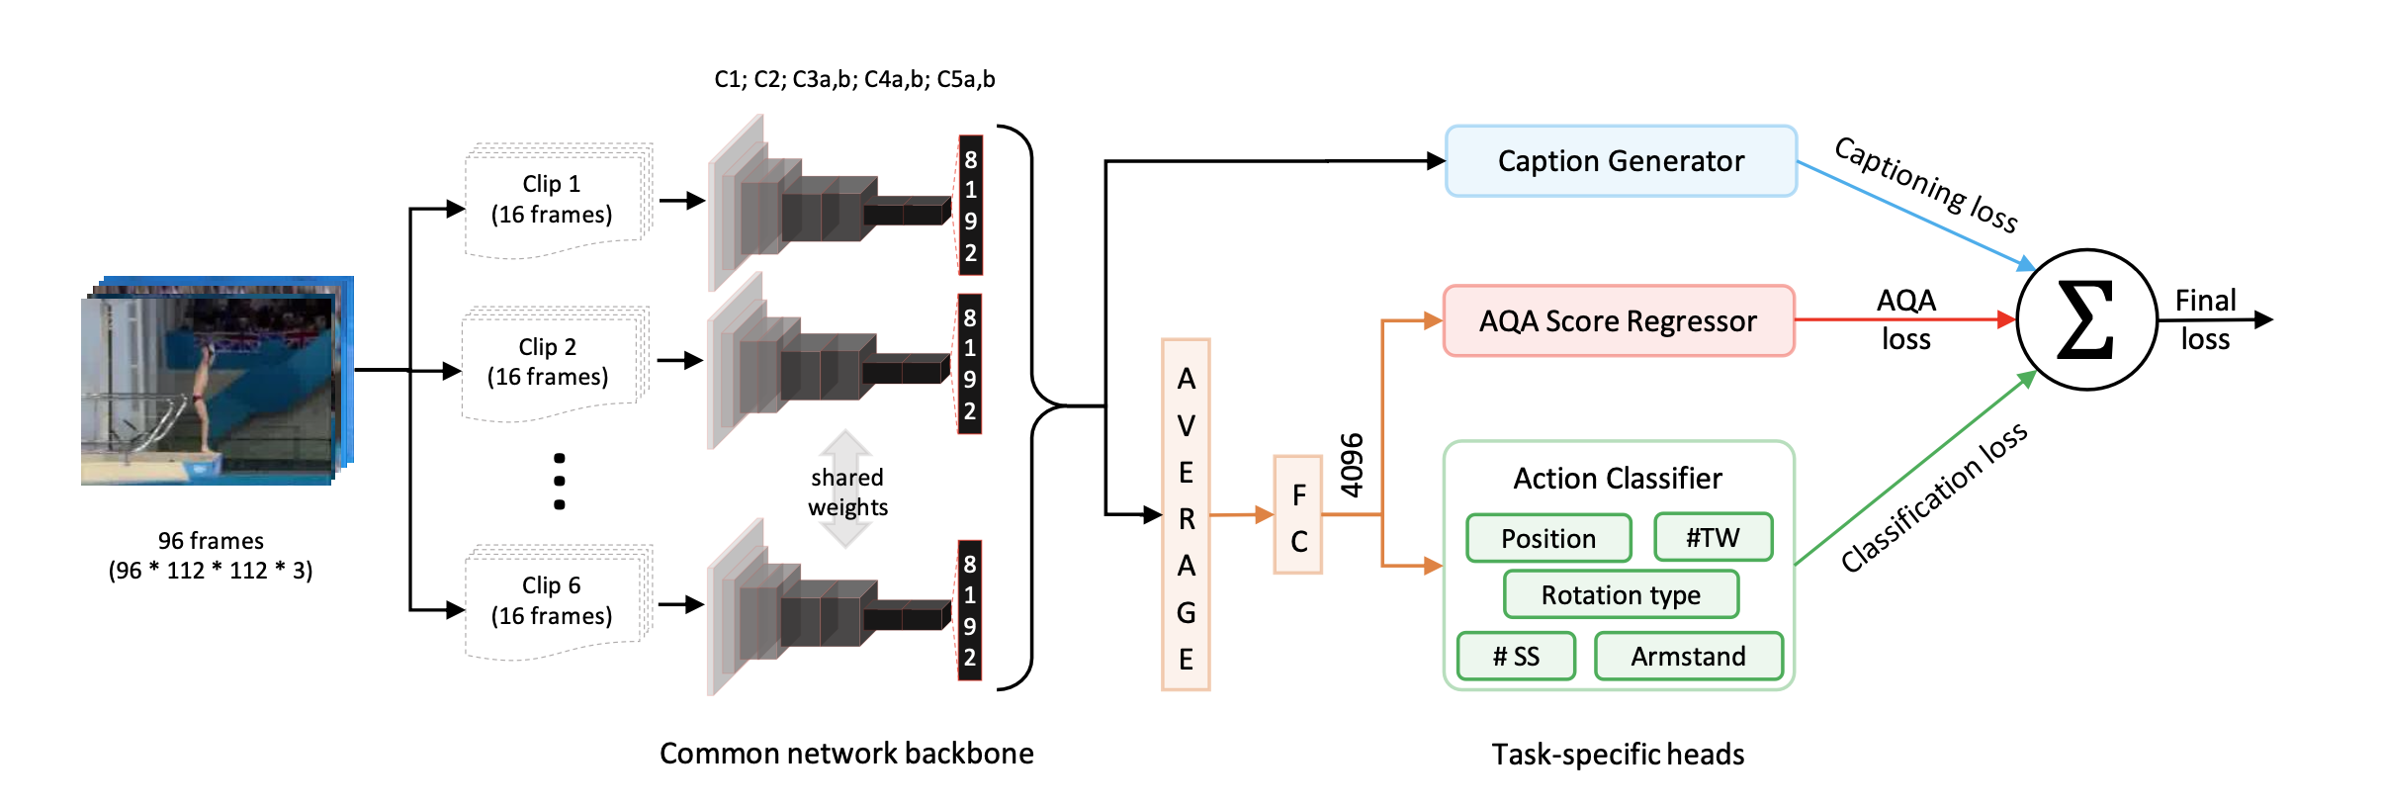
What and How Well You Performed? A Multitask Learning Approach to Action Quality Assessment
What and How Well You Performed? A Multitask Learning Approach to Action Quality Assessment. In CVPR, 2019

Slide 4
下周工作计划
线上系统的数据搞定线上系统上线
继续跑attention的代码，冲周六的组会

