Slide 1
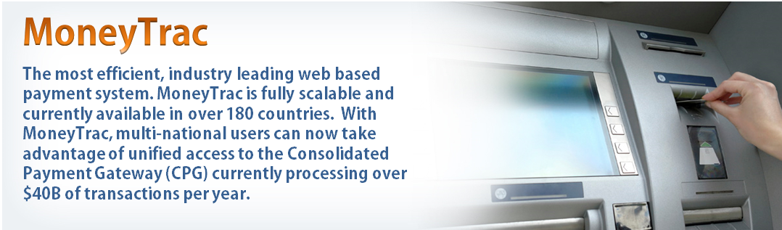
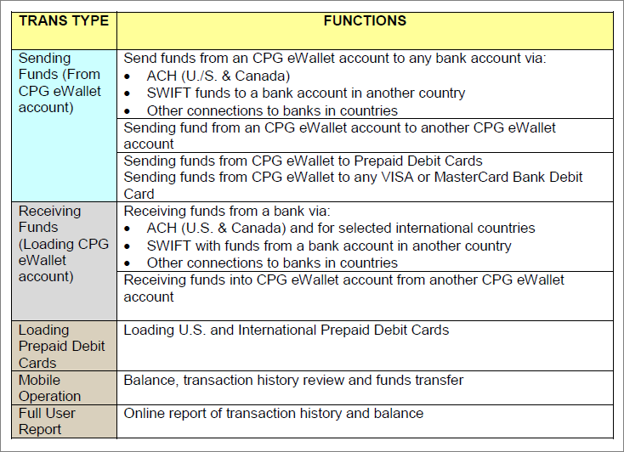
https://www.moneytrac.net/client/register/7VIYRF
Introduction
WorldwidePays provides an integrated suite of payment system products through its MoneyTrac Consolidated Payment Gateway (CPG):
An eWallet account allowing user to receive funds on a global basis and access those funds through multiple options
A U.S. prepaid debit card option
International prepaid debit card options
Domestic and international bank account and credit card options
What Is CPG eWallet
The concept of EFTS (Electronic Funds Transfer System) has been around for years, and every major bank has a hand-built system of such. However, the concept of having a general purpose EFTS for the general public, businesses and corporations to use without having to go through banks is brand new.
The CPG eWallet in the most simple comparison is like PayPal for business; a user can send or receive funds to and from bank accounts. However, a CPG eWallet account also provides the user a temporary funds depository and accesibility to user’s multiple bank accounts within country - Perhaps at different banks.
CPG eWallet Transaction Types
Please used this links as below for your members to create an e-Wallet account;
https://www.moneytrac.net/client/register/7VIYRF

