Slide 1
OOP in C
Inherit
elpam.tw@gmail.com
elpam@Taiwan, Taipei, 2008

Slide 2



LICENSE
本投影片授權方式為：
  姓名標示─非商業性─相同方式分享 3.0 台灣版
  http://creativecommons.org/licenses/by-nc-sa/3.0/tw/
所有的範例程式皆為 Public Domain

Slide 3
About This Slides
All example was build by
  GCC-4.1.3
  GLIB-1.2.10
  GMAKE-3.81

Slide 4
C Language Review
Stack
  Caller Function's Address
  CPU's Register
  Local Value
Heap (run-time heap)
  managed by malloc

Slide 5
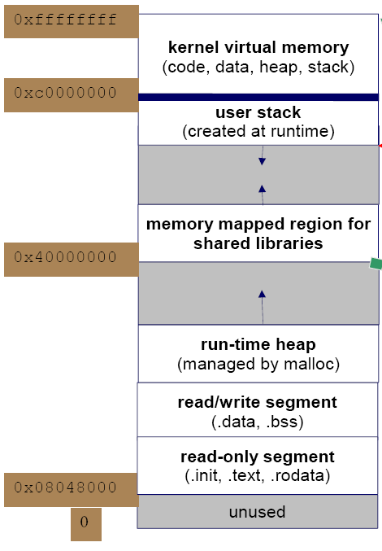
Address Space
Linux Memory Model
  copy from Jserv's Hacking Hello World
STACK
HEAP

Slide 6
Function Stack
Caller's Address
Return Address
Local Value
void Func_B()
{
int a,b;
/* do nothing*/
}
void Func_A()
{
char a;
Func_B();
}
int main()
{
Func_A();
}
Func_B's Stack
int b
int a
Func_A
Low
Func_A's Stack
char a
main
main's stack
....
High

Slide 7
After Review
請了解Callee Stack裡頭會放置那些東西
請了解Callee Stack Release後那些變數會被清除掉
請確定已正確的了解Stack與Heap的差別

Slide 8
Structure

Slide 9
Structure (I)
/* 1-1.c */
struct A{
int a;
int b;
};
int main()
{
struct A* pa =malloc(sizeof(struct A));
printf("%x,%x,%x\n"
,pa, &(pa->a), &(pa->b) );
free( pa );
}
Address + Offset
  pa = 0x804a008
  pa -> a == pa + 0
  pa -> b == pa + 4
#> ./1-1
804a008,804a008,804a00c
#>

Slide 10
所有的東西都是Memory Address
-> 所代表的意義是offset，而這一個數值的大小可以在Compiler Time被決定

Slide 11
Structure (II)
/* 1-2.c */
struct A{
int a; int b;
};
struct B{
int a; int b;
int c;
};
int main()
{
struct A* pa =malloc(sizeof(B));
struct B* pb = pa;
pa -> a = 1; pa -> b = 2;
pb -> c = 3;
printf("pb(%d,%d,%d)\n"
,pb->a,pb->b,pb->c );
}
Size = 8 byte
pa == pb
  pa -> c Compile Error
  pb -> c Correct
Size = 12 byte
#> ./1-2
1,2,3
#>

Slide 12
Pointer的Type與被allocate的記憶體大小是沒有關係的
請注意我們是如何使用casting

Slide 13
Structure (III)
/* 1-3.c */
struct A{
int a;
};
struct B{
short b;
short c;
};
struct C{
char low_b;
char hi_b;
char low_c;
char hi_c;
};
Casting
int main()
{
struct A* pa = malloc( sizeof(struct A) );
struct B* pb = pa;
struct C* pc = pa;
pc -> hi_b = 0x12;
pc -> low_b = 0x34;
pc -> hi_c = 0x56;
pc -> low_c = 0x78;
printf("pb->b(0x%x) pb->c(0x%x)\n",pb->b,pb->c );
printf("pa->a(0x%x)\n",pa->a );
free( pa );
}

Slide 14
Structure (III) (cont')
Memory Casting
x86 is little-endian
pc -> hi_b = 0x12;
pc -> low_b = 0x34;
pc -> hi_c = 0x56;
pc -> low_c = 0x78;
#>./1-3
pb->b(0x1234) pb->c(0x5678)
pa->a(0x56781234)
#>

Slide 15
Inherit

Slide 16
C++ Review
/* 1-6.cpp */
class A{
public:
int a;
};
class B : public A{
public:
int b;
};
int main()
{
B b;
b . b = 2;
A(b) . a = 1
}
Casting to Parent

Slide 17
Inherit
int main()
{
struct B* pb = malloc(sizeof(struct B));
pb -> parent . a = 0;
pb -> parent . b = 1;
pb -> c = 2
}
sizeof(A) = 8
sizeof(B) = 12
/* 1-4.h */
struct A{
int a;
int b;
};
struct B{
struct A parent;
int c;
};
Inherit A
/* 1-4.c */
int main()
{
struct A* pa =malloc(sizeof(struct B));
struct B* pb = pa;
pa -> a = 0;
pa -> b = 1;
pb -> c = 2;
}
#>./1-4
pa(1,2) pb(3)
#>

Slide 18
Inherit & Casting
/* 1-5.c */
int main()
{
struct B* pb =malloc(sizeof(struct B));
pb -> c = 3;
struct A* pa = pb;
pa -> a = 1;
pa -> a = 2;
printf("pa(%d,%d) pb(%d)\n"
,pa->a,pa->b,pb->c );
}
Casting to Parent
/* 1-5.h */
struct A{
int a;
int b;
};
struct B{
struct A parent;
int c;
};
#>./1-5
pa(1,2) pb(3)
#>

Slide 19
Public Member Value in C++
int main()
{
B* b = new B;
b . a = 0;
b . b = 1;
b . c = 2;
}
class A{
public:
int a;
int b;
};
class B : public A {
public:
int c;
};
int main()
{
A* a = new b;
a . a = 0;
a . b = 1;
a . c = 2; /* error */
B(a) . c = 2; /* correct */
}

Slide 20
Object Inherit
C Language
C++
struct A{
int a;
int b;
};
struct B{
struct A parent;
int c;
};
class A{
public:
int a;
int b;
};
class B : public A {
public:
int c;
};

Slide 21
Type Casting (形態轉換)
C Language
  Structure-to-Structure
    Address-to-Address
C++
  dynamic_cast
  static_cast
  reinterpret_cast
  const_cast

Slide 22
Inherit in C
C -> B -> A
/* error memory access */
int main()
{
struct B* pb = malloc(sizeof(B));
struct C* pc = pb; /* correct */
pc -> v1 = 0; /* run time error */
}
struct A{
int v1;
int v2;
};
struct B{
struct A parent;
int v1;
};
struct C{
struct B parent;
int v1;
};
struct C c;
struct B* pb = &c; /* use B's member */
struct A* pb = &c; /* use A's member */

Slide 23
Conclusion
我們可以使用memory casting
的技巧來描述繼承關係
* 因為缺乏語法(Compiler)的保護，所以我們必須要小心的使用

Slide 24
Questions
建構子(Constructor) 還有需要嗎 ?
但C++的繼承還提供了 Virtual Function, 需要這樣的功能嗎? 該如何實作 ?
  下一個投影片將討論這兩個問題

