Slide 1
0xb331b0x™
authors: jchen, saktar, achen, slides: jchen

Slide 2
Big Aspirations
We originally wanted to make a real time translation from beatbox to real drums tool. Hearing audio and playing back.
Most systems have an awful delay between just microphone input and speaker output. (few ms is perceivable)
The smallest AI model we can get takes ~15ms processing and needs >10ms context. Leads to around 30ms delay including processing.
30 ms ~ 30hz, for graphics engineering we call this bad

Slide 3
Realistic Opportunity
If something is infeasible, solve an easier problem
Real time feedback for inputs are unnecessary and sometimes not preferred in certain genres (rhythm)
First asynchronous AI powered Input system???
Requires an awful amount of domain specific data
We have 24 hours, lets run it!

Slide 4
Architecture(?)
Renderer
(pygame)
AI Powered Input
(pytorch)
3 Processes communicate with shared memory. Only 2 Processes actually matter here though.
These processes are (almost entirely) basically asynchronous, all modifications to shared memory is thread safe.
Design has some advantages but in hindsight was mostly disadvantages
By necessity, we cannot use any web API’s:
Parent Process + Shared Memory
(multiprocess)

Slide 5
WORKS OFFLINE!!!

Slide 6
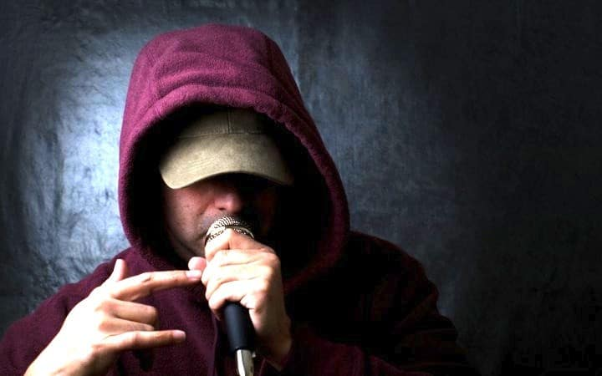
Use Cases
Extremely portable in architecture and in application by design (only a microphone and display needed, platform independent)
Accelerates learning beatboxing
Helps experienced beatboxers get better
People who just want to have fun, games are usually fun after all

Slide 7
Caveats
A game where your input is correct 90% of the time is frustrating
Currently, the AI model does not handle the chatter of crowds very well

Slide 8
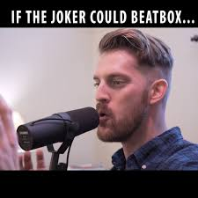
Demo

